Slide 1


程序设计范式
5 – 面向对象的编程
赵钦佩（博士，副教授）
Email: qinpeizhao@tongji.edu.cn
http://sse.tongji.edu.cn/zhaoqinpei

Slide 2

5–面向对象的编程
5.1面向对象编程与基于对象编程区别在哪里？
5.2 如何处理类“是一种“关系？
5.3 类的层次继承和多态背后的原理是什么？
5.4 什么是虚函数？
5.5 如何设计一个抽象基类？
5.6 如何设计一个派生类？
5.7 如何使用一个派生体系？
5.8 基类该多抽象？
5.9 继承体系中的类该如何初始化？
5.10 如何拷贝？
5.11 派生类中的虚函数怎么处理？
5.12 什么时候虚函数机制不起作用？
5.13 类之间的关系如何？
5.14 是否可以在运行时动态判断类别？

Slide 3

5.1 Object-based V.S. object-oriented
Object Based Programming
Classes regarded as new data types
Single layer in hierarchy
Not convenient in “Entity-Relation” relationship
“is-a”
“has-a”
“is implemented of”
Object Oriented Programming
Focus on the relationship between classes
Hierarchical in structure
Good at “Entity-Relation” relationship
Main features: inheritance and polymorphism

Slide 4
5.1 Inheritance
Organize those related classes, and share their common data and operations
Parent/child relationship
Parent (Base) class: defined common public interfaces and private implements of all child classes
Child (Derived) class: could override what is inherited, or add new implementations, to fit its specialty

Slide 5
5.1 Inheritance Hierarchy
Abstract Base Class →
Lib Materials
Books
Magazines
Files
Rental Books
Audio Books
E-Books
If the root do not represent a real object, and it is only for design need, we could call it Abstract Base Class (Conceptual)

Slide 6
5.1 Polymorphism
Example
void loan_check_in(LibMat& mat)
{
mat.check_in();
if (mat.is_late())
mat.assess_fine();
if (mat.waiting_list())
mat.notify_available();
}
Since LibMat is an abstract base class, and there are only real objects of class RentalBook or Magazine in the program, how could mat be instantiated and referenced?

Slide 7
5.1 Polymorphism
Means “one name and multiple forms”
Use the pointer or reference of the base class to point to any object of its derived class
Thus we got transparency that we manipulate those real objects in a type-independent way
Same code will represent different objects and make different behaviors
Code will remain same if the inheritance hierarchy changes

Slide 8
5.1 Polymorphism
Static Binding – common situation
Which function entrance to use could be decided before execution
Dynamic Binding – mechanism of polymorphism
Which version of the check_in() should be called, could only be decided during execution by the addressed real object that mat represents
Delay the resolution until run-time

Slide 9
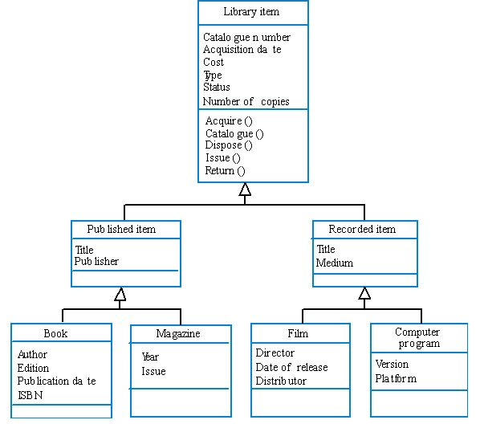
5.2 What is a class hierarchy?
Notes:
需要重画

Slide 10
5.2 Implement an inheritance hierarchy
An example of 3 layers: LibMat derives Book, Book derives AudioBook
We define a simple public interface, which containing only constructor, destructor and print function (each class has its own print way)
class LibMat
{
public:
LibMat()
{ cout << “LibMat Default Constructor!” << endl; }
virtual ~LibMat()
{ cout << “LibMat Destructor!” << endl; }
virtual void print() const
{ cout << “This is a LibMat object!” << endl; }
};

Slide 11
5.2 Virtual function
If certain function has different implementations in the inheritance hierarchy, declare it as virtual
Dynamic binding makes the corresponding version of virtual function called according to the real object type
If there’s virtual member function in the class, the destructor should also be declared as virtual
class Base
{
// ...
virtual ~Base();
};
class Derived : public Base
{
// ...
~Derived();
};
void f()
{
Base* p = new Derived;
delete p;
//virtual destructor ensures resources in derived classes could be released correctly in polymorphism
}

Slide 12
5.2 base class calling
void global_print(const LibMat& mat)
{
mat.print();
}
int main()
{
cout << “Create a LibMat object!” << endl;
LibMat libmat;
global_print(libmat);
};
Result:
Create a LibMat object!
LibMat Default Constructor! //constructing
This is a LibMat object! //print
LibMat Destructor! //destructing

Slide 13
5.2 derived class
The Book derived class
class Book : public LibMat //public inheritance
{
public:
Book(const string& title, const string& author)
:m_szTitle(title), m_szAuthor(author)
{ cout << “Book( ” << m_szTitle << “, ”<< m_szAuthor << “ ) Constructor!” << endl; }
virtual ~Book() { cout << “Book Destructor!” << endl; }
virtual void print() const
{ cout << “This is a Book object!” << endl;
cout << “Title: ” << m_szTitle << endl;
cout << “Author: ” << m_szAuthor << endl; }
const string& title() { return m_szTitle; }
const string& author() { return m_szAuthor; }
protected: //will be used in derived classes, so can’t be private
string m_szTitle, m_szAuthor;
};

Slide 14
5.2 derived class calling
int main()
{
cout << “Create a Book object!” << endl;
Book b(“The Castle”, “Franz Kafka”);
global_print(b);
};
Result:
Create a Book object!
LibMat Default Constructor! //constructing
Book(The Castle, Franz Kafka) Constructor!
This is a Book object! //print
Title: The Castle
Author: Franz Kafka
Book Destructor! //destructing
LibMat Destructor!

Slide 15
5.2 derived class
The AudioBook derived class
class AudioBook:public Book
{public:
AudioBook(const string& title, const string& author, const string& narrator):Book(title, author), m_szNarrator(narrator)
{ cout << “AudioBook( ” << m_szTitle << “, ”<< m_szAuthor
<< “, ” << m_szNarrator << “ ) Constructor!” << endl; }
virtual ~AudioBook() { cout << “AudioBook Destructor!” << endl; }
virtual void print() const
{ cout << “This is an AudioBook object!” << endl;
cout << “Title: ” << m_szTitle << endl;
cout << “Author: ” << m_szAuthor << endl;
cout << “Narrator: ” << m_szNarrator << endl; }
const string& narrator() { return m_szNarrator; }
//title() & author() have been inherited
protected:
string m_szNarrator;
};
Inherited from class Book

Slide 16
5.2 derived class calling
int main()
{
cout << “Create an AudioBook object!”<< endl;
AudioBook ab(“Man Without Quarlities”, “Robert Musil”, “Kenneth Meyer”);
global_print(ab);
};

Slide 17
5.2 derived class calling
int main()
{
cout << “Create an AudioBook object!”<< endl;
AudioBook ab(“Man Without Quarlities”, “Robert Musil”, “Kenneth Meyer”);
global_print(ab);
};
Result:
Create an AudioBook object!
LibMat Default Constructor! //constructing
Book(Man Without Quarlities, Robert Musil) Constructor!
AudioBook(Man Without Quarlities, Robert Musil, Kenneth Meyer) Constructor!
This is an AudioBook object! //print
Title: Man Without Quarlities
Author: Robert Musil
Narrator: Kenneth Meyer
AudioBook Destructor! //destructing
Book Destructor!
LibMat Destructor!

Slide 18
5.2 class hierarchy
When constructing a derived class object, every constructor is executed in the inheritance order
When destructing, in reverse order
For a derived object, no difference between its own members and inherited members
int main()
{
AudioBook ab(“Mason and Dixon”, “Thomas Pynchon”, “Edwin Leonard”);
cout << ab.title() << endl;
cout << ab.author() << endl;
cout << ab.narrator() << endl;
};

Slide 19
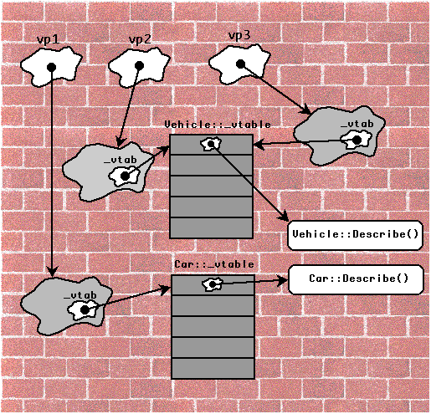
5.3 What’s the story behind?
Notes:
需要重画

Slide 20
5.3 function overriding
Inherit a class into the derived class and provide a definition for one of the base class’s function again inside the derived class.
Inheritance should be there.
Function that is redefined must have exactly the same declaration in both base and derived class (same name, return type, parameter list).
Polymorphism means having multiple forms of one thing.
In inheritance, polymorphism is done by function overriding.

Slide 21
5.3 Story of inheritance & polymorphism
What’s beneath the virtual function mechanism and overriding? – Layout of objects
Virtual table (vtbl) and virtual table pointer (vptr)
Every class maintains its vtbl
Every object contains a vptr pointing to the vtbl of this class

Slide 22
5.3 Story of inheritance & polymorphism
B’s vtbl
Object B
B’s type_info object
Data members
for the object
Impl. of B::~B
Impl. of B::mf1
Object’s vptr
Impl. of B::mf2
Impl. of B::mf3
Object B
class B
{
public:
B();
virtual ~B();
virtual void mf1();
virtual int mf2(char c) const;
virtual void mf3(string& s);
void mf4();
}
Data members
for the object
Object’s vptr

Slide 23
5.3 Story of inheritance & polymorphism
B’s vtbl
Object B
B’s type_info object
Data members
for the object
Impl. of B::~B
Impl. of B::mf1
Object’s vptr
Impl. of B::mf2
Impl. of B::mf3
Object B
Data members
for the object
class D : public B
{public:
D();
virtual ~D();
virtual void mf1();
virtual void mf5(char* str);
}
Object’s vptr
How the vtbl and vptr take effects in inheritance?

Slide 24
5.3 Story of inheritance & polymorphism
B Object
Data members
for the object
B’s vtbl
B’s type_info object
Object’s vptr
Impl. of B::~B
B Object
Impl. of B::mf1
Impl. of B::mf2
Data members
for the object
Impl. of B::mf3
Object’s vptr
D Object
Data members
for the object
D’s vtbl
D’s type_info object
Object’s vptr
Impl. of D::~D
Impl. of D::mf1
D Object
Impl. of B::mf2
Data members
for the object
Impl. of B::mf3
Impl. of D::mf5
Object’s vptr

Slide 25
5.3 Story of inheritance & polymorphism
What happened in constructing and destructing a derived object?
A derived class object contains 2 parts:
Sub-object from base class (non-static data members)
Sub-object from its definition (non-static data members)
Base class data members
Base class sub-object
Base sub-object vptr
Derived object
Derived class data members
Derived class sub-object
Derived sub-object vptr

Slide 26
5.3 Story of inheritance & polymorphism
float mx
_vptr_Point1d
float mx
Point1d sub-obj
_vptr_Point1d
Point1d p1d;
float my
_vptr_Point2d
float mx
Point2d p2d;
_vptr_Point1d
Point2d sub-obj
float my
_vptr_Point2d
float mz
_vptr_Point3d
Point3d p3d;

Slide 27
5.3 Understanding Inheritance
Public Inheritance
The access control of the base class data members are remain same in the derived class object
Modeling the ‘is-a’ relationship, the strongest relationship
Private Inheritance
All data members from base classes are private in the derived class object
Modeling the ‘is-implemented-in-terms-of’ relationship
Other further topics: Protected Inheritance, Multiple Inheritance, Virtual Inheritance

Slide 28
5.4 What is virtual function?
A virtual function must be declared in a parent class
syntax
virtual function
virtual returnType functionName ( argsi ) { function body ;}
pure virtual function
virtual returnType functionName ( argsi ) = 0;

Slide 29
5.4 Declaration
A function name is preceded by the keyword virtual
Function name can only be used once in the parent class
Cannot overload virtual functions
Only class member functions can be declared virtual
A function is virtual…..
If it is declared virtual
There is a base class function with the same signature declared virtual
Any or all class member functions (except constructors)
can be declared virtual

Slide 30
5.4 Implementation
The body of the virtual function must be supplied in the parent class unless declared to be a pure virtual function
A derived class can override the definition by providing its own implementation
A virtual function still permitted in a subsequently derived class

Slide 31
5.4 Virtual functions
When function in a class is declared virtual
Keyword virtual tells compiler
Don’t perform early binding
Install mechanisms to perform late binding
Compiler responds by creating
Table of function pointers
Installing a data member to the class to point to the table

Slide 32
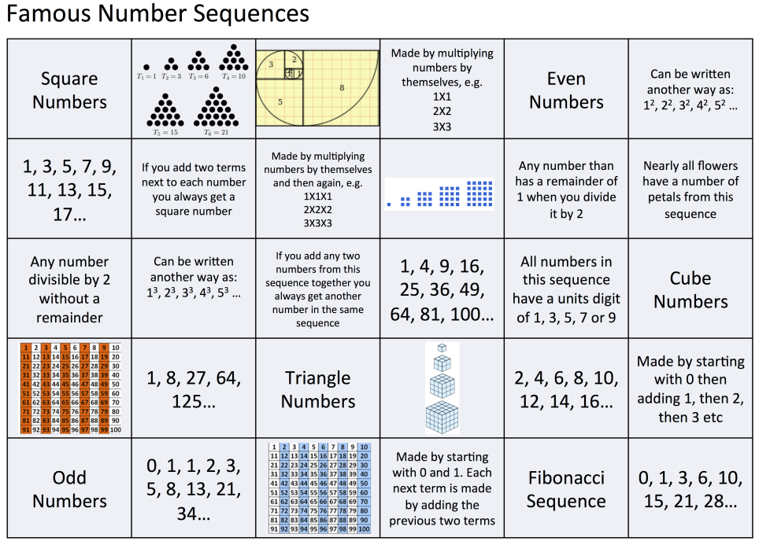
5.5 How to design an abstract base class?

Slide 33
5.5 Define an abstract base class
Imagine the various data sequences example
It is possible that we get polymorphism-like effects without inheritance
We could simulate the polymorphism by using programming skills (pointers to member functions, etc.)
But it’s expensive in maintenance
Using inheritance is more efficient and scalable
Polymorphism is supported by C++ from its nature
We will design a num_sequence abstract base class, which will derive the Fibonacci, Triangular and Square number sequences

Slide 34
5.5 Define an abstract base class
First step: find out all common operations of the child classes
class num_sequence
{
public:
//return the element on certain position
int elem(int pos);
//generate elements to certain position
void gen_elems(int pos);
//return the number sequence type
const char* what_am_I() const;
//output all elements to os
ostream& print(ostream& os = cout) const;
//check whether certain position is valid
bool check_integrity(int pos);
//return the max elements number that allowed
static int max_elems();
};

Slide 35
5.5 Define an abstract base class
Second step: find out those type-dependent operations (their logic are different among derived classes, so they should be virtual)
gen_elems(int) must be virtual, for every derived class should have its own implementation
check_integrity(int), max_elems() need not be virtual, for they are type-independent (and static member function can’t be declared as virtual)
what_am_I(), elem(int), print(ostream&) might be virtual, for they depend on our design strategy (we declare them as virtual in current design)

Slide 36
5.5 Define an abstract base class
Third step: design the access level of every operation (public, private, protected)
class num_sequence
{
public:
virtual ~num_sequence() {};
virtual int elem(int pos);
virtual const char* what_am_I() const;
virtual ostream& print(ostream& os = cout) const;
static int max_elems();
protected:
virtual void gen_elems(int pos) = 0; //pure virtual function
bool check_integrity(int pos) const;
};

Slide 37
5.5 Pure virtual functions
If certain functions of a class is meaningless in providing implementations, declare them as pure virtual functions by assigning 0
If certain class has pure virtual functions, it is an abstract base class (in implementation), and couldn’t be instantiated to any real objects due to the incompleteness of its interface
Classes having pure virtual functions could only be inherited to become sub-objects of the derived classes objects which having provided implementations of all virtual functions

Slide 38
5.6 How to design a derived class?
Abstract base class provides only some interfaces for derived classes
Derived classes should provide their own implementations and data members

Slide 39
5.6 Define a derived class
class Fibonacci: public num_sequence
{
public:
Fibonacci(int len = 1, int beg_pos = 1)
: m_iLength(len), m_iBeg_pos(beg_pos) {};
virtual int elem(int pos); //definition is outside the class
virtual const char* what_am_I() const { return “Fibonacci”; };
virtual ostream& print(ostream& os = cout) const;
int length() { return m_iLength; };
int beg_pos() { return m_iBeg_pos; };
protected:
virtual void gen_elems(int pos);
int m_iLength;
int m_iBeg_pos;
static vector<int> s_elems;
};

Slide 40
5.6 Define a derived class
We provide the following
new data members and new member functions
new version of virtual member functions inherited
implementations of pure virtual functions inherited
Calling example
//ok, re-implemented virtual member func
//ok, inherited static member func
//error, not defined in num_sequence
//ok, destructor of Fibonacci
num_sequence* ps = new Fibonacci(12, 8);
ps->who_am_I();
ps->max_elems();
ps->length();
delete ps;

Slide 41
5.6 Define a derived class
If we do need to access the member functions defined in derived class using the pointer or reference of base class, we must modify our initial design
Declared them as pure virtual functions in base class (every derived class must provide their own implementations)
Declared and defined them as inline non-virtual functions in base class (the function interface and implementation will remain all the same in all derived objects)
Design is such an iterative process that solution is improved bit by bit by programmer’s experiences and user’s feedback

Slide 42
5.6 Define a derived class
Using class scope operator in class members
Skip the virtual function calling mechanism
int Fibonacci::elem( int pos ) const
{
if (! num_sequence::check_integrity(pos))
return 0;
}

Slide 43
5.6 Define a derived class
Using class scope operator in class members
If non-virtual functions of same name defined in the base class and derived class, the former will be hided by the latter during run-time resolution
class Base
{public:
int f(int i)
{ cout << "f(int): ";
return i+1; }
};
class Derived : public Base
{public:
double f(double d)
{ cout << "f(double): ";
return d+1.3; }
};
int main()
{
Derived* pd = new Derived;
cout << pd->f(2) << '\n';
cout << pd->f(2.3) << '\n';
}
Results:
f(double): 3.3 //why is not f(int):3?
f(double): 3.6

Slide 44
5.6 Define a derived class
Solution – we could overload among the scopes now
class Derived : public Base
{
public:
//make every f from Base available in this class
using Base::f;
double f(double d)
{
cout << "f(double): ";
return d+1.3;
}
};

Slide 45
5.6 Define a derived class
Although :: will expose the hided functions, it is not a good idea to override non-virtual functions in inheritance
Invoking function of the same object will lead different results
Because non-virtual functions are statically bound
class Base
{public:
void mf()
{ cout << “Base::mf“ <<endl; }
};
class Derived : public Base
{public:
void mf() //override non-virtual functions
{ cout << “Derived::mf“ <<endl; }
};

Slide 46
5.6 Define a derived class
class Base
{public:
void mf()
{ cout << “Base::mf“ <<endl; }
};
class Derived : public Base
{public:
void mf() //override non-virtual functions
{ cout << “Derived::mf“ <<endl; }
};
int main()
{
Derived d;
//use different pointers to point same object
Base* pb = &d;
Derived* pd = &d;
pb->mf(); //Base::mf() called
pd->mf(); //Derived:mf() called
}

Slide 47
5.6 Define a derived class
The default parameter value is also statically bound
So never to re-define the inherited default value in virtual functions (dynamically bound)
enum ShapeColor {RED, GREEN, BLUE};
class Shape
{public:
virtual void draw(ShapeColor color = RED) const = 0;
};
class Circle : public Shape
{public:
virtual void draw(ShapeColor color = GREEN) const;
};
int main()
{ Shape* ps = new Circle;
ps->draw(); //Draw a RED circle
//the value comes from the base class
//while the function logic from the derived class
}

Slide 48
5.7 How to use an inheritance hierarchy?
Suppose we now have a 2-layer inheritance hierarchy, which contains 1 abstract base class num_sequence and 3 derived class Fibonacci, Triangular and Square
How could we use it?
num_sequence
Fibonacci
Triangular
Square

Slide 49
5.7 How to use an inheritance hierarchy?
inline void display(ostream& os, const num_sequence& ns, int pos){
os << “The element at position ” << pos
<< “ for the ”<< ns.what_am_I() //virtual function
<< “ sequence is ” << ns.elem(pos) << endl; //virtual function
}
int main()
{ const int pos = 8;
Fibonacci fib;
display(cout, fib, pos);
Triangular tri;
display(cout, tri, pos);
Square squ;
display(cout, squ, pos);
}
Result:
The element at position 8 for the Fibonacci sequence is 21
The element at position 8 for the Triangular sequence is 36
The element at position 8 for the Square sequence is 64

Slide 50
5.7 How to use an inheritance hierarchy?
ostream& operator<<(ostream& os, const num_sequence& ns)
{ return ns.print(os); //virtual function }
int main()
{
Fibonacci fib(8);
Triangular tri(12);
Square squ(6, 6);
cout << “fib: ” << fib << endl
<< “tri: ” << tri << endl
<< “squ: ” << squ << endl;
}
Result:
fib: (1, 8) 1 1 2 3 5 8 13 21
tri: (1, 12) 1 3 6 10 15 21 28 36 45 55 66 78
squ: (6, 6) 36 49 64 81 100 121
By inheritance and virtual function, we could simplify the burden of modifications and extensions
It is convenient to add or remove a sequence from the hierarchy

Slide 51
5.8 How abstract a base class?
class num_sequence
{
public:
virtual ~num_sequence() {};
virtual int elem(int pos);
virtual const char* what_am_I() const;
virtual ostream& print(ostream& os = cout) const;
static int max_elems();
protected:
//pure virtual function
virtual void gen_elems(int pos) = 0;
bool check_integrity(int pos) const;
};

Slide 52
5.8 How abstract a base class?
class num_sequence
{
public:
virtual ~num_sequence() {};
virtual const char* what_am_I() const = 0;
int elem(int pos) const;
ostream& print(ostream& os = cout) const;
static int max_elems() { return 1024 };
int length() const { return m_iLength; }
int beg_pos() const { return m_iBegpos; }
protected:
virtual void gen_elems(int pos) = 0;
bool check_integrity(int pos) const;
num_sequence(int len, int bp, vector<int>& ref)
:m_iLength(len), m_iBegpos(pos),
m_refElems(ref){};。。
int m_iLength;
int m_Begpos;
vector<int>& m_refElems;
};

Slide 53
5.8 How abstract a base class?
The base class now have data members, it is recommended we provide initialization operations in its constructor
Since num_sequence is an abstract base class (having pure virtual function) and impossible to define any real object; its role is only sub-object in objects of derived classes
We declared the data members protected, so they could be used in derived classes

Slide 54
5.8 How abstract a base class?
In this version we also provide
Members for sequence maintenance, m_iLength, m_iBegpos, length(), beg_pos()
A reference to vector which will represent the static elements vector in the derived class (reference could not represent a null object, and could not change the object’s representing after initialized)
A constructor which initializes the vector (reference must be initialized in the member initialization list, while pointers need not do so
Some functions are not virtual any more: elem(), print()
Though num_sequence is still an abstract base class, it do provide some implementations for the derived classes to inherit and reuse

Slide 55
5.8 How abstract a base class?
The derived class are quite simple now
class Fibonacci: public num_sequence
{
public:
//definition is outside the class
Fibonacci(int len = 1, int beg_pos = 1);
virtual const char* what_am_I() const
{ return “Fibonacci”; };
protected:
//definition is outside the class
virtual void gen_elems(int pos);
static vector<int> s_elems;
};

Slide 56
5.9 How to initialize?
class Fibonacci: public num_sequence
{
public:
//definition is outside the class
Fibonacci(int len = 1, int beg_pos = 1);
virtual const char* what_am_I() const
{ return “Fibonacci”; };
protected:
//definition is outside the class
virtual void gen_elems(int pos);
static vector<int> s_elems;
};

Slide 57
5.9 How to initialize?
The initialization mechanism of the derived objects is to call the constructor of base class first (base class sub-object), then the constructor of itself (derived class sub-object)
Use the member initialization list of the derived class constructor to initialize the data members in base class
Fibonacci::Fibonacci(int len, int beg_pos)
: num_sequence(len, beg_pos, s_elems) {};

Slide 58
5.9 How to initialize?
Ignoring the num_sequence constructor will cause compiling error, because there is not default constructor for num_sequence, and compiler does not know which arguments to provide
If we really do not want to explicitly call the base class constructor, provide a default constructor for the base class
num_sequence::num_sequence(int len=1, int beg_pos=1. vector<int>* pe=0)
: m_iLength(len), m_iBegpos(pos), m_pElems(pe) {};
//use pointer which could be initialized 0
Fibonacci::Fibonacci(int len, int beg_pos) {};
//default constructor will be called

Slide 59
5.10 How to copy?
If we want to use in this way
Fibonacci fib2(fib);
Fibonacci fib3; … fib3 = fib2;

Slide 60
5.10 How to copy?
Use copy constructor and copy assignment of the base class
Fibonacci::Fibonacci(const Fibonacci& rhs)
: num_sequence(rhs) {};
//copy constructor of base class will be called
Fibonacci& Fibonacci::operator=(const Fibonacci& rhs)
{
if (this != &rhs)
num_sequence::operator=(rhs);
//copy assignment of base explicitly called
return *this;
}

Slide 61
5.11 How to define a virtual function in a derived class?
When we define the derived class, we must decide whether to re-write(override) the virtual functions in base class, or inherit them without modification
If we inherit a pure virtual function without providing implementation, this derived class will also be an abstract class and could not be defined any real objects
If we re-write the virtual function, the type of new function must be completely the same as the prototype (return value, parameter list, constness)

Slide 62
5.11 How to define a virtual function in a derived class?
class num_sequence
{public:
virtual const char* what_am_I() const
{ return “num_sequence\n”; }
};
class Fibonacci : public num_sequence
{public:
virtual const char* what_am_I()
{ return “Fibonacci\n”; }
};
int main()
{
Fibonacci fib;
num_sequence ns;
num_sequence* pns = &fib;
cout << pns->what_am_I();
cout << fib.what_am_I();
}
//not the same in constness, so it did not override the
//one in base class, will generate warning message
//virtual is not necessary
Result:
num_sequence
Fibonacci

Slide 63
5.11 How to define a virtual function in a derived class?
class num_sequence
{public:
virtual const char* what_am_I() const
{ return “num_sequence\n”; }
};
class Fibonacci : public num_sequence
{public:
virtual char* what_am_I()
{ return “Fibonacci\n”; }
};
//not the same in return value,
// will generate compiling error

Slide 64
5.11 How to define a virtual function in a derived class?
One exception in the rule of consistence of return value type in re-written virtual functions
class num_sequence
{public:
virtual num_sequece* clone() = 0;
};
class Fibonacci : public num_sequence
{public:
virtual Fibonacci* clone()
{ return new Fibonacci(*this); }
};
//return value is pointer or reference of base class
//OK, it could be replaced by a derived type

Slide 65
5.12 When “virtual” not working?
The virtual function mechanism will not work in 2 conditions
In the constructor and destructor of the base class
When constructing the derived objects, the constructor of base class is called first
Data members of derived class have not been initialized at that time
If virtual functions called in the constructor, it must be resolved as the version in base class
Same reason for the destructor

Slide 66
5.12 Static resolution of virtual functions
We don’t use pointer or reference, but the base class object itself
In C++, We need an indirect intermedia to support the polymorphism
void print(Libmat ob, const Libmat* p, const Libmat& r)
{
ob.print();
p->print();
r.print();
}
//will call Libmat::print()
//can only be decided while running
//can only be decided while running

Slide 67
5.12 Static resolution of virtual functions
Slicing
When we declare a base class object, corresponding size of memory is configured to accommodate
But if we pass into a derived class object, there will be not enough space for data members in derived class
Only the sub-object of base class is copied to the reserved memory, other sub-objects are sliced off
int main()
{
AudioBook ab(“Some Title”, “Some Author”, “Some Narrator”);
print(ab, &ab, ab);
}

Slide 68

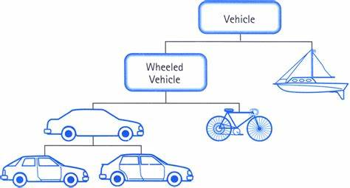
5.13 What’s the relationship between classes?
Look()
Smell()
Listen()
Eat()

Slide 69
5.13 What’s the relationship between classes?
Composition (Layering)
Modeling “has-a” or “is-implemented-in-terms-of” relationship
The weakest relationship, often the first choice
Private Inheritance
Public Inheritance

Slide 70
5.13 What’s the relationship between classes?
Composition (Layering)
Private Inheritance
Does not mean logic relationship between the base and the derived, the compiler will not convert a derived class object to a base class object
Modeling “is-implemented-in-terms-of” relationship
A bit stronger, used when we have the protected members and virtual function needs
Public Inheritance

Slide 71
5.13 What’s the relationship between classes?
Composition (Layering)
Private Inheritance
Public Inheritance
Modeling “is-a” relationship
All operations supported by base class must also be supported in derived object
The strongest relationship; make sure you really need this

Slide 72
5.13 What’s the relationship between classes?
In public inheritance
A pure virtual function, means we inherit an interface
A normal virtual function, means we inherit the interface, and inherit the implementation according to our needs
A non-virtual function, means we have to inherit not only the interface but also the implementation

Slide 73
5.14 What is Run-Time Type Identification?
Run-Time Type Identification
RTTI is such a language-supported mechanism, from which we could query the polymorphic class pointers or references to get object type

Slide 74
5.14 What is Run-Time Type Identification?
Suppose we provide the what_am_I() implementation in the base class
Consider this implementation
#include <typeinfo>
inline const char* num_sequence::what_am_I()
{
return typeid(*this).name();
};
//required by typeid operator
//typeid return a type_info object, which has the name() member function

Slide 75
5.14 What is Run-Time Type Identification?
Use typeid operator to check object type
num_sequence* pns = &fib;
if (typeid(*pns) == typeid(Fibonacci))
//type_info class support == and != operators
//ok, pns do point to a Fibonacci object
pns->gen_elems(64);
//Error, though pns is pointing to a Fibonacci
//object, it is not a Fibonacci* pointer and can’t
//call functions defined in class Fibonacci

Slide 76
5.14 What is Run-Time Type Identification?
Manually type cast
if (typeid(*pns) == typeid(Fibonacci))
Fibonacci* pf = static_cast<Fibonacci*>(pns);
//unconditional cast
pf->gen_elems(64);
dynamic_cast operator will have run-time check
If pns points to a Fibonacci object, the cast will do and pf points to the object
Return 0 otherwise
if (Fibonacci* pf = dynamic_cast<Fibonacci*>(pns)) //conditional cast
pf->gen_elems(64);

Slide 77
5.14 What is Run-Time Type Identification?
Type cast ops are usually used for safe downcast
Derived* cast to Base* - upcast
Base* cast to Derived* - downcast
Upcast is always safe, while downcast is very dangerous
downcast
Normal
Point1d*
Point1d
Point2d*
Caution!
Polymorphism
Point1d*
Point2d
Point2d*
Normal
upcast

Slide 78
5.14 Cast Operators in C++
4 cast operators to narrow down specific cast needs
const_cast – modify the constness of objects
reinterpret_cast – cast types of pointer to function, always rely on compiler platform
dynamic_cast – used in safe downcast
static_cast – the remaining needs, like () cast operator in C the most

