Slide 1


程序设计范式
0 – 序曲
赵钦佩（博士，副教授）
Email: qinpeizhao@tongji.edu.cn
http://sse.tongji.edu.cn/zhaoqinpei

Slide 2
课程目的
掌握用程序来解决问题
获得基础的编程理念
了解各种程序设计的一些技巧
培养良好的编程风格
https://canvas.tongji.edu.cn/courses/78477

Slide 3
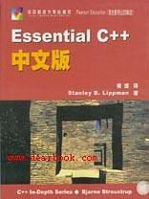
关于课程
时间：每周三3-4节课 10:00-11:35
Examination:
activity in class & class performance 10%
Exercise 25%
Exam 20%
Project 45%
Bonus: raspberry pi
教材: Essential C++

Slide 4

0–序曲
0.1为什么要学习这门课？

Slide 5

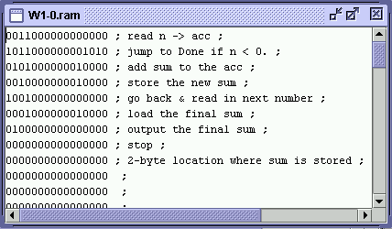
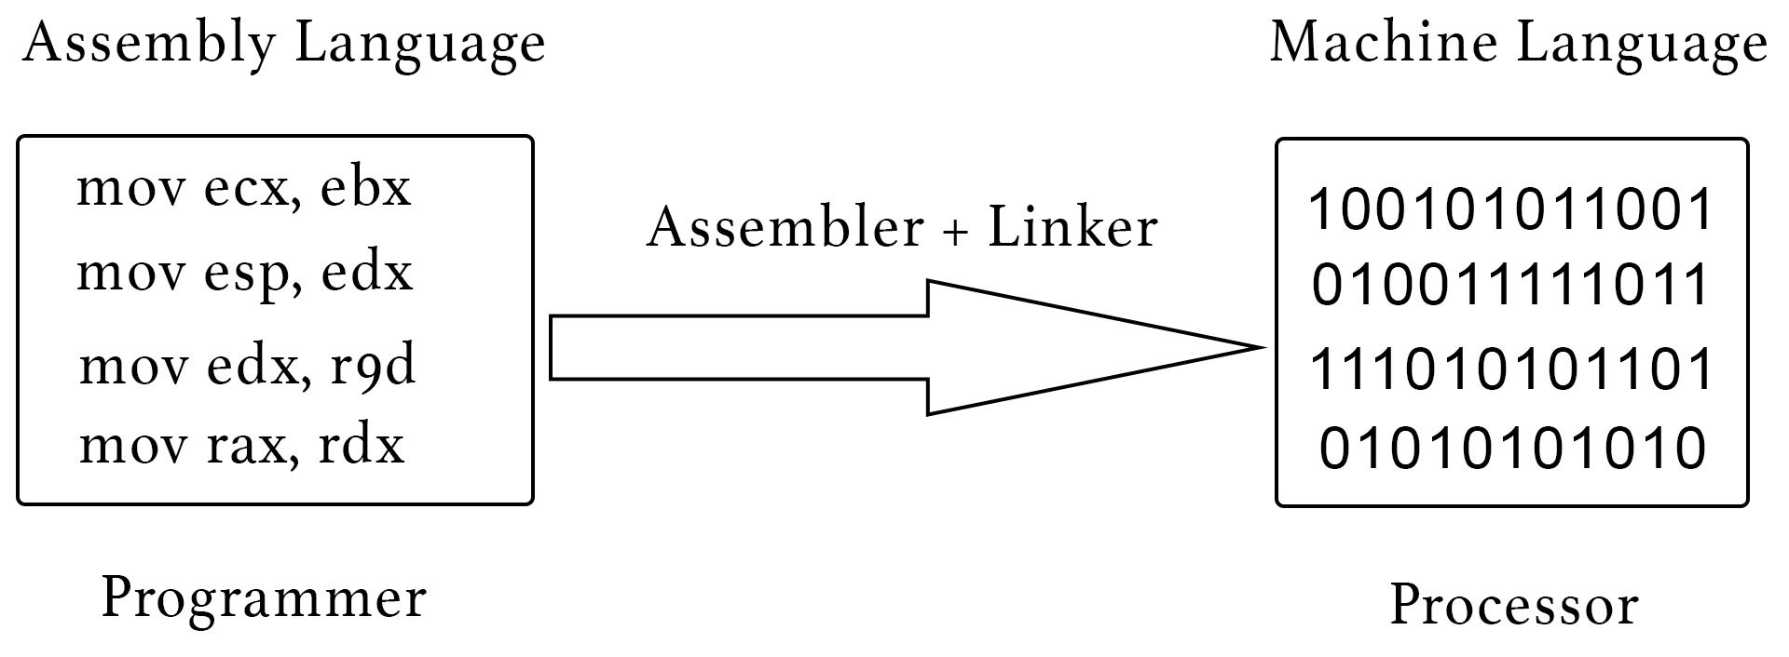
Language Families
Machine language
Assembly language
High-level languages
Procedures and recursion (C, Pascal)
Objects (C++, C#, Java, PHP, Python)

Slide 6
Machine Languages
Comprised of 1s and 0s
The “native” language of a computer
Difficult to program – one misplaced 1 or 0 will cause the program to fail.
Example of code: 1110100010101 111010101110 10111010110100 10100011110111

Slide 7
Assembly Languages
Assembly languages are:
a step towards easier programming.
comprised of a set of elemental commands which are tied to a specific processor.
Assembly language code needs to be translated to machine language before the computer processes it.
Example of code: ADD 1001010, 1011010

Slide 8
High-level Languages
High-level languages represent a giant leap towards easier programming.
The syntax of HL languages is similar to English.
Historically, we divide HL language into two groups:
Procedural languages
Object-oriented languages (OOP)

Slide 9
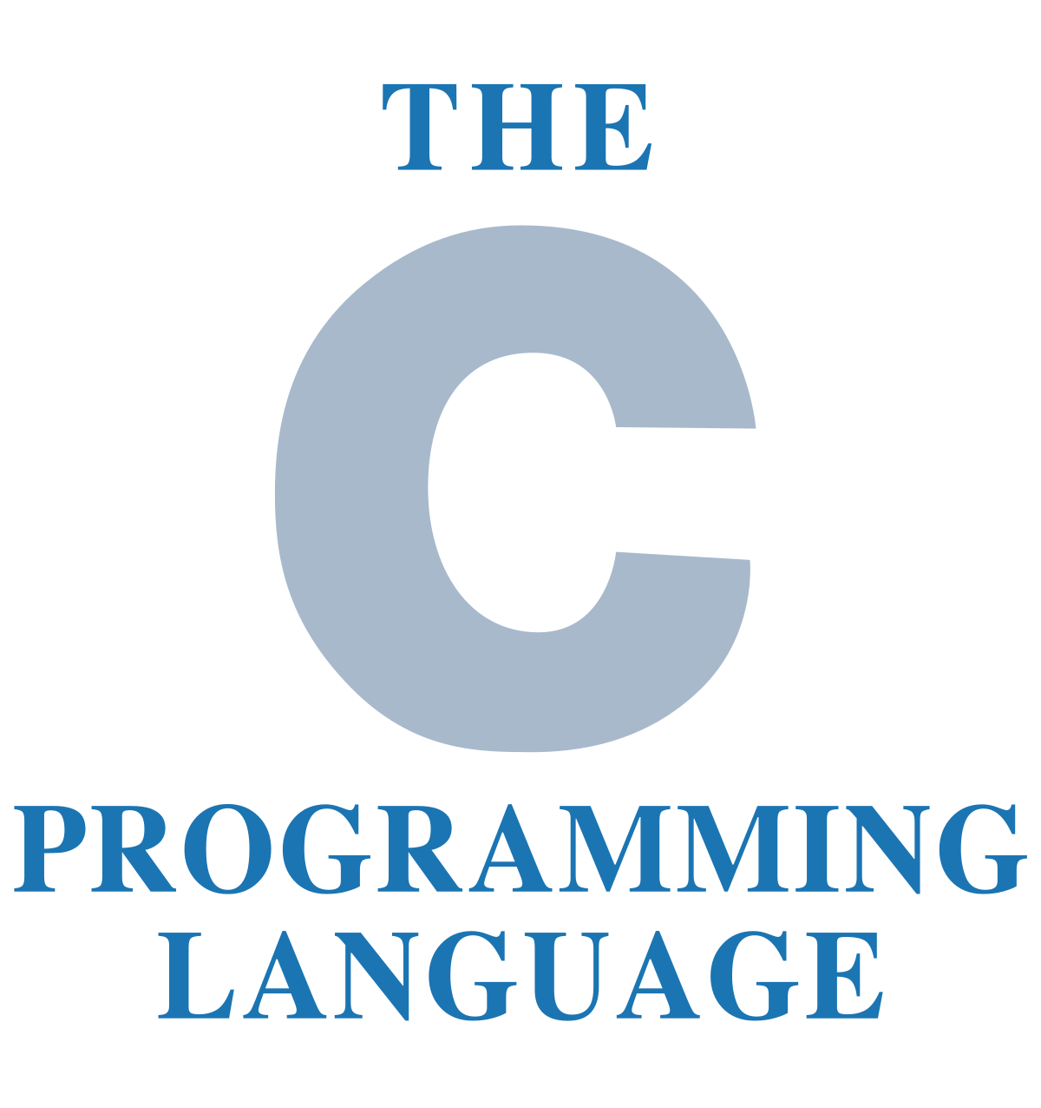
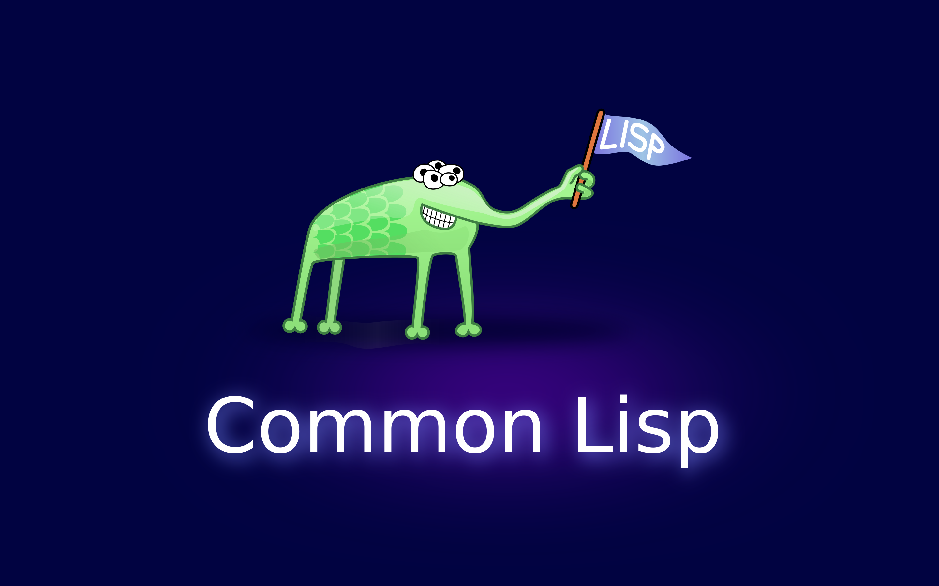
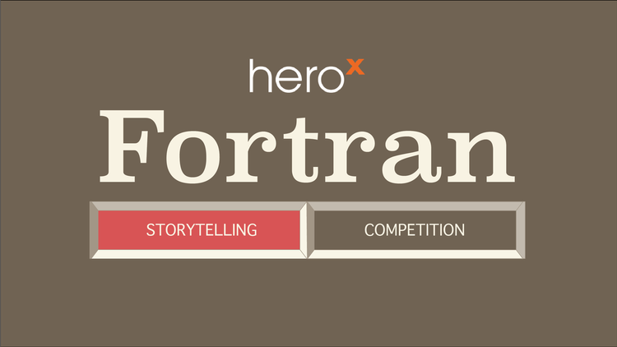

Procedural Languages
Early high-level languages are typically called procedural languages.
Procedural languages are characterized by sequential sets of linear commands. The focus of such languages is on structure.
Examples include C, COBOL, Fortran, LISP, Perl, HTML, VBScript etc.
Notes:
COBOL (/ˈkoʊbɒl, -bɔːl/; an acronym for "common business-oriented language") is a compiled English-like computer programming language designed for business use. It is imperative, procedural and, since 2002, object-oriented. COBOL is primarily used in business, finance, and administrative systems for companies and governments.
Fortran (/ˈfɔːrtræn/; formerly FORTRAN, derived from Formula Translation[2]) is a general-purpose, compiled imperative programming language that is especially suited to numeric computation and scientific computing. Originally developed by IBM[3] in the 1950s for scientific and engineering applications. Fortran's design was the basis for many other programming languages. Among the better known is BASIC, which is based on FORTRAN II.
Originally specified in 1958, Lisp is the second-oldest high-level programming language in widespread use today. Only Fortran is older, by one year. Lisp was originally created as a practical mathematical notation for computer programs. It quickly became the favored programming language for artificial intelligence (AI) research. Linked lists are one of Lisp's major data structures, and Lisp source code is made of lists.
Perl is a family of two high-level, general-purpose, interpreted, dynamic programming languages. "Perl" usually refers to Perl 5, but it may also refer to its redesigned "sister language", Perl 6. Perl was originally developed by Larry Wall in 1987 as a general-purpose Unix scripting language to make report processing easier.
VBScript ("Microsoft Visual Basic Scripting Edition") is an Active Scripting language developed by Microsoft that is modeled on Visual Basic. It allows Microsoft Windows system administrators to generate powerful tools for managing computers with error handling, subroutines, and other advanced programming constructs. It can give the user complete control over many aspects of their computing environment.

Slide 10
Object-Oriented Languages
Most object-oriented languages are high-level languages.
The focus of OOP languages is not on structure, but on modeling data.
Programmers code using “blueprints” of data models called classes.
Example of OOP languages include C++, Visual Basic.NET and Java etc.

Slide 11
Object-Oriented Languages
C++
JAVA
C#
PHP
Python
“Object-inspired” Javascript, supports inheritance and encapsulation, but not polymorphism.
Notes:
（1）Java比C++程序可靠性更高。有人曾估计每50行C++程序中至少有一个BUG。姑且不去讨论这个数字是否夸张，但是任何一个C++程序员都不得不承认C++语言在提供强大的功能的同时也提高了程序含BUG的可能性。Java语言通过改变语言的特性大大提高了程序的可靠性。
（2）Java 性能比C++慢约20倍
（3）Java语言不需要程序对内存进行分配和回收。Java丢弃了C++ 中很少使用的、很难理解的、令人迷惑的那些特性，如操作符重载、多继承、自动的强制类型转换。
（4）Java语言中没有指针的概念，引入了真正的数组
（5）单继承，Java用接口（Interface）技术取代C++程序中的多继承性，省却了多继承在实现和维护上的复杂性
（6）C# 没有指针，模版，与java类似，oo特性更彻底。
（7）PHP，Python，javascript脚本式语言, PHP（外文名:PHP: Hypertext Preprocessor，中文名：“超文本预处理器”）是一种通用开源脚本语言。语法吸收了C语言、Java和Perl的特点，利于学习，使用广泛，主要适用于Web开发领域。Python 是一种动态的、面向对象的脚本语言，最初被设计用于编写自动化脚本(shell)，随着版本的不断更新和语言新功能的添加，越来越多被用于独立的、大型项目的开发。

Slide 12
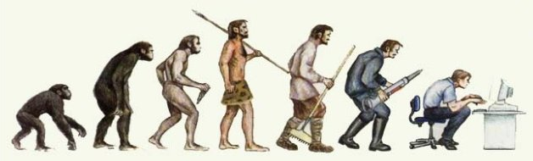
Differences
Procedural languages
Every small system has specific starts and ends. There is rigorous relationship between the starts and ends.
God creates human, how about 7,000 million human?
Object-oriented languages
God creates human, think the pattern of a human first. The image of a human is abstract. However, a certain human is concrete.
Use class and object to describe data.

Slide 13
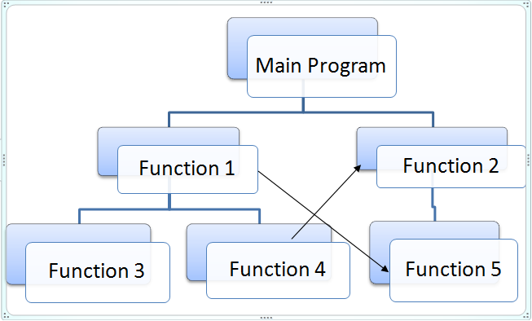
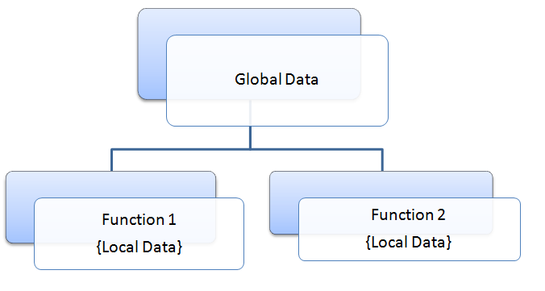
Differences -procedural
Notes:
In C, a data member must be declared GLOBAL inorder to make it accessible by 2 or more functions in the program. What happens when 2 or more functions work on the same data member ? If there are 10 functions in a program, all these 10 functions can access a global data member. It is possible one function may accidentally change values of this global data member. If this data member is a key element of the program, any such accidental manipulation will affect the whole program. It will be too difficult to debug & identify which function is causing the problem if the program is really big.

Slide 14
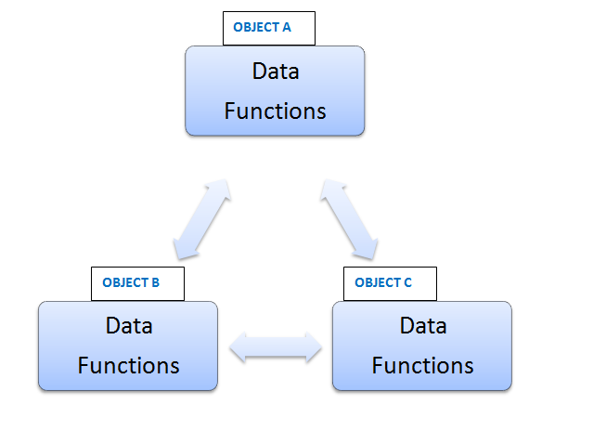
Differences – OO
Notes:
Data encapsulation: OOP ties the data closely to a particular class and its objects. There is no need of “global data types” as in POP and hence data will not flow freely around the program. This makes sure there will be no ‘accidental modification’ of critical data.
Code resusability: This simply means, a piece of code written earlier in a program can be used later. This is made possible by a feature of classes named “inheritance”.

