Slide 1


程序设计范式
1 – C++编程基础
赵钦佩（博士，副教授）
Email: qinpeizhao@tongji.edu.cn
http://sse.tongji.edu.cn/zhaoqinpei

Slide 2

1–C++编程基础
1.1 我已经掌握了C语言，还要学习C++吗？
1.2 What’s new in C++？
1.3 我可以随便命名吗？
1.4 在C++中如何输入输出？
1.5 C++支持什么数据类型？
1.6 怎么交换两个数？
1.7 除了数组（array）我们还能用点别的吗？

Slide 3

1.1 Why C++?
Compliant with C, but better than C
Protect legacy codes
Safer
Easier for debugging
Support data abstraction
Support 4 kinds of Programming and Design style
Procedure-Based Programming
Object-Based Programming
Object-Oriented Programming
Especially useful in modern project developing
Generic Programming
Necessary for excellent programs
Notes:
保护遗留的代码
更安全，更容易
数据抽象化：现实世界中充斥大量数据，数据具有一定的模式存在，oop的主要特点。来源于人的认知特性。
支持四种编程和设计风格
c和C++兼容问题，IDE是visual studio
封装，继承，多态

Slide 4
1.1 C++ Applications
The kernels of the operating systems, e.g., windows, linux and unix are written in C and assembly language, however, the high-level part of them is written by C++.
Create new languages, such as C#, Java, Python etc.
Games, such as “world of warcraft” (魔兽世界）
Scientific researches
Telecommunication
Softwares, such as 3Dmax, CAD, Photoshop, QQ, office
Hack, virus
Search engines, such as google, baidu
XML, HTML parser

Slide 5
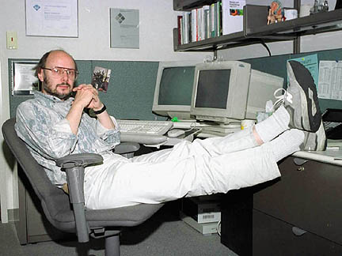
1.1 C++ Applications - Bjarne Stroustrup
Amazon.com：Software for large-scale e-commerce.
Apple: OS X is written in a mix of language, but a few important parts are C++.
AT&T: The largest US telecommunications provider.
Autodesk: A large number of major number of application in the CAD domain
Ericsson: server platform.
Google: web search engine, etc.
HP, IBM, Intel, Nokia
JPL (Jet Propulsion Lab, NASA): Mars rover autonomous driving system (incl. scene analysis and route planning). C++ on Mars! Also lots of supporting software "on the ground" (i.e. Earth).

Slide 6
1.1 C++ Applications - Bjarne Stroustrup
Microsoft:
o Windows XP o Windows NT (NT4 and 2000) o Windows 9x (95, 98, Me) o Microsoft Office (Word, Excel, Access, PowerPoint, Outlook) o Internet Explorer (including Outlook Express) o Visual Studio o SQL
Mozilla: Firefox browser and Thunderbird mail client (open source)
MySQL: MySQL Server (about 250,000 lines of C++) and MySQL Cluster. Arguably the world's most popular open source database
telephone systems
I think it would be almost easier to list the systems which aren't written in C++ .

Slide 7

1.2 C++ features
Classes
User-defined types
Operator overloading
Attach different meaning to expressions such as a + b
References
Pass-by-reference function arguments
Virtual Functions
Dispatched depending on type at run time
Templates
Macro-like polymorphism for containers (e.g., arrays)
Exceptions

Slide 8

1.2 A stack in C
Creator function ensures stack is created properly.
Does not help for stack that is an automatic variable.
Programmer could inadvertently create uninitialized stack.
typedef struct {
char s[SIZE];
int sp;
} Stack;
stack *create() {
Stack *s;
s = (Stack *)malloc(sizeof(Stack));
s->sp = 0;
return s;
}
Notes:
In computer programming, an automatic variable is a local variable which is allocated and deallocated automatically when program flow enters and leaves the variable's scope.

Slide 9
1.2 A stack in C
Not clear these are the only stack-related functions.
Another part of program can modify any stack any way it wants to, destroying invariants.
Temptation to inline these computations, not use functions.
char pop(Stack *s) {
if (sp = 0) error(“Underflow”);
return s->s[--sp];
}
void push(Stack *s, char v) {
if (sp == SIZE) error(“Overflow”);
s->s[sp++] = v;
}

Slide 10
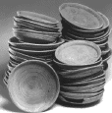
1.2 C++ solution
Definition of both representation and operations
class Stack {
char s[SIZE];
int sp;
public:
Stack() { sp = 0; }
void push(char v) {
if (sp == SIZE) error(“overflow”);
s[sp++] = v;
}
char pop() {
if (sp == 0) error(“underflow”);
return s[--sp];
}
};
Public: visible outside the class
Constructor: initializes
Member functions see object fields like local variables

Slide 11
1.2 C++ Stack class
Natural to use
Stack st;
st.push(‘a’); st.push(‘b’);
char d = st.pop();
Stack *stk = new Stack;
stk->push(‘a’); stk->push(‘b’);
char d = stk->pop();

Slide 12
1.2 C++ Stack class
Members (functions, data) can be public, protected, or private
class Stack {
char s[SIZE];
public:
char pop();
};
Stack st;
st.s[0] = ‘a’; // Error: s is private
st.pop(); // OK
Notes:
c++中，如果我们对类的成员（包括成员变量和成员函数）没有定义属性，则默认是private

Slide 13
1.2 C -> C++
C++ compiler translates to C-style implementation
C++
class Stack {
char s[SIZE];
int sp;
public:
Stack();
void push(char);
char pop();
};
Equivalent C implementation
struct Stack {
char s[SIZE];
int sp;
};
void st_Stack(Stack*);
void st_push(Stack*, char);
char st_pop(Stack*);

Slide 14
1.3 Namespace
The problem: When two variables (or functions) in global scope have the same identifier (name), we get a compile error.
To avoid such name collisions, programmers need to use unique identifiers in their own code.
In C, if you use multiple third-party libraries and there is a name collision, you have three choices:
get the source code to the libraries and modify and recompile it.
ask one of the library publishers to rename their identifiers, or
decide not to use one of the libraries.

Slide 15
1.3 Namespace
Wrap the library to avoid name collision in global scope, a better way than prefixes
std is the namespace wrapping all standard C++ libraries.
int abc_NumOfInstances = 0;
int abc_Create(int InstNo);
namespace abc
{
int NumOfInstances = 0;
int Create(int InstNo);
}

Slide 16
1.3 Namespace
3 ways to use namespace
Use prefix style to specify every time
Import one symbol to current scope
Import all symbols in a namespace to current scope – using directive
void f1()
{ abc::Create(NumOfInstances);
abc::NumOfInstances++;}
void f2()
{ using abc::NumOfInstances;
Create(NumOfInstances); //Error! Only NumOfInstances is visible, Create not imported
NumOfInstances++; //OK
}
void f3()
{ using namespace abc;
Create(NumOfInstances); //OK
NumOfInstances++; //OK
}

Slide 17
1.3 Namespace
But we suggest the using directive form to expose all names in standard libraries
using namespace std;

Slide 18
1.4 Input and Output (IO)
C’s printing facility is clever but unsafe
char *s; int d; double g;
printf(“%s %d %g”, s, d, g);
Hard for compiler to type check argument types against format string
C++ IO overloads the << and >> operators
cout << s << ‘ ‘ << d << ‘ ‘ << g;
Type safe
Notes:
scanf的时候在输入自由的情况下，很难确定错误的类型在哪里。

Slide 19
1.4 C++ IO
Object oriented by references, function overloading, operator overloading
e.g., Printing user-defined types:
ostream &operator<<(ostream &o, MyType &m) {
o << “An Object of MyType”;
return o;
}
Type safe
I/O sensitive to data type
Error if types do not match
User-defined and standard types: makes C++ extensible

Slide 20
1.4 C++ IO
Stream: sequence of bytes
Input: from device (keyboard, disk drive) to memory
Output: from memory to device (monitor, printer, etc.)
iostream library
Has header files with hundreds of I/O capabilities
<iostream.h>
Standard input (cin)
Standard output (cout)
Unbuffered error (cerr)
Buffered error (clog)
<fstream.h>
File processing operations

Slide 21
1.4 Stream output
Output
Use ostream
Formatted and unformatted
Standard data types (<<)
Characters (put function)
Integers (decimal, octal, hexadecimal)
Floating point numbers
Various precision, forced decimal points, scientific notations
Justified, padded data
Uppercase/lowercase control

Slide 22
1.4 Stream input
Formatted and unformatted input (istream)
>> operator
Normally skips whitespace (blanks, tabs, newlines)
Returns 0 when EOF encountered
Otherwise, returns reference to object
cin >> grade;
get function
End-of-file (EOF)
Indicates end of input
cin.eof() returns 1(true) if EOF has occurred.

Slide 23
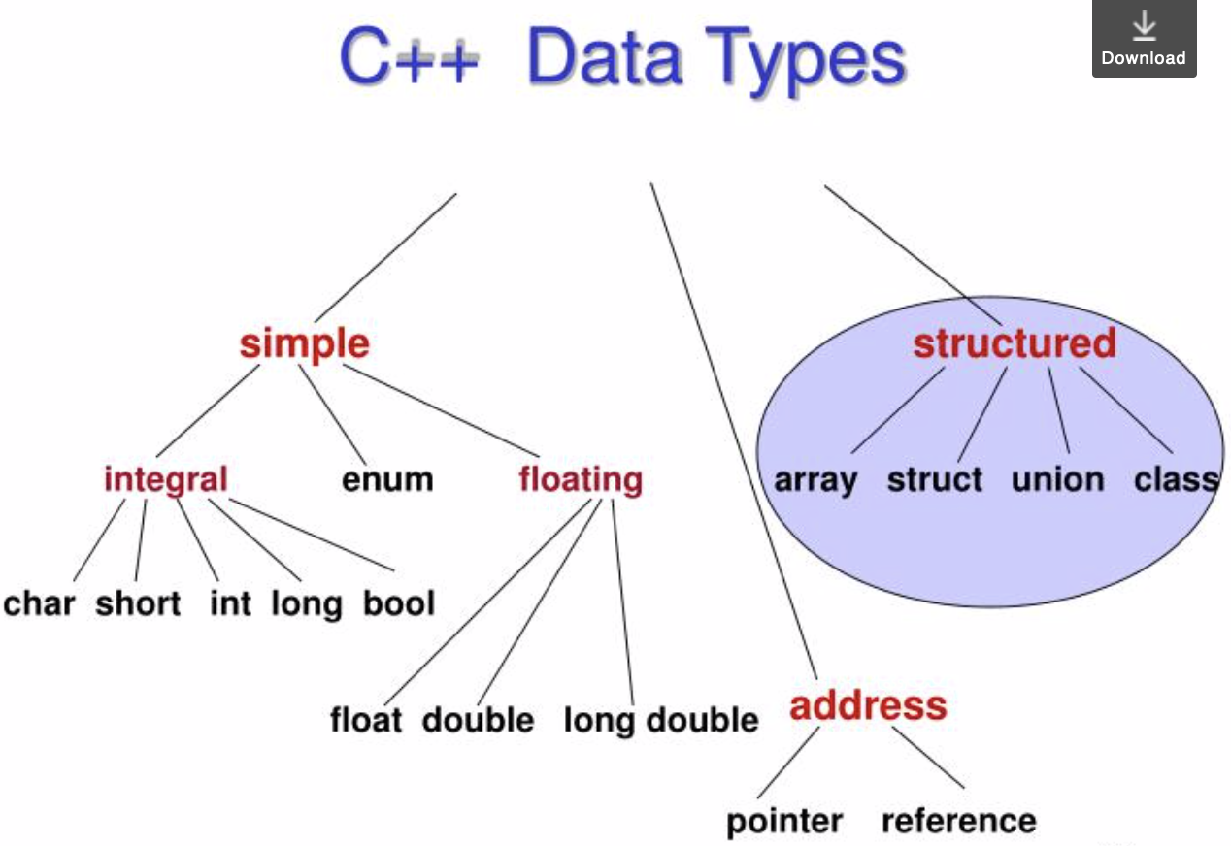
1.5 Data types

Slide 24
1.5 Numeric data types
Type char represents individual characters and small integers (1 byte).
Type short, int, and long represent integer values (half a machine word, 1 machine word, 1 or more machine words).
Type float, double and long double represent floating point values (1 machine word, 2 machine words, 3 or 4 machine words).
Type char, short, int, and long are also called integral types, which can be signed or unsigned.
Notes:
Int =4 byte

Slide 25
1.5 Literal constants
Literal constants are values that occur in a program.
We can use prefixes to write literal integer constants in decimal, octal, or hexadecimal notation.
Decimal (no prefix): 15
Octal (prefix 0): 015 = 13 (decimal)
Hexadecimal (prefix 0x): 0x15 = 21 (decimal)
You can specify different types by appending a letter to the literal integer constant.
e.g., 2344U (unsigned), 1555L (long), 166UL (unsigned long), 3.1415F (float), 6.283L (long double)
Notes:
A literal is a value that is expressed as itself. Forexample, the number 25 or the string "Hello World" areboth literals.

Slide 26
1.5 Literal constants
A built-in (or primitive) C++ data type is the type bool.
Its only literals are true and false.
Note that the type bool does not exist in C.
In C, we represent the Boolean values true and false by the integers 1 and 0.
We use single quotation marks to write literal character constants. E.g., ‘x’, ‘4’, ‘:’, ‘\n’.
A literal string constant is composed of zero or more characters enclosed in double quotation marks. E.g., “hello”, “x”, “”. “Hi, \nHow are you”.

Slide 27
1.5 the C++ string type
To use the C++ string type, you must #include <string> .
Initialize strings:
string myString(“Hello folks!”);
string myOtherString(myString);
string myFinalString; //empty string
The length of a string is returned by size() without the terminating null character): cout << myString.size();
empty() operation to find out whether a string is empty.
The equality operator (==) to check whether two strings are equal.

Slide 28
1.5 the C++ string type (cont.)
Copy one string to another with the assignment operator (=)
Use the plus operator to concatenate strings.
string s1 = “Wow!”, s2 = “Ouch!”;
const char *s3 = “Yuck!”;
s2 += s1 + s3 + s2;
cout << s2;
= Ouch!Wow!Yuck!Ouch!

Slide 29
1.5 structures
A structured data type is a type in which each value is a collection of component items.
The entire collection has a single name, each component can be accessed individually.
Often, we have related information of various types that we’d like to store together for convenient access under the same identifier, for example…

Slide 30
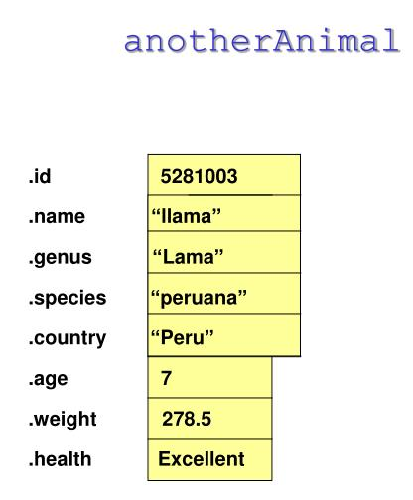
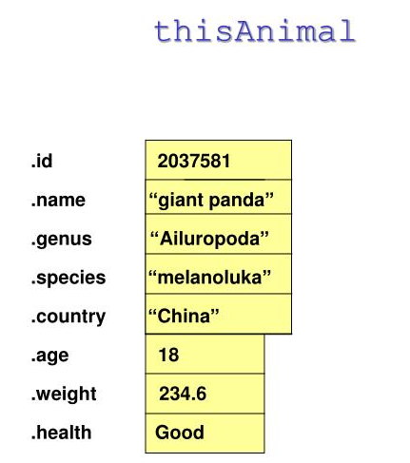
1.5 structures

Slide 31
1.5 struct
enum HealthType {Poor, Fair, Good, Excellent};
struct AnimalType // declares a struct data type
{ // does not allocate memory
long id;
string name;
string genus;
string species;
string country;
int age;
float weight;
HealthType health;
};
AnimalType thisAnimal; //declare variables of AnimalType
AnimalType anotherAnimal;
Structure members

Slide 32
1.5 Abstraction
Abstraction is the separation of the essential qualities of an object from the details of how it works or is composed.
It focuses on what, not how.
It is necessary for managing large, complex software projects.

Slide 33
1.5 Data abstraction
Separates the logical properties of a data type from its implementation.
Logical properties
What are the possible values?
What operations will be needed?
Implementation
How can this be done in C++?
How can data types be used?

Slide 34
1.5 Data abstraction
Data Type
Set of values (domain)
Allowable operations on the values
For example, data type int has
domain operations
-32768…32767 +, -, *, /, %, >>, <<

Slide 35
1.5 Abstract Data Type (ADT)
Is a programmer-defined type with a set of values and allowable operations for the type.
Ways to define a new C++ type are
using typedef
typedef char String20[21]; // variable declaration
String20 message;
using struct
struct EmployeeType{
long idNumber;
String20 name;} myself;
using class

Slide 36
1.5 Abstract Data Type (ADT) example
TYPE
TimeType
DOMAIN
Each TimeType value is a time in hours, minutes, and seconds.
OPERATIONS
set the time
print the time
increment by one second
compare 2 times for equality

Slide 37
1.6 How to swap two numbers?

Slide 38
1.6 solution in C
// This function swaps values pointed by xp and yp
void swap(int *xp, int *yp) {
int temp = *xp;
*xp = *yp;
*yp = temp;
}
int main()
{
int x, y;
scanf("%d", &x);
scanf("%d", &y);
swap(&x, &y);
printf("\nAfter Swapping: x = %d, y = %d", x, y);
return 0;
}
pointer

Slide 39
1.6 How can we do in C++?
// This function swaps values by reference x and y
void swap(int &x, int &y) {
int temp = x;
x = y;
y = temp;
}
int main()
{
int x, y;
scanf("%d", &x);
scanf("%d", &y);
swap(x, y);
printf("\nAfter Swapping: x = %d, y = %d", x, y);
return 0;
}
passing by reference

Slide 40
1.6 Reference in C++
3 Reasons to use passing by reference:
To modify the objects that passed in the function
To avoid the cost of copying large objects
To have more than one return values
bool add_even(int a, int b, int& c)
{
if (a%2 == 0 && b%2 == 0)
{
c = a+b;
return true;
}
return false;
}
struct Matrix { double a[10000][10000] };
int f1(Matrix m);
int f2(Matrix& m);

Slide 41


1.6 Reference and Pointer
The inner mechanism of reference and pointer may be similar, but they are quite different in usage
Using Reference when you find
It always represents a non-null object
And it will not represent any other objects
Using Pointer otherwise
Pointer could be re-assigned values, while reference could not

Slide 42
1.6 Reference
References as aliases to other variables
Refer to same variable
References must be initialized when declared
Otherwise, compiler error
int count = 1; //declare integer variable count
Int &cRef = count; //create cRef as an alias for count
++cRef; // increment count (using its alias)

Slide 43
1.6 Reference
Reference parameter
Alias for argument in function call
passes parameter by reference
Use & after data type in prototype
void myFunction( int &data )
Read “data is a reference to an int”
Function call format the same

Slide 44
1.6 Without the third variable? + and -
#include<stdio.h>
int main()
{
int a=10, b=20;
printf("Before swap a=%d b=%d",a,b);
a=a+b; //a=30 (10+20)
b=a-b; //b=10 (30-20)
a=a-b; //a=20 (30-10)
printf("\nAfter swap a=%d b=%d",a,b);
return 0;
}

Slide 45
1.6 Without the third variable? * and /
#include<stdio.h>
#include<stdlib.h>
int main()
{
int a=10, b=20;
printf("Before swap a=%d b=%d",a,b);
a=a*b; //a=200 (10*20)
b=a/b; //b=10 (200/20)
a=a/b; //a=20 (200/10)
printf("\nAfter swap a=%d b=%d",a,b);
return 0;
}

Slide 46
1.6 Without the third variable? XOR
#include<stdio.h>
int main()
{
int a;
int b;
scanf("%i",&a);
scanf("%i",&b);
a ^= b;
b ^= a;
a ^= b;
printf("A : %i",a);
printf("\nB : %i",b);
return 0;
}
Notes:
异或

Slide 47
1.7 Except for arrays?
Arrays in C++ have a number of drawbacks:
Array size is a fixed constant.
Passing an array as a parameter to a function is inconvenient, the size of the array must be passed as a separate parameter.
There is no way to conveniently insert elements at the beginning or in the middle of an array.
Similarly, it is inconvenient to remove an element from an array.
You cannot return an array from a function.

Slide 48
1.7 Vectors
Vectors, like strings, are a class in C++.
It is another type that you can use to declare variables.
#include <vector> //you must include this header
Using namespace std; //like everything else, vectors live in the std namespace

Slide 49
1.7 Use Vectors
Declare an array of 20 ints:
Declare a vector of 20 ints
const int SIZE = 20;
int Numbers[SIZE];
const int SIZE = 20;
vector <int> Numbers(SIZE);

Slide 50
1.7 Initialize Vectors
The initialization can also be:
Unlike an array, the elements of a vector are initialized with appropriate default values.
More conveniently than for loop
const int SIZE = 20;
vector <int> Numbers(SIZE);
0
const int SIZE = 20;
vector <int> Numbers(SIZE,18);
18
const int SIZE = 20;
vector <int> Numbers(SIZE,3.5);
3.5

Slide 51
1.7 methods in Vectors
Reports the number of elements in the vector: size()
Check the vector is empty or not: empty()
Resize the vector V so that it contains exactly N elements: V.resize(int N)
Removes all of the elements from the vector and sets its size to 0: clear()
Adds an element to the end of the vector, increasing its size by 1: push_back(Type element)
To be continued…

