Slide 1
CLIPS
https://sourceforge.net/projects/clipsrules/files/CLIPS/6.31/
找到适合自己的操作系统

Slide 2
Facts
添加事实Facts 用关键字assert
(assert(duck))
(facts) 查看所有的facts
清除事实用关键字 retract
(retract 1)
清除所有数据用 clear
(clear)

Slide 3
多个fact
(deffacts walk (status walking) (walk-sign walk))
(reset)
It removes existing facts from the fact-list, which may remove activated rules from the agenda.
It asserts facts from existing (deffacts) statements.

Slide 4
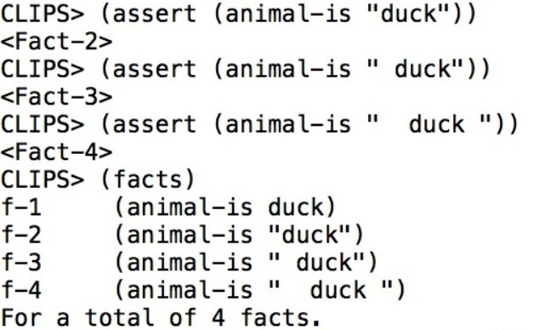
外部文件
外部clp文件 (save ***.clp) (load ***.clp)
注释用 ;
空格不影响facts 但空格在string 里会影响

Slide 5
Rules
(assert (animal-is duck))
(defrule duck (animal-is duck)
=>(assert (sound-is quack)))
打印 rule (ppdefrule duck)
(rules)
(agenda) to show which rules can be fired, and the order in which will be fired
没有（run）一条规则，(run)之后两条
printout

Slide 6
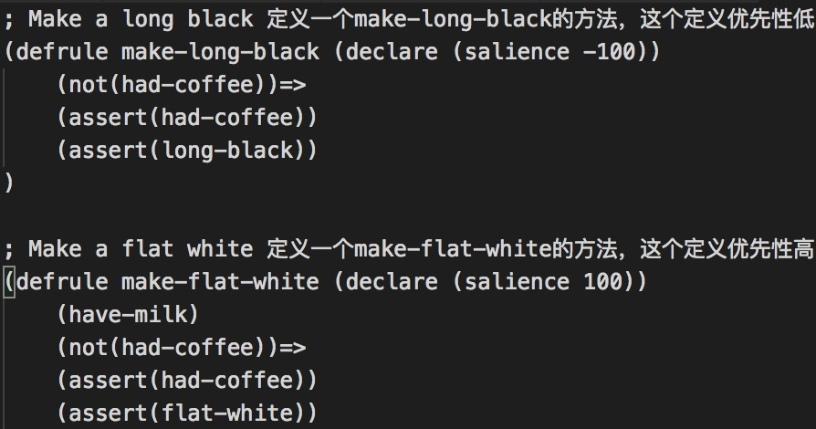
优先级问题
rules 的执行顺序不是说从上到下的，而是按照这个方法是否被触发而执行的
(declare (salience -100))
Notes:
先agenda 再assert agenda

Slide 7
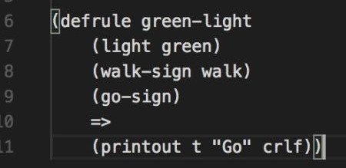
多个rule
多个rule都要满足才触发

Slide 8
运算
(+ 3 4) 7
(= (+ 3 4) 7) True
(+ ) (- ) (* ) (/ ) (mod ) (** )
(and ) (or ) (not )
(random ) (max ) (min )
(printout t "hello world" crlf)
~ | & (严格意义上是constraint)

Slide 9
variable
只要缓缓打出一个?，你就是个变量 .
(defrule make-quake
(duck-sound ?sound)=>(assert (sound-is ?sound)))
(assert (duck-sound quack))
多个变量，一个萝卜一个坑

Slide 10
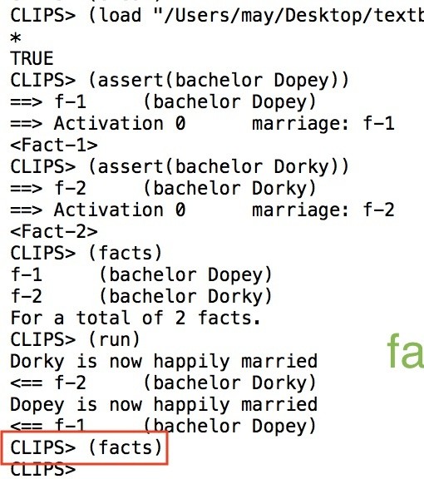
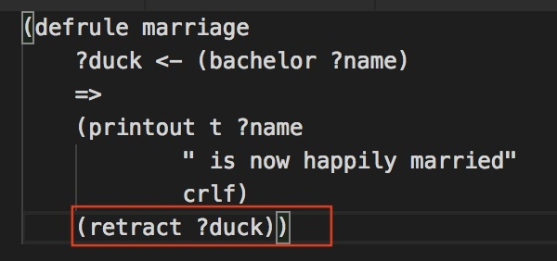
删除variable

Slide 11
function
(deffunction hypotenuse
(?a ?b)
(sqrt (+ (* ?a ?a)(* ?b ?b)))
)
(defrule calculate-hypotenuse
(dimensions ?base ?height)
=>
(printout t "Hypotenuse = " (hypotenuse ?base ?height) crlf)
)

Slide 12
template
(deftemplate prospect
(slot name
(default ?DERIVE))
(slot assets
(default rich))
(slot age
(default 80))
)
# define the rule
(defrule matrimonial_candidate
(prospect (name ?name)
(assets ?net_worth)
(age ?months))
=>
(printout t "Prospect:"
?name crlf
?net_worth crlf
?months " months old" crlf)
)
Java 和C中的Construct
deftemplate people
(multislot name
(type SYMBOL)
(default ?DERIVE))
(slot assets
(type SYMBOL)
(allowed-symbols
poor rich wealthy loaded)
(default rich))
(slot age
(type INTEGER)
(range 80 ?VARIABLE)
(default 80))
)

Slide 13
Prolog

Slide 14
swi-prolog安装
Windows
https://www.swi-prolog.org/download/stable 安装时勾选添加环境变量
Linux
sudo add-apt-repository ppa:swi-prolog/stable
sudo apt-get update
sudo apt-get install swi-prolog
Mac
port install swi-prolog
or
brew install swi-prolog

Slide 15
Getting started quickly
命令行键入 swipl
或者打开SWI-prolog(console)
或者打开prolog 应用
命令行操作
文件读入操作
自定义规则

Slide 16
Syntax
Atoms
A string of characters: butch , big_kahuna_burger , listens2Music and playsAirGuitar
An arbitrary sequence of characters enclosed in single quotes: ’ &^%&#@$ &* ’
A string of special characters: :-
Numbers
most Prolog implementations do support floating point numbers or floats
23 , 1001 , 0 , -365
Variables
starts either with an upper-case letter or with an underscore: X , Y , Variable , _tag
_ :anonymous variable
Complex terms
functor followed by a sequence of arguments
programmer(linux).
father(father(fahter(john))).

Slide 17
Facts
father(tom, john).
father(john, ive).
Rules
grandfather(X,Z):-father(X, Y),
father(Y, Z).
Queries
programmer(linux).
programmer(bill).
designer(jonathan).
?- programmer(X).
X = linux
输入;
X = bill
再次输入;
no

Slide 18
Recursion
child(anne,bridget).
child(bridget,caroline).
child(caroline,donna).
child(donna,emily).
Rule Ordering
descend(X,Y) :- child(X,Y).
descend(X,Y) :- child(X,Z), descend(Z,Y).
?- descend(X,Y).
3. descend(X,Y) :- descend(Z,Y), child(X,Z).
descend(X,Y) :- child(X,Y).
?- descend(anne,emily).
2. descend(X,Y) :- child(X,Z), descend(Z,Y).
descend(X,Y) :- child(X,Y).
Notes:
1和2运行？-descend(X,Y)返回的X和Y不同。3运行?- descend(anne,emily).会报错

Slide 19
Exercise1:
byCar(auckland,hamilton).
byCar(hamilton,raglan).
byCar(valmont,saarbruecken).
byCar(valmont,metz).
byTrain(metz,frankfurt).
byTrain(saarbruecken,frankfurt).
byTrain(metz,paris).
?- travel(valmont,raglan).
yes
byTrain(saarbruecken,paris).
byPlane(frankfurt,bangkok).
byPlane(frankfurt,singapore).
byPlane(paris,losAngeles).
byPlane(bangkok,auckland).
byPlane(singapore,auckland).
byPlane(losAngeles,auckland).

Slide 20
List
[mia, vincent, jules, yolanda]
[mia, robber(honey_bunny), X, 2, mia]
[ ]
[mia, [vincent, jules], [butch, girlfriend(butch)]]
Head&Tail
?- [Head|Tail] = [mia, vincent, jules, yolanda].
Head = mia
Tail = [vincent,jules,yolanda]
Q1: How about [ ]?
Q2: How to get the first two elements?
Recursive
member: whether something is an element of a list or not
member(X,[X|T]).
member(X,[H|T]) :- member(X,T).
Notes:
Q1:特殊，既没有head也没有tail
Q2:?- [Head1,Head2 | Tail]

Slide 21
Exercise2:
?- combine1([a,b,c],[1,2,3],X).
X = [a,1,b,2,c,3]
?- combine2([a,b,c],[1,2,3],X).
X = [[a,1],[b,2],[c,3]]
?- combine3([a,b,c],[1,2,3],X).
X = [j(a,1),j(b,2),j(c,3)]

Slide 22
Arithmetic
6 + 2 = 8→8 is 6+2.
6 − 8 = − 2→ -2 is 6-8.
7 ÷ 2 = 3→ 3 is 7/2.
add_3_and_double(X,Y) :- Y is (X+3)*2.
?- add_3_and_double(1,X).
X = 8
Q1: How about ?- 6+2 is X.
Q2:How about ?- add_3_and_double(X,12).
Q3:How aout ?- is(X,+(3,2))
Arithmetic and Lists
len([ ],0).
len([ _|T ],N) :- len(T,X), N is X+1.
?- X = 3+2
X = 3+2
Notes:
Q1:错误；Q2：错误；Q3：可以

Slide 23
Exercise3:
?- scalarMult(3,[2,7,4],Result).
Result = [6,21,12]
?- dot([2,5,6],[3,4,1],Result).
Result = 32

Slide 24
数独
数据结构表示数独
List!
规则：
给定玩家一个9×9的盘面，玩家填充完所有的空格后最终的解仍然是这个9×9的盘面；
填充完空格后，每一个空格内的数字均在1~9之内； （内置谓词：fd_domain）
填充完空格后，每一行9个数字各不相同； （内置谓词：fd_all_different）
填充完空格后，每一列9个数字各不相同；
填充完空格后，每一个宫格内的数字各不相同。
Notes:
9*9为例

Slide 25
规则1：
sudoku(Puzzle,Solution):- Solution = Puzzle.
?- sudoku([1,2,3,4,5,6,7,8,9,
1,2,3,4,5,6,7,8,9,
1,2,3,4,5,6,7,8,9,
1,2,3,4,5,6,7,8,9,
1,2,3,4,5,6,7,8,9,
1,2,3,4,5,6,7,8,9,
1,2,3,4,5,6,7,8,9,
1,2,3,4,5,6,7,8,9,
1,2,3,4,5,6,7,8,9],Solution).
Solution = [1,2,3,4,5,6,7,8,9,1,2,3,4,5,6,7,8,9,…]

Slide 26
规则2：
sudoku(Puzzle,Solution):- Solution = Puzzle,
Puzzle = [S11,S12,S13,S14,S15,S16,S17,S18,S19, S21,S22,S23,S24,S25,S26,S27,S28,S29, S31,S32,S33,S34,S35,S36,S37,S38,S39, S41,S42,S43,S44,S45,S46,S47,S48,S49, S51,S52,S53,S54,S55,S56,S57,S58,S59, S61,S62,S63,S64,S65,S66,S67,S68,S69, S71,S72,S73,S74,S75,S76,S77,S78,S79, S81,S82,S83,S84,S85,S86,S87,S88,S89, S91,S92,S93,S94,S95,S96,S97,S98,S99],
fd_domain(Puzzle,1,9).

Slide 27
规则3：
Row1 = [S11,S12,S13,S14,S15,S16,S17,S18,S19],
Row2 = [S21,S22,S23,S24,S25,S26,S27,S28,S29],
Row3 = [S31,S32,S33,S34,S35,S36,S37,S38,S39],
Row4 = [S41,S42,S43,S44,S45,S46,S47,S48,S49],
Row5 = [S51,S52,S53,S54,S55,S56,S57,S58,S59],
Row6 = [S61,S62,S63,S64,S65,S66,S67,S68,S69],
Row7 = [S71,S72,S73,S74,S75,S76,S77,S78,S79],
Row8 = [S81,S82,S83,S84,S85,S86,S87,S88,S89],
Row9 = [S91,S92,S93,S94,S95,S96,S97,S98,S99],
fd_all_different(Row1),
fd_all_different(Row2),
……
完成规则4和5
用递归优化

Slide 28
Prolog还可以做什么？
文字冒险游戏
化学方程式配平
国际象棋A
Minesweeper （演示）

