Slide 1
DISTRIBUTED FILE SYSTEMS
Try to make a file system transparently available to remote clients.
Tanenbaum & Van Steen, Distributed Systems: Principles and Paradigms, 2e, (c) 2007 Prentice-Hall, Inc. All rights reserved. 0-13-239227-5

Slide 2
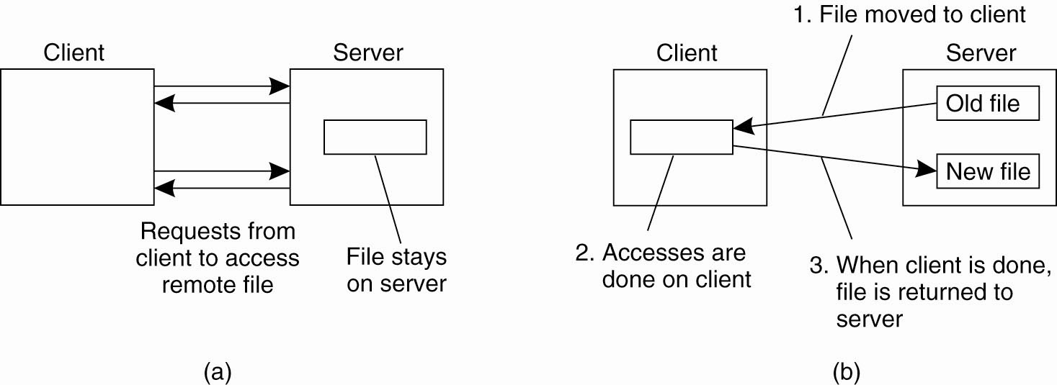
Client-Server Architectures (1)
Figure 11-1. (a) The remote access model.
(b) The upload/download model.
Tanenbaum & Van Steen, Distributed Systems: Principles and Paradigms, 2e, (c) 2007 Prentice-Hall, Inc. All rights reserved. 0-13-239227-5

Slide 3
NFS (Network File System)
NFS (Network File System) allows hosts to mount partitions on a remote system and use them as though they are local file systems.
This allows the system administrator to store resources in a central location on the network, providing authorized users continuous access to them.

Slide 4
What is NFS?
First commercially successful network file system:
  Developed by Sun Microsystems for their diskless workstations
  Designed for robustness and “adequate performance”
  Sun published all protocol specifications
  Many many implementations

Slide 5
highlights
NFS is stateless
  All client requests must be self-contained
The virtual filesystem interface
  VFS operations
Performance issues
  Impact of tuning on NFS performance

Slide 6
Objectives (I)
Machine and Operating System Independence
  Could be implemented on low-end machines of the mid-80’s
Fast Crash Recovery
  Major reason behind stateless design
Transparent Access
  Remote files should be accessed in exactly the same way as local files

Slide 7
Objectives (II)
UNIX semantics should be maintained on client
  Best way to achieve transparent access
“Reasonable” performance
  Robustness and preservation of UNIX semantics were much more important
    Contrast with Sprite and Coda

Slide 8
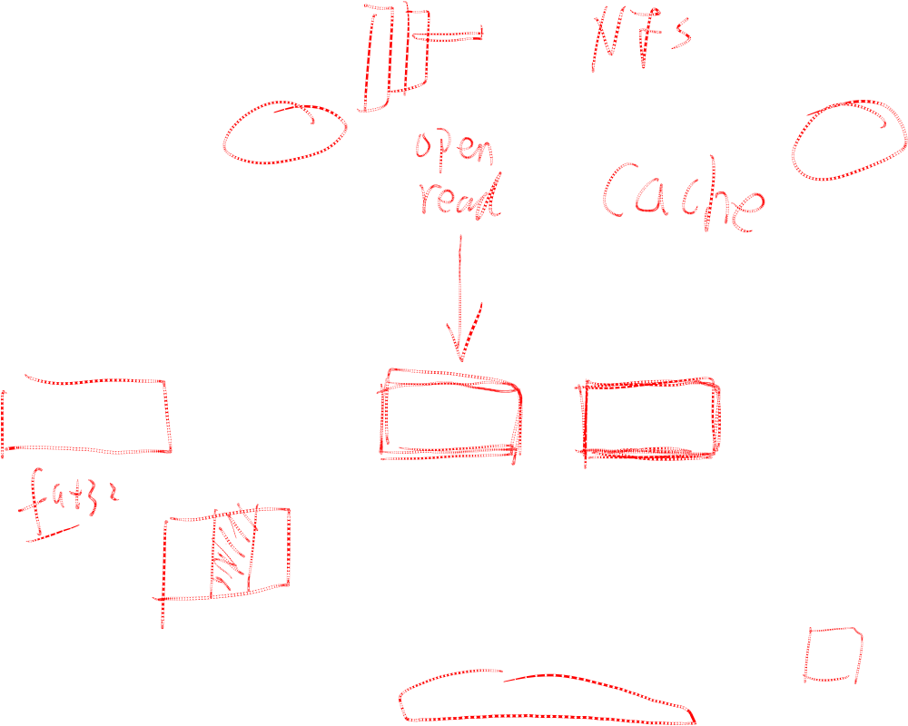
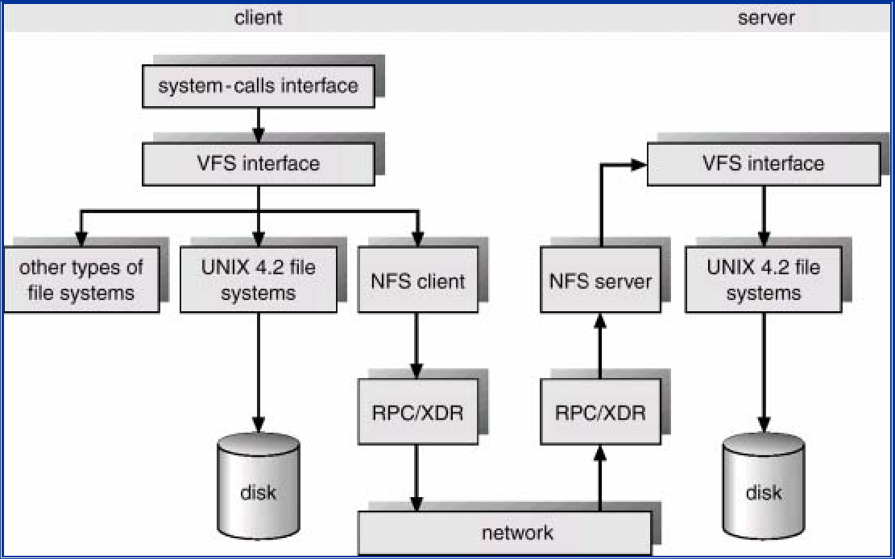
NFS (Network File System)

Slide 9
NFS Architecture
NFS is implemented using the Virtual File System （VFS） abstraction
VFS provides standard file system interface,
and allows to hide difference between accessing
local or remote file system.
Tanenbaum & Van Steen, Distributed Systems: Principles and Paradigms, 2e, (c) 2007 Prentice-Hall, Inc. All rights reserved. 0-13-239227-5

Slide 10
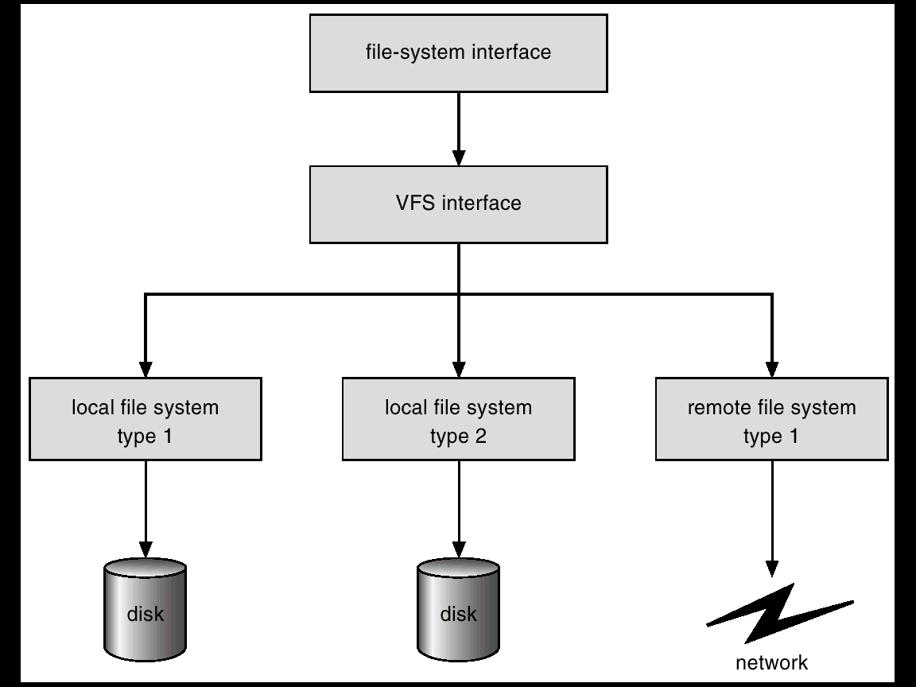
Schematic View of Virtual File System

Slide 11
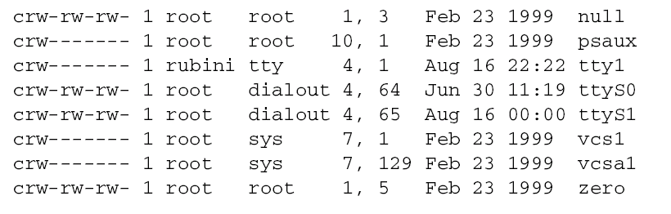
major and minor number
Major and Minor Numbers

Slide 12

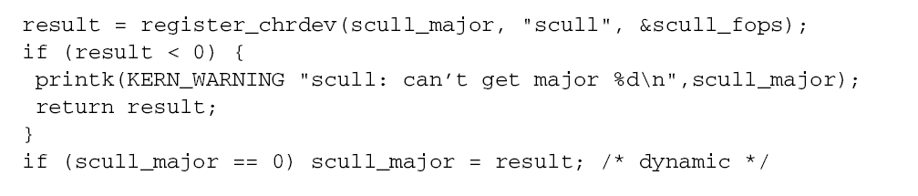
register a device

Slide 13

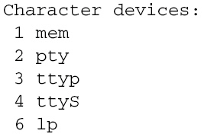
access interface
Dynamic Allocation of Major Numbers
  result = register_chrdev( 0, "scull", &scull_fops);
return value: 0, positive
/proc/devices

Slide 14
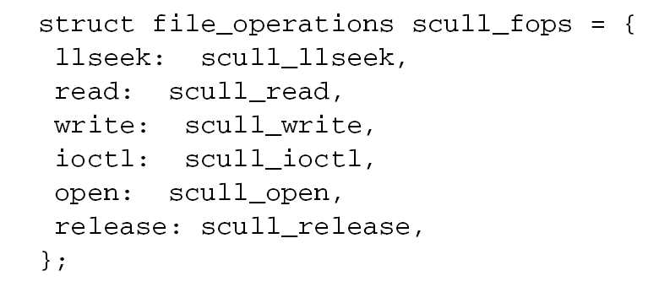
file_operations

Slide 15
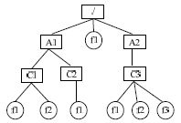
naming——Directory structure

Slide 16
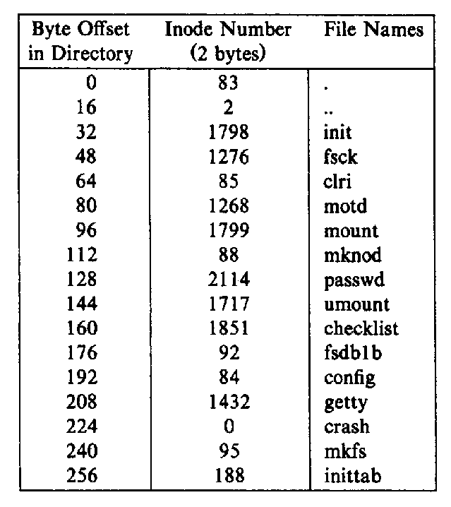
Directory file content
Notes:
here, the directory file is a record file

Slide 17
Starting up NFS
There are three key things you need to start on Linux to make NFS work.
  /usr/sbin/rpc.portmap
  /usr/sbin/rpc.mountd
  /usr/sbin/rpc.nfsd
These things should start up automatically at boot time.
  The file that makes this happen is "/etc/rc.d/rc.inet2"
rpcinfo -p localhost
program vers proto port
100000 2 tcp 111 portmapper
100000 2 udp 111 portmapper
100005 1 udp 679 mountd
100005 1 tcp 681 mountd
100003 2 udp 2049 nfs
100003 2 tcp 2049 nfs

Slide 18
Exporting File System
To make parts of your file system accessible over the network to other systems
  The /etc/exports file must be set up to define which of the local directories will be available to remote users and how each is used
    # sample /etc/exports file
    /home/yourname 192.168.12.1(rw)
    /master(rw) trusty(rw,no_root_squash)
    /projects proj*.local.domain(rw)
    /usr *.local.domain(ro) @trusted(rw)
    /home/joe pc001(rw,all_squash,anonuid=150,anongid=100)
    /pub (ro,insecure,all_squash)
    /pub/private (noaccess)
  stop and restart the server
    # etc/rc.d/init.d/nfs stop
    # etc/rc.s/init.d/nfs start

Slide 19
Remote mount
Client tree
/
Server subtree
usr
rmount
bin
After rmount, root of server subtree
can be accessed as /usr

Slide 20
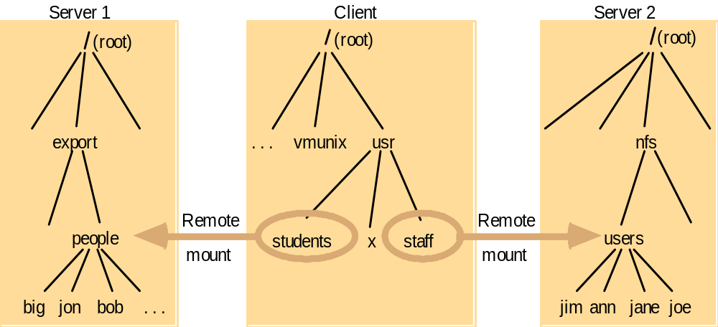
Local and remote file systems accessible on an NFS client
mount –t nfs Server1:/export/people /usr/students
mount –t nfs Server2:/nfs/users /usr/staff

Slide 21
Basic design
Three important parts
  The protocol
  The server side
  The client side

Slide 22
NFS Transport protocol
Originally used UDP.
  Better performance in LANs.
  NFS and RPC do their own reliability checks.
Most current implementations support also TCP.
  WANs: congestion control.
TCP officially integrated in NFS v.3.

Slide 23
The protocol
Uses the Sun RPC mechanism and Sun eXternal Data Representation (XDR) standard
Defined as a set of remote procedures
Protocol is stateless
  Each procedure call contains all the information necessary to complete the call
  Server maintains no “between call” information

Slide 24
Advantages of statelessness
Crash recovery is very easy:
  When a server crashes, client just resends request until it gets an answer from the rebooted server
  Client cannot tell difference between a server that has crashed and recovered and a slow server
Client can always repeat any request

Slide 25
Consequences of statelessness
Read and writes must specify their start offset
  Server does not keep track of current position in the file
  User still use conventional UNIX reads and writes
“open” system call translates into several
lookup calls to server
No NFS equivalent to UNIX close system call

Slide 26
The lookup call (I)
Returns a file handle instead of a file descriptor
  File handle specifies unique location of file
lookup(dirfh, name) returns (fh, attr)
  Returns file handle fh and attributes of named file in directory dirfh
  Fails if client has no right to access directory dirfh

Slide 27
The lookup call (II)
  One single open call such as
    fd = open(“/usr/joe/6360/list.txt”)
  will be result in several calls to lookup
  lookup(rootfh, “usr”) returns (fh0, attr)
  lookup(fh0, “joe”) returns (fh1, attr)
  lookup(fh1, “6360”) returns (fh2, attr)
  lookup(fh2, “list.txt”) returns (fh, attr)

Slide 28
The lookup call (III)
Why all these steps?
  Any of components of /usr/joe/6360/list.txt
  could be a mount point
  Mount points are client dependent and mount information is kept above the lookup() level

Slide 29
Server side (I)
Server implements a write-through policy（old version）
  Required by statelessness
  Any blocks modified by a write request (including i-nodes and indirect blocks)
  must be written back to disk before the call completes

Slide 30
Server side (II)
File handle consists of
  Filesystem id identifying disk partition
  I-node number identifying file within partition
  Generation number changed every time
  i-node is reused to store a new file
Server will store
  Filesystem id in filesystem superblock
  I-node generation number in i-node

Slide 31
File consistency issues
Cannot build an efficient network file system without client caching
  Cannot send each and every read or write to the server
Client caching introduces consistency issues

Slide 32
Example
Consider a one-block file X that is concurrently modified by two workstations
If file is cached at both workstations
  A will not see changes made by B
  B will not see changes made by A
We will have
  Inconsistent updates
  Non respect of UNIX semantics

Slide 33
Example
A
B
Server
x’
x’’
x
Inconsistent updates

Slide 34
UNIX file access semantics (I)
Conventional timeshared UNIX semantics guarantee that
  All writes are executed in strict sequential fashion
  Their effect is immediately visible to all other processes accessing the file
Interleaving of writes coming from different processes is left to the kernel discretion

Slide 35
UNIX file access semantics (II)
UNIX file access semantics result from the use of a single I/O buffer containing all cached blocks and i-nodes
Server caching is not a problem
Disabling client caching is not an option:
  Would be too slow
  Would overload the file server

Slide 36
Tuning (I)
First version of NFS was much slower than Sun Network Disk (ND)
1st improvement
  Added client buffer cache
  Increased the size of UDP packets from 2048 to 9000 bytes
2nd improvement reduced the amount of buffer to buffer copying in NFS and RPC (bcopy)

Slide 37
Tuning (II)
3rd improvement introduced a client-side attribute cache
  Cache is updated every time new attributes arrive from the server
  Cached attributes are discarded after
    3 seconds for file attributes
    30 seconds for directory attributes
These three improvements cut benchmark run time by 50%

Slide 38
NFS (Network File System)
Other systems:
  CIFS (Microsoft Common Internet File System based on SMB protocol). Widely used in Microsoft Windows Networks and in heterogeneous environment.
  Andrew file system (Carnegie-Mellon university implementation). Widely used in distributed and in academic environment.

Slide 39
NFS (Network File System)
We take a look at NFSv3.
NFSv3:
  Client side import file system from remote machine
  Server side export file system to remote machine
  Each machine can be client, server and client+server.

Slide 40
NFS (Network File System)
Main goal of NFS protocol:
  NFS protocol designed without states. That’s why it’s very easy to recover server or client, because there are no states for them.
  NFS designed to support UNIX file system semantic,adopted to support any file system semantic
  Security and access check mechanisms based on Unix UID and GID mechanism.
  NFS protocol design doesn’t depend on transport protocols. It’s used with UDP by default, but still can be used with TCP protocol.

Slide 41
NFS (Network File System)
NFS constrains:
  NFS protocol works good on high speed networks, but works not so good on slow links.
  Cache design implemented, that not very much files are used together same time. If it is so, performance may decrease
  As NFS doesn’t have states, then file system locks (flock()) should be implemented using different daemons

Slide 42
NFS (Network File System)
NFS structure and work:
  Work as a typical client-server application
  Based on RPC (remote procedure call)
  NFS can be used over any kind of datagram or stream protocols. In most cases UDP or TCP

Slide 43
NFS (Network File System)
RCP request | Action | Idempotent
GETATTR | Get file attribute | YES
SETATTR | Set file attribute | YES
LOOKUP | File name search | YES
ACCESS | Check access | YES
READLINK | Read from symbolic link | YES
READ | Read file | YES
WRITE | Write to the file | YES
COMMIT | Fix server cache data to the disk | YES
CREATE | Create file | NO
REMOVE | Remove file | NO
RENAME | Rename file | NO

Slide 44
NFS (Network File System)
RCP request | Action | Idempotent
LINK | Create hard link | NO
SYMLINK | Create symbolic link | NO
MKNOD | Create special node | NO
MKDIR | Crate directory | NO
RMDIR | Remove directory | NO
READDIR | Read directory | YES
READDIRPLUS | Extended directory read | YES
FSSTAT | Get FS dynamic attribute | YES
FSINFO | Get FS static attribute | YES
PATHCONF | Get POSIX information | YES

Slide 45
NFS (Network File System)
  Each file on the server are identified by the file handler. And using file handler clients can access this file.
  FreeBSD NFS implementation create file handlers using inode + file system id + generation number. The main aim of this manipulation to create file handler globally unique.

Slide 46
Virtual File System (1)
VFS added to UNIX kernel.
  Location-transparent file access.
  Distinguishes between local and remote access.
@ client:
  Processes file system / system calls to determine whether access is local (passes it to UNIX FS) or remote (passes it to NFS client).
@ server:
  NFS server receives request and passes it to local FS through VFS.

Slide 47
VFS (2)
V-node:
    If file local, reference to file’s i-node.
    If file remote, reference to file handle.
File handle: uniquely distinguishes file.
File system id
I-node #
I-node generation #

Slide 48
FreeBSD NFS implementation
NFSv3
  64 bit file shift and size
  RPC access command
  The way to create special file node and fifo files
  Asynchronous RCP requests
  Extended information about file system

Slide 49
FreeBSD NFS implementation（2）
NFS server and client implementation are resident for the kernel.
1. In order to start up server part you need to start portmap, mountd and nfsd.
2. In order to get extended functions you need to start rcp.lockd and rcp.statd

Slide 50
FreeBSD NFS implementation
Client
Server
mount
portmap mountd
User level
Kernel level
1
2
3
4

Slide 51
FreeBSD NFS implementation
1. It is better to run nfsiod on client side. But it’s not obligatory to do it.
2. nfsiod daemon can be used for read and write operations using cache.
Client
Server
write()
nfsiod
nfsd
1
User level
2
Kernel level
3
4
5
disk

Slide 52
FreeBSD NFS implementation
Client-server interconnection:
Hard mount – means that client will try to mount file system always (default behavior)
Soft mount – will try to mount and make RPC request certain amount of times and then system call will exit with temporary error.
Interruptible mount. Depend on if there is interrupt signal process is waiting for. If it is, then system call exit with temporary error.

Slide 53
FreeBSD NFS implementation
How to increase performance
Use client side cache mechanisms
Problems:
If second client will have old data in their cache, then he can use it if there is no information about updated data from the server.
First client can have new data, but it’s still not synchronized with server.

Slide 54
FreeBSD NFS implementation
NQNFS protocol
1. This protocol if supported from both sides can give full cache synchronization between server and client by means of short time leases.
2. Lease – it’s like a ticket and it’s ok to use this ticket until ticket time expires.
It means, that when client hold the ticket it knows that server will inform him about any file modification that will happened during this time.
If ticket time expires and client want to use data from his cache it needs contact server.

Slide 55
FreeBSD NFS implementation
Client get relative time leases in order to avoid time synchronization between client and server.
  maximum_leases_time – upper value of lease duration. Between 30 sec – and 1 min.
  clock_skew – added to all server leases in order to avoid different clock speed on different machines.
  write_slack – time in seconds, during which server want to wait for client with expired leases to write down dirty cache records.

Slide 56
FreeBSD NFS implementation
There are 3 type of leases:
  Non-cache lease – define that all file system operations should be take synchronously with server
  Read cache lease – let client cache data, not allow to change file.
  Write cache lease – let client to cache write operations for lease time. So if client cache write data, then this data will not be written to the server synchronously. When lease time coming to the end client will try to get another lease, but if it’s not possible, then data have to be written to the server.

Slide 57
FreeBSD NFS implementation (read cache lease)
Client A
Server
Client B
Read sys. call
Read req. + lease
Read cache lease
for client A
Time
Answer
Read sys. Call
(from cache)
Read req.
(cache miss)
Answer
Lease timeout
Lease expired
Read sys. call
Read lease req.
ctime the same -
cache valid
Answer with
same ctime
Read req. + lease
Read sys. call
Read sys. Call
(from cache)
Read req.
(cache miss)
Answer
Client B added to lease
Read sys. call
Read req.
(cache miss)
Answer
Lease timeout
Answer
Lease timeout

Slide 58
FreeBSD NFS implementation (write cache lease)
Server
Client B
Write cached lease
Write system call
Write cached lease
for client B
Answer
(write cache lease)
Write system call
(cached leaved records)
Get record
lease
Write cached lease
req. before previous lease
expired.
Lease update
Answer
(write cache lease)
System call
Lease timeout
record
Lease expired
Lease expiration
Stopped for a
moment because
of records
answer
record
Time
Write_slack seconds
After last records
answer

Slide 59
FreeBSD NFS implementation (non-cache lease)
Client A
Server
Client B
Read req. + lease
Read sys. call req.
Read cache lease for A client
Time
Read req.
(from cache)
Read req.
(miss cache)
answer
answer
Lease expired
Lease timeout
Get write cache lease
Write sys. call req.
Lease request
Write sys. call
(async write cached)
Read sys. call req.
Cleanup req.
record
Write cached
data to server
record
answer
Release msg.
answer
Get write cache lease
Write sys. call req.
Answer (non-cache lease)
Read sys. call req.
(non-cache lease
mode)
Read req.
Answer (non-cache lease)
record
Read data
Synchronous
Writes wihout cache
answer

Slide 60
FreeBSD NFS implementation
Server recovery procedure:
No need to recover client states
When maximum_lease_term expires server knows that clients haven’t non-expired leases
After crash server just ignore any RPC request except write requests (mainly from clients with previous write cache lease), until write_slack time pass
During server overload server can answer with “try again later” message in order to avoid recovery storms.

Slide 61
Introducing SMB
SMB is Microsoft’s protocol to share files and printers
  Also renamed CIFS (Common Internet File System)
  Client/Server, no location transparency
  Not the same as Samba: an open source implementation of SMB primarily found on UNIX systems (Linux)
  SMB usually runs on NetBIOS (naming + sessions + datagram)
NetBIOS + SMB developed for LAN use
A number of other services run on top of SMB
  In particular MS-RPC, a modified variant of DCE-RPC
  Authentication for SMB handled by the NT Domains
  suite of protocols, running on top of MS-RPC
NT-Domain
MS-RPC
SMB
NetBIOS
TCP/IP
To know more: Timothy D Evans, NetBIOS, NetBEUI, NBF, NBT, NBIPX, SMB, CIFS Networking
http://timothydevans.me.uk/nbf2cifs/nbf2cifs.pdf

Slide 62
Samba Services
File sharing.
Printer sharing.
Client authentication.

Slide 63
SMB Protocol
Request/response.
Runs atop TCP/IP.
E.g., file and print operations.
  Open close, read, write, delete, etc.
  Queuing/dequeing files in printer spool.

Slide 64
SMB: How does it work?
Set of UNIX applications running the Server Message Block (SMB) protocol.
  SMB is the protocol MS Windows use for client-server interactions over a network.
  By running SMB, Unix systems appear as another MS Windows system.
  smbd daemon.

Slide 65
SMB Message
Header + command/response.
Header: protocol id, command code, etc.
Command: command parameters.

Slide 66
Establishing a SMB Connection
Establish TCP connection.
Negotiate protocol variant.
  Client sends SMBnegprot.
  Client sends lists of variants it can speak.
  Server responds with index into client’s list.
Set session and login parameters.
  Account name, passwd, workgroup name, etc.

Slide 67
Security Levels
“Share-wide”: authorized clients can access any file under that share.
“File-level”: before accessing any file, client needs to be authenticated; in fact, client authenticated once and uses UID for future accesses.

Slide 68
Background on AFS
AFS (the Andrew File System) is a distributed, client-server, file system used to provide file-sharing services
Some properties of AFS are that it:
  Provides transparent access to files. Files in AFS may be located on different servers, but are accessed the same way as files on your local disk regardless of which server they are on;
  Provides a uniform namespace. A file's pathname is exactly the same from any Unix host that you access it from;
  Provides secure, fine-grained access control for files. You can control exactly which users have access to your files and the rights that each one has.
Resources
  http://www.openafs.org/
  http://www.angelfire.com/hi/plutonic/afs-faq.html

Slide 69
AFS: Neat Idea #1 (Whole File Caching)
What is whole file caching?
  When a file (or directory) is first accessed from the server (Vice) it is cached as a whole file on Venus
  Subsequent read and write operations are performed on the cache
  The server is updated when a file is closed
  Cached copies are retained for further opens
    Supported by callback mechanism to invalidate cache on concurrent updates
    This is therefore a stateful approach
Why is this a good idea?
  Scalability, scalability and scalability!
  By off-loading work from servers to clients, servers can deal with much larger numbers of clients (e.g. 5,000)
  Ask Francois how NFS scales!

Slide 70
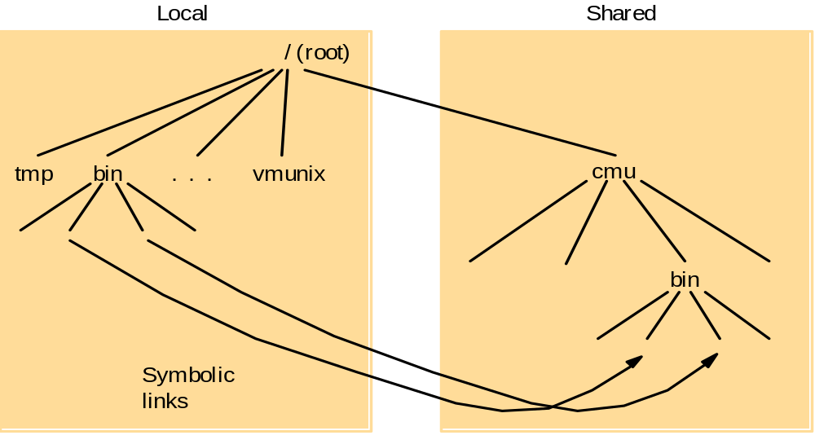
AFS: Neat Idea #2 (A Common View of the Global Namespace)

Slide 71
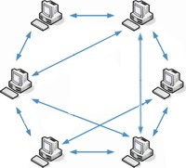
Recent Advances in Distributed File Systems
Improvements in storage techniques
  Emergence of RAID technology (Redundant Arrays of Inexpensive Disks)
  Log-structured file systems
New design approaches
  Striping of files across multiple servers
  The emergence of peer-to-peer file systems
    PAST
    BitTorrent
    Freenet
    Kazaa

