Slide 1
Understand the Linux kernel
chapter 2
Memory Addressing

Slide 2
addressing on 80x86
Logical address
  machine language instructions to specify the address
  logical address consists of a segment and an offset
Linear address ( virtual address)
  up to 4 GB
Physical address
  Used to address memory cells in memory chips.
  represented as 32-bit unsigned integers

Slide 3
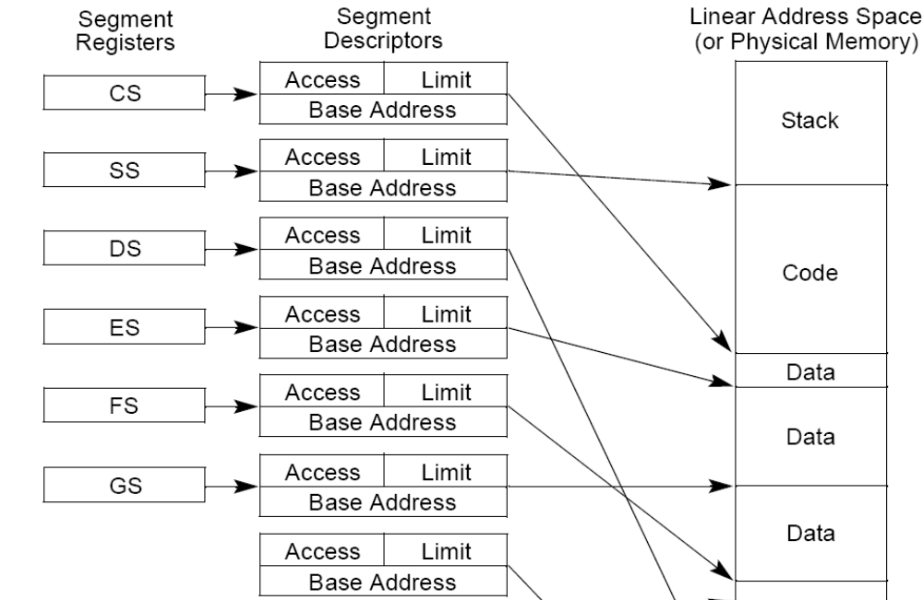

Slide 4
Segmentation in Hardware
Segmentation Registers
  A logical address consists of two parts:
    segment identifier -----16-bit Segment Selector
    offset ----- 32-bit
  cs
    The code segment register
    includes a 2-bit field that specifies the Current Privilege Level (CPL) of the CPU
  ss
    The stack segment register
  ds
    The data segment register

Slide 5
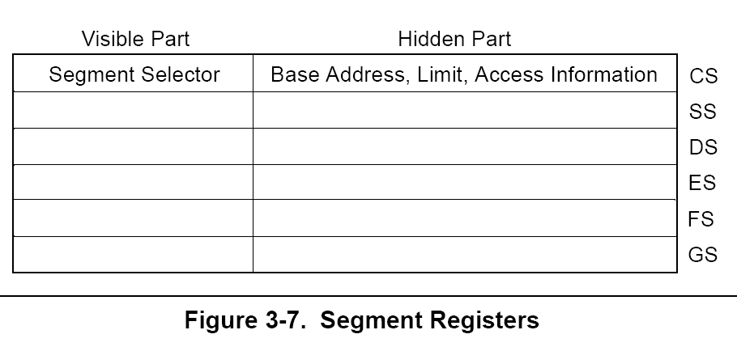

Slide 6
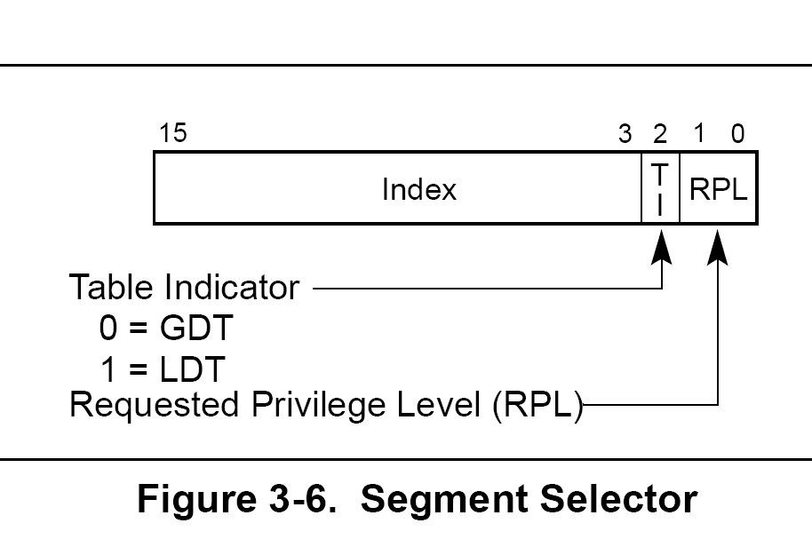
segment selector

Slide 7
loading the segment registers
Two kinds of load instructions are provided for loading the segment registers:
  1. Direct load instructions such as the MOV, POP, LDS, LES, LSS, LGS, and LFS instructions.
  2. Implied load instructions such as the far pointer versions of the CALL, JMP, and RET instructions, the SYSENTER and SYSEXIT instructions, and the IRET, INTn, INTO and INT3 instructions.
  These instructions change the contents of the CS register (and sometimes other segment registers) as an incidental part of their operation.

Slide 8
Segmentation in Hardware
Segment Descriptors
  8-byte ,
  in the Global Descriptor Table (GDT ) or in the Local Descriptor Table (LDT ).
  one GDT , processes have their own LDT
  Base field --- start adress of segment
  G granularity flag
    0 --- byte
    1 --- 4096 byte
  Limit field --- segment length in bytes, coordinate with G flag
  S system flag

Slide 9
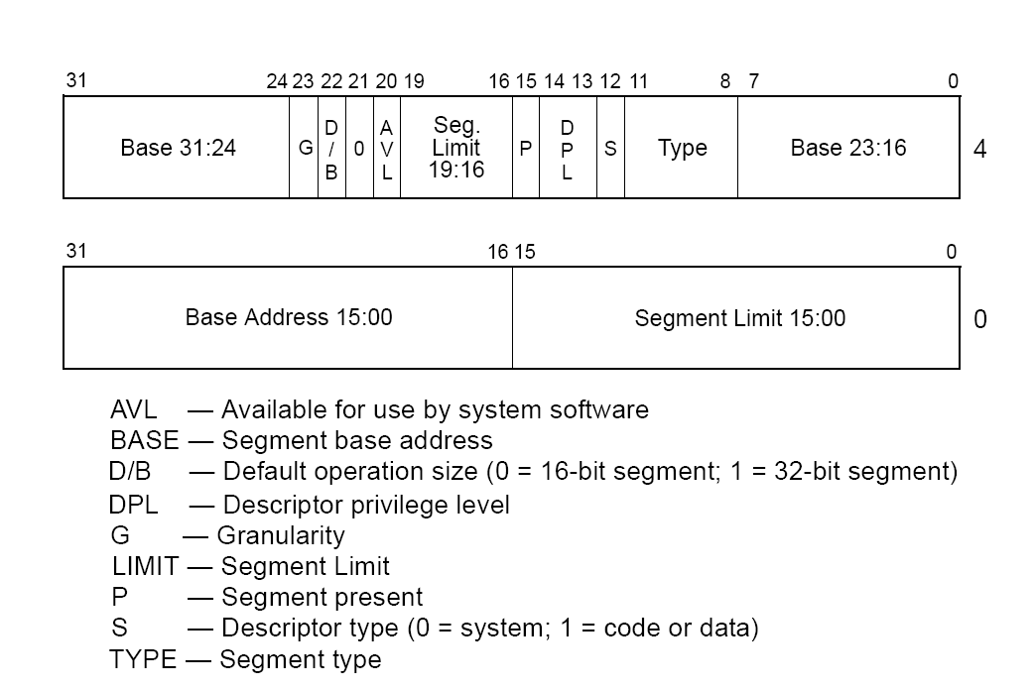
Segment Descriptors

Slide 10
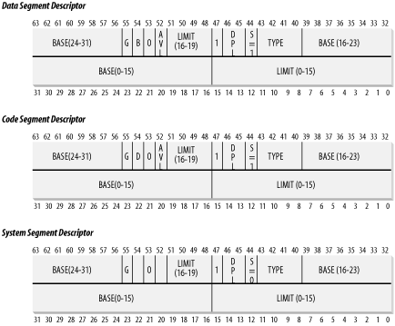

Slide 11
Segment Descriptors
  4-bit Type field
    segment type and its access rights.
  Code Segment Descriptor
    in the GDT or in the LDT , S flag set
  Data Segment Descriptor
    in the GDT or in the LDT , S flag set
  Task State Segment Descriptor (TSSD)
    refers to a Task State Segment (TSS)
  Local Descriptor Table Descriptor (LDTD)

Slide 12
Segment Descriptors
  DPL (Descriptor Privilege Level ) --- 2-bit field , restrict accesses to the segment
  Segment-Present flag
    equal to 0 if the segment is currently not stored in main memory , Linux always sets this field to 1, since it never swaps out whole segments to disk
  D or B flag
    1 --- 32 bit long
    0 --- 16 bit long
  AVL flag
    can be used by operating system, Linux ignore it

Slide 13
Fast Access to Segment Descriptors
nonprogrammable Segment Descriptor register
  corresponding to programmable segmentation registers
  Every time a Segment Selector is loaded in a segmentation register, the corresponding Segment Descriptor is loaded from memory into the matching nonprogrammable CPU register.
segmentation registers
  13-bit index that identifies the corresponding Segment Descriptor entry contained in the GDT or in the LDT
  TI (Table Indicator) flag that specifies whether the Segment Descriptor is included in the GDT (TI = 0) or in the LDT (TI = 1)
  An RPL (Requestor Privilege Level ) 2-bit field, which is precisely the Current Privilege Level of the CPU when the corresponding Segment Selector is loaded into the cs register[1]

Slide 14
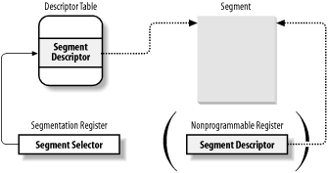
Segment Selector and Segment Descriptor

Slide 15
Segmentation Unit
logical address to linear address
  Examines the TI field of the Segment Selector to determine Segment Descriptor is either in the GDT ( base linear address of the GDT in the gdtr register) or in the active LDT (the base linear address of that LDT in ldtr register).
  Computes the address of the Segment Descriptor from the index field of the Segment Selector.
  Adds the offset of the logical address to the Base field of the Segment Descriptor, thus obtaining the linear address.

Slide 16
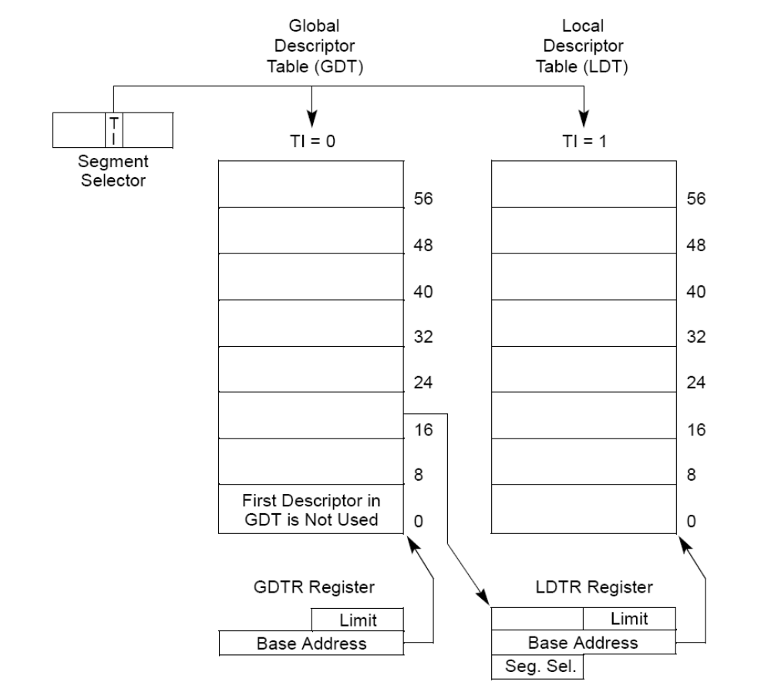

Slide 17
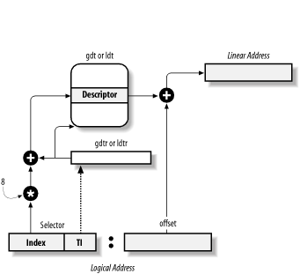
logical address to linear address

Slide 18
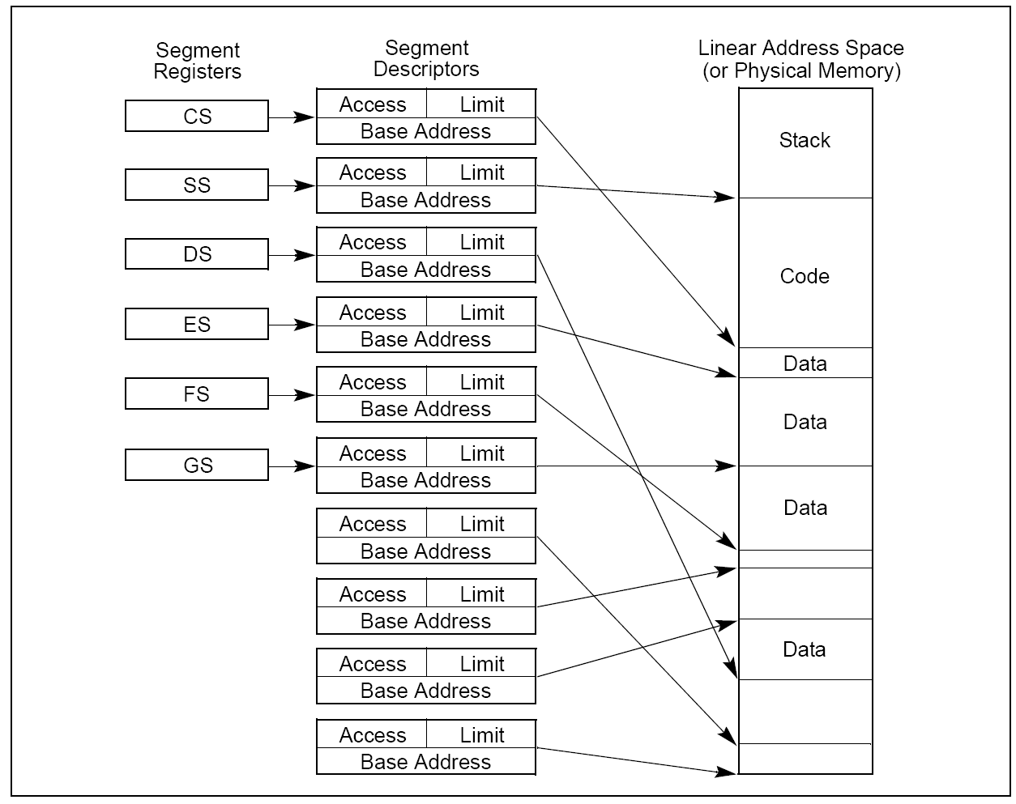

Slide 19
Segmentation in Linux
Linux prefers paging to segmentation, because :
  Memory management is simpler when all processes use the same segment register values — that is, when they share the same set of linear addresses.
  One of the design objectives of Linux is portability to a wide range of architectures; RISC architectures in particular have limited support for segmentation.
  all processes use the same logical addresses, so the total number of segments to be defined is quite limited, and it is possible to store all Segment Descriptors in the Global Descriptor Table (GDT).

Slide 20
segments used by Linux
A kernel code segment
  Base = 0x00000000
  Limit = 0xfffff
  G (granularity flag) = 1, for segment size expressed in pages
  S (system flag) = 1, for normal code or data segment
  Type = 0xa, for code segment that can be read and executed
  DPL (Descriptor Privilege Level) = 0, for Kernel Mode
  D/B (32-bit address flag) = 1, for 32-bit offset addresses
  Thus, the linear addresses associated with that segment start at 0 and reach the addressing limit of 2³² -1. The corresponding Segment Selector is defined by the _ _KERNEL_CS macro. To address the segment, the kernel just loads the value yielded by the macro into the cs register.

Slide 21
segments used by Linux
A kernel data segment
  Base = 0x00000000
  Limit = 0xfffff
  G (granularity flag) = 1, for segment size expressed in pages
  S (system flag) = 1, for normal code or data segment
  Type = 2, for data segment that can be read and written
  DPL (Descriptor Privilege Level) = 0, for Kernel Mode
  D/B (32-bit address flag) = 1, for 32-bit offset addresses
  This segment is identical to the previous one (in fact, they overlap in the linear address space), except for the value of the Type field. The corresponding Segment Selector is defined by the _ _KERNEL_DS macro.

Slide 22
segments used by Linux
A user code segment shared by all processes in User Mode
  Base = 0x00000000
  Limit = 0xfffff
  G (granularity flag) = 1, for segment size expressed in pages
  S (system flag) = 1, for normal code or data segment
  Type = 0xa, for code segment that can be read and executed
  DPL (Descriptor Privilege Level) = 3, for User Mode
  D/B (32-bit address flag) = 1, for 32-bit offset addresses
  The S and DPL fields specify that the segment is not a system segment and its privilege level is equal to 3; it can thus be accessed both in Kernel Mode and in User Mode. The corresponding Segment Selector is defined by the _ _USER_CS macro

Slide 23
segments used by Linux
A user data segment shared by all processes in User Mode
  Base = 0x00000000
  Limit = 0xfffff
  G (granularity flag) = 1, for segment size expressed in pages
  S (system flag) = 1, for normal code or data segment
  Type = 2, for data segment that can be read and written
  DPL (Descriptor Privilege Level) = 3, for User Mode
  D/B (32-bit address flag) = 1, for 32-bit offset addresses
  This segment overlaps the previous one: they are identical, except for the value of Type. The corresponding Segment Selector is defined by the _ _USER_DS macro.

Slide 24
A Task State Segment (TSS) for each processor.
  The linear address space corresponding to each TSS is a small subset of the linear address space corresponding to the kernel data segment.
  All the Task State Segments are sequentially stored in the init_tss array; in particular, the Base field of the TSS descriptor for the nth CPU points to the nth component of the init_tss array. The G (granularity) flag is cleared, while the Limit field is set to 0xeb, since the TSS segment is 236 bytes long.
  The Type field is set to 9 or 11 (available 32-bit TSS), and the DPL is set to 0, since processes in User Mode are not allowed to access TSS segments. refer to Section 3.3.2.

Slide 25
A default Local Descriptor Table (LDT) --- that is usually shared by all processes
  This segment is stored in the default_ldt variable.
  The default LDT includes a single entry consisting of a null Segment Descriptor.
  Each processor has its own LDT Segment Descriptor, which usually points to the common default LDT segment;
  When a process requiring a nonempty LDT is running, the LDT descriptor in the GDT corresponding to the executing CPU is replaced by the descriptor associated with the LDT that was built by the process. You will find more details of this mechanism in Chapter 3.

Slide 26
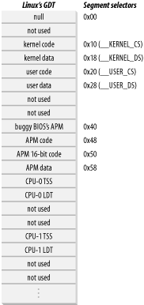
The Global Descriptor Table

Slide 27
CPL
  the Current Privilege Level of the CPU indicates whether the processor is in User or Kernel Mode and is specified by the RPL field of the Segment Selector stored in the cs register.
  Whenever the CPL is changed, some segmentation registers must be correspondingly updated. For instance, when the CPL is equal to 3 (User Mode), the ds register must contain the Segment Selector of the user data segment, but when the CPL is equal to 0, the ds register must contain the Segment Selector of the kernel data segment.
  A similar situation occurs for the ss register.

Slide 28
Paging in Hardware
  The paging unit translates linear addresses into physical ones .
  enable paging
    by setting the PG flag of a control register named cr0. When PG = 0, linear addresses are interpreted as physical addresses.
  The 32 bits of a linear address are divided into three fields:
  Directory
    The most significant 10 bits
  Table
    The intermediate 10 bits
  Offset
    The least significant 12 bits

Slide 29
why use this two-level scheme ?
Each active process must have a Page Directory assigned to it . However, there is no need to allocate RAM for all Page Tables of a process at once.
cr3 --- physical address of the Page Directory in use

Slide 30
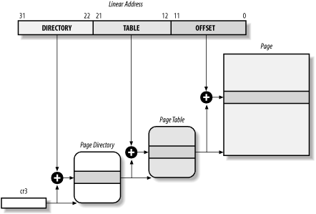
Paging by 80x86 processors

Slide 31
fields of Page Directories and Page Tables
  Present flag
    If it is set, the referred-to page (or Page Table) is contained in main memory;
  a page frame physical address
  Accessed flag
    Sets each time the paging unit addresses the corresponding page frame
  Dirty flag
    Applies only to the Page Table entries. It is set each time a write operation is performed on the page frame
  Read/Write flag
    Contains the access right (Read/Write or Read) of the page or of the Page Table .

Slide 32
  User/Supervisor flag
    Contains the privilege level required to access the page or Page Table
  PCD and PWT flags
    Controls the way the page or Page Table is handled by the hardware cache
  Page Size flag
    Applies only to Page Directory entries. If it is set, the entry refers to a 2 MB- or 4 MB-long page frame
  Global flag
    Applies only to Page Table entries. This flag was introduced in the Pentium Pro to prevent frequently used pages from being flushed from the TLB cache

Slide 33
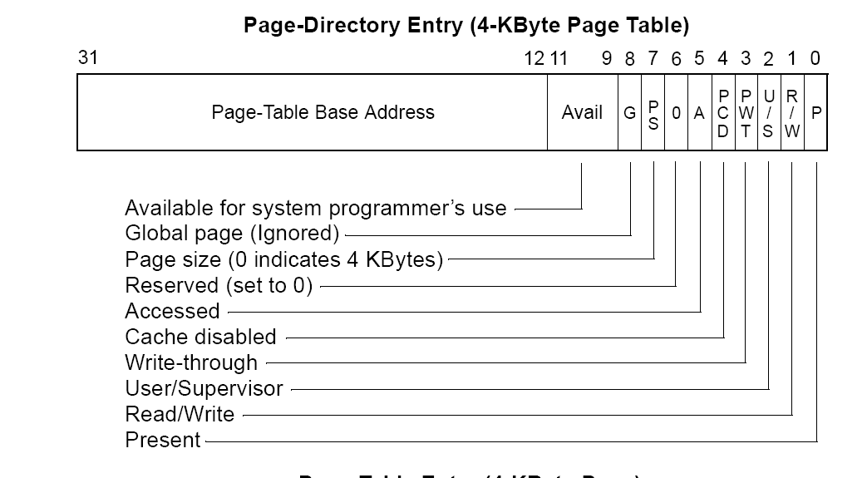
page-directory entry

Slide 34
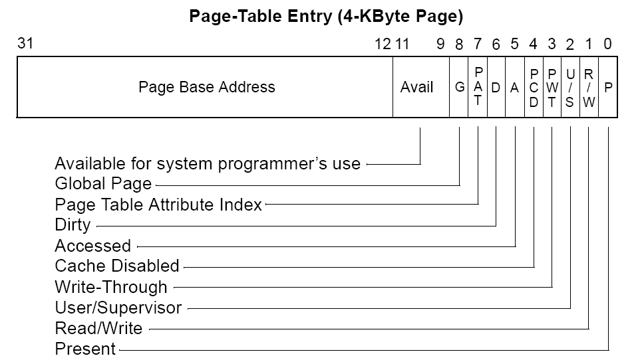
page-table entry

Slide 35
Extended Paging
Directory
  The most significant 10 bits
Offset
  The remaining 22 bits
Page Directory entries for extended paging are the same as for normal paging, except that:
The Page Size flag must be set.
it is enabled by setting the PSE flag of the cr4 processor register.

Slide 36
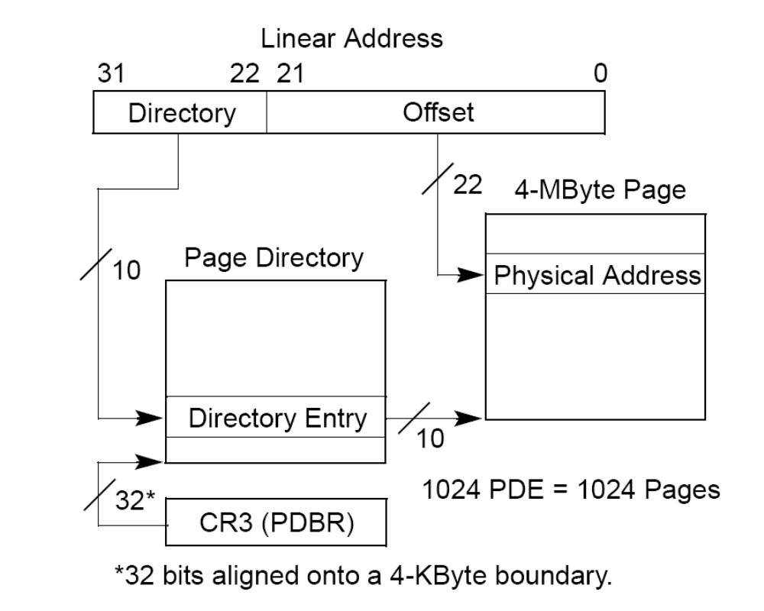
Extended Paging

Slide 37
Hardware Protection Scheme
The paging unit uses a different protection scheme from the segmentation unit.
only two privilege levels are associated with pages and Page Tables . User/Supervisor flag : 0 --- CPL<3; 1--- the page can always be addressed
Read/Write flag: 0 --- read only, 1 --- R/W

Slide 38
Paging in Linux
3 level page table
  Page Global Directory
  Page Middle Directory
  Page Table

Slide 39
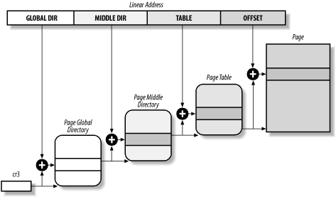

Slide 40
8.4 page fault handler

Slide 41
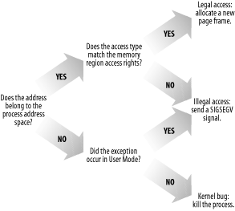
Overall scheme for the Page Fault handler

Slide 42
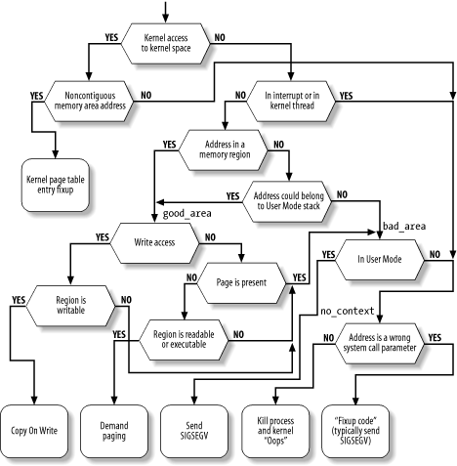

Slide 43
