Slide 1
Understand Linux kernel: process
Understand the Linux kernel
chapter 3
process

Slide 2
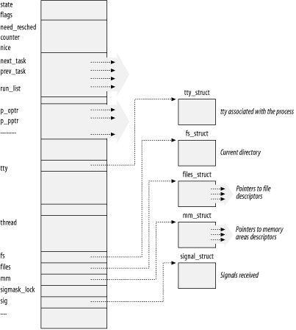
Process descriptor-- task_struct

Slide 3
Process State
TASK_RUNNING
  The process is either executing on a CPU or waiting to be executed
TASK_INTERRUPTIBLE
  suspended (sleeping)
TASK_UNINTERRUPTIBLE
TASK_STOPPED
TASK_ZOMBIE
  Process execution is terminated , wait( ) returns information about the dead process

Slide 4
Identifying a Process
process descriptor pointers
Process ID (or PID)
thread group :
  a collection of lightweight processes
  identifier is the PID of the first lightweight process
  stored in the tgid field
  reason: POSIX 1003.1c standard states that all threads of a multithreaded application must have the same PID

Slide 5
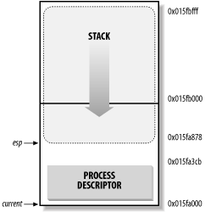
Storing the process descriptor
union task_union {
struct task_struct task;
unsigned long stack[2048];
};
The current macro
  current->pid
the correct current
process for each
hardware processor
can be derived just
by checking the stack

Slide 6

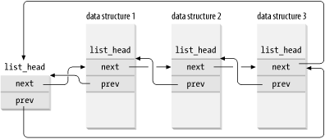
The process list

Slide 7
link list built with list_head data structures
LIST_HEAD(list_name)
list_add(n,p) ，list_add_tail(n,h) ，list_del(p)
list_entry(p,t,f) ：Returns the address of the data structure of type t in which the list_head field that has the name f and the address p is included

Slide 8
The list of TASK_RUNNING processes
the wake_up_process( ) function is used to make a process runnable.
  It sets the process state to TASK_RUNNING and invokes add_to_runqueue( ) to insert the process in the runqueue list.
  It also forces the invocation of the scheduler when the process has a dynamic priority larger than that of the current process

Slide 9
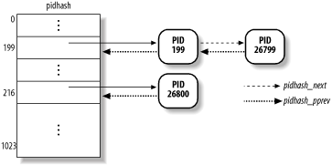
The pidhash table and chained lists
#define pid_hashfn(x) ((((x) >> 8) ^ (x)) & (PIDHASH_SZ - 1))

Slide 10
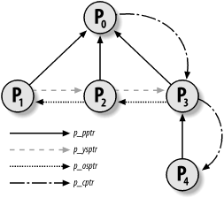
Parenthood Relationships Among Processes
p_opptr (original parent)
p_pptr (parent)
p_cptr (child)
p_ysptr (younger sibling)
p_osptr (older sibling

Slide 11
Wait queues
struct _ _wait_queue_head {
spinlock_t lock;
struct list_head task_list;
};
typedef struct _ _wait_queue_head wait_queue_head_t;
struct _ _wait_queue {
unsigned int flags;
struct task_struct * task; struct list_head task_list;
};
typedef struct _ _wait_queue wait_queue_t;

Slide 12
Handling wait queues
void sleep_on(wait_queue_head_t *q)
{
unsigned long flags;
wait_queue_t wait;
wait.flags = 0;
wait.task = current;
current->state = TASK_UNINTERRUPTIBLE;
add_wait_queue(q, &wait);
schedule( );
remove_wait_queue(q, &wait);
}

Slide 13
Handling wait queues
interruptible_sleep_on( )
sleep_on_timeout( )
wait_event()
wait_event_interruptible()

Slide 14
wait_event
if (!(condition))
{ wait_queue_t _ _wait;
init_waitqueue_entry(&_ _wait, current);
add_wait_queue(&wq, &_ _wait);
for (;;)
{ set_current_state(TASK_INTERRUPTIBLE);
if (condition)
break;
schedule();
}
current->state = TASK_RUNNING;
remove_wait_queue(&wq, &_ _wait);
}

Slide 15
wake_up
void wake_up(wait_queue_head_t *q)
{
struct list_head *tmp;
wait_queue_t *curr;
list_for_each(tmp, &q->task_list) {
curr = list_entry(tmp, wait_queue_t, task_list);
wake_up_process(curr->task);
if (curr->flags)
break;
}
}

Slide 16
Wait queues
thundering herd
  multiple processes are awoken only to race for a resource that can be accessed by one of them
exclusive processes are selectively woken up by the kernel
nonexclusive processes are always woken up by the kernel when the event occurs

Slide 17
Process Resource Limits
RLIMIT_AS ，maximum size of process address space
RLIMIT_CORE
RLIMIT_CPU
RLIMIT_FSIZE
RLIMIT_LOCKS
RLIMIT_NOFILE
struct rlimit {
unsigned long rlim_cur;
unsigned long rlim_max;
};
The resource limits are stored in the rlim field of the process descriptor.

Slide 18
Process Switch
（contex switch）

Slide 19
Hardware Context
The set of data that must be loaded into the registers before the process resumes its execution on the CPU is called the hardware context.
hardware context is a subset of the process execution context
execution context includes all information needed for the process execution
In Linux, a part of the hardware context of a process is stored in the process descriptor, while the remaining part is saved in the Kernel Mode stack.

Slide 20
Hardware Context
prev --- the process being switched out
next --- the one being switched in
process switch is defined as the activity consisting of saving the hardware context of prev and replacing it with the hardware context of next
Process switching occurs only in Kernel Mode.
The contents of all registers used by a process in User Mode have already been saved before performing process switching

Slide 21
Task State Segment
x86 rpovides Task State Segment (TSS), store hardware contexts
Linux has a TSS for each CPU
  When an 80 x 86 CPU switches from User Mode to Kernel Mode, it fetches the address of the Kernel Mode stack from the TSS
  When a User Mode process attempts to access an I/O port by means of an in or out instruction, the CPU may need to access an I/O Permission Bitmap stored in the TSS .
tss_struct structure describes the format of the TSS.

Slide 22
Task State Segment
8-byte Task State Segment Descriptor (TSSD) - in GDT.
  32-bit Base field
  20-bit Limit field
  S flag is cleared -------- System Segment
register tr -- TSS selector

Slide 23
thread struct
  the hardware context is saved
  for most of the CPU registers

Slide 24
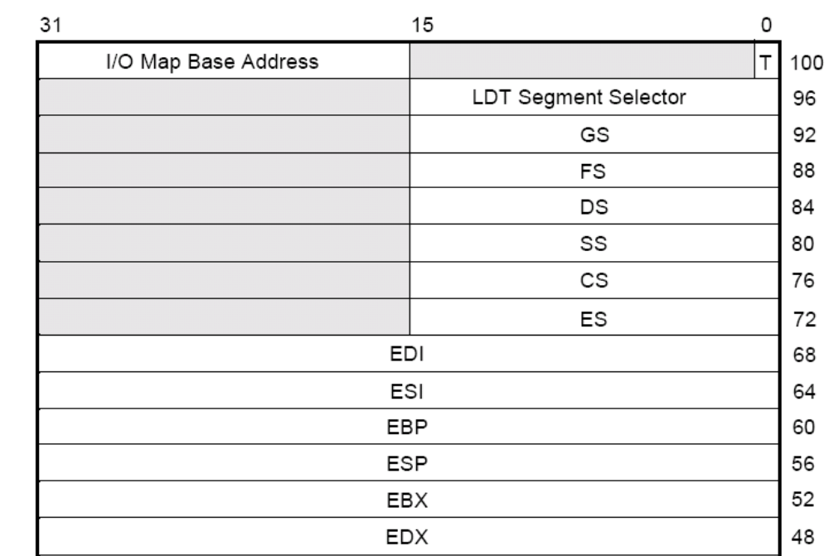
TSS

Slide 25
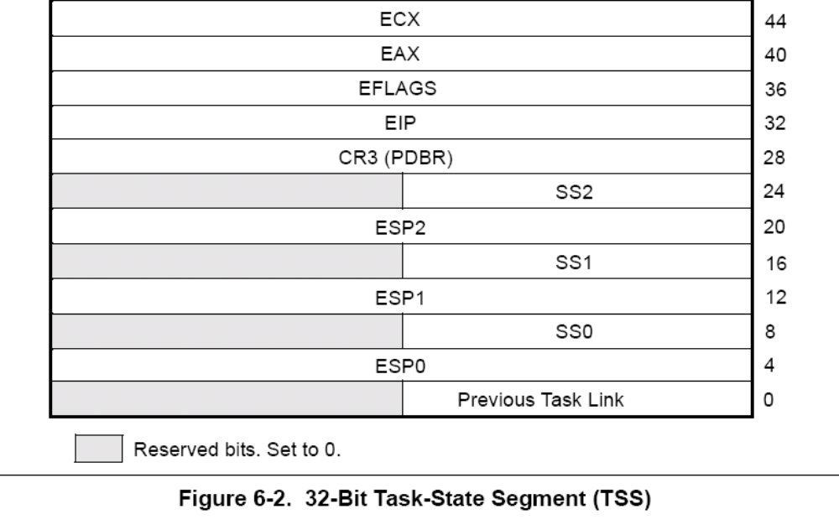
TSS

Slide 26
Performing the Process Switch
occur at just one well-defined point: the schedule( )
two steps:
Switching the Page Global Directory to install a new address space;
Switching the Kernel Mode stack and the hardware context, which provides all the information needed by the kernel to execute the new process, including the CPU registers , --- switch_to macro

Slide 27
switch_to
switch_to(prev, next, prev);
  what about the third parameter last?
  in any process switch, three processes are involved, not just two .
switch_to
  1 Saves the values of prev and next in the eax and edx registers, respectively:
  movl prev,%eax
  movl next,%edx
  2 Saves another copy of prev in the ebx register; ebx corresponds to the last parameter of the macro:
  movl %eax,%ebx

Slide 28
switch_to
  3 Saves the contents of the esi, edi, and ebp registers in the prev Kernel Mode stack. They must be saved because the compiler assumes that they will stay unchanged until the end of switch_to:
  pushl %esi
  pushl %edi
  pushl %ebp
  4 Saves the content of esp in prev->thread.esp so that the field points to the top of the prev Kernel Mode stack:
  movl %esp, 616(%eax)
  The 616(%eax) operand identifies the memory cell whose address is the contents of eax plus 616.

Slide 29
  5 Loads next->thread.esp in esp. From now on, the kernel operates on the Kernel Mode stack of next, so this instruction performs the actual process switch from prev to next. Since the address of a process descriptor is closely related to that of the Kernel Mode stack (as explained in Section 3.2.2 earlier in this chapter), changing the kernel stack means changing the current process:
  movl 616(%edx), %esp
  6 Saves the address labeled 1 (shown later in this section) in prev->thread.eip. When the process being replaced resumes its execution, the process executes the instruction labeled as 1:
  movl $1f, 612(%eax)

Slide 30
  7 On the Kernel Mode stack of next, the macro pushes the next->thread.eip value, which, in most cases, is the address labeled 1:
pushl 612(%edx)
  8 Jumps to the _ _switch_to( ) C function:
  jmp _ _switch_to
  _ _switch_to( ) function is declared as follows:
  _ _switch_to(struct task_struct *prev,
  struct task_struct *next)
  _ _attribute_ _(regparm(3))
  _ _attribute_ _ and regparm force the function to go to the registers for its parameters.
  and other works.......

Slide 31
  a unlazy_fpu(prev);
  b init_tss[smp_processor_id( )].esp0 = next->thread.esp0;
  any future privilege level change from User Mode to Kernel Mode automatically forces this address into the esp register:
  c movl %fs,620(%esi) movl %gs,624(%esi)
  esi register points to the prev->thread structure
  d movl 12(%ebx),%fs
  movl 17(%ebx),%gs
  ebx register points to the next->thread structure
  e Loads six debug registers with the contents of the
  next->thread. debugreg array.

Slide 32
  f Updates the I/O bitmap in the TSS, if necessary
  g Terminates.

Slide 33
  9 Includes a few instructions that restore the contents of the esi, edi, and ebp registers. The first of these three instructions is labeled 1:
  1: popl %ebp
  popl %edi
  popl %esi
  Notice how these pop instructions refer to the kernel stack of the prev process. They will be executed when the scheduler selects prev as the new process to be executed on the CPU, thus invoking switch_to with prev as the second parameter. Therefore, the esp register points to the prev's Kernel Mode stack.

Slide 34
  10 Copies the content of the ebx register (corresponding to the last parameter of the switch_to macro) into the prev local variable:
  movl %ebx,prev
  As discussed earlier, the ebx register points to the descriptor of the process that has just been replaced.

Slide 35
Creating Processes
to create processes efficiently:
  Copy On Write
  Lightweight processes --- allow both the parent and the child to share many per-process kernel data structures, such as the paging tables , the open file tables, and the signal dispositions.
  vfork( )

Slide 36
clone( ), fork( ), and vfork( )
clone( ), four parameters :
  fn
    Specifies a function to be executed by the new process; when the function returns, the child terminates. The function returns an integer, which represents the exit code for the child process.
  arg
    Points to data passed to the fn( ) function.
  child_stack
    Specifies the User Mode stack pointer to be assigned to the esp register of the child process. If it is equal to 0, the kernel assigns the current parent stack pointer to the child.

Slide 37
  flags
    signal number sent to parent, when terminated
    CLONE_VM
      Shares the memory descriptor and all Page Tables
    CLONE_FS
      Shares the table that identifies the root directory and the current working directory, as well as umask
    CLONE_FILES
      Shares the table that identifies the open files
    CLONE_PARENT
      Sets the parent of the child (p_pptr and p_opptr fields in the process descriptor) to the parent of the calling process.
    CLONE_PID
      Shares the PID. only used by process 0.

Slide 38
    CLONE_PTRACE
      If a ptrace( ) system call is causing the parent process to be traced, the child will also be traced
    CLONE_SIGHAND
      Shares the table that identifies the signal handlers
    CLONE_THREAD
      Inserts the child into the same thread group of the parent, and the child's tgid field is set accordingly. If this flag is true, it implicitly enforces CLONE_PARENT.
    CLONE_SIGNAL
      Equivalent to setting both CLONE_SIGHAND and CLONE_THREAD, so that it is possible to send a signal to all threads of a multithreaded application.
    CLONE_VFORK
      Used for the vfork( ) system call

Slide 39
fork()
  call clone() with:
    proper flags --- cleared
    child_stack --- 0
vfork( )
  SIGCHLD signal
  the flags CLONE_VM and CLONE_VFORK
do_fork()

Slide 40
do_fork ( )
check CLONE_PID (only used by process 0)
The alloc_task_struct( ) function is invoked to get a new 8 KB union task_union memory area to store the process descriptor and the Kernel Mode stack of the new process.
copy parent process descriptor into the new process descriptor in the memory area just allocated.
checks the resources : process number of the user
the number of processes is smaller than the value of the max_threads variable ---total process num in system.

Slide 41
do_fork ( )
If the parent process uses any kernel modules, the function increments the corresponding reference counters.
updates some of the flags included in the flags field that have been copied from the parent process:
PF_SUPERPRIV , PF_USEDFPU , PF_FORKNOEXEC
give it a PID
update all the process descriptor fields that cannot be inherited from the parent process
copy_files( ), copy_fs( ), copy_sighand( ), and copy_mm( ) according to the flags

Slide 42
invokes copy_thread( ) to initialize the Kernel Mode stack ; forces the value 0 into the field corresponding to the eax register ; thread.esp field in the descriptor of the child process is initialized with the base address of the child's Kernel Mode stack ; the address of an assembly language function (ret_from_fork( )) is stored in the thread.eip field.
sets p_opptr and p_pptr , if CLONE_THREAD or CLONE_PARENT is set , copy parent's , else use current
CLONE_PTRACE flag
CLONE_PTRACE flag

Slide 43
The do_fork( ) function checks the value of CLONE_THREAD. If the flag is set, the function inserts the child in the thread group of the parent and copies in the tgid field the value of the parent's tgid;
SET_LINKS macro inserts the new process descriptor in the process list
hash_pid( ) inserts the new process descriptor in the pidhash hash table.
increments the values of nr_threads and current->user->processes
If the child is being traced, the function sends a SIGSTOP signal to it

Slide 44
invokes wake_up_process( ) to set the state field of the child process descriptor to TASK_RUNNING and to insert the child in the runqueue list.
If the CLONE_VFORK flag is specified, the function inserts the parent process in a wait queue and suspends it until the child releases its memory address space
The do_fork( ) function returns the PID of the child, which is eventually read by the parent process in User Mode.

Slide 45
child run
load esp ,eip
eip point to ret_from_fork( ) ----> call ret_from_sys_call( )
new process then starts its execution right at the end of the fork( ), vfork( ), or clone( ) system call.
value returned by the system call is contained in eax

Slide 46
Kernel Threads
Traditional Unix systems delegate some critical tasks to intermittently running processes. while kernel threads are more efficient, kernel threads differ from regular processes :
  kernel thread executes a single specific kernel C function
  Kernel threads run only in Kernel Mode
  Since kernel threads run only in Kernel Mode, they use only linear addresses greater than 0xc0000000

Slide 47
kernel_thread
int kernel_thread(int (*fn)(void *), void * arg, unsigned long flags)
{
int p;
p = clone( 0, flags | CLONE_VM );
if ( p ) /* parent */
return p;
else { /* child */
fn(arg);
exit( );
}
}

Slide 48
Process 0
process 0 or, for historical reasons, the swapper process, is a kernel thread created from scratch during the initialization phase of Linux by the start_kernel( ) .
start_kernel( ) initialize all the data structure
  init_mm
  init_fs
  init_files
  init_signals
create process 1
  kernel_thread(init, NULL, CLONE_FS | CLONE_FILES | CLONE_SIGNAL);

Slide 49
Destroying Processes
do_exit( )
  Sets the PF_EXITING flag in the flag field of the process descriptor
  if necessary, Removes the process descriptor from an IPC semaphore queue or from a dynamic timer queue
  Examines and may remove related to paging, filesystem, open file descriptors, and signal handling
  Decrements the resource counters of the modules used by the process

Slide 50
  Sets the exit_code field of the process descriptor
  Invokes the exit_notify( ) function to update the parenthood relationships
  Invokes the schedule( ) function to select a new process to run.

