Slide 1
《Understand the Linux kernel》
chapter 4
Interrupts and exceptions

Slide 2
synchronous interrupts (exception) and asynchronous interrupts
  Synchronous interrupts are produced by the CPU control unit while executing instructions
  Asynchronous interrupts are generated by other hardware devices at arbitrary times

Slide 3
The Role of Interrupt
what is the role of Interrupt ???
satisfy the following constraints
  finish the interrupt code as soon as possible
    top half that the kernel executes right away and a bottom half that is left for later
  in a nested manner
  critical regions exist inside the kernel code where interrupts must be disabled. Such critical regions must be limited.

Slide 4
Interrupts and Exceptions
Interrupts:
  Maskable interrupts
    All Interrupt Requests (IRQs) issued by I/O devices give rise to maskable interrupts.
  Nonmaskable interrupts
    a few critical events (such as hardware failures) give rise to nonmaskable interrupts.
Exceptions:
  Faults
    Can generally be corrected; once corrected, the program is allowed to restart
  Traps
    The main use of traps is for debugging purposes.
  Aborts
    A serious error occurred;
Programmed exceptions
  to implement system calls and to notify a debugger of a specific event

Slide 5
Sources of Interrupts
External (hardware generated) interrupts.
  External interrupts are received through pins on the processor or through the local APIC
Software-generated interrupts.
  INT n

Slide 6
IRQs and Interrupts
All existing IRQ lines are connected to the input pins of a hardware circuit called the Interrupt Controller :
  Monitors the IRQ lines, checking for raised signals
  If a raised signal occurs on an IRQ line:
    Converts the raised signal received into a corresponding vector.
    Stores the vector in an Interrupt Controller I/O port, thus allowing the CPU to read it via the data bus.
    Sends a raised signal to the processor INTR pin .
    Waits until the CPU acknowledges the interrupt signal by writing into one of the Programmable Interrupt Controllers (PIC) I/O ports; when this occurs, clears the INTR line.
  Goes back to Step 1.

Slide 7
IRQs and Interrupts
Each IRQ line can be selectively disabled.
When the IF flag of the eflags register is clear, each maskable interrupt issued by the PIC is temporarily ignored by the CPU.
8259
APIC

Slide 8
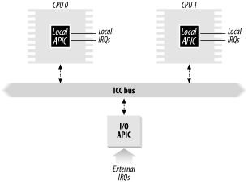
Multi-APIC system

Slide 9
Exceptions
0 - "Divide error" (fault)----------------SIGFPE
1- "Debug" (trap or fault) -------------SIGTRAP
2 - Not used
3 - "Breakpoint" (trap) -----------------SIGTRAP
4 - "Overflow" (trap) --------------------SIGSEGV
5 - "Bounds check" (fault) -------------SIGSEGV
6 - "Invalid opcode" (fault) -------------SIGILL

Slide 10
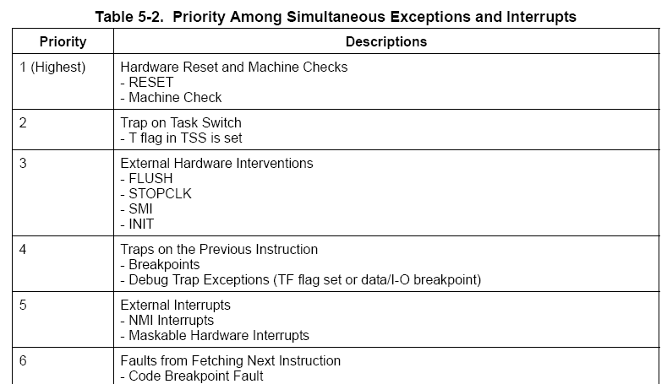
PRIORITY AMONG EXCEPTIONS AND
INTERRUPTS

Slide 11
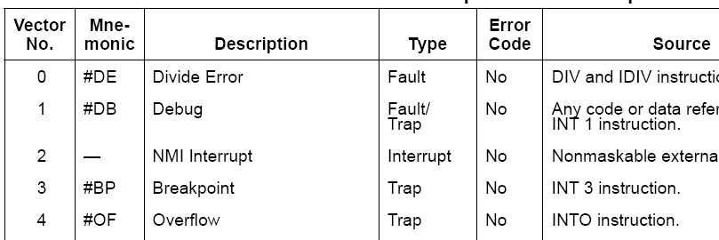
EXCEPTION AND INTERRUPT VECTORS
The vectors in the range 0 through 31 are assigned to the exceptions and the NMI interrupt.
The vectors in the range 32 to 255 are designated as user-defined ( OS ) interrupts.

Slide 12
Interrupt Descriptor Table
Interrupt Descriptor Table (IDT) associates each interrupt or exception vector with the address of the corresponding interrupt or exception handler.
idtr CPU register allows the IDT to be located anywhere in memory: it specifies both the IDT base linear address and its limit.
The LIDT (load IDT register) and SIDT (store IDT register) instructions load and store the contents of the IDTR register, respectively

Slide 13
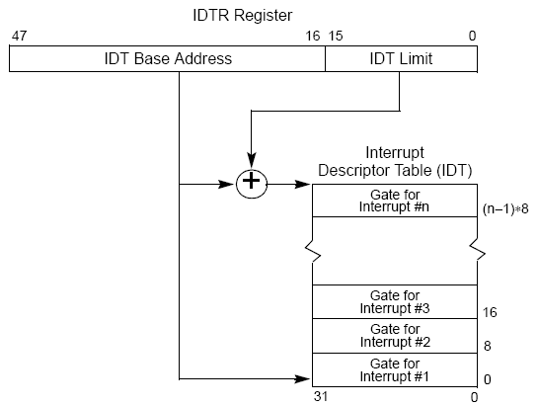
IDTR and IDT

Slide 14
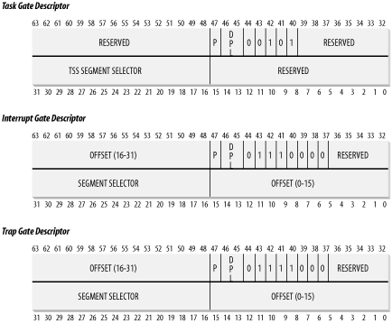

Slide 15
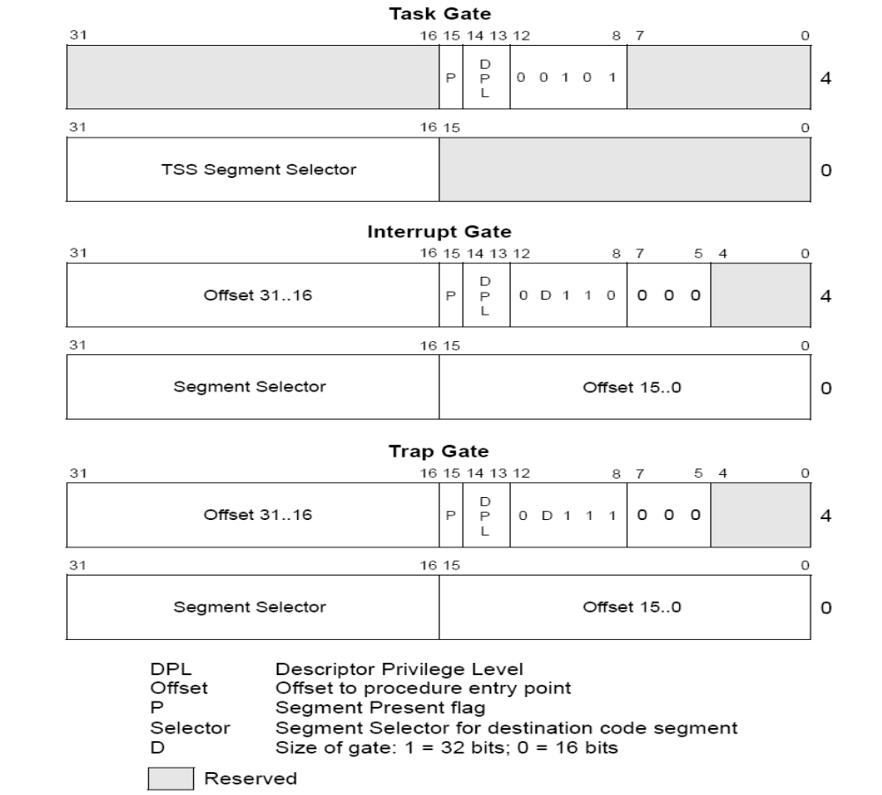

Slide 16
Task gate
  Includes the TSS selector of the process that must replace the current one when an interrupt signal occurs. Linux does not use task gates.
Interrupt gate
  Includes the Segment Selector and the offset inside the segment of an interrupt or exception handler. While transferring control to the proper segment, the processor clears the IF flag, thus disabling further maskable interrupts.
Trap gate
  Similar to an interrupt gate, except that while transferring control to the proper segment, the processor does not modify the IF flag.

Slide 17
set_intr_gate(n,addr)
set_system_gate(n,addr)
set_trap_gate(n,addr)

Slide 18
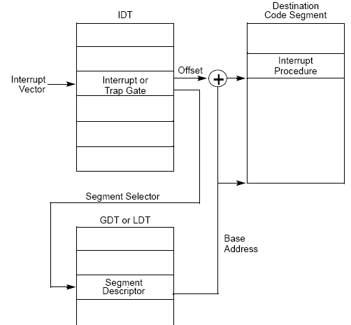
interrupt handler call

Slide 19
setup_idt
setup_idt:
lea ignore_int, %edx
movl $(_ _KERNEL_CS << 16), %eax
movw %dx, %ax /* selector = 0x0010 = cs */
movw $0x8e00, %dx /* interrupt gate, dpl=0, present */
lea idt_table, %edi
mov $256, %ecx
rp_sidt:
movl %eax, (%edi)
movl %edx, 4(%edi)
addl $8, %edi
dec %ecx
jne rp_sidt
ret

Slide 20
exception handling
set_trap_gate(0,&divide_error);
set_trap_gate(6,&invalid_op); set_trap_gate(7,&device_not_available); set_trap_gate(8,&double_fault); set_trap_gate(9,&coprocessor_segment_overrun); set_trap_gate(10,&invalid_TSS); set_trap_gate(11,&segment_not_present); set_trap_gate(12,&stack_segment);

Slide 21
handler_name:
pushl $0 /* only for some exceptions */
pushl $do_handler_name
jmp error_code
leave
current->tss.error_code = error_code;
current->tss.trap_no = vector;
force_sig(sig_number, current);

Slide 22
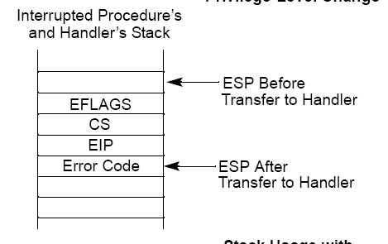
Stack Usage with No
Privilege-Level ChangeStack

Slide 23
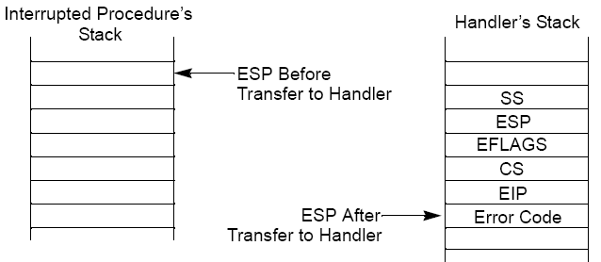
Stack Usage with
Privilege-Level Change

Slide 24
Hardware Handling of Interrupts and Exceptions
If one occurred, the control unit does the following:
  Determines the vector i (0 ≤ i ≤ 255) associated with the interrupt or the exception.
  Reads the i th entry of the IDT referred by the idtr register
  Gets the base address of the GDT from the gdtr register and looks in the GDT to read the Segment Descriptor identified by the selector in the IDT entry.
  Makes sure the interrupt was issued by an authorized source.

Slide 25
  Checks whether a change of privilege level is taking place ?
    Reads the tr register to access the TSS segment of the running process.
    Loads the ss and esp registers with the proper values for the stack segment and stack pointer associated with the new privilege level.
    In the new stack, saves the previous values of ss and esp
  If a fault has occurred, loads cs and eip with the logical address of the instruction that caused the exception so that it can be executed again.

Slide 26
  Saves the contents of eflags, cs, and eip in the stack.
  If the exception carries a hardware error code, saves it on the stack.
  Loads cs and eip, respectively, with the Segment Selector and the Offset fields of the Gate Descriptor stored in the i th entry of the IDT. ------------ handler.

Slide 27
finish interrupt
iret
  Load the cs, eip, and eflags registers with the values saved on the stack.
  Check whether the CPL of the handler is equal to the value contained in the two least significant bits of cs.
    If so, iret concludes execution;
      otherwise, go to the next step.
  Load the ss and esp registers from the stack and return to the stack associated with the old privilege level.

Slide 28
finish interrupt
  Examine the contents of the ds, es, fs, and gs segment registers;
    if any of them contains a selector that refers to a Segment Descriptor whose DPL value is lower than CPL, clear the corresponding segment register.
    The control unit does this to forbid User Mode programs that run with a CPL equal to 3 from using segment registers previously used by kernel routines (with a DPL equal to 0). If these registers were not cleared, malicious User Mode programs could exploit them in order to access the kernel address space.

Slide 29
Nested Execution of Handlers
Linux design does not allow process switching while the CPU is executing a kernel control path associated with an interrupt
interrupt handler may be interrupted by another interrupt handler.
the current process doesn't change while the kernel is handling a nested set of kernel control paths.
most exceptions can occur only while the CPU is in User Mode. except Page Fault . ------- 2 kernel control paths associated with exceptions may be stacked .

Slide 30
write in libc
ssize_t write(int fd, const void *buf, size_t count)
{
long __res;
__asm__ __volatile("int $0x80":"=a"(__res):"0"(4), "b"((long) (fd)), "c"((long) (buf)), "d"((long) (count)));
if (__res >= 0)
return (ssize_t) __res;
errno = -__res;
return -1;
};

Slide 31
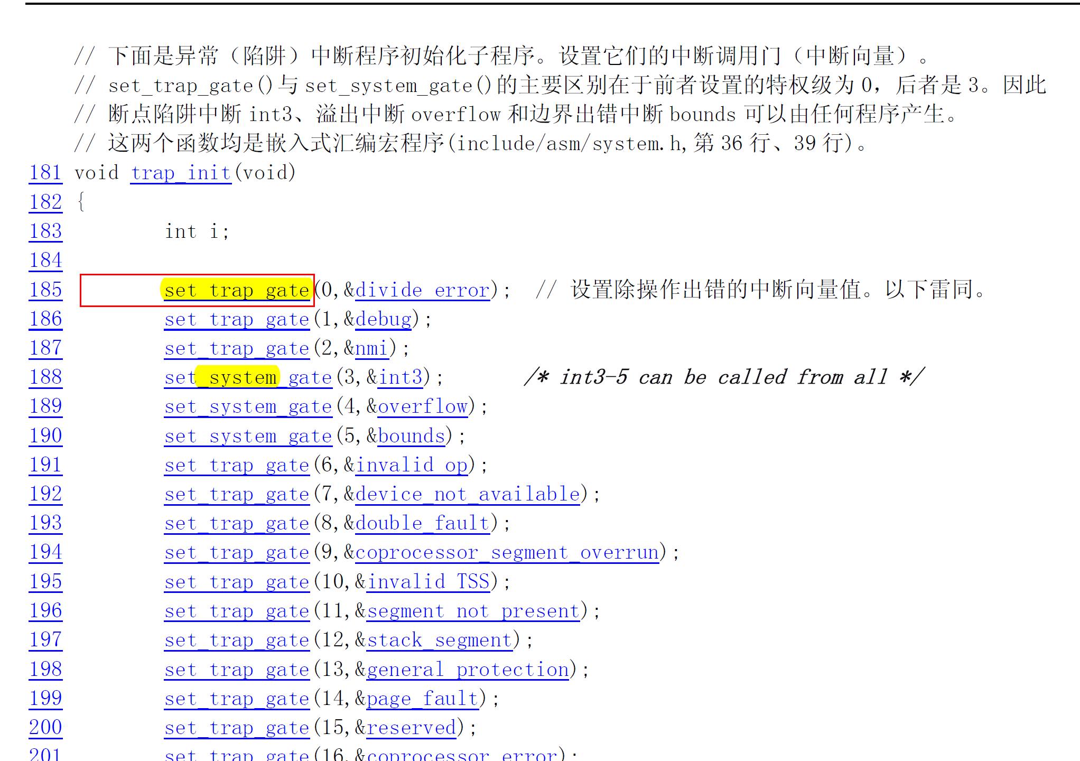

Slide 32
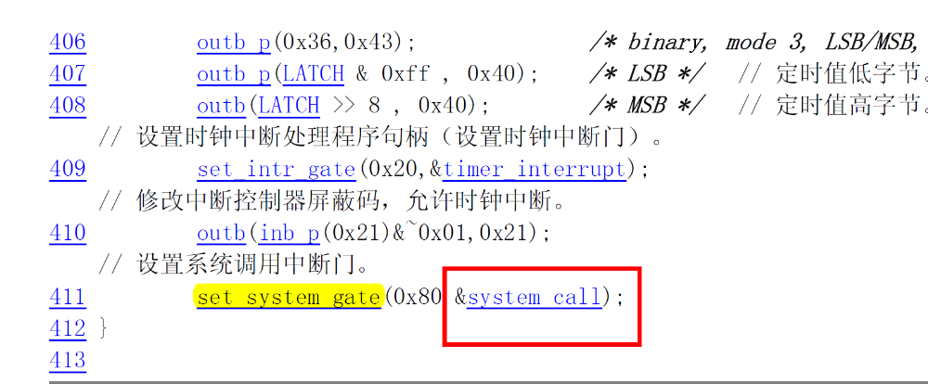

Operating System Concepts

Slide 34
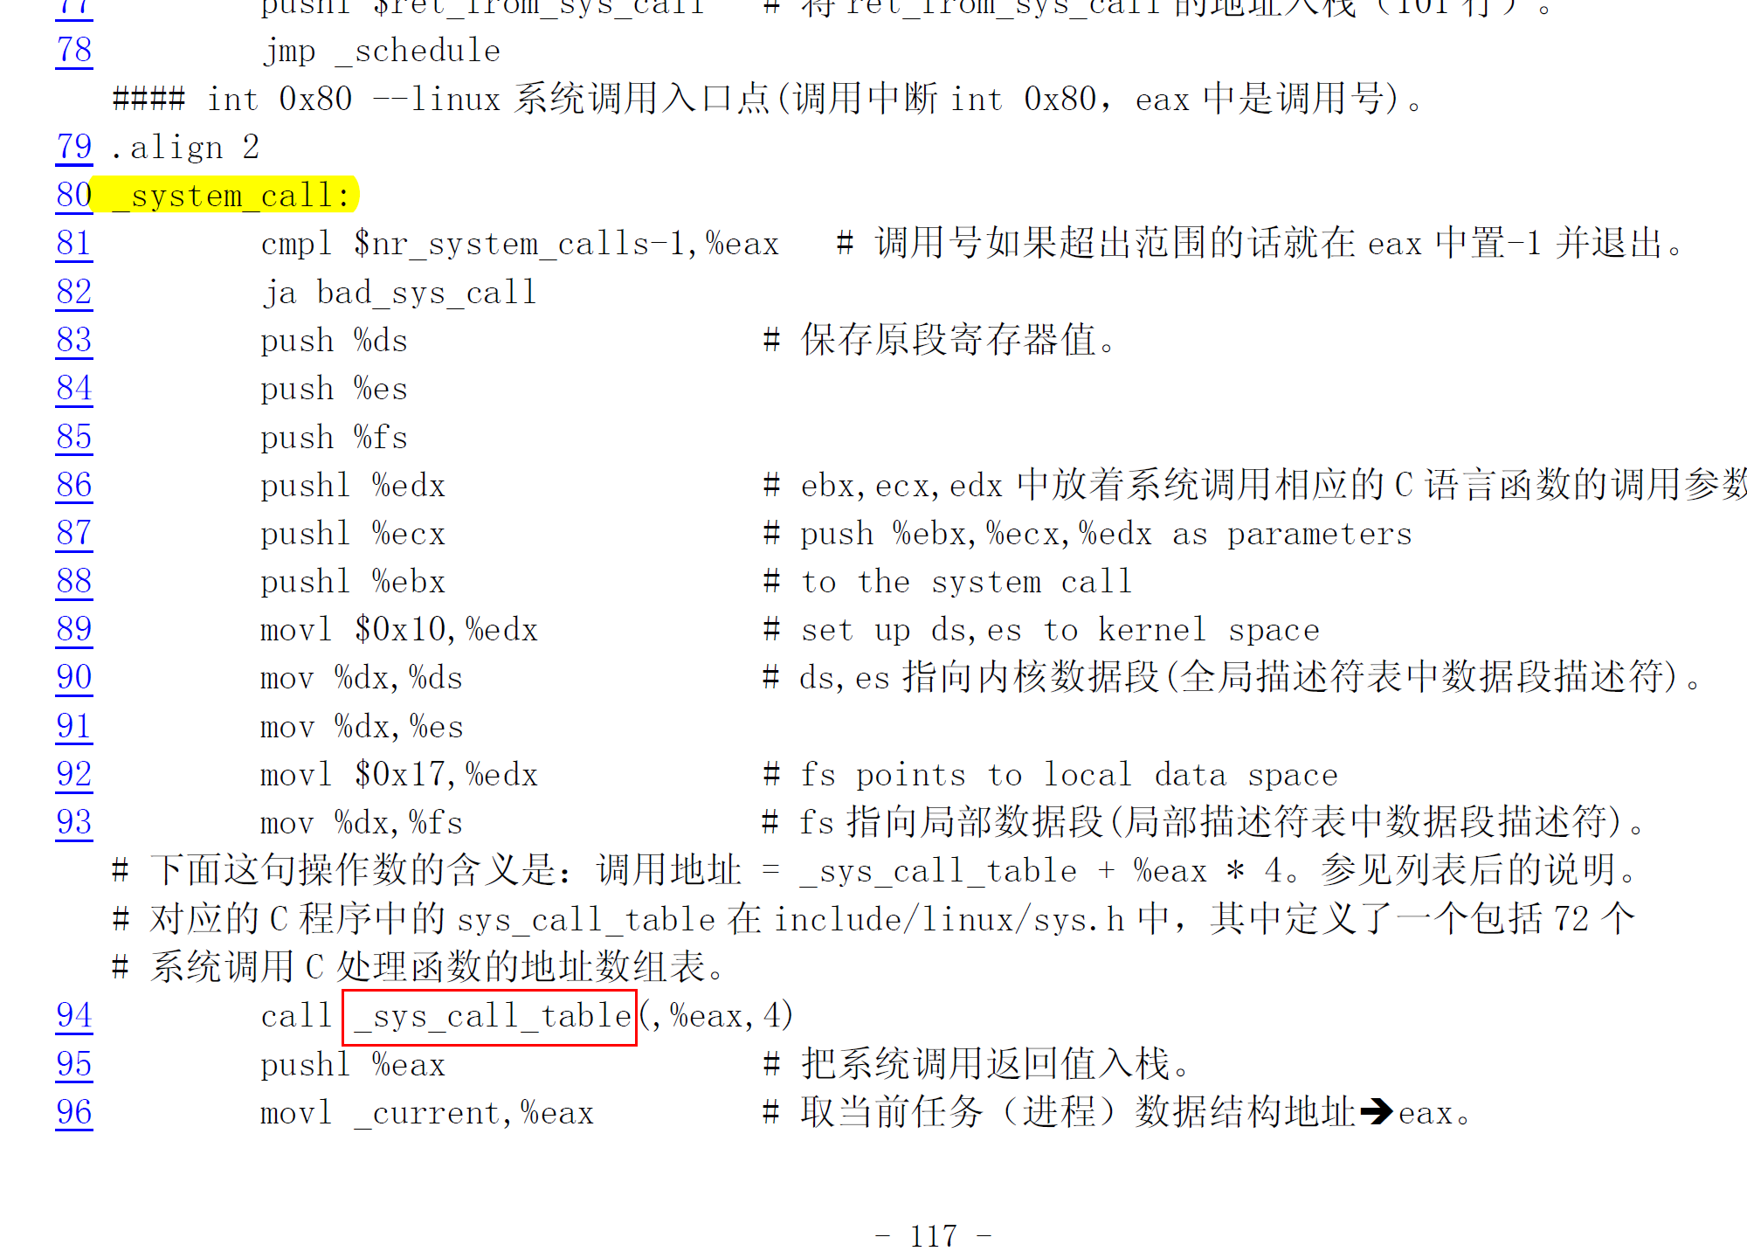
Operating System Concepts

