Slide 1

Loan Default Prediction
Data Pipeline Design Using Medallion Architecture

Slide 2
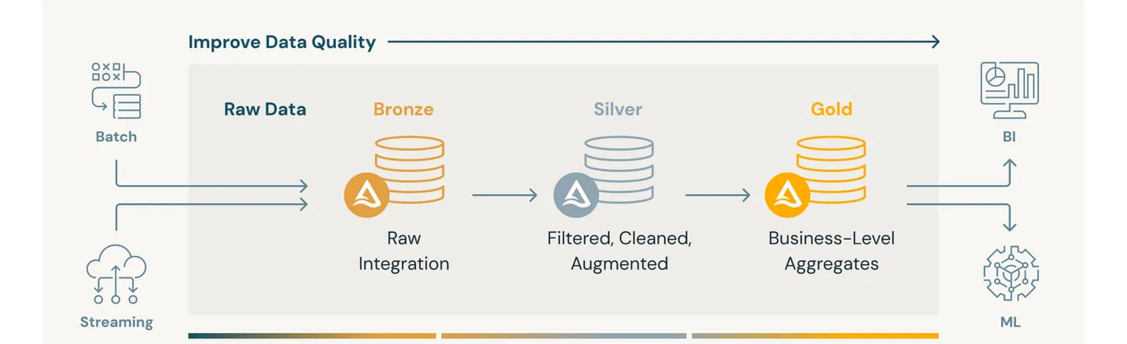
Medallion Architecture Overview
Bronze Layer
Silver Layer
Gold Layer
Raw data ingestion with minimal transformation. Preserves the original data format and content for auditability.
Cleaned and validated data. Applies transformations to handle missing values, standardize formats, and remove duplicates.
Business-ready data optimized for analytics and ML. Contains feature stores and label stores for model training.

Slide 3
Data Pipeline Design
Bronze, Silver, Gold Layers

Slide 4


Bronze Layer: Raw Data Ingestion
Foundation layer that ingests and preserves source data with minimal transformation
User-related Data Sources
Dataset Name | Data Features | Ingestion Method
feature_clickstream | User interaction events and behavioral patterns captured monthly | Partitioned by snapshot date (one parquet file per month)
feature_attributes | User demographic attributes including age, occupation, and personal identifiers | Full table snapshot captured on the 1st of each month
feature_financials | Financial profile metrics including income, credit history, and payment patterns | Full table snapshot captured on the 1st of each month
Loan-related Data Sources
Dataset Name | Data Features | Ingestion Method
lms_loan_daily | Monthly loan status tracking payment history, balances, and overdue amounts | Partitioned by loan tenure month (one parquet file per snapshot)
The Bronze layer preserves raw data in its original form to maintain complete data lineage and auditability.

Slide 5
Silver Layer: Cleaning & Augmentation
Transforming raw data into validated, consistent formats for analytical readiness
User-related Data Sources
Dataset Name | Quality Enhancements
feature_clickstream | Preserved in original format
feature_attributes | Removed quotes marks in Name field Replaced ('_____') with "Unknown" in Occupation | Replaced invalid SSN patterns with "Unknown” Removed underscores (‘_’) in Age and applied constraints (valid range: 0 – 100)
feature_financials | Removed underscores (‘_’) in numeric fields Replaced non-standard values (‘!@9#%8’) with ‘Unknown’ for Payment Behavior | Replaced (‘_’) with "Unknown" for Credit Mix Replaced 'NM' with 'Unknown' for Payment of Min Amount Deduplicated Type of Loan, and removed “Not Specified”
Loan-related Data Sources
Dataset Name | Derived Metrics & Indicators
lms_loan_daily | mob – calculated Month on Book installments_missed – calculated number of missed payments first_missed_date – derived the first date of missed payment dpd – derived Days Past Due metric for default risk assessment
The Silver layer ensures data consistency and quality while preserving the semantic meaning of the original data, preparing it for feature engineering in the Gold layer.

Slide 6


Gold Layer: Feature & Label Store
Business-optimized data assets engineered for machine learning model development
Feature Store
Column | Definition
age | Calculated as age of the user as of every snapshot date. Derived from cleaned Age field in feature attributes.
occupation | Standardized occupation categories from feature attributes, with "Unknown" values handled during Silver layer cleaning.
annual_income | User's annual income derived from feature financials dataset, with proper formatting and validation applied.
credit_mix | Categorized as "standard", "good", or "bad" based on cleaned credit mix information from feature financials.
Label Store
Column | Definition
label | Binary loan default indicator (1 = Default, 0 = Non-default) based on dpd (days past due) threshold of 30+ days.
These curated feature and label stores enable consistent model training, reproducible results, and
seamless transition to production.

Slide 7

Gold Layer: Feature & Label Store
Business-optimized data assets engineered for machine learning model development
Why separate Feature & Label store?
Different Update Frequencies and Patterns
Feature data often changes at different cadences than label data:
Features (like user demographics, financial attributes) may be updated regularly but typically change gradually
Labels (like loan default status) evolve over time as outcomes materialize and may require lookback periods to determine (e.g., 30+ days past due)
Maintaining separate stores allows each to follow its optimal refresh schedule without unnecessary coupling.
Prevent Data Leakage
Separating features from labels helps prevent one of the most common ML pitfalls—data leakage:
Features must represent information available at prediction time
Labels often incorporate future information (e.g., whether a loan defaulted)
Separate stores create a clear boundary that helps ensure features don't inadvertently include information from the future
Reusability Across Different Models
Feature store: Contains reusable features that can serve multiple models and use cases
Label store: Contains specific outcome definitions that may vary by model or business objective

Slide 8
Thank you!

