Slide 1
训练数据读取
TensorFlow
林楚铭
cmlin17@fudan.edu.cn

Slide 3
目的
假设4倍超分模型为F
监督学习 HR_P = F(LR)
需要准备训练数据(LR, HR_GT)
训练数据采用DIV2K，一共800张图片
LR为24x24，HR为96x96
生成训练样本：LR [B, 24, 24, 1] 与对应的 HR [B, 96, 96, 1]

Slide 4
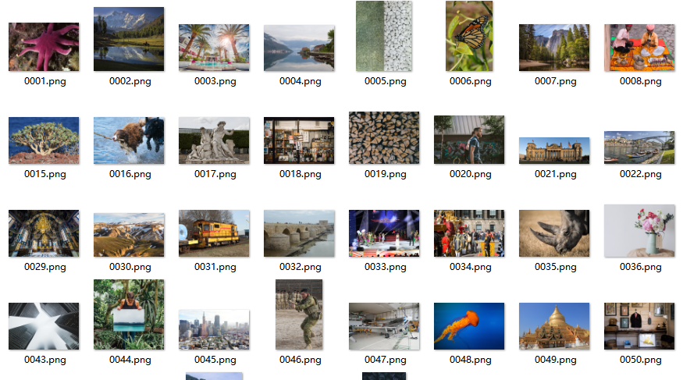
DIV2K

Slide 5
简介
使用tf.data
两种读取数据模式：
将原始数据处理成tfrecords数据，再从tfrecords读取
使用生成器generator，直接处理原始数据

Slide 6
定义DataLoader
class DataLoader(): def __init__(self, data_dir='DIV2K/DIV2K_train_HR', patch_size=96, scale=4, batch_size=64, shuffle_num=2000, prefetch_num=1000, map_parallel_num=8, one_img_patch_num=100): self.data_dir = data_dir self.patch_size = patch_size self.scale = scale self.batch_size = batch_size self.shuffle_num = shuffle_num self.prefetch_num = prefetch_num self.map_parallel_num = map_parallel_num self.one_img_patch_num = one_img_patch_num

Slide 7
生成tfrecords
def gen_tfrecords(self, save_dir='DIV2K/tfrecords', tfrecord_num=10): file_num = tfrecord_num sample_num = 0 if not os.path.exists(save_dir): os.makedirs(save_dir) fs = [] for i in range(file_num): fs.append(tf.python_io.TFRecordWriter(os.path.join(save_dir, 'data%d.tfrecords' % i))) img_paths = sorted(glob.glob(os.path.join(self.data_dir, '*.png'))) for img_path in img_paths: print('processing %s' % img_path) img = misc.imread(img_path) y = utils.img_to_uint8(utils.rgb2ycbcr(img)[:, :, 0]) height, width = y.shape p = self.patch_size step = p // 3 * 2 for h in range(0, height - p + 1, step): for w in range(0, width - p + 1, step): gt = y[h: h + p, w: w + p] assert gt.shape[:] == (p, p) assert gt.dtype == np.uint8 example = tf.train.Example(features=tf.train.Features(feature={ 'gt': _bytes_feature(gt.tostring()) })) fs[sample_num % file_num].write(example.SerializeToString()) sample_num += 1 print('example number: %d' % sample_num) np.savetxt(os.path.join(save_dir, 'sample_num.txt'), np.asarray([sample_num]), '%d') for f in fs: f.close()
为什么要生成10个tfrecords?

Slide 8
使用tf.data读取tfrecords
def _parse_one_example(self, example): features = tf.parse_single_example( example, features={ 'gt': tf.FixedLenFeature([], tf.string) }) p = self.patch_size gt = features['gt'] gt = tf.decode_raw(gt, tf.uint8) gt = tf.reshape(gt, [p, p]) gt = tf.cast(gt, tf.float32) lr = tf.py_func(lambda x: misc.imresize(x, 1.0 / self.scale, 'bicubic', 'F'), [gt], tf.float32) gt = tf.reshape(gt, [p, p, 1]) / 255.0 lr = tf.reshape(lr, [p // self.scale, p // self.scale, 1]) / 255.0 c1 = tf.random_uniform([], 0, 1) c2 = tf.random_uniform([], 0, 1) gt, lr = tf.cond(c1 < 0.5, lambda : (gt[::-1, :], lr[::-1, :]), lambda : (gt, lr)) gt, lr = tf.cond(c2 < 0.5, lambda: (gt[:, ::-1], lr[:, ::-1]), lambda: (gt, lr)) return lr, gt def read_tfrecords(self, save_dir='DIV2K/tfrecords'): fs_paths = sorted(glob.glob(os.path.join(save_dir, '*.tfrecords'))) dataset = tf.data.TFRecordDataset(fs_paths) dataset = dataset.map(self._parse_one_example, self.map_parallel_num).shuffle(self.shuffle_num) \ .prefetch(self.prefetch_num).batch(self.batch_size).repeat() lrs, gts = dataset.make_one_shot_iterator().get_next() return lrs, gts
为什么需要tf.py_func?
优点与缺点？
为什么需要shuffle与prefetch?
Shuffle的大小如何决策？
map/shuffle/batch/repeat调用顺序是否可以交换？

Slide 9
使用tf.data与生成器读取数据
def get_generator(self): img_paths = sorted(glob.glob(os.path.join(self.data_dir, '*.png'))) one_img_patch_num = self.one_img_patch_num p = self.patch_size scale = self.scale for img_path in img_paths: img = misc.imread(img_path) height, width, _ = img.shape for i in range(one_img_patch_num): h = np.random.randint(height - p + 1) w = np.random.randint(width - p + 1) patch = img[h: h + p, w: w + p] gt = utils.rgb2ycbcr(patch)[:, :, 0] gt = np.float32(gt) lr = misc.imresize(gt, 1.0 / scale, 'bicubic', 'F') gt = gt / 255.0 lr = lr / 255.0 c1 = np.random.rand() c2 = np.random.rand() if c1 < 0.5: gt, lr = gt[::-1, :], lr[::-1, :] if c2 < 0.5: gt, lr = gt[:, ::-1], lr[:, ::-1] yield lr, gt def read_pngs(self): dataset = tf.data.Dataset.from_generator(self.get_generator, (tf.float32, tf.float32)) dataset = dataset.shuffle(self.shuffle_num).prefetch(self.prefetch_num).batch(self.batch_size).repeat() lrs, gts = dataset.make_one_shot_iterator().get_next() p = self.patch_size lrs = tf.reshape(lrs, [-1, p // self.scale, p // self.scale, 1]) gts = tf.reshape(gts, [-1, p, p, 1]) return lrs, gts
使用tfrecords读取与generator读取数据各有什么优点？
两者分别的应用场景？

Slide 10
测试
if __name__ == '__main__': os.environ['CUDA_VISIBLE_DEVICES'] = '-1' data_loader = DataLoader() # data_loader.gen_tfrecords() # lrs, gts = data_loader.read_tfrecords() lrs, gts = data_loader.read_pngs() sess = tf.Session() # import matplotlib.pyplot as plt # while True: # im1, im2 = sess.run([lrs, gts]) # plt.imshow(utils.img_to_uint8(im2[0, :, :, 0])) # plt.show() im1, im2 = sess.run([lrs, gts]) print(im1.shape, im2.shape)
Out: (64, 24, 24, 1) (64, 96, 96, 1)

Slide 11
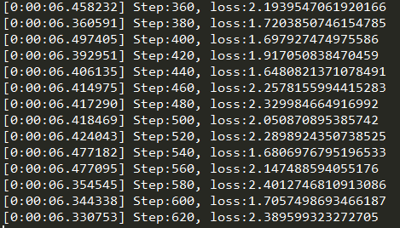
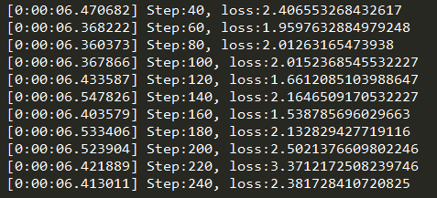
两者性能对比
左：TFrecords 右：Generator

