Slide 1
模型建立
Tensorflow
林楚铭
cmlin17@fudan.edu.cn

Slide 3
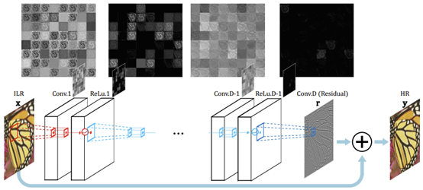
构造VDSR模型
输入图为bicubic图像
20层卷积层，都为3x3卷积，前19层的激活函数为ReLU

Slide 4
tf.layers.conv2d
tf.layers.conv2d( inputs, filters, kernel_size, strides=(1, 1), padding='valid', data_format='channels_last', dilation_rate=(1, 1), activation=None, use_bias=True, kernel_initializer=None, bias_initializer=tf.zeros_initializer(), kernel_regularizer=None, bias_regularizer=None, activity_regularizer=None, kernel_constraint=None, bias_constraint=None, trainable=True, name=None, reuse=None )
def conv2d(x, num_output, kernel_size=3, stride=1, act=tf.nn.relu, name=None): return tf.layers.conv2d(x, num_output, kernel_size, stride, 'same', activation=act, name=name, kernel_regularizer=tf.contrib.layers.l2_regularizer(scale=1e-5))

Slide 5
搭建VDSR
class VDSR(): def __init__(self, scale=4): self.scale = scale def __call__(self, lr, bic=None): with tf.variable_scope('VDSR', reuse=tf.AUTO_REUSE): b, h, w, c = tf.unstack(tf.shape(lr)) scale = self.scale layer_num = 20 if bic == None: bic = tf_resize_image(lr, scale) bic = tf.reshape(bic, [b, h * scale, w * scale, 1]) self.bic = bic x = bic for i in range(layer_num - 1): x = conv2d(x, 64) x = conv2d(x, 1, act=tf.identity) + bic return x

Slide 6
tf_resize_image
def tf_resize_image(imgs, scale): def resize_image(imgs, scale): b = imgs.shape[0] c = imgs.shape[-1] res = [] for i in range(b): img = imgs[i] tar_img = [] for j in range(c): tar_img.append(misc.imresize(img[:, :, j], scale / 1.0, 'bicubic', mode='F')) img = np.stack(tar_img, -1) res.append(img) return np.stack(res) return tf.py_func(lambda x: resize_image(x, scale), [imgs], tf.float32)

Slide 7
测试模型是否可运行
if __name__ == '__main__': import os os.environ['CUDA_VISIBLE_DEVICES'] = '-1' lr = tf.zeros([1, 24, 24, 1]) model = VDSR() # model = EDSR() res = model(lr) sess = tf.Session() sess.run(tf.global_variables_initializer()) out = sess.run(res) print(out.shape)
Out: (1, 96, 96, 1)

Slide 8
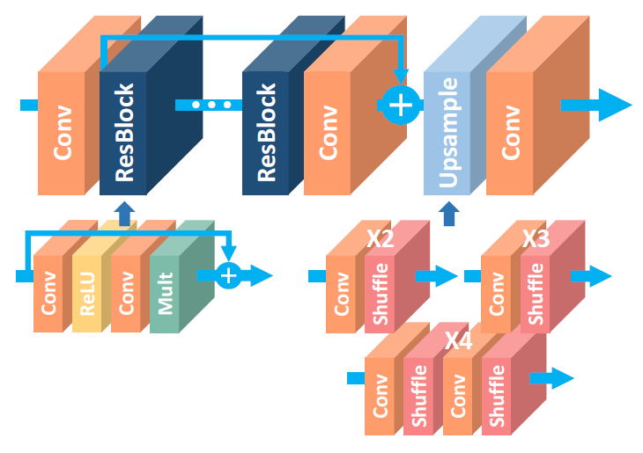
构造EDSR模型
构造一个类似EDSR模型
用一个反卷积层作为上采样层
反卷积层直接输出结果

Slide 9
tf.layers.conv2d_transpose
tf.layers.conv2d_transpose( inputs, filters, kernel_size, strides=(1, 1), padding='valid', data_format='channels_last', activation=None, use_bias=True, kernel_initializer=None, bias_initializer=tf.zeros_initializer(), kernel_regularizer=None, bias_regularizer=None, activity_regularizer=None, kernel_constraint=None, bias_constraint=None, trainable=True, name=None, reuse=None )
def deconv2d(x, num_output, kernel_size, stride, act=None, name=None): return tf.layers.conv2d_transpose(x, num_output, kernel_size, stride, 'same', activation=act, name=name, kernel_regularizer=tf.contrib.layers.l2_regularizer(scale=1e-5))

Slide 10
搭建EDSR
class EDSR(): def __init__(self, scale=4): self.scale = scale def res2d(self, x, num_output, kernel_size, name, scale=0.1): with tf.variable_scope(name): x0 = x x = conv2d(x, num_output, kernel_size) x = conv2d(x, num_output, kernel_size, act=tf.identity) x = x0 + x * scale return x def __call__(self, lr, bic=None): with tf.variable_scope('EDSR', reuse=tf.AUTO_REUSE): b, h, w, c = tf.unstack(tf.shape(lr)) scale = self.scale if bic == None: bic = tf_resize_image(lr, scale) bic = tf.reshape(bic, [b, h * scale, w * scale, 1]) self.bic = bic x = conv2d(lr, 256) x0 = x for i in range(16): x = self.res2d(x, 256, 3, 'res2d_%d' % i) x = conv2d(x, 256) x = x + x0 x = deconv2d(x, 1, kernel_size=2 * scale, stride=scale) return x + bic

