Slide 1
模型训练与测试
Tensorflow
林楚铭
cmlin17@fudan.edu.cn

Slide 3
简介
结合之前的数据读取与模型建立模块，进行模型的训练
使用Adam优化器进行训练
训练中可以定时保存训练结果
训练过程可视化
将训练好的模型在测试集上测试

Slide 4
基础参数与准备
MODEL = 'VDSR' # 'VDSR' or 'EDSR' TRAIN_DIR = 'output/{}/model'.format(MODEL) LOG_DIR = 'output/{}/log'.format(MODEL) BATCH_SIZE = 64 SHUFFLE_NUM = 20000 PREFETCH_NUM = 10000 MAX_TRAIN_STEP = 50000 LR_BOUNDS = [45000] LR_VALS = [1e-4, 1e-5] SAVE_PER_STEP = 2000 TRAIN_PNG_PATH = 'DIV2K/DIV2K_train_HR' TRAIN_TFRECORD_PATH = 'DIV2K/tfrecords' DATA_LOADER_MODE = 'RAW' # 'TFRECORD' or 'RAW' DEVICE_MODE = 'GPU' # 'CPU' or 'GPU' DEVICE_GPU_ID = '0' if not os.path.exists(TRAIN_DIR): os.makedirs(TRAIN_DIR) if not os.path.exists(LOG_DIR): os.makedirs(LOG_DIR) if DEVICE_MODE == 'CPU': os.environ['CUDA_VISIBLE_DEVICES'] = '-1' else: os.environ['CUDA_VISIBLE_DEVICES'] = DEVICE_GPU_ID

Slide 5
配置数据与模型
if MODEL == 'VDSR': model = VDSR() else: model = EDSR() data_loader = DataLoader(data_dir=TRAIN_PNG_PATH, batch_size=BATCH_SIZE, shuffle_num=SHUFFLE_NUM, prefetch_num=PREFETCH_NUM) if DATA_LOADER_MODE == 'TFRECORD': if len(os.listdir(TRAIN_TFRECORD_PATH)) == 0: data_loader.gen_tfrecords(TRAIN_TFRECORD_PATH) lrs, bics, gts = data_loader.read_tfrecords(TRAIN_TFRECORD_PATH) else: lrs, bics, gts = data_loader.read_pngs() res = model(lrs, bics)

Slide 6
配置训练操作
with tf.name_scope('train'): global_step = tf.Variable(0, trainable=False, name='global_step') mse_loss = tf.reduce_sum(tf.square(res - gts)) / BATCH_SIZE reg_loss = tf.losses.get_regularization_loss() loss = mse_loss + reg_loss learning_rate = tf.train.piecewise_constant(global_step, LR_BOUNDS, LR_VALS) optimizer = tf.train.AdamOptimizer(learning_rate) train_op = optimizer.minimize(loss, global_step)

Slide 7
配置训练可视化操作
with tf.name_scope('summaries'): tf.summary.scalar('learning_rate', learning_rate) tf.summary.scalar('mse_loss', mse_loss) tf.summary.scalar('reg_loss', reg_loss) tf.summary.scalar('loss', loss) tf.summary.image('lr', lrs, 1) tf.summary.image('bic', model.bic, 1) tf.summary.image('out', tf.clip_by_value(res, 0, 1), 1) tf.summary.image('gt', gts, 1) summary_op = tf.summary.merge_all()

Slide 8
Session启动训练
saver = tf.train.Saver(max_to_keep=500) config = tf.ConfigProto() config.gpu_options.allow_growth = True sess = tf.Session(config=config) sess.run(tf.global_variables_initializer()) restore_session_from_checkpoint(sess, saver) start_time = datetime.datetime.now() writer = tf.summary.FileWriter(LOG_DIR, sess.graph) while True: _, loss_value, step = sess.run([train_op, loss, global_step]) if step % 20 == 0: end_time = datetime.datetime.now() print('[{}] Step:{}, loss:{}'.format( end_time - start_time, step, loss_value )) summary_value = sess.run(summary_op) writer.add_summary(summary_value, step) start_time = end_time if step % SAVE_PER_STEP == 0: saver.save(sess, os.path.join(TRAIN_DIR, 'checkpoint.ckpt'), global_step=step) if step >= MAX_TRAIN_STEP: print('Done train.') break
def restore_session_from_checkpoint(sess, saver): checkpoint = tf.train.latest_checkpoint(TRAIN_DIR) if checkpoint: saver.restore(sess, checkpoint) return True else: return False

Slide 9
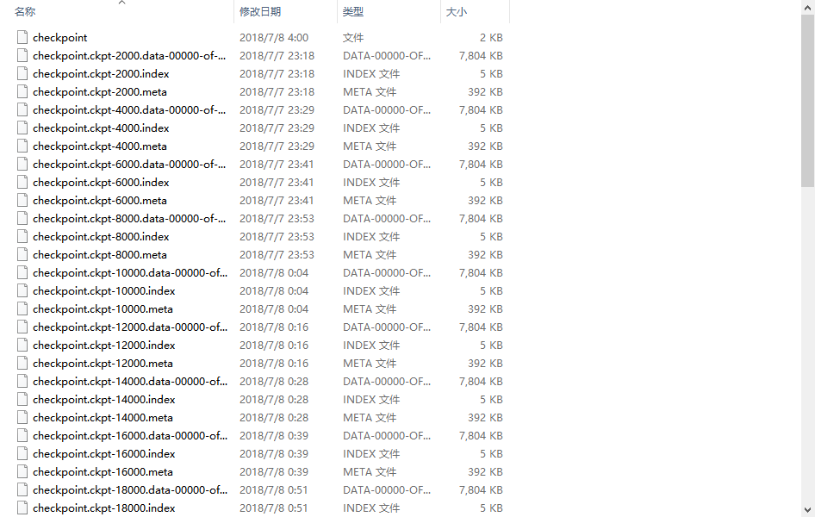

Slide 10
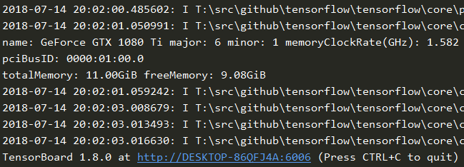
训练可视化
当前目录下执行 tensorboard --logdir=output
执行后会启动，查找该目录下所有的log
浏览器访问指定地址即可查看训练信息

Slide 11
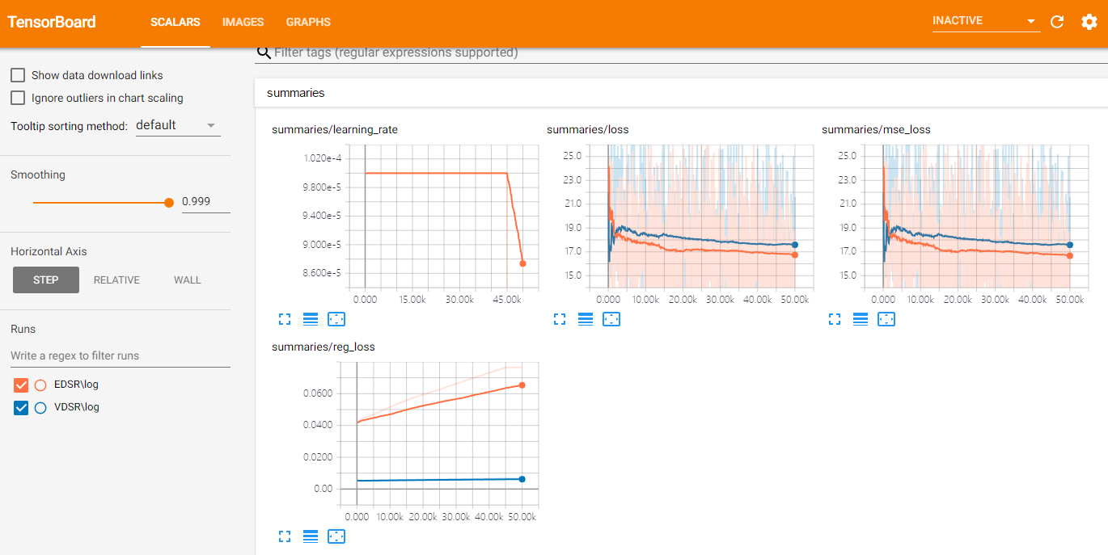
训练可视化

Slide 12
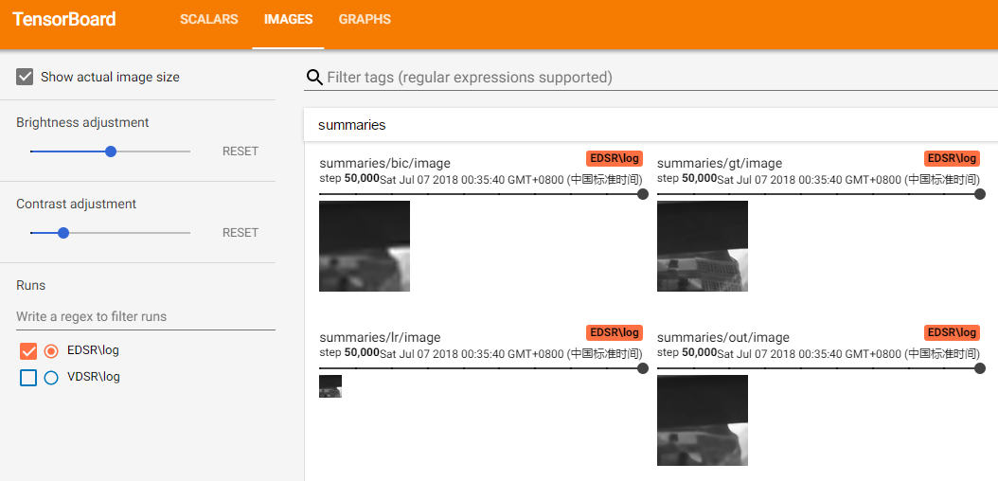
训练可视化

Slide 13
模型测试
TEST_DIR = 'test_data/Set5' MODEL = 'VDSR' # 'VDSR' or 'EDSR' or 'BICUBIC' MODEL_CKPT_PATH = 'model/{}/checkpoint.ckpt-50000'.format(MODEL) OUTPUT_DIR = 'result/calendar/{}'.format(MODEL) DEVICE_MODE = 'GPU' # 'CPU' or 'GPU' DEVICE_GPU_ID = '0' SCALE = 4 if DEVICE_MODE == 'CPU': os.environ['CUDA_VISIBLE_DEVICES'] = '-1' else: os.environ['CUDA_VISIBLE_DEVICES'] = DEVICE_GPU_ID if not os.path.exists(OUTPUT_DIR): os.makedirs(OUTPUT_DIR) if MODEL == 'VDSR': model = VDSR() elif MODEL == 'EDSR': model = EDSR() else: model = BICUBIC() lr = tf.placeholder(tf.float32, [None, None, None, 1]) res = model(lr)

Slide 14
if not MODEL == 'BICUBIC': saver = tf.train.Saver() config = tf.ConfigProto() config.gpu_options.allow_growth = True sess = tf.Session(config=config) sess.run(tf.global_variables_initializer()) if not MODEL == 'BICUBIC': saver.restore(sess, MODEL_CKPT_PATH) fs = glob.glob(os.path.join(TEST_DIR, '*.png')) psnrs = [] for f in fs: img = misc.imread(f) lr_img = misc.imresize(img, 1.0 / SCALE, 'bicubic') lr_y = utils.rgb2ycbcr(lr_img)[:, :, :1] lr_y = np.expand_dims(lr_y, 0).astype(np.float32) / 255.0 res_y = sess.run(res, feed_dict={lr: lr_y}) res_y = np.clip(res_y, 0, 1)[0] * 255.0 bic_img = misc.imresize(lr_img, SCALE / 1.0, 'bicubic') bic_ycbcr = utils.rgb2ycbcr(bic_img) bic_ycbcr[:, :, :1] = res_y res_img = utils.img_to_uint8(utils.ycbcr2rgb(bic_ycbcr)) img_name = f.split(os.sep)[-1] misc.imsave(os.path.join(OUTPUT_DIR, img_name), res_img) gt_y = utils.rgb2ycbcr(img)[:, :, :1] psnr = utils.psnr(res_y[SCALE:-SCALE, SCALE:-SCALE], gt_y[SCALE:-SCALE, SCALE:-SCALE]) psnrs.append(psnr) print(img_name, 'PSNR:', psnr) print('AVG PSNR:', np.mean(psnrs))

Slide 15
需要思考的一些问题
1. 如何确保训练的过程中是几乎完全利用了GPU？如果没有完全利用，有哪些步骤影响了其训练计算过程？
2. 如何将自己的模型与他人的模型进行混合利用，如通过预训练好的VGG16网络进行一部分特征计算？
3. 如何将不同的网络参数以不同的学习率进行训练，或者部分网络参数不参与训练？
4. 如何将模型的部分参数用预训练好的参数进行初始化？
5. 为了增大batch size，有时候使用多张卡进行并行训练，具体怎么做？

