Slide 1
分类器训练
Tensorflow
林楚铭
cmlin17@fudan.edu.cn

Slide 2
简介
利用在ImageNet上训练好的分类器模型，加以修改，利用fine-tune机制训练一个属于自己的分类器
在VOC2007数据集上训练一个1-k分类器

Slide 3
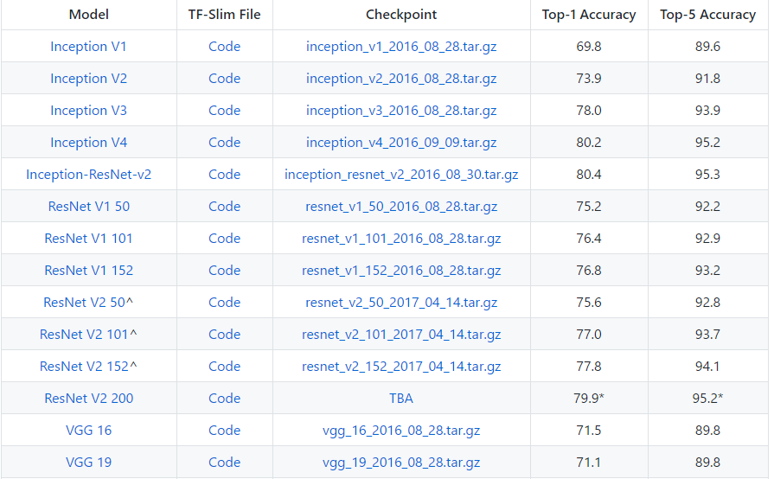
下载预训练模型
https://github.com/tensorflow/models/tree/master/research/slim

Slide 4
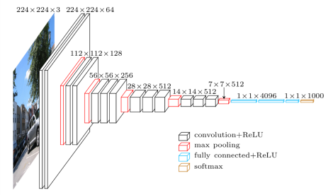
修改VGG16网络
训练一个新的分类器
去除最后一层全连接层
新建一层全连接层
VOC2007一共有20分类，所以新建的全连接层的输出长度为20

Slide 5
修改VGG16网络
if num_classes: net = slim.dropout(net, dropout_keep_prob, is_training=is_training, scope='dropout7') net = slim.conv2d(net, num_classes, [1, 1], activation_fn=None, normalizer_fn=None, scope='fc8')
if num_classes: net = slim.dropout(net, dropout_keep_prob, is_training=is_training, scope='dropout7') net = slim.conv2d(net, num_classes, [1, 1], activation_fn=None, normalizer_fn=None, scope='m_fc8')
logits, end_points = our_vgg_16(img, num_classes=20)

Slide 6
读取预训练权值参数
Var_list
V_A
V_A
V_B
V_B
vgg_16.ckpt
Saver
V_C
V_C
V_D

Slide 7
读取预训练权值参数
var_list = set(tf.trainable_variables('vgg_16')) - set(tf.trainable_variables('vgg_16/m_fc8')) saver_init = tf.train.Saver(var_list=var_list)
sess.run(tf.global_variables_initializer()) saver_init.restore(sess, 'vgg16_model/vgg_16.ckpt')

Slide 8


数据准备1：输入图片
将VOC2007图片全都缩放为224x224

Slide 9
数据准备2：标签
标签使用one hot编码
Person Car Bicycle
0 1 0
1 0 1

Slide 10
K分类交叉熵损失
logits = tf.sigmoid(logits) loss = -1.0 * tf.reduce_mean(gt * tf.log(logits + 1e-8) + (1 - gt) * tf.log(1 - logits + 1e-8))
使用adam优化器
学习率设置为1e-5
Batch size设置为32
训练6000次左右即完成训练
PS：输入RGB图需减去平均值[123.68, 116.78, 103.94]

Slide 11
进阶
如果不想使用slim框架，想自己重新搭建网络
或者网络权值来源于其他框架，不能使用saver直接复用
1. 保存权值
2. 训练前对权值重新赋值

Slide 12
保存权值
inp = tf.placeholder(tf.float32, [1, 224, 224, 3]) net, _ = our_vgg_16(inp, 20) var_list = set(tf.trainable_variables('vgg_16')) - set(tf.trainable_variables('vgg_16/m_fc8')) saver = tf.train.Saver(var_list=var_list) sess = tf.Session() saver.restore(sess, 'vgg16_model/vgg_16.ckpt') out = {} for v in var_list: print(v) out[v.name] = sess.run(v) np.save('vgg16_model/vgg16.npy', out)

Slide 13
建立自己的VGG16网络
class vgg16(): def build(self, inp, num_classes=20, training=True, name='vgg16'): with tf.variable_scope(name, reuse=tf.AUTO_REUSE): x = conv2d(inp, 64, name='conv1_1') x = conv2d(x, 64, name='conv1_2') x = tf.layers.max_pooling2d(x, 2, 2, 'same') x = conv2d(x, 128, name='conv2_1') x = conv2d(x, 128, name='conv2_2') x = tf.layers.max_pooling2d(x, 2, 2, 'same') x = conv2d(x, 256, name='conv3_1') x = conv2d(x, 256, name='conv3_2') x = conv2d(x, 256, name='conv3_3') x = tf.layers.max_pooling2d(x, 2, 2, 'same') x = conv2d(x, 512, name='conv4_1') x = conv2d(x, 512, name='conv4_2') x = conv2d(x, 512, name='conv4_3') x = tf.layers.max_pooling2d(x, 2, 2, 'same') x = conv2d(x, 512, name='conv5_1') x = conv2d(x, 512, name='conv5_2') x = conv2d(x, 512, name='conv5_3') x = tf.layers.max_pooling2d(x, 2, 2, 'same') x = conv2d(x, 4096, 7, padding='valid', name='fc6') x = tf.layers.dropout(x, training=training) x = conv2d(x, 4096, 1, name='fc7') x = tf.layers.dropout(x, training=training) x = conv2d(x, num_classes, 1, name='fc8', act=None) # [-1, 1, 1, num_classes] to [-1, num_classes] x = tf.squeeze(x, [1, 2]) return x

Slide 14
构建权值名称 映射矩阵
v2k = { 'vgg16/conv1_1/kernel:0': 'vgg_16/conv1/conv1_1/weights:0', 'vgg16/conv1_1/bias:0': 'vgg_16/conv1/conv1_1/biases:0', 'vgg16/conv1_2/kernel:0': 'vgg_16/conv1/conv1_2/weights:0', 'vgg16/conv1_2/bias:0': 'vgg_16/conv1/conv1_2/biases:0', 'vgg16/conv2_1/kernel:0': 'vgg_16/conv2/conv2_1/weights:0', 'vgg16/conv2_1/bias:0': 'vgg_16/conv2/conv2_1/biases:0', 'vgg16/conv2_2/kernel:0': 'vgg_16/conv2/conv2_2/weights:0', 'vgg16/conv2_2/bias:0': 'vgg_16/conv2/conv2_2/biases:0', 'vgg16/conv3_1/kernel:0': 'vgg_16/conv3/conv3_1/weights:0', 'vgg16/conv3_1/bias:0': 'vgg_16/conv3/conv3_1/biases:0', 'vgg16/conv3_2/kernel:0': 'vgg_16/conv3/conv3_2/weights:0', 'vgg16/conv3_2/bias:0': 'vgg_16/conv3/conv3_2/biases:0', 'vgg16/conv3_3/kernel:0': 'vgg_16/conv3/conv3_3/weights:0', 'vgg16/conv3_3/bias:0': 'vgg_16/conv3/conv3_3/biases:0', 'vgg16/conv4_1/kernel:0': 'vgg_16/conv4/conv4_1/weights:0', 'vgg16/conv4_1/bias:0': 'vgg_16/conv4/conv4_1/biases:0', 'vgg16/conv4_2/kernel:0': 'vgg_16/conv4/conv4_2/weights:0', 'vgg16/conv4_2/bias:0': 'vgg_16/conv4/conv4_2/biases:0', 'vgg16/conv4_3/kernel:0': 'vgg_16/conv4/conv4_3/weights:0', 'vgg16/conv4_3/bias:0': 'vgg_16/conv4/conv4_3/biases:0', 'vgg16/conv5_1/kernel:0': 'vgg_16/conv5/conv5_1/weights:0', 'vgg16/conv5_1/bias:0': 'vgg_16/conv5/conv5_1/biases:0', 'vgg16/conv5_2/kernel:0': 'vgg_16/conv5/conv5_2/weights:0', 'vgg16/conv5_2/bias:0': 'vgg_16/conv5/conv5_2/biases:0', 'vgg16/conv5_3/kernel:0': 'vgg_16/conv5/conv5_3/weights:0', 'vgg16/conv5_3/bias:0': 'vgg_16/conv5/conv5_3/biases:0', 'vgg16/fc6/kernel:0': 'vgg_16/fc6/weights:0', 'vgg16/fc6/bias:0': 'vgg_16/fc6/biases:0', 'vgg16/fc7/kernel:0': 'vgg_16/fc7/weights:0', 'vgg16/fc7/bias:0': 'vgg_16/fc7/biases:0', }
通过使用trainable_variables获取可训练的变量，输出变量的名称，然后编写变量与变量之间对应名称的映射

Slide 15
网络权值赋值
with tf.name_scope('vgg16/restore'): vals = np.load(npy_path) vals = vals.item() var_list = set(tf.trainable_variables('vgg16')) - set(tf.trainable_variables('vgg16/fc8')) for v in var_list: v_name = str(v.name) print('restore:', v_name) k_name = v2k[v_name] assert len(k_name) > 0 val = vals[k_name] inp = tf.placeholder(tf.float32, val.shape) sess.run(tf.assign(v, inp, validate_shape=True), feed_dict={inp: val}) print('restore finish.')

