Slide 1
其他
Tensorflow
林楚铭
cmlin17@fudan.edu.cn

Slide 2
Name Scope
变量复用
def foo(): with tf.variable_scope("foo", reuse=tf.AUTO_REUSE): v = tf.get_variable("v", [1]) return v v1 = foo() # Creates v. v2 = foo() # Gets the same, existing v. assert v1 == v2

Slide 3
Name Scope
网络复用
class vgg16(): def build(self, inp, num_classes=20, training=True, name='vgg16'): with tf.variable_scope(name, reuse=tf.AUTO_REUSE): x = conv2d(inp, 64, name='conv1_1') x = conv2d(x, 64, name='conv1_2') x = tf.layers.max_pooling2d(x, 2, 2, 'same') x = conv2d(x, 128, name='conv2_1')
…
inp1 = tf.placeholder(tf.float32, [1, 224, 224, 3]) inp2 = tf.placeholder(tf.float32, [1, 224, 224, 3]) x1 = net.build(inp1) x2 = net.build(inp2) # reuse network

Slide 4
Name Scope
通过命名找到tensor
a = tf.add(1, 2, name='add') b = tf.Graph.get_tensor_by_name(tf.get_default_graph(), 'add:0') assert a == b
设置name scope还可以方便获取某一父命名下的所有变量或可训练的变量
tf.global_variables(scope=None)
tf.trainable_variables(scope=None)

Slide 5
BatchNorm
x_norm = tf.layers.batch_normalization(x, training=training) # ... update_ops = tf.get_collection(tf.GraphKeys.UPDATE_OPS) with tf.control_dependencies(update_ops): train_op = optimizer.minimize(loss)
1. 使用BatchNorm时，必须执行update_ops
2. denpendency可以保证update_ops先执行，后再执行train_op
3. 当batch_normalization的training为False时，update_ops为空

Slide 6
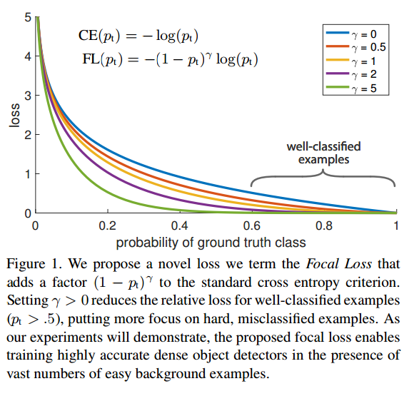
Focal Loss
Focal loss用来解决分类问题中样本不均衡的问题
以softmax为例
def softmax_focal_loss(logits, one_hot_label, beta=2): with tf.name_scope("softmax_focal_loss"): l_softmax = tf.nn.softmax(logits=logits, axis=-1) l_log = -1.0 * tf.log(tf.clip_by_value(l_softmax, 1e-10, 1.0)) l_focal = l_log * (1 - l_softmax) ** beta return tf.reduce_sum(one_hot_label * l_focal, axis=-1)

Slide 7
Perceptual Loss
IMG_Y
L2_LOSS
IMG_Label
Pretrained on ImageNet
IMG_Y
VGG19: Conv4_4
L2_LOSS
IMG_Label
VGG19: Conv4_4 (reuse)
与分类器训练类似，从slim model中下载VGG19模型，使用返回的end_points[‘vgg_19/conv4/conv4_4’]
Perceptual loss不一定要使用VGG模型，其他在ImageNet上的分类模型也是可以的

Slide 8
Optimizer
需求1：只想训练Net_A的参数，Net_B的参数不参与训练
注意：不是改变参数的trainable属性，而是让优化器指定要更新的参数
lr = 1e-4 optimizer = tf.train.AdamOptimizer(lr) train_op = optimizer.minimize(loss, global_step, var_list=tf.trainable_variables('Net_A'))

Slide 9
Optimizer
需求2：不同变量使用不同的学习率进行训练
例子：var_list1内的变量学习率为1e-5，其余1e-4
minimize = compute_gradients + apply_gradients
lr = 1e-4 optimizer = tf.train.AdamOptimizer(lr) capped_grads_and_vars = [] grads = optimizer.compute_gradients(loss) for grad, var in grads: if var in var_list1: capped_grads_and_vars.append((0.1 * grad, var)) else: capped_grads_and_vars.append((1 * grad, var)) train_op = optimizer.apply_gradients(capped_grads_and_vars, global_step)

Slide 10
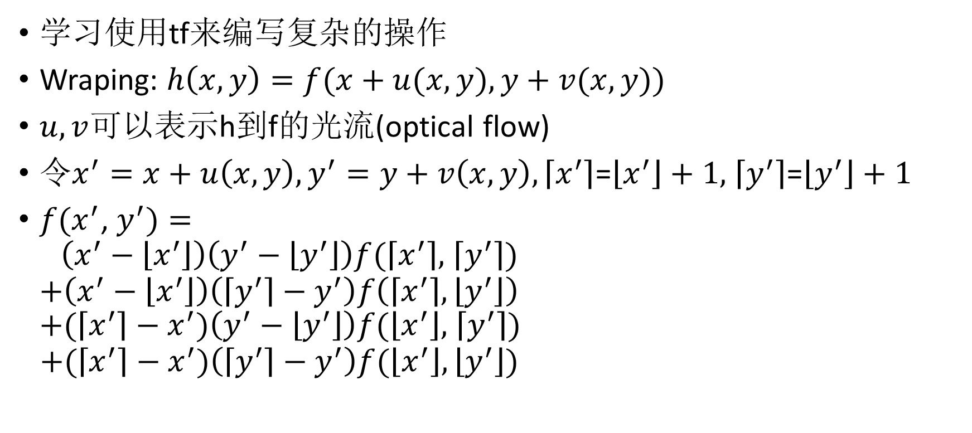
Warping
学习使用tf来编写复杂的操作
Wraping: $h\left(x,y\right)=f(x+u(x,y),y+v(x,y))$
$u,v$可以表示h到f的光流(optical flow)
令$x^{′}=x+u\left(x,y\right),y^{′}=y+v\left(x,y\right),\left\lceil x^{′}\right\rceil$=$\left\lfloor x^{′}\right\rfloor +1,$ $\left\lceil y^{′}\right\rceil$=$\left\lfloor y^{′}\right\rfloor +1$
$f(x^{′}$, $y^{′})=$ $\left(x^{′}−\left\lfloor x^{′}\right\rfloor \right)\left(y^{′}−\left\lfloor y^{′}\right\rfloor \right)f(\left\lceil x^{′}\right\rceil ,$ $\left\lceil y^{′}\right\rceil )$ $+\left(x^{′}−\left\lfloor x^{′}\right\rfloor \right)\left(\left\lceil y^{′}\right\rceil −y^{′}\right)f\left(\left\lceil x^{′}\right\rceil ,\left\lfloor y^{′}\right\rfloor \right)$ $+(\left\lceil x^{′}\right\rceil −x^{′})\left(y^{′}−\left\lfloor y^{′}\right\rfloor \right)f(\left\lfloor x^{′}\right\rfloor ,$ $\left\lceil y^{′}\right\rceil )$
$$+(\left\lceil x^{′}\right\rceil −x^{′})\left(\left\lceil y^{′}\right\rceil −y^{′}\right)f(\left\lfloor x^{′}\right\rfloor ,\left\lfloor y^{′}\right\rfloor )$$

Slide 11
Warping
tf可以通过构造下标索引，获取某矩阵对应索引的值
a = tf.random_uniform([2, 36, 24, 3]) N, H, W, C = tf.unstack(tf.shape(a)) n, h, w = tf.meshgrid(tf.range(0, N), tf.range(0, H), tf.range(0, W), indexing='ij') n = tf.expand_dims(n, axis=-1) h = tf.expand_dims(h, axis=-1) w = tf.expand_dims(w, axis=-1) b = tf.gather_nd(a, tf.concat([n, h, w], -1)) sess = tf.Session() out1, out2 = sess.run([a, b]) assert np.all(out1 == out2)

Slide 12
Warping
def tf_inverse_warp(input, flow): shape = tf.shape(input) i_H = shape[1] i_W = shape[2] shape = tf.shape(flow) N = shape[0] H = shape[1] W = shape[2] N_i = tf.range(0, N) # [0, ..., N-1] W_i = tf.range(0, W) H_i = tf.range(0, H) n, h, w = tf.meshgrid(N_i, H_i, W_i, indexing='ij') n = tf.expand_dims(n, axis=3) # [N, H, W, 1] h = tf.expand_dims(h, axis=3) w = tf.expand_dims(w, axis=3) n = tf.cast(n, tf.float32) h = tf.cast(h, tf.float32) w = tf.cast(w, tf.float32)

Slide 13
Warping
v_col, v_row = tf.split(flow, 2, axis=-1) # split flow into v_row & v_col """ calculate index """ v_r0 = tf.floor(v_row) v_r1 = v_r0 + 1 v_c0 = tf.floor(v_col) v_c1 = v_c0 + 1 H_ = tf.cast(i_H - 1, tf.float32) W_ = tf.cast(i_W - 1, tf.float32) i_r0 = tf.clip_by_value(h + v_r0, 0., H_) i_r1 = tf.clip_by_value(h + v_r1, 0., H_) i_c0 = tf.clip_by_value(w + v_c0, 0., W_) i_c1 = tf.clip_by_value(w + v_c1, 0., W_) i_r0c0 = tf.cast(tf.concat([n, i_r0, i_c0], axis=-1), tf.int32) # [N, H, W, 3] i_r0c1 = tf.cast(tf.concat([n, i_r0, i_c1], axis=-1), tf.int32) i_r1c0 = tf.cast(tf.concat([n, i_r1, i_c0], axis=-1), tf.int32) i_r1c1 = tf.cast(tf.concat([n, i_r1, i_c1], axis=-1), tf.int32)

Slide 14
Warping
""" take value from index """ f00 = tf.gather_nd(input, i_r0c0) # [N, H, W, C] f01 = tf.gather_nd(input, i_r0c1) f10 = tf.gather_nd(input, i_r1c0) f11 = tf.gather_nd(input, i_r1c1) """ calculate coeff """ w00 = (v_r1 - v_row) * (v_c1 - v_col) w01 = (v_r1 - v_row) * (v_col - v_c0) w10 = (v_row - v_r0) * (v_c1 - v_col) w11 = (v_row - v_r0) * (v_col - v_c0) out = w00 * f00 + w01 * f01 + w10 * f10 + w11 * f11 return out

Slide 15
并行训练
为了加快大模型的训练，会采用多张GPU进行模型训练的加速
并行训练的模式：
数据并行
模型并行
混合并行
数据并行比较常用，用于训练大的BatchSize，在一些比赛中可能可以提高性能

Slide 16
并行训练：数据并行
以双GPU的数据并行为例：
update
GPU:0
Batch:64
Model
Optimizer
Gradients
Sum
Gradients
Batch:128
weights
sharing
Batch:64
Model
Optimizer
Gradients
GPU:1
update

Slide 17
并行训练：数据并行
device_string = '/gpu:%d' num_towers = 2 tower_label_losses = [] tower_gradients = [] f1s, f2s, gts = batch_data(batch_size) tower_f1s = tf.split(f1s, num_towers) tower_f2s = tf.split(f2s, num_towers) tower_gts = tf.split(gts, num_towers) optimizer = tf.train.AdamOptimizer(learning_rate) for i in range(num_towers): with tf.device(device_string % i): m = net(tower_f1s[i], tower_f2s[i], training=True) loss = tf.reduce_mean(tf.abs(m.logits - tower_gts[i])) * 1e3 tower_label_losses.append(loss) gradients = optimizer.compute_gradients(loss, colocate_gradients_with_ops=False) tower_gradients.append(gradients) loss = tf.reduce_mean(tf.stack(tower_label_losses)) merged_gradients = combine_gradients(tower_gradients) train_op = optimizer.apply_gradients(merged_gradients, global_step=global_step)

Slide 18
并行训练：数据并行
def combine_gradients(tower_grads): """Calculate the combined gradient for each shared variable across all towers. Note that this function provides a synchronization point across all towers. Args: tower_grads: List of lists of (gradient, variable) tuples. The outer list is over individual gradients. The inner list is over the gradient calculation for each tower. Returns: List of pairs of (gradient, variable) where the gradient has been summed across all towers. """ filtered_grads = [[x for x in grad_list if x[0] is not None] for grad_list in tower_grads] final_grads = [] for i in xrange(len(filtered_grads[0])): grads = [filtered_grads[t][i] for t in xrange(len(filtered_grads))] grad = tf.stack([x[0] for x in grads], 0) grad = tf.reduce_sum(grad, 0) final_grads.append((grad, filtered_grads[0][i][1],)) return final_grads

