Slide 1
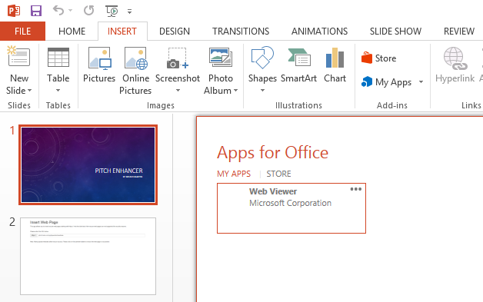
PITCH ENHANCER
By Bruno Martin
请使用PowerPoint 2013或更新的版本，同时安装插入式Web Viewer。
收到提示时请按“开始编辑”键。
Please use PowerPoint 2013 or later, with its Add-in Web Viewer installed.
And click on "Enable Editing" if you see the notification.
Notes:
lincko_pitch
lincko_info

Slide 2
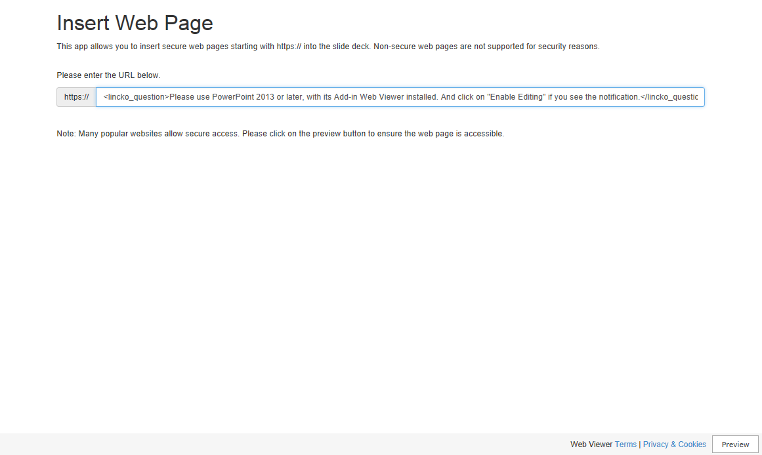
Notes:
https://lincko_url
lincko_question
lincko_info

Slide 3
Notes:
https://lincko_url
lincko_question
lincko_info

Slide 4
Notes:
https://lincko_url
lincko_question
lincko_info

Slide 5
Notes:
https://lincko_url
lincko_question
lincko_info

Slide 6
Notes:
https://lincko_url
lincko_question
lincko_info

Slide 7
Notes:
https://lincko_url
lincko_question
lincko_info

Slide 8
Notes:
https://lincko_url
lincko_question
lincko_info

Slide 9
Notes:
https://lincko_url
lincko_question
lincko_info

Slide 10
Notes:
https://lincko_url
lincko_question
lincko_info

Slide 11
Notes:
https://lincko_url
lincko_question
lincko_info

Slide 12
Notes:
https://lincko_url
lincko_question
lincko_info

Slide 13
Notes:
https://lincko_url
lincko_question
lincko_info

Slide 14
Notes:
https://lincko_url
lincko_question
lincko_info

Slide 15
Notes:
https://lincko_url
lincko_question
lincko_info

Slide 16
Notes:
https://lincko_url
lincko_question
lincko_info

Slide 17
Notes:
https://lincko_url
lincko_question
lincko_info

Slide 18
Notes:
https://lincko_url
lincko_question
lincko_info

Slide 19
Notes:
https://lincko_url
lincko_question
lincko_info

Slide 20
Notes:
https://lincko_url
lincko_question
lincko_info

Slide 21
Notes:
https://lincko_url
lincko_question
lincko_info

Slide 22
Notes:
https://lincko_url
lincko_question
lincko_info

Slide 23
Notes:
https://lincko_url
lincko_question
lincko_info

Slide 24
Notes:
https://lincko_url
lincko_question
lincko_info

Slide 25
Notes:
https://lincko_url
lincko_question
lincko_info

Slide 26
Notes:
https://lincko_url
lincko_question
lincko_info

Slide 27
Notes:
https://lincko_url
lincko_question
lincko_info

Slide 28
Notes:
https://lincko_url
lincko_question
lincko_info

Slide 29
Notes:
https://lincko_url
lincko_question
lincko_info

Slide 30
Notes:
https://lincko_url
lincko_question
lincko_info

Slide 31
Notes:
https://lincko_url
lincko_question
lincko_info

Slide 32
Notes:
https://lincko_url
lincko_question
lincko_info

Slide 33
Notes:
https://lincko_url
lincko_question
lincko_info

Slide 34
Notes:
https://lincko_url
lincko_question
lincko_info

Slide 35
Notes:
https://lincko_url
lincko_question
lincko_info

Slide 36
Notes:
https://lincko_url
lincko_question
lincko_info

Slide 37
Notes:
https://lincko_url
lincko_question
lincko_info

Slide 38
Notes:
https://lincko_url
lincko_question
lincko_info

Slide 39
Notes:
https://lincko_url
lincko_question
lincko_info

Slide 40
Notes:
https://lincko_url
lincko_question
lincko_info

Slide 41
Notes:
https://lincko_url
lincko_question
lincko_info

Slide 42
Notes:
https://lincko_url
lincko_question
lincko_info

Slide 43
Notes:
https://lincko_url
lincko_question
lincko_info

Slide 44
Notes:
https://lincko_url
lincko_question
lincko_info

Slide 45
Notes:
https://lincko_url
lincko_question
lincko_info

Slide 46
Notes:
https://lincko_url
lincko_question
lincko_info

Slide 47
Notes:
https://lincko_url
lincko_question
lincko_info

Slide 48
Notes:
https://lincko_url
lincko_question
lincko_info

Slide 49
Notes:
https://lincko_url
lincko_question
lincko_info

Slide 50
Notes:
https://lincko_url
lincko_question
lincko_info

Slide 51
Notes:
https://lincko_url
lincko_question
lincko_info

Slide 52
Notes:
https://lincko_url
lincko_question
lincko_info

Slide 53
Notes:
https://lincko_url
lincko_question
lincko_info

Slide 54
Notes:
https://lincko_url
lincko_question
lincko_info

Slide 55
Notes:
https://lincko_url
lincko_question
lincko_info

Slide 56
Notes:
https://lincko_url
lincko_question
lincko_info

Slide 57
Notes:
https://lincko_url
lincko_question
lincko_info

Slide 58
Notes:
https://lincko_url
lincko_question
lincko_info

Slide 59
Notes:
https://lincko_url
lincko_question
lincko_info

Slide 60
Notes:
https://lincko_url
lincko_question
lincko_info

Slide 61
Notes:
https://lincko_url
lincko_question
lincko_info

Slide 62
Thank You 谢谢

