Slide 1
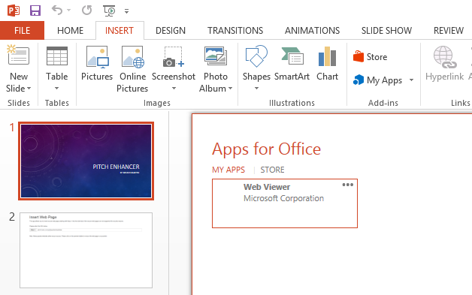
PITCH ENHANCER
By Bruno Martin
请使用PowerPoint 2013或更新的版本，同时安装插入式Web Viewer。
收到提示时请按“开始编辑”键。
Please use PowerPoint 2013 or later, with its Add-in Web Viewer installed.
And click on "Enable Editing" if you see the notification.

Slide 2
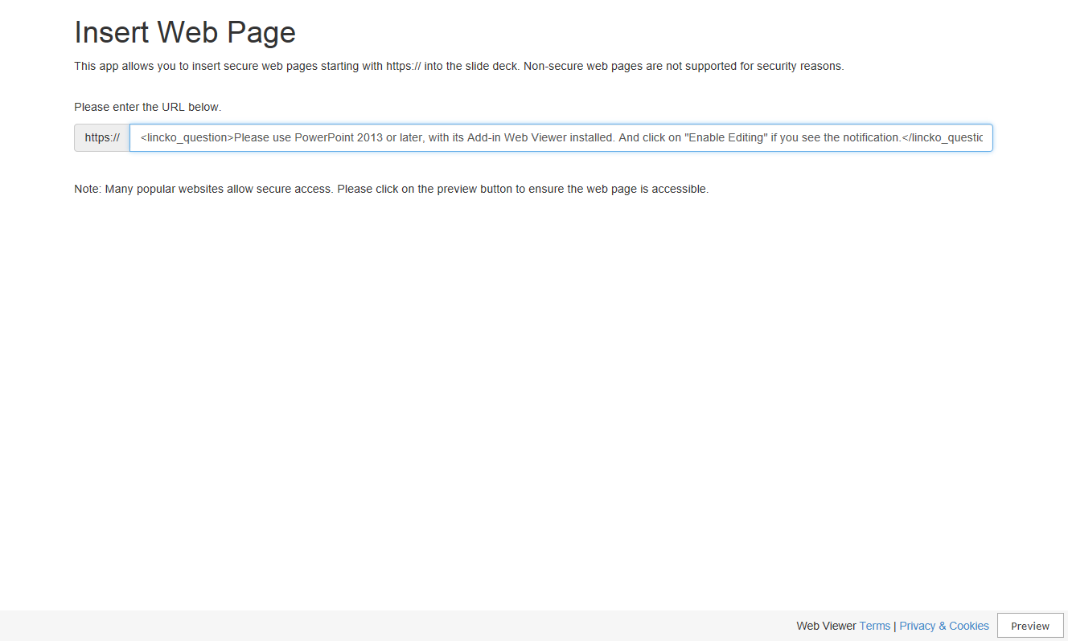

Slide 3


Slide 4
Thank You 谢谢

