Slide 1
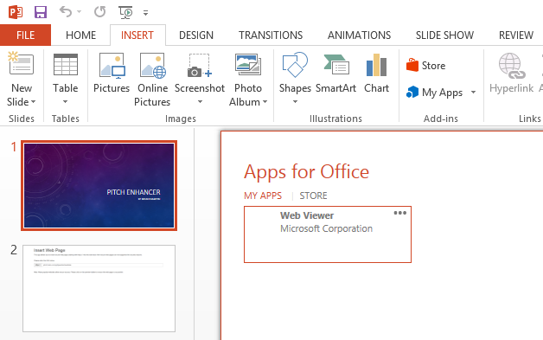

PITCH ENHANCER
By Bruno MARTIN
lincko_pitch_title
lincko_by
请使用PowerPoint 2013或更高级的版本，同时安装插入式Web Viewer。
收到提示后请按“开始编辑”。
Please use PowerPoint 2013 or later, with its Add-in Web Viewer installed.
And click on "Enable Editing" if you see the notification.
pitch.lincko.com
Notes:
https://lincko_url
lincko_pitch
lincko_info

Slide 2
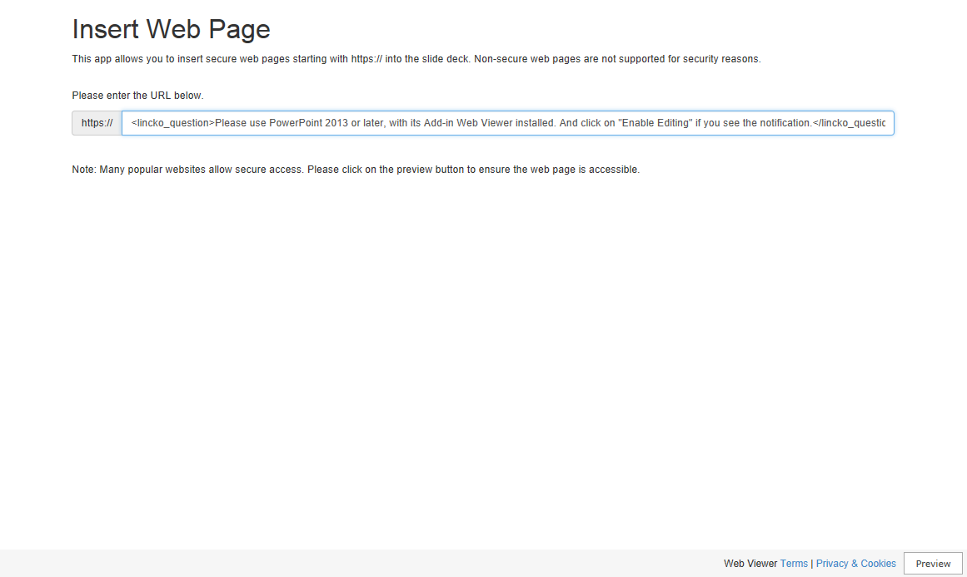
Notes:
https://lincko_url
lincko_question
lincko_info

Slide 3
Notes:
https://lincko_url
lincko_question
lincko_info

Slide 4
Notes:
https://lincko_url
lincko_question
lincko_info

Slide 5
Notes:
https://lincko_url
lincko_question
lincko_info

Slide 6
Notes:
https://lincko_url
lincko_question
lincko_info

Slide 7
Notes:
https://lincko_url
lincko_question
lincko_info

Slide 8
Notes:
https://lincko_url
lincko_question
lincko_info

Slide 9
Notes:
https://lincko_url
lincko_question
lincko_info

Slide 10
Notes:
https://lincko_url
lincko_question
lincko_info

Slide 11
Notes:
https://lincko_url
lincko_question
lincko_info

Slide 12
Notes:
https://lincko_url
lincko_question
lincko_info

Slide 13
Notes:
https://lincko_url
lincko_question
lincko_info

Slide 14
Notes:
https://lincko_url
lincko_question
lincko_info

Slide 15
Notes:
https://lincko_url
lincko_question
lincko_info

Slide 16
Notes:
https://lincko_url
lincko_question
lincko_info

Slide 17
Notes:
https://lincko_url
lincko_question
lincko_info

Slide 18
Notes:
https://lincko_url
lincko_question
lincko_info

Slide 19
Notes:
https://lincko_url
lincko_question
lincko_info

Slide 20
Notes:
https://lincko_url
lincko_question
lincko_info

Slide 21
Notes:
https://lincko_url
lincko_question
lincko_info

Slide 22
Notes:
https://lincko_url
lincko_question
lincko_info

Slide 23
Notes:
https://lincko_url
lincko_question
lincko_info

Slide 24
Notes:
https://lincko_url
lincko_question
lincko_info

Slide 25
Notes:
https://lincko_url
lincko_question
lincko_info

Slide 26
Notes:
https://lincko_url
lincko_question
lincko_info

Slide 27
Notes:
https://lincko_url
lincko_question
lincko_info

Slide 28
Notes:
https://lincko_url
lincko_question
lincko_info

Slide 29
Notes:
https://lincko_url
lincko_question
lincko_info

Slide 30
Notes:
https://lincko_url
lincko_question
lincko_info

Slide 31
Notes:
https://lincko_url
lincko_question
lincko_info

Slide 32
Notes:
https://lincko_url
lincko_question
lincko_info

Slide 33
Notes:
https://lincko_url
lincko_question
lincko_info

Slide 34
Notes:
https://lincko_url
lincko_question
lincko_info

Slide 35
Notes:
https://lincko_url
lincko_question
lincko_info

Slide 36
Notes:
https://lincko_url
lincko_question
lincko_info

Slide 37
Notes:
https://lincko_url
lincko_question
lincko_info

Slide 38
Notes:
https://lincko_url
lincko_question
lincko_info

Slide 39
Notes:
https://lincko_url
lincko_question
lincko_info

Slide 40
Notes:
https://lincko_url
lincko_question
lincko_info

Slide 41
Notes:
https://lincko_url
lincko_question
lincko_info

Slide 42
Notes:
https://lincko_url
lincko_question
lincko_info

Slide 43
Notes:
https://lincko_url
lincko_question
lincko_info

Slide 44
Notes:
https://lincko_url
lincko_question
lincko_info

Slide 45
Notes:
https://lincko_url
lincko_question
lincko_info

Slide 46
Notes:
https://lincko_url
lincko_question
lincko_info

Slide 47
Notes:
https://lincko_url
lincko_question
lincko_info

Slide 48
Notes:
https://lincko_url
lincko_question
lincko_info

Slide 49
Notes:
https://lincko_url
lincko_question
lincko_info

Slide 50
Notes:
https://lincko_url
lincko_question
lincko_info

Slide 51
Notes:
https://lincko_url
lincko_question
lincko_info

Slide 52
Notes:
https://lincko_url
lincko_question
lincko_info

Slide 53
Notes:
https://lincko_url
lincko_question
lincko_info

Slide 54
Notes:
https://lincko_url
lincko_question
lincko_info

Slide 55
Notes:
https://lincko_url
lincko_question
lincko_info

Slide 56
Notes:
https://lincko_url
lincko_question
lincko_info

Slide 57
Notes:
https://lincko_url
lincko_question
lincko_info

Slide 58
Notes:
https://lincko_url
lincko_question
lincko_info

Slide 59
Notes:
https://lincko_url
lincko_question
lincko_info

Slide 60
Notes:
https://lincko_url
lincko_question
lincko_info

Slide 61
Notes:
https://lincko_url
lincko_question
lincko_info

Slide 62
Notes:
https://lincko_url
lincko_question
lincko_info

Slide 63
Notes:
https://lincko_url
lincko_question
lincko_info

Slide 64
Notes:
https://lincko_url
lincko_question
lincko_info

Slide 65
Notes:
https://lincko_url
lincko_question
lincko_info

Slide 66
Notes:
https://lincko_url
lincko_question
lincko_info

Slide 67
Notes:
https://lincko_url
lincko_question
lincko_info

Slide 68
Notes:
https://lincko_url
lincko_question
lincko_info

Slide 69
Notes:
https://lincko_url
lincko_question
lincko_info

Slide 70
Notes:
https://lincko_url
lincko_question
lincko_info

Slide 71
Notes:
https://lincko_url
lincko_question
lincko_info

Slide 72
Notes:
https://lincko_url
lincko_question
lincko_info

Slide 73
Notes:
https://lincko_url
lincko_question
lincko_info

Slide 74
Notes:
https://lincko_url
lincko_question
lincko_info

Slide 75
Notes:
https://lincko_url
lincko_question
lincko_info

Slide 76
Notes:
https://lincko_url
lincko_question
lincko_info

Slide 77
Notes:
https://lincko_url
lincko_question
lincko_info

Slide 78
Notes:
https://lincko_url
lincko_question
lincko_info

Slide 79
Notes:
https://lincko_url
lincko_question
lincko_info

Slide 80
Notes:
https://lincko_url
lincko_question
lincko_info

Slide 81
Notes:
https://lincko_url
lincko_question
lincko_info

Slide 82
Notes:
https://lincko_url
lincko_question
lincko_info

Slide 83
Notes:
https://lincko_url
lincko_question
lincko_info

Slide 84
Notes:
https://lincko_url
lincko_question
lincko_info

Slide 85
Notes:
https://lincko_url
lincko_question
lincko_info

Slide 86
Notes:
https://lincko_url
lincko_question
lincko_info

Slide 87
Notes:
https://lincko_url
lincko_question
lincko_info

Slide 88
Notes:
https://lincko_url
lincko_question
lincko_info

Slide 89
Notes:
https://lincko_url
lincko_question
lincko_info

Slide 90
Notes:
https://lincko_url
lincko_question
lincko_info

Slide 91
Notes:
https://lincko_url
lincko_question
lincko_info

Slide 92
Notes:
https://lincko_url
lincko_question
lincko_info

Slide 93
Notes:
https://lincko_url
lincko_question
lincko_info

Slide 94
Notes:
https://lincko_url
lincko_question
lincko_info

Slide 95
Notes:
https://lincko_url
lincko_question
lincko_info

Slide 96
Notes:
https://lincko_url
lincko_question
lincko_info

Slide 97
Notes:
https://lincko_url
lincko_question
lincko_info

Slide 98
Notes:
https://lincko_url
lincko_question
lincko_info

Slide 99
Notes:
https://lincko_url
lincko_question
lincko_info

Slide 100
Notes:
https://lincko_url
lincko_question
lincko_info

Slide 101
Notes:
https://lincko_url
lincko_question
lincko_info

Slide 102
Notes:
https://lincko_url
lincko_question
lincko_info

Slide 103
Thank You 谢谢
pitch.lincko.com

