Slide 1

Android Control PPT

Slide 2

Content
1. Design and methodology
2. Code
3. Difficulty & Demonstration
4. Q & A
5. Thank you

Slide 3

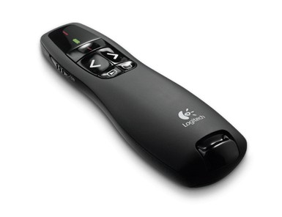

Design and methodology
At first, we saw Nokia phone demo a picture and PC demo the same picture.
Then we wanted to make a tools as Remote Desktop.
Later we found PPT controller.
How about Smart Phone control PPT?

Slide 4

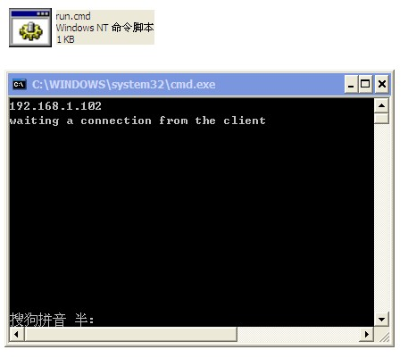
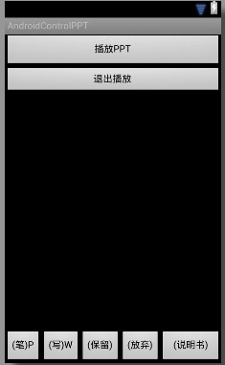
UI Design

Slide 5

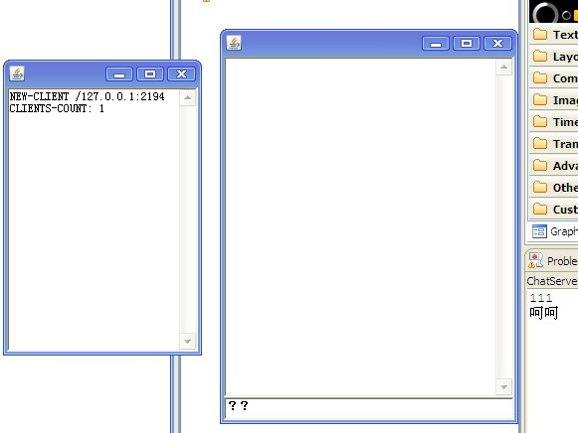
Server and client
JAVA Server and Client, then communicate between Android Device and PC Server.

Slide 6

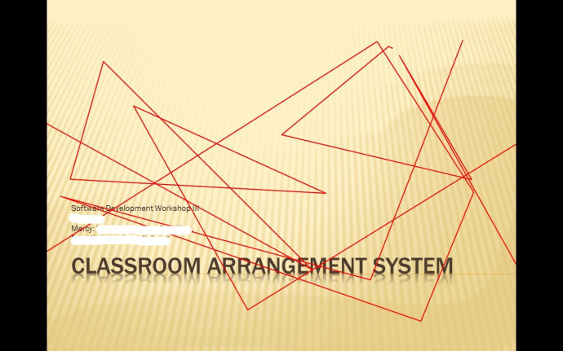
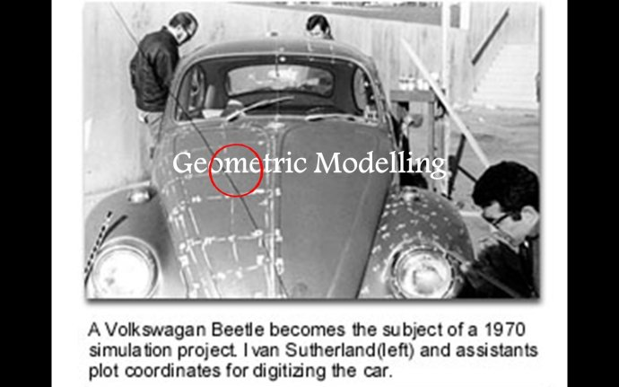
Java Robot Controller
This part we used Java Robot to draw in PPT

Slide 7


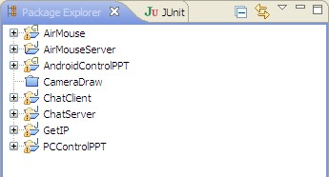
Code

Slide 8

Difficulty & Demonstration
Network Optimization
Controller

Slide 9

Q & a

Slide 10

THANK YOU

