Slide 1
Intro2Github
Jan. 1st, 2023
HNLee

Slide 2

Github is Free

Slide 3
We will use Github for our projects
Will use it to manage projects
Management
Issues
올리면 자동으로 지정자에게 e-mail이 보내진다.
담당자가 해결후 등록한다
지정 소통 시간(오전10:00 – 16:00)내에는 SNS로도 소통한다.
문서관리
회의관리 등
ToDo (개발자 주별, 일별, 등록)

Slide 4
What is Git? Github?
Git is a free and open source version control system.
Github – online website for cooperation and showing your work to others.

Slide 5
Git and Github for Beginners
https://www.youtube.com/watch?v=RGOj5yH7evk
Directory
Command line
Git – code version control system
Github– website
Clone → bring a repository into a folder in your local node.
Add → add your file to the git.

Slide 6
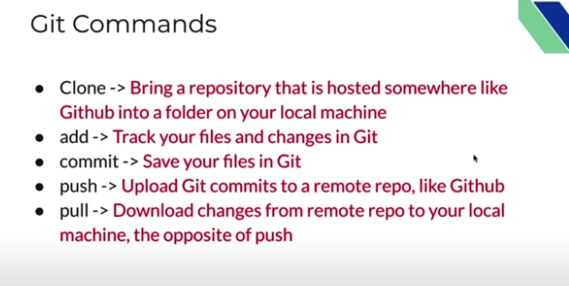
Git commands (비 개발자는 source tree gui 사용)

Slide 7
github
Use Prompt Commands
Use Gui– install Source tree

Slide 8
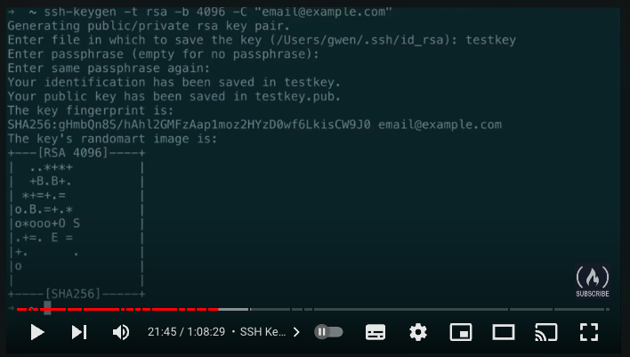
SSH Keys

Slide 9
⭐️ Contents ⭐️
⌨️ (0:00) Introduction
⌨️ (1:10) What is git?
⌨️ (1:30) What is version control?
⌨️ (2:10) Terms to be learn in video
⌨️ (5:20) Git commands
⌨️ (7:05) sign up in GitHub
⌨️ (11:32) using git in local machine
⌨️ (11:54) git install
⌨️ (12:48) getting code editor
⌨️ (13:30) inside VS Code
⌨️ (14:30) cloning through VS Code
⌨️ (17:30) git commit command ⌨️
⌨️(18:15) git add command
⌨️ (19:15) committing
⌨️ (20:20) git push command
⌨️ (20:30) SSH Keys
⌨️ (25:25) git push
⌨️ (30:21) Review workflow so far
⌨️ (31:40) Compare between GitHub workflow and local git workflow
⌨️ (32:42) git branching
⌨️ (56:30) Undoing in git
⌨️ (1:01:50) Forking in git
⌨️ (1:07:55) Ending

Slide 10
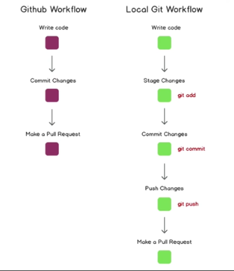
Workflow

Slide 11
Follow
Make a project at github
Open the VS code
Open
Go to Terminal (ls –la show all files)
Download the project
Locally create index.html (hello world)
“git status” shows all activities thus far.
“git add .” track all files or “git add index.html”
“git commit –m “Added index.html” –m “some description”
“git push”

Slide 12
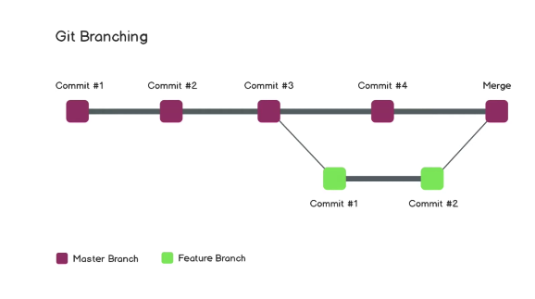
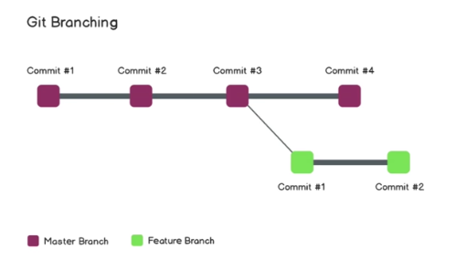
Git branching

Slide 13
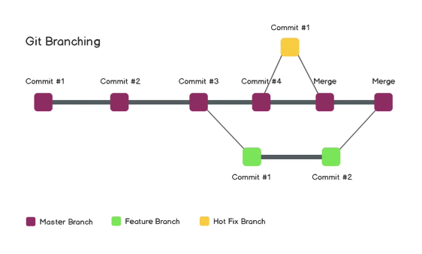
Hot fix

Slide 14
Let’s do it
Git branch
Letter q to get out
Git checkout –b feature-11 (ticket number or issue number)
Git checkout –b feature-readme-instructions
“Git diff feature-readme-instunctions” to see differences
“git merge feature-readme-…”
Git status
Git push

Slide 15
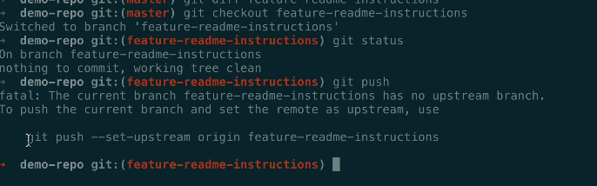
Push to a branch

Slide 16
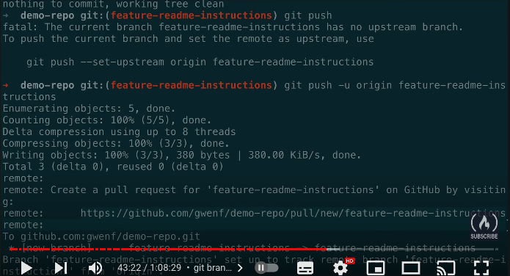
Push to your working branch

Slide 17
Make a pull request
It is making a request to have my code in a current branch pulled into another branch.
Make a “Pr” From feature branch to master branch
Once pr’ed, others can review it, comment on it, asking for a change, …;
I can update, commit, and pr again.

Slide 18
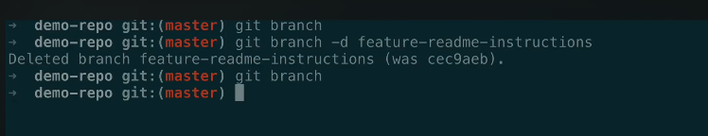
Merge
Once pr is merged, feature directory can be deleted.

Slide 19
Merge conflict
You are doing; others are also changing the same files.
Git dose not know which you want to keep..

Slide 20
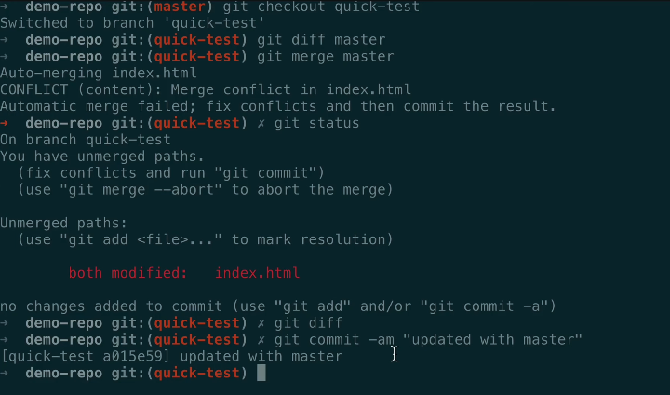
Git diff master, git merge master

Slide 21
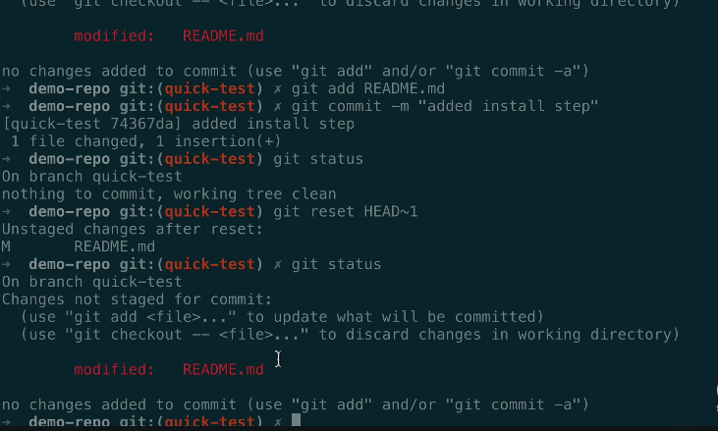
Undoing in Git
What if we made a mistake, we need to undo it.

Slide 22
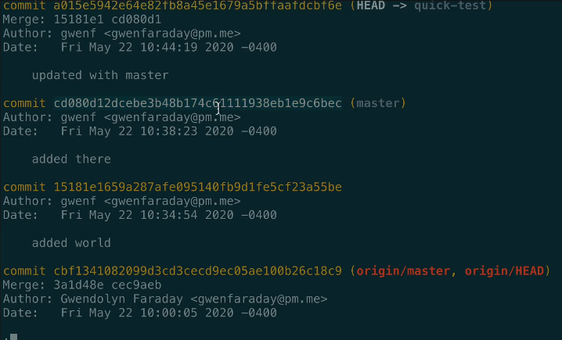
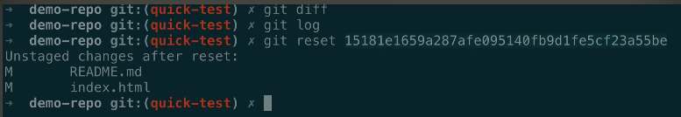
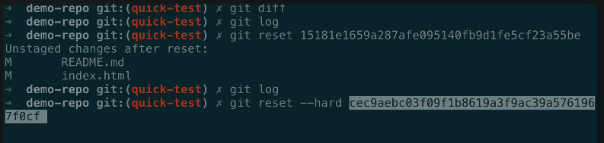
Git log → commit hash copied,

Slide 23
Forking
Making a complete repository copied.

Slide 24
Github desktop
You can download it for convenience.

Slide 25
Source Tree Installation

Slide 26
Source tree 설치하면
로컬 리스트
원격 리스트

Slide 27
Repository
하나의 서비스와 1대1 대응되는 저장소

Slide 28
Branch gitflow
Master – 완료 및 서비스 중인 branch
Develop –개발중, 최종 확인 후 master로 머지
Update
Release
Feature - 기능 개발 후 develop로 머지 삭제
Release
Hotfix

Slide 29
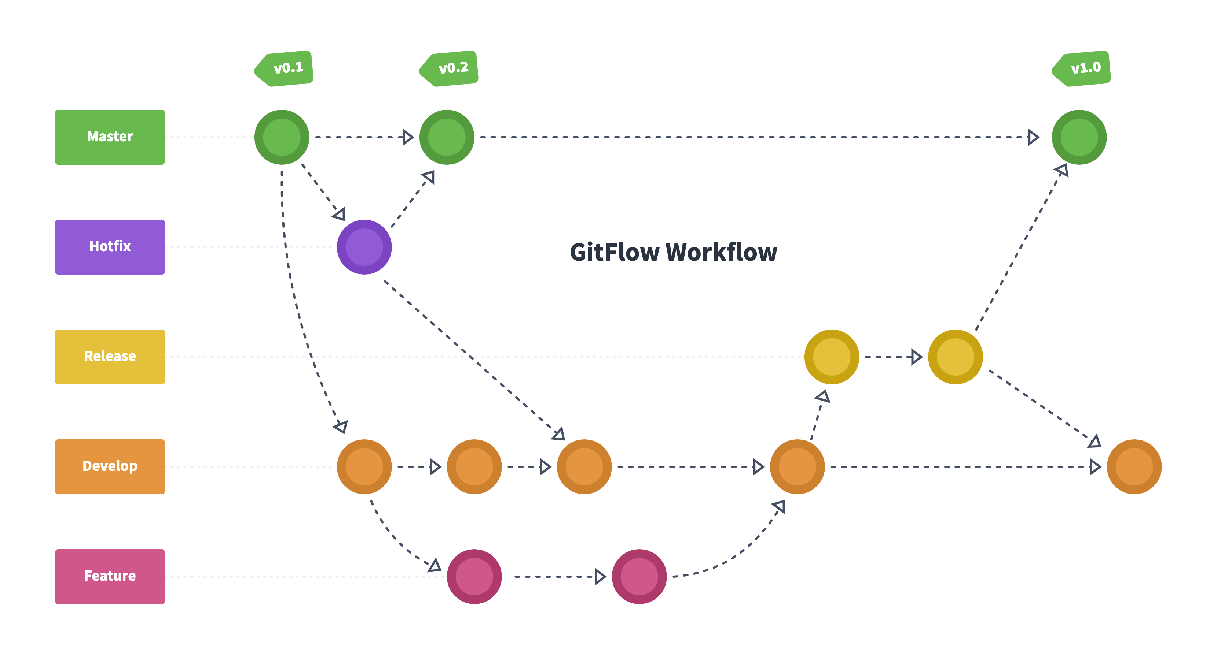
gitflow

Slide 30
There are other topics of importance
Git Actions
Git Projects

