Slide 1

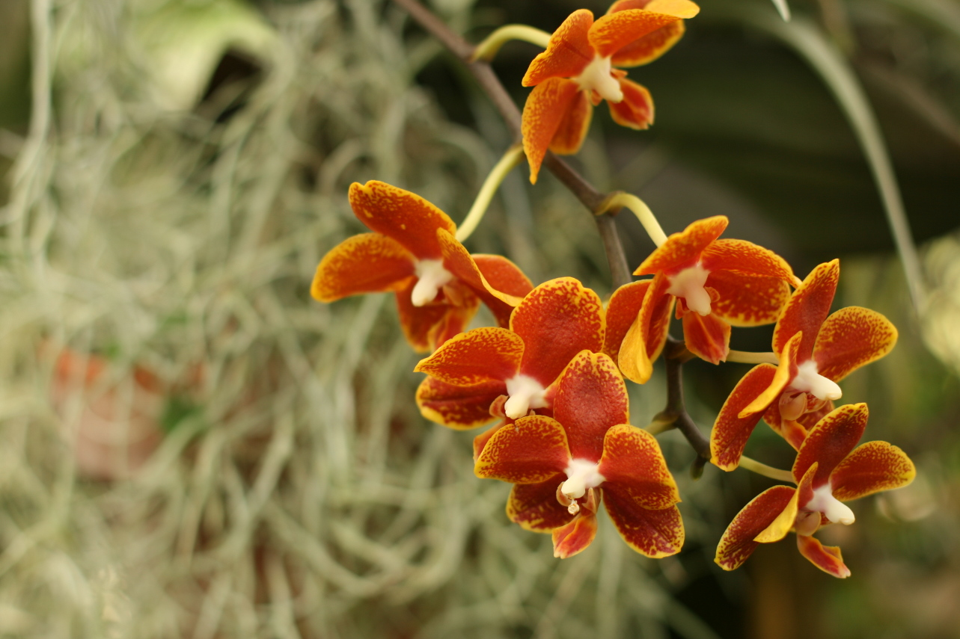
PrettyFaces
Client-facing JSF – Lincoln Baxter, III
Notes:
Thank everyone for attending
Tell them who you are
Tell them where you are from and some of your hobbies

Slide 2
SiteMap
PrettyFaces
  background
  basics
  navigation
  SEO
  examples

Slide 3
PrettyFaces is:
Url Rewriting
http://example.com/faces/store.jsf
http://example.com/store

Slide 4
PrettyFaces is:
Url Parameterization
http://example.com/store/item/Z34SD498

Slide 5
PrettyFaces is:
Declarative Data Loading
<action> #{storeBean.loadItem} </action>

Slide 6
PrettyFaces is:
Simplified Navigation
“viewStore” → http://example.com/store

Slide 7
SiteMap
PrettyFaces
  background
  basics
  navigation
  SEO
  examples

Slide 8





The PrettyFaces Story
Notes:
Went to Northfield Mount Hermon, and Penn State
I want to start my own company
Went through a few ideas with friends, landed on scrumshark
I'm talking about this because... scrumshark started prettyfaces

Slide 9
The Problem
JSF1.x
  Good separation between M & V of MVC
  Had usability issues, pitfalls
  Navigation was a pain...
  No bookmarks? Not entirely true.
  What about Pretty URLs / SEO?

Slide 10
The Result
Took a while
  Tried a few other tools
  Applied the 80/20 rule
  Destroyed Thanksgiving 2008

Slide 11
The Result
Came out with a Gem: PrettyFaces
  URLs were clean, search optimized
  Faces-config practically gone
  Data loading easy & declarative
Easy, Bookmarkable JSF

Slide 12
:)
Life is good

Slide 13
Why do we need Pretty URLs?
Build Trust
Enhance User Experience
Self-Promote

Slide 14
SiteMap
PrettyFaces
  background
  basics
  navigation
  SEO
  examples

Slide 15

Rethinking Navigation
The Basics
Keep it simple...
Notes:
Client Facing Applications
You've got a stunning user interface, but your URLs are ugly... put in the extra effort

Slide 16
SiteMap
PrettyFaces
  background
  basics
  navigation
  SEO
  examples
  clean
  parameterize
  validate
  load

Slide 17
Keep URLs Clean
Build trust by reducing clutter
Before:
http://example.com/news.xhtml?p=my-new-post
After:
http://example.com/news/my-new-post/
.xhtml?p=

Slide 18
Keep URLs Clean
Real Life:
Should have been:
Vulnerable!
http://www.llbean.com/webapp/wcs/stores/servlet/CategoryDisplay?categoryId=28&storeId=1&catalogId=1&langId=-1&nav=hp-gndp
http://www.llbean.com/webapp/wcs/stores/servlet/CategoryDisplay?categoryId=28&storeId=1&catalogId=1&langId=-1&nav=hp-gndp
http://llbean.com/kids

Slide 19
Keep URLs Clean
Why don't more people buy used cars?

Slide 20
Keep URLs Clean
They don't trust the last owner.
They're afraid of getting a bad deal.

Slide 21
Keep URLs Clean
Trust me?
Trust me.
http://www.youtube.com/watch?v=f2b1D5w82yU
http://www.linkedin.com/in/lincolnthree
http://ocpsoft.com/prettyfaces
http://sourceforge.net/projects/resteasy/

Slide 22
Keep URLs Clean
Clean, readable URLs:
  Build trust
  Are self-promoting, benefit SEO
  Reduce vulnerability
  Root the user

Slide 23
SiteMap
PrettyFaces
  background
  basics
  navigation
  SEO
  examples
  clean
  parameterize
  validate
  load

Slide 24
Parameterization (p14n)
/ root / the / user
  Be consistent... always
  Be general, progress to specific
  Keep the query string optional

Slide 25
Parameterization (p14n)
P14N is:
  a “Scope”
  where I am & what I'm looking at
  user accessible

Slide 26
Parameterization (p14n)
Examples:
No!
http://scrumshark.com/project/PrettyFaceshttp://scrumshark.com/project/PrettyFaces/s7http://scrumshark.com/project/PrettyFaces/iterationshttp://scrumshark.com/project/PrettyFaces/iterations/Sprint1
http://scrumshark.com/PrettyFaces/Sprint1/iterations/project

Slide 27
Problem solved
PrettyFaces
<pretty-config>
...
<url-mapping id=”viewProject”>
<pattern>/project/#{currentProjectBean.project}</pattern>
<view-id>/faces/project/view.xhtml</view-id>
</url-mapping>
…
</pretty-config>

Slide 28
SiteMap
PrettyFaces
  background
  basics
  navigation
  SEO
  examples
  clean
  parameterize
  validate
  load

Slide 29
Validation
P14n is a “Scope”
End-users have DIRECT ACCESS
Validate everything

Slide 30
Validation
pretty-config.xml
<url-mapping id=”viewProject”>
<pattern value=”/project/#{currentProjectBean.project}”>
<validate param="0" validatorIds=”projectName ...” />
</pattern>
<view-id>/faces/project/view.xhtml</view-id>
</url-mapping>
@FacesValidator(“projectName”)
public class ProjectNameValidator
{
public void validate(...)
}

Slide 31
Validation
PrettyFaces Validation
Is onError handler
defined?
Handler returned
Successfully?
Throw
Exception
Send
404
Inject values & continue
or redirect to “pretty:id”
Yes – pretty:id or empty

Slide 32
SiteMap
PrettyFaces
  background
  basics
  navigation
  SEO
  examples
  clean
  parameterize
  validate
  load

Slide 33
Data Loading
A few ways to do it:
  Always Load (On construction)
  Lazy Loading (On access)
  Declarative Loading (On event)

Slide 34
Data Loading
Declarative Loading
  JSF1.x traditionally sticky with this
  Enables deterministic behavior
  JSF2 helps a lot
    More on that later

Slide 35
Nothing fancy
PrettyFaces
<pretty-config>
...
<url-mapping id=”viewProject”>
<pattern>/project/#{currentProjectBean.project}</pattern>
<view-id>/faces/project/view.xhtml</view-id>
<action>#{currentProjectBean.load}</action>
</url-mapping>
…
</pretty-config>

Slide 36
Action Methods
PrettyFaces Action Invocation
<action>#{currentProjectBean.load}</action>
RESTORE_VIEW
APPLY_REQUEST_VALUES
PROCESS_VALIDATION
…
ANY_PHASE
CurrentProjectBean
+ load()
Continue Lifecycle
Trigger Navigation

Slide 37
Alternatives
More Configuration
2.0 view
params
Url Rewrite
Filter
2.0 event
listeners
1.x: requires
seam or other
Lines:
+3
+8
+1+n
+4
= ~17!
PrettyFaces
pretty-config.xml
= ~4 :)

Slide 38
The Basics
Keep URLs clean – Build trust, self promote
Logical Parameter Order – Root the User
Validate everything
Load data declaratively

Slide 39
SiteMap
PrettyFaces
  background
  basics
  navigation
  SEO
  examples
  clean
  parameterize
  validate
  load

Slide 40

Rethinking Navigation
Rethinking Navigation
so many channels, so little time...

Slide 41
SiteMap
PrettyFaces
  background
  basics
  navigation
  SEO
  examples
  history
  mappingId
  de-coupling
  GET

Slide 42
History: the old
<navigation-rule>
<from-view-id> * </from-view-id>
<navigation-case>
<from-action> * </from-action>
<from-outcome>viewProject</from-outcome>
<to-view-id>/faces/project/view.xhtml</to-view-id>
</navigation-case>
</navigation-rule>
<h:commandLink action=”viewProject” />

Slide 43
History: the new
<h:link action=”/faces/project/view.jsf”>
<f:param name=”project” value=”prettyfaces”/>
</h:link>
<f:metadata>
<f:viewParam name=”project” value=”...” />
</f:metadata>

Slide 44
History: Navigation Cases
Complex logic can be pulled into XML
Conditional evaluation and outcomes
Selectively pass page-params
  … sounds like code?

Slide 45





How often do we need them?
“The baby's coming!”
“What if we don't remember
This? Let's get a video
Camera!” NO!
pretty:hospital
“It might be a late night,
Should we get some coffee?”
No...
“Should I pick up my mother?”
DRIVE!!

Slide 46
SiteMap
PrettyFaces
  background
  basics
  navigation
  SEO
  examples
  history
  mappingId
  de-coupling
  GET

Slide 47
pretty:mappingId
<p:link mappingId=”hospital”>
<f:param value=”delivery”/>
</p:link>
private String actionMethod()
{
if(user.isMember)
{
return “pretty:viewProject”;
}
return “pretty:joinProject”;
}

Slide 48
That Same Configuration
PrettyFaces
The mapping ID
<pretty-config>
...
<url-mapping id=”viewProject”>
<pattern>/project/#{currentProjectBean.project}</pattern>
<view-id>/faces/project/view.xhtml</view-id>
<action>#{currentProjectBean.load}</action>
</url-mapping>
…
</pretty-config>

Slide 49
P14N is a “Scope”
private String createProject()
{
if(dao.createProject(project))
{
currentProjectBean.setProject(“scrumshark”);
return “pretty:viewProject”;
}
FacesUtils.addError(“Something went wrong! Try again.”);
return null;
}
project.getName()
“P14N is a Scope”

Slide 50
SiteMap
PrettyFaces
  background
  basics
  navigation
  SEO
  examples
  history
  mappingId
  de-coupling
  GET

Slide 51
But what about coupling?
PrettyFaces - Coupling pretty:ids to action methods
JSF2 - Coupling view locations to action methods
(what happens when you need to refactor?)
Take your pick...

Slide 52
But what about coupling?
JSF2
Action
Methods
/WebContent
/faces
/project
view.xhtml
<h:link>
<h:commandLink>
faces-config.xml

Slide 53
But what about coupling?
PrettyFaces
pretty:viewProject
Action
Methods
<p:link>
<h:commandLink>
/WebContent
/faces
/project
view.xhtml
faces-config.xml

Slide 54
But what about coupling?
PrettyFaces – pretty:ids abstract resource locations, lowers maintenance cost.
“You GET what you ask for”

Slide 55
SiteMap
PrettyFaces
  background
  basics
  navigation
  SEO
  examples
  history
  mappingId
  de-coupling
  GET

Slide 56
“You GET what you ask for”
GET /newproject
GET /project/scrumshark
Create Project Action
#{bean.create}
<action>
Load Project Data
?
Invoke Navigation
“pretty:viewProject”
Render Response

Slide 57
“You GET what you ask for”
GET /project/scrumshark
<action>
Load Project Data
?
Option to handle behavior up front, instead of “behind” a submit.

Slide 58
Can I still use JSF navigation?
Yes – PrettyFaces extends, does not interfere with, JSF navigation.

Slide 59
In summary
PrettyFaces offers:
  Declarative navigation via GET
  Encapsulation, de-coupling from view-location
  Extension to existing JSF navigation

Slide 60
SiteMap
PrettyFaces
  background
  basics
  navigation
  SEO
  examples
  history
  mappingId
  de-coupling
  GET

Slide 61



Search Engine Optimization

Slide 62
SiteMap
PrettyFaces
  background
  basics
  navigation
  SEO
  examples
  keywords
  basics
  change

Slide 63

Keywords
PUT KEYWORDS IN THE URL
Self-promoting Links
#1

Slide 64
Keywords examples
Poor:
http://example.com/shop.jsf?catId=23&itemId=Z34FK94SE
Partly there:
http://example.com/shop.jsf?cat=books&item=how-to-start-a-web-store
Perfect:
http://example.com/shop/books?item=how-to-start-a-web-store
Self-promoting Links

Slide 65
Keywords examples
<url-mapping id="viewItem">
<pattern>/store/#{catBean.item}</pattern>
<query-param name=”item”>{itemBean.itemName}</query-param>
<view-id>/faces/store.jsf</view-id>
<action> #{itemBean.load} </action>
</url-mapping>

Slide 66
Why do we need Pretty URLs?
Build Trust, Transparency
Enhance User Experience
Self-Promote, SEO

Slide 67
SiteMap
PrettyFaces
  background
  basics
  navigation
  SEO
  examples
  keywords
  basics
  change

Slide 68
SEO is all you need
False

Slide 69

Install Google Analytics
http://ocpsoft.com
July 2008: 0
Nov 2009: 13,287 views
68% from search

Slide 70
Three Fundamentals
Actually provide information
Get people to say they believe you
Get search engines to believe you both

Slide 71
That means...
Content:
Choose your keywords, make sure they are appropriate for your content.

Slide 72
That means...
Credibility:
Get other people to link back to your site, or create those links yourself.

Slide 73
That means...
Context:
Make sure your external links appear on pages relevant to your content.

Slide 74
SiteMap
PrettyFaces
  background
  basics
  navigation
  SEO
  examples
  keywords
  basics
  change

Slide 75
Plan for Change
.jsf
.jsp
.php
.do
.cgi
.asp

Slide 76
Clean up your URLs
Technology changes...
be agnostic.
/

Slide 77
SiteMap
PrettyFaces
  background
  basics
  navigation
  SEO
  examples
  keywords
  basics
  change

Slide 78
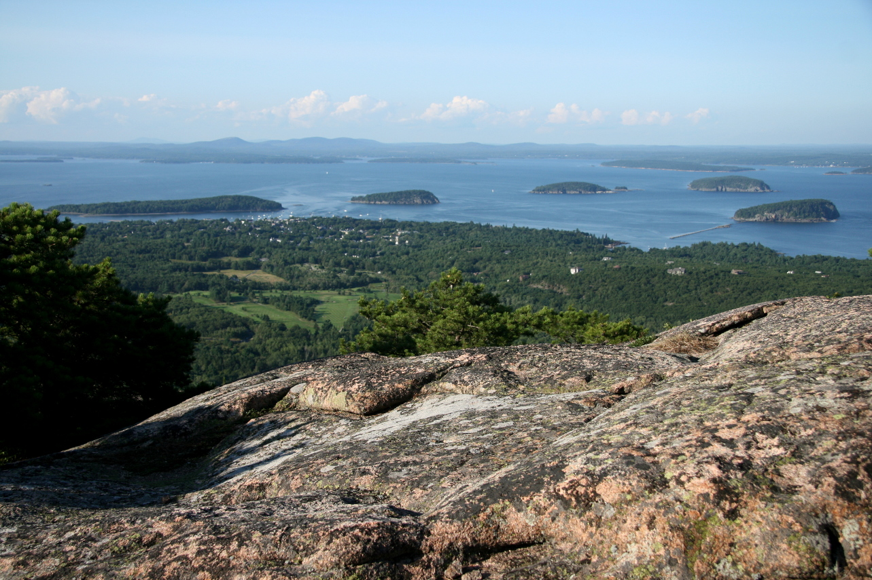
Examples
what a “view”

Slide 79
Setup
Add Pretty Filter in web.xml
<filter>
<filter-name>Pretty Filter</filter-name>
<filter-class>com.ocpsoft.pretty.PrettyFilter</filter-class>
</filter>
<filter-mapping>
<filter-name>Pretty Filter</filter-name>
<url-pattern>/*</url-pattern>
<dispatcher>REQUEST</dispatcher>
<dispatcher>FORWARD</dispatcher>
</filter-mapping>

Slide 80
Map your first pages
Create /WEB-INF/pretty-config.xml
<pretty-config
xmlns="http://ocpsoft.com/prettyfaces-xsd"
xmlns:xsi="http://www.w3.org/2001/XMLSchema-instance"
xsi:schemaLocation="http://ocpsoft.com/prettyfaces-xsd
http://ocpsoft.com/xml/ns/prettyfaces/pretty-1.0.xsd">
<url-mapping id="home">
<pattern> /home </pattern>
<view-id> /faces/home.jsf </view-id>
</url-mapping>
<url-mapping id="viewComment">
<pattern value=”/story/#{myBean.currentStoryId}/#{myBean.commentId}” />
<view-id>/faces/story/comment.jsf</view-id>
</url-mapping>
</pretty-config>

Slide 81
Add some actions
Take action ;)
<pretty-config
xmlns="http://ocpsoft.com/prettyfaces-xsd"
xmlns:xsi="http://www.w3.org/2001/XMLSchema-instance"
xsi:schemaLocation="http://ocpsoft.com/prettyfaces-xsd
http://ocpsoft.com/xml/ns/prettyfaces/pretty-1.0.xsd">
<url-mapping id="home">
<pattern> /home </pattern>
<view-id> /faces/home.jsf </view-id>
<action> #{homeBean.loadUserLayout} </action>
</url-mapping>
<url-mapping id="viewComment">
<pattern value=”/story/#{myBean.currentStoryId}/#{myBean.commentId}” />
<view-id>/faces/story/comment.jsf</view-id>
<action> #{myBean.load} </action>
</url-mapping>
</pretty-config>

Slide 82
Validate
(2.0.x series only)
<pretty-config
xmlns="http://ocpsoft.com/prettyfaces-xsd"
xmlns:xsi="http://www.w3.org/2001/XMLSchema-instance"
xsi:schemaLocation="http://ocpsoft.com/prettyfaces-xsd
http://ocpsoft.com/xml/ns/prettyfaces/pretty-1.0.xsd">
<url-mapping id="home">
<pattern> /home </pattern>
<view-id> /faces/home.jsf </view-id>
<action> #{homeBean.loadUserLayout} </action>
</url-mapping>
<url-mapping id="viewComment">
<pattern value=”/story/#{myBean.currentStoryId}/#{myBean.commentId}”>
<validate param=”0” validatorIds=”integerValidator” />
<validate param=”1” validatorIds=”integerValidator” />
</pattern>
<view-id>/faces/story/comment.jsf</view-id>
<action>#{myBean.load}</action>
</url-mapping>
</pretty-config>

Slide 83
Navigate
viewComment.xhtml
<%@ taglib prefix="pretty" uri="http://ocpsoft.com/prettyfaces" %>
<pretty:link mappingId="comment">
<f:param value="23" />
<f:param value="5" />
Go to Comment. (This is Link Text)
</pretty:link>
<pretty:link mappingId="comment">
<f:param value="#{myBean.storyId}" />
<f:param value="#{myBean.nextCommentId}" />
View next comment. (This is Link Text)
</pretty:link>

Slide 84
The SiteMap
If this presentation were a website...
<pretty-config
xmlns="http://ocpsoft.com/prettyfaces-xsd"
xmlns:xsi="http://www.w3.org/2001/XMLSchema-instance"
xsi:schemaLocation="http://ocpsoft.com/prettyfaces-xsd
http://ocpsoft.com/xml/ns/prettyfaces/pretty-1.0.xsd">
<url-mapping id="home">
<pattern> /prettyfaces </pattern>
<view-id> /faces/home.jsf </view-id>
</url-mapping>
<url-mapping id="levelOne">
<pattern> /prettyfaces/#{presBean.levelOne} </pattern>
<view-id> /faces/present.jsf </view-id>
</url-mapping>
<url-mapping id="levelTwo">
<pattern> /prettyfaces/#{presBean.levelOne}/#{presBean.levelTwo} </pattern>
<view-id> /faces/present.jsf </view-id>
</url-mapping>
</pretty-config>

Slide 85
SiteMap
PrettyFaces
  background
  basics
  navigation
  SEO
  examples

Slide 86
Questions?
I've been talking for an hour; please, somebody, say something.

