Slide 2
FORGE NEW GROUND IN RAPID ENTERPRISE JAVA DEVELOPMENT
Lincoln Baxter, III
Senior Software Engineer - Red Hat, Inc.
Weds, May 4 - 2011

Slide 3

“Tweet, tweet!”
#seamforge #summitjbw

Slide 4
Lincoln Baxter, III ( @lincolnthree )
Senior Software Engineer - JBoss, by Red Hat
Founder and Project Lead of Seam Forge
Founder of OCPSoft.com (PrettyFaces URL-rewriting, PrettyTime)
Open-source advocate (addict.)
JSF2.2 Expert Group Member (JSR-344)
And more, but who cares.

Slide 5
And then there was Forge

Slide 6
On the agenda:
The problem...
Demo
Forge ahead!
PLUGINS!
Demo
The power of openness
Wrap-up and Q/A

Slide 7
The problem...

Slide 8
Java/EE development today
There's $#@! that wastes your time...
Many *gotchas* and inconsistencies
Integration becomes increasingly complex as you work-around these issues
Fragmented communities of frameworks

Slide 9
Addressing *Gotchas*
$#@!
Requires:
Good education, examples, or abstraction
Deprecating old APIs and configurations
A centralized community for knowledge sharing

Slide 10
Addressing Integration
“You're suffocating me!”
“I just want to talk...”

Slide 11
“I pity 'da foo!”
CDI
Loose coupling and strong typing; a dream come true.

Slide 12
//fires
Event<Type>
“I love you!”
@Observes
Type event
“You're right, we just needed some space!”

Slide 13
“It works well because, among reasons, it is declarative, logical, and separates concerns.”
- Me.

Slide 14
Fragmentation
Java EE
Security
Servlets
RichFaces
Spring
Java Transactions API (JTA)
NetBeans
Java Persistence API (JPA)
Eclipse
jquery
OAUTH
CDI
JDBC
AJAX
Ant
JAX-RS (REST)
Payment Gateways
Enterprise Java Beans 3.1 (EJB)
SOAP
yui
Tapestry
Maven
PrettyFaces
Java Server Faces (JSF)
Html 5
JSP
Seam 3
Java Messaging Service (JMS)
Wicket
OpenID
Bean Validation
websockets
Infinispan
Gradle

Slide 15



Your brain in tech heaven →

Slide 16
WTF!!
Your brain on drugs →
deadline

Slide 17
Addressing Fragmentation
Requires:
A centralized platform/experience
A centralized on-line presence (the app market)
Empowered contribution and involvement

Slide 18
So what if we could have:

Slide 19
1. Someone to take care of us, fix the *gotchas* and handle most configuration

Slide 20


Slide 21
2. An abstract, yet consistent process for integrating frameworks

Slide 22
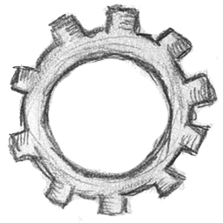
$ setup persistence
$ setup faces
$ setup messaging
$ setup security

Slide 23

3. A common place to love and collaborate

Slide 24
RichFaces
NetBeans
jquery
Security
yui
Eclipse
Spring
Maven
Java EE
OAUTH
Community
Tapestry
Ant
Gradle
Payment Gateways
PrettyFaces
Seam 3
HTML5
Wicket
OpenID
websockets
AJAX
Infinispan

Slide 25
+
+

Slide 26

RichFaces
NetBeans
jquery
Security
yui
Eclipse
Spring
Maven
Java EE
OAUTH
Tapestry
Ant
Gradle
Payment Gateways
PrettyFaces
Seam 3
HTML5
Wicket
OpenID
websockets
AJAX
Infinispan

Slide 27
demo.

Slide 28
Forge ahead!

Slide 29
Forge ahead!
What just happened?
We created a webapp, yay.
Forge does not leave $#@! in your project
We used PLUGINS!

Slide 30
PLUGINS!!
Project
JavaFacet
WebFacet
ServletFacet
Plugin 1
Plugin 2
Plugin N
...
(yes, we actually did think about this)

Slide 31
demo.

Slide 32
The power of openness

Slide 33
The power of openness
Forge is easy to extend
Anyone can write and distribute plug-ins
Anyone can contribute to modular development

Slide 34
+1 Plugins are cool!!
And can be loaded from:
Maven
Git Repo
Local project sources
Local JAR file
Remote URL JAR file
The Forge Search Index

Slide 35
The power of openness
By hosting plugins on Git:
You establish trust via transparency
You encourage collaboration!
You can still be registered in the Forge Search Index!

Slide 36
Wrap-up and Q/A

Slide 37
Why another tool?
Design for the situation: joining fragmented communities
Open-source, standards oriented
+5 Plugins still cool!!

Slide 38
Why a shell?
GUIs are often cumbersome for simple tasks
Empowers scripting and automation: repeatability
Testability (forge-test-harness)

Slide 39
Is this just a Maven wrapper?
No...
Maven is used for what it's good at, an excellent dependency management tool
Forge's architecture is actually build-system agnostic

Slide 40
Why not use Maven archetypes?
Difficult to make “choices”
Archetype run = archetype done. Forge continues to enhance existing projects
Much like UNIX-style applications, plug-ins decouple concerns

Slide 41
In Summary
Forge helps us to:
  Reduce barrier to entry & repetitive tasks
  Smooth out configuration woes
  Integrate with existing tools / technologies

Slide 42
?

Slide 43
Wrap-up and Q/A
Join us:
  http://bit.ly/seamforge
Fork us on GitHub:
  http://github.com/seam/forge
“Tweet, tweet!”
#seamforge #summitjbw

Slide 44
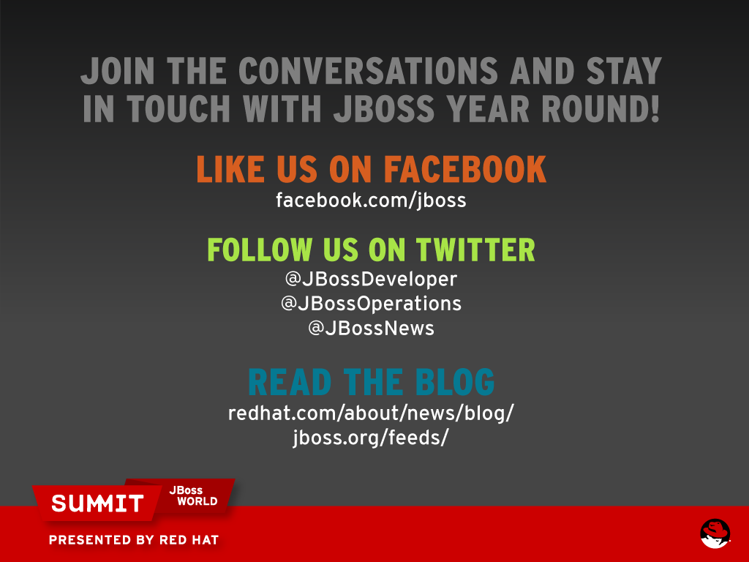

Slide 45


