Slide 1
CS35L – Fall 2018
Slide set: | 1.1
Slide topics: | Linux basics
Assignment: | 1
Notes:
Survey
Cs vs non cs
Programming experience?
Linux, windows, mac
Cs 31, 32?

Slide 2
What’s this class about?
“Fundamentals of commonly used software tools and environments, particularly open-source tools to be used in upper division computer science courses.”

Slide 3
What is open source software?
Source code is publicly available
Anyone is allowed to modify the source code
Examples
Firefox
Android
Apache

Slide 4
GNU/Linux
Open-source operating system
Kernel: core of operating system
Allocates time and memory to programs
Handles file system and communication between software and hardware
Shell: interface between user and kernel
Interprets commands user types in
Takes necessary action to cause commands to be carried out
Programs

Slide 5
Which Linux for this course?
Ubuntu Linux Distribution
Most popular
Frequently updated, fixed release cycle (6 months)
Seasnet servers(recommended):
lnxsrv.seas.ucla.edu (lnxsrv06, lnxsrv07, or lnxsrv09)
Username: SEAS ID
Password: SEAS password
On Windows: putty
On Mac: terminal

Slide 6
Command Line Interface vs. Graphical User Interface
CLI
GUI
Steep learning curve
Pure control (e.g., scripting)
Cumbersome multitasking
Convenient remote access
Intuitive
Limited control
Easy multitasking
Bulky remote access

Slide 7
Files and Processes
Everything is either a process or a file:
Process: an executing program identified by PID
File: collection of data
A document
Text of program written in high-level language
Executable
Directory
Devices

Slide 8
Linux File System Layout
Tree structured hierarchy
/
root
bin
dev
home
usr
tmp
lakers
celtics
bulls
lib
README
music
doc
game1
game2
Notes:
Each file is under a directory.
A directory is also a file.
Only one root “/”.
Regular files can only be leaves.
e.g., documents, music, etc.

Slide 9
Absolute Path vs. Relative Path
root
/
bin
dev
home
usr
tmp
lakers
celtics
bulls
lib
README
music
doc
game1
game2
Current directory: home

Slide 10
The Basics: Moving Around
pwd: print working directory
cd: change directory
~ home directory
. current directory
/ root directory, or directory separator
.. parent directory

Slide 11
The Basics: Shell
<up arrow>: previous command
<tab>: auto-complete
!!: replace with previous command
![str]: refer to previous command with str
Notes:
PAUSE and ask next slide commands

Slide 12
The Basics: Dealing with Files
mv: move/rename a file
cp: copy a file
rm: remove a file
r: remove directories and their contents recursively
mkdir: make a directory
rmdir: remove an empty directory
ls: list contents of a directory
d: list only directories
a: list all files including hidden ones
l: show long listing including permission info
s: show size of each file, in blocks

Slide 13
Linux File Permissions

Slide 14
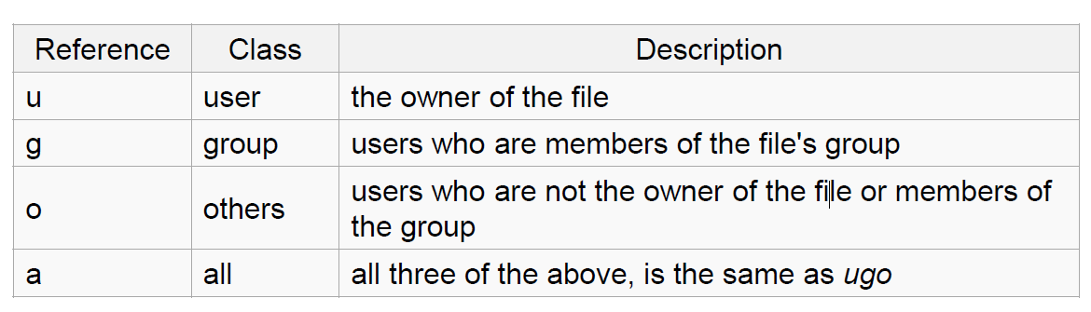
Linux File Permissions
chmod
read (r), write (w), executable (x)
User, group, others

Slide 15
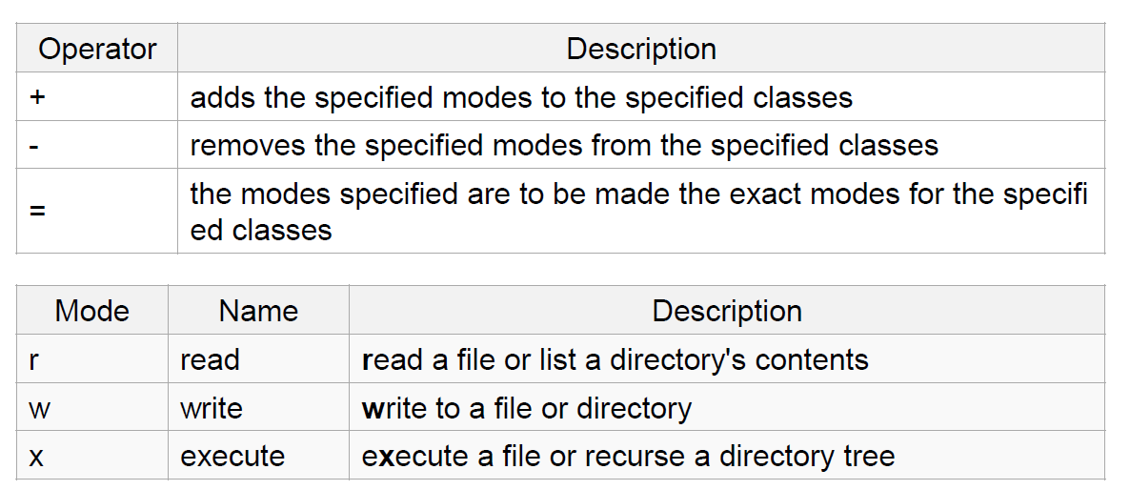
The Basics: chmod (symbolic)

Slide 16
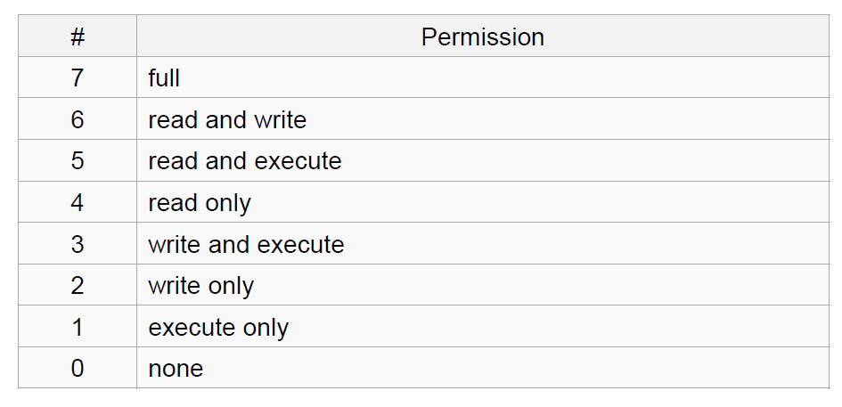
The Basics: chmod (numeric)
Usage
– chmod [''references''][''operator''][''modes''] ''file1'' ...
Example: chmod ug+rw mydir, chmod a-w myfile,
Example: chmod ug=rx mydir, chmod 664 myfile

Slide 17
The Basics: find
-type: type of a file (e.g: directory, symbolic link)
-perm: permission of a file
-name: name of a file
-user: owner of a file
-maxdepth: how many levels to search

Slide 18
File Name Matching
?: matches any single character in a filename
*: matches one or more characters in a filename
[]: matches any one of the characters between the brackets. Use ‘-’ to separate a range of consecutive characters.

Slide 19
find Examples
Examples
find . -name my*
find . -name my* -type f
find / -type f -name myfile –print

Slide 20
man
Extensive documentation that comes preinstalled with almost all substantial Unix and Unix-like operating systems
Usage
read a manual page for a Linux command
man <command_name>
man section command_name
1 User Commands 2 System Calls 3 C Library Functions 4 Devices and Special Files 5 File Formats and Conventions 6 Games et. al. 7 Miscellanea 8 System Administration tools and Daemons
Hit “q” to get out of man page

Slide 21
wh… Commands
whatis <command>: returns Name section of man page
whereis <command>: locates the binary, source, and manual page files for a command

Slide 22
More Basics: Look these up
cat
head
tail
du
ps
kill
diff
cmp
wc
sort

Slide 23
Connecting to SEAS from OS X or Linux
Terminal
$ ssh username@lnxsrv.seas.ucla.edu
Username = your SEAS user name

Slide 24
Connecting to SEAS from Windows
Putty
Recommended
Small and easy to use
Host name: lnxsrv.seas.ucla.edu
User name: your SEAS user name

Slide 25
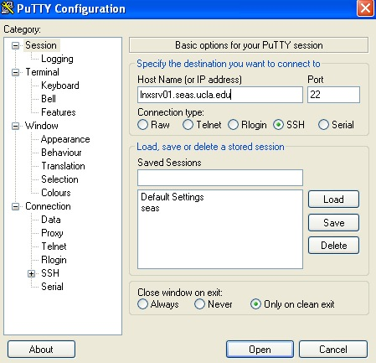
Putty

Slide 26
Assignment 1 – Example ans1.txt
ans1.txt is specifically for LABORATORY section
1. Here is the answer to question 1
2. Here is the answer to question 2
3. Here is the answer to question 3
…..

Slide 27
Assignment 1 – Example key1.txt
key1.txt is specifically for HOMEWORK section
C-s H E L L O W O R L D
C-s H T M L
C-d
C-n
M-x goto-line Enter 1 2 3 Enter

