Slide 1
CS 35L: Software Construction Lab
Shrey Agarwal
Lecture 1.2
Update: OH – Tuesday 9:30am to 11:30am

Slide 2
Honestly…
I am teaching this course for the first time…
What does it mean?
It means that I am learning everything with you guys!
How does this benefit you?
You get to challenge me at every step. DO NOT BLINDLY TRUST ME ON ANYTHING. :P
Open your laptops/terminals and test it out. Correct me if you think I made a mistake.

Slide 3
The Basics: find
-type: type of a file (e.g,, directory, symbolic link)
-perm: permission of a file
-name: name of a file
-ls: list current file

Slide 4
find contd…
?: matches any single character in a filename
*: matches one zero or more characters in a filename
[]: matches any one of the characters between the brackets. Use ‘-’ to separate a range of consecutive characters.
Examples:
find . -name my*
find . -name my* -type f
find / -type f -name myfile

Slide 5
The Basics: Redirection
> file: write stdout to a file
>> file: append stdout to a file
< file: use contents of a file as stdin

Slide 6
The Basics: Dealing with Files (Mini-task)
Create two files
$ touch foo.txt $ touch bar.txt
Add text into the files and print it
echo "Cat" > foo.txt
echo "Dog" > bar.txt
cat foo.txt bar.txt (concatenates the output)
Output:
Cat
Dog

Slide 7
diff command
A file comparison utility that outputs the differences between two files.
Usage:
diff file1 file2

Slide 8
Process: ps and kill
Process
An instance of a computer program in execution
ps
List processes that are currently running
kill
Terminate a certain process
Usage
kill PID

Slide 9
Daemon
A process that runs in the background
Example: cron
Enables users to schedule jobs to run periodically at certain times (cron jobs)
Usage: Full Backup every month

Slide 10
wget command
A computer program that retrieves content from web servers
Usage
wget <URL>

Slide 11
The Basics: Look These Up
head
tail
du
top
ps
kill
diff
cmp
echo
find
wc
sort
ping 8.8.8.8
diff
wget <url>

Slide 12
Text editors
Emacs and vim

Slide 13
vi editor
Open a file - vi <filename> or vim <filename>
Close a file - :q
Save a file - :w
Save and close a file - :wq

Slide 14
Emacs editor (We will be using Emacs for this course)
Almost like a Windows text editor, but much more powerful
Run emacs on the linux server
C-h r (manual) and C-h t (tutorial)
All emacs commands start with ‘C’ or ‘M’
‘C’ = ctrl; ‘M’ = alt (windows)/ option (Mac)
Start emacs
emacs <filename>
Exit emacs
C-x C-c

Slide 15
Basic emacs editing
Insert text by simply typing it
Undo by typing C-x u
Save changes by typing C-x C-s
Copy, cut, paste
C-space (starts selecting region)
M-w (copy a region)
C-w (cuts a region)
C-k (kill a line)
C-y (yank/paste)

Slide 16
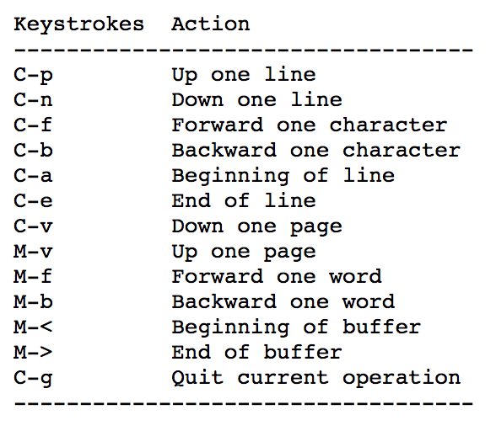
Moving around

Slide 17
More emacs commands
Search – C-s
Replace – M-%
Accessing menu – F10
Switch buffer – C-x b
Switch current window – C-x o
Kill the current window – C-x 0 (zero)
Help – C-h

Slide 18
Directory edit (dired) (C-x d)
Creates an Emacs buffer containing list of directory contents
Allows you to operate on files
Allows you to navigate filesystem
+ - new directory, C-x C-f new file in directory, g - refresh dired buffer
! - run shell command
https://www.gnu.org/software/emacs/refcards/pdf/dired-ref.pdf

Slide 19
EMACS tutorial links
http://bit.ly/2CQy3H8 (some basic commands)
http://stanford.io/2CTWNyl

Slide 20
Todo
Read the tutorial and manual
Navigate and get used to emacs in the next 15 min
We’ll have a small task after this

Slide 21
Task 1
Create a cpp file (print “hello”) using emacs
Run the file
Edit the file (print “hello again”) using emacs and save it as a new file
Run the new file

Slide 22
Cpp program
#include<iostream>
using namespace std;
int main(){
cout<< “Hello”;
return 0;
}
Compiling instr:
g++ -o filename filename.cpp
./filename

Slide 23
Task 2
Create 2 txt files (insert some lines) using emacs
Find the difference between both of them using a linux command

Slide 24
Lab 1: Hints
Hints for lab questions:
man man
which
find
readlink
man chmod
man find
find
whereis, man find
find, sort
localedef

Slide 25
Assignment submission specifics

Slide 26
Submission details
Go through Homework 1 again on CCLE, there may be minor changes in the wording of the assignment (Due: Oct 6th)
Submit on CCLE under your Lab <number> (if specified)
No submissions will be accepted via email
Test your files on seasnet before submitting
key1.txt should record keystrokes of Homework
ans1.txt should have keystrokes and answers of the lab assignment
[I hope the lateness penalty policy is clear]
Assignment 7 requirements
You will have to buy a BeagleBone Green which will be required for Assignment 7.

Slide 27
Assignment 1: Example key1.txt
key1.txt is for HOMEWORK section
Exercise 1.1
C-s H E L L O W O R L D
…
…
Exercise 1.2
C-s H T M L
…
so on…

Slide 28
Assignment 1: Example ans1.txt
ans1.txt is specifically for LABORATORY section
1. Here is the answer to question 1
2. Here is the answer to question 2
3. Here is the answer to question 3
…..
Rest of the guidelines are on the link

Slide 29
Plagiarism Policy
Any instance of cheating is intolerable – serious consequences
You are requested to do the assignments on your own and not refer to any public forums or github
Do not put your assignments on a public platform

Slide 30
Tasks
Create a file using emacs. Try the Cut/Copy/Paste commands.
Write a command to find the hidden files in your home directory.
Remove a non-empty directory.
Assign the value 10 to a variable x, 15 to a variable y; Compute and display their addition in the shell. Do not use any editor!
Create a directory ‘test’ and ‘subtest’ inside test (in the home directory) without using mkdir twice. (mkdir –p test/subtest)
Create empty files ans.txt, ans.html, assign.txt, assign.html
Find all directories and subdirectories in your home directory
find . –type d
Find all files in the test directory starting with ‘a’ (find ./test –type f –name ‘a*’)
Find all text files inside test directory
find ./test –type f –name ‘*.txt’
Find all html files inside test directory
Find ./test –type f –name ‘*.html’
Delete test directory from the home directory (rm –rf <dirname>)
Notes:
echo $(($a + $b))

