Slide 1
CS35L – Fall 2018
Slide set: | 2.1
Slide topics: | Shell scripting, regex, streams
Assignment: | 2

Slide 2
Environment Variables
Variables that can be accessed from any child process
Common ones:
HOME: path to user’s home directory
PATH: list of directories to search in for command to execute
Change value:
export VARIABLE=…

Slide 3
Locale
A locale
Set of parameters that define a user’s cultural preferences
Language
Country
Other area-specific things
locale command
prints information about the current locale environment to standard output
Notes:
3

Slide 4
LC_* Environment Variables
locale gets its data from the LC_* environment variables
Examples:
LC_TIME
Date and time formats
LC_NUMERIC
Non-monetary numeric formats
LC_COLLATE
Order for comparing and sorting

Slide 5
The 'C' Locale
The default locale
An environment of “least surprise”
Behaves like Unix systems before locales

Slide 6
Locale Settings Can Affect Program Behavior!!
Default sort order for the sort command depends:
LC_COLLATE=‘C’: sorting is in ASCII order
LC_COLLATE=‘en_US’: sorting is case insensitive except when the two strings are otherwise equal and one has an uppercase letter earlier than the other.
Other locales have other sort orders!
Notes:
Talk about ascii:
En_US sort: 1 2 3 a A b B c C
Ascii sort:1 2 3 A B C a b c
0 – 48
A- 65
A – 97

Slide 7
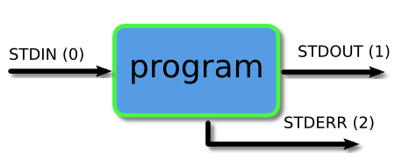
Piping and Redirection
Every program we run on the command line automatically has three data streams connected to it.
STDIN (0) - Standard input (data fed into the program)
STDOUT (1) - Standard output (data printed by the program, defaults to the terminal)
STDERR (2) - Standard error (for error messages, also defaults to the terminal)
Piping and redirection is the means by which we may connect these streams between programs and files to direct data in useful ways.

Slide 8
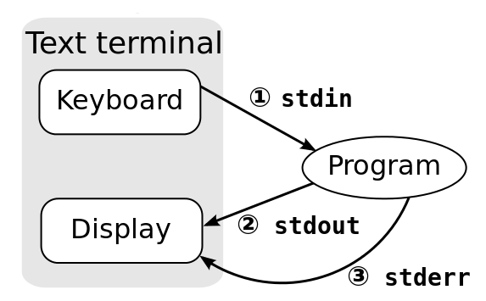
Standard Streams
Every program has these 3 streams to interact with the world
stdin (0): contains data going into a program
stdout (1): where a program writes its output data
stderr (2): where a program writes its error msgs

Slide 9
Redirection and Pipelines
program < file redirects file to programs’s stdin:
cat <file
program > file redirects program's stdout to file2:
cat <file >file2
program 2> file redirects program's stderr to file2:
cat <file 2>file2
program >> file appends program’s stdout to file
program1 | program2 assigns stdout of program1 as the stdin of program2; text 'flows' through the pipeline
cat <file | sort >file2
Notes:
9

Slide 10
Pipe
It lets you feed the output from the program on the left as input to the program on the right.
Example –
ls | head -3
barry.txt
bob
example.png
ls | head -3 | tail -1
example.png

Slide 11
sort, comm, and tr
sort: sorts lines of text files
Usage: sort [OPTION]…[FILE]…
Sort order depends on locale
C locale: ASCII sorting
comm: compare two sorted files line by line
Usage: comm [OPTION]…FILE1 FILE2
Comparison depends on locale
tr: translate or delete characters
Usage: tr [OPTION]…SET1 [SET2]
Ex: echo "12345" | tr "12" "ab"
Notes:
Comm – unique to 1, uniq to 2, common to both
cat file1.txt | tr “[a-z]” “[A-Z]”
tr “[:lower:]” “[:upper:]”
tr “[a-z]” “[A-Z]” < file1.txt
tr “[a-z]” “[A-Z]” < file1.txt > file5.txt

Slide 12
Shell Scripting

Slide 13
The Shell and OS
The shell is a user interface to the OS
Accepts commands as text, interprets them, uses OS API to carry out what the user wants – open files, start programs...
Common shells
bash, sh, csh, ksh
Notes:
13
Korn shell
Bourne and bourne again shell
C shell
Tcsh
etc

Slide 14
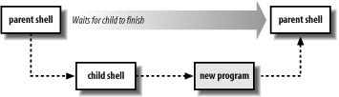
Scripts: First Line
A shell script file is just a file with shell commands
When shell script is executed a new child “shell” process is spawned to run it
The first line is used to state which child “shell” to use
#! /bin/sh
#! /bin/bash

Slide 15
Example
A lab directory for each lab
Before each lab:
Remove old directory called “lab”
Create new directory called “lab”
Create 3 files in “lab”
lab.log
lab.txt
hw.txt
rm –rf lab
mkdir lab
touch lab/lab.log
touch lab/lab.txt
touch lab/hw.txt

Slide 16
Execute shell scripts
$ touch script.sh
$ ./script.sh
-bash: ./script.sh: Permission denied
$ ls –al
-rw-r--r-- 1 user1 csgrad 0 Apr 6 11:19 script.sh
$ chmod +x script.sh
$ ./script.sh

Slide 17
Simple Execution Tracing
Shell prints out each command as it is executed
Execution tracing within a script:
set –x: to turn it on
set +x: to turn it off

Slide 18
Output Using echo or printf
echo writes arguments to stdout, can’t output escape characters (without –e)
$ echo “Hello\nworld”
Hello\nworld
$ echo –e “Hello\nworld”
Hello
world
printf can output data with complex formatting, just like C printf()
$ printf "%.3e\n" 46553132.14562253
4.655e+07

