Slide 1
CS35L – Fall 2018
Slide set: | 2.2
Slide topics: | Shell scripting, regex, streams
Assignment: | 2

Slide 2
Variables
Declared using =
var=“hello” #NO SPACES!!!
Referenced using $
echo $var
#!/bin/sh message="HELLO WORLD!!!" echo $message
Notes:
2

Slide 3
POSIX Built-in Shell Variables
Variable | Meaning
# | Number of arguments given to current process.
@ | Command-line arguments to current process. Inside double quotes, expands to individual arguments.
* | Command-line arguments to current process. Inside double quotes, expands to a single argument.
- (hyphen) | Options given to shell on invocation.
? | Exit status of previous command.
$ | Process ID of shell process.
0 (zero) | The name of the shell program.
! | Process ID of last background command. Use this to save process ID numbers for later use with the wait command.
ENV | Used only by interactive shells upon invocation; the value of $ENV is parameter-expanded. The result should be a full pathname for a file to be read and executed at startup. This is an XSI requirement.
HOME | Home (login) directory.
IFS | Internal field separator; i.e., the list of characters that act as word separators. Normally set to space, tab, and newline.
LANG | Default name of current locale; overridden by the other LC_* variables.
LC_ALL | Name of current locale; overrides LANG and the other LC_* variables.
LC_COLLATE | Name of current locale for character collation (sorting) purposes.
LC_CTYPE | Name of current locale for character class determination during pattern matching.
LC_MESSAGES | Name of current language for output messages.
LINENO | Line number in script or function of the line that just ran.
NLSPATH | The location of message catalogs for messages in the language given by $LC_MESSAGES (XSI).
PATH | Search path for commands.
PPID | Process ID of parent process.
PS1 | Primary command prompt string. Default is "$ ".
PS2 | Prompt string for line continuations. Default is "> ".
PS4 | Prompt string for execution tracing with set -x. Default is "+ ".
PWD | Current working directory.
Notes:
3

Slide 4
Exit: Return value
Check exit status of last command that ran with $?
Value | Typical/Conventional Meaning
0 | Command exited successfully.
> 0 | Failure to execute command.
1-125 | Command exited unsuccessfully. The meanings of particular exit values are defined by each individual command.
126 | Command found, but file was not executable.
127 | Command not found.
> 128 | Command died due to receiving a signal

Slide 5
Accessing Arguments
Positional parameters represent a shell script’s command-line arguments
For historical reasons, enclose the number in braces if it’s greater than 9
#! /bin/sh
#test script
echo first arg is $1
#echo tenth arg is ${10}
./test hello
first arg is hello

Slide 6
Quotes-Exercise
# a=pwd
# echo ‘$a’
# echo “$a”
# echo `$a`

Slide 7
Quotes
Three kinds of quotes
Single quotes ' '
Do not expand at all, literal meaning
Try temp=‘$hello$hello’ ; echo $temp
Double quotes " "
Almost like single quotes but expand backticks and $
Backticks ` ` or $()
Expand as shell commands
Try temp=`ls` ; echo $temp

Slide 8
if Statements
If statements use the test command or [ ]
“man test” to see the expressions that can be done
Condition for less than or equal??
#!/bin/bash if [ 5 –gt 1 ]
then echo “5 greater than 1" else echo “error" fi
Notes:
Answer: -le

Slide 9
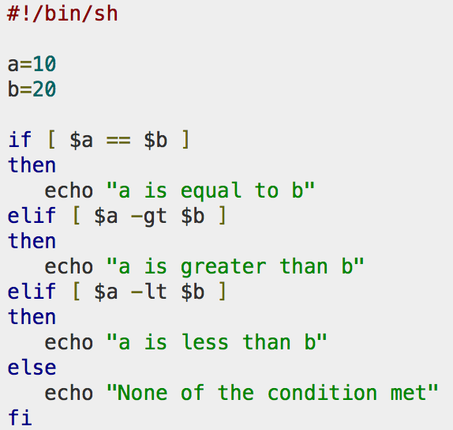
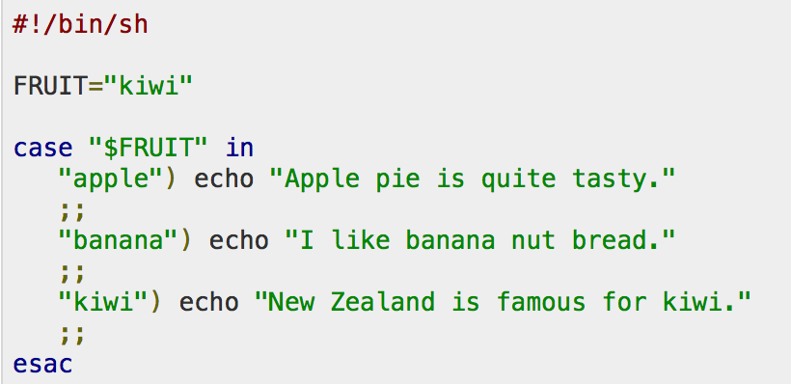
Conditional
if…then…fi
if…then…else…fi
if…then…elif..then…fi
case…esac
Unconditional
break
continue

Slide 10
Loops
While loop
The “let” command is used to do arithmetic
For loop
f will refer to each word in ls output
#!/bin/sh COUNT=6 while [ $COUNT -gt 0 ]
do echo “Value of count is: $COUNT” let COUNT=COUNT-1 done
#!/bin/sh
temp=`ls` for f in $temp
do echo $f done

Slide 11
Regular Expressions

Slide 12
Regular Expressions
Table 3-1. POSIX BRE and ERE metacharacters
Notation that lets you search for text with a particular pattern:
For example: starts with the letter a, ends with three uppercase letters, etc.
http://regexpal.com/ to test your regex expressions

Slide 13
Regular expressions
Character | BRE / ERE | Meaning in a pattern
\ | Both | Usually, turn off the special meaning of the following character. Occasionally, enable a special meaning for the following character, such as for \(...\) and \{...\}.
. | Both | Match any single character except NULL. Individual programs may also disallow matching newline.
* | Both | Match any number (or none) of the single character that immediately precedes it. For EREs, the preceding character can instead be a regular expression. For example, since . (dot) means any character, .* means "match any number of any character." For BREs, * is not special if it's the first character of a regular expression.
^ | Both | Match the following regular expression at the beginning of the line or string. BRE: special only at the beginning of a regular expression. ERE: special everywhere.

Slide 14
Regular Expressions (cont’d)
$ | Both | Match the preceding regular expression at the end of the line or string. BRE: special only at the end of a regular expression. ERE: special everywhere.
[...] | Both | Termed a bracket expression, this matches any one of the enclosed characters. A hyphen (-) indicates a range of consecutive characters. (Caution: ranges are locale-sensitive, and thus not portable.) A circumflex (^) as the first character in the brackets reverses the sense: it matches any one character not in the list. A hyphen or close bracket (]) as the first character is treated as a member of the list. All other metacharacters are treated as members of the list (i.e., literally). Bracket expressions may contain collating symbols, equivalence classes, and character classes (described shortly).
\{n,m\} | BRE | Termed an interval expression, this matches a range of occurrences of the single character that immediately precedes it. \{n\} matches exactly n occurrences, \{n,\} matches at least n occurrences, and \{n,m\} matches any number of occurrences between n and m. n and m must be between 0 and RE_DUP_MAX (minimum value: 255), inclusive.
\( \) | BRE | Save the pattern enclosed between \( and \) in a special holding space. Up to nine subpatterns can be saved on a single pattern. The text matched by the subpatterns can be reused later in the same pattern, by the escape sequences \1 to \9. For example, \(ab\).*\1 matches two occurrences of ab, with any number of characters in between.

Slide 15
Examples
Expression | Matches
tolstoy | The seven letters tolstoy, anywhere on a line
^tolstoy | The seven letters tolstoy, at the beginning of a line
tolstoy$ | The seven letters tolstoy, at the end of a line
^tolstoy$ | A line containing exactly the seven letters tolstoy, and nothing else
[Tt]olstoy | Either the seven letters Tolstoy, or the seven letters tolstoy, anywhere on a line
tol.toy | The three letters tol, any character, and the three letters toy, anywhere on a line
tol.*toy | The three letters tol, any sequence of zero or more characters, and the three letters toy, anywhere on a line (e.g., toltoy, tolstoy, tolWHOtoy, and so on)

Slide 16
Regular Expressions (cont’d)
\n | BRE | Replay the nth subpattern enclosed in \( and \) into the pattern at this point. n is a number from 1 to 9, with 1 starting on the left.
{n,m} | ERE | Just like the BRE \{n,m\} earlier, but without the backslashes in front of the braces.
+ | ERE | Match one or more instances of the preceding regular expression.
? | ERE | Match zero or one instances of the preceding regular expression.
| | ERE | Match the regular expression specified before or after.
( ) | ERE | Apply a match to the enclosed group of regular expressions.

Slide 17
Matching Multiple Characters with One Expression
* | Match zero or more of the preceding character
\{n\} | Exactly n occurrences of the preceding regular expression
\{n,\} | At least n occurrences of the preceding regular expression
\{n,m\} | Between n and m occurrences of the preceding regular expression

Slide 18
POSIX Bracket Expressions
Class | Matching characters | Class | Matching characters
[:alnum:] | Alphanumeric characters | [:lower:] | Lowercase characters
[:alpha:] | Alphabetic characters | [:print:] | Printable characters
[:blank:] | Space and tab characters | [:punct:] | Punctuation characters
[:cntrl:] | Control characters | [:space:] | Whitespace characters
[:digit:] | Numeric characters | [:upper:] | Uppercase characters
[:graph:] | Nonspace characters | [:xdigit:] | Hexadecimal digits

Slide 19
Searching for Text
grep: Uses basic regular expressions (BRE)
“meta-characters ?, +, {, |, (, and ) lose their special meaning; instead use the backslashed versions” –`man grep`
egrep (or grep -E): Uses extended regular expressions (ERE) – no backslashes needed
fgrep (or grep -F): Matches fixed strings instead of regular expressions.
Notes:
19
Global re print

Slide 20
Simple grep
$ who Who is logged on
tolstoy tty1 Feb 26 10:53
tolstoy pts/0 Feb 29 10:59
tolstoy pts/1 Feb 29 10:59
tolstoy pts/2 Feb 29 11:00
tolstoy pts/3 Feb 29 11:00
tolstoy pts/4 Feb 29 11:00
austen pts/5 Feb 29 15:39 (mansfield-park.example.com)
austen pts/6 Feb 29 15:39 (mansfield-park.example.com)
$ who | grep -F austen Where is austen logged on?
austen pts/5 Feb 29 15:39 (mansfield-park.example.com)
austen pts/6 Feb 29 15:39 (mansfield-park.example.com)

Slide 21
sed (stream editor)
Now you can extract, but what if you want to replace parts of text?
Use sed!
sed 's/regExpr/replText/[g]'
Example
Display the first directory in PATH
echo $PATH | sed 's/:.*//'
Remove everything after and including the first colon
Notes:
echo $PATH | sed 's/:.*//'

Slide 22
Regular Expression Review

Slide 23
4 Basic Concepts
Quantification
How many times of previous expression?
Most common quantifiers: ?(0 or 1), *(0 or more), +(1 or more)
Grouping
Which subset of previous expression?
Grouping operator: ()
Alternation
Which choices?
Operators: [] and |
Hello|World [A B C]
Anchors
Where?
Characters: ^ (beginning) and $ (end)

Slide 24
RegEx Exercises
Which of the following strings would match the regular expression: aab?b
A. aabb
B. aa\nbbb
C. aab
Answer: aabb
aab

Slide 25
RegEx Exercises
Which regular expression would match the words “favorite” and “favourite”?
Answer: “favou?rite”

Slide 26
RegEx Exercises
Which regular expression would match the words “Ggle”, “Gogle” and “Google”?
Answer: “Go*gle”
Which one would match “Gogle”, “Google” and “Gooogle” but not “Ggle”?
Answer: “Go+gle”

Slide 27
RegEx Exercises
Which regular expression would match any version of the word “Google” that has an even number of o’s?
Answer: “G(oo)+gle”
Which regular expression would match any version of the word “Google” that has fewer than 7 O’s?
Answer: “Go{0,6}gle”

Slide 28
RegEx Exercises
Which line(s) would this regular expression match? “^T.+e$”
A. The
B. Te
C. Three
D. Then
Answer: The, Three (ERE)

Slide 29
RegEx Exercises
Which regular expression(s) would match the words “Ted”, “Ned” and “Sed”?
A. (T|N|S)ed
B. [T N S]ed
C. .ed
D. [L-U]?ed
E. *ed
Answer: A., B., C.,
D., E. (ERE)

Slide 30
RegEx Exercises
Which regular expression would match all subdirectories within a directory?
Answer: ls –l | grep “^d”

Slide 31
Lab 2

Slide 32
What is Lab 2 About?
Build a spelling checker for the Hawaiian language
(Get familiar with sort, comm and tr commands!)
Steps:
Download a copy of web page containing basic English-to-Hawaiian dictionary
Extract only the Hawaiian words from the web page to build a simple Hawaiian dictionary. Save it to a file called hwords (site scraping)
Automate site scraping: buildwords script (cat hwnwdseng.htm | buildwords > hwords)
Modify the command in the lab assignment to act as a spelling checker for Hawaiian
Use your spelling checker to check hwords and the lab web page for spelling mistakes

Slide 33
Useful Text Processing Tools
wc: outputs a one-line report of lines, words, and bytes
head: extract top of files
tail: extracts bottom of files
tr: translate or delete characters
grep: print lines matching a pattern
sort: sort lines of text files
sed: filtering and transforming text

Slide 34
Lab Hints
Run your script on seasnet servers before submitting to CCLE
sed '/patternstart/,/patternstop/d‘
delete patternstart to patternstop, works across multiple lines will delete all lines starting with patternstart to patternstop
The Hawaiian words html page uses \r and \n for new lines
od –c hwnwdseng.htm to see the ASCII characters
You can delete blank white spaces such as tab or space using
tr -d '[:blank:]’
Use tr -s to squeeze multiple new lines into one
sed 's/<[^>]*>//g' a.html to remove all HTML tags

Slide 35
Assignment 2 Details
Submit 3 files:
Script “buildwords”
Simple text file “lab2.log”
80 character limit per row
Script “sameln”
Check everything on SEASnet!
Assignments graded on SEASnet servers (lnxsrv07)

Slide 36
Buildwords
Hawaiian.html -> buildwords -> hwords
Buildwords
Read from STDIN and perform work on input
Output to STDOUT
Ex:
$ ./buildwords < hawaiian.html > hwords

Slide 37
Lab2.log
.log is the same as .txt – no difference
Ex:
1. I used wget to download the webpage
2. I ….
3. Answer to #3 here
Should read basically like a lab journal
Keep things concise!

Slide 38
Lab Hints
Run your script on seasnet servers before submitting to CCLE
sed '/patternstart/,/patternstop/d‘
delete patternstart to patternstop, works across multiple lines will delete all lines starting with patternstart to patternstop
The Hawaiian words html page uses \r and \n for new lines
od –c hwnwdseng.htm to see the ASCII characters
You can delete blank white spaces such as tab or space using
tr -d '[:blank:]’
Use tr -s to squeeze multiple new lines into one
sed 's/<[^>]*>//g' a.html to remove all HTML tags

Slide 39
Homework 2
Write a script sameln that does the following:
User provides a directory name as an argument
Finds all regular files in directory(do not recurse) and ignores all other types (directories, symlinks, etc.)
If 2 or more files have the same content (cmp)
Keep the file whose name is alphabetically first or starts with a dot
Replace duplicates with hard links (ln)
File names may contain special characters!
Hint: see the cmp, ln, and test utilities.

Slide 40
Checking Hard Links
Inode: data structure that stores information about files
File type
Permission
Owner
File Size, etc.
Each inode is identified by a unique inode number within the file system
Check a file’s inode number: ls –i filename
How do you check if two files are hard-linked?
Same inode number

Slide 41
Homework Hints
Array itself
${arrayName[@]}
Iterate over an array in bash
for i in ${arrayName[@]}
Length of array
${#arrayName[@]}
Length of element
${#arrayName[1]}

Slide 42
Hardware prerequisite (Assignment 7)
BeagleBone Green Wireless
http://web.cs.ucla.edu/classes/winter18/cs35L/syllabus.html

