Slide 1
CS35L – Fall 2018
Slide set: | 3.1
Slide topics: | Diff, modifying programs
Assignment: | 3

Slide 2
How to Install Software
Windows
Installshield
Microsoft/Windows Installer
OS X
Drag and drop from .dmg mount -> Applications folder
Linux
rpm(Redhat Package Management)
RedHat Linux (.rpm)
apt-get(Advanced Package Tool)
Debian Linux, Ubuntu Linux (.deb)
Good old build process
configure, make, make install

Slide 3
Decompressing Files
Generally, you receive Linux software in the tarball format (.tgz) or (.gz)
Decompress file in current directory:
$ tar –xzvf filename.tar.gz
Option –x: --extract
Option –z: --gzip
Option –v: --verbose
Option –f: --file

Slide 4
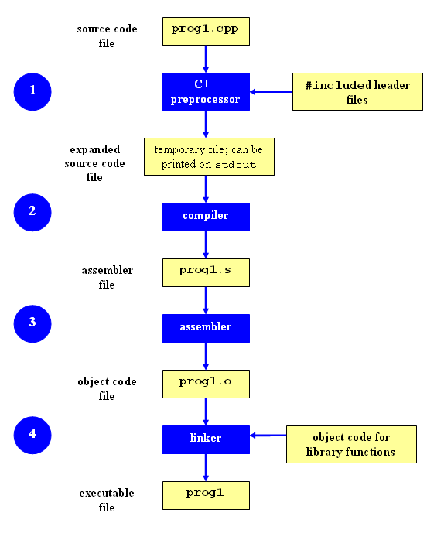
Compilation Process

Slide 5
GCC compilation …
Preprocessor:
Removes comments from code
Includes header files code in the file itself
Replaces macro name (small functions) with values #define x 6 => this value replaced into file
Compiler
Generate assembly code
Assembler
Converts assembly code to machine code (binary) - object code)
Linker:
Used when we have multiple modules
We need a single executable file, linker is used to combine all files
Links library functions

Slide 6
Command-Line Compilation
item.h
item.c
#includes item.h
shoppingList.h
#includes item.h
shoppingList.c
#includes shoppingList.h
shop.h
shop.c
#includes shoppingList.h and shop.h
How to compile?
gcc -Wall shoppingList.c item.c shop.c –o shop

Slide 7
Expanding the command
gcc - compiler program
-Wall - turn all warnings on
-o - to name the executable as the name given, instead of a.out

Slide 8
What if…
We change one of the header or source files?
Rerun command to generate new executable
We only made a small change to item.cpp?
not efficient to recompile shoppinglist.cpp and shop.cpp
Solution: avoid waste by producing a separate object code file for each source file
g++ -Wall –c item.cpp… (for each source file)
g++ item.o shoppingList.o shop.o –o shop (combine)
Less work for compiler, saves time but more commands

Slide 9
What if…
We change item.h?
Need to recompile every source file that includes it & every source file that includes a header that includes it. Here: item.cpp and shop.cpp
Difficult to keep track of files when project is large
Windows 7 ~40 million lines of code
Google ~2 billion lines of code
=> Make

Slide 10
Make
Utility for managing large software projects
Compiles files and keeps them up-to-date
Efficient Compilation (only files that need to be recompiled)

Slide 11
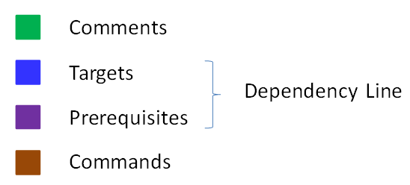
Makefile Example
# Makefile - A Basic Example
all : shop #usually first
shop : item.o shoppingList.o shop.o
g++ -g -Wall -o shop item.o shoppingList.o shop.o
item.o : item.cpp item.h
g++ -g -Wall -c item.cpp
shoppingList.o : shoppingList.cpp shoppingList.h
g++ -g -Wall -c shoppingList.cpp
shop.o : shop.cpp item.h shoppingList.h
g++ -g -Wall -c shop.cpp
clean :
rm -f item.o shoppingList.o shop.o shop
Rule

Slide 12
Build Process
configure
Script that checks details about the machine before installation
Dependency between packages
Creates ‘Makefile’
make
Requires ‘Makefile’ to run
Compiles all the program code and creates executables in current temporary directory
make install (make <option>)
make utility searches for a label named install within the Makefile, and executes only that section of it
executables are copied into the final directories (system directories)

Slide 13
Lab 3
Coreutils 8.29 has a problem
Flags –a and –A override issue.
$ ls –a –A : -a overrides –A. should be vice-versa
Why?
With –A, ‘.’ and ‘..’ should not be listed
Fix the ls program

Slide 14
Getting Set Up (Step 1)
Make a directory ~/coreutilsInstall in your home directory (this is where you’ll be installing coreutils)
mkdir coreutilsInstall
Download coreutils- 8.29 to your home directory (or any directory)
Use ‘wget’
Untar and Unzip it
tar –xzvf coreutils- 8.29.tar.gz (OR)
tar xf coreutils-8.29.tar.xz

Slide 15
Building coreutils (Step 2)
Go into coreutils- 8.29 directory. This is what you just unzipped.
Read the INSTALL file on how to configure “make”, especially --prefix flag
Run the configure script using the prefix flag so that when everything is done, coreutils will be installed in the directory ~/coreutilsInstall
Compile it: make
Install it: make install (won’t work on Linux server without proper prefix!)
Why?
Notes:
Autoreconf – force –install #to install the latest automake version
Patch –pnum < patchfile # -pnum is relative path.

Slide 16
Reproduce Bug (Step 3)
Reproduce the bug by running the version of ‘ls’ in coreutils 8.29
If you just type $ ls at CLI it won’t run ‘ls’ in coreutils 8.29
Why? Shell looks for /bin/ls
To use coreutils 8.29 : $ ./ls
This manually runs the executable in this directory

Slide 17
Patching
A patch is a piece of software designed to fix problems with or update a computer program
It’s a diff file that includes the changes made to a file
A person who has the original (buggy) file can use the patch command with the diff file to add the changes to their original file

Slide 18
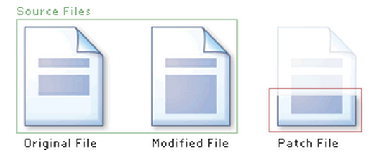
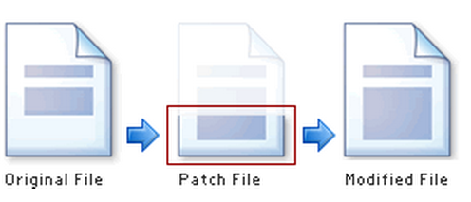
Applying a Patch

Slide 19
diff Unified Format
diff –u original_file modified_file
--- path/to/original_file
+++ path/to/modified_file
@@ -l,s +l,s @@
@@: beginning of a hunk
l: beginning line number
s: number of lines the change hunk applies to for each file
A line with a:
- sign was deleted from the original
+ sign was added to the original
stayed the same
Example on Patch

Slide 20
Patching and Building (Steps 4 & 5)
cd coreutils- 8.29
vim or emacs patch_file: copy and paste the patch content
Patch < patch_file
‘man patch’ to find out what it is and how to use it
cd into the coreutils- 8.29 directory and type make to rebuild patched ls.c.
Don’t install yet!!
Install the patched version and note the changes.

Slide 21
Homework 3
shuf.py

Slide 22
Homework 3
shuf.py – this should end up working almost exactly like the utility ‘shuf’
Check $ man shuf for extensive documentation
Extra options
--input-range (-i): shuf -i 1-4
--head-count (-n): shuf –n 4 -i 0-9
--repeat (-r): shuf –n -r 20 -i 0-9
--help: usage documentation.

Slide 23
Homework 3
Use randline.py as a starting point!
Modify to accomplish logical task of shuf
Shuf C source code :
Shuf C source code - sample
This will give you an idea of the logic behind the operation that shuf executes

