Slide 1
CS35L – Fall 2018
Slide set: | 5.1
Slide topics: | System call programming
Assignment: | 5

Slide 2
Processor Modes
Operating modes that place restrictions on the type of operations that can be performed by running processes
User mode: restricted access to system resources
Kernel/Supervisor mode: unrestricted access
User
Process
User Space
Supervisor
Process
Supervisor Space

Slide 3
User Mode vs. Kernel Mode
Hardware contains a mode-bit, e.g. 0 means kernel mode, 1 means user mode
User mode
CPU restricted to unprivileged instructions and a specified area of memory
Supervisor/kernel mode
CPU is unrestricted, can use all instructions, access all areas of memory and take over the CPU anytime

Slide 4
Why Dual-Mode Operation?
System resources are shared among processes
OS must ensure:
Protection
an incorrect/malicious program cannot cause damage to other processes or the system as a whole
Fairness
Make sure processes have a fair use of devices and the CPU

Slide 5
Goals for Protection and Fairness
Goals:
I/O Protection
Prevent processes from performing illegal I/O operations
Memory Protection
Prevent processes from accessing illegal memory and modifying kernel code and data structures
CPU Protection
Prevent a process from using the CPU for too long
=> instructions that might affect goals are privileged and can only be executed by trusted code

Slide 6
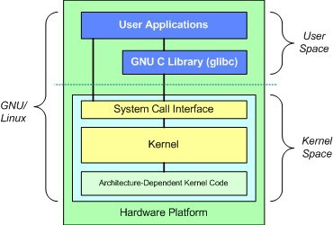
Which Code is Trusted?
=> The Kernel ONLY
•
Core of OS software executing in supervisor state
Trusted software:
•
–
Manages hardware resources (CPU, Memory and I/O)
Implements protection mechanisms that could not be changed through actions of untrusted software in user space
–
•
System call interface is a safe way to expose privileged functionality and services of the processor
Image by: Tim Jones (IBM)

Slide 7
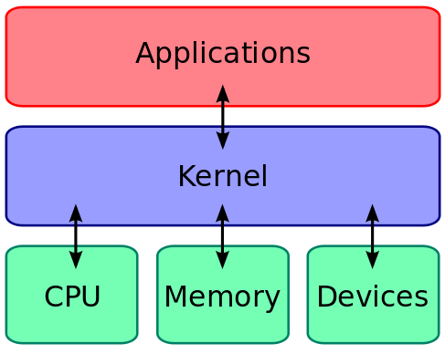
What About User Processes?
The kernel executes privileged operations on behalf of untrusted user processes

Slide 8
System Calls
Special type of function that:
Used by user-level processes to request a service from the kernel
Changes the CPU’s mode from user mode to kernel mode to enable more capabilities
Is part of the kernel of the OS
Verifies that the user should be allowed to do the requested action and then does the action (kernel performs the operation on behalf of the user)
Is the only way a user program can perform privileged operations

Slide 9
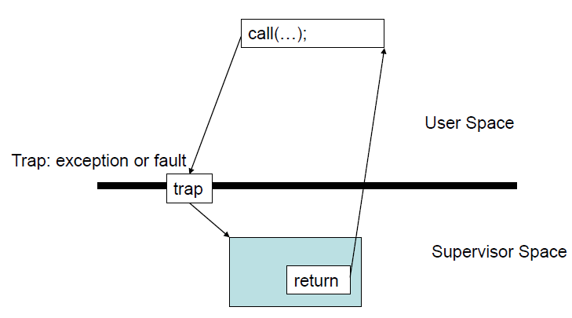
System Calls
When a system call is made, the program being executed is interrupted and control is passed to the kernel
If operation is valid the kernel performs it

Slide 10
System Call Overhead
System calls are expensive and can hurt performance
The system must do many things
Process is interrupted & computer saves its state
OS takes control of CPU & verifies validity of op.
OS performs requested action
OS restores saved context, switches to user mode
OS gives control of the CPU back to user process

Slide 11
Example System Calls
#include<unistd.h>
ssize_t read(int fildes,
•
void
*buf,
size_t
nbyte)
–
–
–
fildes: file descriptor buf: buffer to write to
nbyte: number of bytes to read
•
ssize_t write(int fildes, const void
*buf, size_t nbyte);
fildes: file descriptor
buf: buffer to write from
nbyte: number of bytes to write
int open(const char *pathname,
int close(int fd);
File descriptors
int flags, mode_t
mode);
–
–
–
0 stdin
stdout
stderr

Slide 12
Example System Calls
•
pid_t getpid(void)
Returns the process ID of the calling process
int dup(int fd)
Duplicates a file descriptor fd. Returns a second file descriptor that points to the same file table entry as fd does.
int fstat(int filedes, struct stat *buf)
Returns information about the file with the descriptor filedes into buf
•
•
struct stat { dev_t
ino_t mode_t nlink_t uid_t gid_t dev_t off_t
st_dev; st_ino; st_mode; st_nlink; st_uid; st_gid; st_rdev; st_size;
/* ID of device containing file */
/* inode number */
/* protection */
/* number of hard links */
/* user ID of owner */
/* group ID of owner */
/* device ID (if special file) */
/* total size, in bytes */
blksize_t st_blksize; /* blocksize for file system I/O */
blkcnt_t
time_t time_t time_t
st_blocks;
st_atime; st_mtime; st_ctime;
/* number of 512B blocks allocated */
/* time of last access */
/* time of last modification */
/* time of last status change */
};

Slide 13
Library Functions
Functions that are a part of standard C library
To avoid system call overhead use equivalent library functions
getchar, putchar vs. read, write (for standard I/O)
fopen, fclose vs. open, close (for file I/O), etc.
How do these functions perform privileged operations?
They make system calls

Slide 14
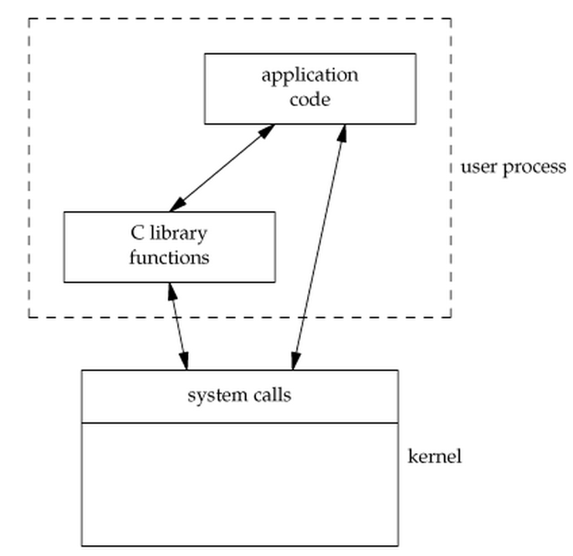
So What’s the Point?
Many library functions invoke system calls indirectly
So why use library calls?
Usually equivalent library functions make fewer system calls
non-frequent switches from user mode to kernel mode => less overhead
Notes:
Benefit: call from one library function to another doesn’t involve any context switch. Hence less overhead. Code portability.
Library functions can be debugged by using a debugger but System calls cannot be debugged because they are executed by the kernel.

Slide 15
Unbuffered vs. Buffered I/O
Unbuffered
Every byte is read/written by the kernel through a system call
Buffered
collect as many bytes as possible (in a buffer) and read more than a single byte (into buffer) at a time and use one system call for a block of bytes
=> Buffered I/O decreases the number of read/write system calls and the corresponding overhead
Notes:
There’s also user buffering, done by the application.

Slide 16
Pointers on system calls
www.cs.uregina.ca/Links/class-info/330/SystemCall_IO/SystemCall_IO.html
courses.engr.illinois.edu/cs241/sp2009/Lectures/04-syscalls.pdf
www.bottomupcs.com/system_calls.xhtml

Slide 17
Laboratory
•
Write tr2b and tr2u programs in 'C' that transliterates bytes. They take two arguments 'from' and 'to'. The programs will transliterate every byte in 'from' to corresponding byte in 'to'
–
./tr2b 'abcd' 'wxyz' < bigfile.txt
Replace 'a' with 'w', 'b' with 'x', etc
./tr2b 'mno' 'pqr' < bigfile.txt
–
•
tr2b uses getchar and putchar to read from STDIN and write to STDOUT.
tr2u uses read and write to read and write each byte, instead of using getchar and putchar. The nbyte argument should be 1 so it reads/writes a single byte at a time.
Test it on a big file with 5,000,000 bytes
$ head --bytes=# /dev/urandom > output.txt
•
•

Slide 18
tr2b.c
Write a main function which accepts arguments
main(int argc, const char* argv[])
Check for the length of arguments
Retrieve first argument in char * from, second argument in char * to
Compare the lengths of from and to; If not same, throw an error and exit
You can use strlen to get lengths
To throw an error, write to stderr
To exit, write exit(1)
Check if ‘from’ has duplicates
In a loop, take input from stdin (till you reach eof of stdin) using getchar()
Check if the character you just retrieved is a part of from; if yes then put the corresponding character in stdout with putchar()

Slide 19
Tr2u.c (read and write)
Repeat the same procedure as in tr2b.c except replace:
getchar() with read
putchar() with write

Slide 20
time and strace
time [options] command [arguments...]
Output:
real 0m4.866s: elapsed time as read from a wall clock
user 0m0.001s: the CPU time used by your process
sys 0m0.021s: the CPU time used by the system on behalf of your process(to make system calls etc)
strace: intercepts and prints out system calls to stderr or to an output file
$ strace –o strace_output ./tr2b ‘AB’ ‘XY’ < input.txt
$ strace –o strace_output2 ./tr2u ‘AB’ ‘XY’ < input.txt

Slide 21
Homework 5 (sfrobu.c)
Rewrite sfrob using system calls (sfrobu)
sfrobu should behave like sfrob except:
If stdin is a regular file, it should initially allocate enough memory to hold all data in the file all at once
-f option, your program should ignore case while sorting (use the standard toupper function to upper-case each byte after decrypting and before comparing the byte)
Functions you’ll need: read, write, and fstat (read the man pages)
Measure differences in performance between sfrob and sfrobu using the time command

Slide 22
Homework 5(sfrobs)
Write a shell script “sfrobs” that uses tr and the sort utility to perform the same overall operation as sfrobu (support –f option as well)
Use pipelines (create no temporary files)
Encrypted input -> tr (decrypt) -> sort (sort decrypted text) -> tr (encrypt) -> encrypted output

Slide 23
Homework 5(sfrob.txt)
Measure any differences in performance between sfrob and sfrobu using the time command.
Run your program on inputs of varying numbers of input lines, and estimate the number of comparisons as a function of the number of input lines.
Use the time command to compare the overall performance of sfrob, sfrobu, sfrobs, sfrobu -f, and sfrobs -f.

Slide 24
Homework 5(sfrob.txt)
Run your program on inputs of varying numbers of input lines, and estimate the number of comparisons as a function of the number of input lines.
Varying number of input lines => number of words
Number of comparisons => keep a counter in the frobcmp() function to check how many times it is being called

