Slide 1
CS 35L Software Construction Lab Week 7 Lecture 1 – Multithreading

Slide 2
Types of resources
CPU
It is an active resource
Can be used by only one runtime entity
Can be multiplexed in time (time sharing)
Therefore, scheduling
Memory
Passive resource
Can be shared among multiple runtime entities
Can be multiplexed in space (allocated)

Slide 3
Virtual Memory?
Finite amount of RAM -> memory can run out
Virtual memory is a memory management technique
"creates the illusion to users of a very large memory”
Virtual memory can help load multiple programs without having to purchase more RAM

Slide 4
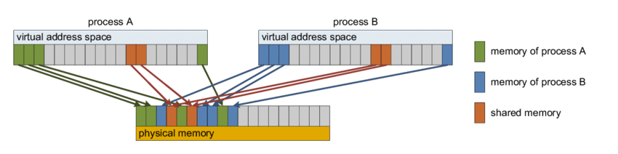

Slide 5
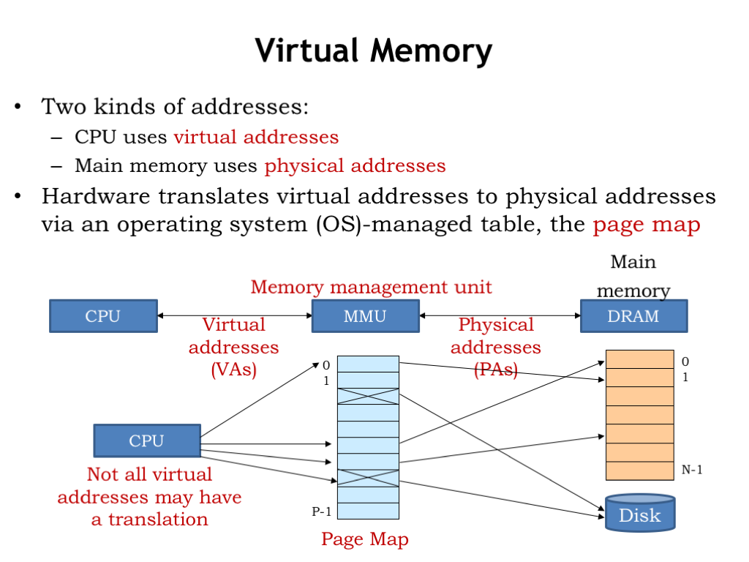

Slide 6
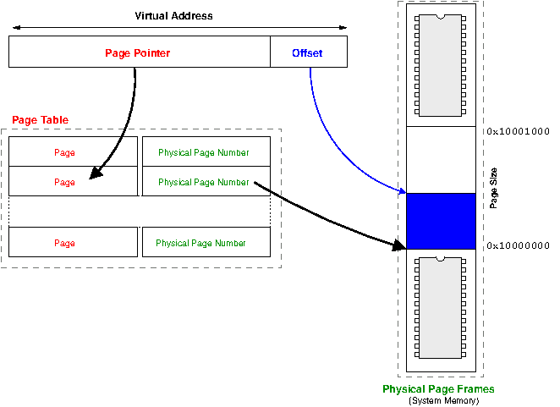
Virtual addressing

Slide 7
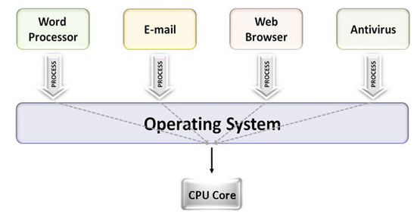
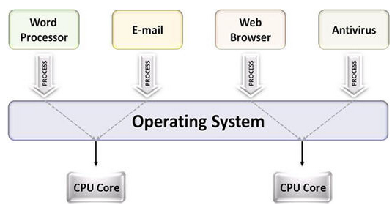
Multiprocessing
The use of multiple CPUs/cores to run multiple tasks simultaneously
Uniprocessing system
Multiprocessing system

Slide 8
Parallelism
Executing several computations simultaneously to gain performance
Different forms of parallelism
Multitasking
Several processes are scheduled alternately or possibly simultaneously on a multiprocessing system
Multithreading
Same job is broken logically into pieces (threads) which may be executed simultaneously on a multiprocessing system

Slide 9
Parallelism…
Two different parallel architectures :
SIMD (Single Instruction Multiple Data)
Performs single identical action simultaneously on multiple data pieces
Ex. retrieving multiple files at the same time
MIMD (Multiple Instruction Multiple Data)
Performs multiple actions simultaneously
Ex. addition, multiplication simultaneously
May/may not be synchronized
Complex architecture

Slide 10
SIMD vs MIMD
SIMD used for problems which require a lot of computation with processors performing same operation in parallel
MIMD used for problems that break down into separate and independent parts with each part assigned to different processor simultaneously

Slide 11
What is a thread?
A flow of instructions, path of execution within a process
The smallest unit of processing scheduled by OS
A process consists of at least one thread
Multiple threads can be run on:
A uniprocessor (time-sharing)
Processor switches between different threads
Parallelism is an illusion
A multiprocessor
Multiple processors or cores run the threads at the same time
True parallelism

Slide 12
Process vs Threads
Different processes see separate address spaces
good for protection, bad for sharing
All threads in the same process share the same memory (except stack)
good for sharing, bad for protection
each thread can access the data of other thread

Slide 13
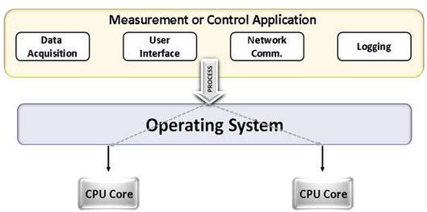
Multitasking vs. Multithreading
Multitasking
Multitasking
Multithreading

Slide 14
Multithreading vs Multitasking
Multithreading
Threads share the same address space
Light-weight creation/destruction
Easy inter-thread communication
An error in one thread can bring down all threads in process
Multitasking
Processes are insulated from each other
Expensive creation/destruction
Expensive inter process communication
An error in one process cannot bring down another process

Slide 15
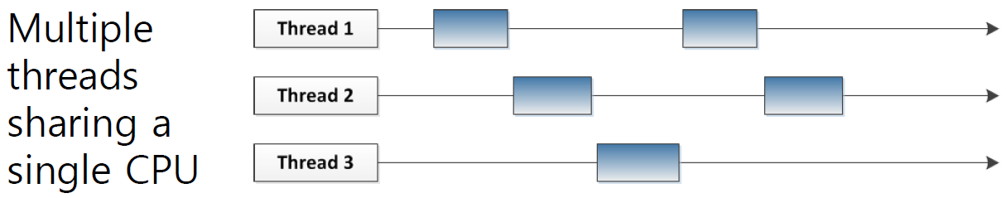
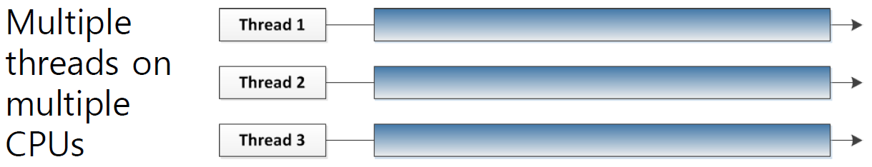

Slide 16
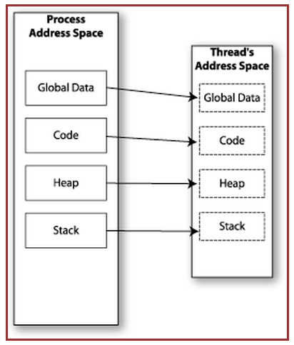

Memory Layout: Single-Threaded Program

Slide 17
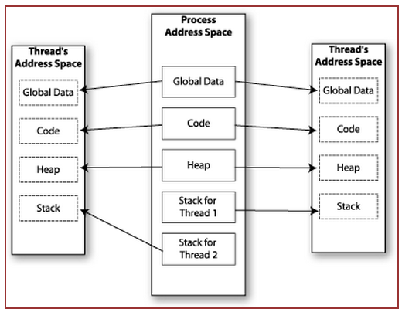

Memory Layout: Multithreaded Program

Slide 18
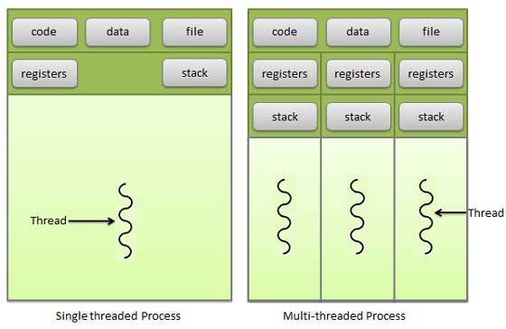
Multithreading memory layout

Slide 19
Shared Memory
Makes multithreaded programming
Powerful
can easily access data and share it among threads
More efficient
No need for system calls when sharing data
Thread creation and destruction less expensive than process creation and destruction
Non-trivial
Have to prevent several threads from accessing and changing the same shared data at the same time (synchronization)

Slide 20
Process/thread synchronization
Because threads share the same resources, we need synchronization
To prevent inconsistency

Slide 21
Race Condition
int count = 0; void increment()
{ count = count + 1; }
A
B
C
r(count) : 0
w(count) : 1
time
r(count) : 1
r(count) : 1
w(count) : 2
w(count) : 2
Result depends on order of execution
=> Synchronization needed

Slide 22
Example
a=10
F(){
read(a);
a = a+1;
write(a);
}
#1: T1 should first execute F and then T2.
Ans = 12
#2: T1 -> reads a=10, context switch to T2
T2 -> reads a=10, adds 1 to a -> 11, switch to T1
T1 -> (has already read 10) a=11
Ans = 11

Slide 23
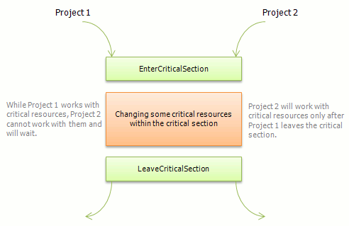
How to deal with it?
Critical section (shared memory access, guard it to prevent race condition)

Slide 24
Mutex
Mutex is an object which allows only one thread into a critical section
Mutex is owned by a thread
It forces other threads which attempt to gain access to that section, to wait until the first thread has exited from the section
Each resource has a mutex

Slide 25
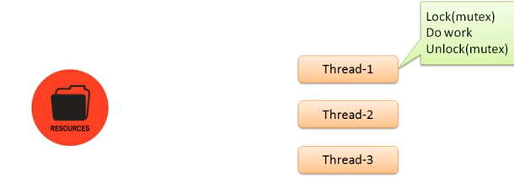

Slide 26
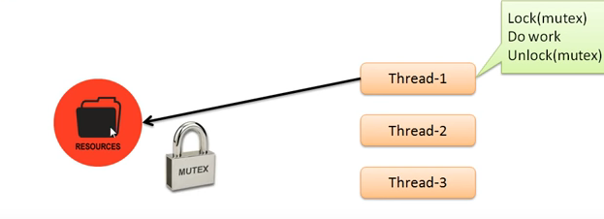

Slide 27
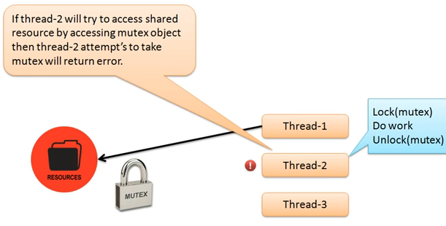

Slide 28
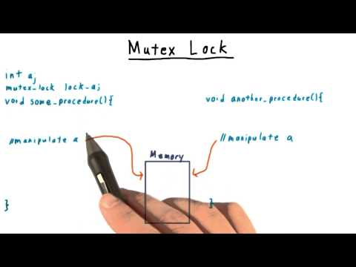

Slide 29
Semaphores
A semaphore is a value in a designated place in the OS (or kernel) storage that each process can check and then change
signaling mechanism
restricts/allows the number of simultaneous threads of a shared resource upto a maximum number
threads can request access to a resource (decrements the semaphore)
threads signal that the have finished using the resource (increments the semaphore)

Slide 30


Slide 31


Slide 32
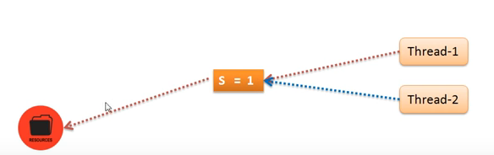

Slide 33
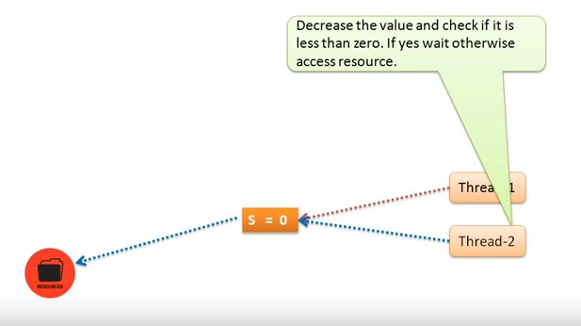

Slide 34


Slide 35
Semaphores v/s mutex
Semaphore allows multiple program threads to access the finite instance of resources.
On the other hand, Mutex allows multiple program threads to access a single shared resource but one at a time.

Slide 36
Multitasking
$ tr -cs 'A-Za-z' '[\n*]' | sort -u | comm -23 – words
Process 1 (tr)
Process 2 (sort)
Process 3 (comm)
Each process has its own address space
How do these processes
communicate?
Pipes/System Calls

Slide 37
Multithreading
Threads share all of the process's memory except for their stacks
=> Data sharing requires no extra work (no system calls, pipes, etc.)

Slide 38
POSIX Threads
import the pthread library
Example: #include<pthread.h>
Use -pthread while compiling
Represented by pthread_t (datatype)

Slide 39
Basic pthread Functions
There are 5 basic pthread functions:
1. pthread_create: creates a new thread within a process
2. pthread_join: waits for another thread to terminate
3. pthread_equal: compares thread ids to see if they refer to the same thread
4. pthread_self: returns the id of the calling thread
5. pthread_exit: terminates the currently running thread

