Slide 1


Slide 2
Business Problem to be Solved:
Optimal location for new marijuana dispensary
Marijuana may be the newest economic bubble. Investors are flocking to anything marijuana-related, without evaluating the business fundamentals.
Challenges to opening a new marijuana dispensary are local zoning restrictions, neighborhood opposition, and competition from nearby dispensaries.
Current marijuana dispensaries are often clustered in tolerant locales, typically low-income locales which currently contain strip clubs or adult boutiques (indicative of favorable zoning), alcohol dispensaries (indicative of demand).

Slide 3
Research
Review of research on marijuana dispensaries found that marijuana dispensaries are most constrained by zoning regulations and neighborhood opposition. Marijuana shops are often located near strip clubs, liquour stores, bars, and other adult diversions, possibly due to favorable zoning regulations and tolerant neighbors.
Although the patrons are normally higher income, marijuana dispensiers are generally located in low income areas, often near the outskirts of the city limits, and usually near a freeway offramp. From this we conclude that generally people don't want to live next door to a pot shop, and don't mind driving to a seedier neighborhood to purchase their recreational drugs.

Slide 4
Research sources:
https://www.ncbi.nlm.nih.gov/pmc/articles/PMC4814366/
https://www.sfchronicle.com/bayarea/article/Cannabis-dispensary-rules-in-SF-create-clusters-11746532.php
https://www.crainsdetroit.com/article/20160424/NEWS/160429925/detroit-medical-marijuana-shops-sprout-like-weeds-near-the-suburbs

Slide 5
Data Gathering:
Data was obtained via the Foursquare API and included location data for Strip Clubs, Adult Boutiques, Bars and Pubs. Housing prices were used to extrapolate household income. Existing Marijuana Dispenseries in New York were also included in the search. Foursquare data was augmented with local census data.
Toronto, with newly legalized recreational cannabis, and New York, with soon to be more legalized recreational cannabis, were the target cities and data was collected and analyzed. After further research it was determined that marijuana dispensaries were severly curtailed in Canada, as the government is handling marijuana sales online with delivery by post. The government regulates marijuana dispensaries and is sensitive to local desires; consequently most neighborhoods in the Toronto area have chosen to disallow marijuana dispenseries.

Slide 6
Tools:
Language chosen for evaluation: Python, Jupyter notebook
Data Acquisition: Foursquare
Clustering Analysis: K-means
Geo Visualization Folium
Config Management: Github

Slide 7
Procedures (via Jupyter):
1. Download data via Internet page scrape, 2. Using the data from the page scrape, create pandas dataframe, 3. Clean data in pandas dataframe (remove/rename empty cells), 4. Explore and cluster neighborhoods, 5. Geocode using postal codes, 6. GeoMap neighborhoods, 7. Assign FourSquare feature data to neighborhoods, 8. Cluster neighborhoods based on FourSquare-assigned features, 9. Group, One-Hot Encode and Analyze Neighborhood Clusters, 10. Visualize Feature-Grouped Clusters.

Slide 8
Project Deliverables:
Neighborhood Clustering:
Numeric - textual results.
Folium GeoMaps (Heatmaps, Choropleths, Bubble)
C

Slide 9
Lessons Learned:
Pickle outputs, reduce dependency on geolocating tools
Presentation as driver, create first
Reduce focus on graphical outputs

Slide 10
Graphical outputs will be similar to those following

Slide 11
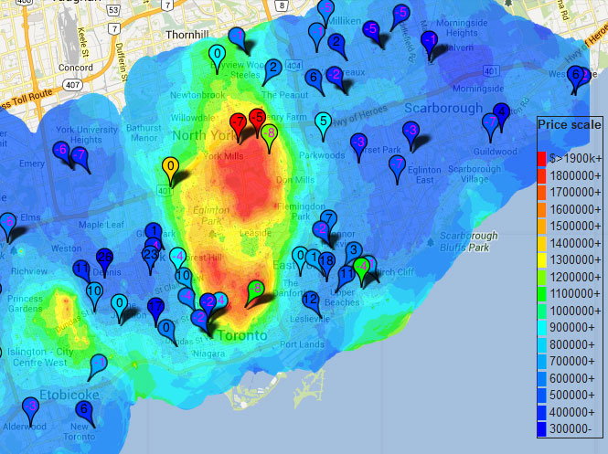
Problem
EXAMPLE GRAPHIC. For illustrative purposed only and not created with project data

Slide 12
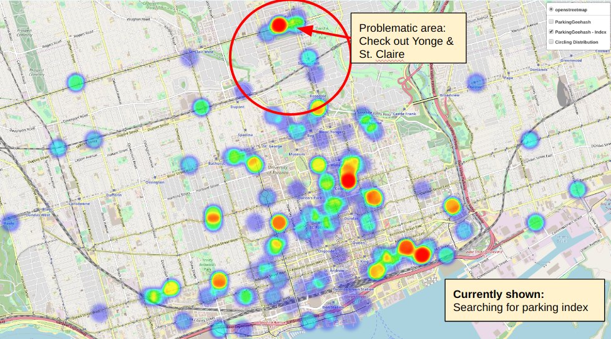
Problem
EXAMPLE GRAPHIC. For illustrative purposed only and not created with project data

Slide 13
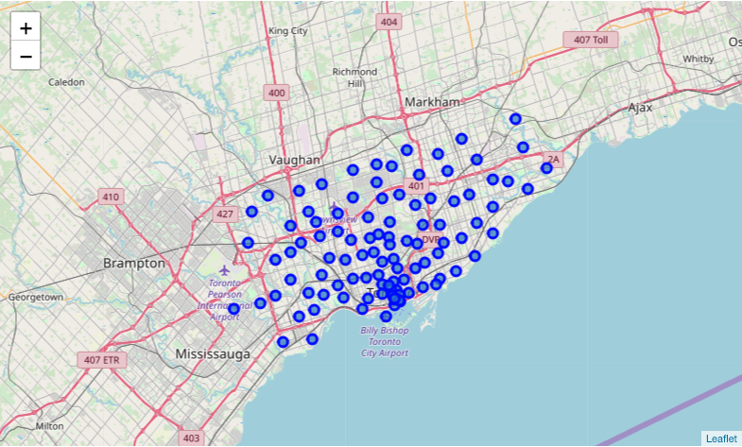
Problem
EXAMPLE GRAPHIC. For illustrative purposed only and not created with project data

Slide 14
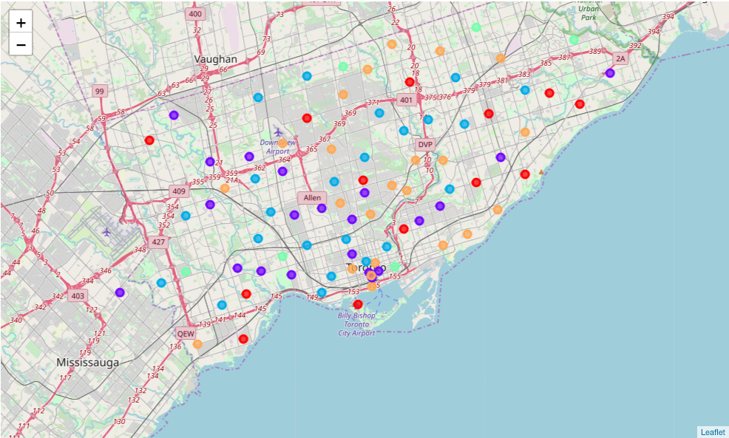
Foursqaure API
EXAMPLE GRAPHIC. For illustrative purposed only and not created with project data
Cluster 0 = Red Cluster 1 = Purple Cluster 2 = Blue Cluster 3 = Turquoise Cluster 4 = Orange

Slide 15
Conclusion
Resources should be applied to opening a new marijuana dispensary in , New York.
Due to uncertainties in regulations and neighborhood mores and activism, resources should also be applied to opening a location in SomeLocale, New York, as a backup.

Slide 16
Thank you!

