Slide 1

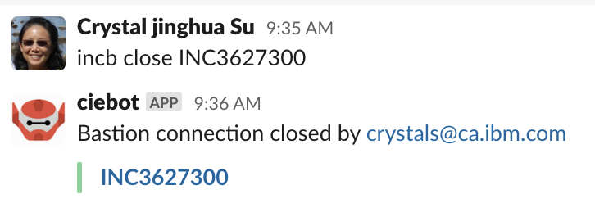
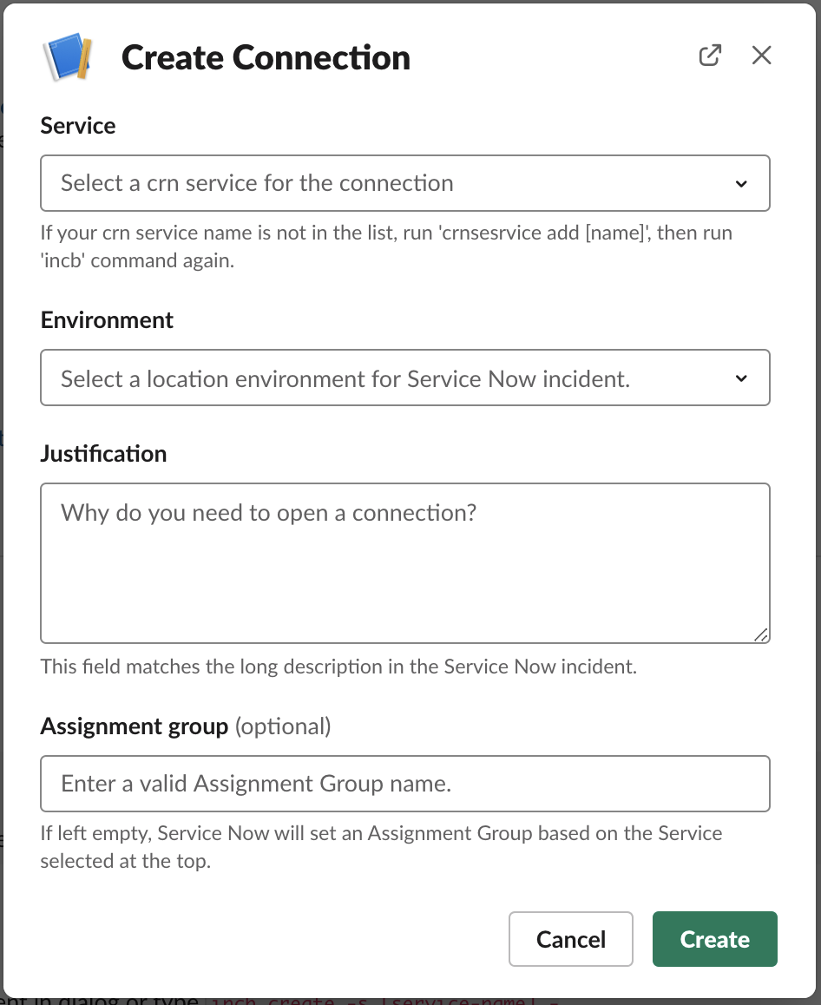
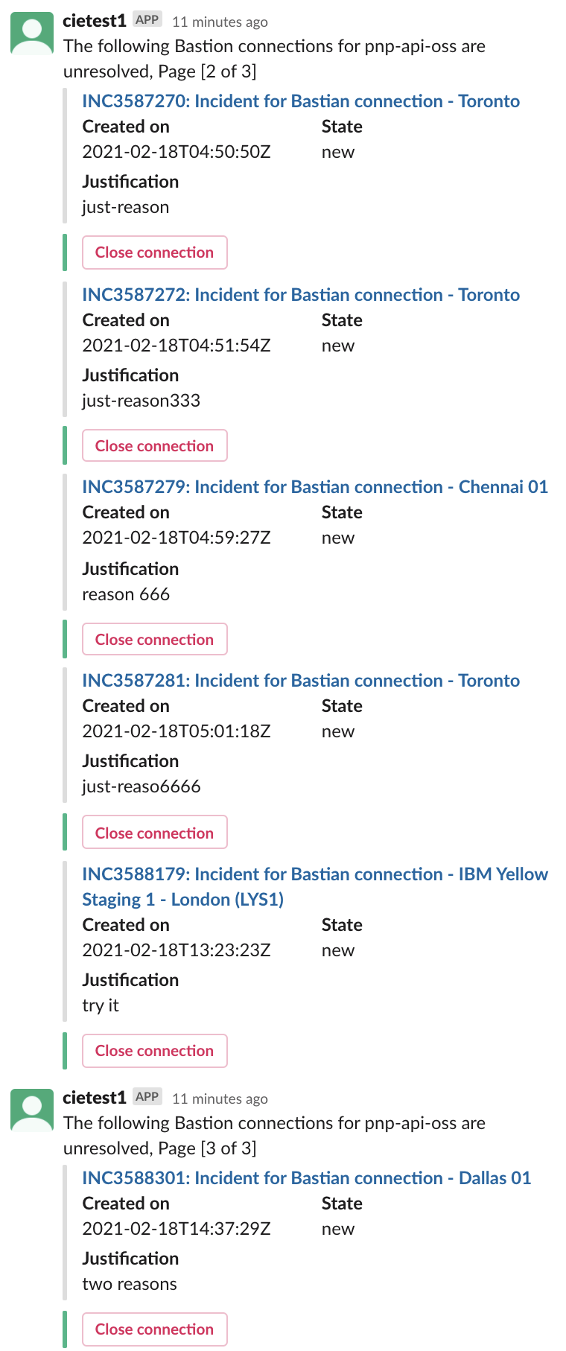
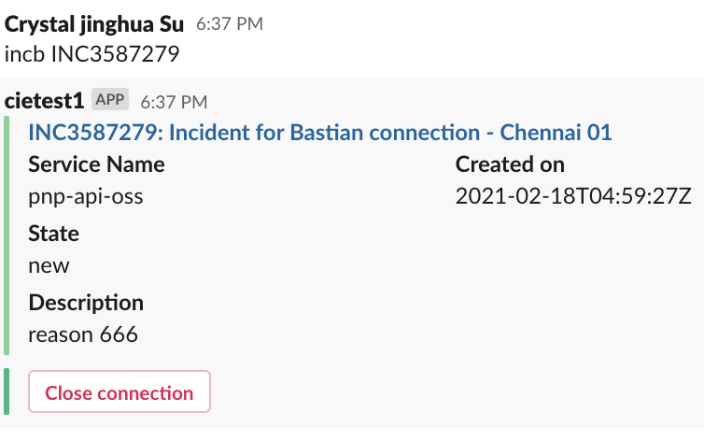
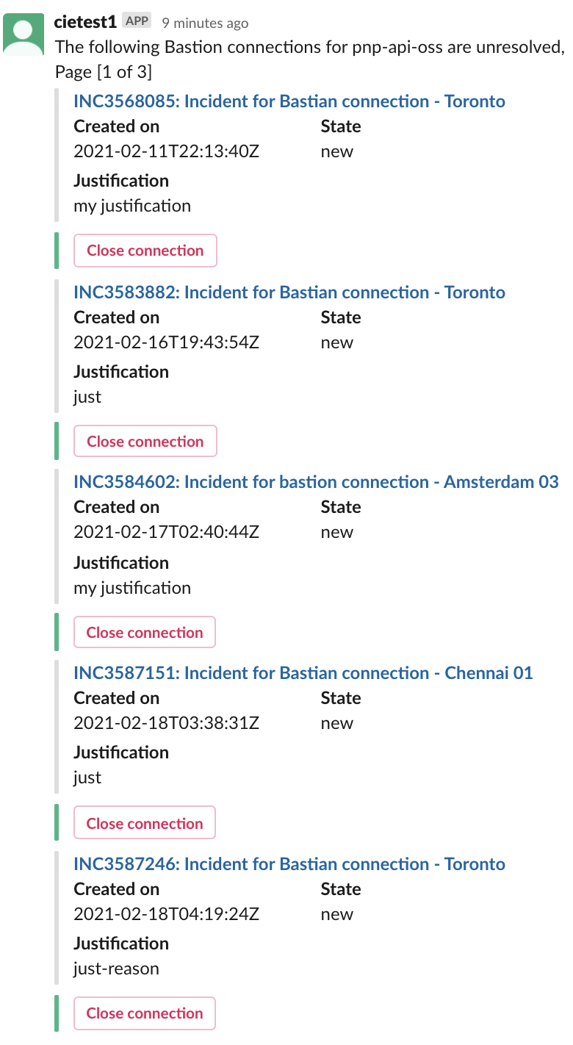
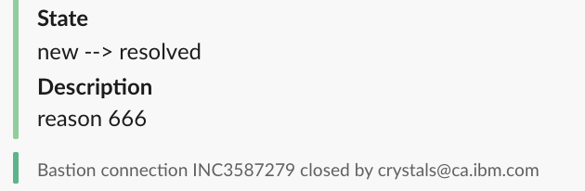

INCB – Incident for Bastion
Login
Close
incb close (INC)[nnnnnn]
CIEBOT authentication shared by cie and incb. Type any incb command.
Also use the
Close connection
buttons in view
Connect
View
incb create
-s [service name]
-e [env]
-j [justification]
(-a [assignment group])
incb (INC)[nnnnnn]
crnservice
incb env list
incb list [service name]

