Slide 1
SPEED DATING
Exploratory Data Analysis
KINN Linda – Jedha Bootcamp - 2022

Slide 2
SUMMARY
Use Case presentation
Database exploratory
Candidat’s profil analysis
Matching analysis
Conclusion
To go further

Slide 3
Use Case presentation
Kaggle Challenge
Columbia Business School : Ray Fisman and Sheena Lyengar
Experimental speed dating event from 2002-2004
4 minutes « first date »
Goal : Understand what happens during speed dating and especially yo understand :
« What will influence the obtaining of the second date ? »

Slide 4
Database exploratory
Number of observations : 8378
Number of features : 195
Attributes : ['Attractive', 'Sincere', 'Intelligent', 'Fun', 'Ambitious', 'Share Interests’]
Number of candidate : 551
Number of wave : 21
Time : [Time1, Time2, Time3]

Slide 5

Candidat’s profile analysis

Slide 6
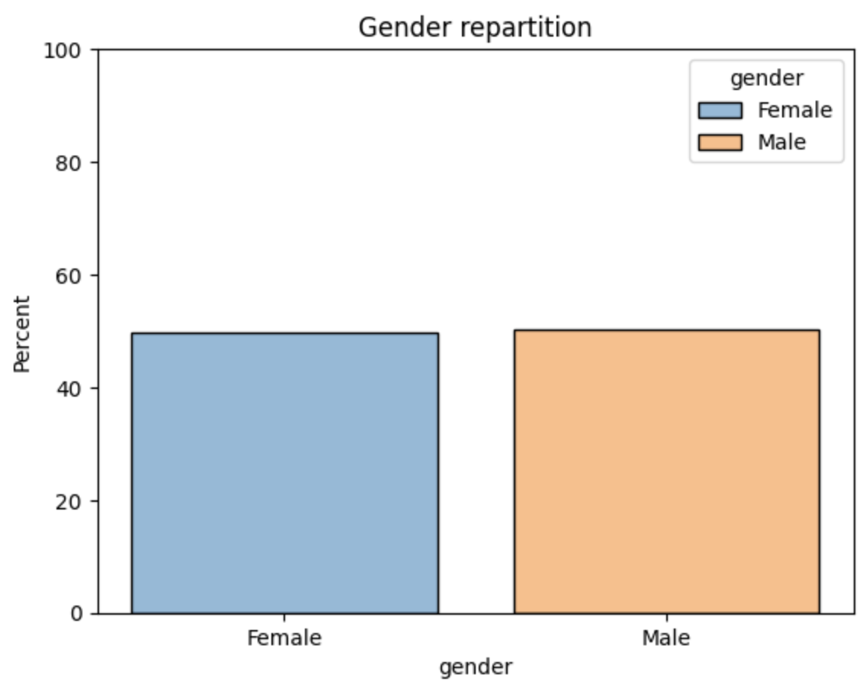
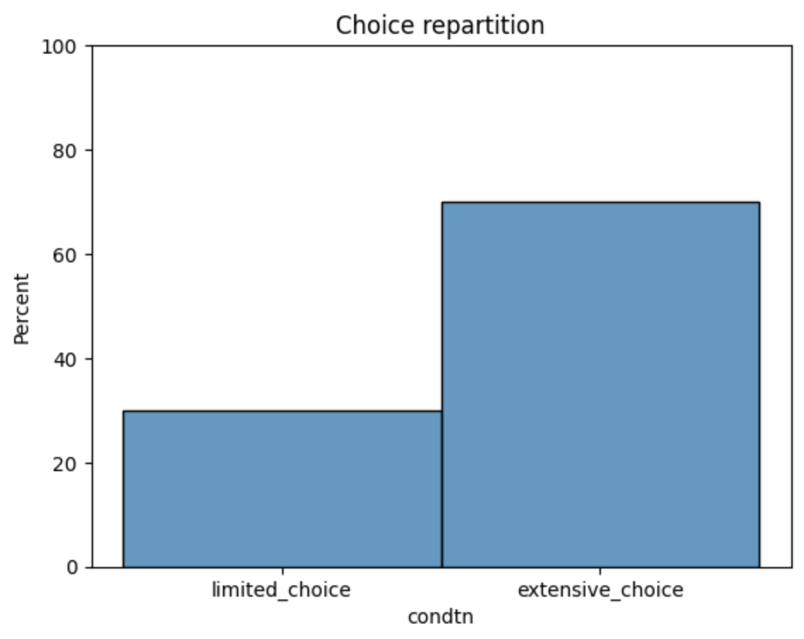
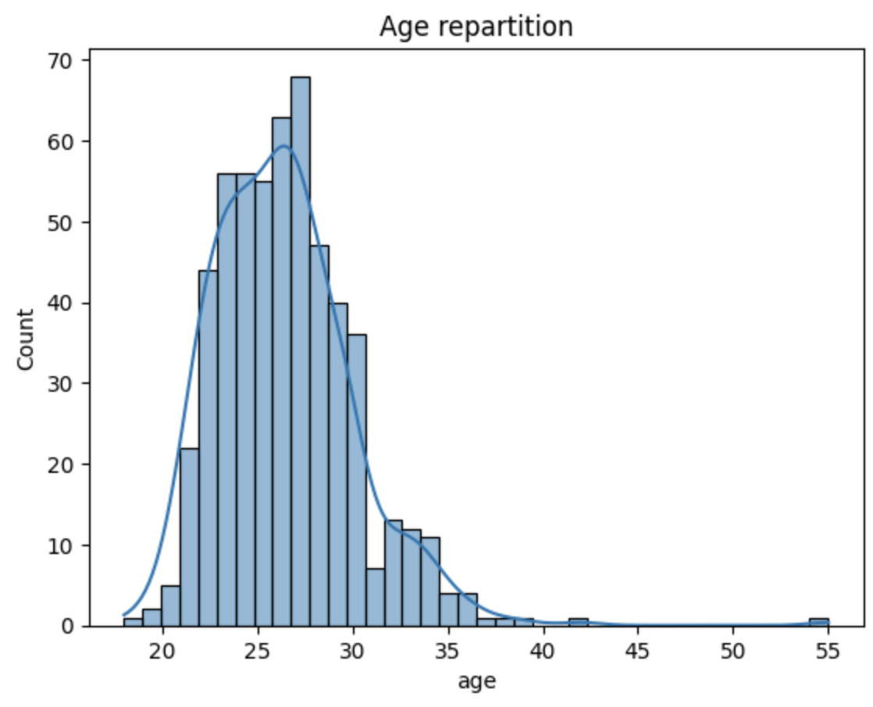
Gender repartition between male and female is equal
70 % of candidate choose the extensive choice against 30% for limited choice
Most of the age of candidate have 22-34 years old

Slide 7
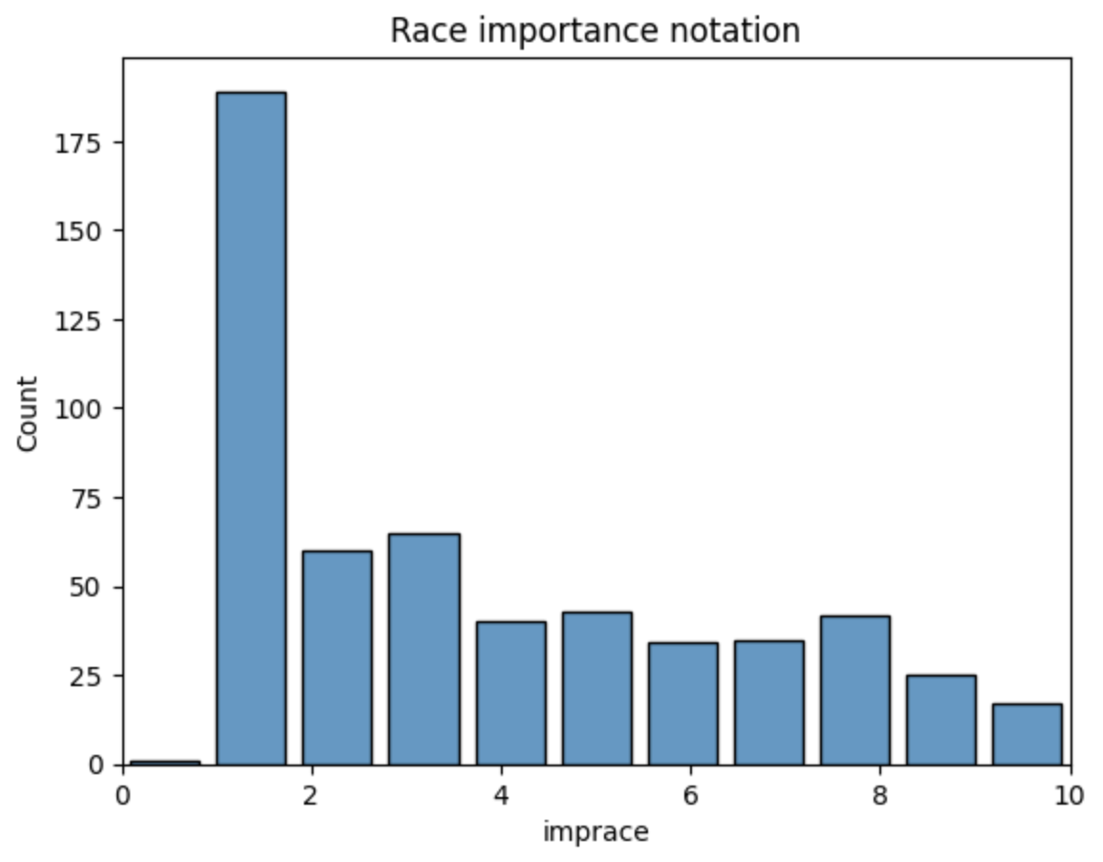
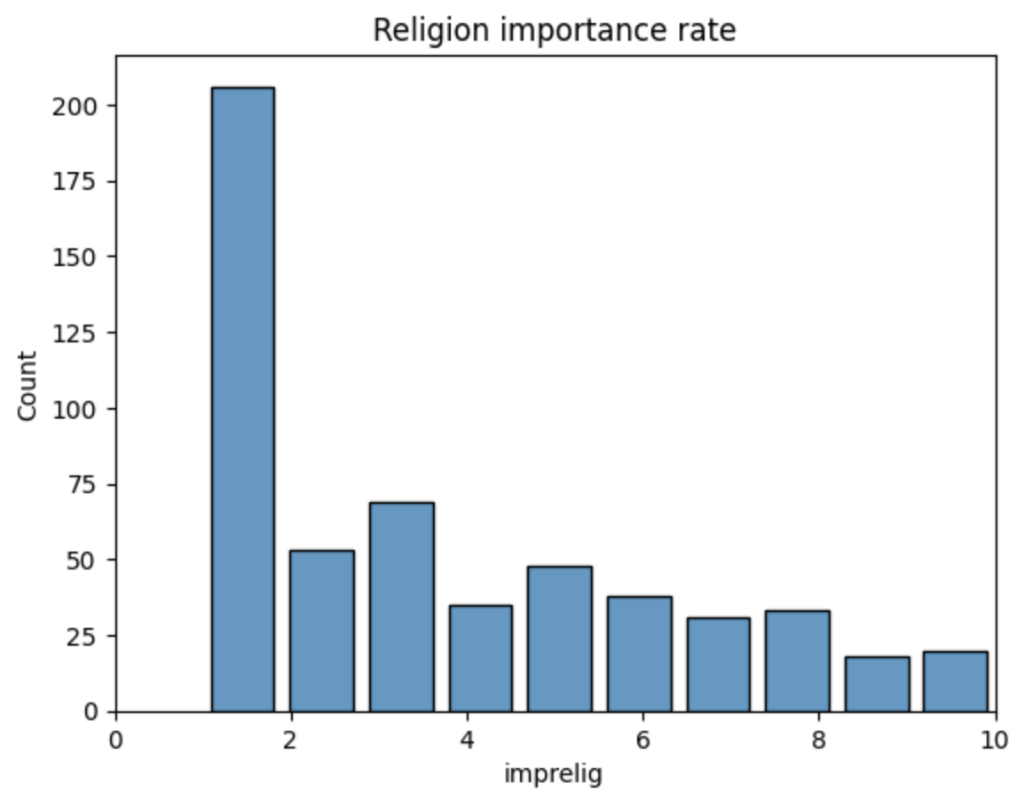
The Race and Religion of the partner is mostly not important to the decision

Slide 8
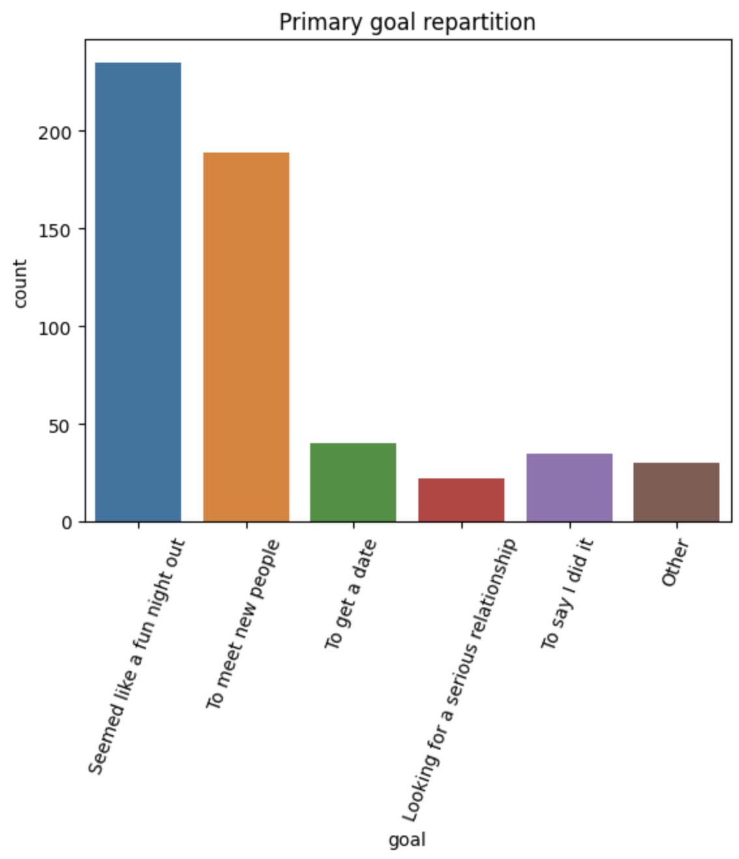
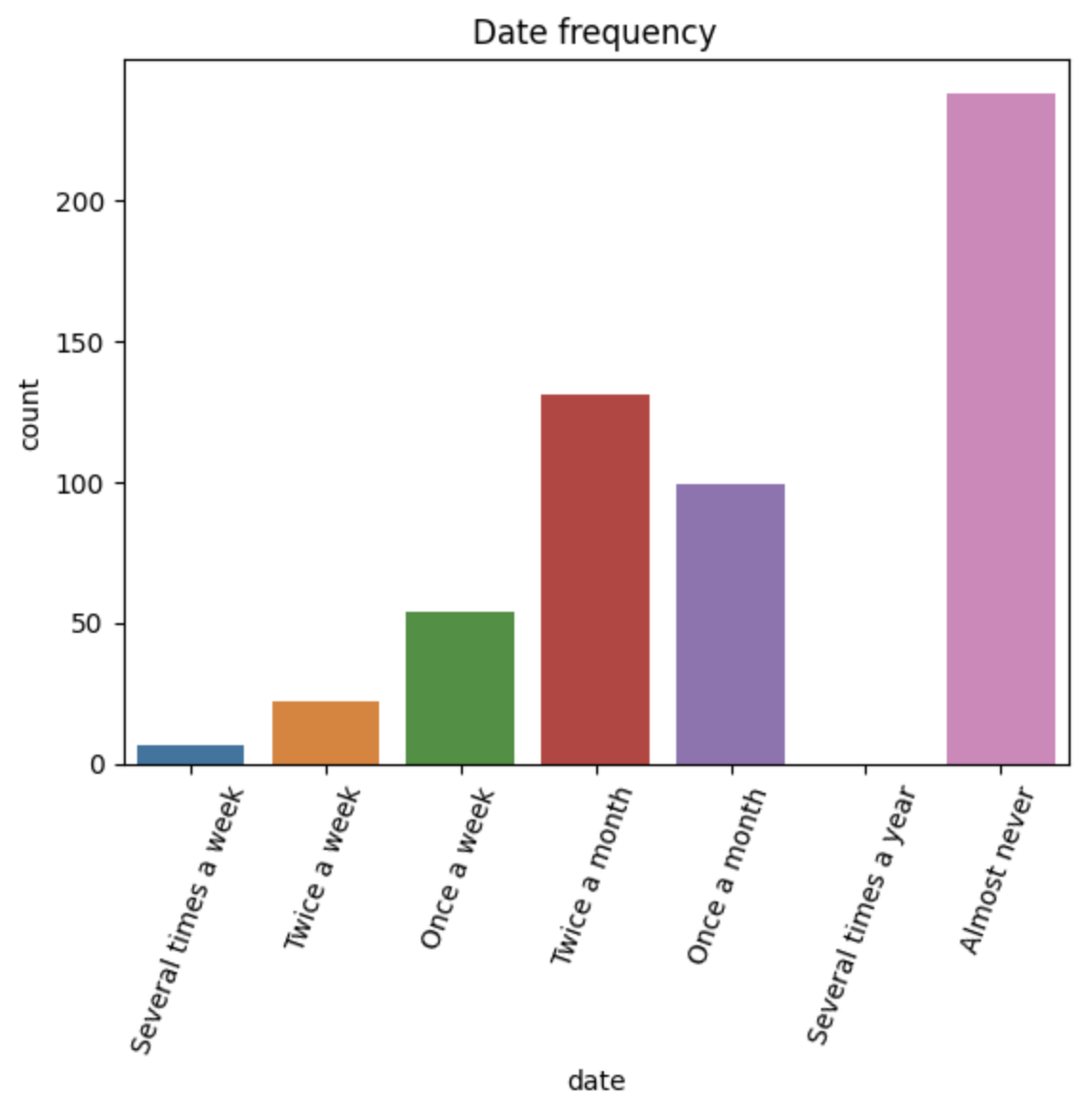
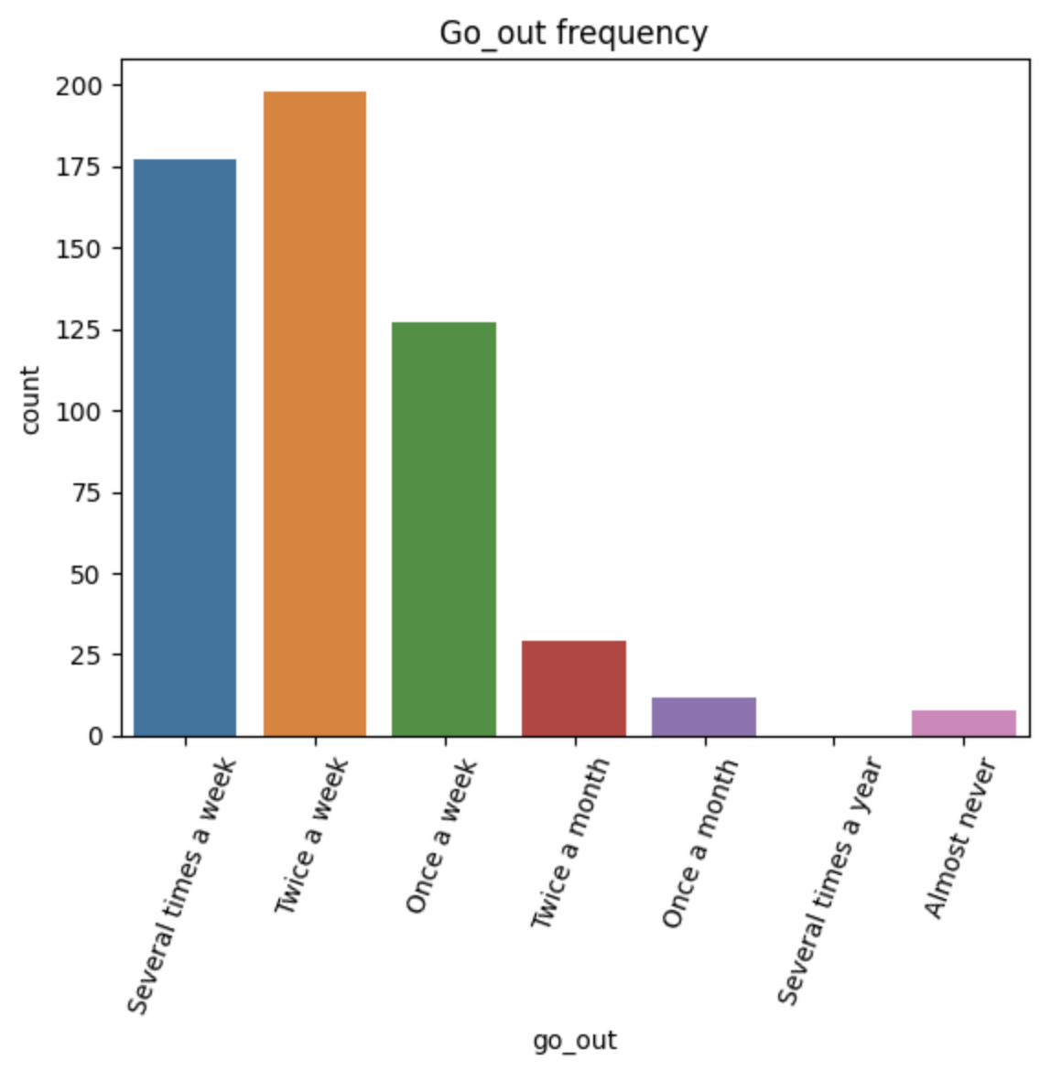
Primary goal of candidate are coming to the speed dating for a fun night out and to meet people
Candidates are almostly never dating otherwise once or twice a month
In the other hand, candidates often going out (several time, twice, once a week)

Slide 9
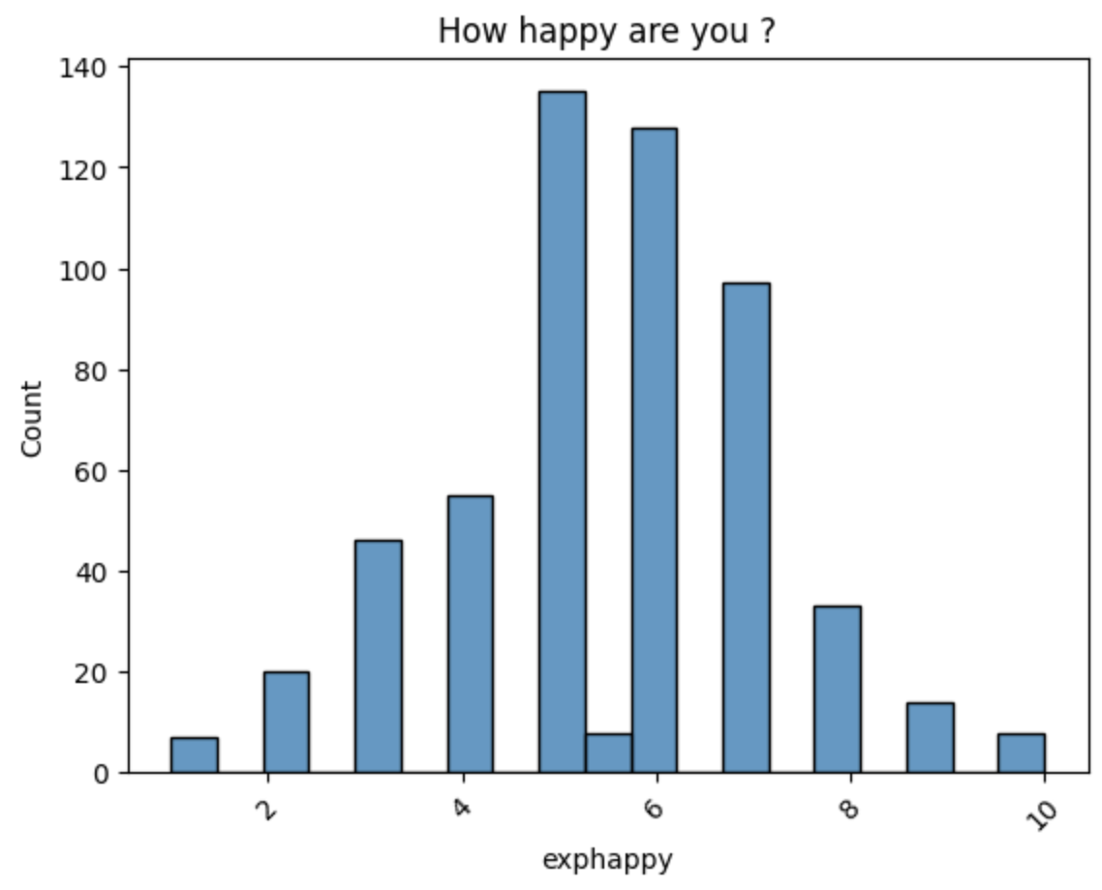
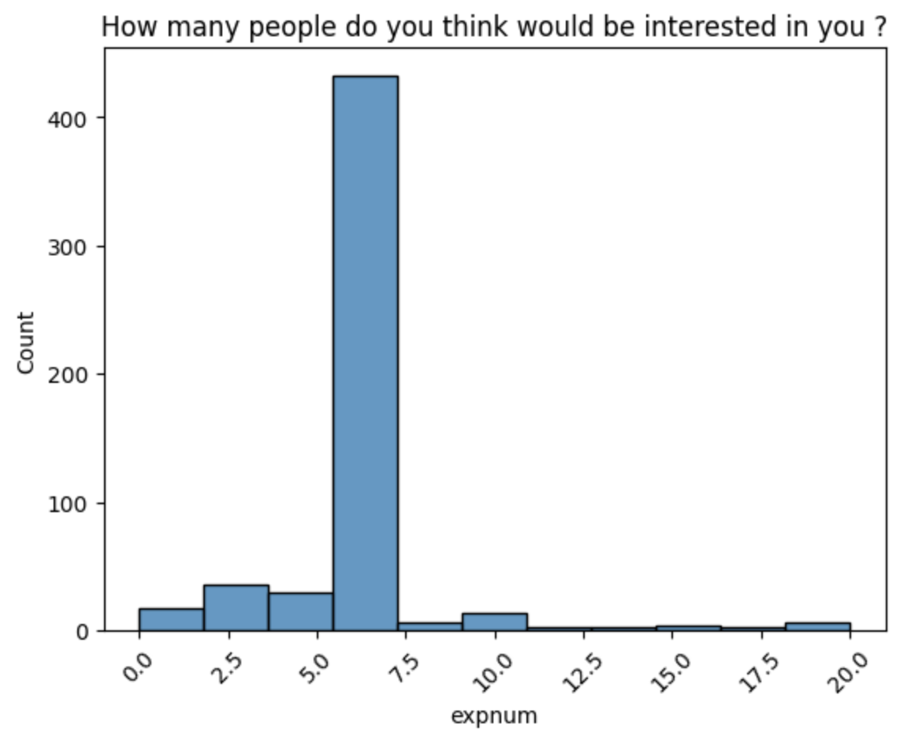
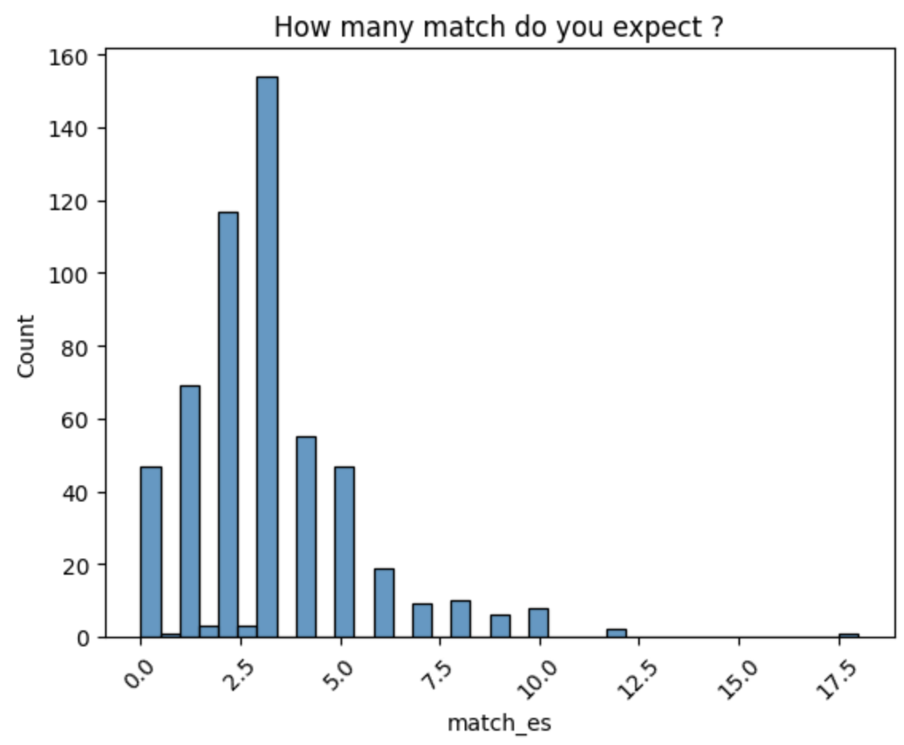
Generally, candidate are half happy with their life
They mostly expect around 6 peoples to be interested of them
They hope to have between 2 and 5 matching

Slide 10
Resume Candidate’s profile
Candidates :
Took the extensive choice
Have between 22-34 years old
Don’t take importance to the race and religious of the partner
Expect to pass a fun night out and wanted to meet new people
Don’t often go on date but go out frequently
Are half happy with their life

Slide 11

MATCHING ANALYSIS 452 second dates

Slide 12
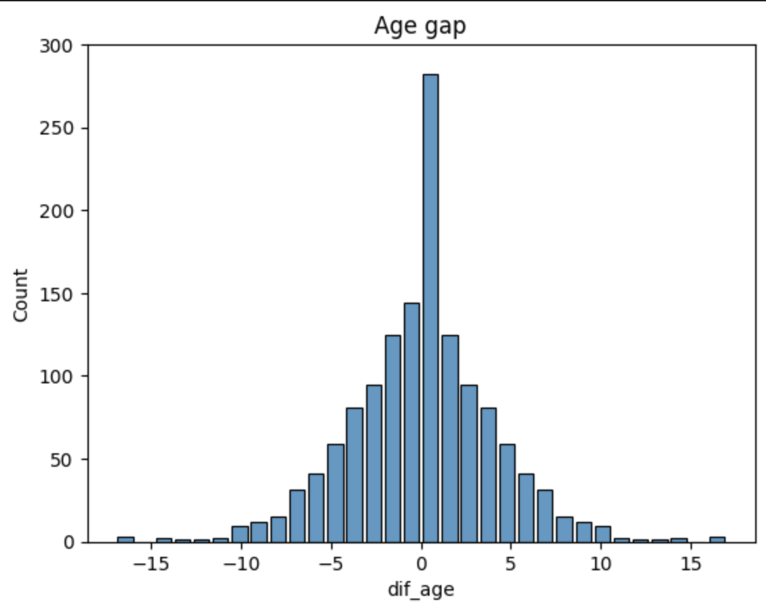
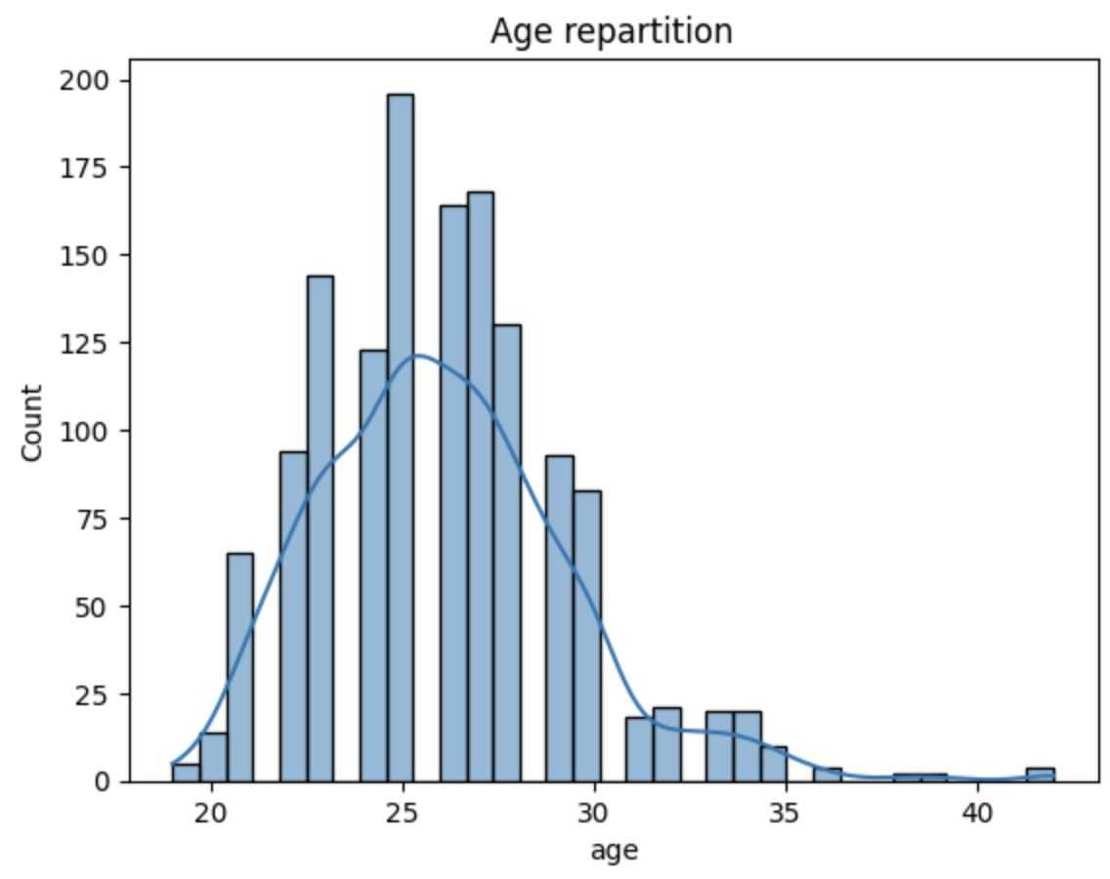
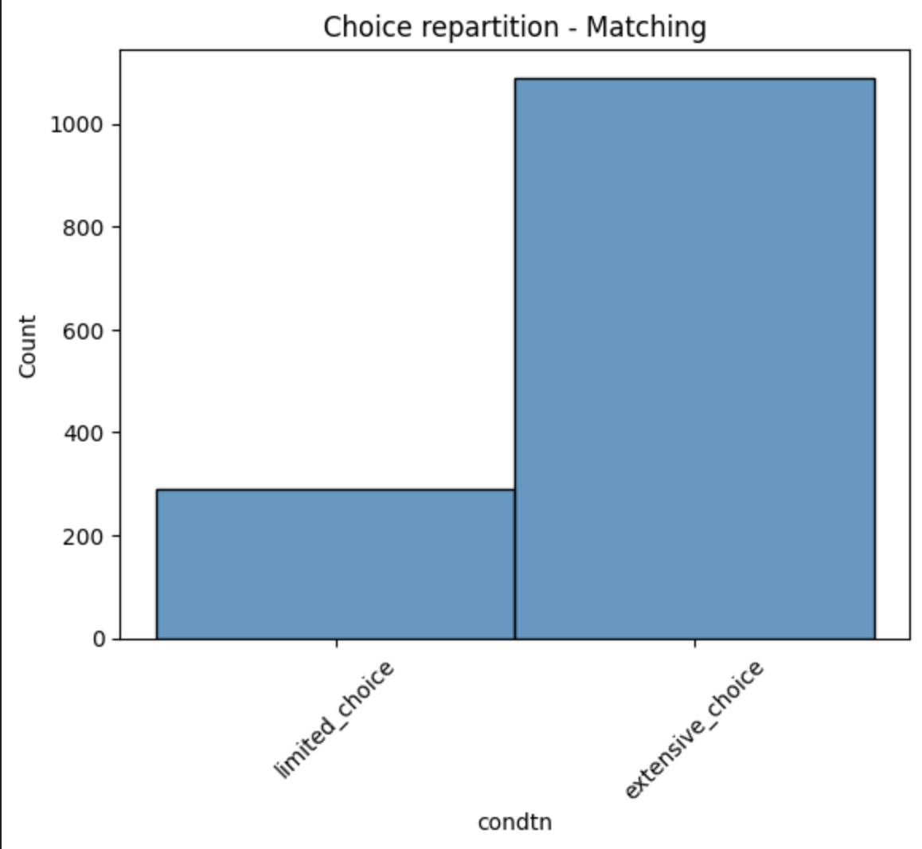
Most of matching are due to the extensive choice
The gap between their age are really close to small gap
Candidates from 23 to 30 years old succeed to get a second date

Slide 13
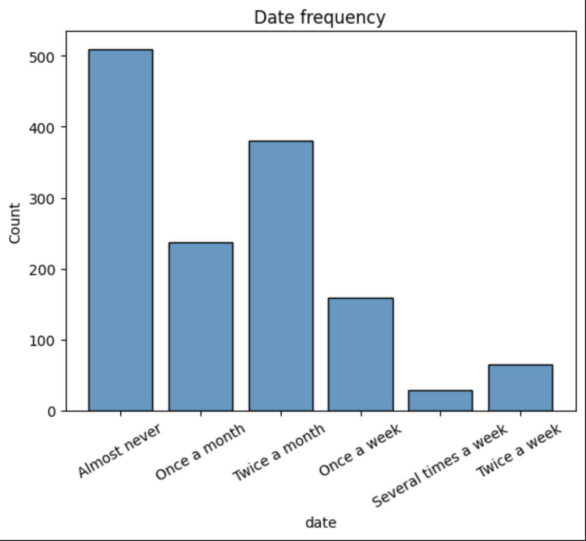
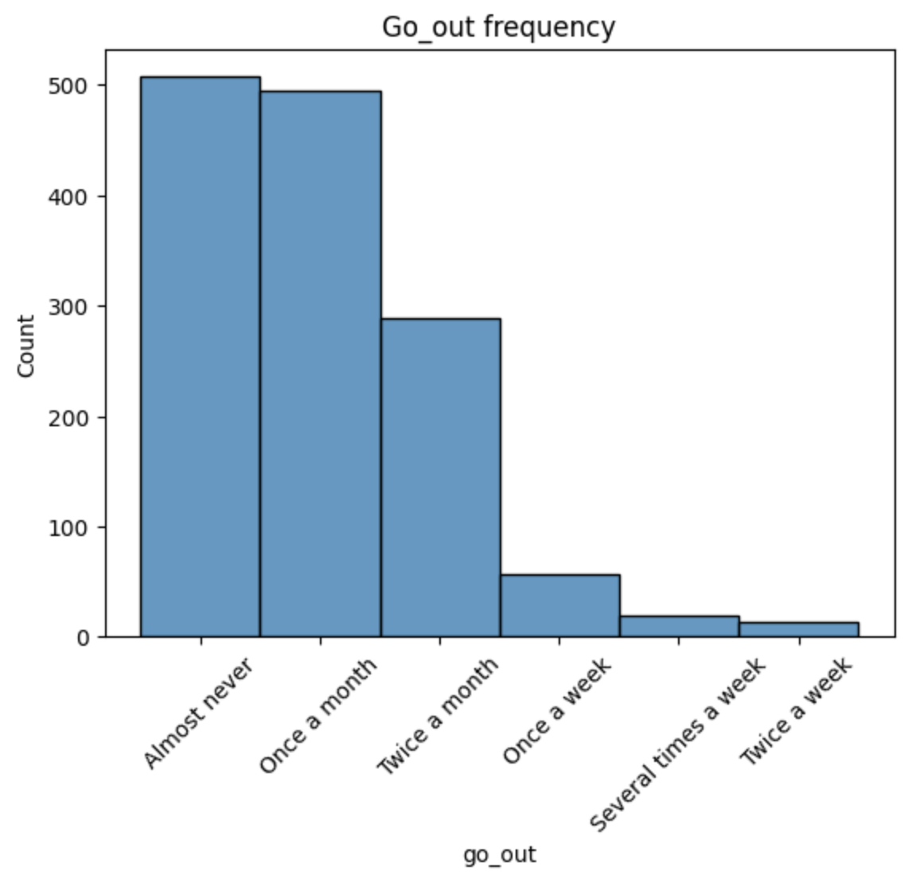
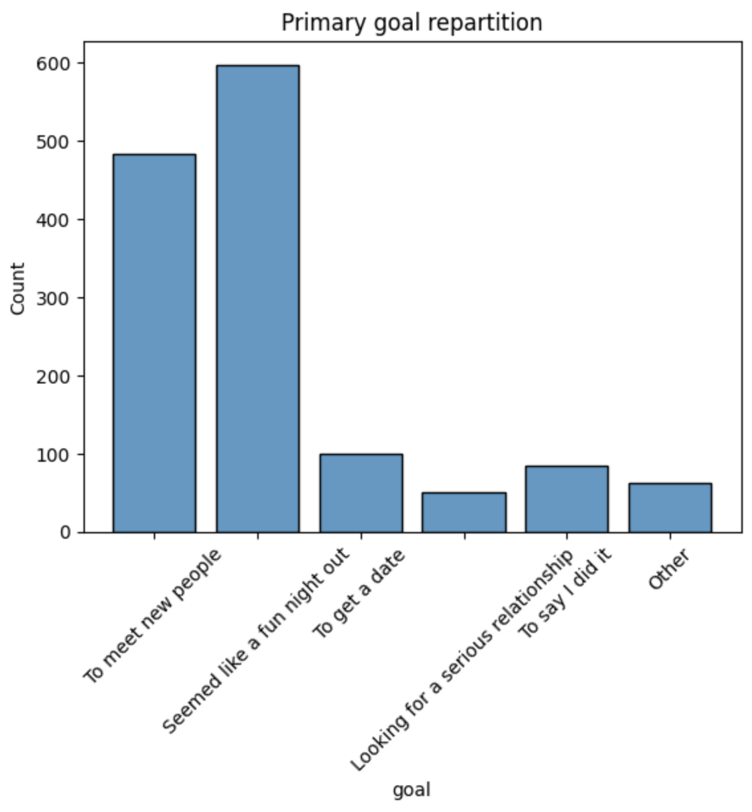
Candidates with the state of mind with goal to meet new people and to have a fun night out are the most candidate who get a second date against people really wish to get a date, looking for a serious relationship or to say I did it
Low date frequency of candidate is mostly the people who get a second date face to people who dating a lot
We get the same situation for the going out frequency, most of people don’t go out are more the intention to get a second date

Slide 14
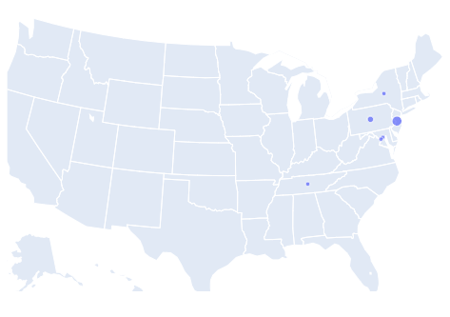
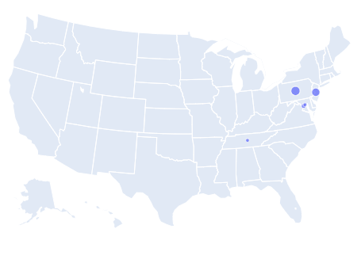
CANDIDATE’S LOCATIONS
ALL CANDIDATES
ONLY MATCHING CANDIDATES

Slide 15
CONCLUSION

Slide 16
Matching influence
If you :
take the extensive choice
have between 23 to 30 years old
met people close to your age
have the intention to having a fun night out and wish to meet new people
don’t go on date and go out frequently
=> You have more chance to get a second date

Slide 17

TO GO FURTHER…

Slide 18
TO GO FURTHER...
Analyse the rate progression on the attritubes during the experiment
1
Analyse match with leisure
2
Analyse the state of mind before, during and after the date
3
Compare attributes and state of mind male and female matching
4
Analyse the non matching people
5
Take just a wave to try
6

