Slide 1
League of Legends Ranked Statistics
CS 677 Final Project Linda Zhang
Notes:
Hi My name is linda zhang and for my final project for cs 677 im going to be talking about statistics for a game called League of Legend’s

Slide 2
About the Dataset
Found on Kaggle.com
https://www.kaggle.com/datasets/gyejr95/league-of-legends-challenger-ranked-games2020
About ranked league of legends
5 player vs 5 player game
Capture the enemy “Nexus”
There will be two towers in each of the three lanes
Buy items to give you boosts
Notes:
So a brief introduction about this dataset. It is found on kaggle.com I used to play this game so I was really interested in the statistics behind this.
A little bit about the game league of legends is that it is a game where a set of five players play against another set of five players. In order to win the game you need to capture the enemy nexus.

Slide 3
Setting up the Dataset
Original dataset had around 30,000 rows of data and 46 columns
No empty space or N/A values
Loaded the data into Pandas and randomly selected 600 rows to use
Selected nominal data for features
Selected columns
'blueWins'
'blueWardPlaced'
'blueKills'
'blueAvgLevel'
'blueTotalGold'
'blueKillingSpree'
Notes:
The original dataset had 30,000 rows and 46 columns. Luckily for me there was no N/A values so I did not need to clean up the data there. I selected 600 rows and 6 columns to use for my project. Blue wins is going to be what im testing. Blue wards placed are items in the game that gives the team vision. I also selected blue kills, blue average level which goes from level 1 to level 18 ,blue total gold, and blue killing spree which happens if a player kills three people in a row before dying..

Slide 4
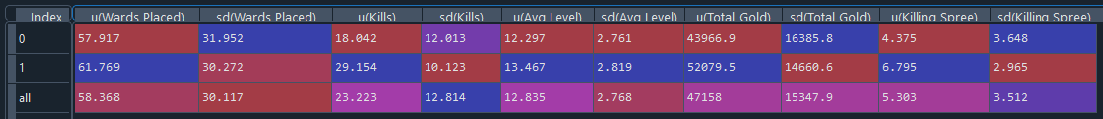
Calculate mean and standard deviation
0 = games that were lost
1 = games that were won
Average wards placed was also really close for both wins and losses
Average level was really close to each other for both wins and losses
Not surprising that when the team win they had a lot more kills as well as gold than the average of the losing team
Notes:
I calculated the mean and the standard deviation of each features and put it into a table
The first row of table is games that were lost and the second row of data is games that were won.
I found that there are a few interesting points in this table. The first thing that stood out to me was that the average wards placed were pretty close to each other, I expected a larger difference for average wards placed. Another thing that surprised me was that average level of the players were around the same and there is only a difference of one level. I was expecting the levels to be closer to the max level of 18. What didn't surprise me about this dataset was that the that the when the team won there was a lot more gold that they had

Slide 5
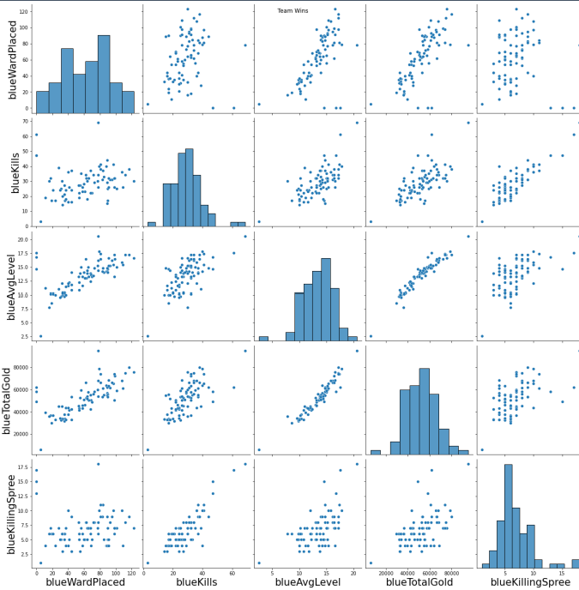
Pairplot Graph-Win
Somewhat normal distribution with for the features when the team win
High correlation between Total Gold and Average Level
Notes:
This is a pairplot graph for the features when the team win. We can see that total gold and average level was more correlated to each other than other features. I also noticed that there is a somewhat normal distribution

Slide 6
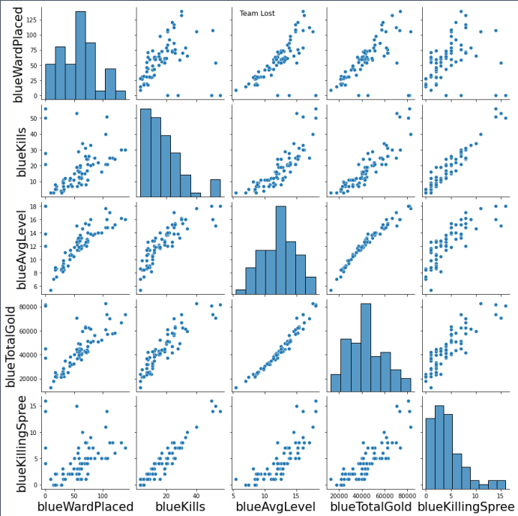
Pairplot Graph-Lose
High Correlation for Average Level and Total gold as well
There are heavily skewed table for when the team loses
Blue Kills
Blue Killing Spree
Notes:
This is the pairplot graph of features when the team loses. Like the winning features there is a high correlation for average level and total gold. What didnt surprise me was that Blue kills and blue killing spree was more right skewed

Slide 7
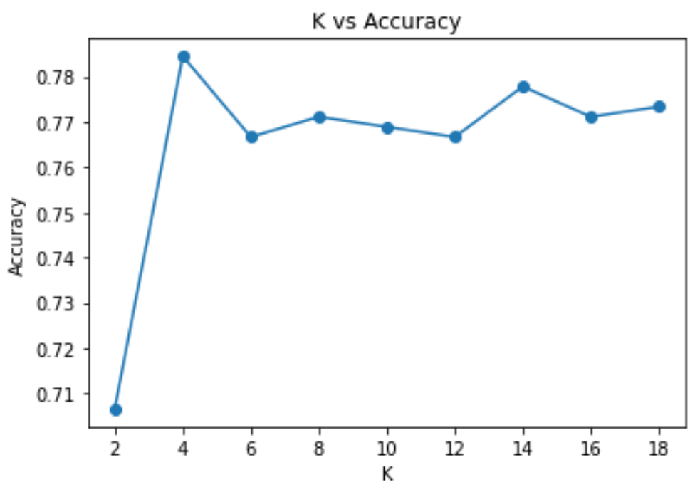
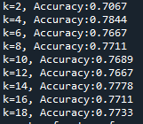

KNN-Finding the best K
Notes:
I am going to be using knn and in order to do that I need to find the k with the highest accuracy and after plotting it into a graph I found that k=4 gives me the highest accuracy of 78%. When I set k=4 and compared it to the test results I found it interesting that the machine was a lot more likely to predict a false positive than a false negative.

Slide 8
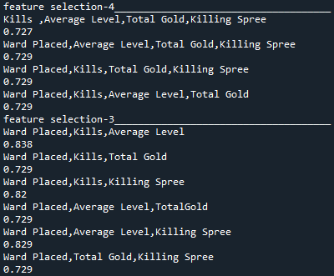
Features Selection Using K-NN
When picking 4 features using knn the ones with Wards placed are the highest
Ward placed, kills, and average level has the highest accuracy prediction of 83.8%
Notes:
I did feature selecting with knn and found out that the ones with wards placed were more likely to have a higher accuracy. So when it came to selecting three features I included wards placed and changed out the other two features. I found out that the highest accuracy reached was when wards placed, kills, and total gold was selected. The highest accuracy is 83.8 and it is better than accuracy with all five features selected and the various 4 features selected

Slide 9

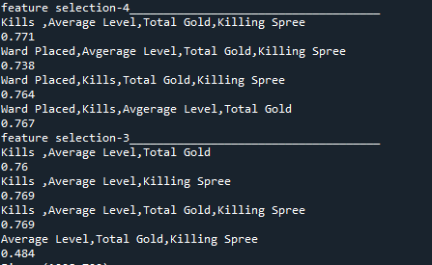
Logistic Regression
When using 5 features have less accuracy than knn
When looking at selecting 4 features the highest accuracy is kills, average level, total gold, and killing spree
When selecting 3 features the overall accuracy became lower
Notes:
Other than K-nn I decide to do logistic regression as well. For logistic regression when I used all five features it produces an accuracy of 77.1% which is lower than knn. It was interesting because like knn it is more likely to predict a false positive over a false negative. When it came to selecting four features, the one with the highest features is kills, average level, total gold and killing spree. I decide to use those four features for my selecting three features. The results surprised me because the accuracy rating was a less than before. For logistic regression the best accuracy was using all five features.
For this dataset, it is better to use knn and three features because it produce the highest accuracy.

