Slide 1
Linda Relay
Linda Zou

Slide 2
Overview
Gateway Server Relay
Requirement Analysis
Design
Demo
Micro Services Design
Requirement Analysis
Architecture Diagram
Continuous Delivery and Continuous Deployment
Jenkins Configuration and Jenkinsfile
Code Structure and Source Codes Review
- Spring Boot Project: Gateway Server Relay

Slide 3
Gateway Server Relay - Analysis
Protocol: TCP/IP
Communication: Client Server
Communication: Client Another Client
Message: Communication Ready
Message: Connection End

Slide 4
Gateway Server Relay -Design
Technology
Network: Java Socket and ServerSocket
Multithreading: One thread per client
Server: establish the connection, obtain the streams, create a handler object, invoke the start() method
Client: extends Thread and add business logic to run() method
IO Stream: Read and Write
Stretch Goal
Array Synchronization via Thread Safe Vector
Command Line via GUI

Slide 5
Gateway Server Relay -Design
Functionality
Connection Setup: Clients chat with each other
Message Broadcast:
Clients know when the gateway is ready
Clients know when the gateway is shutdown
Clients know who they are talking with
Clients know who has left the chat room
Server shutdown

Slide 6
Micro Services – Analysis
Apache Tomcat: Apache License
Jenkins: MIT License
Bitbucket: Atlassian
Continuous Delivery: Automatically send every code change to a production-faithful environment to be automatically tested.
Continuous Deployment: Automating the release of the changes integrated and tested during continuous delivery.

Slide 7
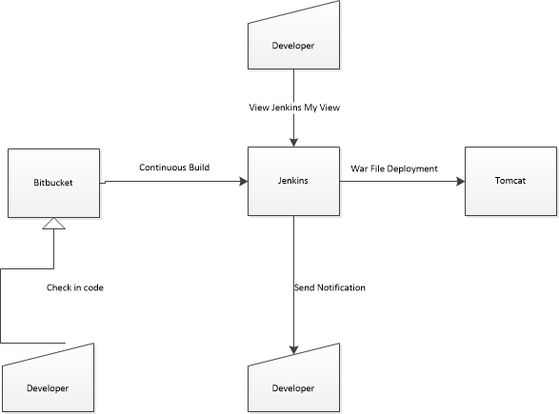
Continuous Delivery

Slide 8
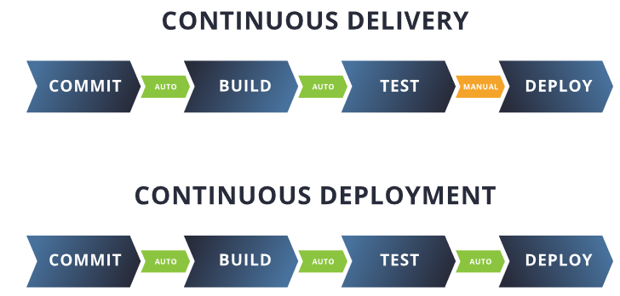
Continuous Deployment

Slide 9
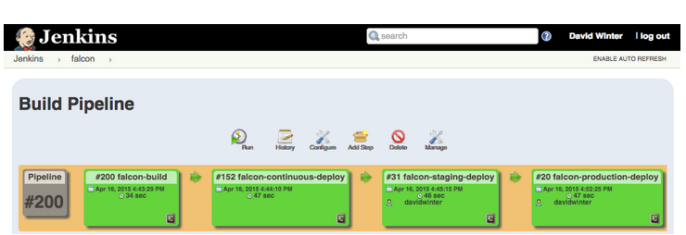
Jenkins Setup - Jenkinsfile
Create Jenkinsfile for Pipeline: Each Stage will end with a true/false check to ensure that the stage was run and returned the expected results. If the value is returned false at any stage, the deployment will automatically fail.
Sequential: sonar scan, linting, automated tests, etc
Parallel: multiple testers
Manual button click: https://plugins.jenkins.io/build-pipeline-plugin/

Slide 10
Jenkins Setup–Bitbuckets & Tomcat
Connect Jenkins to Bitbucket-> Configure Source Code Management (Repository URL, Branch to build, Credentials)
Setup Build Triggers and Build Environment
Connect Jenkins to Tomcat -> Configure Post-build Actions (WAR/EAR files, Containers: Tomcat 9.x remote, Tomcat URL: http://localhost:8081/, Credentials: C:\Dev\apache-tomcat-9.0.36\conf\tomcat-users.xml)

Slide 11
Sample Jenkinsfile
pipeline {
agent any
stages {
stage('Build') {
steps {
echo 'Building...'
echo "Running ${env.BUILD_ID} ${env.BUILD_DISPLAY_NAME}
on ${env.NODE_NAME} and JOB ${env.JOB_NAME}"
}
}
stage('Test') {
steps {
echo 'Testing...'
}
}
stage('Deploy') {
steps { echo 'Deploying...'
}
}
}
}

Slide 12
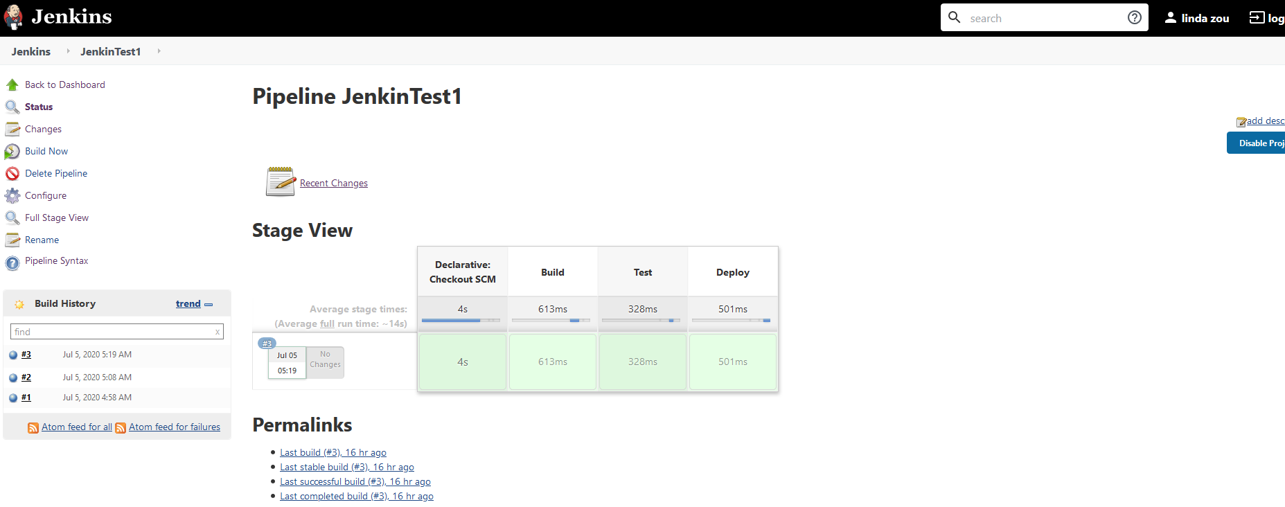
Localhost Jenkins

Slide 13
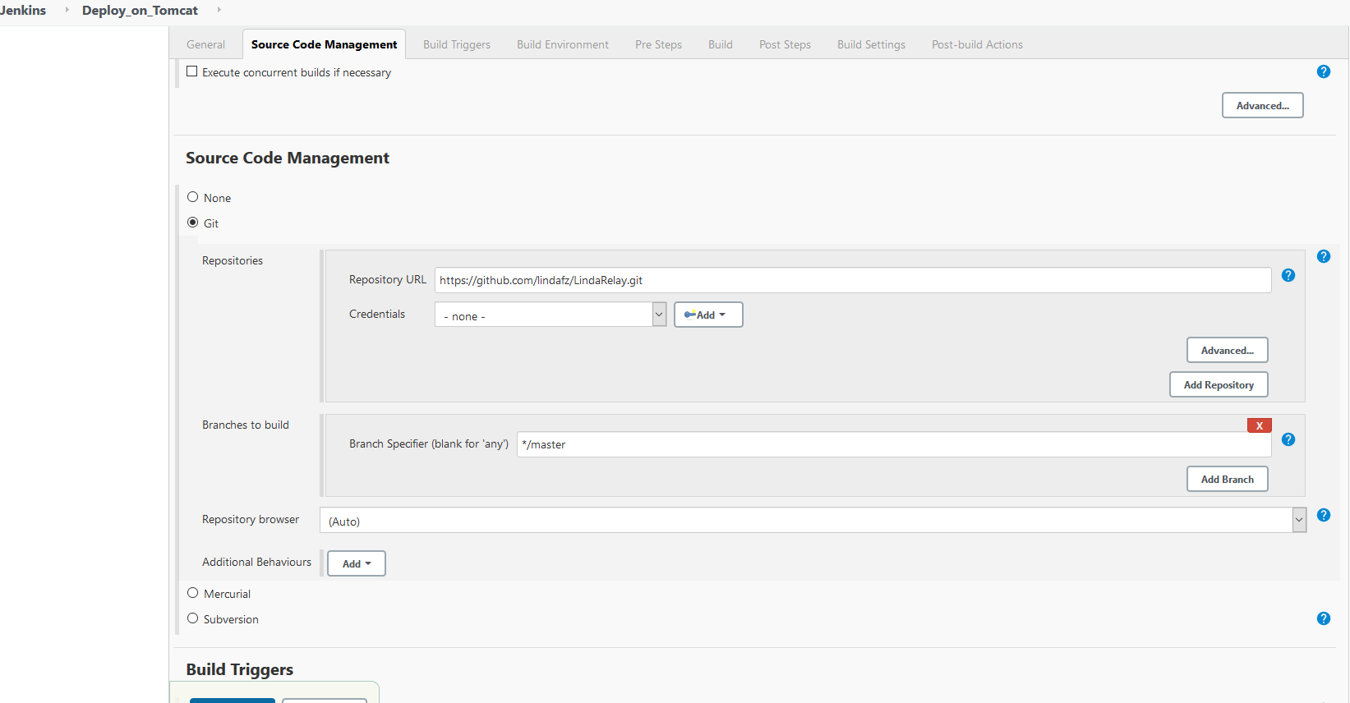
Localhost Jenkins

