Slide 1
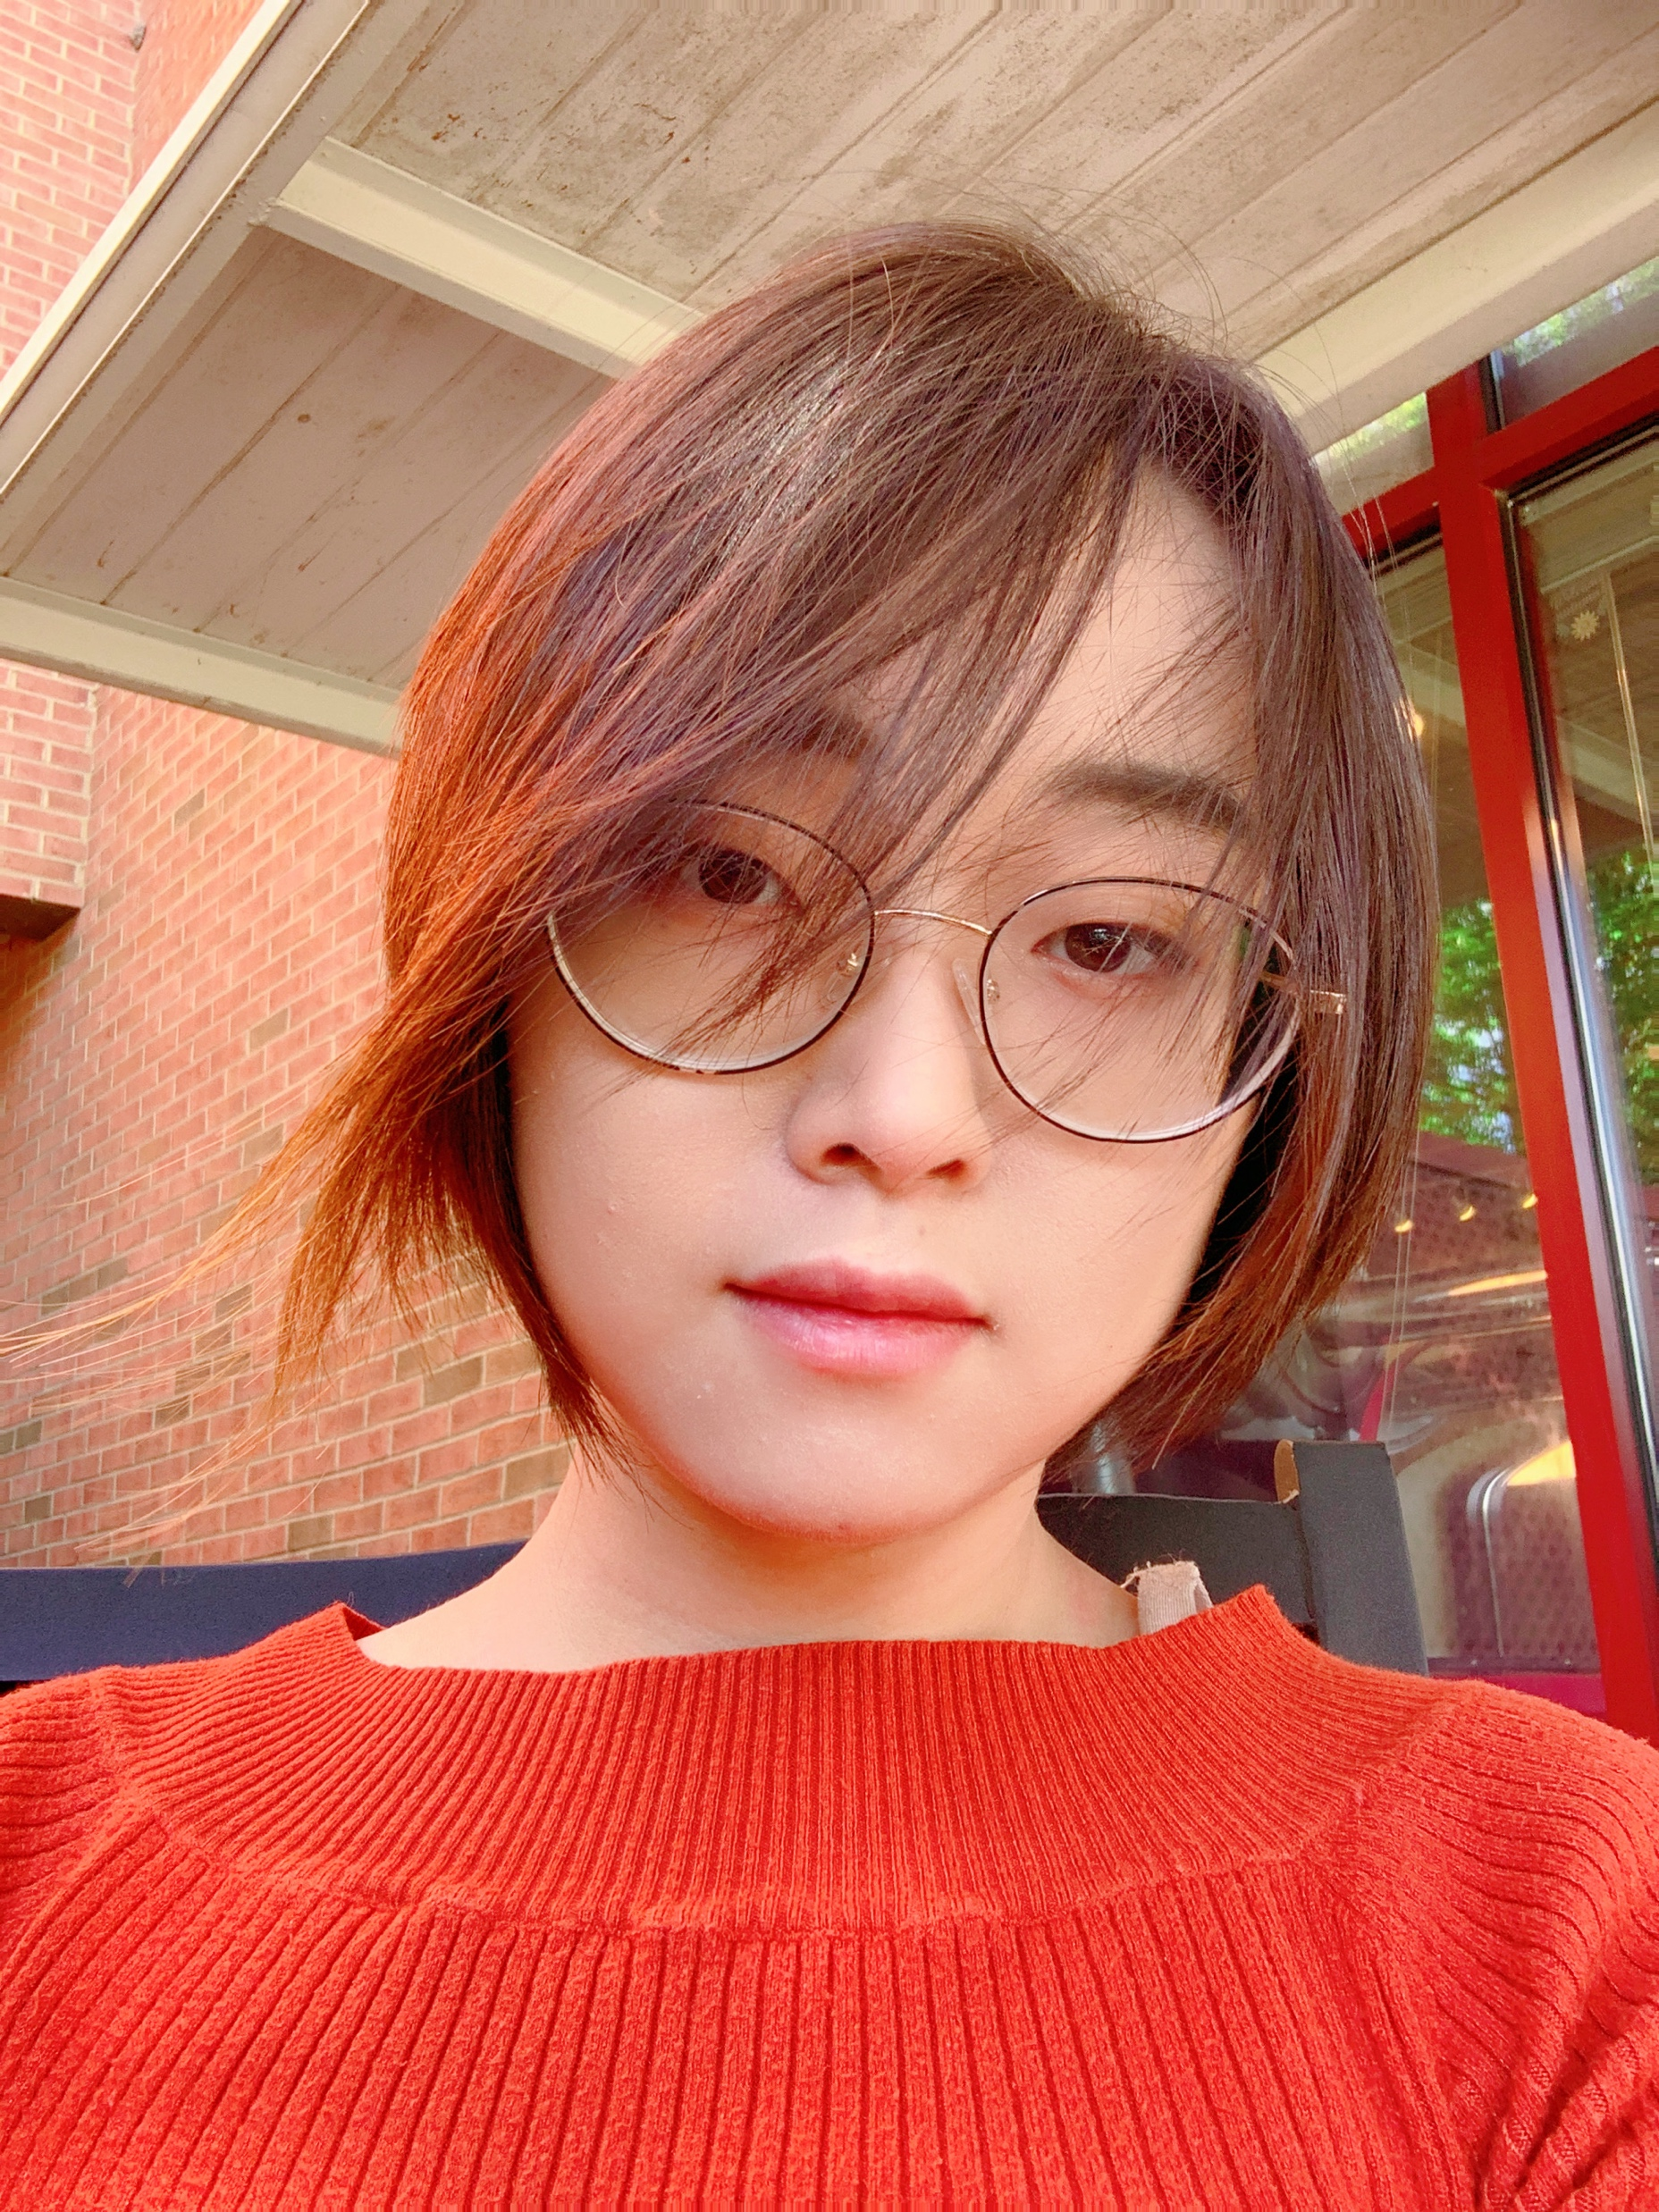
Position
01
Assistant Professor, Computer Science, W&M
Transfer Learning
02
A model trained on one task or dataset is adapted and fine-tuned for a different but related task
Domain Generalization
03
Domain generalization involves training models to perform well on unseen domains.
Ashley Gao
Smart Healthcare
04
The integration of TL and DG to enhance medical processes and make healthcare more efficient and personalized.

