Slide 1
EAA: Emotion-Aware Audio Large Language Models with Dual Cross-Attention and Context-Aware Instruction Tuning
Hongfei Du, Sidi Lu, Gang Zhou, Ashely Gao
William & Mary, USA

Slide 2

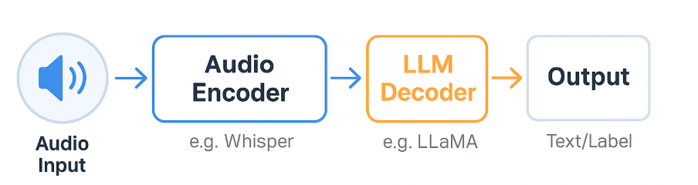
Background
Speech Emotion Recognition (SER) is vital for:
Human-computer interaction (e.g., empathetic dialogue agents)
Mental health
What are Audio LLMs (ALLMs)?
Emerging models that combine audio inputs with large language models
Recent models: Pengi, WavLLM, Qwen-Audio, SALMONN

Slide 3
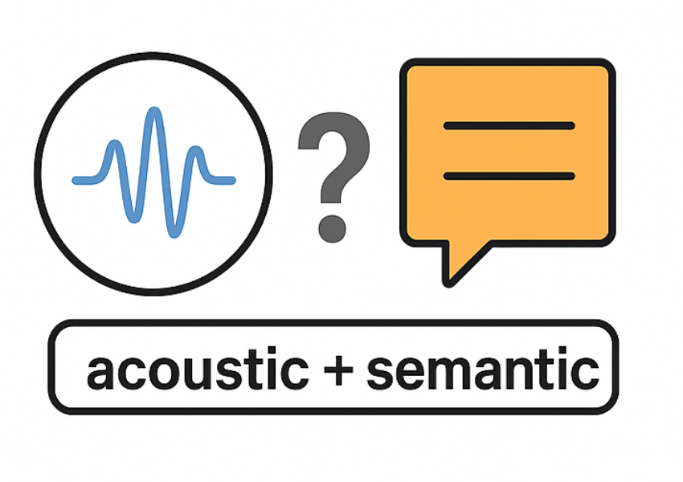

Motivation
Challenge 1:
Poor fusion between acoustic + semantic features
Challenge 2:
Lack of dialogue context modeling

Slide 4
Contribution
Dual Cross-Attention Fusion
Bidirectional attention between acoustic and semantic feature.
Learns which modality to prioritize dynamically based on emotional cues.
Context-Aware Instruction Tuning
Uses both current and prior utterances during fine-tuning
Prompt format: "Describe the speaker's emotion in one word"

Slide 5
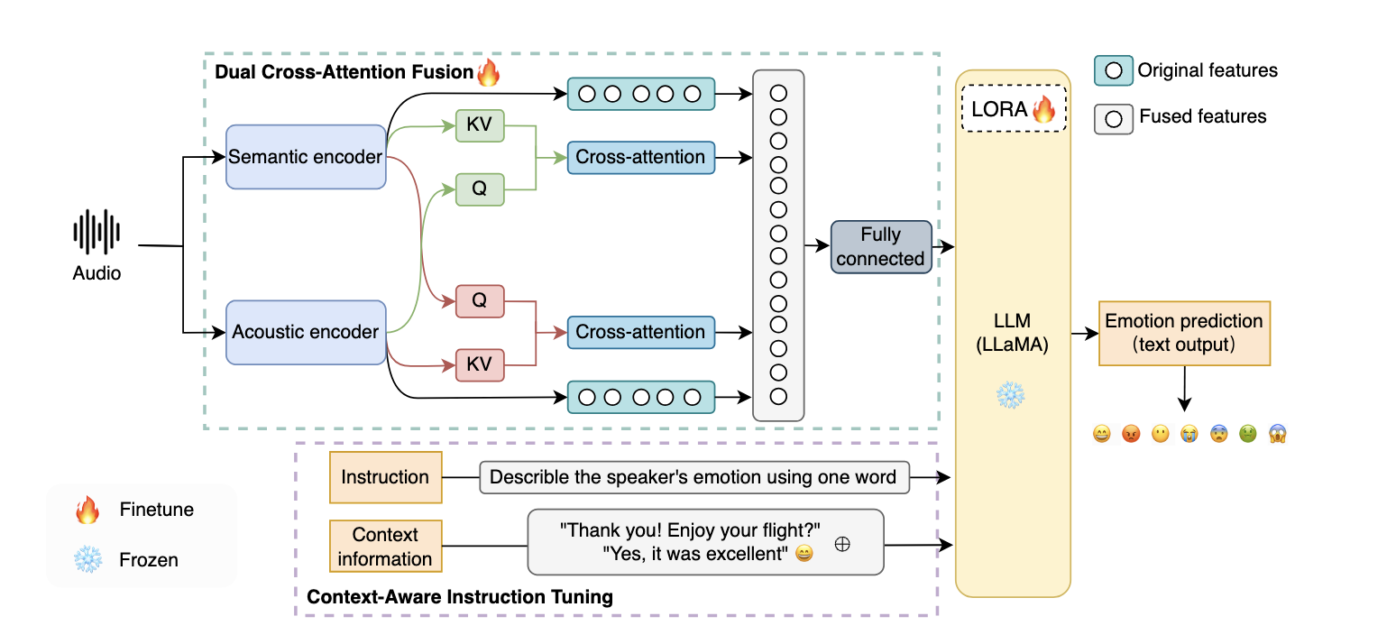
Architecture Overview
(Fuses acoustic & semantic features)
(Adds dialogue context & instruction)

Slide 6

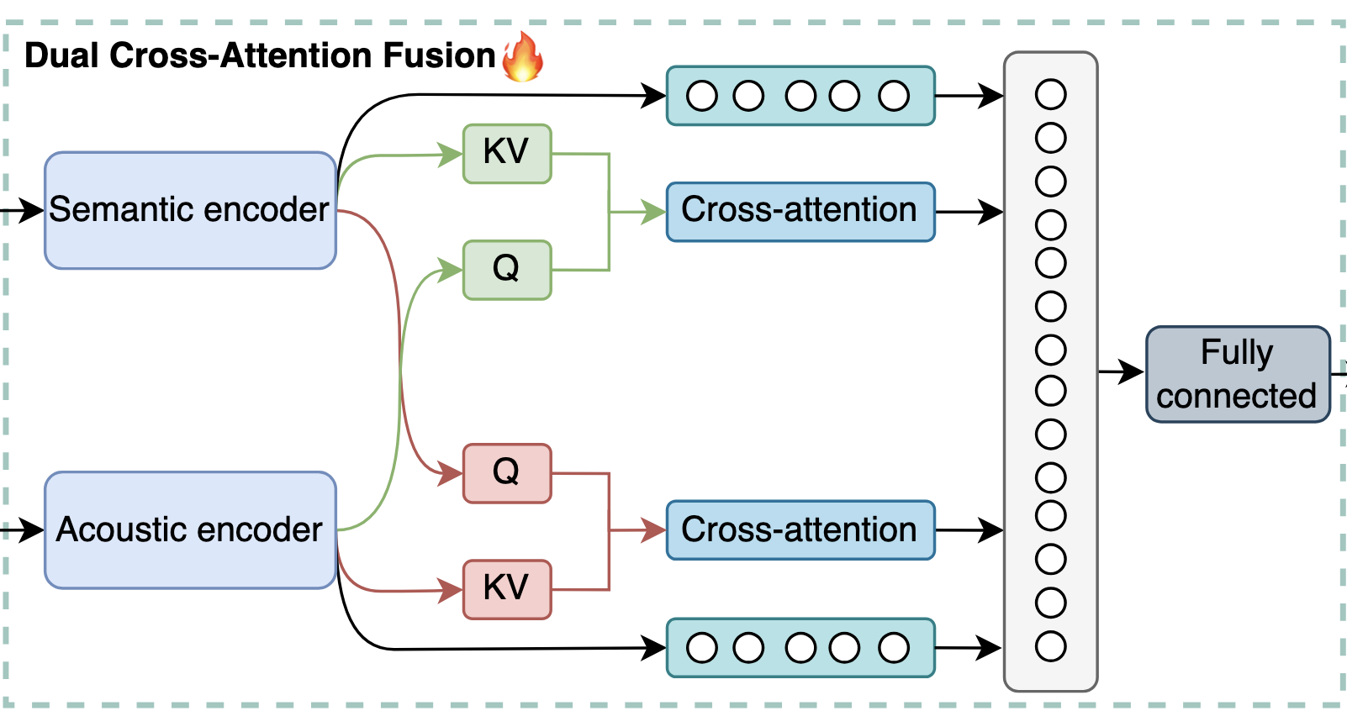

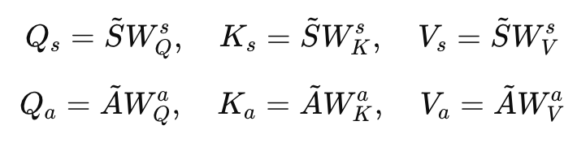
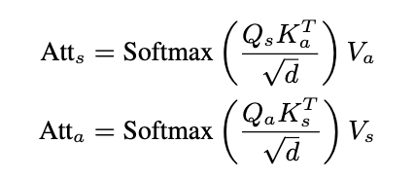
Dual Cross-Attention (Fusion Module)
Cross-attention enables dynamic, bidirectional fusion between acoustic and semantic features

Slide 7
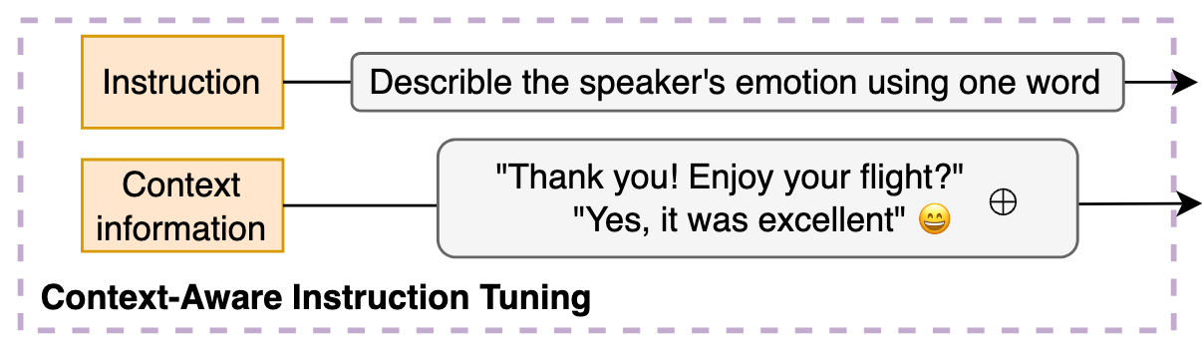

Context-Aware Instruction Tuning
Helps model distinguish ambiguous replies (“OK”, “Fine”) depending on context.

Slide 8
Experimental Setup
Dataset: MELD (7 emotions, 12.2 hours, 13,847 utterances)
Model: LLaMA-3-8B fine-tuned using LoRA:
Lora Rank: 2, α: 16, Dropout: 0.2
All encoder layers frozen except the last two
Optimizer: AdamW (lr = 5e-6, cosine decay)
Hardware: Experiments conducted on H100 GPUs

Slide 9
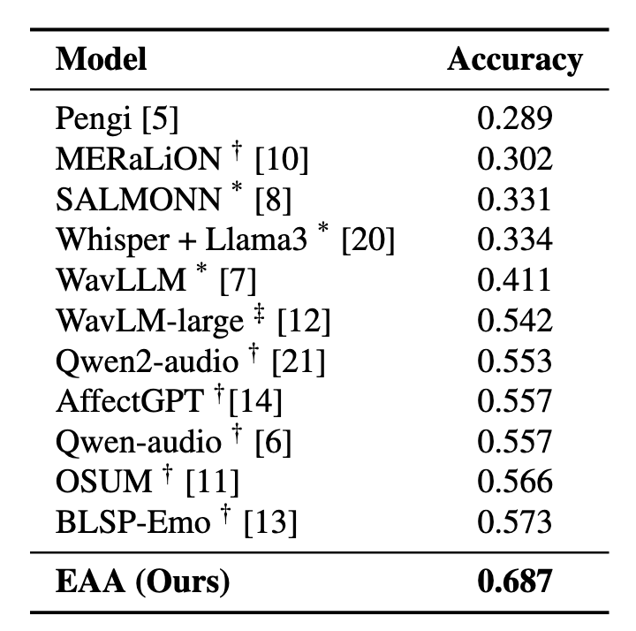
Results vs Existing ALLMs
Key insights:
EAA achieves the highest accuracy (+11.4%) over prior best (BLSP-Emo)
Strong improvements come from better modality fusion + context modeling

Slide 10
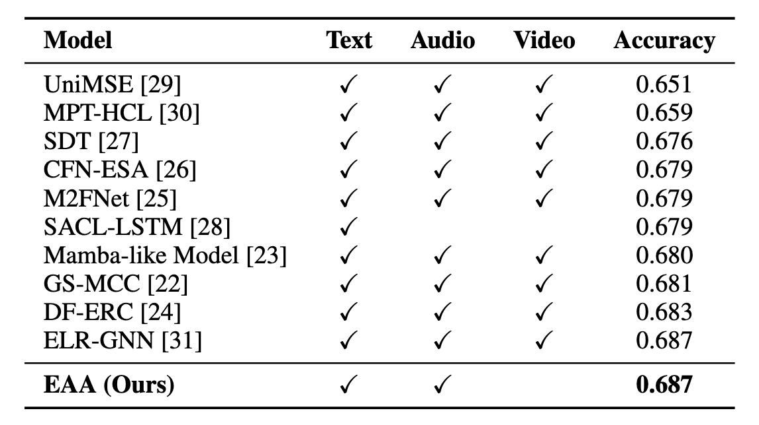
Results vs Traditional Models
EAA uses only audio + text (no video!)

Slide 11
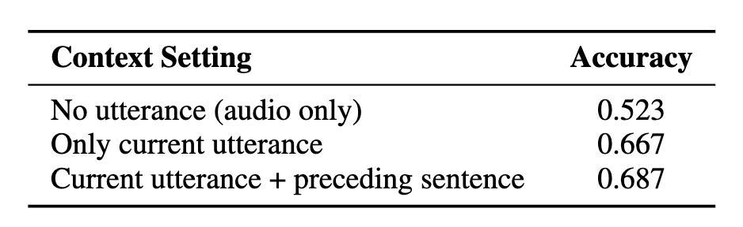
Ablation Study
Context-Aware Instruction Tuning
Adding text (utterance) dramatically boosts accuracy
Adding dialogue context gives further gains

Slide 12
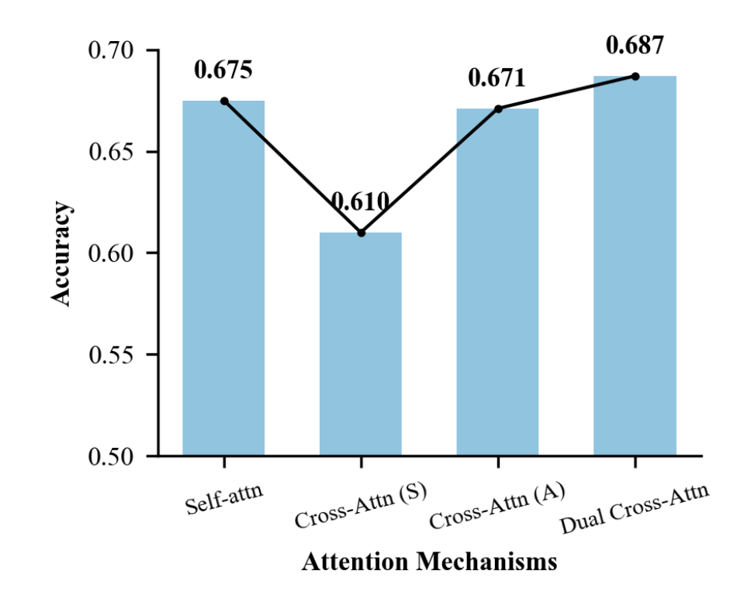
Ablation Study
Dual Cross-Attention
Self-attention: each modality processed independently
Cross-attention (S): semantic as query, acoustic as key-value
Cross-attention (A): acoustic as query, semantic as key-value
Dual cross-attention: both modalities attend to each other bidirectionally
Dual cross-attention achieves the best performance, validating the importance of bidirectional modality fusion
Cross-attention with acoustic queries and semantic keys/values is more effective than the reverse direction.

Slide 13
Takeaways
EAA introduces:
Dual cross-attention for better feature integration
Context-aware prompts for better emotion grounding
State-of-the-art emotion accuracy for audio LLMs

Slide 14


