Slide 1
EMO-TTA
Improving Test-Time Adaptation of Audio-Language Models
for Speech Emotion Recognition
Jiacheng Shi, Hongfei Du, Y. Alicia Hong, Ye Gao
College of William & Mary · George Mason University
Training-free
Single-sample TTA
No model updates
OOD SER
Audio
stream
Frozen
ALM
Streaming
EM
Emotion
prediction
ICASSP 2026 Oral Presentation

Slide 2
Background: Audio–Language Models for SER
CLAP-style models classify emotions by matching audio embeddings with emotion text prototypes.
Zero-shot emotion recognition
But deployment is different
OOD shifts: speaker, channel, noise, language, label taxonomy SER is ambiguous: emotion is less structured than ASR Frozen ALMs degrade: zero-shot similarity alone is brittle
Test audio
aₜ
Audio
encoder f(·)
Embedding
Cosine similarity
+ softmax
Emotion label
Text prompts
“This is a happy sound”
Text
encoder g(·)
Class
prototypes
Question: Can we adapt at test time without training or buffering?
EMO-TTA: Training-Free Test-Time Adaptation for SER · ICASSP 2026
2

Slide 3
Motivation: Practical TTA Has Stricter Requirements
Existing TTA directions
Deployment friction
Emo-TTA target
Prompt / adapter tuning
Requires updates
→ latency / instability
Training-free
Batch-wise entropy minimization
Needs test batches
→ buffering / privacy issues
Single-sample adaptation
Retrieval / heuristic calibration
Explicit test distribution estimation
No explicit distribution
→ weak adaptation signal
No source data · No weight updates · No sample storage
EMO-TTA: Training-Free Test-Time Adaptation for SER · ICASSP 2026
3

Slide 4
Core Idea: Estimate the Test-Time Emotion Distribution
Instead of updating the model, update the statistics around emotion prototypes.
Frozen ALM
embedding Fₜ
Initialize
μᵧ = text prototype
E-step
soft responsibility γᵧ,ₜ
M-step
update μ, Σ, π
Prediction
CLAP + GDA
Streaming EM in CLAP embedding space
Why this helps
p(Fₜ | y) = 𝒩(Fₜ | μᵧ, Σ)
Distribution-aware
not just heuristic smoothing
Incremental
works with streaming tests
Model-preserving
no gradient update
γᵧ,ₜ ∝ πᵧ · 𝒩(Fₜ | μᵧ, Σ)
EMO-TTA: Training-Free Test-Time Adaptation for SER · ICASSP 2026
4

Slide 5
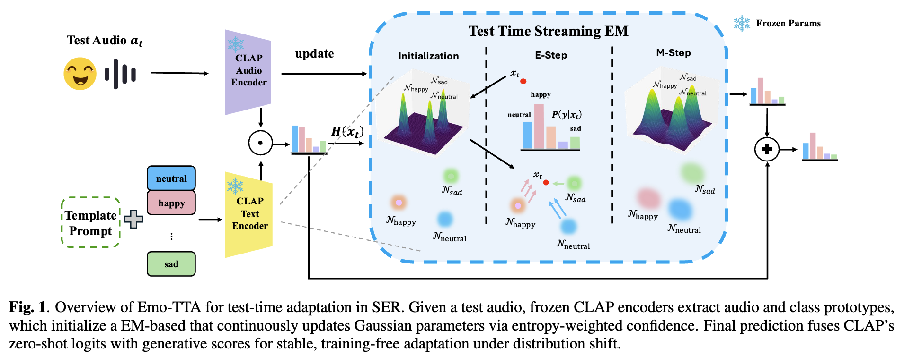
Method Overview: Emo-TTA
A frozen ALM provides semantic anchors; streaming EM adapts class statistics online.
EMO-TTA: Training-Free Test-Time Adaptation for SER · ICASSP 2026
5

Slide 6
Emo-TTA as Gaussian Discriminant Analysis
We estimate class-conditional distributions in the frozen ALM embedding space.
Class likelihood
Posterior responsibility
p(Fₜ | y) = 𝒩(Fₜ | μᵧ, Σ)
γᵧ,ₜ = πᵧ𝒩(Fₜ|μᵧ,Σ) / Σⱼ πⱼ𝒩(Fₜ|μⱼ,Σ)
Fₜ = CLAP audio embedding
μᵧ = emotion prototype
Σ = shared covariance
γᵧ,ₜ softly assigns each test sample
to emotion classes during inference.
Prediction rule
Intuition: nearest emotion distribution
under Mahalanobis distance.
y* = argmaxᵧ [ log πᵧ − ½(Fₜ−μᵧ)ᵀΣ⁻¹(Fₜ−μᵧ) ]
EMO-TTA: Training-Free Test-Time Adaptation for SER · ICASSP 2026
6

Slide 7
Stabilizing TTA with ALM Priors and Confidence
Early test samples can be uncertain; Emo-TTA uses CLAP confidence to control how much each sample updates the distribution.
Confidence from entropy
Incremental update
H(aₜ) = −Σᵧ P_CLAP(y|aₜ) log P_CLAP(y|aₜ)
μᵧ ← (Nᵧμᵧ + w(H)γᵧ,ₜFₜ) / (Nᵧ + w(H)γᵧ,ₜ)
w(H) = exp(−βH)
Nᵧ ← Nᵧ + w(H)γᵧ,ₜ
Low entropy → confident → stronger update
High entropy → uncertain → weaker update
Semantic grounding from text prototypes
+ drift control from confidence weighting
Final fusion
logitsᵧ = TᵧᵀF + α(wᵧᵀF + bᵧ)
EMO-TTA: Training-Free Test-Time Adaptation for SER · ICASSP 2026
7

Slide 8
Algorithm: Single-Sample Streaming Emo-TTA
For each incoming test utterance, Emo-TTA performs one lightweight EM update and predicts immediately.
1
Encode
Extract CLAP audio embedding Fₜ from test audio aₜ
2
E-step
Compute responsibility γᵧ,ₜ using current Gaussian statistics
3
Confidence
Weight the update by entropy-based confidence w(H)
4
M-step
Update class prior πᵧ, mean μᵧ, and covariance Σ
5
Predict
Fuse CLAP logits with GDA logits for final emotion label
EMO-TTA: Training-Free Test-Time Adaptation for SER · ICASSP 2026
8

Slide 9
Experimental Setup: Out-of-Domain SER
Evaluation focuses on cross-corpus robustness under distribution shift.
Six SER benchmarks
Backbones
IEMOCAP
dialogue
MELD
TV dialogue
RAVDESS
studio
CLAP-PANN-14
CLAP-HTSAT
TESS
acted
SAVEE
acted
CREMA-D
crowd
Baselines
Strict setting
CoOp / CoCoOp
Treff-Adapter
TPT
Batch size = 1
No backpropagation
No source access
MTA / ZERO
Foundation audio models
Metric: mean top-1 accuracy over three runs
EMO-TTA: Training-Free Test-Time Adaptation for SER · ICASSP 2026
9

Slide 10
Main Result: Best Training-Free OOD Adaptation
Emo-TTA consistently improves average accuracy over prompt-learning and TTA baselines.
+6.65
+7.90
10/12
over zero-shot CLAP
(PANN-14 Avg)
over zero-shot CLAP
(HTSAT Avg)
best dataset/backbone
combinations
Key takeaway: explicit test-time distribution estimation outperforms optimization-heavy or heuristic TTA.
EMO-TTA: Training-Free Test-Time Adaptation for SER · ICASSP 2026
10

Slide 11
What Drives the Gain? Foundation Comparison and Ablation
Against foundation audio models
Ablation: each component matters
+4.28
+10.96
Updating covariance and using ALM priors are critical for stable adaptation under distribution shift.
over SELM
over CLAP
EMO-TTA: Training-Free Test-Time Adaptation for SER · ICASSP 2026
11

Slide 12
Conclusion
Emo-TTA enables practical test-time adaptation for speech emotion recognition under distribution shift.
1
Training-free adaptation
2
Streaming distribution estimation
3
Robust OOD performance
No model weight update
No source data access
No prompt tuning
Incremental EM updates
Class means, covariance, priors
Single-sample operation
Consistent gains across
6 SER benchmarks
2 CLAP backbones
Takeaway: adapt the distribution, not the model.
Thank you!
EMO-TTA: Training-Free Test-Time Adaptation for SER · ICASSP 2026
12

