Slide 1

Emotion-Aligned Generation in Diffusion TTS via Preference-Guided Optimization
Jiacheng Shi¹, Hongfei Du¹, Yangfan He², Y. Alicia Hong³, Ye Gao¹
¹ College of William and Mary
² University of Minnesota - Twin Cities,
³ George Mason University

Slide 2
Motivation
Existing alignment
Limitation
Research Question
Flawed assumption: all steps are equally preferred
Final waveform preference
Move from endpoint supervision
→ stepwise supervision
Apply the same signal
to all steps
Emotion is formed progressively during denoising
• Emotion cues are local and temporally varying
• Endpoint supervision is too sparse to capture this ^{[1]}
[1]: Emo-DPO (Gao et al., ICASSP’25)
Emotion-Aligned Generation in Diffusion TTS via Preference-Guided Optimization · ICASSP 2026

Slide 3
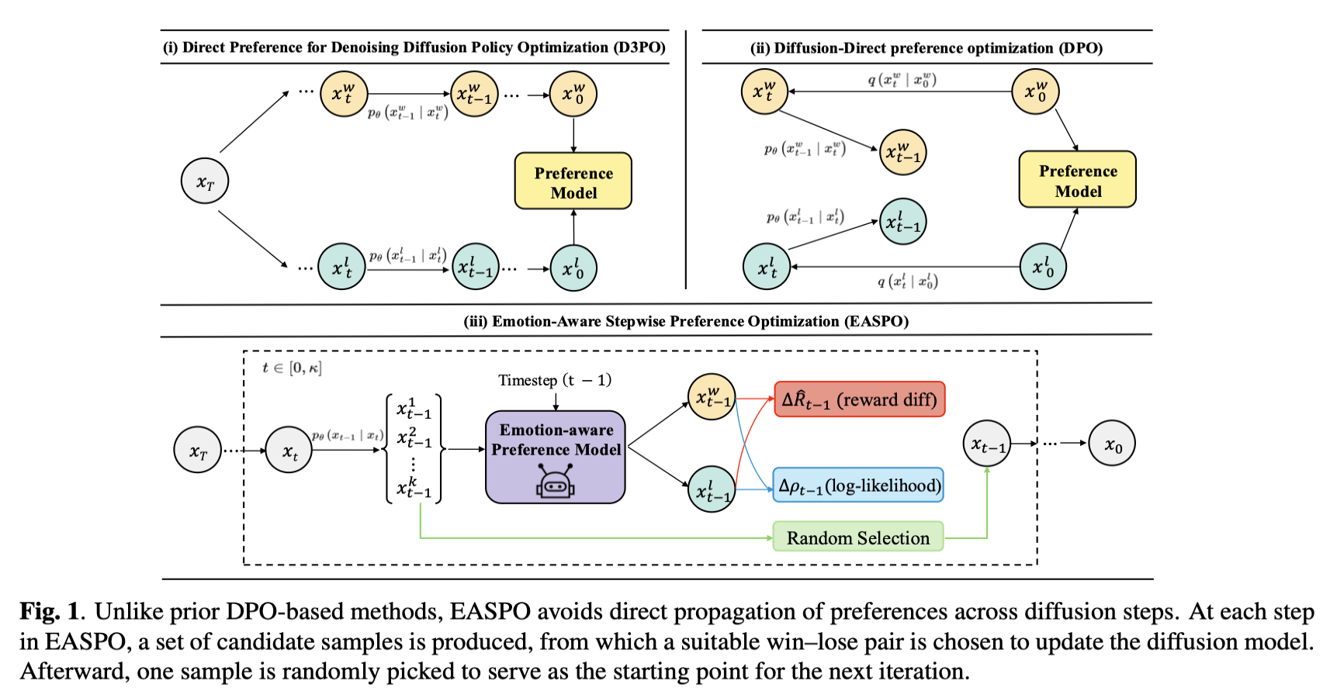
Method
1. Sample k candidates from the same latent
2. Score each candidate with EASPM
3. Use best–worst pair for stepwise alignment
4. Randomly continue rollout to avoid biased paths
Why it matters
Localized differences isolate emotion/prosody
Shared latent keeps content and noise comparable
Dense feedback steers the full diffusion trajectory
Emotion-Aligned Generation in Diffusion TTS via Preference-Guided Optimization · ICASSP 2026

Slide 4
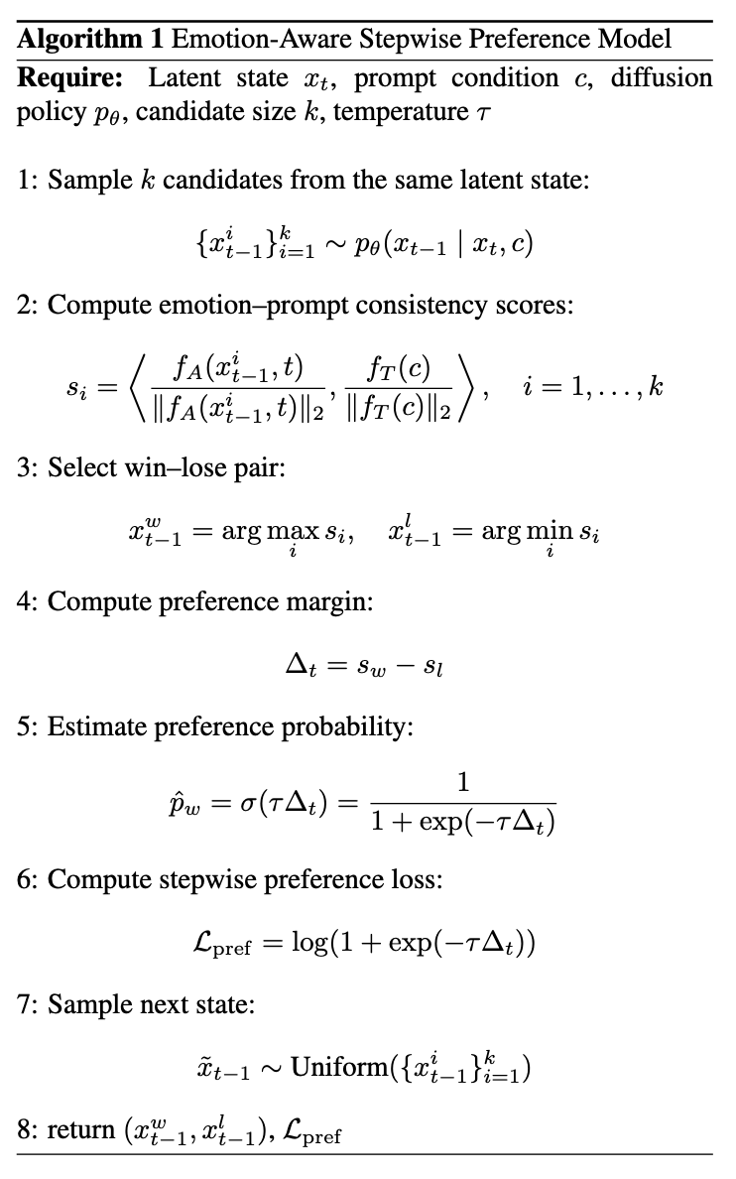
EASPM: a timestep-aware emotion preference scorer
Emotion-Aligned Generation in Diffusion TTS via Preference-Guided Optimization · ICASSP 2026
Notes:
Now let me explain EASPM, the timestep-aware emotion preference scorer.
EASPM is responsible for answering a local question: among several candidate intermediate states at the same denoising step, which one better matches the target emotional prompt?
We build EASPM on top of CLEP, a contrastive audio-language model for emotional speech. The audio branch encodes the noisy intermediate mel-spectrogram together with the timestep, and the text branch encodes the emotion prompt. We then compute the normalized inner product between the audio embedding and the text embedding.
This gives us an emotion–prompt consistency score for each candidate.
The important design is timestep conditioning. Intermediate diffusion states are noisy and their acoustic structure changes over time. A scorer that works on clean audio may not correctly evaluate noisy intermediate states. By making the scorer timestep-aware, EASPM can provide meaningful preference scores across different denoising stages.

Slide 5




EASPO objective: match reward differences with policy preference shifts
Dense reward gap
Log-ratio gap
Stepwise alignment
How to read the objective
Why difference matching?
Practical training
• EASPM says which local transition is more emotional
• Reference policy stabilizes diffusion fine-tuning
• Time weight controls where alignment is strongest
• Uses relative preference, not absolute reward
• Avoids high-variance policy gradients
• Aligns subtle prosodic differences
• Skip high-noise early steps
• Sample k = 4 candidates
• Fine-tune only score decoder
Outcome: controllable emotional shaping throughout the denoising trajectory
Emotion-Aligned Generation in Diffusion TTS via Preference-Guided Optimization · ICASSP 2026

Slide 6
Experimental setup
Training pipeline
MSP-Podcast
≈55k utterances
>1,200 speakers
Train EASPM
CLEP initialized
time-aware scoring
ESD English
5 emotions × 10 speakers
8:1:1 split
Fine-tune Grad-TTS
score decoder only
HiFi-GAN vocoder
Baselines
Objective metrics
Subjective metrics
• FG-TTS, PromptTTS, EmoSpeech
• EmoDiff, CosyVoice, CosyVoice2
• EmoVoice + diffusion RL methods
• Emo SIM: emotion2vec cosine
• Prosody SIM: AutoPCP
• WER: Whisper Large-v3
• UTMOS: perceptual quality
• 20 raters
• MOS / Emo MOS / MOS EC
• Emotion Recall over 5 choices
Goal: measure emotion alignment, prosody, intelligibility, and perceptual quality
Emotion-Aligned Generation in Diffusion TTS via Preference-Guided Optimization · ICASSP 2026

Slide 7
Main results: stronger emotion alignment with competitive quality
99.15
3.89
3.74
4.47
4.28
85.84
Emo SIM
Prosody SIM
WER
UTMOS
Emo MOS
Recall
best overall
best overall
lowest error
best quality
human rated
human emotion ID
Objective comparison
Subjective evaluation
Emo SIM
MOS
Ours
99.15
Ours
3.94
CosyVoice2
98.47
CosyVoice2
3.63
EmoVoice
98.59
EmoVoice
3.56
Prosody SIM
Emo MOS
Ours
3.89
Ours
4.28
CosyVoice2
3.78
CosyVoice2
3.71
EmoVoice
3.67
EmoVoice
3.79
EASPO improves expressiveness and naturalness while preserving intelligibility.
Emotion-Aligned Generation in Diffusion TTS via Preference-Guided Optimization · ICASSP 2026

Slide 8
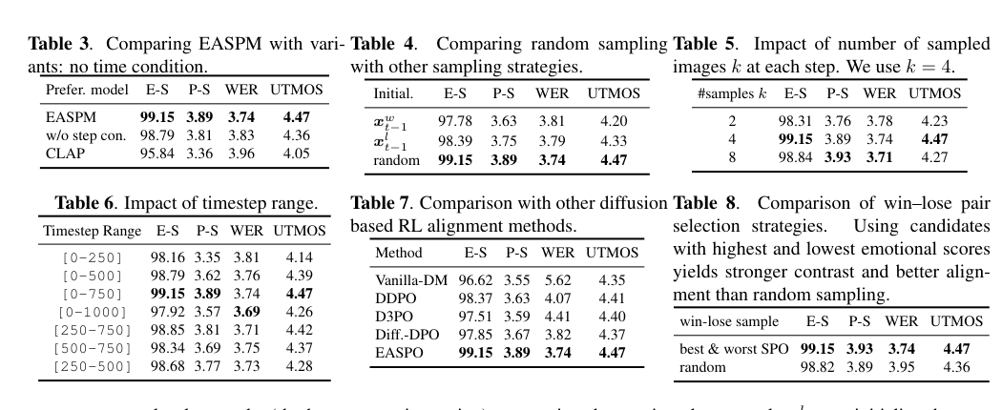
Ablations: what makes stepwise alignment work?
Time-aware scoring matters
EASPM > w/o step condition
Random rollout avoids
degenerate paths
Moderate candidate pool
k = 4 balances contrast & quality
EASPO beats DDPO, D3PO, Diff-DPO
Interpretation
• Scoring noisy intermediate states requires timestep conditioning.
• Continuing with only the winner biases the denoising trajectory.
• Best–worst pairs create stronger emotional contrast than random pairs.
• Aligning a middle/late timestep window is more stable than using all steps.
Key finding: stepwise local contrast is more informative than endpoint preference propagation.
Emotion-Aligned Generation in Diffusion TTS via Preference-Guided Optimization · ICASSP 2026

Slide 9

Audio Comparison
Sample 1 (Angry)
Text: No, I burst the balloon!
Target
EmoSpeech
CosyVoice2
Ours
Sample 2 (Surprise)
Text: The football teams give a tea party.
Target
EmoSpeech
CosyVoice2
Ours
Emotion-Aligned Generation in Diffusion TTS via Preference-Guided Optimization · ICASSP 2026

Slide 10
Conclusion: dense emotional preference signals for diffusion TTS
Problem
Endpoint preferences are sparse for evolving emotion/prosody.
Method
EASPM scores local candidates; EASPO aligns reward and likelihood differences.
Result
Better emotion similarity, prosody, naturalness, and human-rated recall.
Takeaways
Future direction: extend stepwise preferences from categorical emotion to richer paralinguistic and human preference signals.
• Stepwise preference optimization fixes the sparse-supervision limitation of endpoint DPO.
• Time-conditioned emotion scoring enables dense, localized supervision over noisy diffusion states.
• Preference-guided diffusion alignment improves emotional expressiveness without sacrificing intelligibility.
Thank you!
Questions?
Emotion-Aligned Generation in Diffusion TTS via Preference-Guided Optimization · ICASSP 2026

