Slide 1

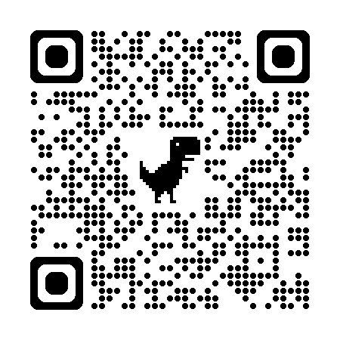
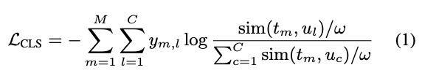
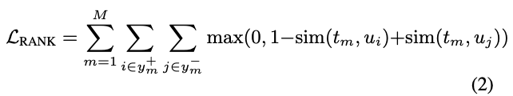
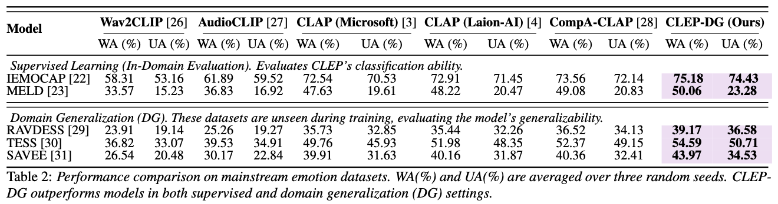
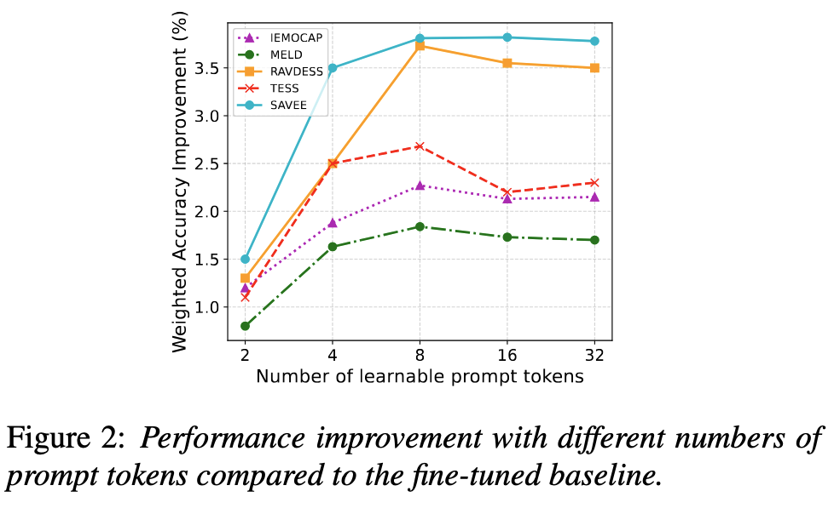
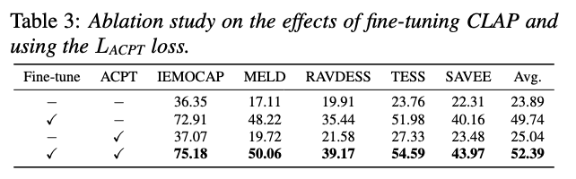
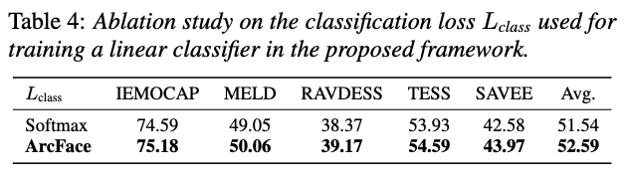
CLEP-DG: Contrastive Learning for Speech Emotion Domain Generalization via Soft Prompt Tuning
Jiacheng Shi, Yanfu Zhang, Ye Gao
The College of William & Mary
1.Motivation
Generalization Gap: Existing SER models perform poorly under unseen acoustic conditions due to domain shifts (e.g., background noise, recording environment).
CLAP’s Limitation: Although CLAP provides strong audio-text alignment, it lacks dedicated mechanisms for modeling fine-grained emotional cues.
Heavy Supervision Burden: Prior adaptations of CLAP for SER require retraining on domain-specific labeled emotional audio, limiting scalability.
Prompt-Based Adaptation Potential: Recent advances in soft prompt tuning in vision-language models suggest a lightweight alternative for domain generalization without additional labeled data.
Key Hypothesis: Simulating diverse acoustic contexts via textual prompts can enable emotion-aware generalization in CLAP models.
2.Method
CLEP-DG introduces a unified framework that enhances CLAP’s emotion modeling and cross-domain robustness through three components:
CLEP: A CLAP variant fine-tuned on large-scale emotional speech corpora to improve emotion-audio alignment.
ACPT (Acoustic Context Prompt Tuning): A soft prompt learning method that simulates diverse acoustic conditions using learnable tokens.
Cross-Modal Classifier: A linear classifier trained on text-derived emotion representations, applied to audio embeddings during inference.
Acoustic Context Prompt Tuning for Soundscape
4. Experiment
5.Alation Study
6.Conclusion
We propose CLEP-DG, a CLAP-based framework that enhances speech emotion recognition through soft prompt tuning. By simulating diverse acoustic conditions with Acoustic Context Prompt Tuning (ACPT) and leveraging cross-modal transfer, CLEP-DG achieves strong generalization without requiring labeled audio from new domains, and sets a new state-of-the-art across multiple SER benchmarks.

