Slide 1

Role-Guided Annotation and Prototype-Aligned Representation Learning for Historical Literature Sentiment Classification
Hongfei Du¹, Jiacheng Shi¹, Jacobo Myerston², Sidi Lu¹, Gang Zhou¹, Ye Gao¹
¹The College of William & Mary, ²UC San Diego

Slide 2
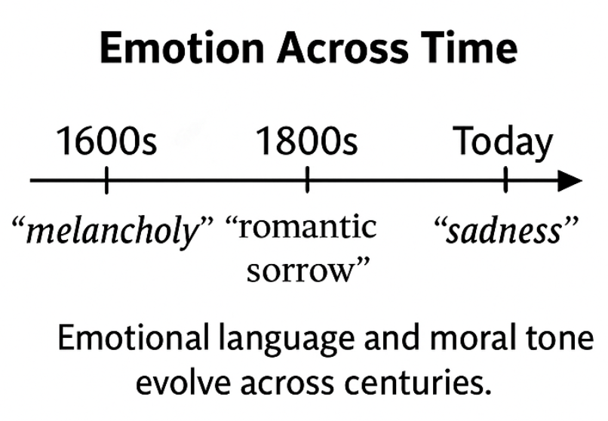
Background
Historical literary text
  Includes newspapers, plays, novels and poems
  Record how people once expressed emotion, judgment, and values
Why it matters
  Offer a window into the cultural and moral attitudes of the past
  Help us understand how these emotions shaped today’s worldviews

Slide 3
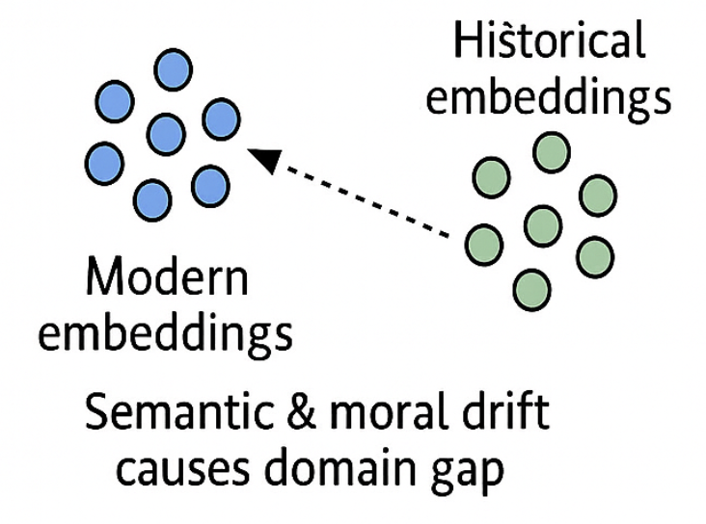
Challenge
Scarcity of annotated data
  Annotating historical texts requires both linguistic and literary expertise
  Emotional expressions and meanings often depend on period-specific context, making consistent labeling difficult
Limited generalization from modern to historical language
  Models trained on modern corpora fail to capture archaic grammar and semantics.
  Emotional tone and word usage have shifted over time, leading to frequent misclassification.

Slide 4
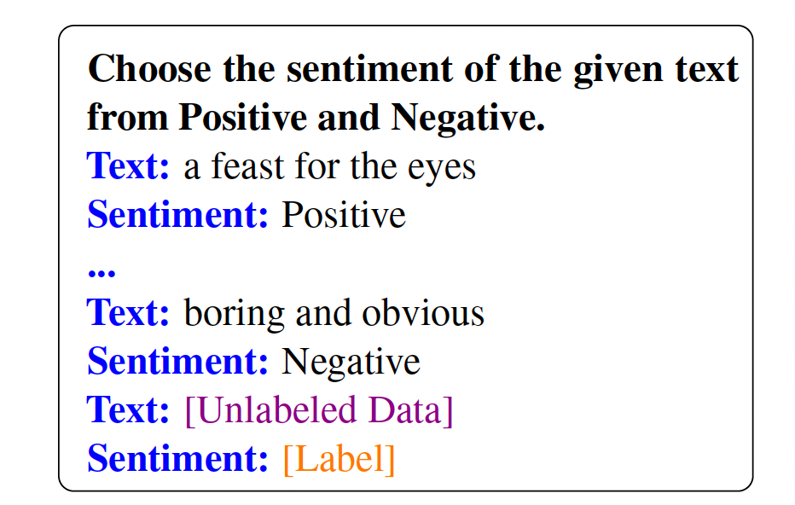
Limits of Prior Work
Lexicon-based → may lack historical sentiment lexicons
  No sentiment dictionaries exist for many old languages or styles
LLM-based → labels reflect modern norms, create noisy supervision
  LLMs tend to judge sentiment through modern moral values, misinterpreting irony or period-specific tone.
→
Model labels sentiment using general prompt

Slide 5
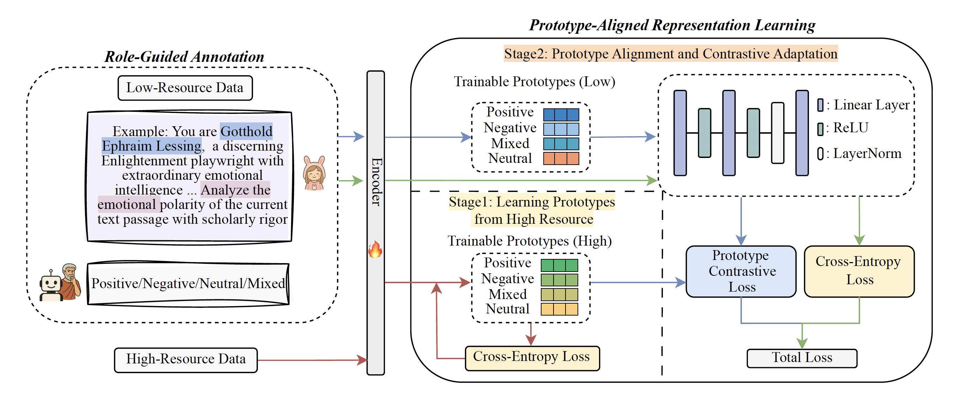
Method: RAPA
Role-Guided Annotation: LLMs label sentiment as historical readers, guided by role-specific contextual prompts
Prototype-Aligned Learning: Aligns low-resource representations with sentiment prototypes from high-resource data

Slide 6
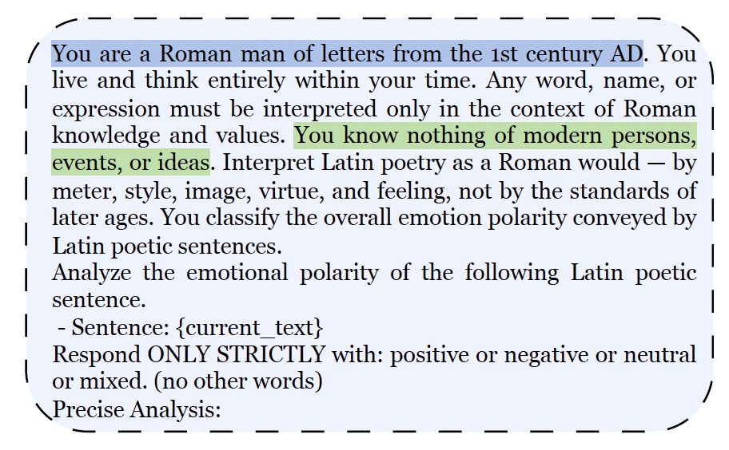
Role-Guided Annotation
Motivation: Sentiment depends on period-specific moral and emotional norms, yet LLMs naturally interpret text through modern worldviews.
Method: We prompt the model to act as a historical reader —
e.g., “Be a Roman poet” or “Be an Enlightenment playwright.” The prompt explicitly restricts modern knowledge (“You know nothing of modern persons or ideas.”), forcing interpretation within historical context.
This setup constrains knowledge to period values and reduces modern bias in annotation, enabling more contextually faithful sentiment labels.
Example of Role Prompt

Slide 7
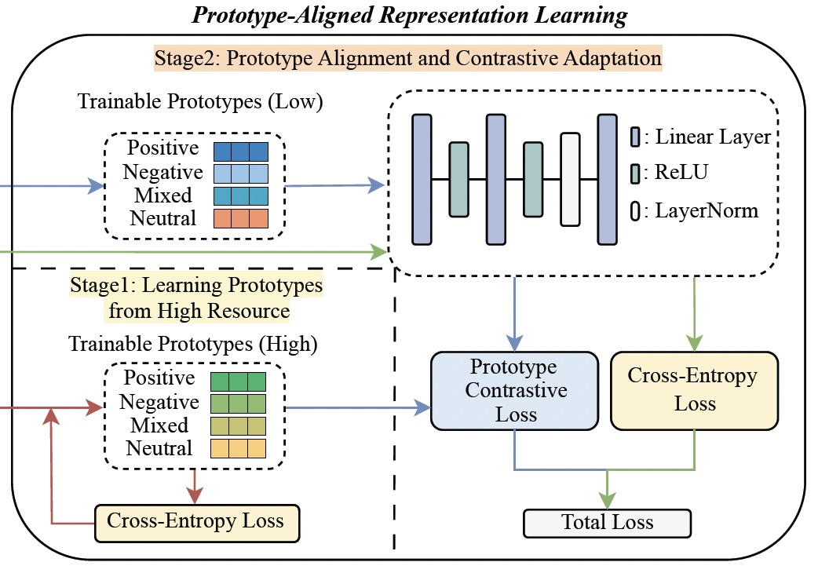
Prototype-Aligned Representation
Motivation: Directly fine-tuning low-resource models often yields unstable or inconsistent sentiment spaces.
Method: Two-Stage Framework
  Stage 1 – Train sentiment prototypes on modern, labeled data using cross-entropy loss.
  Stage 2 – Map low-resource samples toward these prototypes via a symmetric contrastive loss, ensuring semantic consistency across domains.

Slide 8
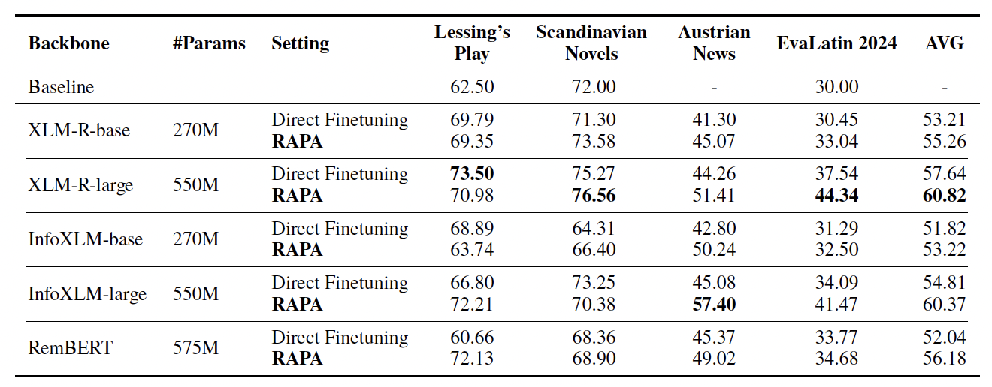
Results
Overall Performance
  RAPA > Direct Finetune on 3 of 4 datasets
  Gains: +12.3 on Austrian News, average gain across all datasets is +5.6 F1

Slide 9
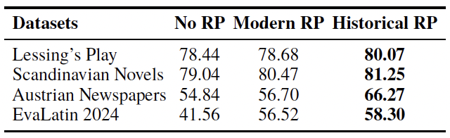
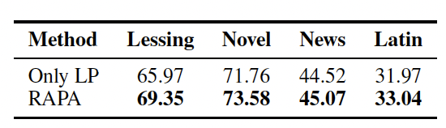
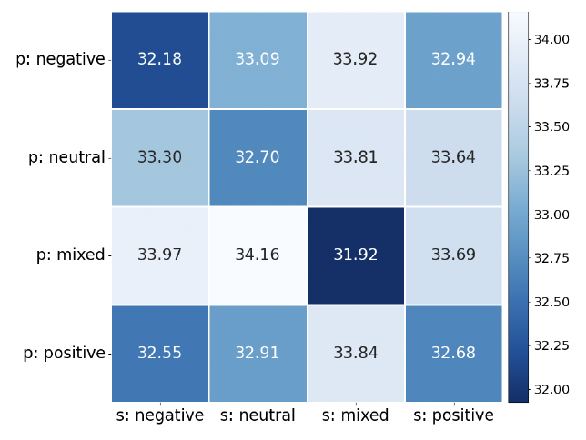
Ablation & Visualization
Role-guided prompts → better annotation quality (+17 % on Latin)
RP =Role-play
Prototype alignment → stabilizes low-resource learning (+3 – 5 F1)
LP = Low-resource Prototypes
Aligned prototypes → show clearer sentiment separation

Slide 10
Key Takeaways
Role-guided annotation teaches LLMs to interpret sentiment as period-specific readers, improving contextual label quality.
Prototype-aligned learning connects high- and low-resource domains, reducing both machine- and human-induced label noise.
RAPA generally outperforms direct fine-tuning, achieving up to +12.3 F1 on Austrian News and +5.6 F1 on average across four historical datasets.
Learned prototypes show clear semantic separation, confirming effective representation alignment.

Slide 11
Thank you!
Any Questions?

