Slide 1
JavaScript程式設計 (JavaScript Programming)
109 學年度 第 1 學期
蘇俊銘(Jun-Ming Su)
jmsu@mail.nutn.edu.tw
數位學習科技學系, 國立台南大學
2020

Slide 2
CH 14 (Eloquent) Document Object Model (DOM)
browser builds up a model of the document’s structure and uses
this model to draw the page on the screen
It is a data structure that you can read or modify.
It acts as a live data structure:
when it’s modified,
the page on the screen is updated to reflect the changes.

Slide 3
Document structure
an HTML document as a nested set of boxes:
<!doctype html>
<html>
<head>
<title>My home page</title>
</head>
<body>
<h1>My home page</h1>
<p>Hello, I am Marijn and this is my home page.</p>
<p>I also wrote a book! Read it
<a href="http://eloquentjavascript.net">here</a>.</p>
</body>
</html>

Slide 4
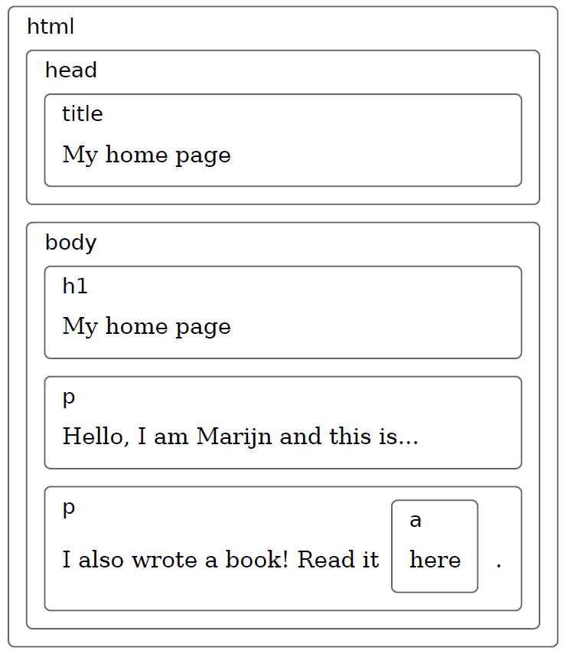
This page has the data structure
each box, there is an object:
we can interact with to find out things:
what HTML tag it represents
which boxes and text it contains
This representation is called:
Document Object Model (DOM)
global binding document:
gives us access to these objects.
documentElement property:
refers to the object representing the <html> tag.
also has head and body properties

Slide 5
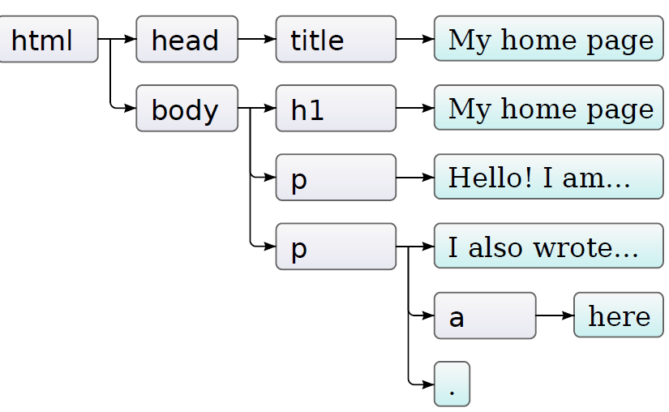
Trees
document.documentElement:
as the root of tree.
Nodes for elements:
represent HTML tags,
determine the structure of the document.
have child nodes.
EX:
document.body:
Some of these children can be leaf nodes,
text or comment nodes.
Each DOM node object has a nodeType property:
contains a code (number):
identifies the type of node.
constant property: Node.ELEMENT_NODE
Text nodes: Node.TEXT_NODE:
a section of text in the document,
Comments node: Node.COMMENT_NODE

Slide 6
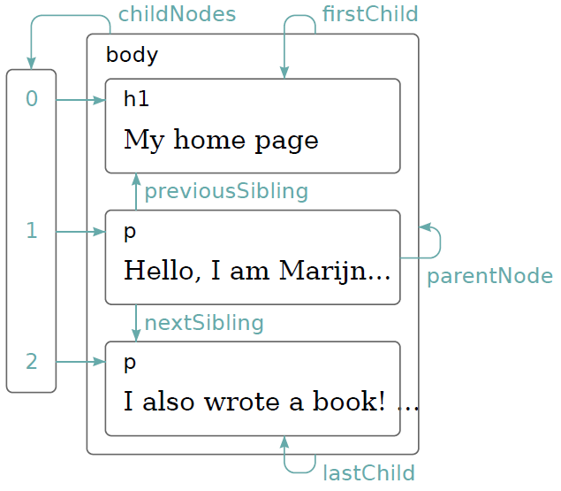
Moving through the tree
DOM nodes contain a wealth of links to other nearby nodes
An array-like object holding its children
every node has a parentNode property:
points to the node it is part of
a first child, previousSibling = null
a last child, nextSibling = null.
value null for nodes without children

Slide 7
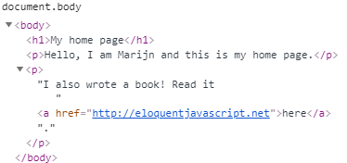
dealing with a nested data structure:
recursive functions are often useful
EX: scans a document for text nodes containing a given string and returns true when it has found one
function talksAbout(node, string) {
if (node.nodeType == Node.ELEMENT_NODE) {
for (let i = 0; i < node.childNodes.length; i++) {
// traverse the DOM tree using recursive function
if (talksAbout(node.childNodes[i], string)) {
return true; }
}
return false;
} else if (node.nodeType == Node.TEXT_NODE) {
//nodeValue property holds the string of text that it represents.
return node.nodeValue.indexOf(string) > -1; }
}
console.log(talksAbout(document.body, "book"));
//book字串改為網頁中有的 text (嘗試如何傳回true)
// → true / false (無)

Slide 8
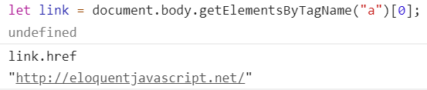
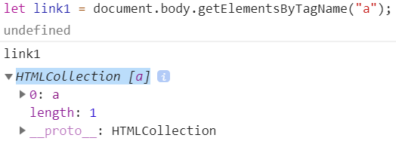

Finding elements
to get the href attribute of the link in that document:
let link = document.body.getElementsByTagName("a")[0];
// <a href=“ xxxxx”> </a>
console.log(link.href);
All element nodes have a getElementsByTagName method:
collects all elements with the given tag name:
are descendants (direct or indirect children) of that node
returns them as an array-like object.
To find a specific single node:
give it an id attribute and use document.getElementById
<p>My ostrich Gertrude:</p>
<p><img id="gertrude" src="img/ostrich.png"></p>
<script>
let ostrich = document.getElementById("gertrude");
console.log(ostrich.src);
</script>
getElementsByClassName:
like getElementsByTagName
searches through the contents of an element node and retrieves all elements:
have the given string in their class attribute.

Slide 9
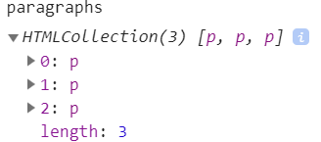
Changing the document
DOM data structure can be changed
remove:
remove nodes from their current parent node
appendChild:
add a child node to an element node: puts it at the end of the list of children
insertBefore:
(inserts the node given, before the node given)
<!DOCTYPE html>
<html>
<head>
<meta charset="utf-8">
<meta name="viewport" content="width=device-width">
<title>DOM01</title>
</head>
<body>
<h1> hello js </h1>
<p>One</p>
<p>Two</p>
<p>Three</p>
<script>
let paragraphs = document.body.getElementsByTagName("p");
document.body.insertBefore(paragraphs[2], paragraphs[0]);
</script>
</body>
</html>
A node can exist in the document in only one place.
inserting paragraph Three in front of paragraph One:
will first remove it from the end of the document
then insert it at the front, resulting in Three/One/Two.
side effect:
cause it to be removed from its current position (if it has one).

Slide 10
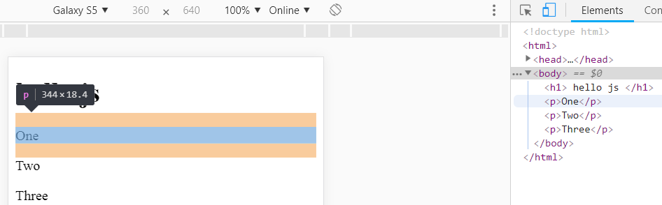
Use Element to check & modify HTML

Slide 11
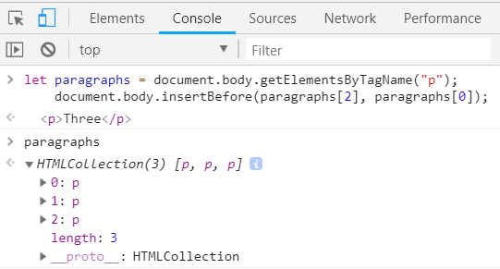
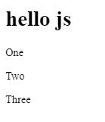
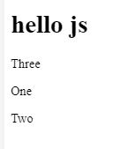
<!DOCTYPE html>
<html>
<head>
<meta charset="utf-8">
<meta name="viewport" content="width=device-width">
<title>DOM01</title>
</head>
<body>
<h1> hello js </h1>
<p>One</p>
<p>Two</p>
<p>Three</p>
</body>
</html>
let paragraphs = document.body.getElementsByTagName("p");
document.body.insertBefore(paragraphs[2], paragraphs[0]);

Slide 12
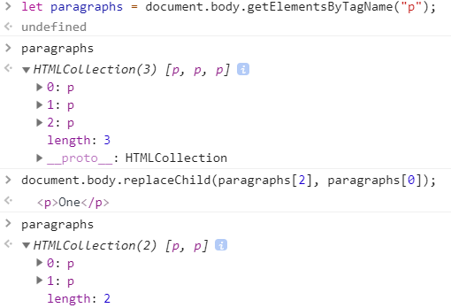
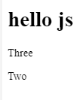
replaceChild:
replace a child node with another one.
arguments two nodes: (a new node, the node to be replaced)
The replaced node must be a child of the element the method is called on.
Note that:
replaceChild & insertBefore:
expect the new node as their first argument.
One →
(Three)
(One)
Three

Slide 13
Creating nodes
document.createTextNode
creates the text nodes
to write a script:
replaces all images (<img> tags) in the document with the text held in their alt attributes:
specifies an alternative textual representation of the image.
It involves:
not only removing the images
but adding a new text node to replace them.
<p>The <img src="img/cat.png" alt="Cat"> in the
<img src="img/hat.png" alt="Hat">.</p>
<p><button onclick="replaceImages()">Replace</button></p>
<script>
function replaceImages() {
let images = document.body.getElementsByTagName("img");
for (let i = images.length - 1; i >= 0; i--) {
let image = images[i];
if (image.alt) {
let text = document.createTextNode(image.alt);
image.parentNode.replaceChild(text, image);
}
}
}
</script>
HTML <img>
<img src=“xxx.gif" alt=“alt text" height="42" width="42">

Slide 14
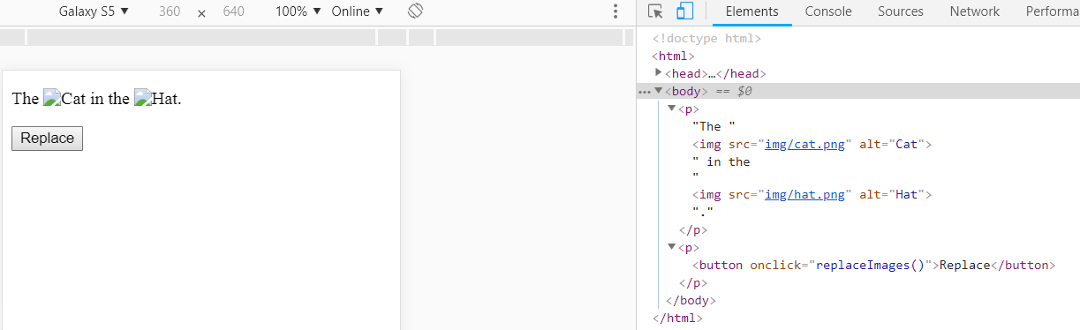
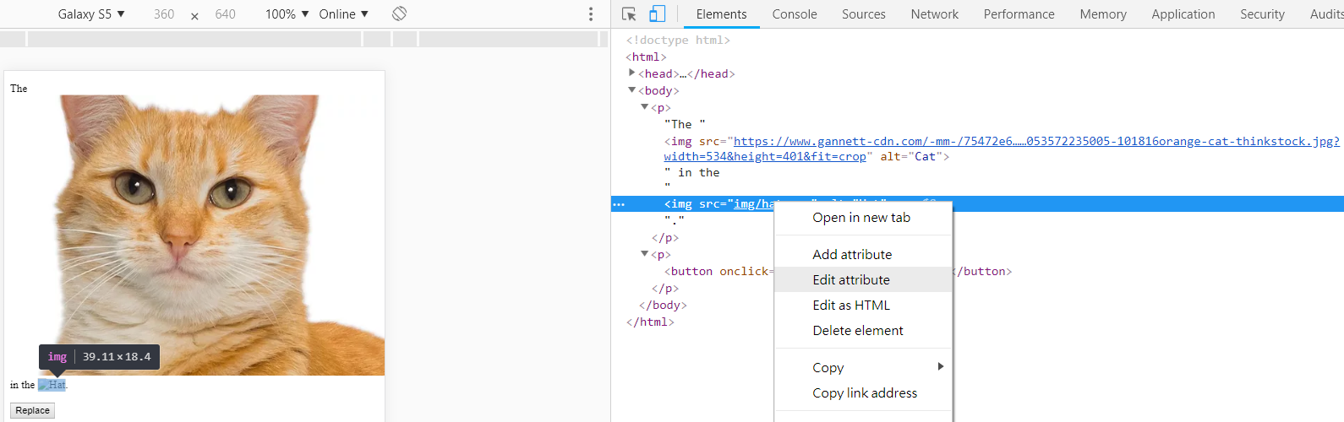
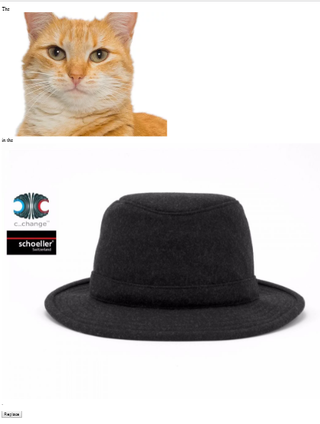
<img src=“xxx.gif" alt="Smiley face" height="42" width="42">

Slide 15
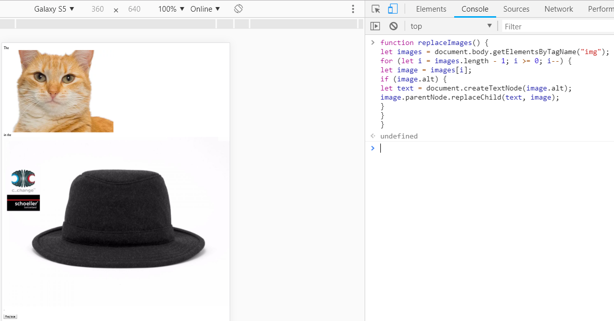
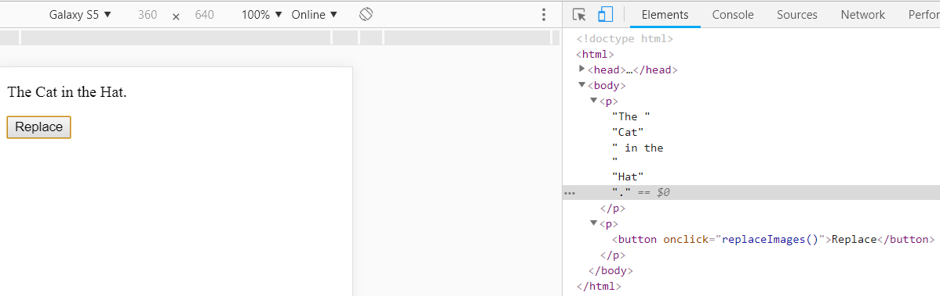
replaces all images with the text held in their alt attributes

Slide 16
練習時間
(練習上述操作)

Slide 17
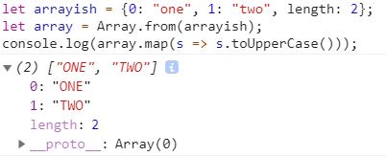
Note
The loop:
for (let i = images.length - 1; i >= 0; i--) {...}
goes over the images starts at the end of the list.
because the node list returned by a method like getElementsByTagName (or a property like childNodes) is live.
it is updated as the document changes. (動態調整)
If we started from the front:
removing the first image would cause the list to lose its first element:
the second time the loop repeats:
where i = 1, it would stop:
because the length of the collection is now also 1.
Solution:
a solid collection of nodes
convert the collection to a real array by calling Array.from
let arrayish = {0: "one", 1: "two", length: 2};
let array = Array.from(arrayish);
console.log(array.map(s => s.toUpperCase()));
// → ["ONE", "TWO"]

Slide 18
create element nodes
document.createElement
takes a tag name and returns a new empty node of the given type.
Example: defines a utility elt:
creates an element node and treats the rest of its arguments as children to that node.
used to add an attribution to a quote
<blockquote id="quote">
No book can ever be finished. While working on it we learn just enough to find it immature the moment we turn away from it.
</blockquote>
<script>
function elt(type, ...children) {
let node = document.createElement(type);
for (let child of children) {
if (typeof child != "string") node.appendChild(child);
else node.appendChild(document.createTextNode(child));}
return node; }
document.getElementById("quote").appendChild(
elt("footer", "-",
elt("strong", "Karl Popper"),
", preface to the second editon of ",
elt("em", "The Open Society and Its Enemies"),
", 1950"));
</script>
HTML <blockquote> Tag
specifies a section that is quoted from another source.
Browsers usually indent <blockquote> elements.
<blockquote cite="http://xxx/index.html">
</blockquote>

Slide 19
HTML Text Formatting
<b> - Bold text
<strong> - Important text
<i> - Italic text
<em> - Emphasized text
<mark> - Marked text
<small> - Small text
<del> - Deleted text
<ins> - Inserted text
<sub> - Subscript text
<sup> - Superscript text
<ins> Defines inserted text
<del> Defines deleted text
<mark> Defines marked/highlighted text

Slide 20
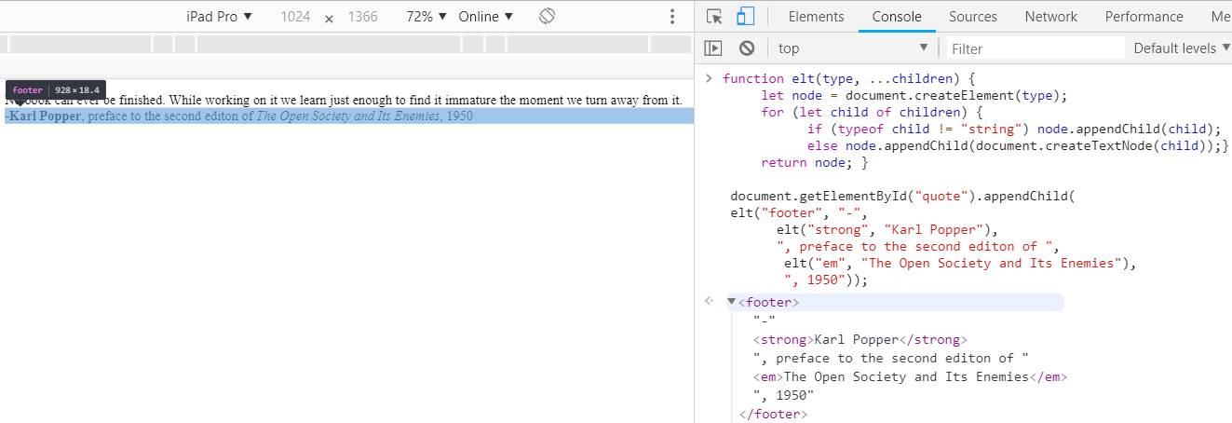
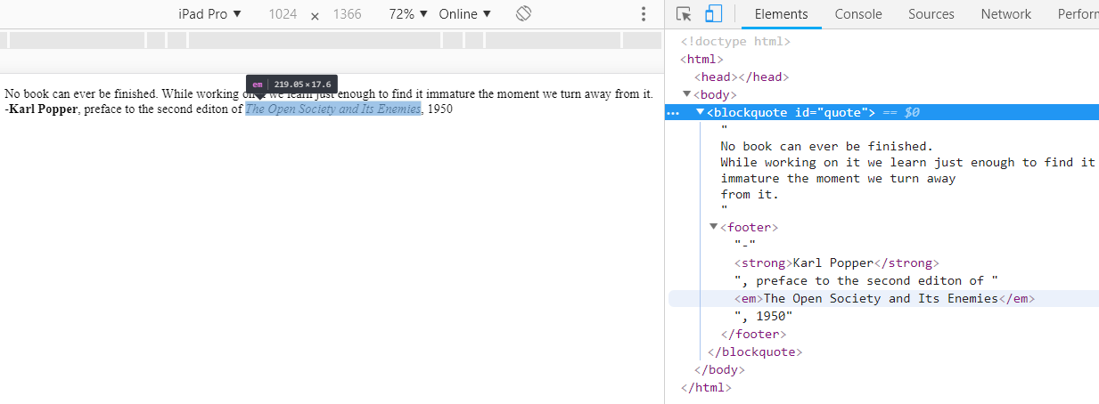

Slide 21
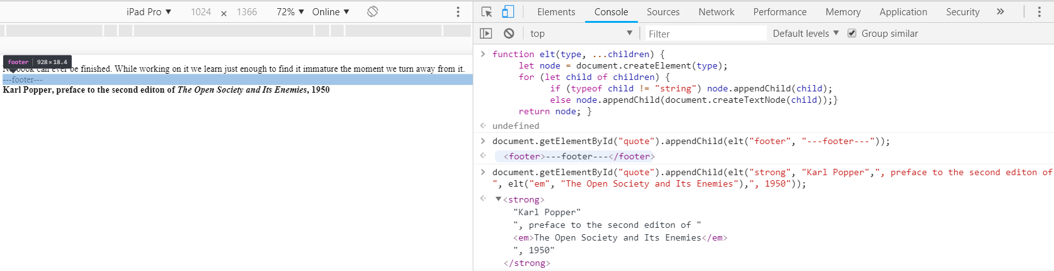
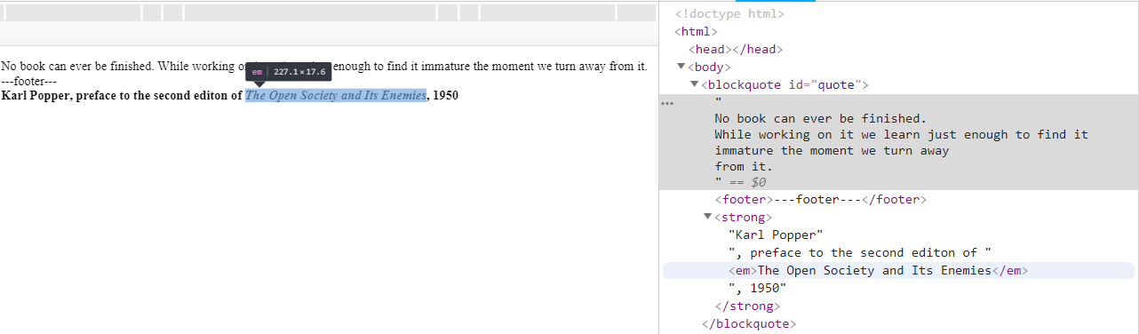
document.getElementById("quote").appendChild(elt("footer", "---footer---"));
document.getElementById("quote").appendChild(elt("strong", "Karl Popper",", preface to the second editon of ", elt("em", "The Open Society and Its Enemies"),", 1950"));

Slide 22
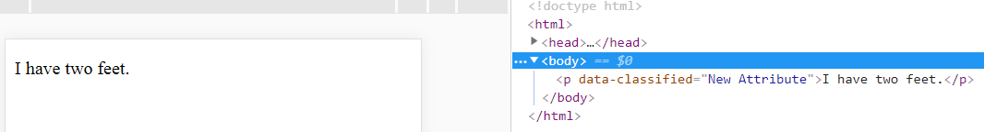
Attributes
HTML allows to set any attribute you want on nodes
getAttribute & setAttribute methods
<p data-classified="secret">The launch code is 00000000.</p>
<p data-classified="unclassified">I have two feet.</p>
<script>
let paras = document.body.getElementsByTagName("p");
for (let para of Array.from(paras)) {
if (para.getAttribute("data-classified") == "secret") {
para.remove(); }
else para.setAttribute("data-classified","New Attribute")
}
</script>

Slide 23

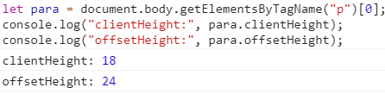
Layout
clientWidth & clientHeight:
give the size of the space inside the element,
<p style="border: 3px solid red">
I'm boxed in
</p>
<script>
let para = document.body.getElementsByTagName("p")[0];
console.log("clientHeight:", para.clientHeight);
console.log("offsetHeight:", para.offsetHeight);
</script>

Slide 24
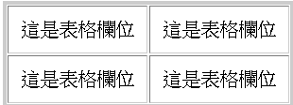
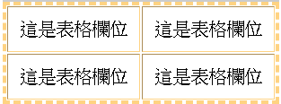
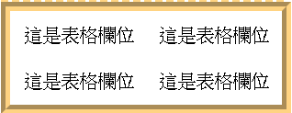
HTML Table
<table style="border:3px #cccccc solid;" cellpadding="10" border='1'> <tr><td>這是表格欄位</td><td>這是表格欄位</td></tr> <tr><td>這是表格欄位</td><td>這是表格欄位</td></tr> </table>
<table style="border:3px #FFD382 dashed;" cellpadding="10" border='1'> <tr><td>這是表格欄位</td><td>這是表格欄位</td></tr> <tr><td>這是表格欄位</td><td>這是表格欄位</td></tr> </table>
<table style="border:8px #FFD382 groove;" cellpadding="10" border='0'> <tr><td>這是表格欄位</td><td>這是表格欄位</td></tr> <tr><td>這是表格欄位</td><td>這是表格欄位</td></tr> </table>

Slide 25
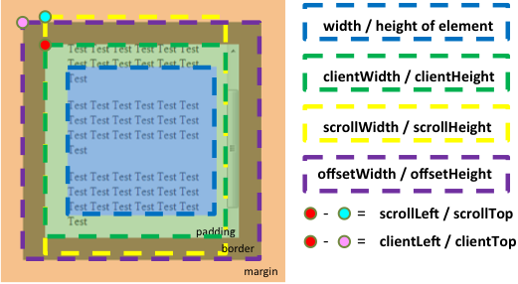
圖解clientLeft, clientTop, clientWidth和clientHeight
DOM物件中使用clientLeft、clientTop、clientWidth和clientHeight的屬性

Slide 26
getBoundingClientRect :
The most effective way to find the precise position of an element on the screen
returns an object:
with top, bottom, left, and right properties,
indicating the pixel positions of the sides of the element relative to the top left of the screen.
pageXOffset & pageYOffset :
the current scroll position
browser engines do not immediately re-layout a document every time you change it:
but wait as long as they can.
When a JS program:
changed the document finishes running,
the browser will have to compute a new layout to draw the changed document to the screen.
When a program asks for the position or size of something by reading properties:
Ex: offsetHeight or calling getBoundingClientRect

Slide 27

HTML span 標籤用法
透過 span 標籤:
可修改網頁各種小區塊:
如:替文章中特定文字做特效:
包含: 修改文字顏色、修改文字大小、替文字增加底線、修改文字的字型、把文字變粗 ... 等
HTML span 標籤語法:
<span id=“” class=“” style=“”>文字區塊內容放在這裡</span>
id : 標示特定 ID 名稱
class:標示特定 class 名稱
style: 宣告 span 標籤的樣式
<span style=“border:2px red solid;font-size:12px;background-color: yellow; padding:10px;"> 增加 HTML span 的內距 </span>

Slide 28
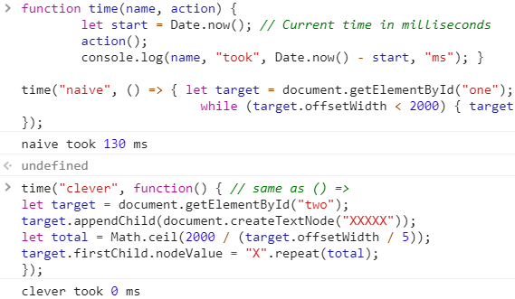
The performance of Layout computations
program repeatedly alternates between reading DOM layout information and changing the DOM:
forces a lot of layout computations to happen
will consequently run very slowly.
<p><span id="one"></span></p>
<p><span id="two"></span></p>
<script>
function time(name, action) {
let start = Date.now(); // Current time in milliseconds
action();
console.log(name, "took", Date.now() - start, "ms"); }
time("naive", () => { let target = document.getElementById("one");
while (target.offsetWidth < 2000) { target.appendChild(document.createTextNode("X")); }
}); // → naive took 32 ms
time("clever", function() { // same as () =>
let target = document.getElementById("two");
target.appendChild(document.createTextNode("XXXXX"));
let total = Math.ceil(2000 / (target.offsetWidth / 5));
target.firstChild.nodeValue = “X”.repeat(total); //add at one time
}); // → clever took 1 ms
</script>

Slide 29

Styling
<strong> makes its content bold
<a> makes it blue and underlines it:
causes a link to be followed when it is clicked
<p><a href=".">Normal link</a></p>
<p><a href="." style="color: green">Green link</a></p>
style attribute:
EX: "color: red; border: none".
display property:
controls whether an element is displayed as a block or an inline element.
This text is displayed <strong>inline</strong>,
<strong style="display: block">as a block</strong>, and
<strong style="display: none">not at all</strong>.
display: none:
prevents an element from showing up on the screen.
This is a way to hide elements.

Slide 30


JS code can directly manipulate the style of an element through the element’s style property
<p id="para" style="color: purple">
Nice text
</p>
<script>
let para = document.getElementById("para");
console.log(para.style.color);
para.style.color = "magenta";
</script>

Slide 31

Cascading styles (a Brief)
Cascading Style Sheets (CSS):
The styling system for HTML
A style sheet is a set of rules for how to style elements in a document
It can be given inside a <style> tag.
<style>
strong {
font-style: italic;
color: gray;
}
</style>
<p>Now <strong>strong text</strong> is italic and gray.</p>

Slide 32
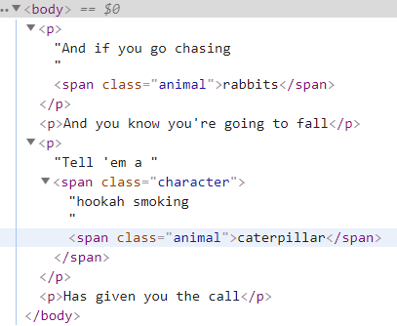
Query selectors
selector syntax:
the notation used in style sheets to determine which elements a set of styles apply to
is that we can use this same mini-language as an effective way to find DOM elements
<p>And if you go chasing
<span class="animal">rabbits</span></p>
<p>And you know you're going to fall</p>
<p>Tell 'em a <span class="character">hookah smoking
<span class="animal">caterpillar</span></span></p>
<p>Has given you the call</p>
<script>
function count(selector) {return document.querySelectorAll(selector).length;}
console.log(count("p")); // All <p> elements // → 4
console.log(count(".animal")); // Class animal // → 2
console.log(count("p .animal")); // Animal inside of <p> // → 2
console.log(count("p > .animal")); // Direct child of <p> // → 1
</script>

Slide 33
Positioning and animating
position style property:
influences layout in a powerful way
static: default value
the element sits in its normal place in the document
relative:
now the top and left style properties can be used to move it relative to that normal place
absolute:
the element is removed from the normal document flow:
it no longer takes up space
may overlap with other elements
its top and left properties can be used:
to absolutely position it relative to the top-left corner of the nearest enclosing element:
whose position property isn’t static,
or relative to the document if no such enclosing element exists.

Slide 34
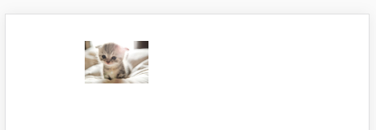
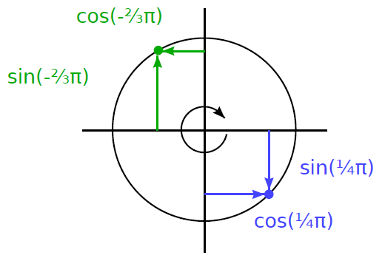
Positioning and animating
<img src="https://cdn2.ettoday.net/images/771/d771489.jpg" style="position: relative" height="42">
<!-- <button onclick="TryAnimate()">Try it</button> --!>
<script>
let cat = document.querySelector("img");
let angle = Math.PI / 2;
function animate(time, lastTime) {
if (lastTime != null) { angle += (time - lastTime) * 0.001; }
cat.style.top = (Math.sin(angle) * 20) + "px";
cat.style.left = (Math.cos(angle) * 200) + "px";
requestAnimationFrame(newTime => animate(newTime, time));
}
requestAnimationFrame(animate);
//function TryAnimate(){ requestAnimationFrame(animate); }
</script>
append "px" to tell browser that counting in pixels

Slide 35
requestAnimationFrame()
uses requestAnimationFrame to schedule the animate function to run:
whenever the browser is ready to repaint the screen
animate function itself again calls requestAnimationFrame to schedule next update
When browser window (or tab) is active:
will cause updates to happen at a rate of about 60 per second:
produce a good-looking animation
If we just updated the DOM in a loop:
the page would freeze
nothing would show up on the screen.
Browsers do not update their display:
while a JS program is running,
nor do they allow any interaction with the page
This is why we need requestAnimationFrame:
it lets the browser know that we are done for now
it can go ahead and do the things that browsers do:
Such as updating the screen and responding to user actions.
The animation function is passed the current time as an argument:
To ensure that the motion of the cat per millisecond is stable

Slide 36
練習時間
(練習上述操作)

Slide 37
CH 15 (Eloquent) Handling Events
Some programs work with direct user input,
such as mouse and keyboard actions.

Slide 38
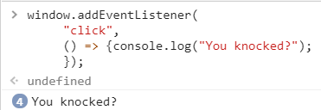
Event handlers
A better mechanism is for the system to actively notify our code when an event occurs.
Browsers do this by allowing us to register functions as handlers for specific events.
<p>Click this document to activate the handler.</p>
<script>
window.addEventListener(
"click",
() => {console.log("You knocked?");
});
</script>
window binding refers to a built-in object provided by browser:
browser window contains the document
Calling its addEventListener:
registers the second argument to be called:
whenever the event described by its first argument occurs.
target.addEventListener(type, listener[, options]);
EventTarget :是 Document的 Element 物件、Document物件本身、Window物件，或其它支援事件的物件(EX: XMLHttpRequest)

Slide 39
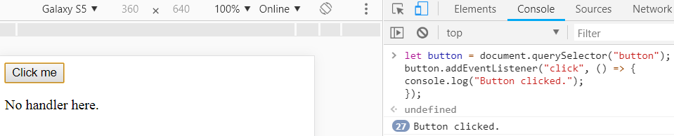
Events and DOM nodes
Each browser event handler is registered in a context:
EX: called addEventListener on the window object:
to register a handler for the whole window
It can also be found on DOM elements and some other types of objects.
Event listeners are called only:
when event happens in the context of the object they are registered on
<button>Click me</button>
<p>No handler here.</p>
<script>
let button = document.querySelector("button");
button.addEventListener("click", () => {console.log("Button clicked.");});
</script>
attaches a handler to the button node

Slide 40
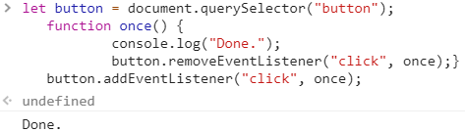
a node can have only one onclick attribute:
so you can register only one handler per node that way.
The addEventListener:
allows to add any number of handlers:
it is safe to add handlers even if there is already another handler on the element
removeEventListener:
removes a handler
(arguments similar to addEventListener)
<button>Act-once button</button>
<script>
let button = document.querySelector("button");
function once() {
console.log("Done.");
button.removeEventListener("click", once);}
button.addEventListener("click", once);
</script>

Slide 41

Event objects
event handler functions are passed an argument:
the event object:
object holds additional information about the event
to know which mouse button was pressed:
can look at the event object’s button property.
<button>Click me any way you want</button>
<script>
let button = document.querySelector("button"); //you can try <p>
button.addEventListener("mousedown",
event => {
if (event.button == 0) {console.log("Left button");}
else if (event.button == 1) {console.log("Middle button");}
else if (event.button == 2) {console.log("Right button");}
});
</script>
information stored in an event object differs per type of event
object’s type property always holds a string identifying the event:
EX: "click" or "mousedown"

Slide 42
Propagation
For most event types:
handlers registered on nodes with children :
will also receive events that happen in the children
If a button inside a paragraph is clicked:
event handlers on the paragraph will also see the click event
But if both the paragraph and the button have a handler:
the more specific handler—the one on the button—gets to go first
The event is said to propagate outward:
from the node where it happened:
to that node’s parent node
and on to the root of the document
after all handlers registered on a specific node have had their turn:
handlers registered on the whole window get a chance to respond to the event
stopPropagation :
an event handler can call it on the event object to prevent handlers further up from receiving the event

Slide 43
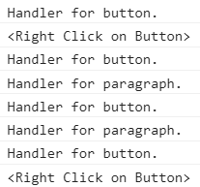
Example:
a button inside another clickable element:
don’t want clicks on the button to activate the outer element’s click behavior
registers "mousedown" handlers on both a button and the paragraph around it
Button clicked with right mouse :
the handler for the button calls stopPropagation:
prevent the handler on the paragraph from running
Button clicked with another mouse:
both handlers will run
<p>A paragraph with a <button>button</button>.</p>
<script>
let para = document.querySelector("p");
let button = document.querySelector("button");
para.addEventListener("mousedown", () => {
console.log("Handler for paragraph.");});
button.addEventListener("mousedown", event => {
console.log("Handler for button.");
if (event.button == 2) {alert('<Right Click on Button>');
console.log("<Right Click on Button>");
event.stopPropagation();}
});
</script>

Slide 44


Most event objects have a target property:
refers to the node where they originated.
use it:
to ensure that you’re not accidentally handling something:
that propagated up from a node you do not want to handle
to cast a wide net for a specific type of event
EX: a node containing a long list of buttons:
It’s convenient:
to register a single click handler on the outer node
have it use target to figure out whether a button was clicked:
rather than register individual handlers on all of the buttons.
<button>A</button>
<button>B</button>
<button>C</button>
<script>
document.body.addEventListener("click", event => {
if (event.target.nodeName == "BUTTON") {
console.log("Clicked", event.target.textContent); }
});
</script>

Slide 45

Default actions
Many events have a default action associated with them:
click a link: taken to the link’s target
press the down arrow: browser scrolls the page down
right-click: get a context menu.
JS event handlers are called before the default behavior takes place
preventDefault method:
If the handler doesn’t want this normal behavior to happen
can be used to implement your own keyboard shortcuts or context menu
EX: here is a link that cannot be followed:
<a href="https://developer.mozilla.org/">MDN</a>
<script>
let link = document.querySelector("a");
link.addEventListener("click", event => {
console.log("Nope.");
event.preventDefault();
});
</script>

Slide 46
Key events
When a key on the keyboard is pressed:
browser fires a "keydown" event.
When keyboard is released:
you get a "keyup" event
EX:
<p>This page turns violet when you hold the V key.</p>
<script>
window.addEventListener("keydown", event => {
if (event.key == "v") {
document.body.style.background = "violet";}
});
window.addEventListener("keyup", event => {
if (event.key == "v") {
document.body.style.background = ""; }
});
</script>

Slide 47
Blink the background color
let BOOL=false;
window.addEventListener("mousedown",
event => {
BOOL=!BOOL;
if(BOOL)
document.body.style.background = "violet";
else
document.body.style.background = "" ;
} );

Slide 48
練習時間
(練習上述操作)

Slide 49

key combinations
find out whether these keys are held down by looking at:
the shiftKey, ctrlKey, altKey, and metaKey properties of keyboard and mouse events.
<p>Press Control-Alt to continue.</p>
<script>
window.addEventListener("keydown", event => {
if (event.altKey && event.ctrlKey) {
console.log("Continuing!"); }
});
</script>
When nothing in particular has focus:
document.body acts as the target node of key events.

Slide 50
Pointer events
mice, touchpads, trackballs, touchscreens
Mouse clicks:
"mousedown“ & "mouseup" events:
similar to "keydown" and "keyup“
After "mouseup" event:
a "click" event fires on the most specific node:
contained both the press and the release of the button
press down mouse button on A paragraph
then move to B paragraph and release the button
"click" event will happen on the element:
contains both A and B paragraphs.
"dblclick" (double-click) event
clientX and clientY properties:
the top-left corner of the window,
pageX and pageY:
the top-left corner of the whole document
may be different when the window has been scrolled

Slide 51
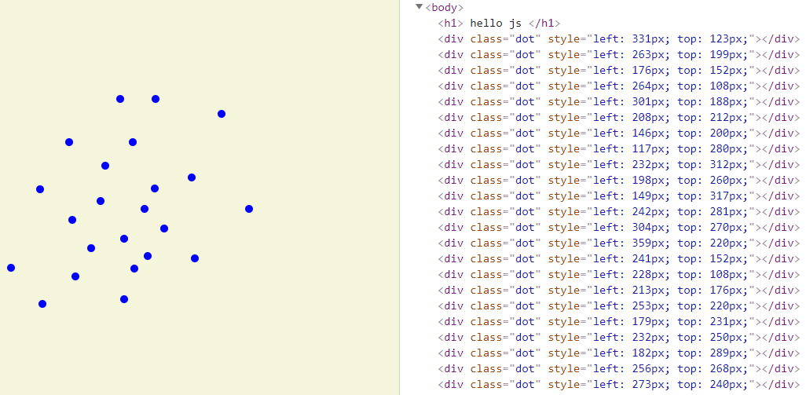
<style>
body {
height: 200px;
background: beige;
}
.dot {
height: 8px; width: 8px;
border-radius: 4px; /* rounds corners */
background: blue;
position: absolute;
}
</style>
<script>
window.addEventListener("click", event => {
let dot = document.createElement("div");
dot.className = "dot";
dot.style.left = (event.pageX - 4) + "px";
dot.style.top = (event.pageY - 4) + "px";
document.body.appendChild(dot);
});
</script>

Slide 52
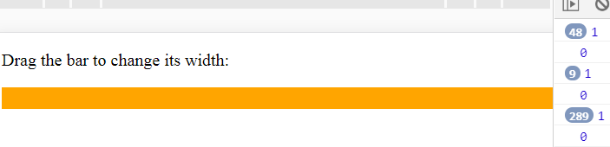
Mouse motion
a "mousemove" event is fired:
Every time the mouse pointer moves
used to track the position of the mouse
EX: it is useful is for some form of mouse-dragging functionality
displays a bar and sets up event handlers:
dragging to left or right on this bar makes it narrower or wider
<p>Drag the bar to change its width:</p>
<div style="background: orange; width: 60px; height: 20px"></div>
<script>
let lastX; // Tracks the last observed mouse X position
let bar = document.querySelector("div");
bar.addEventListener("mousedown", event => {
if (event.button == 0) { lastX = event.clientX;
window.addEventListener("mousemove", moved);
event.preventDefault(); // Prevent selection
} });
function moved(event) {
if (event.buttons == 0) { console.log(event.buttons);window.removeEventListener("mousemove", moved); }
else {console.log(event.buttons);
let dist = event.clientX - lastX;
let newWidth = Math.max(10, bar.offsetWidth + dist);
bar.style.width = newWidth + "px";
lastX = event.clientX; }
}
</script>
Note that the "mousemove" handler is registered on the whole window
event.buttons (buttons property):
about the buttons that are currently held down.
Zero: no buttons are down

Slide 53
Touch events
A touchscreen works differently from a mouse
"touchstart" event :
When a finger starts touching the screen,
"touchmove" events :
When it is moved while touching
"touchend" event:
when it stops touching the screen
event objects have a touches property:
holds an array-like object of points:
has its own clientX, clientY, pageX, and pageY properties

Slide 54
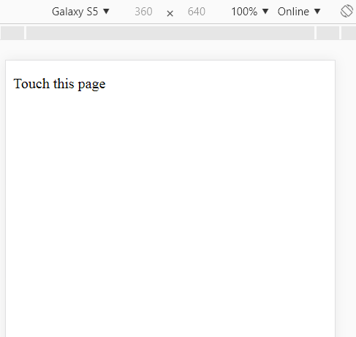
show red circles around every touching finger
<style>
dot { position: absolute; display: block;
border: 2px solid red; border-radius: 50px;
height: 100px; width: 100px; }
</style>
<p>Touch this page</p>
<script>
function update(event) {
for (let dot; dot = document.querySelector("dot");) { dot.remove();}
for (let i = 0; i < event.touches.length; i++) {
let {pageX, pageY} = event.touches[i];
let dot = document.createElement("dot");
dot.style.left = (pageX - 50) + "px";
dot.style.top = (pageY - 50) + "px";
document.body.appendChild(dot); }
}
window.addEventListener("touchstart", update);
window.addEventListener("touchmove", update);
window.addEventListener("touchend", update);
</script>
(行動模式)

Slide 55

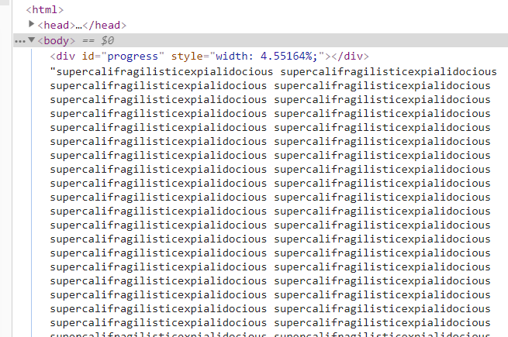
Scroll events
"scroll" event:
Whenever an element is scrolled
EX: draws a progress bar above the document and updates it to fill up as you scroll down
<style>
#progress {
border-bottom: 2px solid blue;
width: 0;
position: fixed;
top: 0; left: 0; }
</style>
<div id="progress"></div>
<script>
// Create some content
document.body.appendChild(document.createTextNode(
"supercalifragilisticexpialidocious ".repeat(1000)));
let bar = document.querySelector("#progress"); //# find value
window.addEventListener("scroll", () => {
let max = document.body.scrollHeight - innerHeight;
bar.style.width = `${(pageYOffset / max) * 100}%`; });
</script>
//browser 視窗內的網頁內容高度。
use %, rather than px, as a unit
when setting the width so that the element is sized relative to the page width

Slide 56
Focus events
"focus" event:
When an element gains focus
"blur" event:
When an element loses focus,
these two events do not propagate.
EX: displays help text for text field that currently has focus:
<p>Name: <input type="text" data-help="Your full name"></p>
<p>Age: <input type="text" data-help="Your age in years"></p>
<p id="help"></p>
<script>
let help = document.querySelector(“#help”); //# find value
let fields = document.querySelectorAll("input");
for (let field of Array.from(fields)) {
field.addEventListener("focus", event => {
let text = event.target.getAttribute("data-help");
help.textContent = text; } );
field.addEventListener("blur", event => {
help.textContent = ""; });
}
</script>

Slide 57
Load event
"load" event fires on the window and the document body objects:
When a page finishes loading
This is often used to schedule initialization actions:
That require the whole document to have been built
content of <script> tags is run immediately when the tag is encountered
Elements such as images and script tags that load an external file:
also have a "load" event:
indicates the files they reference were loaded
loading events do not propagate.
"beforeunload" event:
When a page is closed or navigated away from (following a link)
It is to prevent the user from accidentally losing work by closing a document:
show the user a dialog asking “EXIT or NOT”

Slide 58
Events and the event loop
For cases where you really do want to do some time-consuming thing in the background without freezing the page:
browsers provide something called web workers.
A worker is a JS process:
runs alongside the main script, on its own timeline.
a file called code/squareworker.js :
responds to messages by computing a square and sending a message back.
addEventListener("message", event => {
postMessage(event.data * event.data); });
code spawns a worker running that script, sends it a few messages, and outputs the responses: (a web example)
let squareWorker = new Worker("code/squareworker.js");
squareWorker.addEventListener("message", event => {
console.log(“The worker responded:”, event.data); });
squareWorker.postMessage(10);
squareWorker.postMessage(24);

Slide 59
Timer
to cancel a function you have scheduled:
by storing the value returned by setTimeout() and calling clearTimeout() on it.
let bombTimer = setTimeout( () => {
console.log("BOOM!");}, 500);
if (Math.random() < 0.5) { // 50% chance
console.log("Defused.");
clearTimeout(bombTimer); }
cancelAnimationFrame function: as clearTimeout()
calling it on a value returned by requestAnimationFrame() will cancel that frame
setInterval & clearInterval:
used to set timers that should repeat every X milliseconds
let ticks = 0;
let clock = setInterval(() => { console.log("tick", ticks++);
if (ticks == 10) {
clearInterval(clock);
console.log("stop.");} }, 200);

Slide 60


Debouncing
to react when the user has typed something:
But we don’t want to do it immediately for every input event.
To avoid the slow interaction:
Use setTimeout to make sure you are not doing it too often
<textarea>Type something here...</textarea>
<script>
let textarea = document.querySelector("textarea");
let timeout;
textarea.addEventListener("input", () => {
clearTimeout(timeout);
timeout = setTimeout( () => console.log("Typed!"), 500); } );
</script>

Slide 61

To respond to "mousemove" events:
by showing the current coordinates of the mouse:
but only every 250 milliseconds
<script>
let scheduled = null;
window.addEventListener("mousemove", event => {
if (!scheduled) {
setTimeout(() => {
document.body.textContent =
`Mouse at ${scheduled.pageX}, ${scheduled.pageY}`;
scheduled = null; }, 250);
}
scheduled = event;
});
</script>

Slide 62
練習時間
(練習上述操作)

Slide 63
THE END
Q&A

