Slide 1
JavaScript程式設計 (JavaScript Programming)
109 學年度 第 1 學期
蘇俊銘(Jun-Ming Su)
jmsu@mail.nutn.edu.tw
數位學習科技學系, 國立台南大學
2020

Slide 2
CH 16 (Eloquent) Project: A Platform Game
All reality is a game
-Iain Banks, The Player of Games

Slide 3
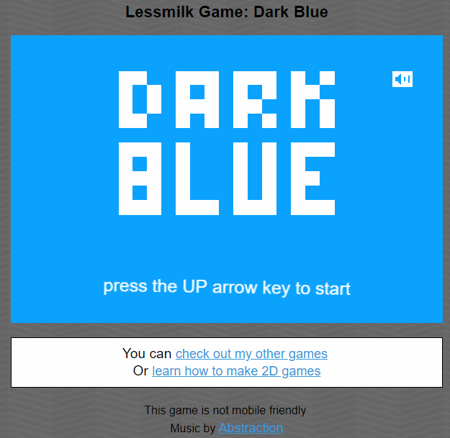
The game
Our game will be roughly based on Dark Blue:
by Thomas Palef

Slide 4
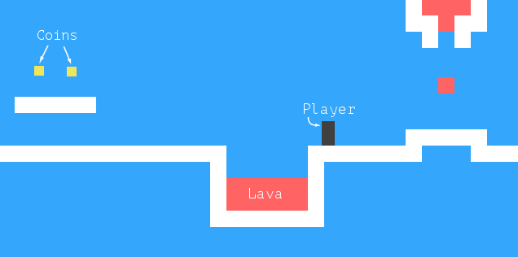
The game
dark box represents the player:
whose task is to collect the yellow boxes (coins):
while avoiding the red stuff (lava).
A level is completed when all coins have been collected

Slide 5

Play the Game
Download the code:
ch16.zip from the ecourse.
\code\chapter
16_game.js
\code
levels.js
\css
game.css
Index.html

Slide 6
練習時間
(練習上述操作)

Slide 7
The technology
use the browser DOM to display the game
read user input by handling key events.
everything looks like colored boxes:
drawing is uncomplicated:
create DOM elements and use styling:
to give them a background color, size, and position.
represent the background as a table :
since it is an unchanging grid of squares.
The free-moving elements can be overlaid:
using absolutely positioned elements.
DOM was not originally designed for high-performance graphics

Slide 8
Levels
a human-readable, human-editable way to specify levels:
it is okay for everything to start out on a grid:
use big strings:
each character represents an element:
either a part of the background grid or a moving element.
a small level:
let simpleLevelPlan = `
......................
..#................#..
..#..............=.#..
..#.........o.o....#..
..#.@......#####...#..
..#####............#..
......#++++++++++++#..
......##############..
......................`;

Slide 9
const levelChars = {
".": "empty", "#": "wall", "+": "lava",
"@": Player, "o": Coin,
"=": Lava, "|": Lava, "v": Lava
};
Periods (.) are empty space,
hash (#) characters are walls,
plus signs (+) are lava.
The player’s starting position is the at sign (@).
Every O character is a coin,
equal sign (=) at the top is a block of lava:
that moves back and forth horizontally.
two additional kinds of moving lava:
the pipe character (|) creates vertically moving blobs,
(v) indicates dripping lava:
vertically moving lava:
doesn’t bounce back and forth
but only moves down,
jumping back to its start position when it hits the floor.

Slide 10
Reading a level
The following class stores a level object.
Its argument should be the string that defines the level.
class Level {
constructor(plan) {
let rows = plan.trim().split("\n").map(l => [...l]);
this.height = rows.length;
this.width = rows[0].length;
this.startActors = [];
this.rows = rows.map((row, y) => {
return row.map((ch, x) => {
let type = levelChars[ch];
if (typeof type == "string") return type;
this.startActors.push(
type.create(new Vec(x, y), ch));
return "empty";
});
});
}
}
trim is used to remove whitespace at the start and end of the plan string
rows holds an array of arrays of characters,
=> the rows of the plan
call moving elements actors: stored in an array of objects.
background will be an array of arrays of strings:
holding field types such as "empty", "wall", or "lava".
map passes the array index as a second argument to the mapping function: tells us the x- and y-coordinates of a given character
type is an actor class, its static create method is used to create an object: added to startActors, and the mapping function returns "empty" for this background square
Actor position is stored as a Vec object

Slide 11
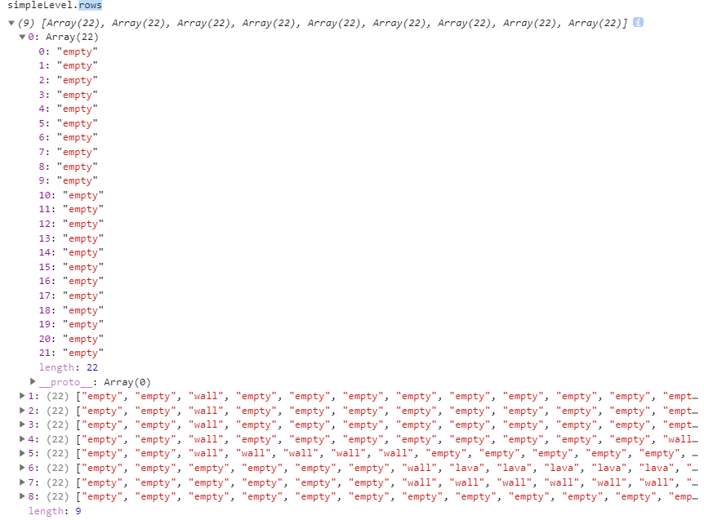
var simpleLevel = new Level(simpleLevelPlan);

Slide 12
a State class to track the state of a running game:
class State {
constructor(level, actors, status) {
this.level = level;
this.actors = actors;
this.status = status;
}
static start(level) {
return new State(level, level.startActors, "playing");
}
get player() {
return this.actors.find(a => a.type == "player");
}
}
status property will switch to "lost" or "won"
a persistent data structure—updating the game state creates a new state and leaves the old one intact

Slide 13
Actors
Vec class:
use for 2D values, EX: position and size of actors.
class Vec {
constructor(x, y) {
this.x = x; this.y = y;
}
plus(other) {
return new Vec(this.x + other.x, this.y + other.y);
}
times(factor) {
return new Vec(this.x * factor, this.y * factor);
}
}
times method scales a vector by a given number: It is useful to multiply a speed vector by a time interval to get the distance traveled during that time.

Slide 14
player class has a property speed:
stores its current speed to simulate momentum and gravity
class Player {
constructor(pos, speed) {
this.pos = pos;
this.speed = speed;
}
get type() { return "player"; }
static create(pos) {
return new Player(pos.plus(new Vec(0, -0.5)),
new Vec(0, 0));
}
}
Player.prototype.size = new Vec(0.8, 1.5);
size property is the same for all instances of Player

Slide 15
a Lava actor:
need to initialize the object differently:
depending on the character it is based on
class Lava {
constructor(pos, speed, reset) {
this.pos = pos;
this.speed = speed;
this.reset = reset;
}
get type() { return "lava"; }
static create(pos, ch) {
if (ch == "=") {
return new Lava(pos, new Vec(2, 0));
} else if (ch == "|") {
return new Lava(pos, new Vec(0, 2));
} else if (ch == "v") {
return new Lava(pos, new Vec(0, 3), pos);
}
}
}
Lava.prototype.size = new Vec(1, 1);
Dynamic lava moves along at its current speed until it hits an obstacle:
it has a reset property: jump back to its start position (dripping).
If it does not, (no reset property): invert its speed and continue in the other direction (bouncing)
create method looks at the character that the Level constructor passes and creates the appropriate lava actor

Slide 16
Coin actors are relatively simple.
mostly just sit in their place.
But to liven up the game a little:
are given a “wobble”, a slight vertical back-and-forth motion.
class Coin {
constructor(pos, basePos, wobble) {
this.pos = pos;
this.basePos = basePos;
this.wobble = wobble;
}
get type() { return "coin"; }
static create(pos) {
let basePos = pos.plus(new Vec(0.2, 0.1));
return new Coin(basePos, basePos,
Math.random() * Math.PI * 2);
}
}
Coin.prototype.size = new Vec(0.6, 0.6);
Math.random by that number to give the coin a random starting position on the wave.
makes the sine function useful for modeling a wavy motion

Slide 17
the levelChars object:
maps plan characters to either background grid types or actor classes.
const levelChars = {
".": "empty", "#": "wall", "+": "lava",
"@": Player, "o": Coin,
"=": Lava, "|": Lava, "v": Lava
};
gives us all the parts needed to create a Level instance.
let simpleLevel = new Level(simpleLevelPlan);
console.log(`${simpleLevel.width} by ${simpleLevel.height}`);
// → 22 by 9

Slide 18
Drawing
The encapsulation of the drawing code is done by defining a display object:
displays a given level and state.
The display type is called DOMDisplay :
because it uses DOM elements to show the level.
using a style sheet to set the actual colors and other fixed properties of the elements that make up the game
a succinct way to create an element and give it some attributes and child nodes:
function elt(name, attrs, ...children) {
let dom = document.createElement(name);
for (let attr of Object.keys(attrs)) {
dom.setAttribute(attr, attrs[attr]);
}
for (let child of children) {
dom.appendChild(child);
}
return dom;
}
CH 14-15 (elt())
function elt(type, ...children) {
let node = document.createElement(type);
for (let child of children) {
if (typeof child != "string") node.appendChild(child);
else node.appendChild(document.createTextNode(child));}
return node; }

Slide 19
A display is created:
by giving it a parent element to which it should append itself and a level object.
class DOMDisplay {
constructor(parent, level) {
this.dom = elt("div", {class: "game"}, drawGrid(level));
this.actorLayer = null;
parent.appendChild(this.dom);
}
clear() { this.dom.remove(); }
}
actorLayer property will be used to track the element: holds the actors so that they can be easily removed and replaced.
Level’s background grid, which never changes, is drawn once.
Actors are redrawn every time the display is updated with a given state

Slide 20
a size or distance of 1 means one grid block
scale constant gives the number of pixels:
a single unit takes up on the screen.
const scale = 20;
function drawGrid(level) {
return elt("table", {
class: "background",
style: `width: ${level.width * scale}px`
}, ...level.rows.map(row =>
elt("tr", {style: `height: ${scale}px`},
...row.map(type => elt("td", {class: type})))
));
}
background is drawn as a <table> element. This nicely corresponds to the structure of the rows property of the level—each row of the grid is turned into a table row (<tr> element).
The strings in the grid are used as class names for the table cell (<td>) elements.
spread (triple dot) operator is used to pass arrays of child nodes to elt as separate arguments

Slide 21
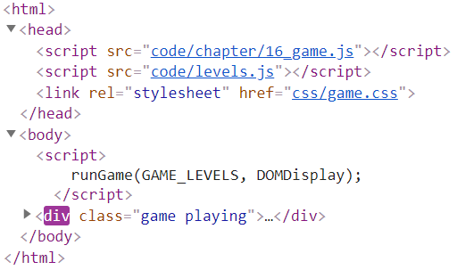
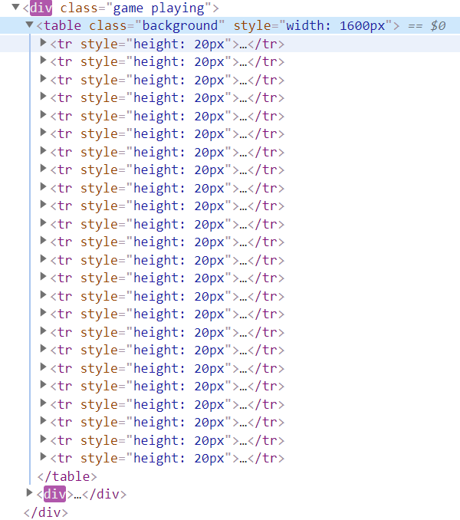
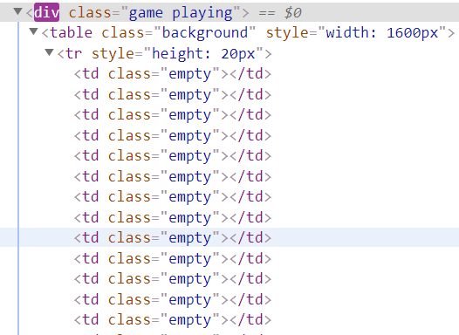
Index.html
function drawGrid(level) {
return elt("table", {
class: "background",
style: `width: ${level.width * scale}px`
}, ...level.rows.map(row =>
elt("tr", {style: `height: ${scale}px`},
...row.map(type => elt("td", {class: type})))
));
}

Slide 22
CSS makes the table look like the background
.background { background: rgb(52, 166, 251);
table-layout: fixed;
border-spacing: 0; }
.background td { padding: 0; }
.lava { background: rgb(255, 100, 100); }
.wall { background: white; }
Some of these (table-layout, border-spacing, and padding) are used to suppress unwanted default behavior

Slide 23
draw each actor by creating a DOM element for it:
setting that element’s position and size based on the actor’s properties.
The values must be multiplied by scale to go from game units to pixels.
function drawActors(actors) {
return elt("div", {}, ...actors.map(actor => {
let rect = elt("div", {class: `actor ${actor.type}`});
rect.style.width = `${actor.size.x * scale}px`;
rect.style.height = `${actor.size.y * scale}px`;
rect.style.left = `${actor.pos.x * scale}px`;
rect.style.top = `${actor.pos.y * scale}px`;
return rect;
}));
}

Slide 24
the actor class gives the actors their absolute position
.actor { position: absolute; }
.coin { background: rgb(241, 229, 89); }
.player { background: rgb(64, 64, 64); }
syncState method is used to:
make the display show a given state.
It first removes the old actor graphics, if any,
and then redraws the actors in their new positions.
DOMDisplay.prototype.syncState = function(state) {
if (this.actorLayer) this.actorLayer.remove();
this.actorLayer = drawActors(state.actors);
this.dom.appendChild(this.actorLayer);
this.dom.className = `game ${state.status}`;
this.scrollPlayerIntoView(state);
};

Slide 25
By adding the level’s current status as a class name to the wrapper:
we can style the player actor slightly differently:
when the game is won or lost by adding a CSS rule:
takes effect only when the player has an ancestor element with a given class.
.lost .player {
background: rgb(160, 64, 64);
}
.won .player {
box-shadow: -4px -7px 8px white, 4px -7px 8px white;
}
touching lava, the player’s color turns dark red
the last coin has been collected:
add two blurred white shadows:
one to the top left and one to the top right:
to create a white halo effect.

Slide 26
We can’t assume that the level always fits in the viewport:
the element into which we draw the game.
That is why the scrollPlayerIntoView call is needed:
ensures that if the level is protruding outside the viewport:
scroll that viewport to make sure the player is near its center
CSS gives the game’s wrapping DOM element a maximum size:
ensures that anything that sticks out of the element’s box is not visible.
.game {
overflow: hidden;
max-width: 600px;
max-height: 450px;
position: relative;
}

Slide 27
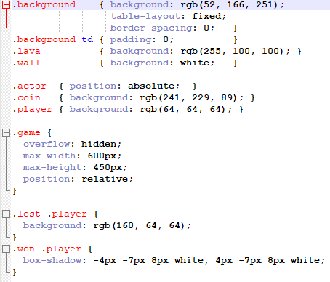
game.css

Slide 28
scrollPlayerIntoView method:
find the player’s position and update the wrapping element’s scroll position.
change the scroll position:
by manipulating that element’s scrollLeft and scrollTop properties:
when the player is too close to the edge.
DOMDisplay.prototype.scrollPlayerIntoView = function(state) {
let width = this.dom.clientWidth;
let height = this.dom.clientHeight;
let margin = width / 3;
// The viewport
let left = this.dom.scrollLeft, right = left + width;
let top = this.dom.scrollTop, bottom = top + height;
let player = state.player;
let center = player.pos.plus(player.size.times(0.5)).times(scale);
if (center.x < left + margin) {
this.dom.scrollLeft = center.x - margin;
} else if (center.x > right - margin) {this.dom.scrollLeft = center.x + margin - width;}
if (center.y < top + margin) {
this.dom.scrollTop = center.y - margin;
} else if (center.y > bottom - margin) {
this.dom.scrollTop = center.y + margin - height; }
};
Setting scrollLeft to -10 will cause it to become 0.

Slide 29
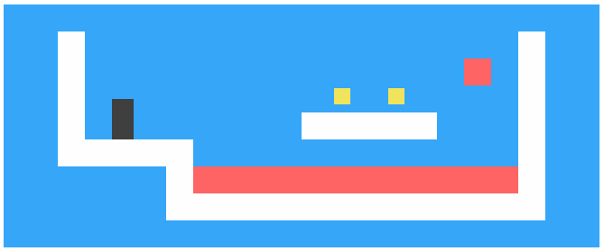
We are now able to display our tiny level.
<link rel="stylesheet" href=" https://eloquentjavascript.net/css/game.css">
<script>
//copy the code before (including) the scrollPlayerIntoView to console using Chrome
// let simpleLevel = new Level(simpleLevelPlan);
let display = new DOMDisplay(document.body, simpleLevel);
display.syncState(State.start(simpleLevel));
</script>

Slide 30
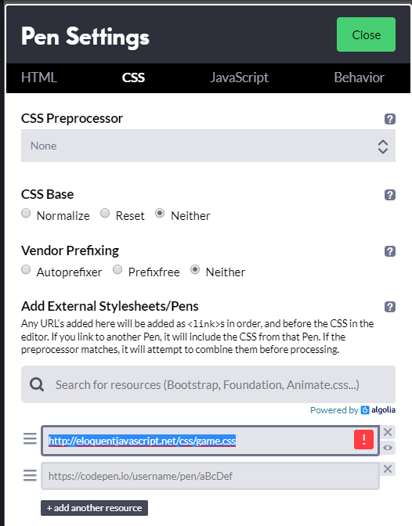
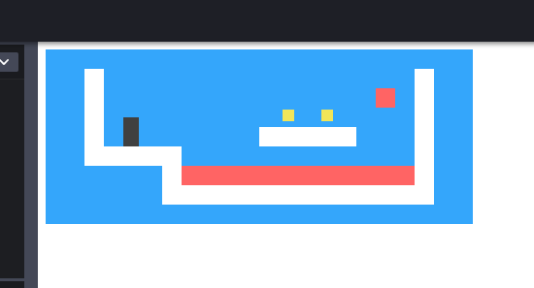

Using Codepen
https://eloquentjavascript.net/css/game.css

Slide 31
練習時間
(練習上述操作)

Slide 32
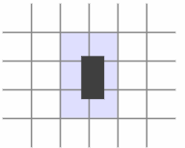
Motion and collision
This method tells us:
whether a rectangle (specified by a position and a size) touches a grid element of the given type
Level.prototype.touches = function(pos, size, type) {
var xStart = Math.floor(pos.x);
var xEnd = Math.ceil(pos.x + size.x);
var yStart = Math.floor(pos.y);
var yEnd = Math.ceil(pos.y + size.y);
for (var y = yStart; y < yEnd; y++) {
for (var x = xStart; x < xEnd; x++) {
let isOutside = x < 0 || x >= this.width ||
y < 0 || y >= this.height;
let here = isOutside ? "wall" : this.rows[y][x];
if (here == type) return true;
}
}
return false;
};
method computes the set of grid squares that the body overlaps with by using Math.floor and Math.ceil on its coordinates
grid squares are 1 by 1 units in size
return true when a matching square is found.
Squares outside of the level are always treated as "wall" to ensure that the player can’t leave the world
we won’t accidentally try to read outside of the bounds of our rows array

Slide 33
state update method:
uses touches to figure out whether the player is touching lava.
State.prototype.update = function(time, keys) {
let actors = this.actors.map(actor => actor.update(time, this, keys));
let newState = new State(this.level, actors, this.status);
if (newState.status != "playing") return newState;
let player = newState.player;
if (this.level.touches(player.pos, player.size, "lava")) {
return new State(this.level, actors, "lost");
}
for (let actor of actors) {
if (actor != player && overlap(actor, player)) {
newState = actor.collide(newState);
}
}
return newState;
};
method is passed a time step and a data structure that tells it which keys are being held down
first thing is call the update method on all actors, producing an array of updated actors.
The actors also get the time step, the keys, and the state, so that they can base their update on those

Slide 34
Overlap between actors is detected with the overlap function.
takes two actor objects and returns true when they touch:
is the case when they overlap both along the x-axis and along the y-axis.
function overlap(actor1, actor2) {
return actor1.pos.x + actor1.size.x > actor2.pos.x &&
actor1.pos.x < actor2.pos.x + actor2.size.x &&
actor1.pos.y + actor1.size.y > actor2.pos.y &&
actor1.pos.y < actor2.pos.y + actor2.size.y;
}

Slide 35
If any actor does overlap:
its collide method gets a chance to update the state.
Touching a lava actor sets the game status to "lost".
Coins vanish when you touch them
set the status to "won" when they are the last coin of the level.
Lava.prototype.collide = function(state) {
return new State(state.level, state.actors, "lost");
};
Coin.prototype.collide = function(state) {
let filtered = state.actors.filter(a => a != this);
let status = state.status;
if (!filtered.some(a => a.type == "coin")) status = "won";
return new State(state.level, filtered, status);
};

Slide 36
Actor updates
Actor objects’ update methods take as arguments:
the time step, the state object, and a keys object.
The one for the Lava actor type ignores the keys object.
Lava.prototype.update = function(time, state) {
let newPos = this.pos.plus(this.speed.times(time));
if (!state.level.touches(newPos, this.size, "wall")) {
return new Lava(newPos, this.speed, this.reset);
} else if (this.reset) {
return new Lava(this.reset, this.speed, this.reset);
} else {
return new Lava(this.pos, this.speed.times(-1));
}
};
If no obstacle blocks that new position, it moves there. If there is an obstacle, the behavior depends on the type of the lava block—dripping lava has a reset position, to which it jumps back when it hits something.
update method computes a new position by adding the product of the time step and the current speed to its old position.
Bouncing lava inverts its speed by multiplying it by -1 so that it starts moving in the opposite direction.

Slide 37
Coins use their update method to wobble.
They ignore collisions with the grid since they are simply wobbling around inside of their own square.
const wobbleSpeed = 8, wobbleDist = 0.07;
Coin.prototype.update = function(time) {
let wobble = this.wobble + time * wobbleSpeed;
let wobblePos = Math.sin(wobble) * wobbleDist;
return new Coin(this.basePos.plus(new Vec(0, wobblePos)),
this.basePos, wobble);
};
wobble property is incremented to track time and then used as an argument to Math.sin to find the new position on the wave.
The coin’s current position is then computed from its base position and an offset based on this wave.

Slide 38
Player motion is handled separately per axis:
because hitting the floor should not prevent horizontal motion
hitting a wall should not stop falling or jumping motion.
const playerXSpeed = 7;
const gravity = 30;
const jumpSpeed = 17;
Player.prototype.update = function(time, state, keys) {
let xSpeed = 0;
if (keys.ArrowLeft) xSpeed -= playerXSpeed;
if (keys.ArrowRight) xSpeed += playerXSpeed;
let pos = this.pos;
let movedX = pos.plus(new Vec(xSpeed * time, 0));
if (!state.level.touches(movedX, this.size, "wall")) { pos = movedX; }
let ySpeed = this.speed.y + time * gravity;
let movedY = pos.plus(new Vec(0, ySpeed * time));
if (!state.level.touches(movedY, this.size, "wall")) {
pos = movedY;
} else if (keys.ArrowUp && ySpeed > 0) { ySpeed = -jumpSpeed; }
else { ySpeed = 0; }
return new Player(pos, new Vec(xSpeed, ySpeed));
};
horizontal motion is computed based on the state of the left and right arrow keys.
Vertical motion works in a similar way but has to simulate jumping and gravity.
Player’s vertical speed (ySpeed) is first accelerated to account for gravity.

Slide 39
Tracking keys
when given an array of key names:
return an object that tracks the current position of those keys.
registers event handlers for "keydown" and "keyup" events:
when the key code in the event is present in the set of codes that it is tracking, updates the object.
function trackKeys(keys) {
let down = Object.create(null);
function track(event) {
if (keys.includes(event.key)) {
down[event.key] = event.type == "keydown";
event.preventDefault();
}
}
window.addEventListener("keydown", track);
window.addEventListener("keyup", track);
return down;
}
const arrowKeys = trackKeys(["ArrowLeft", "ArrowRight", "ArrowUp"]);

Slide 40
Running the game
requestAnimationFrame function (in Ch14):
requires to track the time at which our function was called the last time around
call requestAnimationFrame again after every frame.
function runAnimation(frameFunc) {
let lastTime = null;
function frame(time) {
if (lastTime != null) {
let timeStep = Math.min(time - lastTime, 100) / 1000;
if (frameFunc(timeStep) === false) return;
}
lastTime = time;
requestAnimationFrame(frame);
}
requestAnimationFrame(frame);
}
set a maximum frame step of 100 milliseconds
the difference between lastTime and time will be the entire time in which the page was hidden.
function also converts the time steps to seconds, which are an easier quantity to think about than milliseconds.

Slide 41
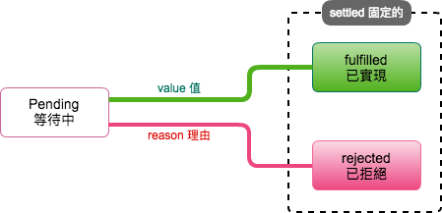
runLevel function takes a Level object and a display constructor and returns a promise (in Ch 18-20):
displays the level (in document.body) and lets the user play through it.
When level is finished (lost or won),
runLevel waits one more second (to let user see what happens)
then clears the display, stops the animation, and resolves the promise to the game’s end status.
function runLevel(level, Display) {
let display = new Display(document.body, level);
let state = State.start(level);
let ending = 1;
return new Promise(resolve => {
runAnimation(time => {
state = state.update(time, arrowKeys);
display.syncState(state);
if (state.status == "playing") { return true; }
else if (ending > 0) { ending -= time; return true; }
else { display.clear(); resolve(state.status); return false; }
});
});
}
Promise是個強大異步執行流程語法結構(ES6)
Promise狀態:

Slide 42
A game is a sequence of levels:
Whenever the player dies, the current level is restarted.
When a level is completed, we move on to the next level.
async function runGame(plans, Display) {
for (let level = 0; level < plans.length;) {
let status = await runLevel(new Level(plans[level]),
Display);
if (status == "won") level++;
}
console.log("You've won!");
}
Because we made runLevel return a promise, runGame can be written using an async function
async function (AsyncFunction 物件): (in Ch 18-20)
代表一個非同步函式，該函式會執行該函式內的程式碼。
當 async 函式被呼叫時，它會回傳一個 Promise

Slide 43
Run the Game < index.html>
<!doctype html>
<script src="code/chapter/16_game.js"></script>
<script src="code/levels.js"></script>
<link rel="stylesheet" href="css/game.css">
<body>
<script>
runGame(GAME_LEVELS, DOMDisplay);
</script>
</body>

Slide 44
player start with three lives
<!doctype html>
<script src="code/chapter/16_game.js"></script>
<script src="code/levels.js"></script>
<link rel="stylesheet" href="css/game.css">
<body>
<script>
// The old runGame function. Modify it...
async function runGame(plans, Display) {
for (let level = 0; level < plans.length;) {
let status = await runLevel(new Level(plans[level]),
Display);
if (status == "won") level++;
}
console.log("You've won!");
}
runGame(GAME_LEVELS, DOMDisplay);
</script>
</body>

Slide 45
<!doctype html>
<script src="code/chapter/16_game.js"></script>
<script src="code/levels.js"></script>
<link rel="stylesheet" href="css/game.css">
<body>
<script>
// The old runLevel function. Modify this...
function runLevel(level, Display) {
let display = new Display(document.body, level);
let state = State.start(level);
let ending = 1;
return new Promise(resolve => {
runAnimation(time => {
state = state.update(time, arrowKeys);
display.syncState(state);
if (state.status == "playing") {
return true;
} else if (ending > 0) {
ending -= time;
return true;
} else {
display.clear();
resolve(state.status);
return false;
}
});
});
}
runGame(GAME_LEVELS, DOMDisplay);
</script>
</body>
to pause (suspend) and unpause the game by pressing the Esc key

Slide 46
A monster
<!doctype html>
<script src="code/chapter/16_game.js"></script>
<script src="code/levels.js"></script>
<link rel="stylesheet" href="css/game.css">
<style>.monster { background: purple }</style>
<body>
<script>
// Complete the constructor, update, and collide methods
class Monster {
constructor(pos, /* ... */) {}
get type() { return "monster"; }
static create(pos) {
return new Monster(pos.plus(new Vec(0, -1)));
}
update(time, state) {}
collide(state) {}
}
Monster.prototype.size = new Vec(1.2, 2);
levelChars["M"] = Monster;
runLevel(new Level(`
..................................
.################################.
.#..............................#.
.#..............................#.
.#..............................#.
.#...........................o..#.
.#..@...........................#.
.##########..............########.
..........#..o..o..o..o..#........
..........#...........M..#........
..........################........
..................................
`), DOMDisplay);
</script>
</body>

Slide 47
練習時間
(練習上述操作)

Slide 48
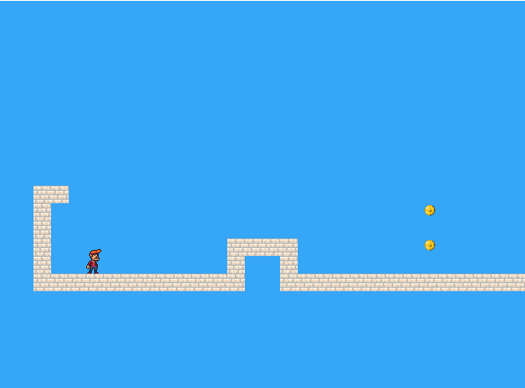
CH 17 (Eloquent) Project: A Platform Game using CANVAS

Slide 49

Play the Game
Download the code:
ch17.zip from the ecourse.
\code\chapter
16_game.js
17_game.js
\code
levels.js
\img
player.png
sprites.png
Index.html

Slide 50
Game code using CANVAS
use drawImage to draw pictures :
represent the game’s elements
define another display object type called CanvasDisplay:
supporting the same interface as DOMDisplay (Ch16):
the methods syncState and clear.
keeps a little more information than DOMDisplay.
Rather than using the scroll position of its DOM element,
it tracks its own viewport:
tells what part of the level we are currently looking at.
Finally, it keeps a flipPlayer property:
so that even when the player is standing still,
it keeps facing the direction it last moved in.

Slide 51
class CanvasDisplay {
constructor(parent, level) {
this.canvas = document.createElement("canvas");
this.canvas.width = Math.min(600, level.width * scale);
this.canvas.height = Math.min(450, level.height * scale);
parent.appendChild(this.canvas);
this.cx = this.canvas.getContext("2d");
this.flipPlayer = false;
this.viewport = {
left: 0,
top: 0,
width: this.canvas.width / scale,
height: this.canvas.height / scale
};
}
clear() {
this.canvas.remove();
}
}
viewport
this.flipPlayer = false;

Slide 52
syncState method:
first computes a new viewport
then draws the game scene at the appropriate position.
CanvasDisplay.prototype.syncState = function(state) {
this.updateViewport(state);
this.clearDisplay(state.status);
this.drawBackground(state.level);
this.drawActors(state.actors);
};
Contrary to DOMDisplay, this display style does have to redraw the background on every update.
Because shapes on a canvas are just pixels,
(after we draw them there is no good way to move them (or remove them). )
The only way to update the canvas display is to clear it and redraw the scene.

Slide 53
updateViewport method:
is similar to DOMDisplay’s scrollPlayerIntoView method.
checks whether player is too close to the edge of the screen
moves the viewport when this is the case.
CanvasDisplay.prototype.updateViewport = function(state) {
let view = this.viewport, margin = view.width / 3;
let player = state.player;
let center = player.pos.plus(player.size.times(0.5));
if (center.x < view.left + margin) {
view.left = Math.max(center.x - margin, 0);
} else if (center.x > view.left + view.width - margin) {
view.left = Math.min(center.x + margin - view.width,
state.level.width - view.width);
}
if (center.y < view.top + margin) {
view.top = Math.max(center.y - margin, 0);
} else if (center.y > view.top + view.height - margin) {
view.top = Math.min(center.y + margin - view.height,
state.level.height - view.height);
}
};
The calls to Math.max and Math.min ensure that the viewport does not end up showing space outside of the level.
Math.max(x, 0) makes sure the resulting number is not less than zero.
Math.min similarly guarantees that a value stays below a given bound.

Slide 54
When clearing the display,
use a slightly different color depending on whether the game is won (brighter) or lost (darker).
CanvasDisplay.prototype.clearDisplay = function(status) {
if (status == "won") {
this.cx.fillStyle = "rgb(68, 191, 255)";
} else if (status == "lost") {
this.cx.fillStyle = "rgb(44, 136, 214)";
} else {
this.cx.fillStyle = "rgb(52, 166, 251)";
}
this.cx.fillRect(0, 0,
this.canvas.width, this.canvas.height);
};

Slide 55

To draw the background:
run through the tiles:
are visible in the current viewport,
using the same trick used in the touches method from CH16.
let otherSprites = document.createElement("img");
otherSprites.src = "img/sprites.png";
CanvasDisplay.prototype.drawBackground = function(level) {
let {left, top, width, height} = this.viewport;
let xStart = Math.floor(left);
let xEnd = Math.ceil(left + width);
let yStart = Math.floor(top);
let yEnd = Math.ceil(top + height);
for (let y = yStart; y < yEnd; y++) {
for (let x = xStart; x < xEnd; x++) {
let tile = level.rows[y][x];
if (tile == "empty") continue;
let screenX = (x - left) * scale;
let screenY = (y - top) * scale;
let tileX = tile == "lava" ? scale : 0;
this.cx.drawImage(otherSprites, tileX, 0, scale, scale, screenX, screenY, scale, scale);
}
}
};
Tiles that are not empty are drawn with drawImage
otherSprites image contains the pictures used for elements other than the player
wall tile, the lava tile, and the sprite for a coin
Background tiles are 20 by 20 pixels

Slide 56
sprites are slightly wider than the player object:
24 instead of 16 pixels to allow some space for feet and arms
method has to adjust the x-coordinate and width by a given amount (playerXOverlap).
let playerSprites = document.createElement("img");
playerSprites.src = "img/player.png";
const playerXOverlap = 4;
CanvasDisplay.prototype.drawPlayer = function(player, x, y, width, height)
{
width += playerXOverlap * 2;
x -= playerXOverlap;
if (player.speed.x != 0) { this.flipPlayer = player.speed.x < 0; }
let tile = 8;
if (player.speed.y != 0) { tile = 9; } else if (player.speed.x != 0) {
tile = Math.floor(Date.now() / 60) % 8; }
this.cx.save();
if (this.flipPlayer) { flipHorizontally(this.cx, x + width / 2); }
let tileX = tile * width;
this.cx.drawImage(playerSprites, tileX, 0, width, height, x, y, width, height);
this.cx.restore();
};

Slide 57
drawPlayer method:
is called by drawActors,
is responsible for drawing all the actors in the game.
CanvasDisplay.prototype.drawActors = function(actors) {
for (let actor of actors) {
let width = actor.size.x * scale;
let height = actor.size.y * scale;
let x = (actor.pos.x - this.viewport.left) * scale;
let y = (actor.pos.y - this.viewport.top) * scale;
if (actor.type == "player") {
this.drawPlayer(actor, x, y, width, height);
} else {
let tileX = (actor.type == "coin" ? 2 : 1) * scale;
this.cx.drawImage(otherSprites, tileX, 0, width, height,
x, y, width, height);
}
}
};
When drawing something that is not the player,
we look at its type to find the offset of the correct sprite.
lava tile is found at offset 20, and the coin sprite is found at 40 (two times scale).

Slide 58
Run the Game using CANVAS
<!doctype html>
<script src="code/chapter/16_game.js"></script>
<script src="code/levels.js"></script>
<script src="code/chapter/17_canvas.js"></script>
<body>
<script>
runGame(GAME_LEVELS, CanvasDisplay);
</script>
</body>

Slide 59
練習時間
(練習上述操作)

Slide 60
THE END
Q&A

