Slide 1
JavaScript程式設計 (JavaScript Programming)
109 學年度 第 1 學期
蘇俊銘(Jun-Ming Su)
jmsu@mail.nutn.edu.tw
數位學習科技學系, 國立台南大學
2020

Slide 2
CH 16 (rhino) Cascading Style Sheets (CSS)
a standard for specifying the visual presentation of HTML documents

Slide 3
Cascading Style Sheets (CSS)
it allows a designer to precisely specify:
fonts, colors, margins, indentation,
borders, position of document elements.
CSS calls them: style properties.
a property with a colon and a value:
font-weight: bold
margin-left: 10%; /* left margin is 10% of page width */
text-indent: .5in; /* indent by 1/2 inch */
font-size: 12pt; /* 12 point font size */
CSS cmments: /* and */
It does not support comments with //

Slide 4
two ways to associate a set of CSS property values with HTML elements:
the inline style:
setting the style attribute of an individual HTML element:
<p style="margin: 20px; border: solid red 2px;">
This paragraph has increased margins and is
surrounded by a rectangular red border.
</p>
in a stylesheet:
A stylesheet associates sets of style properties with sets of HTML elements that are described using selectors.
selector “selects” one or more elements of a document:
based on element ID, class, tag name, on more specialized criteria
querySelectorAll():
to obtain the set of elements that match the selector

Slide 5
a stylesheet
p { /* the selector "p" matches all <p> elements */
text-indent: .5in; /* indent the first line by .5 inches */
}
.warning { /* Any element with class="warning" */
background-color: yellow; /* gets a yellow background */
border: solid black 5px; /* and a big black border */
}
<html>
<head><title>Test Document</title>
<style>
body { margin-left: 30px; margin-right: 15px; background-color: #ffffff }
p { font-size: 24px; }
</style>
</head>
<body><p>Testing, testing</p>
</html>

Slide 6
a stylesheet is to be used by more than one page on a website:
It’s better to store it in its own file:
without any enclosing HTML tags
<head>
<title>Test Document</title>
<link rel="stylesheet" href="mystyles.css" type="text/css">
</head>

Slide 7
The Cascade
“cascading” indicates that:
the style rules that apply to any given element in a document:
can come from a “cascade” of different sources:
The web browser’s default stylesheet
The document’s stylesheets
The style attribute of individual HTML elements
Styles from the style attribute override styles from stylesheets
styles from a document’s stylesheets override the browser’s default styles
The visual presentation of any given element may be a combination of style properties from all three sources:
If different selectors define different values for the same style property:
the value associated with the most specific selector overrides the value associated with less specific selectors
computed style:
browser must combine the style attribute of that element with styles from all the matched selectors:

Slide 8
CSS current work
https://www.w3.org/Style/CSS/current-work:
CSS is a relatively old standard.
CSS1 was adopted in December 1996:
specifying colors, fonts, margins, borders, and other basic styles
CSS2, was adopted in May 1998
defines a number of more advanced features,
most notably support for absolute positioning of elements
CSS3, the current work

Slide 9
Shortcut Properties
Certain style properties that are commonly used together can be combined using:
special shortcut properties:
font-family, font-size, font-style, and fontweight properties:
can all be set at once
EX: using a single font property with a compound value:
font: bold italic 24pt helvetica;
border, margin, and padding properties :
specify borders, margins,
padding (space between the border and element content)
EX:
border-left, border-right, border-top, and border-bottom:
specify the border of each side separately.

Slide 10
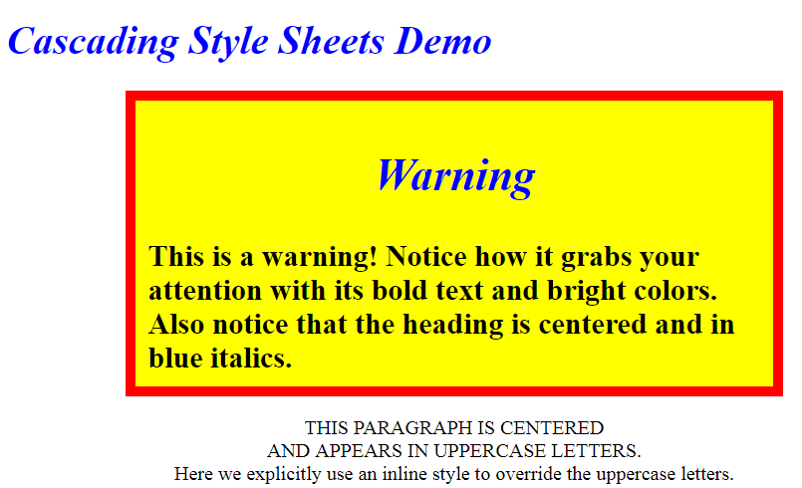
CSS Example

Slide 11
<head>
<style type="text/css">
/* Specify that headings display in blue italic text. */
h1, h2 { color: blue; font-style: italic }
/* Any element of class="WARNING" displays in big bold text with large margins
* and a yellow background with a fat red border.*/
.WARNING {
font-weight: bold;
font-size: 150%;
margin: 0 1in 0 1in; /* top right bottom left */
background-color: yellow;
border: solid red 8px;
padding: 10px; /* 10 pixels on all 4 sides */
}
/* Text within an h1 or h2 heading within an element with class="WARNING"
* should be centered, in addition to appearing in blue italics.*/
.WARNING h1, .WARNING h2 { text-align: center }
/* The single element with id="special" displays in centered uppercase. */
#special {
text-align: center;
text-transform: uppercase;
}
</style>
</head>

Slide 12
<body>
<h1>Cascading Style Sheets Demo</h1>
<div class="WARNING">
<h2>Warning</h2>
This is a warning!
Notice how it grabs your attention with its bold text and bright colors.
Also notice that the heading is centered and in blue italics.
</div>
<p id="special">
This paragraph is centered<br>
and appears in uppercase letters.<br>
<span style="text-transform: none">
Here we explicitly use an inline style to override the uppercase letters.
</span>
</p>
</body>
h1, h2 { color: blue; font-style: italic }
.WARNING {…}
.WARNING h1, .WARNING h2 { text-align: center }
div 標籤在網頁中創造各個不同區塊，每個區塊內還可增加更小區塊(排版)
#special {…}

Slide 13
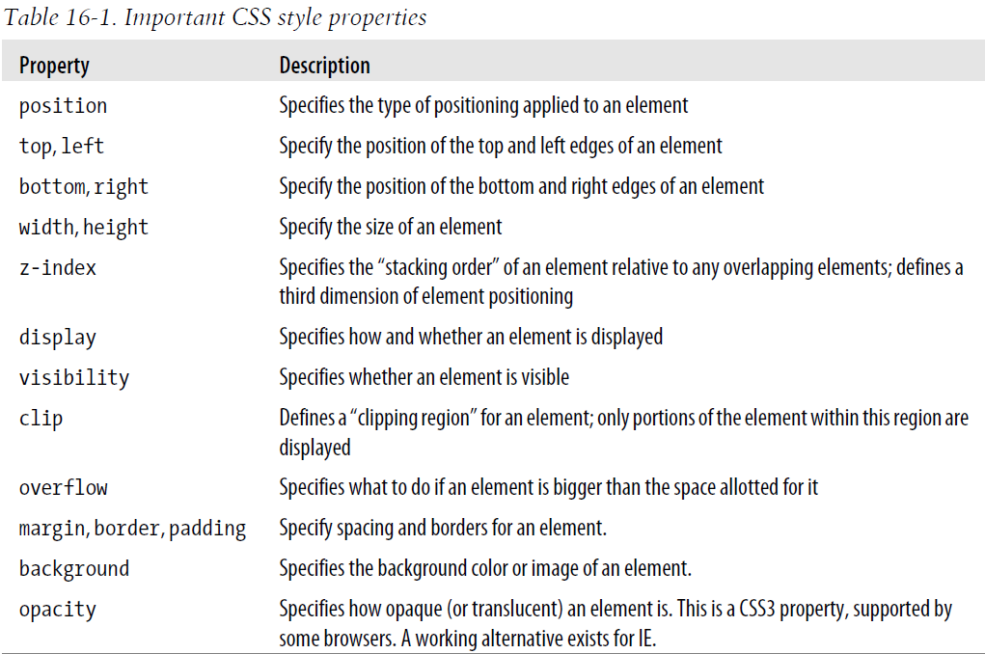
Important CSS Properties

Slide 14
Positioning Elements with CSS
position property:
specifies the type of positioning applied to an element
Static:
the default value
element is positioned according to normal flow of document content:
most Western languages, this is left to right & top to bottom
Statically positioned elements cannot be positioned:
with top, left, and other properties
absolute:
the position of an element relative to its containing element.
Absolutely positioned elements:
are positioned independently of all other elements
are not part of the flow of statically positioned elements
is positioned either relative to its nearest positioned ancestor or relative to the document itself

Slide 15
fixed :
an element’s position with respect to the browser window.
are always visible and do not scroll with the rest of the document
Like absolutely positioned elements :
are independent of all others and are not part of the document flow.
relative:
an element is laid out according to the normal flow,
its position is then adjusted relative to its position in the normal flow.
set the position property (other than static):
with some combination of the left, top, right, and bottom properties
<div style="position: absolute; left: 100px; top: 100px;">
to place an element 100 pixels from the left and 100 pixels from the top of the document:
top and left properties are interpreted relative to the closest ancestor element:
that has its position property set to something other than static.
top and left properties are measured in document coordinates:
If no positioned ancestor:
they are offsets from the top-left corner of the document

Slide 16
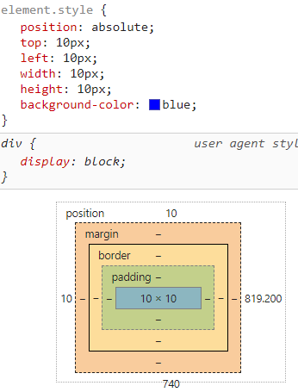

can also use right & bottom:
to specify the position of the bottom and right edges of an element relative to the bottom and right edges of the containing element:
EX:
position: absolute; right: 0px; bottom: 0px;
to position an element so that its bottom-right corner is at the bottom-right of the document:
assuming it is not nested within another dynamic element
position: fixed; right: 10px; top: 10px;
its top edge is 10 pixels from the top of the window
its right edge is 10 pixels from the right of the window
so that it does not scroll with the document,
to specify size: width & height style properties
<div style="position: absolute; top: 10px; left: 10px;
width: 10px; height: 10px; background-color: blue">
</div>
creates an absolutely positioned element with no content
make it appear as a small blue square

Slide 17

CSS requires position and dimension properties to be specified with a unit:
pixels (“px”)
inches (“in”)
centimeters (“cm”)
Points (“pt”)
ems (“em”)
a measure of the line height for the current font).
to specify the position and size of an element:
as a percentage of the size of the containing element
<div style="position: absolute; left: 25%; top: 25%; width: 50%; height: 50%;border: 2px solid black">
</div>
creates an empty element with a black border:
that is half as wide and half as high as the containing element (or the browser window)
and centered within that element

Slide 18
練習時間
(練習上述操作)

Slide 19
The third dimension: z-index
z-index property defines a kind of third dimension:
specify the stacking order of elements
indicate which of two or more overlapping elements is drawn on top of the others.
z-index property is an integer & default is zero
highest z-index appears on top of all the others
the same z-index:
are drawn in the order in which they appear in the document:
so that the last overlapping element appears on top
Note that z-index stacking applies only to sibling elements

Slide 20

positioning example: Shadowed text
text-shadow property to produce drop-shadow effects under text:
<!-- The text-shadow property produces shadows automatically -->
<span style="text-shadow: 3px 3px 1px #888">Shadowed</span>
<!-- Here's how we can produce a similar effect with positioning. -->
<span style="position:relative;">
Shadowed <!-- This is the text that casts the shadow. -->
<span style="position:absolute; top:3px; left:3px; z-index:-1; color: #888">
Shadowed <!-- This is the shadow -->
</span>
</span>
標準的 HTML 註解寫法
span標籤組只佔用自己空間，不像DIV一次佔掉一整行

Slide 21
Borders, Margins and Padding
the style, color, and thickness of the border:
border: solid black 1px; /* border is drawn with a solid, black 1-pixel line */
border: 3px dotted red; /* border is drawn in 3-pixel red dots */
border-radius property:
border-top-right-radius: 50px;
the margin and padding of an element:
margin: 5px; padding: 5px;
margin-left: 25px;
padding-bottom: 5px;
Two equivalent ways to set different padding values for each of the four sides of an element:
padding: 1px 2px 3px 4px;
/* The previous line is equivalent to the following lines. */
padding-top: 1px;
padding-right: 2px;
padding-bottom: 3px;
padding-left: 4px;

Slide 22
CSS Box Model and Positioning Details
the CSS box model and visually explains the meaning of the top, left, width, and height for elements that have borders and padding

Slide 23
Color, Transparency, and Translucency
background-color property:
the background color of any element
the red, green, and blue components of a color:
#000000 /* black */
#fff /* white */
#f00 /* bright red */
#404080 /* dark unsaturated blue */
#ccc /* light gray */
RGBA color space: (Transparency)
red, green, and blue values plus an alpha value:
that specifies the transparency of the color
opacity property: (Translucency)
the value is a number between 0 and 1:
1 means 100 percent opaque
opacity: .75; /* standard CSS3 style for transparency */
filter: alpha(opacity=75); /* transparency for IE; note no decimal point */

Slide 24
Partial Visibility: overflow and clip
visibility property:
to completely hide a document element.
overflow & clip properties:
display only part of an element.
style="clip: rect(0px 100px 100px 0px);"
overflow property:
specifies what happens when the content of an element exceeds the size specified
The allowed values and their meanings:
visible: (default)
Content may overflow and be drawn outside of the element’s box if necessary.
hidden:
Content that overflows is clipped and hidden:
so that no content is ever drawn outside the region defined by the size and positioning properties.
scroll:
element’s box has permanent horizontal and vertical scrollbars
auto:
Scrollbars are displayed only when content exceeds the element’s size:
rather than being permanently displayed.

Slide 25
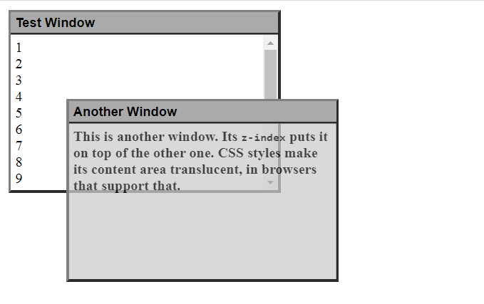
Example: Overlapping Translucent Windows

Slide 26
<head>
<style type="text/css">
/*This is a CSS stylesheet that defines three style rules that we use in the body of the document to create a "window" visual effect.
The rules use positioning properties to set the overall size of the window and the position of its components. Changing the size of the window requires careful changes to positioning properties in all three rules.*/
div.window { /* Specifies size and border of the window */
position: absolute; /* The position is specified elsewhere */
width: 300px; height: 200px; /* Window size, not including borders */
border: 3px outset gray; /* Note 3D "outset" border effect */
}
div.titlebar { /* Specifies position, size, and style of the titlebar */
position: absolute; /* It's a positioned element */
top: 0px; height: 18px; /* Titlebar is 18px + padding and borders */
width: 290px; /* 290 + 5px padding on left and right = 300 */
background-color: #aaa; /* Titlebar color */
border-bottom: groove gray 2px; /* Titlebar has border on bottom only */
padding: 3px 5px 2px 5px; /* Values clockwise: top, right, bottom, left */
font: bold 11pt sans-serif; /* Title font */
}

Slide 27
div.content { /* Specifies size, position and scrolling for window content */
position: absolute; /* It's a positioned element */
top: 25px; /* 18px title+2px border+3px+2px padding */
height: 165px; /* 200px total - 25px titlebar - 10px padding*/
width: 290px; /* 300px width - 10px of padding */
padding: 5px; /* Allow space on all four sides */
overflow: auto; /* Give us scrollbars if we need them */
background-color: #fff; /* White background by default */
}
div.translucent { /* this class makes a window partially transparent */
opacity: .75; /* Standard style for transparency */
filter: alpha(opacity=75); /* Transparency for IE */
}
</style>
</head>

Slide 28
<body>
<!-- Here is how we define a window: a "window" div with a titlebar and -->
<!-- content div nested inside. Note how position is specified with -->
<!-- a style attribute that augments the styles from the stylesheet. -->
<div class="window" style="left: 10px; top: 10px; z-index: 10;">
<div class="titlebar">Test Window</div>
<div class="content">
1<br>2<br>3<br>4<br>5<br>6<br>7<br>8<br>9<br>0<br><!-- Lots of lines to -->
1<br>2<br>3<br>4<br>5<br>6<br>7<br>8<br>9<br>0<br><!-- demonstrate scrolling-->
</div>
</div>
<!-- Here's another window with different position, color, and font weight -->
<div class="window" style="left: 75px; top: 110px; z-index: 20;">
<div class="titlebar">Another Window</div>
<div class="content translucent"
style="background-color:#ccc; font-weight:bold;">
This is another window. Its <tt>z-index</tt> puts it on top of the other one.
CSS styles make its content area translucent, in browsers that support that.
</div>
</div>
</body>

Slide 29
Scripting Inline Styles
Like most HTML attributes:
style is also a property of the Element object,
you can manipulate it in JavaScript
JS properties of this style object represent CSS properties specified by the HTML style attribute:
To make the text of an element e big, bold, and blue,
to set the JS properties:
correspond to font-size font-weight & color style properties:
e.style.fontSize = "24pt";
e.style.fontWeight = "bold";
e.style.color = "blue";
//a hyphen(-) is interpreted as a minus sign
e.style.font-size = "24pt"; // Syntax error!
e.style.fontFamily = "sans-serif"; //without hyphen (-)

Slide 30
a stylesheet or style attribute:
position: absolute; font-family: sans-serif; background-color: #ffffff;
the same thing for an element e with JavaScript:
e.style.position = "absolute";
e.style.fontFamily = "sans-serif";
e.style.backgroundColor = "#ffffff";
the positioning properties require units:
e.style.left = "300px";
e.style.left = (x0 + left_margin + left_border + left_padding) + "px";
In CSS properties:
margin shortcuts:
margin-top, margin-right, margin-bottom, margin-left
In CSSStyleDeclaration object:
e.style.margin = topMargin + "px " + rightMargin + "px " + bottomMargin + "px " + leftMargin + "px";
it is easier to set the four margin properties individually:
e.style.marginTop = topMargin + "px";
e.style.marginRight = rightMargin + "px";
e.style.marginBottom = bottomMargin + "px";
e.style.marginLeft = leftMargin + "px";

Slide 31
練習時間
(練習上述操作)

Slide 32
CH 17 (Eloquent) Drawing on Canvas
It is a single DOM element that encapsulates a picture.
It provides a programming interface for drawing
shapes onto the space taken up by the node

Slide 33
several ways to display graphics
The simplest way:
to use styles to position and color regular DOM elements
DOM wasn’t originally designed for Graphics.
EX: drawing a line between arbitrary points
The second way:
DOM-based but utilizes Scalable Vector Graphics (SVG):
rather than HTML
focuses on shapes rather than text.
You can embed an SVG document directly in an HTML document or include it with an <img> tag
The third way:
Canvas:
a single DOM element that encapsulates a picture
provides a programming interface for drawing shapes onto the space taken up by the node
The main difference between a Canvas and an SVG picture:
in SVG,
the original description of the shapes is preserved:
so that they can be moved or resized at any time.
A canvas:
converts the shapes to pixels (colored dots on a raster) as soon as they are drawn
does not remember what these pixels represent.
The only way to move a shape on a canvas is to:
clear the canvas (or the part of the canvas around the shape)
redraw it with the shape in a new position.

Slide 34
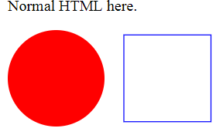
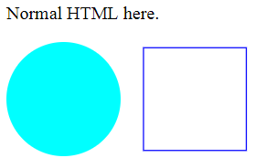
an HTML document with a simple SVG picture
xmlns attribute:
changes an element (and its children) to a different XML namespace.
<circle> & <rect> tags:
do not exist in HTML, do have a meaning in SVG
create DOM elements
<p>Normal HTML here.</p>
<svg xmlns="http://www.w3.org/2000/svg">
<circle r="50" cx="50" cy="50" fill="red"/>
<rect x="120" y="5" width="90" height="90" stroke="blue" fill="none"/>
</svg>
<script>
//changes <circle> to be colored cyan instead
let circle = document.querySelector("circle");
circle.setAttribute("fill", "cyan");
</script>

Slide 35
The canvas element
Canvas graphics can be drawn onto a <canvas> element
give such an element width & height attributes to determine its size in pixels.
A new canvas is empty:
it is entirely transparent
shows up as empty space in the document
<canvas> tag:
is intended to allow different styles of drawing
access to an actual drawing interface:
first need to create a context:
an object whose methods provide the drawing interface
Two drawing styles: "2d" & "webgl" (for 3D OpenGL interface)

Slide 36
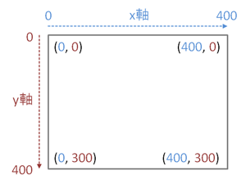
create a context with getContext method
<p>Before canvas.</p>
<canvas width="120" height="60"></canvas>
<p>After canvas.</p>
<script>
let canvas = document.querySelector("canvas");
let context = canvas.getContext("2d");
context.fillStyle = "red";
context.fillRect(10, 10, 100, 50);
</script>
top-left corner

Slide 37
Lines and surfaces
In canvas:
a shape can be filled:
its area is given a certain color or pattern,
It can be stroked:
a line is drawn along its edge.
fillRect : fills a rectangle
strokeRect : draws the outline of a rectangle
fillStyle property: controls the way shapes are filled.
strokeStyle property: determines the color used for a stroked line.
lineWidth property: determines the width of line

Slide 38
<canvas></canvas>
<script>
let cx = document.querySelector("canvas").getContext("2d");
cx.strokeStyle = "blue";
cx.strokeRect(5, 5, 50, 50);
//default width=300 pixels, height=150 pixels
cx.lineWidth = 5;
cx.strokeRect(135, 5, 50, 50);
</script>

Slide 39
Paths
A path is a sequence of lines
<canvas></canvas>
<script>
let cx = document.querySelector("canvas").getContext("2d");
cx.beginPath();
for (let y = 10; y < 100; y += 10) {
//next segment would start at the position passed to moveTo
cx.moveTo(10, y);
//segment created with lineTo starts at the path’s current position:
//That position is usually the end of the last segment, unless moveTo was called
cx.lineTo(90, y);
}
cx.stroke(); //strokes it using the stroke method
</script>
moveTo(10, y)
lineTo(90, y)
stroke()

Slide 40
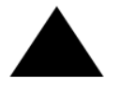
A path can contain multiple shapes
each moveTo motion starts a new one.
<canvas></canvas>
<script>
let cx = document.querySelector("canvas").getContext("2d");
cx.beginPath();
cx.moveTo(50, 10);
cx.lineTo(10, 70);
cx.lineTo(90, 70);
cx.fill();
</script>
beginPath()
moveTo
(50, 10)
fill()
lineTo
(10, 70)
lineTo
(90, 70)

Slide 41

closePath()
close a path by adding an actual line segment back to the path’s start.
<canvas></canvas>
<script>
let ct = document.querySelector("canvas").getContext("2d");
ct.beginPath();
ct.moveTo(20,20);
ct.lineTo(20,100);
ct.lineTo(70,100);
ct.closePath();
ct.stroke();
</script>
beginPath()
moveTo
(20, 20)
ct.stroke();
closePath()
lineTo
(20, 100)
lineTo
(70, 100)

Slide 42


Curves
quadraticCurveTo method draws a curve to a given point:
<canvas></canvas>
<script>
let cx = document.querySelector("canvas").getContext("2d");
cx.beginPath();
cx.moveTo(10, 90);
// control point=(60,10) goal=(90,90)
cx.quadraticCurveTo(60, 10, 90, 90);
cx.lineTo(60, 10);
cx.closePath();
cx.stroke();
</script>
(60, 10)
cx.lineTo(60, 10);
(10, 90)
(90, 90)
Without cx.lineTo(60, 10);

Slide 43
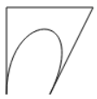
bezierCurveTo method
draws a similar kind of curve.
Instead of a single control point,
this one has two—one for each of the line’s endpoints
<canvas></canvas>
<script>
let cx = document.querySelector("canvas").getContext("2d");
cx.beginPath();
cx.moveTo(10, 90);
// control1=(10,10) control2=(90,10) goal=(50,90)
cx.bezierCurveTo(10, 10, 90, 10, 50, 90);
cx.lineTo(90, 10);
cx.lineTo(10, 10);
cx.closePath();
cx.stroke();
</script>
cx.lineTo(10, 10);
cx.lineTo(90, 10);
cx.moveTo(10, 90);
goal=(50,90)

Slide 44
練習時間
(練習上述操作)

Slide 45
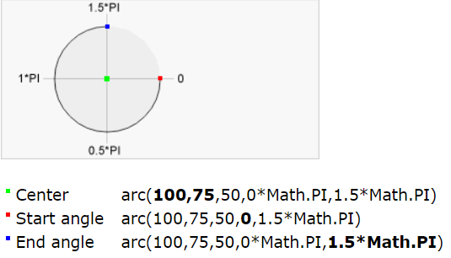
arc method
is a way to draw a line:
that curves along the edge of a circle:
takes a pair of coordinates for the arc’s:
center,
a radius,
a start angle and end angle:
make it possible to draw only part of the circle
<canvas></canvas>
<script>
let cx = document.querySelector("canvas").getContext("2d");
cx.beginPath();
// center=(50,50) radius=40 angle=0 to 7
cx.arc(50, 50, 40, 0, 7);
// center=(150,50) radius=40 angle=0 to PI^{½}
cx.arc(150, 50, 40, 0, 0.5 * Math.PI);
cx.stroke();
</script>
cx.arc(50, 50, 40, 0, 7);
cx.arc(150, 50, 40, 0, 0.5 * Math.PI);

Slide 46
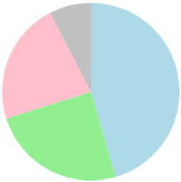
Drawing a pie chart
const results = [
{name: "Satisfied", count: 1043, color: "lightblue"},
{name: "Neutral", count: 563, color: "lightgreen"},
{name: "Unsatisfied", count: 510, color: "pink"},
{name: "No comment", count: 175, color: "silver"} ];
<canvas width="200" height="200"></canvas>
<script>
let cx = document.querySelector("canvas").getContext("2d");
let total = results.reduce((sum, {count}) => sum + count, 0);
// Start at the top
let currentAngle = -0.5 * Math.PI;
for (let result of results) {
let sliceAngle = (result.count / total) * 2 * Math.PI;
cx.beginPath();
// center=100,100, radius=100
// from current angle, clockwise by slice's angle
cx.arc(100, 100, 100,
currentAngle, currentAngle + sliceAngle);
currentAngle += sliceAngle;
cx.lineTo(100, 100);
cx.fillStyle = result.color;
cx.fill(); }
</script>

Slide 47

Text
fillText :
fill the outline of the given text with the current fillStyle
strokeText :
is for outlining letters
<canvas></canvas>
<script>
let cx = document.querySelector("canvas").getContext("2d");
cx.font = "28px Georgia";
cx.fillStyle = "fuchsia";
cx.fillText("I can draw text, too!", 10, 50);
</script>

Slide 48


Images
drawImage method:
allows us to draw pixel data onto a canvas
This pixel data can originate from:
an <img> element or from another canvas
<canvas></canvas>
<script>
let cx = document.querySelector("canvas").getContext("2d");
let img = document.createElement("img");
//img.src = "img/hat.png";
img.src = "https://eloquentjavascript.net/img/hat.png";
img.addEventListener("load", () => {
for (let x = 10; x < 200; x += 30) { cx.drawImage(img, x, 10);}
});
</script>

Slide 49

When drawImage is given nine arguments:
it can be used to draw only a fragment of an image.
second through fifth arguments:
indicate the rectangle (x, y, width, and height) in the source image that should be copied,
sixth to ninth arguments:
give the rectangle (on the canvas) into which it should be copied.
<canvas></canvas>
<script>
let cx = document.querySelector("canvas").getContext("2d");
let img = document.createElement("img");
img.src = "https://eloquentjavascript.net/img/player.png";
let spriteW = 24, spriteH = 30;
img.addEventListener("load", () => {
let cycle = 0;
setInterval(() => {
cx.clearRect(0, 0, spriteW, spriteH);
cx.drawImage(img,
// source rectangle
cycle * spriteW, 0, spriteW, spriteH,
// destination rectangle
0, 0, spriteW, spriteH);
cycle = (cycle + 1) % 8;
}, 120);
});
</script>
setInterval()綁定在瀏覽器 window 的方法，可透過 setInterval 指定一段程式碼或函式定時在多少毫秒(ms)後執行，並回傳此定時器的編號。
透過 clearInterval 取消程式碼的執行。

Slide 50

Transformation
scale method:
will cause anything drawn after it to be scaled
two parameters:
one to set a horizontal scale
one to set a vertical scale.
<canvas></canvas>
<script>
let cx = document.querySelector("canvas").getContext("2d");
cx.scale(3, .5);
cx.beginPath();
cx.arc(50, 50, 40, 0, 7);
cx.lineWidth = 3;
cx.stroke();
</script>
Scaling by a negative amount will flip the picture around
When a horizontal scaling of -1 is applied,
a shape drawn at x position 100 will end up at what used to be position -100

Slide 51
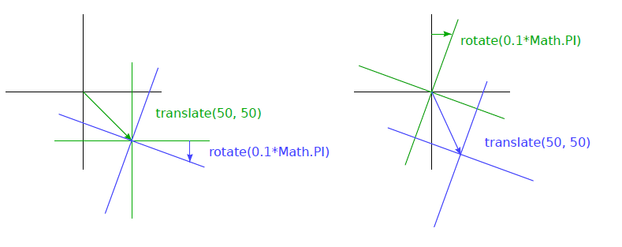
rotate & translate methods
transformations stack:
meaning that each one happens relative to the previous transformations

Slide 52
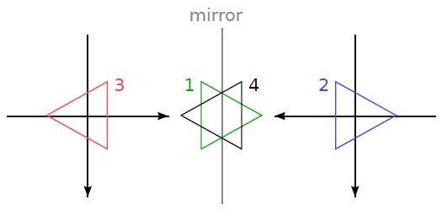

rotate & translate methods
To flip a picture around the vertical line at a given x position:
function flipHorizontally(context, around) {
context.translate(around, 0);
context.scale(-1, 1);
context.translate(-around, 0); }
draw a mirrored character at position (100,0):
by flipping the world around the character’s vertical center
<canvas></canvas>
<script>
let cx = document.querySelector("canvas").getContext("2d");
let img = document.createElement("img");
img.src = " https://eloquentjavascript.net/img/player.png ";
let spriteW = 24, spriteH = 30;
img.addEventListener("load", () => {
flipHorizontally(cx, 100 + spriteW / 2);
cx.drawImage(img, 0, 0, spriteW, spriteH,
100, 0, spriteW, spriteH); });
</script>

Slide 53
Storing and clearing transformations
to save the current transformation:
do some drawing and transforming,
and then restore the old transformation
save & restore methods on the 2D canvas context:
do this transformation management
save:
the current state is pushed onto the stack
restore:
the state on top of the stack is taken off
used as the context’s current transformation
resetTransform:
to fully reset the transformation.

Slide 54
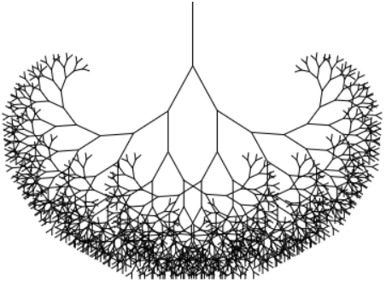
This function draws a treelike shape by:
drawing a line,
moving the center of the coordinate system to the end of the line,
calling itself twice:
first rotated to the left and then rotated to the right.
Every call reduces the length of the branch drawn,
and the recursion stops when the length drops below 8.
<canvas width="600" height="300"></canvas>
<script>
let cx = document.querySelector("canvas").getContext("2d");
function branch(length, angle, scale) {
cx.fillRect(0, 0, 1, length);
if (length < 8) return;
cx.save();
cx.translate(0, length);
cx.rotate(-angle);
branch(length * scale, angle, scale);
cx.rotate(2 * angle);
branch(length * scale, angle, scale);
cx.restore(); }
cx.translate(300, 0);
branch(60, 0.5, 0.8);
</script>

Slide 55
Choosing a graphics interface
HTML, SVG, and canvas:
There is no single best approach:
Plain HTML has the advantage of being simple.
It also integrates well with text.
Both SVG and Canvas allow you to draw text:
but they won’t help you position that text or wrap it:
when it takes up more than one line.
In an HTML-based picture:
it is much easier to include blocks of text.
SVG can be used to produce crisp graphics :
that look good at any zoom level.
Unlike HTML,
it is designed for drawing
is thus more suitable for that purpose.

Slide 56
Both SVG and HTML build up a data structure (the DOM):
that represents your picture.
This makes it possible to modify elements after they are drawn.
If you need to repeatedly change a small part of a big picture:
in response to what the user is doing or as part of an animation,
doing it in a canvas can be needlessly expensive.
The DOM also allows us to register mouse event handlers on every element in the picture (even on shapes drawn with SVG).
You can’t do that with canvas.

Slide 57
canvas’s pixel-oriented approach :
can be an advantage when drawing a huge number of tiny elements
it does not build up a data structure:
but only repeatedly draws onto the same pixel surface gives canvas a lower cost per shape.
rendering a scene one pixel at a time:
EX: using a ray tracer
postprocessing an image with JavaScript:
Blurring or distorting it,
that can be realistically handled only by a pixel-based approach.
you may want to combine several of these techniques:
might draw a graph with SVG or canvas
but show textual information by positioning an HTML element on top of the picture

Slide 58
THE END
Q&A

