Slide 1
JavaScript程式設計 (JavaScript Programming)
109 學年度 第 1 學期
蘇俊銘(Jun-Ming Su)
jmsu@mail.nutn.edu.tw
數位學習科技學系, 國立台南大學
2020

Slide 2
CH 18 (Eloquent) HTTP and Forms
Hypertext Transfer Protocol
is the mechanism through which
data is requested and provided on the World Wide Web

Slide 3
The protocol
eloquentjavascript.net/18_http.html
browser first looks up the address of the server associated with eloquentjavascript.net
tries to open a TCP connection to it on port 80:
The default port for HTTP traffic
the browser might send something like this:
If the server exists and accepts the connection
GET /18_http.html HTTP/1.1
Host: eloquentjavascript.net
User-Agent: Your browser's name
Then the server responds:
HTTP/1.1 200 OK
Content-Length: 65585
Content-Type: text/html
Last-Modified: Mon, 08 Jan 2018 10:29:45 GMT
<!doctype html>
... the rest of the document
browser takes the part of the response after the blank line, its body
and displays it as an HTML document

Slide 4
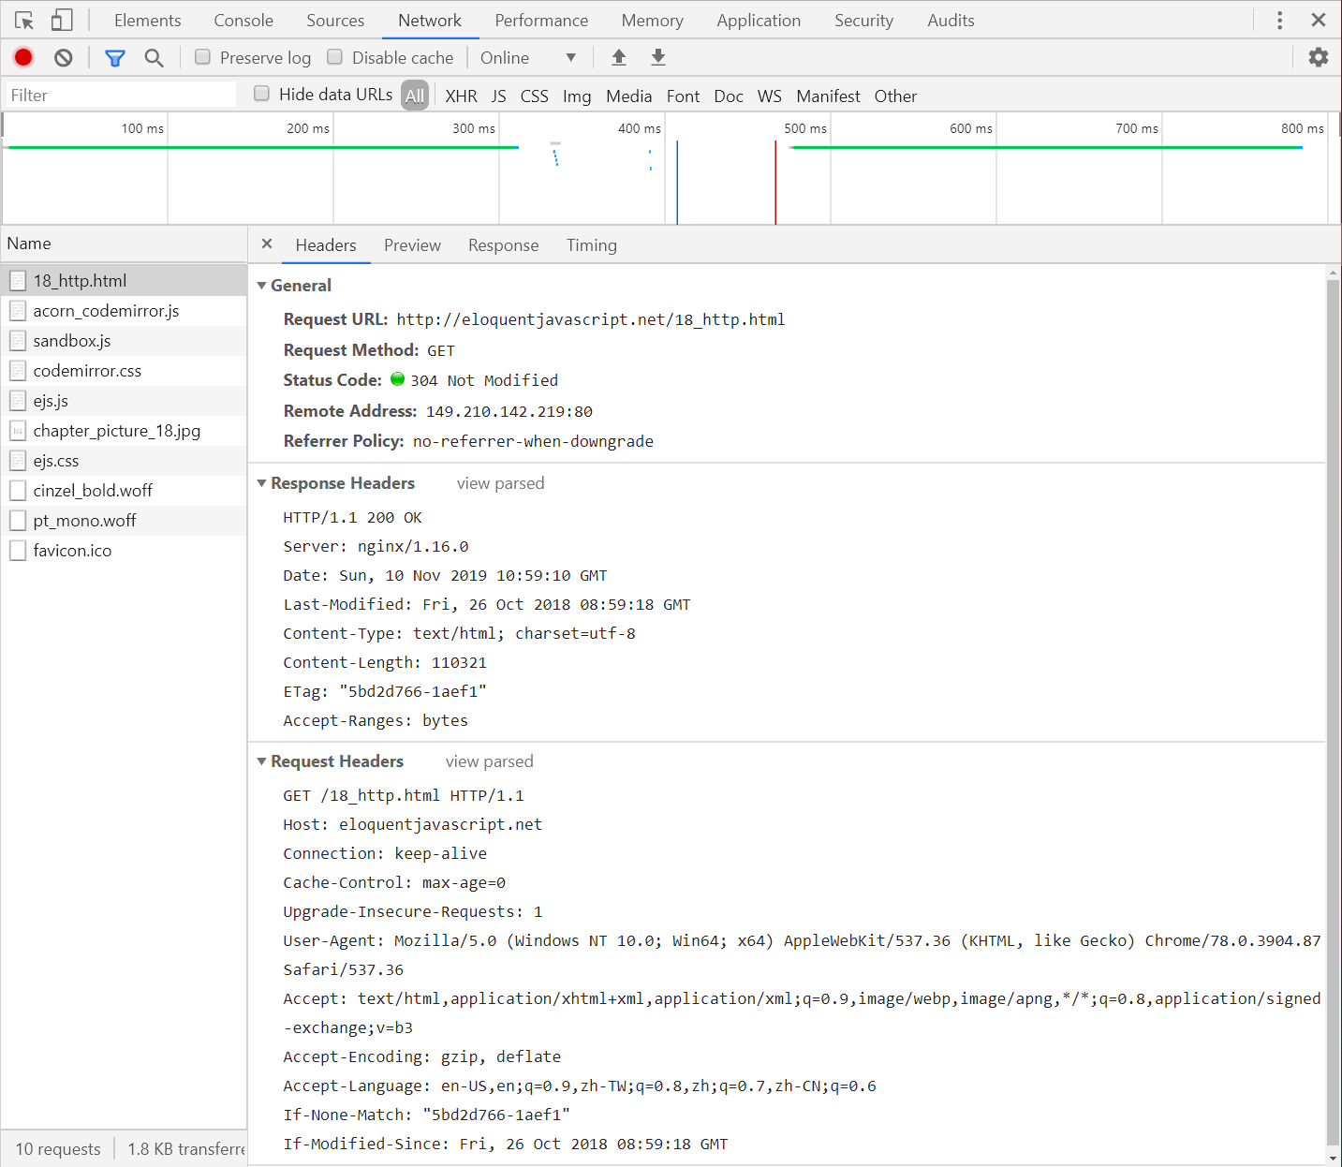

Slide 5
Request:
The information sent by the client
It starts with this line:
GET /18_http.html HTTP/1.1
The GET is the method of the request:
we want to get the specified resource.
DELETE to delete a resource,
PUT to create or replace it,
POST to send information to it.
The part after the method name: /18_http.html
is the path of the resource the request applies to
After the resource path: HTTP/1.1
the first line of the request mentions HTTP/1.1:
indicate the version of the HTTP protocol it is using
server’s response:
HTTP/1.1 200 OK:
three-digit status code and then as a human-readable string.
Status codes:
starting with a 2 indicate that the request succeeded
4 mean there was something wrong with the request:
404 it means that the resource could not be found.
5 mean an error happened on the server and the request is not to blame.

Slide 6
The first line of a request or response may be followed by any number of headers.
These are lines in the form name: value :
specify extra information about the request or response:
EX:
Content-Length: 65585
Content-Type: text/html
Last-Modified: Thu, 04 Jan 2018 14:05:30 GMT
This tells us the size and type of the response document.
it is an HTML document of 65,585 bytes.
It also tells us when that document was last modified.

Slide 7
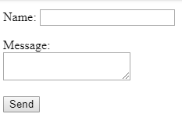
Browsers and HTTP
a browser will make a request when we enter a URL in its address bar.
When the resulting HTML page references other files:
EX: images and JavaScript files:
those are also retrieved
To be able to fetch those quickly,
browsers will make several GET requests simultaneously,
rather than waiting for the responses one at a time.
HTML pages may include forms:
allow the user to fill out information and send it to the server
<form method="GET" action=“http://eloquentjavascript.net/example/message.html">
<p>Name: <input type="text" name="name"></p>
<p>Message:<br><textarea name="message"></textarea></p>
<p><button type="submit">Send</button></p>
</form>
submitted, meaning that the content of its field is packed into an HTTP request and the browser navigates to the result of that request

Slide 8
When the <form> element’s method attribute is GET (or is omitted):
the information in the form is added to:
the end of the action URL as a query string.
The browser might make a request to this URL:
GET /example/message.html?name=Jean&message=Yes%3F HTTP/1.1
question mark (?): indicates
the end of the path part of the URL
the start of the query.
ampersand character (&): is used to separate the pairs.
URL encoding:
uses a percent sign (%) followed by two hexadecimal (base 16) digits:
encode the character code
%3F:
is 63 in decimal notation,
is the code of a question mark character (?)

Slide 9
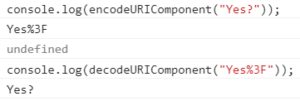
encodeURIComponent & decodeURIComponent functions:
to encode and decode this format.
console.log(encodeURIComponent("Yes?"));
// → Yes%3F
console.log(decodeURIComponent("Yes%3F"));
// → Yes?
change the method attribute to POST:
HTTP request use POST method
put the query string in the body of the request:
rather than adding it to the URL.
POST /example/message.html HTTP/1.1
Content-length: 24
Content-type: application/x-www-form-urlencoded
name=Jean&message=Yes%3F

Slide 10
Form fields
allow web sites to send user-submitted information in an HTTP request
A web form consists of any number of input fields grouped in a <form> tag:
from simple on/off checkboxes to drop-down menus and fields for text input.
A lot of field types use the <input> tag:
tag’s type attribute is used to select the field’s style.
These are some commonly used <input> types:
text: A single-line text field
password: Same as text but hides the text that is typed
checkbox: An on/off switch
radio: (Part of) a multiple-choice field
file: Allows the user to choose a file from their computer

Slide 11
Form fields do not necessarily have to appear in a <form> tag:
You can put them anywhere in a page:
Such form-less fields cannot be submitted:
only a form as a whole can
<p><input type="text" value="abc"> (text)</p>
<p><input type="password" value="abc"> (password)</p>
<p><input type="checkbox" checked> (checkbox)</p>
<p><input type="radio" value="A" name="choice">
<input type="radio" value="B" name="choice" checked>
<input type="radio" value="C" name="choice"> (radio)</p>
<p><input type="file"> (file)</p>

Slide 12

<textarea> </textarea> :
Multiline text fields:
<textarea>
one
two
three
</textarea>
<select> tag:
is used to create a field:
allows the user to select from a number of predefined options
<select>
<option>Pancakes</option>
<option>Pudding</option>
<option>Ice cream</option>
</select>

Slide 13


Focus
Unlike most elements in HTML documents:
form fields can get keyboard focus.
When clicked or activated in some other way:
they become the currently active element and the recipient of keyboard input.
you can type into a text field only when it is focused.
We can control focus from JS with the focus and blur methods
The value in document.activeElement:
corresponds to the currently focused element.
<input type="text">
<script>
document.querySelector("input").focus();
console.log(document.activeElement.tagName);
// → INPUT
document.querySelector("input").blur();
console.log(document.activeElement.tagName);
// → BODY
</script>

Slide 14

Browsers traditionally allow the user to move the focus through the document by pressing the tab key:
We can influence the order in which elements receive focus with the tabindex attribute.
EX: let the focus jump from the text input to the OK button:
rather than going through the help link first:
//拿掉tabindex則恢復default
<input type="text" tabindex=1>
<a href=".">(help)</a>
<button onclick="console.log('ok')" tabindex=2>OK</button>
A tabindex of -1 makes tabbing skip over an element:
even if it is normally focusable
tab
tabindex=1
tabindex=2

Slide 15
Disabled fields
All form fields can be disabled through their disabled attribute:
<button>I'm all right</button>
<button disabled>I'm out</button>
When a program is in the process of handling an action caused by some button or other control:
that might require communication with the server and thus take a while:
it can be a good idea to disable the control until the action finishes.
disabled

Slide 16
The form as a whole
When a field is contained in a <form> element:
its DOM element will have a form property linking back to the form’s DOM element:
The <form> element:
has a property called elements:
that contains an array-like collection of the fields inside it.
The name attribute of a form field:
determines the way its value will be identified:
when the form is submitted
acts both as an array-like object (accessible by number) and a map (accessible by name)

Slide 17
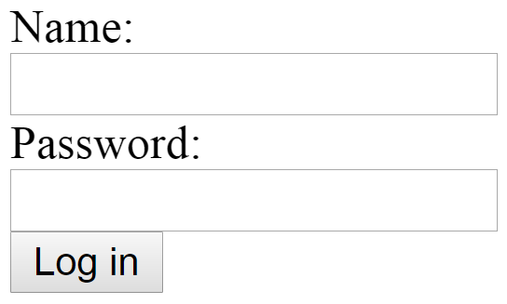
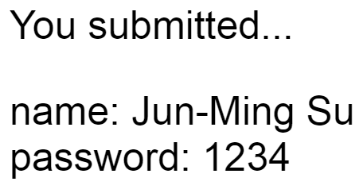
A button with a type attribute of submit:
will, when pressed, cause the form to be submitted.
Pressing enter when a form field is focused has the same effect.
<form action="http://eloquentjavascript.net/example/submit.html">
Name: <input type="text" name="name"><br>
Password: <input type="password" name="password"><br>
<button type="submit">Log in</button>
</form>
<script>
let form = document.querySelector("form");
console.log(form.elements[1].type);
// → password
console.log(form.elements.password.type);
// → password
console.log(form.elements.name.form == form);
// → true
</script>

Slide 18
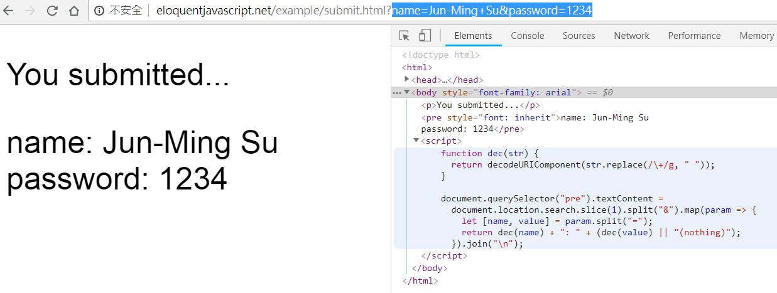

Slide 19
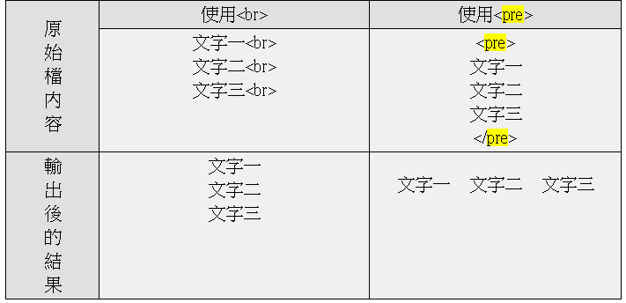
http://eloquentjavascript.net/example/submit.html
<html><head><title>Example form target</title>
</head><body style="font-family: arial">
<p>You submitted...</p>
<pre style="font: inherit"></pre>
<script>
function dec(str) { return decodeURIComponent(str.replace(/\+/g, " ")); }
document.querySelector("pre").textContent =
document.location.search.slice(1).split("&").map(param => {
let [name, value] = param.split("=");
return dec(name) + ": " + (dec(value) || "(nothing)");
}).join("\n");
</script>
</body></html>
<pre></pre>排版用的標籤:
在<pre></pre>之間的文字會以原本的格式顯示出來，不用使用像<br>之類的來斷行

Slide 20
document.location.search.toString();
// → "?name=Jun-Ming+Su&password=1234“
document.location.search.slice(0);
// → "?name=Jun-Ming+Su&password=1234“
document.location.search.slice(1);
//→"name=Jun-Ming+Su&password=1234“
document.location.search.slice(1).split("&");
//→ ["name=Jun-Ming+Su", "password=1234"]
document.location.search.slice(1).split("&").map(param => {let [name, value] = param.split("="); console.log("["+name+"]"+"["+value+"]")})
//→[name][Jun-Ming+Su]
//→[password][1234]

Slide 21

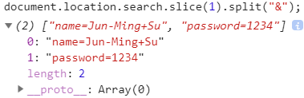

Slide 22
JS decodeURIComponent() 函數
decodeURIComponent() 函數可對 encodeURIComponent() 函數編碼的 URI 進行解碼。
使用 decodeURIComponent() 對編碼後的 URI 進行解碼：
<script type="text/javascript">
var test1="http://www.w3school.com.cn/My first/"
document.write(encodeURIComponent(test1)+ "<br />")
document.write(decodeURIComponent(test1))
</script>
輸出：
http%3A%2F%2Fwww.w3school.com.cn%2FMy%20first%2F
http://www.w3school.com.cn/My first/

Slide 23
練習時間
(練習上述操作)

Slide 24
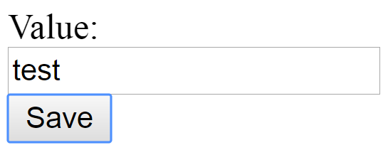
Submitting a form normally means that:
the browser navigates to the page indicated by the form’s action attribute:
using either a GET or a POST request
But before that happens:
a "submit" event is fired.
You can handle this event with JS and prevent this default behavior:
by calling preventDefault on the event object.
<form action="http://eloquentjavascript.net/example/submit.html">
Value: <input type="text" name="value">
<button type="submit">Save</button>
</form>
<script>
let form = document.querySelector("form");
form.addEventListener("submit", event => {
console.log("Saving value", form.elements.value.value);
event.preventDefault();
});
</script>
Intercepting "submit" events in JavaScript has various uses:
Write code to verify that the values the user entered make sense

Slide 25
Text fields
Fields created by <input> tags with a type of text or password:
as well as <textarea> tags, share a common interface
selectionStart & selectionEnd properties of text fields:
give us information about the cursor and selection in the text:
0 indicates the start of the text
10 indicates the cursor is after the 10th character
When nothing is selected:
these two properties hold the same number:
indicating the position of the cursor.

Slide 26

writing an article about Khasekhemwy but have some trouble spelling his name
code wires up a <textarea> tag with an event handler that:
when you press F2, inserts the string “Khasekhemwy” for you.
<textarea></textarea>
<script>
let textarea = document.querySelector("textarea");
textarea.addEventListener("keydown", event => {
// The key code for F2 happens to be 113
if (event.keyCode == 113) {replaceSelection(textarea, "Khasekhemwy");
event.preventDefault(); }
});
function replaceSelection(field, word) {
let from = field.selectionStart, to = field.selectionEnd;
field.value = field.value.slice(0, from) + word + field.value.slice(to);
// Put the cursor after the word
field.selectionStart = from + word.length;
field.selectionEnd = from + word.length; }
</script>

Slide 27

"change" event for a text field
it does not fire every time something is typed:
it fires when the field loses focus after its content was changed.
To respond immediately to changes in a text field:
you should register a handler for the "input" event instead:
which fires for every time the user types a character, deletes text, or otherwise manipulates the field’s content.
EX: a counter displaying the current length of the text in the field:
<input type="text"> length: <span id="length">0</span>
<script>
let text = document.querySelector("input");
let output = document.querySelector("#length");
text.addEventListener("input", () => {output.textContent = text.value.length;});
</script>

Slide 28
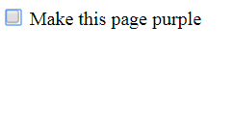
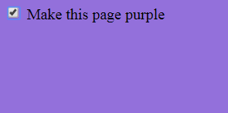
Checkboxes
A checkbox field is a binary toggle:
Its value can be extracted or changed:
through its checked property, which holds a Boolean value.
<label>
<input type="checkbox" id="purple"> Make this page purple
</label>
<script>
let checkbox = document.querySelector("#purple");
checkbox.addEventListener("change", () => {
document.body.style.background =
checkbox.checked ? "mediumpurple" : ""; });
</script>

Slide 29




radio buttons
It is similar to a checkbox:
but it’s implicitly linked to other radio buttons with the same name attribute:
so that only one of them can be active at any time.
Color:
<label>
<input type="radio" name="color" value="orange"> Orange
</label>
<label>
<input type="radio" name="color" value="lightgreen"> Green
</label>
<label>
<input type="radio" name="color" value="lightblue"> Blue
</label>
<script>
let buttons = document.querySelectorAll("[name=color]");
for (let button of Array.from(buttons)) {
button.addEventListener("change", () => {
document.body.style.background = button.value; });
}
</script>

Slide 30
Select fields
Select fields are conceptually similar to radio buttons:
allow the user to choose from a set of options.
But a radio button puts the layout of the options under our control:
the appearance of a <select> tag is determined by the browser.
given the multiple attribute,
<select> tag allow users to select any number of options:
rather than just a single option.
typically drawn as a drop-down control:
that shows the options only when you open it
Each <option> tag has a value:
This value can be defined with a value attribute.
When that is not given, the text inside the option will count as its value.
The value property of a <select> element:
reflects the currently selected option.
<option> tags for a <select> field:
can be accessed as an array-like object through the field’s options property.
Each option has a property called selected:
indicates whether that option is currently selected.

Slide 31


extracts the selected values from a multiple select field and uses them to compose a binary number from individual bits:
Hold control (or command on a Mac) to select multiple options
<select multiple>
<option value="1">0001</option>
<option value="2">0010</option>
<option value="4">0100</option>
<option value="8">1000</option>
</select>
= <span id="output">0</span>
<script>
let select = document.querySelector("select");
let output = document.querySelector("#output");
select.addEventListener("change", () => {
let number = 0;
for (let option of Array.from(select.options)) {
if (option.selected) {number += Number(option.value);}
}
output.textContent = number;
});
</script>

Slide 32

Value is not given, the text inside the option will count as its value
<select multiple>
<option>0001</option>
<option>0010</option>
<option>0100</option>
<option>1000</option>
</select>
= <span id="output">0</span>

Slide 33





File fields
a way to upload files from the browser’s machine through a form
JS cannot simply start reading private files from the user’s computer:
but if the user selects a file in such a field:
browser interprets that action:
mean that the script may read the file.
<input type="file">
<script>
let input = document.querySelector("input");
input.addEventListener("change", () => {
if (input.files.length > 0) {
let file = input.files[0];
console.log("You chose", file.name);
if (file.type) console.log("It has type", file.type); }
});
</script>

Slide 34

multiple attribute: to select multiple files at the same time.
Objects in the files object have properties:
name (the filename),
Size (the file’s size in bytes, which are chunks of 8 bits),
type (the media type of the file, such as text/plain or image/jpeg)
What it does not have:
is a property that contains the content of the file.
reading a file from disk can take time:
the interface must be asynchronous to avoid freezing the document
<input type="file" multiple>
<script>
let input = document.querySelector("input");
input.addEventListener("change", () => {
for (let file of Array.from(input.files)) {
let reader = new FileReader();
reader.addEventListener("load", () => {
console.log("File", file.name, "starts with", reader.result.slice(0, 20));
});
reader.readAsText(file); } //for…
});
</script>
FileReader object: reading a file & registering a "load" event handler for it,
readAsText method: giving it the file we want to read.
reader’s result property: contains the file’s content when loading finishes.

Slide 35
FileReaders fire an "error" event:
when reading the file fails for any reason
error object itself will end up in the reader’s error property
wrap it in a promise like this:
<input type="file" multiple>
<script>
let input = document.querySelector("input");
input.addEventListener("change", () => {
for (let file of Array.from(input.files)) {readFileText(file)} });
function readFileText(file) {
return new Promise((resolve, reject) => {
let reader = new FileReader();
reader.addEventListener("load", () =>{ resolve(reader.result);
console.log("File", file.name, "starts with", reader.result.slice(0, 20));} );
reader.addEventListener("error", () =>{ reject(reader.error);
console.log("File", file.name, "ERROR");});
reader.readAsText(file);
});
}
</script>

Slide 36
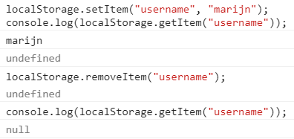
Storing data client-side
To keep the data in the browser
localStorage object:
can be used to store data in a way:
that survives page reloads.
allows you to file string values under names
localStorage.setItem("username", "marijn");
console.log(localStorage.getItem("username"));
// → marijn
localStorage.removeItem("username");

Slide 37

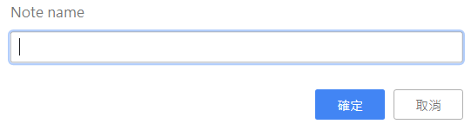

data stored in localStorage by a given website:
can be read/overwritten only by scripts on that same site.
Browsers do enforce a limit on the size of the data:
a site can store in localStorage.
a crude note-taking application:
keeps a set of named notes and allows the user to edit notes and create new ones
<body>
Notes: <select></select>
<button>Add</button><br>
<textarea style="width: 100%"></textarea>
</body>
<script>
let list = document.querySelector("select");
let note = document.querySelector("textarea");

Slide 38
var obj = { 0: 'a', 1: 'b', 2: 'c' };
console.log(Object.keys(obj)); // console: ['0', '1', '2']
let state;
function setState(newState) {
list.textContent = "";
for (let name of Object.keys(newState.notes)) {
let option = document.createElement("option");
option.textContent = name;
if (newState.selected == name) option.selected = true;
list.appendChild(option); }
note.value = newState.notes[newState.selected];
localStorage.setItem("Notes", JSON.stringify(newState));
state = newState;
}
setState( JSON.parse( localStorage.getItem("Notes")) ||
{ notes: {"shopping list": "Carrots\nRaisins"},
selected: "shopping list" });
回傳一個包含給定物件內所有可列舉屬性的字串陣列
Object
Object

Slide 39
list.addEventListener("change", () => {
setState({notes: state.notes, selected: list.value}); });
note.addEventListener("change", () => {
setState({
notes: Object.assign({}, state.notes, {[state.selected]: note.value}),
selected: state.selected }); });
document.querySelector("button").addEventListener("click",
() => { let name = prompt("Note name");
if (name) setState({
notes: Object.assign({}, state.notes, {[name]: ""}),
selected: name });
});
</script>
複製一個或多個物件自身所有可數的屬性到另一個目標物件
var obj = { a: 1 };
var copy = Object.assign({}, obj);
console.log(copy); // { a: 1 }

Slide 40
JS gets its starting state from the "Notes" value stored in localStorage:
or, if that is missing, creates an example state that has only a shopping list in it
the || operator can be used to provide a default value
setState method:
makes sure the DOM is showing a given state and stores the new state to localStorage
Object.assign:
create a new object that is a clone of the old state.notes,
sessionStorage is similar as localStorage:
The difference is that:
the content of sessionStorage is forgotten at the end of each session:
for most browsers means whenever the browser is closed.

Slide 41
練習時間
(練習上述操作)

Slide 42
CH 20 (Eloquent) Node.js
Asynchronous Programming

Slide 43
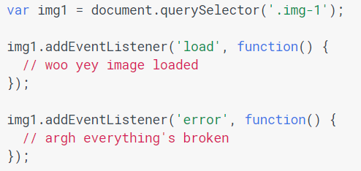
異步(非同步)結構: Promise
JS是單線程工作:
即兩段腳本不能同時運行，必須一個接一個地運行。
JS與因瀏覽器而異的其他 N 種任務共享一個線程:
但通常 JS 與[繪製、更新樣式和處理用戶操作(EX:高亮顯示文本&與格式控件交互)]處於同一隊列:
操作其中一項任務[會延遲]其他任務。
https://developers.google.com/web/fundamentals/primers/promises?hl=zh-tw

Slide 44
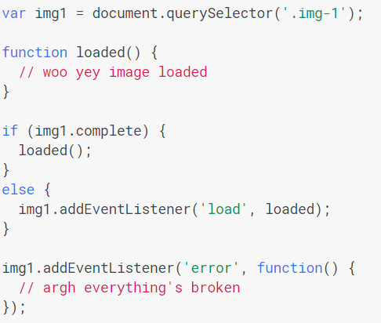
上例中， 事件可能在偵聽前就已發生，需要使用圖像complete屬性解決
但這不會捕獲出錯的圖像:
因這之前我們沒機會偵聽到錯誤。
遺憾的是，DOM 也沒有給出解決之道。
如加載一組圖像，情況會更復雜。

Slide 45
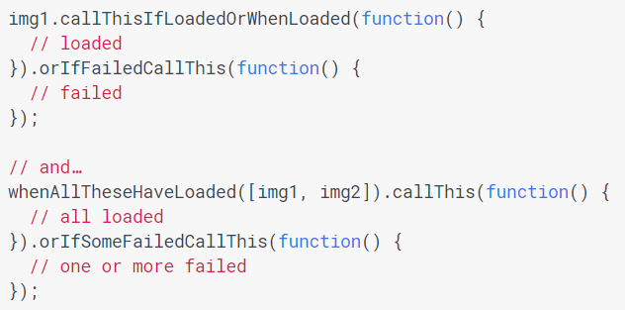
事件(Event)並不總是最佳方法
事件對於同一對象上發生多次的事情:
EX: keyup、touchstart 等非常有用。
但，如果關係到[異步成功/失敗]:
理想的情況是：
這就是 promise 所執行的任務，但以更好的方式命名。

Slide 46
透過Promise可有更好寫法
如 HTML 圖像元素有個返回 promise 的ready method
img1.ready().then(function() {
// loaded
}, function() { // failed });
// and…
Promise.all([img1.ready(), img2.ready()]).then(function() {
// all loaded
}, function() { // one or more failed });
promise 類似於事件偵聽器，但有以下區別：
promise 只能成功或失敗一次，而不能成功或失敗兩次:
也不能從成功轉爲失敗或從失敗轉爲成功。
promise如已成功或失敗，且之後添加成功/失敗回調:
則將會調用正確的回調，即使事件發生在先。

Slide 47
基本概念
Promise是個強大異步執行流程語法結構(ES6):
只有一個建構函式與一個then方法、一個catch方法
加上四個必需以Promise關鍵字呼叫的靜態函式:
Promise.resolve、Promise.reject、Promise.all、Promise.race。
異步Callback(回調):
Promise中的所有回調函式，都是異步執行的:
讓開發者自訂的callbacks(回調)的執行轉變為異步，方式:
使用計時器(timer)函式: setTimeout, setInterval
特殊的函式: nextTick, setImmediate
執行I/O: 監聽網路、資料庫查詢或讀寫外部資源:
執行I/O的API通常出現在伺服器端(Node.js):
EX: 讀寫檔案、資料庫互動等等
訂閱事件
https://eyesofkids.gitbooks.io/javascript-start-es6-promise/content/contents/intro.html

Slide 48
異步程式設計與Promise
promise物件的設計:
就是針對異步函式的執行結果所設計的:
要不就是用一個回傳值來變成已實現(fulfilled)狀態，
要不就是用一個理由(錯誤)來變成已拒絕(rejected)狀態
同步執行函式的結果:
要不就是回傳一個值，
要不然就是執行到一半發生例外:
中斷目前的程式然後拋出例外。
異步執行函式的結果:
要不就是帶有回傳值的成功，
要不就是帶有回傳理由的失敗。

Slide 49
專門用語
promise (承諾):
是一個帶有遵照這個規格的then方法的物件
thenable:
是一個有定義then方法的物件
value :
合法的JavaScript值:
包含undefined、thenable與promise
exception (例外):
使用throw語句丟出來的值
reason (理由):
是表明為什麼promise被拒絕(rejected)的值

Slide 50
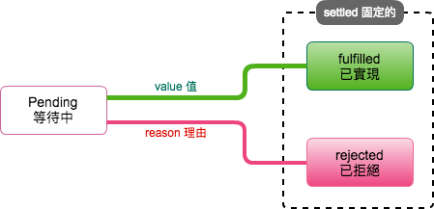
Promise狀態
定是以下三種狀態之一:
pending(等待中):
會轉變到不是fulfilled(已實現)就是rejected(已拒絕)狀態
fulfilled(已實現):
必定不會再轉變到其他任何狀態
必定有不能再更動的值
rejected(已拒絕):
必定不會再轉變到其他任何狀態
必定有不能再更動的值reason(理由)

Slide 51
Promise物件的建立
const promise = new Promise(function(resolve, reject) {
// 成功時
resolve(value)
// 失敗時
reject(reason)
});
promise.then(function(value) {
// on fulfillment(已實現時)
}, function(reason) {
// on rejection(已拒絕時)
})

Slide 52
Promise的建構函式:
new Promise( function(resolve, reject) { ... } )
(箭頭函式可以簡化)
new Promise( (resolve, reject) => { ... } )
建構函式的傳入參數值需要一個函式
函式又有兩個傳入參數值:
resolve(解決)與reject(拒絕):
要求一定是函式類型。
成功的話:
就是有合法值的情況下執行resolve(value)，
promise物件的狀態會跑到fulfilled(已實現)固定住。
失敗或是發生錯誤時:
用執行reject(reason):
reason(理由)通常是用Error物件，
promise物件狀態會跑到rejected(已拒絕)狀態固定住

Slide 53
建構函式的傳入函式:
稱為executor(執行者, 執行函式): 有強制執行的意味
executor會在建構式回傳物件實體前立即執行:
當傳入這個函式時:
Promise物件會立即決定裡面的狀態:
看是要執行resolve來回傳值，
還是要用reject來作錯誤處理。
也因為它與一般的物件實體化的過程不太一樣:
所以常會先包到一個函式中，
使用時再呼叫這個函式來產生promise物件
function asyncFunction(value) {
return new Promise(function(resolve, reject){
if(value)
resolve(value) // 已實現，成功
else
reject(reason) // 有錯誤，已拒絕，失敗
});
}
Promise建構函式與Promise.prototype物件的設計:
是要讓設計師作Promisify用的:
把原本異步或同步的程式碼或函式，打包成為Promise物件來使用:
包裝後才能使用Promise的語法結構

Slide 54
then與catch
then方法是Promise的最核心方法
p.then(onFulfilled, onRejected);
p.then(function(value) { // fulfillment },
function(reason) { // rejection} );
then一樣用兩個函式當作傳入參數:
onFulfilled:
當promise物件的狀態轉變為fulfilled(已實現)呼叫的函式:
有一個傳入參數值可用，就是value(值)。
onRejected:
當promise物件的狀態轉變為rejected(已拒絕)呼叫的函式:
有一個傳入參數值可以用，就是reason(理由)。
then最後的回傳值:
是另一個"新的"promise物件。
then必須回傳一個promise:
promise2 = promise1.then(onFulfilled, onRejected);

Slide 55
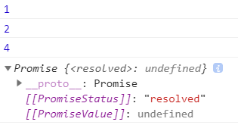
目的是要能作連鎖(chained)的語法結構:
就是稱之為合成(composition)的一種運算方式
const promise = new Promise(function(resolve, reject) {
resolve(1);
})
promise.then(function(value) {
console.log(value) // 1
return value + 1
}).then(function(value) {
console.log(value) // 2
return value + 2
}).then(function(value) {
console.log(value) // 4
})
連鎖
(chained)

Slide 56
錯誤處理通常交給另一個catch方法來作:
catch只需要一個函式傳入參數:
p.catch(onRejected);
p.catch(function(reason) { // rejection });
catch方法相當於then(undefined, onRejected):
是then方法第一個函式傳入參數:
沒有給定值(undefined)的情況。
EX: 第二個then方法假設在中途發生錯誤:
會導致下一個執行被強迫只能使用catch方法:
catch的回調(相當於then中的onRejected函式):
是只能得到理由(錯誤)而得不到值的:
導致最後一個then的onFulfilled函式獲取不到之前的值

Slide 57
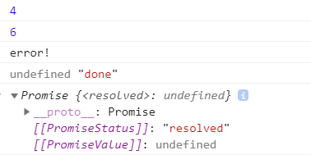

前頁範例code
const p1 = new Promise((resolve, reject) => {
resolve(4)
})
p1.then((val) => {
console.log(val) //4
return val + 2
})
.then((val) => {
console.log(val) //6
throw new Error('error!')
})
.catch((err) => { //catch無法抓到上個promise的回傳值
console.log(err.message)
//這裡如果有回傳值，下一個then可以抓得到
//return 100
})
.then((val) => console.log(val, 'done')) //val是undefined，回傳值消息

Slide 58

錯誤處理
Promise中會吞掉(隱藏)throw例外的錯誤輸出:
改用轉變狀態為rejected(已拒絕)來作錯誤處理
throw與reject
直接使用throw語句相當於用reject方法的作用:
// 用throw語句取代reject
const p1 = new Promise((resolve, reject) => {
throw new Error('rejected!') // 用throw語句
//相當於用以下的語句
//reject(new Error('rejected!'))
})
p1.then((val) => {
console.log(val)
return val + 2
}).then((val) => console.log(val))
.catch((err) => console.log('error:', err.message))
.then((val) => console.log('done'))

Slide 59
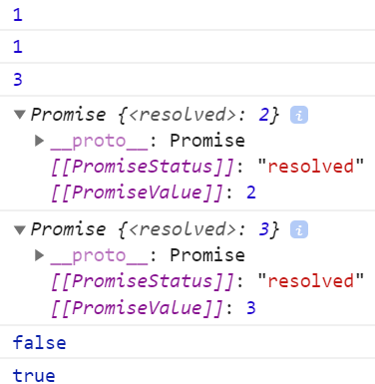
一個promise物件經過then後:
原本的promise物件的內容[不會]改變:
then方法執行完會另外產生一個新的promise物件
const promise = new Promise(function(resolve, reject) { resolve(1); })
const p = promise;
const p1 = promise.then((value) => {
console.log(value); //=> 1
return value + 1; })
const p2 = promise.then((value) => {
console.log(value); //=> 1
return value + 2; })
//延時執行
setTimeout(
() => {
console.log(p1);
console.log(p2);
console.log(p1 === p2); //false
console.log(p === promise); //true
}, 5000);

Slide 60
then方法中onFulfilled函式的回傳值
在onFulfilled或onRejected函式，可自訂啥回傳值?
then中onFulfilled函式回傳值可有三種類型:
值:
就一般在JavaScript的各種值
promise物件:
可自建回傳promise物件(New Promise)
thenable物件:
是一個有定義then方法的物件或函式
是個單純物件，然後裡面有個then方法的定義:
const thenable1 = {
then: function(onFulfill, onReject) { onFulfill('fulfilled!'); } }
const thenable2 = {
then: function(resolve) {
throw new TypeError('Throwing'); resolve('Resolving'); } }

Slide 61
then中傳入參數值
then是promise物件中的方法:
以onFulfilled與onRejected作為兩個傳入參數:
有幾個規則需要遵守:
當onFulfilled或onRejected不是函式時:
忽略跳過
當promise是fulfilled時:
執行onFulfilled函式，
並帶有promise的value作為onFulfilled函式的傳入參數值
當promise是rejected時:
執行onRejected函式，
並帶有promise的reason作為onRejected函式的傳入參數值
then方法最後還要回傳另一個promise:
promise2 = promise1.then(onFulfilled, onRejected)

Slide 62
只用then中的第1個onFulfilled傳入參數:
可有四種傳入的情況 (onRejected也是一樣):
function doSomething1(){
console.log('doSomething1 start')
return new Promise(function(resolve, reject) {
console.log('doSomething1 end')
resolve(1)
})
}
function doSomething2(){
console.log('doSomething2')
return 2
}
function finalThing(value){
console.log('finalThing')
console.log(value)
return 0
}

Slide 63
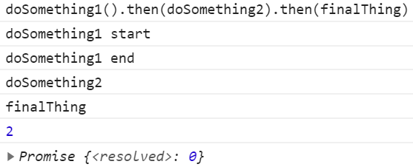
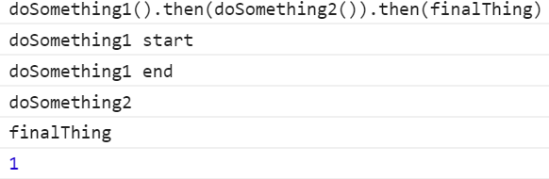
依據前頁範例
//第1種傳入參數
doSomething1().then(doSomething2).then(finalThing)
正常的函式傳入參數。最後的finalThing可以得到doSomething2回傳值2
//第2種傳入參數
doSomething1().then(doSomething2()).then(finalThing)
執行doSomething2()函式，onFulfilled相當於doSomething2()的回傳值
沒執行過怎知是不是回傳一個函式？
故會執行doSomething2()，但得到onFulfilled不是函式，故忽略它
依照連鎖規則:
當onFulfilled不是函式:
繼續用fulfilled狀態與帶值回傳新的Promise物件到下個then:
最後的finalThing得到的值是doSomething1中的1。

Slide 64
依據前頁範例
//第3種傳入參數
doSomething1().then(function(){ doSomething2() }).then(finalThing)
正常的函式傳入參數:
因在函式中執行doSomething2()，這個onFulfilled最後的回傳值其實是undefined，但算有回傳值:
回傳的新Promise物件也是fulfilled狀態，不過值變成undefined。
最後的finalThing得到undefined值。
//第4種傳入參數
doSomething1().then(function(){ return doSomething2() }).then(finalThing)
正常的函式傳入參數，then執行完onFulfilled最後的回傳值是doSomething2()的執行後的值也就是2，
回傳的新Promise物件也是fulfilled狀態，最後的finalThing得到2值。

Slide 65
then中傳入參數值(帶異步執行的函式)
函式中，都有異步callbacks時:
除了值的情況，還會關心整體執行順序 (進階)
function doSomething1(){
console.log('doSomething1 start');
return new Promise(function(resolve, reject) {
setTimeout(function(){ console.log('doSomething1 end'); resolve(1); }, 1000)
})
}
function doSomething2(){
console.log('doSomething2 start');
return new Promise(function(resolve, reject) {
setTimeout(function(){ console.log('doSomething2 end'); resolve(2); }, 1000)
})
}
function finalThing(value){
console.log('finalThing start')
return new Promise(function(resolve, reject) {
setTimeout(function(){ console.log('finalThing end'); console.log(value); resolve(0); }, 1000)
})
}

Slide 66
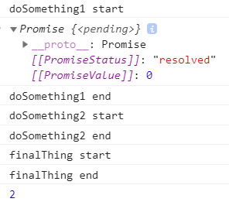
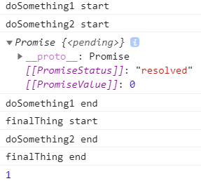
依據前頁範例
//第1種傳入參數，finalThing最後的值為2
doSomething1().then(doSomething2).then(finalThing)
//第2種傳入參數，finalThing最後的值為1
doSomething1().then(doSomething2()).then(finalThing)

Slide 67
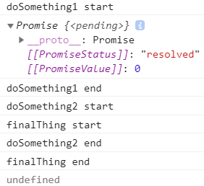
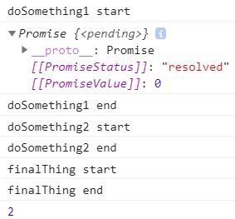
依據前頁範例
//第3種傳入參數，finalThing最後的值為undefined
doSomething1().then(function(){doSomething2()}).then(finalThing)
//第4種傳入參數，finalThing最後的值為2
doSomething1().then(function(){return doSomething2()}).then(finalThing)

Slide 68
其他參考資料
Promise:
https://developer.mozilla.org/zh-TW/docs/Web/JavaScript/Reference/Global_Objects/Promise
使用 Promise:
https://developer.mozilla.org/zh-TW/docs/Web/JavaScript/Guide/Using_promises
Promise:
https://javascript.info/promise-basics

Slide 69
async function https://developer.mozilla.org/zh-TW/docs/Web/JavaScript/Reference/Statements/async_function
宣告被定義為一個回傳
AsyncFunction 物件
的非同步函式。

Slide 70
async function
async function name([param[, param[, ... param]]]) { statements }
AsyncFunction 物件:
代表一個非同步函式，該函式會執行該函式內的程式碼。
當 async 函式被呼叫時，它會回傳一個 Promise:
如該 async 函式回傳一個值:
Promise狀態將為一個帶有該回傳值的 resolved。
如async 函式拋出例外或某個值:
Promise 狀態將為一個帶有被拋出值的 rejected。
async 函式內部可以使用 await 表達式:
它會暫停此 async 函式執行，並等待傳遞至表達式的 Promise 的解析
解析完後會回傳解析值，並繼續此 async 函式的執行。

Slide 71
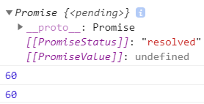
function resolveAfter2Seconds(x) {
return new Promise(resolve => {
setTimeout(() => {
resolve(x);
}, 2000);
});
}
async function add1(x) {
const a = await resolveAfter2Seconds(20);
const b = await resolveAfter2Seconds(30);
return x + a + b;
}
add1(10).then(v => {
console.log(v); // prints 60 after 4 seconds.
});
async function add2(x) {
const p_a = resolveAfter2Seconds(20);
const p_b = resolveAfter2Seconds(30);
return x + await p_a + await p_b;
}
add2(10).then(v => {
console.log(v); // prints 60 after 2 seconds.
});

Slide 72
使用 async function 改寫 promise 鏈
一 API 呼叫所回傳的 Promise 會導致一promise 鏈，將函式分隔成多個部份:
function getProcessedData(url) {
return downloadData(url) // returns a promise
.catch(e => {
return downloadFallbackData(url); // returns a promise
})
.then(v => {
return processDataInWorker(v); // returns a promise
});
}
可用一簡單 async function 來改寫:
async function getProcessedData(url) {
let v;
try {
v = await downloadData(url);
} catch(e) {
v = await downloadFallbackData(url);
}
return processDataInWorker(v);
}
async/await 函式的目的:
在於簡化同步操作 promise 的表現，以及對多個 Promise 物件執行某些操作

Slide 73

await
await運算子:
被用來等待 Promise，只能在 async function內使用。
[return_value] = await expression;
expression: 等待解析的 Promise 物件或任何值。
將 Promise 物件傳給 await，會等待 Promise 解析並回傳 resolve 後的值:
function resolveAfter2Seconds(x) {
return new Promise(resolve => {
setTimeout(() => {
resolve(x);
}, 2000);
});
}
async function f1() {
var x = await resolveAfter2Seconds(10);
console.log(x); // 10
}
f1();

Slide 74
await
若傳給 await 的值並非一個 Promise 物件:
它會將該值轉換為 resolved Promise，並等待之:
async function f2() {
var y = await 20;
console.log(y); // 20
}
f2(); //=>20
若 Promise 被 reject，則丟出 reject 後的異常值:
async function f3() {
try {
var z = await Promise.reject(30);
} catch(e) {
console.log(e); // 30
}
}
f3(); //=>30

Slide 75
練習時間
(練習上述操作)

Slide 76
Node.js
What You Need To Know About Node.js
Bruno Joseph Dmello

Slide 77

Applying JavaScript to the Server Side
Learning traditional JavaScript:
Early web applications were nothing but a collection of static web pages
The only intention was information sharing.
JS usage expanded from client side to server in 2009:
With the invention of Node.js by Ryan Dahl:
JavaScript started running at the server side.

Slide 78
the fundamentals of JS required to proceed towards Node.js:
var getTotal = function(args) {
var result = 0;
for (var i = 0, len = args.length; i<len; i++) {
result += args[i]; }
return result;
};
console.log(`Output :`, getTotal([2, 2, 3]));
//=> Output : 7

Slide 79
When the preceding code runs
JS engine creates a single callstack in an execution context and pushes the getTotal function in our case
When getTotal function is called in the console.log method:
the execution flows in following way
Once the function returns the result:
the local variables are disposed (garbage collected) and the function pops out from the stack.

Slide 80
Why does JavaScript create a single stack?
JS is a single-threaded language:
thus, it creates a single stack.
modern browsers have been successful in implementing web workers:
a multithreaded JavaScript.
everything executes asynchronously in JavaScript
Callback mechanism:
Callback is a chief functional programming technique:
provides the flexibility of passing a function as an argument to another function.
setTimeout(function(){
console.log(`display after sometime!`)
}, 6000) //output after 6 seconds will be display after sometime!

Slide 81
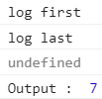
console.log(`log first`);
function getData() { console.log(`Output : `, getTotal([2, 2, 3])); }
setTimeout(getData, 6000);
console.log(`log last`);
For the preceding code:
the following callstack gets created in an execution context:

Slide 82
Once the operation is recognized as asynchronous (which requires web API):
the method is called in a different context
the execution of the callstack continues.
the log last is printed before setTimeout displays the result.
This is why JavaScript code is said to be non-blocking.
works similarly for XMLHTTP request or AJAX request made from the browser. setTimeout can be replaced by them to get an idea of asynchronous requests.

Slide 83
Once it times out in the web API stack (after 6 seconds in our case):
web API stack pushes the code to the task queue.
task queue contains every step that should be executed next in the callstack:
—the order of priority is based on a First In First Out (FIFO) approach.

Slide 84
Introducing eventloop
An eventloop is responsible for:
Fetching the next task in the event queue
Assign the task to the callstack in the execution context.
The following diagram contains a new component called eventloop:
On every event emitted in browser,
eventloop keeps on checking for any tasks prioritized in the queue.

Slide 85
Introducing Node.js
Node.js is a JS runtime environment using Chrome‘s v8 engine (just-in-time (JIT) compiler ): by a programmer named Ryan Dahl.
Eventloop revisited with Node.js :
Ryan used single-threaded eventloop model:
implemented it using server-based APIs written in C++ and JS.
The difference is that the browser's web API is replaced with Node.js API.

Slide 86
Single-threaded eventloop model on a server
web applications follow a three-tier web architecture
web app server is where the Node.js magic happens.

Slide 87
Why and where is Node.js used?
Real-time and multi user apps
Web API's services:
Delayed jobs:
sending an e-mail or writing data to DB
Proxy:
The feature of non-blocking execution stimulates the Node.js usage as a proxy server
Data streaming
Minimum viable apps
Monitoring and notification application
Microservices
Node.js provides support to microservices and IoT

Slide 88
Building a Node.js App
NPM community:
Node package manager (NPM) with Node.js.
a package manager not only for Node.js but for all JS modules
A reusable JS code is said to be a package.
developers share their own packages on NPM repositories:
NPM provides a platform:
to store, browse, and access these packages among developers.

Slide 89
CH1-工欲善其事，必先利其器
開發環境規劃:
如何在 Windows 打造 JavaScript Web 開發環境
Ref:
https://happycoder.org/2017/12/19/javascript101-windows-dev-environment-setup-tutorial/
安裝軟體步驟:
下載安裝 google chrome 瀏覽器
下載安裝 Visual Studio Code 或 Sublime text 文字編輯器
下載安裝 cmder terminal 終端機程式 (請下載含 git 的 full 完整版本)
下載安裝 Node.JS 選擇左邊穩定版本，按照指令安裝完成
在終端機輸入 node -v 若成功顯示版本，代表安裝完成
安裝 http-server 套件：npm install http-server -g

Slide 90
工欲善其事，必先利其器
為什麼我從 Sublime Text 跳槽 Visual Studio Code？
Ref:
https://medium.com/hungys-blog/why-i-switched-from-sublime-to-vscode-ea030b3ff1d9

Slide 91

npm (Node Package Manager)
node包管理器:
是Node.js預設的、
以JavaScript編寫的軟體套件管理系統
Wiki:
https://zh.wikipedia.org/wiki/Npm
npm install npm@latest -g (檢查是否最新版)
npm -v (檢查版本與是否正確安裝)

Slide 92
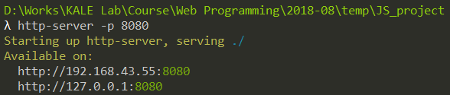
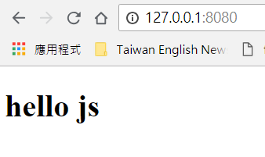
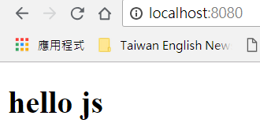
啟動伺服器
終端機移動到該檔案資料夾下
http-server -p 8080
指令 –p(設定port) port編號
Cmder

Slide 93
Package files: package.json
In npm install example:
you could see a warning about the fact:
package.json file did not exist.
It is recommended to create such a file for each project:
either manually or by running npm init:
It contains some information about the project:
its name and version, and lists its dependencies.
{
"author": "Marijn Haverbeke",
"name": "eloquent-javascript-robot",
"description": "Simulation of a package-delivery robot",
"version": "1.0.0",
"main": "run.js",
"dependencies": {
"dijkstrajs": "^1.0.1",
"random-item": "^1.0.0"
},
"license": "ISC"
}
When run npm install without naming a package to install:
NPM will install the dependencies listed in package.json.
When install a specific package that is not already listed as a dependency:
NPM will add it to package.json.

Slide 94
npm init to create package.json
Create a directory named taskList
go to that directory.
Run npm init in the Terminal (console mode)
Write the name as task-list
follow the other questionnaires provided by npminit
All the questionnaires mentioned in the Terminal:
are nothing but the details required to prepare the package.json file.
Once completed, the package.json file is created.

Slide 95
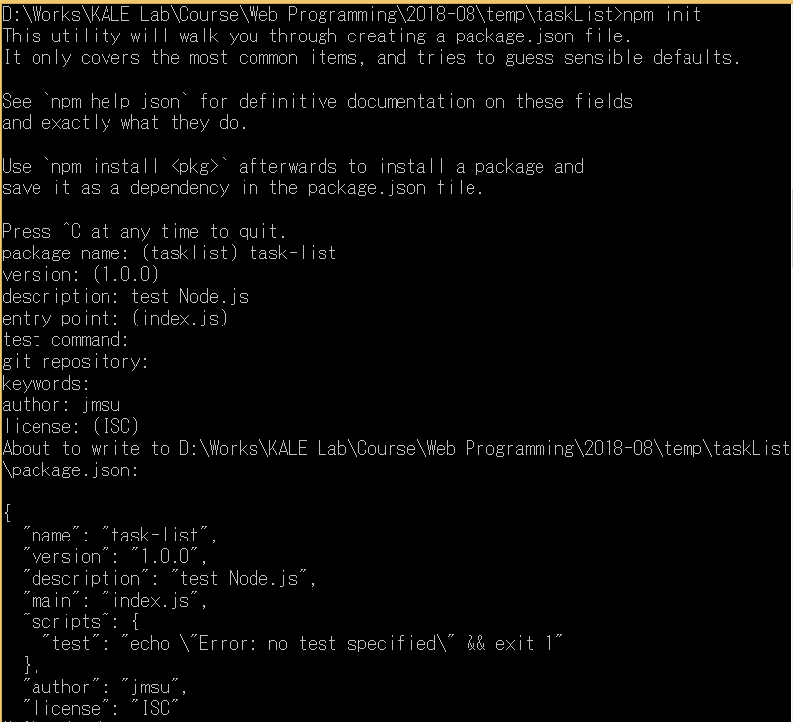


Slide 96
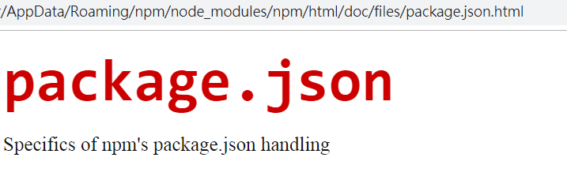
the installation of any NPM module
npm install <package_name><options>
view the options by: npm help json (in the Terminal)
<options> is normally used to save the package in package.json:
This can be done by using --save.
install a framework of Node.js, known as Express.js:
npm install express --save

Slide 97
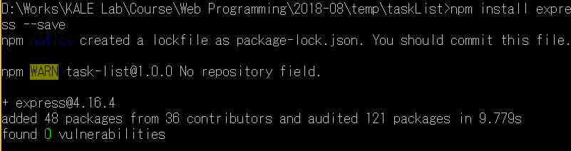

npm install express --save
https://www.npmjs.com/package/express
Fast, unopinionated, minimalist web framework for node.
var express = require('express')
var app = express()
app.get('/', function (req, res) { res.send('Hello World') })
app.listen(3000)

Slide 98
Building the and configuring a server
app.js:
var http = require("http"); //built-in module
var port = 8081;
http.createServer(requestListener).listen(port);
console.log("Server is listening on", port)
function requestListener(req, res){
res.writeHead(200, {'Content-Type': 'text/plain'});
console.log("Request recieved, responding now ...");
res.end("Hello");
}

Slide 99


Run: node app
http.createServer(requestListener).listen(port);
console.log("Server is listening on", port)
res.end("Hello");
res.writeHead(200, {'Content-Type': 'text/plain'});
console.log("Request recieved, responding now ...");

Slide 100
Picking a framework
A framework can be said to be a predefined structure of code with some abstraction:
makes the development quite fast and easily maintainable.
frameworks can be categorized as follows:
Configuration-based frameworks
Syntactic/semantic style-based frameworks
Unopinionated frameworks

Slide 101
require
When require is called:
Node resolve the given string to an actual file that it can load.
Pathnames that start with /, ./, or ../ are resolved relative to the current module’s path:
. stands for the current directory,
../ for one directory up,
/ for the root of the file system.
"./graph" from the file /tmp/robot/robot.js:
Node will try to load the file /tmp/robot/graph.js.
refer to:
either a built-in module
or a module installed in a node_modules directory.

Slide 102
An example of a framework: Express.js
var express = require(‘./node_modules/express'); //installed module
var app = express();
var port = 8081;
app.use(requestListener).listen(port);
console.log("Server is listening on", port)
function requestListener(req, res){
console.log(" responding now");
res.send('Hello Express');
}
var http = require("http"); //built-in module
var port = 8081;
http.createServer(requestListener). listen(port);
console.log("Server is listening on", port)
function requestListener(req, res){
res.writeHead(200, {'Content-Type': 'text/plain'});
console.log("responding now");
res.end("Hello");
}

Slide 103
The HTTP module (Eloquent)
appserver.js
const {createServer} = require("http");
let server = createServer((request, response) => {
response.writeHead(200, {"Content-Type": "text/html"});
response.write(`
<h1>Hello!</h1>
<p>You asked for <code>${request.url}</code></p>
`);
response.end();
});
server.listen(8000);
console.log("Listening! (port 8000)");

Slide 104
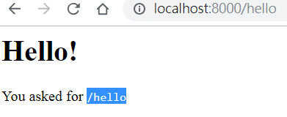
node appserver
http://localhost:8000/hello
to make a request to your server

Slide 105
On method
on method:
Objects that emit events in Node
is similar to the addEventListener method in the browser.
You give it an event name and then a function,
it will register that function to be called:
whenever the given event occurs.
Readable streams have "data" and "end" events:
"data": is fired every time data comes in,
“end" : is called whenever the stream is at its end.
request.on("data", chunk =>
response.write(chunk.toString().toUpperCase()));
request.on("end", () => response.end());
chunk value passed to the data handler will be a binary Buffer:
convert this to a string by toString()

Slide 106
練習時間
(練習上述操作)

Slide 107
A file server: file_server.js
an HTTP server that allows remote access to a file system
treat files as HTTP resources:
the HTTP methods GET, PUT, and DELETE:
can be used to read, write, and delete the files, respectively
If ran the server from /tmp/public/ (or C:\tmp\public\ on Windows):
A request for /file.txt should refer to:
/tmp/public/file.txt (or C:\tmp\public\file.txt).
using an object called methods:
to store the functions:
handle the various HTTP methods.
Method handlers are async functions:
get the request object as argument and return a promise:
resolves to an object that describes the response

Slide 108
const {createServer} = require("http");
const methods = Object.create(null);
createServer((request, response) => {
let handler = methods[request.method] || notAllowed;
//handler promise
handler(request)
.catch(error => {
if (error.status != null) return error;
return {body: String(error), status: 500};
})
.then(({body, status = 200, type = "text/plain"}) => {
response.writeHead(status, {"Content-Type": type});
if (body && body.pipe) body.pipe(response);
else response.end(body);
});
}).listen(8080);
async function notAllowed(request) {
return {
status: 405,
body: `Method ${request.method} not allowed.`
};
}
When value of body is a readable stream, it will have a pipe method that is used to forward all content from a readable stream to a writable stream.
If not, it is assumed to be either null (no body), a string, or a buffer, and it is passed directly to the response's end method.

Slide 109
To figure out which file path corresponds to a request URL:
the urlPath function uses Node’s built-in url module to parse the URL:
takes its pathname,
which will be something like "/file.txt“:
decodes that to get rid of the %20-style escape codes,
resolves it relative to the program’s working directory
const {parse} = require("url");
const {resolve, sep} = require("path");
const baseDirectory = process.cwd(); //cwd: current working directory, used to find this working directory.
function urlPath(url) {
let {pathname} = parse(url);
let path = resolve(decodeURIComponent(pathname).slice(1));
if (path != baseDirectory &&
!path.startsWith(baseDirectory + sep)) {
throw {status: 403, body: "Forbidden"};
}
return path;
}
sep (path package): the system's path separator
—a backslash on Windows and a forward slash on most other systems

Slide 110
set up the GET method:
to return a list of files when reading a directory
to return the file’s content when reading a regular file.
One tricky question is:
what kind of Content-Type header we should set when returning a file’s content.
mime package:
(content type indicators like text/plain are also called MIME types)
knows the correct type for a large number of file extensions
安裝mine module
npm install mime@2.2.0

Slide 111
use the stat function:
looks up information about a file:
to find out both whether the file exists and whether it is a directory
const util = require('util');
const fs = require('fs');
const {createReadStream} = require("fs");
//const {stat, readdir} = require("fs").promises;
const stat = util.promisify(fs.stat);
const readdir = util.promisify(fs.readdir);
const mime = require("./node_modules/mime");
methods.GET = async function(request) {
let path = urlPath(request.url);
let stats;
try { stats = await stat(path); }
catch (error) { if (error.code != "ENOENT") throw error;
else return {status: 404, body: "File not found"}; }
if (stats.isDirectory()) { return {body: (await readdir(path)).join("\n")};
} else { return {body: createReadStream(path),
type: mime.getType(path)};
}
};
//ERROR occurs, modify by: util.promisify(original) method
//=> https://nodejs.org/api/util.html#util_util_promisify_original
the file does not exist, stat will throw an error object with a code property of "ENOENT".

Slide 112
to handle DELETE requests is slightly simpler
//const {rmdir, unlink} = require("fs").promises;
const rmdir = util.promisify(fs.rmdir);
const unlink = util.promisify(fs.unlink);
//DELETE
methods.DELETE = async function(request) {
let path = urlPath(request.url);
let stats;
try { stats = await stat(path); }
catch (error) { if (error.code != "ENOENT") throw error;
else return {status: 204}; }
if (stats.isDirectory()) await rmdir(path);
else await unlink(path);
return {status: 204};
};
const {createWriteStream} = require("fs");
function pipeStream(from, to) {
return new Promise((resolve, reject) => {
from.on("error", reject);
to.on("error", reject);
to.on("finish", resolve);
from.pipe(to);
});
}

Slide 113
//PUT
methods.PUT = async function(request) {
let path = urlPath(request.url);
await pipeStream(request, createWriteStream(path));
return {status: 204}; };
//const {mkdir} = require("fs").promises;
const mkdir = util.promisify(fs.mkdir);
methods.MKCOL = async function(request) {
let path = urlPath(request.url);
let stats;
try { stats = await stat(path);}
catch (error) {
if (error.code != "ENOENT") throw error;
await mkdir(path);
return {status: 204};
}
if (stats.isDirectory()) return {status: 204};
else return {status: 400, body: "Not a directory"};
};
MKCOL method:“make column”,
should create a directory by calling mkdir from the fs module.

Slide 114

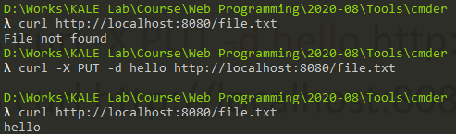


The command line tool: curl
used to make HTTP requests:
-X option is used to set the request’s method
-d is used to include a request body.
$ curl http://localhost:8080/file.txt
File not found
$ curl -X PUT -d hello http://localhost:8080/file.txt
$ curl http://localhost:8080/file.txt
hello
$ curl -X DELETE http://localhost:8080/file.txt
$ curl http://localhost:8080/file.txt
File not found

Slide 115
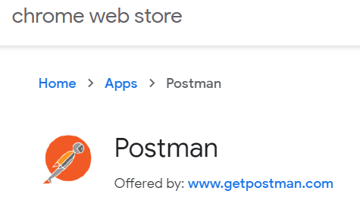
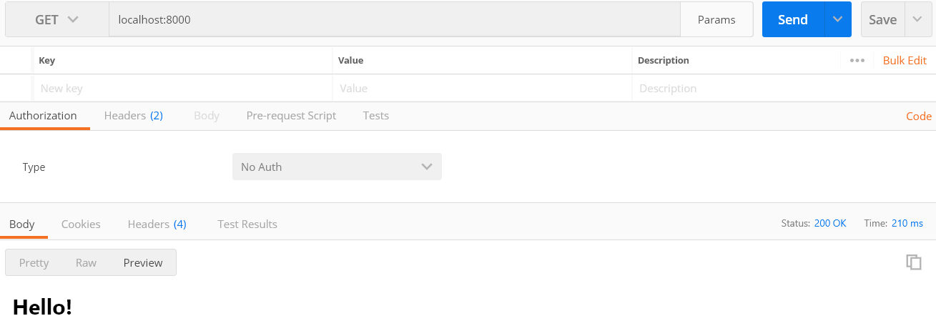
Postman
To check the API code, we can use Postman:
is a Chrome extension to send a request to a server.
使用教學: https://segmentfault.com/a/1190000011991458

Slide 116

Run: file_server
Save the file_server.js to the taskList directory
Create a named files directory
Then, go to the files directory:
cd files
Run: node ../file_server

Slide 117
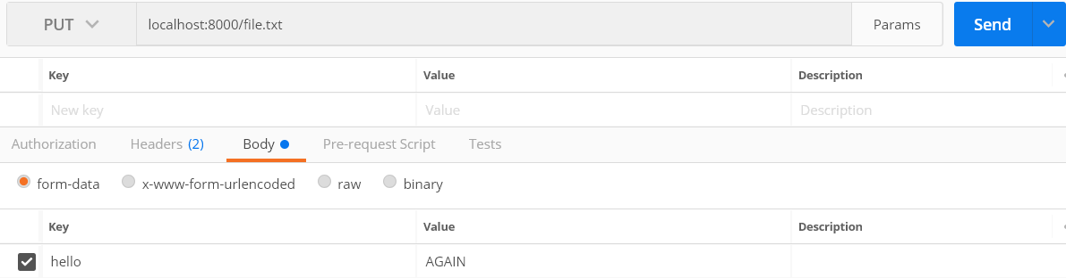

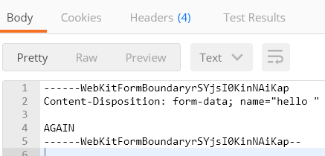



Use postman

Slide 118
練習時間
(練習上述操作)

Slide 119
THE END
Q&A

