Slide 1
運算思維與程式設計 (Computational Thinking & Programming)
109 學年度 第 1 學期
蘇俊銘(Jun-Ming Su)
jmsu@mail.nutn.edu.tw
星期五 (J304)
國立台南大學
2020

Slide 2
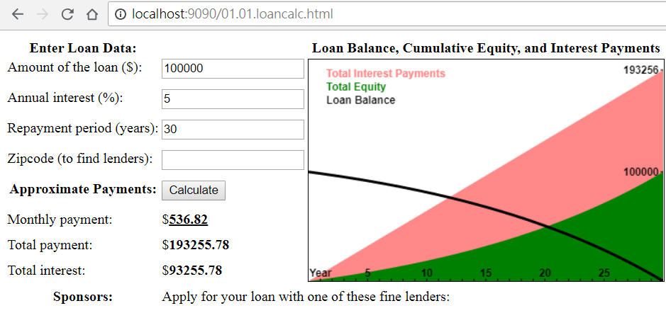
Example: A JavaScript Loan Calculator
https://resources.oreilly.com/examples/9780596805531/blob/master/examples/01.01.loancalc.html

Slide 3
The features of this Example
a number of core JavaScript language features
the important client-side JavaScript techniques
How to find elements in a document.
How to get user input from form input elements.
How to set the HTML content of document elements.
How to store data in the browser.
How to make scripted HTTP requests.
How to draw graphics with the <canvas> element.

Slide 4
Lexical Structure of JavaScript
The lexical structure of a programming language:
is the set of elementary rules that specifies how you write programs in that language.
Character Set:
JS are written using the Unicode character set.
Unicode is a superset of ASCII and Latin-1 and supports virtually every written language
ECMAScript (ES):
scripting-language specification standardized by Ecma International in ECMA-262 and ISO/IEC 16262.
It was created to standardize JavaScript.
ECMA 5 (ES5): 2011(VV) Support Browser
ECMA 6 (ES6): 2015(V): Support Browser
ECMA 7 (ES7): 2016
ECMA 8 (ES8): 2017
ECMA 9 (ES9): 2018

Slide 5
Case Sensitivity
JavaScript is a case-sensitive language:
language keywords, variables, function names, and other identifiers must always be typed with a consistent capitalization of letters:
while: not “While” or “WHILE.”
HTML is not case-sensitive (although XHTML is)
HTML onclick event handler attribute is sometimes specified as onClick in HTML,
But it must be specified as onclick in JavaScript code (or in XHTML documents)

Slide 6
Comments
two styles of comments:
//
/* and */
EX:
// This is a single-line comment.
/* This is also a comment */ // and here is another comment.
/*
* This is yet another comment.
* It has multiple lines.
*/

Slide 7
Literals
a data value that appears directly in a program:
12 // The number twelve
1.2 // The number one point two
"hello world" // A string of text
'Hi' // Another string
true // A Boolean value
false // The other Boolean value
/javascript/gi // A "regular expression" literal (for pattern matching)
null // Absence of an object
{ x:1, y:2 } // An object initializer
[1,2,3,4,5] // An array initializer

Slide 8
Identifiers
Identifiers:
is simply a name
used to name variables and functions and to provide labels for certain loops in JavaScript code.
Rules:
must begin with:
a letter, an underscore (_), or a dollar sign ($).
Subsequent characters can be:
letters, digits, underscores(_), or dollar signs($)
Digits are not allowed as the first character
EX:
i
my_variable_name
V13
_dummy
$str
variable names from non-English languages and also to use mathematical symbols:
EX:
var si = true;
var π = 3.14;

Slide 9
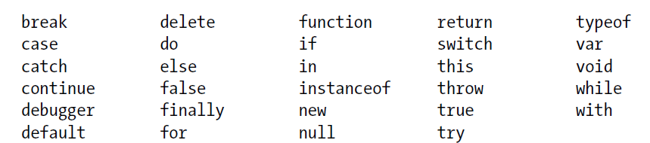

Reserved Words
reserves a number of identifiers as the keywords
cannot use these words as identifiers

Slide 10
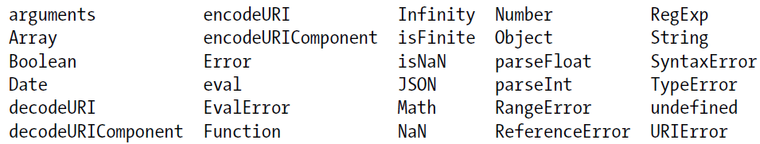
Reserved Words
JavaScript predefines a number of global variables and functions:
you should avoid using their names for your own variables and functions:
Keep in mind that:
JS implementations may define other global variables and functions, and each specific JavaScript embedding (client-side, server-side, etc.):
will have its own list of global properties

Slide 11


Optional Semicolons
you can usually omit the semicolon between two statements:
if those statements are written on separate lines.
EX:
a = 3;
b = 4;
But the first semicolon is required:
a = 3; b = 4;
JS usually treats line breaks as semicolons only:
if it can’t parse the code without the semicolons:
var a
a
=
3
console.log(a)
a = 3
b = 4;
var a; a = 3; console.log(a);

Slide 12
Optional Semicolons
JavaScript will always interpret that line break as a semicolon:
return, break, continue, ++, −−
EX:
return
true;
JS interpret:
return;
true;
In fact, you mean:
return true;
EX:
X
++
Y
JS interpret:
X; ++; Y;
In fact, you mean:
X++; Y;

Slide 13
Types, Values, and Variables
JS types can be divided into two categories:
primitive types:
numbers, strings (strings of text), Booleans:
special JavaScript values: null & undefined are primitive values
object types:
a collection of properties:
each property has a name and a value
special kind of objects:
array
function
to run that executable code and return a computed value
Numbers:
JS does not make a distinction between integer values and floating-point values.
All numbers in JS are represented as floating-point values
64-bit floating-point format (IEEE 754 standard):
±5 × 10⁻³²⁴ ~ ±1.7976931348623157 × 10³⁰⁸

Slide 14

Integer Literals
base-10 integer:
0
3
10000000
base-16 integer:
0xff // 15*16 + 15 = 255 (base 10)
0xCAFE911
base-8 integer:
0377 // 3*64 + 7*8 + 7 = 255 (base 10)

Slide 15
Floating-Point Literals
Syntax:
[digits][.digits][(E|e)[(+|-)]digits]
EX:
3.14
2345.789
.333333333333333333
6.02e23 // 6.02 × 10²³
1.4738223E-32 // 1.4738223 × 10⁻³²

Slide 16
Arithmetic in JavaScript
basic arithmetic operators:
+, -, *, /, % (modulo)
Complex mathematical operations:
Math.pow(2,53) // => 9007199254740992: 2 to the power 53
Math.round(.6) // => 1.0: round to the nearest integer
Math.ceil(.6) // => 1.0: round up to an integer
Math.floor(.6) // => 0.0: round down to an integer
Math.abs(-5) // => 5: absolute value
Math.max(x,y,z) // Return the largest argument
Math.min(x,y,z) // Return the smallest argument
Math.random() // Pseudo-random number x where 0 <= x < 1.0
Math.PI // π: circumference of a circle / diameter
Math.E // e: The base of the natural logarithm
Math.sqrt(3) // The square root of 3
Math.pow(3, 1/3) // The cube root of 3
Math.sin(0) // Trigonometry: also Math.cos, Math.atan, etc.
Math.log(10) // Natural logarithm of 10
Math.log(100)/Math.LN10 // Base 10 logarithm of 100
Math.log(512)/Math.LN2 // Base 2 logarithm of 512
Math.exp(3) // Math.E cubed

Slide 17
Arithmetic in JavaScript
Arithmetic in JavaScript does not raise errors in cases of:
overflow, underflow, or division by zero.
Infinity & - Infinity:
When the (negative) result of a numeric operation is > the largest representable (negative) number (overflow):
the result is a special infinity value
Underflow:
occurs when the result of a numeric operation is closer to zero than the smallest representable number:
JavaScript returns 0
negative zero (if occurs from a negative number)
Division by zero:
is not an error in JavaScript:
it simply returns infinity or negative infinity.
NaN (not-a-number value):
zero divided by zero, divide infinity by infinity
take the square root of a negative number
use arithmetic operators with non-numeric operands that cannot be converted to numbers

Slide 18
global variables Infinity and NaN
These expressions are infinity:
Infinity // A read/write variable initialized to Infinity.
Number.POSITIVE_INFINITY // Same value, read-only.
1/0 // This is also the same value.
Number.MAX_VALUE + 1 // This also evaluates to Infinity.
These expressions are negative infinity.
Number.NEGATIVE_INFINITY -Infinity
-1/0
-Number.MAX_VALUE - 1
These expressions are NaN:
NaN // A read/write variable initialized to NaN.
Number.NaN // A read-only property holding the same value.
0/0 // Evaluates to NaN.
These expressions are 0:
Number.MIN_VALUE/2 // Underflow: evaluates to 0
-Number.MIN_VALUE/2 // Negative zero
-1/Infinity // Also negative 0
-0

Slide 19
not-a-number value (NaN) has one unusual feature in JavaScript
it does not compare equal to any other value, including itself:
you can’t write x == NaN :
to determine whether the value of a variable x is NaN
EX:
var zero = 0; // Regular zero
var negz = -0; // Negative zero
zero === negz // => true: zero and negative zero are equal
1/zero === 1/negz // => false: infinity and -infinity are not equal

Slide 20
Binary Floating-Point and Rounding Errors
a finite number of real numbers can be represented exactly by the JavaScript floating-point format:
18437736874454810627, to be exact
IEEE-754 floating-point representation:
a binary representation
1/2, 1/8, and 1/1024
Not decimal fractions 1/10, 1/100
cannot exactly represent numbers as simple as 0.1.
can approximate 0.1 very closely (not exact)
var x = .3 - .2; // thirty cents minus 20 cents
var y = .2 - .1; // twenty cents minus 10 cents
x == y // => false: the two values are not the same!
x == .1 // => false: .3-.2 is not equal to .1
y == .1 // => true: .2-.1 is equal to .1
Due to Rounding Error

Slide 21
Dates and Times
Date() constructor:
for creating objects that represent dates and times.
var then = new Date(2010, 0, 1); // The 1st day of the 1st month of 2010
var later = new Date(2010, 0, 1, 17, 10, 30); // Same day, at 5:10:30pm, local time
var now = new Date(); // The current date and time
var elapsed = now - then; // Date subtraction: interval in milliseconds
later.getFullYear() // => 2010
later.getMonth() // => 0: zero-based months
later.getDate() // => 1: one-based days
later.getDay() // => 5: day of week. 0 is Sunday 5 is Friday.
later.getHours() // => 17: 5pm, local time
later.getUTCHours() // hours in UTC time; depends on timezone
later.toString() // => "Fri Jan 01 2010 17:10:30 GMT-0800 (PST)"
later.toUTCString() // => "Sat, 02 Jan 2010 01:10:30 GMT"
later.toLocaleDateString() // => "01/01/2010"
later.toLocaleTimeString() // => "05:10:30 PM"
later.toISOString() // => "2010-01-02T01:10:30.000Z"; ES5 only

Slide 22
Text
String:
is an immutable ordered sequence of 16-bit values (Unicode character)
use zero-based indexing:
the first 16-bit value is at position 0,
length of a string:
is the number of 16-bit values
empty string is the string of length 0.
var p = "π"; // π is 1 character with 16-bit codepoint 0x03c0
var e = "e"; // e is 1 character with 17-bit codepoint 0x1d452
p.length // => 1: p consists of 1 16-bit element
e.length // => 2: UTF-16 encoding of e is 2 16-bit values: "\ud835\udc52"

Slide 23
String Literals
string within a matched pair of single or double quotes (' or "):
"" // The empty string: it has zero characters
'testing'
"3.14"
'name="myform"'
"Wouldn't you prefer O'Reilly's book?"
"This string\nhas two lines"
"π is the ratio of a circle's circumference to its diameter“
ES5:
"two\nlines" // A string representing 2 lines written on one line
"one\ // A one-line string written on 3 lines. ECMAScript 5 only.
long\
line"

Slide 24
String Literals
client-side JavaScript programming:
JavaScript & HTML:
uses either single or double quotes to delimit its strings
A good method to discriminate them:
JavaScript uses single quotes
HTML uses double quotes
EX:
<button onclick="alert('Thank you')">Click Me</button>

Slide 25
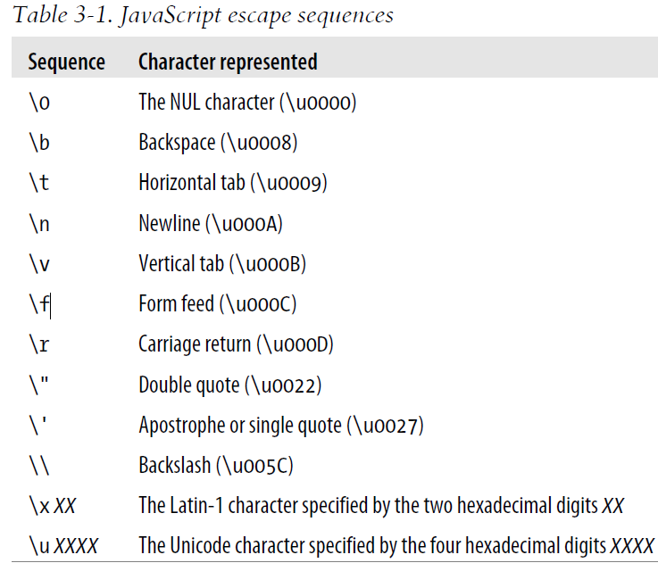
Escape Sequences in String Literals
backslash character (\):
has a special purpose in JavaScript strings.

Slide 26
Working with Strings
concatenate strings (default):
msg = "Hello, " + "world"; // Produces the string "Hello, world"
greeting = "Welcome to my blog," + " " + name;
String operation:
var s = "hello, world" // Start with some text.
s.length // => 12: the length of the string.
s.charAt(0) // => "h": the first character.
s.charAt(s.length-1) // => "d": the last character.
s.substring(1,4) // => "ell": the 2nd, 3rd and 4th characters.
s.slice(1,4) // => "ell": same thing
s.slice(-3) // => "rld": last 3 characters
s.indexOf("l") // => 2: position of first letter l.
s.lastIndexOf("l") // => 10: position of last letter l.
s.indexOf("l", 3) // => 3: position of first "l" at or after 3
s.split(", ") // => ["hello", "world"] split into substrings
s.replace("h", "H") // => "Hello, world": replaces all instances
s.toUpperCase() // => "HELLO, WORLD"

Slide 27

Working with Strings
strings are immutable in JavaScript,
replace() and toUpperCase() return new strings: they do not modify the string
s.replace("h", "H") // => "Hello, world": replaces all instances
s.toUpperCase() // => "HELLO, WORLD“
ES5:
strings can be treated like read-only arrays:
s = "hello, world";
s[0] // => "h"
s[s.length-1] // => "d"

Slide 28


Pattern Matching
https://developer.mozilla.org/zh-TW/docs/Web/JavaScript/Guide/Regular_Expressions
(Detail in Chapter 10 (Bible) or Chapter 9 (Eloquent_JavaScript))
a RegExp() constructor (regular expressions):
for creating objects that represent textual patterns
JS adopts Perl’s syntax for regular expressions:
正規表達式(RE):
是被用來匹配字串中字元組合的模式
/^HTML/ // Match the letters H T M L at the start of a string
/[^1-9][0-9]*/ // Match a non-zero digit, followed by any # of digits
/\bjavascript\b/i //\b:吻合文字邊界, Match "javascript" as a word, case-insensitive
var text = "testing: 1, 2, 3"; // Sample text
var pattern = /\d+/g // Matches all instances of one or more digits
pattern.test(text) // => true: a match exists
text.search(pattern) // => 9: position of first match
text.match(pattern) // => ["1", "2", "3"]: array of all matches
text.replace(pattern, "#"); // => "testing: #, #, #"
text.split(/\D+/); // => ["","1","2","3"]: split on non-digits
\D 挑出非數字，寫法等同於 [^0-9]。
\d 吻合數字，寫法等同於 [0-9]
immutable

Slide 29
練習時間
(練習上述操作)

Slide 30
The Global Object
global properties:
undefined, Infinity, and NaN
global functions:
isNaN(), parseInt() , and eval()
constructor functions:
Date(), RegExp(), String(), Object(), Array()
global objects:
Math and JSON
JS keyword this to refer to the global object:
var global = this; // Define a global variable to refer to the global object
client-side JavaScript:
Window object serves as the global object:
has a self-referential window property that can be used instead of this to refer to the global object

Slide 31

Wrapper Objects
JS objects are composite values:
a collection of properties or named values.
Method:
When the value of a property is a function
o.m():
invoke the method m of an object o
var s = "hello world!"; // A string
var word = s.substring(s.indexOf(" ")+1, s.length); // Use string properties
Strings are not objects:
refer to a property of a string s,
JS converts the string value to an object as if by calling new String(s)
Numbers and Booleans:
temporary object is created using the Number() or Boolean()

Slide 32

Wrapper Objects
wrapper objects:
The temporary objects created when you access a property of a string, number, or Boolean.
To create wrapper objects:
by invoking the String(), Number(), or Boolean() constructors
var s = "test", n = 1, b = true; // A string, number, and boolean value.
var S = new String(s); // A String object
var N = new Number(n); // A Number object
var B = new Boolean(b); // A Boolean object
== 比較
=== 嚴謹比較(strict equality operator)

Slide 33
Immutable Primitive Values and Mutable Object References
Primitive:
booleans, numbers, and strings
Objects are mutable—their values can change:
including arrays and functions
EX:
var o = { x:1 }; // Start with an object
o.x = 2; // Mutate it by changing the value of a property
o.y = 3; // Mutate it again by adding a new property
var a = [1,2,3] // Arrays are also mutable
a[0] = 0; // Change the value of an array element
a[3] = 4; // Add a new array element

Slide 34
Objects are not compared by value
two objects are not equal:
even if they have the same properties and values
EX:
var o = {x:1}, p = {x:1}; // Two objects with the same properties
o === p // => false: distinct objects are never equal
var a = [], b = []; // Two distinct, empty arrays
a === b // => false: distinct arrays are never equal
objects are compared by reference:
two object values are the same ⬄ they refer to the same underlying object
var a = []; // The variable a refers to an empty array.
var b = a; // Now b refers to the same array.
b[0] = 1; // Mutate the array referred to by variable b.
a[0] // => 1: the change is also visible through variable a.
a === b // => true: a and b refer to the same object, so they are equal.

Slide 35
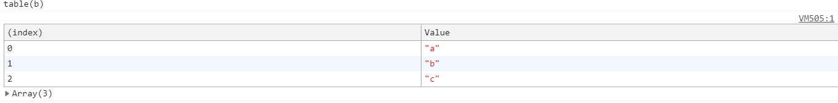
copy & comparison of an object or array
Make a new copy of an object or array:
var a = ['a','b','c']; // An array we want to copy
var b = []; // A distinct array we'll copy into
for(var i = 0; i < a.length; i++) { // For each index of a[]
b[i] = a[i]; // Copy an element of a into b
}
compare two distinct objects or arrays:
function equalArrays(a,b) {
if (a.length != b.length) return false; // Different-size arrays not equal
for(var i = 0; i < a.length; i++) // Loop through all elements
if (a[i] !== b[i]) return false; // If any differ, arrays not equal
return true; // Otherwise they are equal
}

Slide 36
Type Conversions
JS is very flexible about the types of values:
wants a boolean, string, number:
JS will convert whatever value you give it to that:
NaN: if it cannot perform a meaningful number conversion
10 + " objects" // => "10 objects". Number 10 converts to a string
"7" * "4" // => 28: both strings convert to numbers
var n = 1 - "x"; // => NaN: string "x" can't convert to a number
n + " objects" // => "NaN objects": NaN converts to string "NaN"

Slide 37
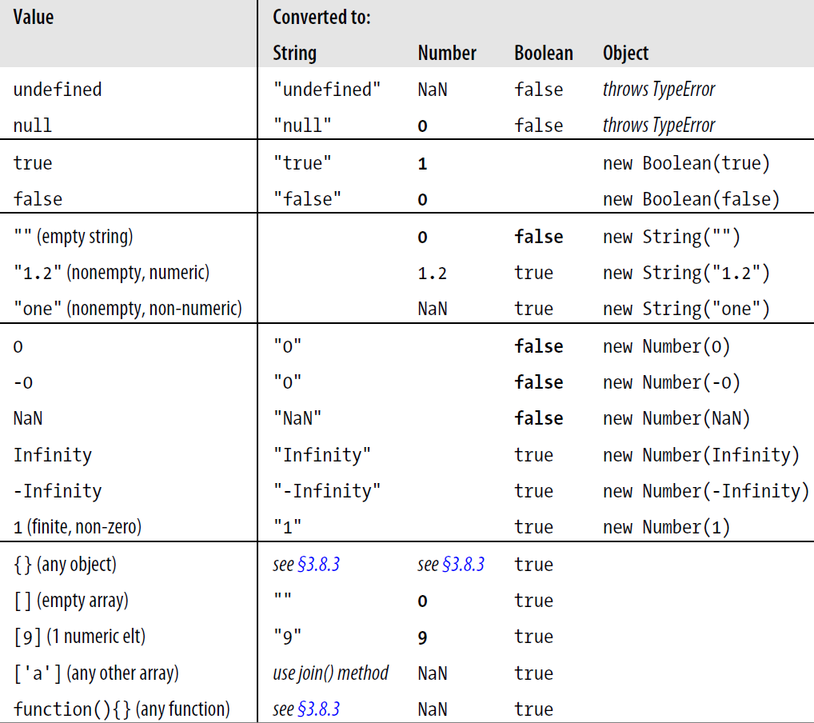
Table 3-2. JavaScript type conversions

Slide 38
Conversions and Equality
JS can convert values flexibly:
== equality operator is also flexible
following comparisons are true:
null == undefined // These two values are treated as equal.
"0" == 0 // String converts to a number before comparing.
0 == false // Boolean converts to number before comparing.
"0" == false // Both operands convert to numbers before comparing.
strict equality operator === :
does not perform conversions when testing for equality.

Slide 39
Explicit Conversions
may sometimes need to perform an explicit conversion
may prefer to make the conversions explicit to keep your code clearer.
explicit type conversion:
Boolean(), Number(), String(), Object() functions
Number("3") // => 3
String(false) // => "false" Or use false.toString()
Boolean([]) // => true
Object(3) // => new Number(3)
+ operator converts to string or number,
! operator converts its operand to a boolean and negates it.
x + "" // Same as String(x)
+x // Same as Number(x). You may also see x-0
!!x // Same as Boolean(x). Note double !

Slide 40
Explicit Conversions
toString() method:
defined by the Number class
accepts an optional argument :
specifies a radix, or base, for the conversion
var n = 17;
binary_string = n.toString(2); // Evaluates to "10001"
octal_string = "0" + n.toString(8); // Evaluates to "021"
hex_string = "0x" + n.toString(16); // Evaluates to "0x11“

Slide 41
Explicit Conversions
toFixed():
converts a number to a string with a specified number of digits after the decimal point.
toExponential():
converts a number to a string using exponential notation
toPrecision():
converts a number to a string with the number of significant digits you specify.
var n = 123456.789;
n.toFixed(0); // "123457"
n.toFixed(2); // "123456.79"
n.toFixed(5); // "123456.78900"
n.toExponential(1); // "1.2e+5"
n.toExponential(3); // "1.235e+5"
n.toPrecision(4); // "1.235e+5"
n.toPrecision(7); // "123456.8"
n.toPrecision(10); // "123456.7890"

Slide 42
Explicit Conversions
Number() conversion function:
it attempts to parse that string as an integer or floating-point literal.
parseInt() and parseFloat() functions:
are global functions, not methods of any class
parseInt() parses only integers,
parseFloat() parses both integers and floating-point numbers.
parseInt("3 blind mice") // => 3
parseFloat(" 3.14 meters") // => 3.14
parseInt("-12.34") // => -12
parseInt("0xFF") // => 255
parseInt("0xff") // => 255
parseInt("-0XFF") // => -255
parseFloat(".1") // => 0.1
parseInt("0.1") // => 0
parseInt(".1") // => NaN: integers can't start with "."
parseFloat("$72.47"); // => NaN: numbers can't start with "$“
parseInt("11", 2); // => 3 (1*2 + 1)
parseInt("ff", 16); // => 255 (15*16 + 15)
parseInt("zz", 36); // => 1295 (35*36 + 35)
parseInt("077", 8); // => 63 (7*8 + 7)
parseInt("077", 10); // => 77 (7*10 + 7)

Slide 43
練習時間
(練習上述操作)

Slide 44
Object to Primitive Conversions
Object-to-boolean conversions are trivial:
all objects (including arrays and functions) convert to true
All objects inherit two conversion methods:
toString() & valueOf()
toString():
return a string representation of the object
({x:1, y:2}).toString() // => "[object Object]“
[1,2,3].toString() // => "1,2,3"
(function(x) { f(x); }).toString() // => "function(x) {\n f(x);\n}"
/\d+/g.toString() // => "/\\d+/g"
new Date(2010,0,1).toString() // => "Fri Jan 01 2010 00:00:00 GMT-0800 (PST)“
valueOf():
convert an object to a primitive value that represents the object
var d = new Date(2010, 0, 1); // January 1st, 2010, (Pacific time)
d.valueOf() // => 1262332800000 (its internal representation)

Slide 45
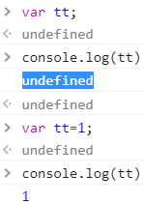
Variable Declaration
Before to use a variable, you should declare it.
ES5:
var & const keyword (define as Global variable):
var i; (without an initial value, value is “undefined”)
var sum;
var message = "hello";
var i = 0, j = 0, k = 0;
var name = "Ayda";
const greeting = "Hello ";
console.log(greeting + name);
// → Hello Ayda
ES6:
let keyword (define as Local variable)
let one = 1, two = 2;
console.log(one + two);
// → 3

Slide 46
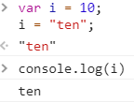
Variable Declaration
var can also appear as part of the for and for/in loops
for(var i = 0; i < 10; i++) console.log(i);
for(var i = 0, j=10; i < 10; i++,j--) console.log(i*j);
for(var p in o) console.log(p);
No type associated with JS variable declarations:
Not like the C or Java
JS variable can hold a value of any type:
var i = 10;
i = "ten";

Slide 47
Variable Scope
EX:
var scope = "global"; // Declare a global variable
function checkscope() {
var scope = "local"; // Declare a local variable with the same name
return scope; // Return the local value, not the global one
}
checkscope() // => "local“
EX:
scope = "global"; // Declare a global variable, even without var.
function checkscope2() {
scope = "local"; // Oops! We just changed the global variable.
myscope = "local"; // This implicitly declares a new global variable.
return [scope, myscope]; // Return two values.
}
checkscope2() // => ["local", "local"]: has side effects!
scope // => "local": global variable has changed.
myscope // => "local": global namespace cluttered up.

Slide 48
Variable Scope (Function)
Function definitions can be nested.
Each function has its own local scope
EX:
var scope = "global scope"; // A global variable
function checkscope() {
var scope = "local scope"; // A local variable
function nested() {
var scope = "nested scope"; // A nested scope of local variables
return scope; // Return the value in scope here
}
return nested();
}
checkscope() // => "nested scope"

Slide 49
Function Scope and Hoisting
Hoisting(提升):
variables are visible before they are declared
變數定義可在變數出現之後。
function catName(name) {
console.log("My cat's name is " + name);
}
catName(“Tigger”); //=> "My cat's name is Tigger“
相同結果:
catName(“Tigger”); //Hoisting
function catName(name) {
console.log("My cat's name is " + name);
}
//=> "My cat's name is Tigger"

Slide 50
Variables As Properties
var & let to declare the variable:
the property that is created is nonconfigurable:
it cannot be deleted with the delete operator
var truevar = 1; // A properly declared global variable, nondeletable.
let truelet=1; // nondeletable
fakevar = 2; // a deletable property of the global object.
this.fakevar2 = 3; // This does the same thing.
delete truevar // => false: variable not deleted
delete truelet // => false: variable not deleted
delete fakevar // => true: variable deleted
delete this.fakevar2 // => true: variable deleted

Slide 51
練習時間
(練習上述操作)

Slide 52
THE END
Q&A

