Slide 1
JavaScript程式設計 (JavaScript Programming)
109 學年度 第 1 學期
蘇俊銘(Jun-Ming Su)
jmsu@mail.nutn.edu.tw
數位學習科技學系, 國立台南大學
2020

Slide 2
CH 21 (Eloquent) Project: Skill-Sharing Website
A skill-sharing meeting is an event
where people with a shared interest come together and give small, informal presentations about things they know

Slide 3
Design
a server part to this project:
written for Node.js,
a client part:
written for the browser.
The server:
stores the system’s data and provides it to the client.
serves the files that implement the client-side system.
keeps the list of talks proposed for the next meeting
the client:
shows this list.
Each talk has a presenter name, a title, a summary, and an array of comments associated with it
allows users to propose new talks (adding them to the list), delete talks, and comment on existing talks.
makes an HTTP request to tell the server:
whenever the user makes such a change

Slide 4
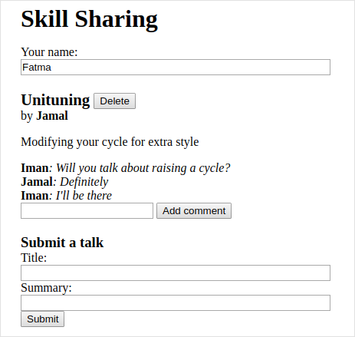

Slide 5


https://eloquentjavascript.net/code/skillsharing.zip
Download file
Create a directory named taskList (like CH20)
go to that directory.
skillsharing.zip:
RUN Client-side JS (Index.html)
when connecting the server-side JS
Server-side JS

Slide 6

ecstatic
A simple static file server middleware. Use it with a raw http server, express/connect or on the CLI!
Go to the taskList directory:
…………\taskList
Install
For using ecstatic as a library, just npm install it into your project:
Npm install –save ecstatic
(using this to install it to the taskList\node_modules)
For using ecstatic as a cli tool, either npm install it globally:
Npm install ecstatic –g

Slide 7
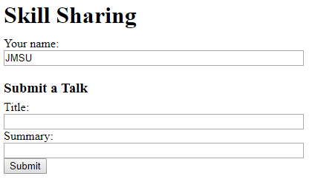
Run node skillsharing_server.js
Go to …..\taskList\skillsharing
Open the skillsharing_server.js
Modify & Save :
var ecstatic = require("../node_modules/ecstatic");
Run node skillsharing_server.js
Chrome: localhost:8000/
When a request is made to the path /, the server looks for the file ./public/index.html

Slide 8
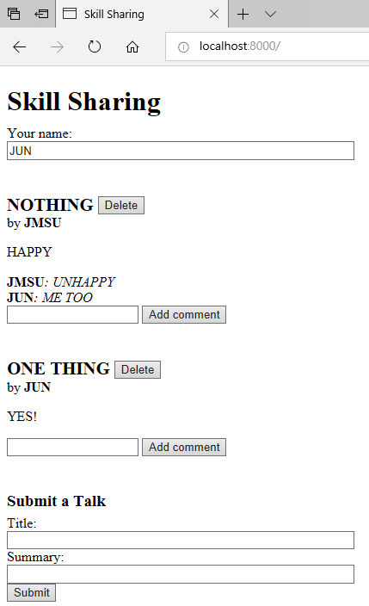
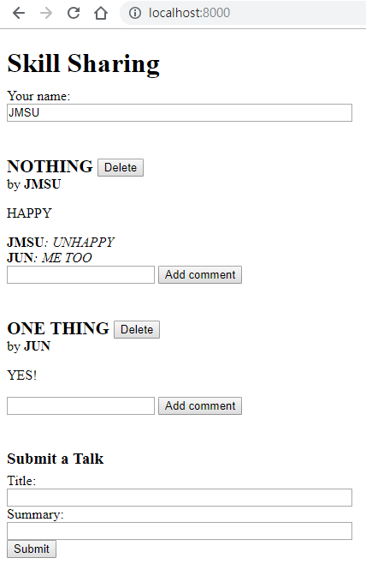

Slide 9
練習時間
(練習上述操作)

Slide 10
Long polling
To be able to immediately notify a client that something changed:
we need a connection to that client.
a technology called WebSockets:
makes it possible to open connections for arbitrary data exchange
we use a simpler technique—long polling:
clients continuously ask the server for new information using regular HTTP requests,
server stalls its answer when it has nothing new to report.
To prevent connections from timing out :
long polling set a maximum time for each request:
after which the server will respond anyway, even though it has nothing to report,
after which the client will start a new request

Slide 11
HTTP interface
the HTTP interface over which they communicate
use JSON as the format of our request and response body
to make good use of HTTP methods and headers
The interface is centered around the /talks path.
Paths that do not start with /talks will be used for serving static files:
HTML and JavaScript code for the client-side system.
A GET request to /talks returns a JSON document like this:
[{"title": "Unituning",
"presenter": "Jamal",
"summary": "Modifying your cycle for extra style",
"comments": []}]
Creating a new talk is done by making a PUT request to a URL like /talks/Unituning
the part after the second slash is the title of the talk.
The PUT request’s body should contain a JSON object:
that has presenter and summary properties.

Slide 12
Since talk titles may contain spaces and other characters :
may not appear normally in a URL,
title strings must be encoded with the encodeURIComponent function when building up such a URL
console.log("/talks/" + encodeURIComponent("How to Idle"));
// → /talks/How%20to%20Idle
A request to create a talk about idling might look something like this:
PUT /talks/How%20to%20Idle HTTP/1.1
Content-Type: application/json
Content-Length: 92
{"presenter": "Maureen",
"summary": "Standing still on a unicycle"}
Such URLs also support GET requests to retrieve JSON representation of a talk and DELETE requests to delete a talk.

Slide 13
Adding a comment to a talk is done:
with a POST request to a URL like:
/talks/Unituning/comments
with a JSON body that has author and message properties.
POST /talks/Unituning/comments HTTP/1.1
Content-Type: application/json
Content-Length: 72
{"author": "Iman",
"message": "Will you talk about raising a cycle?"}
To support long polling:
GET requests to /talks may include extra headers :
inform the server to delay the response if no new information is available.
use a pair of headers normally intended to manage caching: ETag and If-None-Match.

Slide 14
Servers may include an ETag (“entity tag”) header in a response:
Its value is a string:
that identifies the current version of the resource.
Clients, when they later request that resource again,:
may make a conditional request by including an If-None-Match header:
whose value holds that same string.
If the resource hasn’t changed,
the server will respond with status code 304,
which means “not modified”,
telling the client that its cached version is still current.
When the tag does not match, the server responds as normal.
Server:
should stall the response and
return only when something new is available
or a given amount of time has elapsed

Slide 15
To distinguish long polling requests from normal conditional requests:
give them another header: wait=90
tells server that client wait up to 90 seconds for the response.
server keep a version number:
that it updates every time the talks change
will use that as the ETag value.
Clients can make requests like this to be notified when the talks change:
GET /talks HTTP/1.1
If-None-Match: "4"
Prefer: wait=90
(time passes)
HTTP/1.1 200 OK
Content-Type: application/json
ETag: "5"
Content-Length: 295
[....]

Slide 16
The server
Routing
server will use createServer to start an HTTP server
A router is a component:
helps dispatch a request to the function that can handle it.
tell the router, for example,
that PUT requests with a path that matches the regular expression:
/^\/talks\/([^\/]+)$/
(/talks/ followed by a talk title) can be handled by a given function.
help extract the meaningful parts of the path (in this case the talk title),
wrapped in parentheses in the regular expression,
pass them to the handler function.
There are a number of good router packages on NPM:
but we’ll write one ourselves to illustrate the principle.

Slide 17
router.js
//we will later require from our server module
const {parse} = require("url");
// module exports the Router class.
module.exports = class Router {
constructor() {
this.routes = [];
}
add(method, url, handler) {
this.routes.push({method, url, handler});
}
resolve(context, request) {
let path = parse(request.url).pathname;
for (let {method, url, handler} of this.routes) {
let match = url.exec(path);
if (!match || request.method != method) continue;
let urlParts = match.slice(1).map(decodeURIComponent);
return handler(context, ...urlParts, request);
}
return null;
}
};
A router object allows new handlers to be registered with the add method and can resolve requests with its resolve method.
The latter will return a response:
when a handler was found, and null otherwise.
It tries the routes one at a time:
until a matching one is found.
handler functions are called with the context value:
(will be server instance in our case),
match strings for any groups they defined in their RE, and the request object.

Slide 18
Serving files
When a request matches none of the request types defined in our router:
server must interpret it as a request:
for a file in the public directory
we would like to have advanced features such as support for caching.
use a solid, well-tested static file server from NPM instead
ecstatic package:
exports a function that can be called with a configuration object to produce a request handler function.
use the root option to tell the server:
where it should look for files.
handler function accepts request and response parameters:
can be passed directly to createServer :
to create a server that serves only files
first check for requests that we should handle specially, though, so we wrap it in another function.

Slide 19
class SkillShareServer {
constructor(talks) {
this.talks = talks;
this.version = 0;
this.waiting = [];
let fileServer = ecstatic({root: "./public"});
this.server = createServer((request, response) => {
let resolved = router.resolve(this, request);
if (resolved) {
resolved.catch(error => {
if (error.status != null) return error;
return {body: String(error), status: 500};
}).then(({body,
status = 200,
headers = defaultHeaders}) => {
response.writeHead(status, headers);
response.end(body);
});
} else { fileServer(request, response); }
});
}
start(port) {this.server.listen(port); }
stop() {this.server.close();}
}
const {createServer} = require("http");
// module.exports = class Router defined in router.js
const Router = require("./router");
const ecstatic = require(" ("../node_modules/ ecstatic");
const router = new Router();
const defaultHeaders = {"Content-Type": "text/plain"};

Slide 20
Talks as resources
Talks:
have been proposed are stored in the talks property of the server
an object whose property names are the talk titles.
These will be exposed as HTTP resources under /talks/[title]
need to add handlers to our router:
implement the various methods that clients can use to work with them.
handler for requests that GET a single talk must look up the talk and respond:
either with the talk’s JSON data or with a 404 error response
const talkPath = /^\/talks\/([^\/]+)$/;
router.add("GET", talkPath, async (server, title) => {
if (title in server.talks) {
return {body: JSON.stringify(server.talks[title]),
headers: {"Content-Type": "application/json"}};
} else {
return {status: 404, body: `No talk '${title}' found`};
}
});

Slide 21
Deleting a talk is done:
by removing it from the talks object.
router.add("DELETE", talkPath, async (server, title) => {
if (title in server.talks) {
delete server.talks[title];
server.updated(); }
return {status: 204};
});
updated method: (will define later)
notifies waiting long polling requests about the change.

Slide 22
To retrieve the content of a request body:
define a function called readStream:
reads all content from a readable stream
returns a promise that resolves to a string.
function readStream(stream) {
return new Promise((resolve, reject) => {
let data = "";
stream.on("error", reject);
stream.on("data", chunk => data += chunk.toString());
stream.on("end", () => resolve(data));
});
}

Slide 23
One handler that needs to read request bodies is the PUT handler:
is used to create new talks.
It has to check whether the data it was given:
has presenter and summary properties, which are strings.
If data looks valid:
handler stores an object that represents the new talk in the talks object,
overwriting an existing talk with this title, and again calls updated.
router.add("PUT", talkPath,
async (server, title, request) => {
let requestBody = await readStream(request);
let talk;
try { talk = JSON.parse(requestBody); }
catch (_) { return {status: 400, body: "Invalid JSON"}; }
if (!talk ||
typeof talk.presenter != "string" ||
typeof talk.summary != "string") { return {status: 400, body: "Bad talk data"}; }
server.talks[title] = {title,
presenter: talk.presenter,
summary: talk.summary,
comments: []};
server.updated();
return {status: 204};
});

Slide 24
Adding a comment to a talk works similarly.
use readStream to:
get the content of the request,
validate the resulting data,
store it as a comment when it looks valid.
router.add("POST", /^\/talks\/([^\/]+)\/comments$/,
async (server, title, request) => {
let requestBody = await readStream(request);
let comment;
try { comment = JSON.parse(requestBody); }
catch (_) { return {status: 400, body: "Invalid JSON"}; }
if (!comment ||
typeof comment.author != "string" ||
typeof comment.message != "string") {
return {status: 400, body: "Bad comment data"};
} else if (title in server.talks) {
server.talks[title].comments.push(comment);
server.updated();
return {status: 204};
} else { return {status: 404, body: `No talk '${title}' found`}; }
});
Trying to add a comment to a nonexistent talk returns a 404 error.

Slide 25
Long polling support
When a GET request comes in for /talks:
either a regular request or a long polling request.
multiple places where to send an array of talks to the client:
first define a helper method:
builds up such an array and includes an ETag header in the response.
SkillShareServer.prototype.talkResponse = function() {
let talks = [];
for (let title of Object.keys(this.talks)) {
talks.push(this.talks[title]); }
return {
body: JSON.stringify(talks),
headers: {"Content-Type": "application/json",
"ETag": `"${this.version}"`}
};
};

Slide 26
handler needs to look at the request headers to see:
whether If-None-Match and Prefer headers are present.
Node stores headers,
whose names are specified to be case insensitive, under their lowercase names.
router.add("GET", /^\/talks$/, async (server, request) => {
let tag = /"(.*)"/.exec(request.headers["if-none-match"]);
let wait = /\bwait=(\d+)/.exec(request.headers["prefer"]);
if (!tag || tag[1] != server.version) {
return server.talkResponse();
} else if (!wait) {
return {status: 304};
} else { return server.waitForChanges(Number(wait[1])); }
});
exec() 方法用於檢索字串中的規則運算式的匹配: RegExpObject.exec(string)
If request is conditional and talks did not change, consult the Prefer header to see whether we should delay the response or respond right away
If no tag was given or a tag was given that doesn’t match the server’s current version, the handler responds with the list of talks.

Slide 27
Callback functions for delayed requests are stored in the server’s waiting array :
they can be notified when something happens.
The waitForChanges method:
sets a timer to respond with a 304 status (Not Modified)
when the request has waited long enough.
SkillShareServer.prototype.waitForChanges = function(time) {
return new Promise(resolve => {
this.waiting.push(resolve);
setTimeout(() => {
if (!this.waiting.includes(resolve)) return;
this.waiting = this.waiting.filter(r => r != resolve);
resolve({status: 304});
}, time * 1000);
});
};

Slide 28
Registering a change with updated:
increases the version property and wakes up all waiting requests.
SkillShareServer.prototype.updated = function() {
this.version++;
let response = this.talkResponse();
this.waiting.forEach(resolve => resolve(response));
this.waiting = [];
};
That concludes the server code.
If we create an instance of SkillShareServer and start it on port 8000,
the resulting HTTP server serves files from the public subdirectory:
alongside a talk-managing interface under the /talks URL.
new SkillShareServer(Object.create(null)).start(8000);

Slide 29
The client
client-side part of the skill-sharing website consists of three files:
a tiny HTML page, a style sheet, and a JavaScript file.
HTML:
It is a convention for web servers to try to serve a file named index.html
when a request is made directly to a path that corresponds to a directory.
The file server module we use, ecstatic, supports this convention.
When a request is made to the path /,
server looks for the file ./public/index.html
(./public being the root we gave it) and returns that file if found.
// index.html
<!doctype html>
<meta charset="utf-8">
<title>Skill Sharing</title>
<link rel="stylesheet" href="skillsharing.css">
<h1>Skill Sharing</h1>
<script src="skillsharing_client.js"></script>

Slide 30
Actions
application state consists of:
the list of talks & the name of the user,
store it in a {talks, user} object.
We don’t allow the user interface to directly manipulate the state or send off HTTP requests:
it may emit actions that describe what the user is trying to do.
The handleAction function takes such an action and makes it happen.

Slide 31
function handleAction(state, action) {
if (action.type == "setUser") {
localStorage.setItem("userName", action.user);
return Object.assign({}, state, {user: action.user});
} else if (action.type == "setTalks") {
return Object.assign({}, state, {talks: action.talks});
} else if (action.type == "newTalk") {
fetchOK(talkURL(action.title), {
method: "PUT",
headers: {"Content-Type": "application/json"},
body: JSON.stringify({presenter: state.user, summary: action.summary })
}).catch(reportError);
} else if (action.type == "deleteTalk") {
fetchOK(talkURL(action.talk), {method: "DELETE"})
.catch(reportError);
} else if (action.type == "newComment") {
fetchOK(talkURL(action.talk) + "/comments", {
method: "POST",
headers: {"Content-Type": "application/json"},
body: JSON.stringify({ author: state.user, message: action.message})
}).catch(reportError);
}
return state;
}
store the user’s name in localStorage

Slide 32
actions that need to involve the server make network requests:
using fetch, to the HTTP interface
use a wrapper function, fetchOK,
makes sure the returned promise is rejected:
when the server returns an error code.
function fetchOK(url, options) {
return fetch(url, options).then(response => {
if (response.status < 400) return response;
else throw new Error(response.statusText);
});
}

Slide 33
helper function is used to:
build up a URL for a talk with a given title.
function talkURL(title) {
return "talks/" + encodeURIComponent(title);
}
When the request fails:
define a function called reportError,
shows the user a dialog that tells them something went wrong
function reportError(error) {
alert(String(error));
}

Slide 34
Rendering components
splitting the application into components.
either never need to update or are always fully redrawn when updated:
as functions that directly return a DOM node:
EX: shows the field where the user can enter their name
function renderUserField(name, dispatch) {
return elt("label", {}, "Your name: ", elt("input", {
type: "text",
value: name,
onchange(event) {
dispatch({type: "setUser", user: event.target.value});
}
}));
}
elt function used to construct DOM elements in CH19

Slide 35
DOM building
One of the main things that interface components do is creating DOM structure.
don’t want to directly use the verbose DOM methods for that
so here’s a slightly expanded version of the elt function:
function elt(type, props, ...children) {
let dom = document.createElement(type);
if (props) Object.assign(dom, props);
for (let child of children) {
if (typeof child != "string") dom.appendChild(child);
else dom.appendChild(document.createTextNode(child));
}
return dom; }
This allows the following style of registering event handlers:
<body>
<script>
document.body.appendChild(elt("button", {
onclick: () => console.log("click")
}, "The button"));
</script>
</body>

Slide 36
to render talks
include a list of comments and a form for adding a new comment.
function renderTalk(talk, dispatch) {
return elt(
"section", {className: "talk"},
elt("h2", null, talk.title, " ", elt("button", {
type: "button",
onclick() { dispatch({type: "deleteTalk", talk: talk.title}); }
}, "Delete")),
elt("div", null, "by ",
elt("strong", null, talk.presenter)),
elt("p", null, talk.summary),
...talk.comments.map(renderComment),
elt("form", {
onsubmit(event) {
event.preventDefault();
let form = event.target;
dispatch({type: "newComment",
talk: talk.title,
message: form.elements.comment.value});
form.reset();
}
}, elt("input", {type: "text", name: "comment"}), " ",
elt("button", {type: "submit"}, "Add comment")));
}
The "submit" event handler calls form.reset to clear the form’s content after creating a "newComment" action.

Slide 37
Comments are simpler to render.
function renderComment(comment) {
return elt("p", {className: "comment"},
elt("strong", null, comment.author),
": ", comment.message);
}
Finally, the form that the user can use to create a new talk is rendered like this:
function renderTalkForm(dispatch) {
let title = elt("input", {type: "text"});
let summary = elt("input", {type: "text"});
return elt("form", {
onsubmit(event) {
event.preventDefault();
dispatch({type: "newTalk",
title: title.value,
summary: summary.value});
event.target.reset();
}
}, elt("h3", null, "Submit a Talk"),
elt("label", null, "Title: ", title),
elt("label", null, "Summary: ", summary),
elt("button", {type: "submit"}, "Submit"));
}

Slide 38
Polling
To start the app we need the current list of talks.:
ETag from the load must be used when polling
a function
keeps polling the server for /talks
calls a callback function when a new set of talks is available.
async function pollTalks(update) {
let tag = undefined;
for (;;) {
let response;
try {
response = await fetchOK("/talks", {
headers: tag && {"If-None-Match": tag, "Prefer": "wait=90"} });
} catch (e) {
console.log("Request failed: " + e);
await new Promise(resolve => setTimeout(resolve, 500));
continue;
}
if (response.status == 304) continue;
tag = response.headers.get("ETag");
update(await response.json());
}
}
an async function: looping & waiting for request is easier.
It runs an infinite loop that, on each iteration, retrieves the list of talks—
either normally or, if this isn’t the first request, with the headers included that make it a long polling request.
When a request fails,
function waits a moment and then tries again.
promise resolved via setTimeout is a way to force the async function to wait
server gives back a 304 response, means a long polling request timed out, so function should immediately start the next request
response is a normal 200 response, its body is read as JSON and passed to the callback, and its ETag header value is stored for the next iteration

Slide 39
The application
The following component ties the whole user interface together:
class SkillShareApp {
constructor(state, dispatch) {
this.dispatch = dispatch;
this.talkDOM = elt("div", {className: "talks"});
this.dom = elt("div", null,
renderUserField(state.user, dispatch),
this.talkDOM,
renderTalkForm(dispatch));
this.syncState(state);
}
syncState(state) {
if (state.talks != this.talks) {
this.talkDOM.textContent = "";
for (let talk of state.talks) {
this.talkDOM.appendChild(
renderTalk(talk, this.dispatch));
}
this.talks = state.talks;
}
}
}
When the talks change, this component redraws all of them. This is simple but also wasteful.

Slide 40
start the application like this
function runApp() {
let user = localStorage.getItem("userName") || "Anon";
let state, app;
function dispatch(action) {
state = handleAction(state, action);
app.syncState(state);
}
pollTalks(talks => {
if (!app) {
state = {user, talks};
app = new SkillShareApp(state, dispatch);
document.body.appendChild(app.dom);
} else {
dispatch({type: "setTalks", talks});
}
}).catch(reportError);
}
runApp();

Slide 41
練習時間
(練習上述操作)

Slide 42
THE END
Q&A

