Slide 1
JavaScript程式設計
109 學年度 第 1 學期
蘇俊銘(Jun-Ming Su)
jmsu@mail.nutn.edu.tw
星期五，節次8、9、A (J304)
數位學習科技學系, 國立臺南大學
2020

Slide 2
Expressions and Operators
An expression is a phrase of JS:
a JS interpreter can evaluate to produce a value
Literals are constant values:
1.23 // A number literal
"hello" // A string literal
/pattern/ // A regular expression literal
reserved words are primary expressions:
true // Evaluates to the boolean true value
false // Evaluates to the boolean false value
null // Evaluates to the null value
this // Evaluates to the "current" object
bare variable reference::
i // Evaluates to the value of the variable i.
sum // Evaluates to the value of the variable sum.
undefined // undefined is a global variable, not a keyword like null.

Slide 3
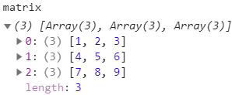
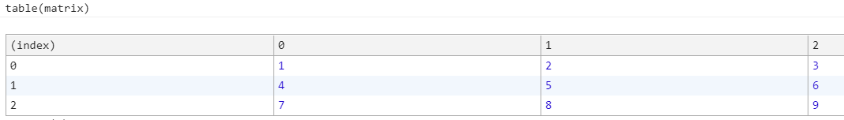
Object and Array Initializers
new array are initialized to the values of the comma-separated expressions:
[] // An empty array: no expressions inside brackets means no elements
[1+2,3+4] // A 2-element array. First element is 3, second is 7
nested arrays:
var matrix = [[1,2,3], [4,5,6], [7,8,9]];

Slide 4
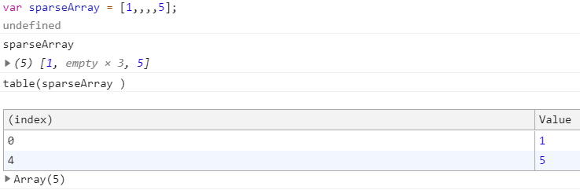
Undefined elements in Array:
by simply omitting a value between commas:
var sparseArray = [1,,,,5];
Object initializer expressions are like array initializer expressions:
var p = { x:2.3, y:-1.2 }; // An object with 2 properties
var q = {}; // An empty object with no properties
q.x = 2.3; q.y = -1.2; // Now q has the same properties as p

Slide 5
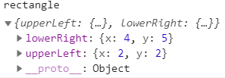
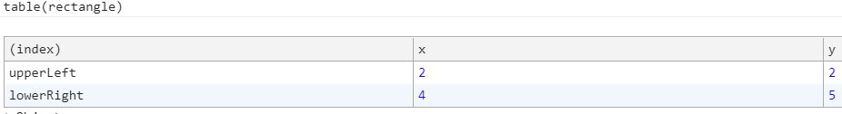
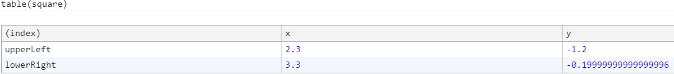
Object literals can be nested:
var rectangle = { upperLeft: { x: 2, y: 2 },
lowerRight: { x: 4, y: 5 } };
var side = 1;
var square = { "upperLeft": { x: p.x, y: p.y },
'lowerRight': { x: p.x + side, y: p.y + side}};

Slide 6
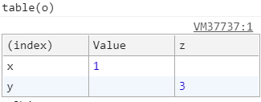
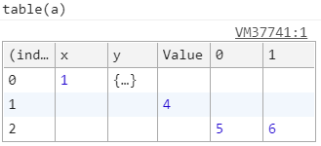
Function Definition Expressions
// This function returns the square of the value passed to it.
var square = function(x) { return x * x; }
defines two syntaxes for property access:
expression.identifier
expression[ expression ]
EX:
var o = {x:1,y:{z:3}}; // An example object
var a = [o,4,[5,6]]; // An example array that contains the object
o.x // => 1: property x of expression o
o.y.z // => 3: property z of expression o.y
o["x"] // => 1: property x of object o
a[1] // => 4: element at index 1 of expression a
a[2]["1"] // => 6: element at index 1 of expression a[2]
a[0].x // => 1: property x of expression a[0]

Slide 7
Invocation Expressions
is JS’s syntax for calling (or executing) a function or method:
f(0) // f is the function expression; 0 is the argument expression.
Math.max(x,y,z) // Math.max is the function; x, y and z are the arguments.
a.sort() // a.sort is the function; there are no arguments.
Object Creation Expressions:
creates a new object and invokes a function (called a constructor) to initialize the properties of that object:
new Object()
new Point(2,3)
new Object // no arguments are passed to the constructor function
new Date

Slide 8
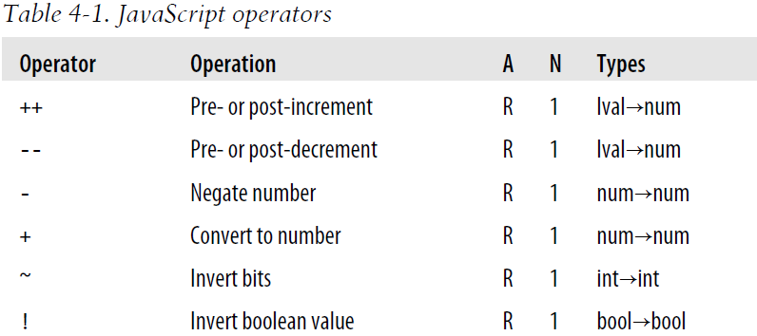
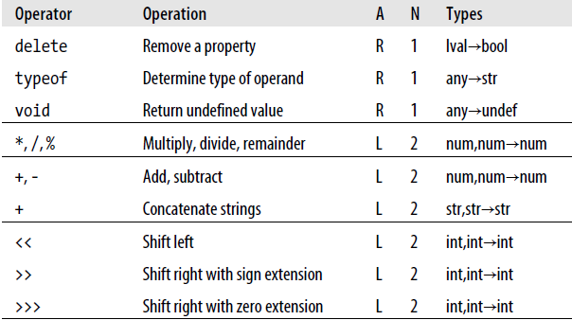
Operator Overview
Operators are used for JavaScript’s arithmetic expressions, comparison expressions, logical expressions, assignment expressions, and more
lval: an expression that can legally appear on the left side of an assignment expression

Slide 9
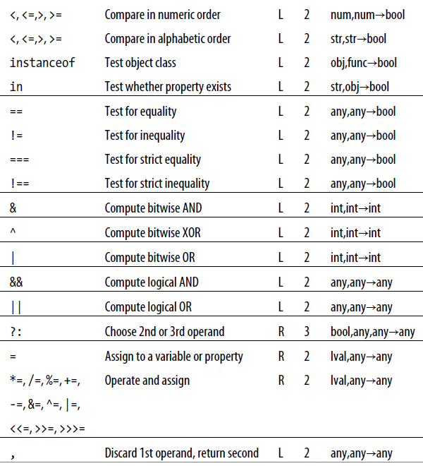

Slide 10
Operator Precedence
w = x + y*z; //(* has a higher precedence > +)
w = (x + y)*z;
property access and invocation expressions have higher precedence than the operators (Table 4-1):
typeof my.functions[x](y)
Operator Associativity:
L :left-to-right associativity: (from left to right)
R: right-to-left associativity:
w = x - y - z; //the same as: w = ((x - y) - z);
x = ~-y; //as: x = ~(-y);
w = x = y = z; //as: w = (x = (y = z));
q = a?b:c?d:e?f:g; //as: a?b:(c?d:(e?f:g));

Slide 11
Arithmetic Expressions
The + Operator:
1 + 2 // => 3: addition
"1" + "2" // => "12": concatenation
"hello" + " " + "there" // => "hello there"
"1" + 2 // => "12": concatenation after number-to-string
1 + {} // => "1[object Object]": concatenation after object-to-string
true + true // => 2: addition after boolean-to-number
2 + null // => 2: addition after null converts to 0
2 + undefined // => NaN: addition after undefined converts to NaN
+ is used with strings and numbers, it may not be associative:
Result may depend on the order in which operations are performed:
1 + 2 + " blind mice"; // => "3 blind mice"
1 + (2 + " blind mice"); // => "12 blind mice"

Slide 12


Unary Arithmetic Operators
Unary operators:
modify the value of a single operand to produce a new value
high precedence and are all right-associative
unary arithmetic operators:
Unary plus (+):
converts its operand to a number (or to NaN) and returns that converted value
Unary minus (-)
Increment (++):
return value depends on its position relative to the operand.
var i = 1, j = ++i; // i and j are both 2 (pre-increment operator)
var i = 1, j = i++; // i is 2, j is 1
++x is not always the same as x=x+1
++ never performs string concatenation:
always converts its operand to a number and increments it
If x is the string “1”, ++x is the number 2, but x+1 is the string “11”.

Slide 13
Bitwise Operators
perform low-level manipulation of the bits in the binary representation of numbers:
NaN, Infinity, and -Infinity all convert to 0 when bitwise operators
AND (&):
0x1234 & 0x00FF evaluates to 0x0034
OR (|):
0x1234 | 0x00FF evaluates to 0x12FF
XOR (^):
0xFF00 ^ 0xF0F0 evaluates to 0x0FF0
NOT (~):
~0x0F evaluates to 0xFFFFFFF0, or −16
Shift left (<<):
7 << 2 evaluates to 28
Shift right with sign (>>):
7 >> 1 evaluates to 3
−7 >> 1 evaluates to −4
Shift right with zero fill (>>>):
−1 >> 4 evaluates to −1
−1 >>> 4 evaluates to 0x0FFFFFFF

Slide 14
Relational Expressions
Equality and Inequality Operators:
== and === (strict equality operator):
check whether two values are the same
!= and !== (strict equality operator)
Comparison Operators:
Less than (<)
Greater than (>)
Less than or equal (<=)
Greater than or equal (>=)
1 + 2 // Addition. Result is 3.
"1" + "2" // Concatenation. Result is "12".
"1" + 2 // Concatenation. 2 is converted to "2". Result is "12".
11 < 3 // Numeric comparison. Result is false.
"11" < "3" // String comparison. Result is true.
"11" < 3 // Numeric comparison. "11" converted to 11. Result is false.
"one" < 3 // Numeric comparison. "one" converted to NaN. Result is false.

Slide 15
in Operator
a left-side operand that is or can be converted to a string.
evaluates to true if the left-side value is the name of a property of the right-side object
var point = { x:1, y:1 }; // Define an object
"x" in point // => true: object has property named "x"
"z" in point // => false: object has no "z" property.
"toString" in point // => true: object inherits toString method
var data = [7,8,9]; // An array with elements 0, 1, and 2
"0" in data // => true: array has an element "0"
1 in data // => true: numbers are converted to strings
3 in data // => false: no element 3

Slide 16
instanceof Operator
expects a left-side operand:
is an object and a right-side operand that identifies a class of objects
evaluates to true:
if the left-side object is an instance of the right-side class
evaluates to false otherwise
var d = new Date(); // Create a new object with the Date() constructor
d instanceof Date; // Evaluates to true; d was created with Date()
d instanceof Object; // Evaluates to true; all objects are instances of Object
d instanceof Number; // Evaluates to false; d is not a Number object
var a = [1, 2, 3]; // Create an array with array literal syntax
a instanceof Array; // Evaluates to true; a is an array
a instanceof Object; // Evaluates to true; all arrays are objects
a instanceof RegExp; // Evaluates to false; arrays are not regular expressions

Slide 17
Logical Expressions
Logical AND (&&):
x == 0 && y == 0 // true if, and only if x and y are both 0
var o = { x : 1 };
var p = null;
o && o.x // => 1: o is truthy, so return value of o.x
p && p.x // => null: p is falsy, so return it and don't evaluate p.x
if (a == b) stop(); // Invoke stop() only if a == b
(a == b) && stop(); // This does the same thing

Slide 18
Logical Expressions
a truthy value is a value that is considered true:
when encountered in a Boolean context
if (true)
if ({})
if ([])
if (42)
if ("foo")
if (new Date())
if (-42)
if (3.14)
if (-3.14)
if (Infinity)
if (-Infinity)
A falsy value:
is a value that is considered false
if (false)
if (null)
if (undefined)
if (0)
if (NaN)
if ('')
if ("")
if (document.all)

Slide 19
Logical Expressions
Logical OR (||):
An idiomatic usage of this operator is to select the first truthy value in a set of alternatives:
// If max_width is defined, use that. Otherwise look for a value in
// the preferences object. If that is not defined use a hard-coded constant.
var max = max_width || preferences.max_width || 500;
often used in function bodies to supply default values for parameters:
// Copy the properties of o to p, and return p
function copy(o, p) {
p = p || {}; //Check & New: If no object passed for p, use a newly created object.
// function body [Code: Copy the properties of o to p] goes here
}

Slide 20


Logical NOT (!)
if x is truthy !x evaluates to false.
If x is falsy, then !x is true.
! always returns true or false
you can convert any value x to its equivalent boolean value:
by applying this operator twice: !!x
// These two equalities hold for any values of p and q
!(p && q) === !p || !q
!(p || q) === !p && !q

Slide 21
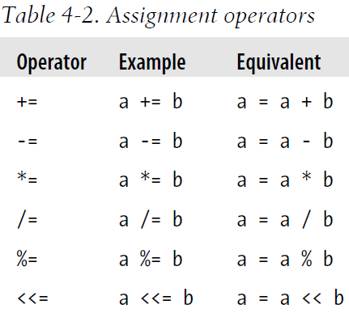
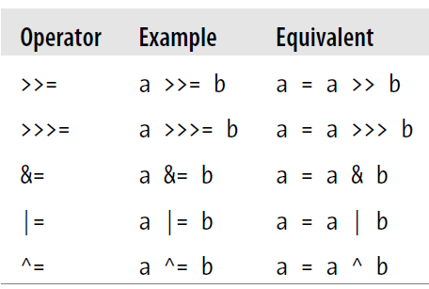
Assignment with Operation
(a = b) == 0 //=> fasle
i = j = k = 0; // Initialize 3 variables to 0
total += sales_tax ⬄ total = total + sales_tax

Slide 22
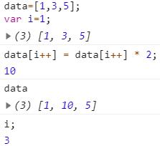
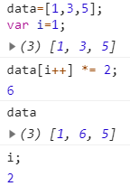
Assignment with Operation
In most cases, the expression:
(1) a op= b ⬄ (2) a = a op b
where op is an operator
The difference:
in (1), a is evaluated once
In (2), a is evaluated twice
differ only if a includes side effects:
such as a function call or an increment operator
data[i++] *= 2;
data[i++] = data[i++] * 2;
i=1
i=1
data=[1,3,5];
var i=1;
data[i++] *= 2;
i=1
i=2
data=[1,3,5];
var i=1;
data[i++] = data[i++] * 2;
i=1
i=1
i=1
i++ (後加)
i++ (後加)
i=3
i=2

Slide 23
Conditional Operator (?:)
is the only ternary operator (three operands) in JS
x > 0 ? x : -x // The absolute value of x
if (condition)==true, then ?, else, :
greeting = "hello " + (username ? username : "there");
//is equivalent to
greeting = "hello ";
if (username)
greeting += username;
else
greeting += "there";

Slide 24
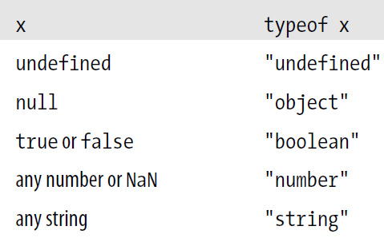


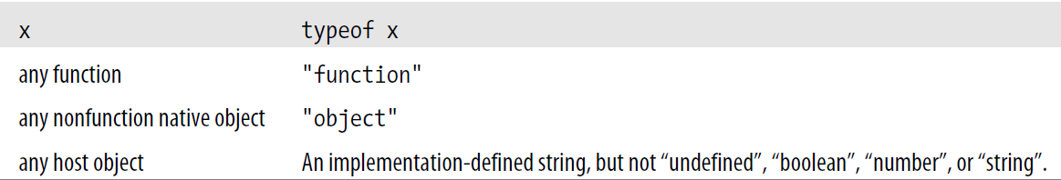
typeof Operator
a unary operator:
Its value is a string that specifies the type of the operand
(typeof value == "string") ? "'" + value + "'" : value

Slide 25
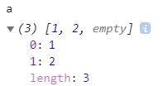
delete Operator
a unary operator:
delete the object property or array element specified as its operand:
EX:
var o = { x: 1, y: 2}; // Start with an object
delete o.x; // Delete one of its properties
"x" in o // => false: the property does not exist anymore
var a = [1,2,3]; // Start with an array
delete a[2]; // Delete the last element of the array
a.length // => 3: array only has two elements now
var o = {x:1, y:2}; // Define a variable; initialize it to an object
delete o.x; // Delete one of the object properties; returns true
typeof o.x; // Property does not exist; returns "undefined"
delete o.x; // Delete a nonexistent property; returns true
delete o; // Can't delete a declared variable; returns false.
// Would raise an exception in strict mode.

Slide 26
The Comma Operator (,)
a binary operator whose operands may be of any type
i=0, j=1, k=2; ⬄ i = 0; j = 1; k = 2;
// The first comma below is part of the syntax of the var statement
// The second comma is the comma operator: it lets us squeeze 2
// expressions (i++ and j--) into a statement (the for loop) that expects 1.
for(var i=0 , j=10; i < j; i++ , j--)
console.log(i+j);

Slide 27
練習時間
(練習上述操作)

Slide 28
CHAPTER 5 Statements
JS statements are terminated with semicolons (;)
Expressions are evaluated to produce a value,
but statements are executed to make something happen

Slide 29
statements
Conditionals:
execute or skip other statements depending on expression value:
if
switch
Loops:
execute other statements repetitively
while
for
Jumps:
jump to another part of the program
break
return
throw

Slide 30
Compound and Empty Statements
statement block:
combines multiple statements into a single compound statement.
{
x = Math.PI;
cx = Math.cos(x);
console.log("cos(π) = " + cx);
}
empty statement looks like this:
;
JS interpreter takes no action when it executes an empty statement
// Initialize an array a
for(i = 0; i < a.length; a[i++] = 0) ;
if ((a == 0) || (b == 0)); // Oops! This line does nothing...
o = null; // and this line is always executed.

Slide 31
Declaration Statements
declaration statements:
var, let, function
var:
var name_1 [ = value_1] [ ,..., name_n [= value_n]]:
var i; // One simple variable
var j = 0; // One var, one value
var p, q; // Two variables
var greeting = "hello" + name; // A complex initializer
var x = 2.34, y = Math.cos(0.75), r, theta; // Many variables
var x = 2, y = x*x; // Second var uses the first
var x = 2, // Multiple variables...
f = function(x) { return x*x }, // each on its own line
y = f(x);
local variables:
a var statement appears within the body of a function
global variables:
var is used in top-level code
a variable without var statement:
the variable’s initial value is undefined
for(var i = 0; i < 10; i++) console.log(i);
for(var i = 0, j=10; i < 10; i++,j--) console.log(i*j);
for(var i in o) console.log(i);

Slide 32
Declaration Statements
Function:
var f = function(x) { return x+1; } // Expression assigned to a variable
function f(x) { return x+1; } // Statement includes variable name
function declaration statement:
function funcname([arg1 [, arg2 [..., argn]]]) {
statements
}
function hypotenuse(x, y) {
return Math.sqrt(x*x + y*y); // return is documented in the next section
}
function factorial(n) { // A recursive function
if (n <= 1) return 1;
return n * factorial(n - 1);
}

Slide 33
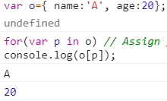
for/in
for/in statement uses the for keyword:
for (variable in object)
Statement
for/in loop makes it easy to do the same for the properties of an object:
for(var i = 0; i < a.length; i++) // Assign array indexes to variable i
console.log(a[i]); // Print the value of each array element
var o={ name:’A’, age:20};
for(var p in o) // Assign property names of o to variable p
console.log(o[p]); // Print the value of each property

Slide 34
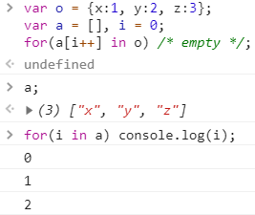
for/in
variable in for/in loop may be an arbitrary expression:
it evaluates to something suitable for the left side of an assignment
evaluated each time through the loop:
it may evaluate differently each time.
EX: copy the names of all object properties into an array:
var o = {x:1, y:2, z:3};
var a = [], i = 0;
for(a[i++] in o) /* empty */;
//array indexes are object properties that can be enumerated with a for/in loop.
//enumerates the array indexes 0, 1, and 2
for(i in a) console.log(i);
for/in loop does not actually enumerate all properties of an object, only the enumerable properties:
EX: built-in methods defined by core JS are not enumerable (EX: All objects have a toString() method)

Slide 35
jump statements
Break:
jump to the end of a loop or other statement
Continue:
skip the rest of the body of a loop and jump back to the top of a loop to begin a new iteration
break and continue:
identify the target loop or other statement label:
JS allows statements to be named, or labeled,
Return:
jump from a function invocation back to the code:
invoked it and also supplies the value for the invocation
Throw an exception to work with try/catch/ finally:
establishes a block of exception handling code
when an exception is thrown:
jumps to nearest enclosing exception handler:
may be in the same function
or up the call stack in an invoking function

Slide 36
Labeled Statements
identifier: statement
statement may be labeled by preceding it with an identifier and a colon
EX: a labeled while loop and a continue statement that uses the label
mainloop: while(token != null) {
// Code omitted...
continue mainloop; // Jump to the next iteration of the named loop
// More code omitted...
}
Break:
for(var i = 0; i < a.length; i++) {
if (a[i] == target) break;
}

Slide 37
Break
break labelname;
break is used with a label:
jumps to the end of, or terminates, the enclosing statement that has the specified label:
EX:
var matrix = getData(); // Get a 2D array of numbers from somewhere
// Now sum all the numbers in the matrix.
var sum = 0, success = false;
// Start with a labeled statement that we can break out of if errors occur
compute_sum: if (matrix) {
for(var x = 0; x < matrix.length; x++) {
var row = matrix[x];
if (!row) break compute_sum;
for(var y = 0; y < row.length; y++) {
var cell = row[y];
if (isNaN(cell)) break compute_sum;
sum += cell;
}
}
success = true;
}
// The break statements jump here. If we arrive here with success == false
// then there was something wrong with the matrix we were given.
// Otherwise sum contains the sum of all cells of the matrix.

Slide 38
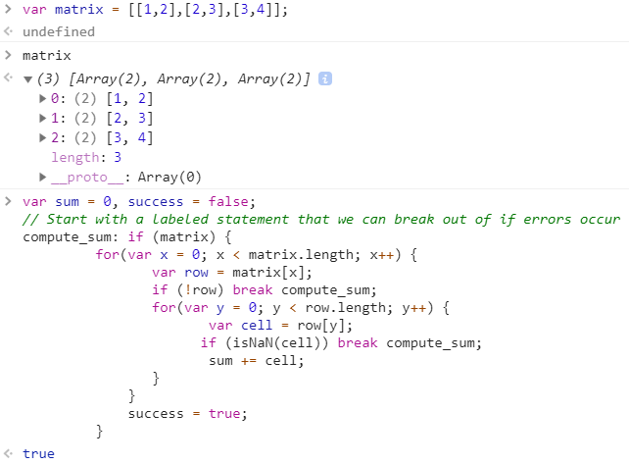

Slide 39
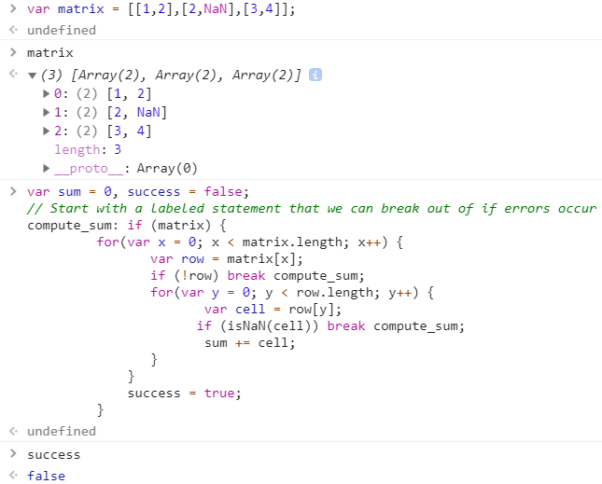

Slide 40
continue
continue:
is similar to the break
continue labelname;
can also be used with a label
It is executed:
the current iteration of the enclosing loop is terminated, and the next iteration begins:
while :
specified expression at the beginning of the loop is tested again,
if it’s true, the loop body is executed starting from the top.
do/while:
execution skips to the bottom of the loop:
Loop condition is tested again before restarting the loop at the top.
For:
increment expression is evaluated, and the test expression is tested again to determine if another iteration should be done.
for/in:
loop starts over with the next property name being assigned to the specified variable.

Slide 41
練習時間
(練習上述操作)

Slide 42

throw
exception is a signal:
indicates some sort of exceptional condition or error has occurred
Exceptions are caught with the try/catch/finally
throw expression;
throw a number that represents an error code or a string:
that contains a human-readable error message
Error class and its subclasses (Error object):
JS throws an error
name: specifies the type of error
message: holds the string passed to the constructor function
function factorial(x) {
// If the input argument is invalid, throw an exception!
if (x < 0) throw new Error("x must not be negative");
// Otherwise, compute a value and return normally
for(var f = 1; x > 1; f *= x, x--) /* empty */ ;
return f;
}

Slide 43
try/catch/finally
is exception handling mechanism.
try:
defines the block of code whose exceptions are to be handled
catch:
try block is followed by a catch clause:
is a block of statements that are invoked when an exception occurs anywhere within the try block.
finally:
catch clause is followed by a finally block:
containing cleanup code:
is guaranteed to be executed,
regardless of what happens in the try block.

Slide 44
try {
// Normally, this code runs from the top of the block to the bottom without problems.
// But it can sometimes throw an exception,
// either directly, with a throw statement,
// or indirectly, by calling a method that throws an exception.
}
catch (e) {
// The statements in this block are executed if, and only if, the try block throws an exception.
// These statements can use the local variable e to refer to the Error object or other value that was thrown.
// This block may handle the exception somehow,
// may ignore the exception by doing nothing, or may rethrow the exception with throw.
}
finally {
// This block contains statements that are always executed, regardless of what happens in the try block.
// They are executed whether the try block terminates:
// 1) normally, after reaching the bottom of the block
// 2) because of a break, continue, or return statement
// 3) with an exception that is handled by a catch clause above
// 4) with an uncaught exception that is still propagating
}

Slide 45
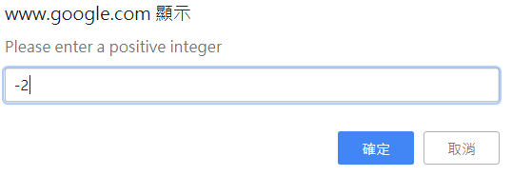
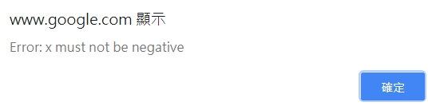
function factorial(x) {
// If the input argument is invalid, throw an exception!
if (x < 0) throw new Error("x must not be negative");
// Otherwise, compute a value and return normally
for(var f = 1; x > 1; f *= x, x--) /* empty */ ;
return f;
}
try {
// Ask the user to enter a number
var n = Number(prompt("Please enter a positive integer", ""));
// Compute the factorial of the number, assuming the input is valid
var f = factorial(n);
// Display the result
alert(n + "! = " + f);
}
catch (ex) { // If the user's input was not valid, we end up here
alert(ex); // Tell the user what the error is
}
client-side JS methods prompt() and alert() for input and output:

Slide 46
finally
Finally:
is guaranteed to be executed if any portion of the try block is executed,
regardless of how the code in the try block completes.
It is generally used to clean up after the code in the try clause.
If to left the try block because of a return, continue, or break:
finally block is executed before to jumps to its new destination
exception occurs in try:
catch handles exception→ finally block
no local catch → finally block
if a finally throws an exception:
it replaces any exception that was in the process of being thrown.
try and finally can be used together without a catch.
can’t completely simulate for with a while:
because continue statement behaves differently for the two loops
// use try/finally to Simulate for( initialize ; test ; increment ) body;
initialize ;
while( test ) {
try { body ; }
finally { increment ; }
}

Slide 47
with
It is used to temporarily extend the scope chain:
with (object)
statement
adds object to the front of the scope chain, executes statement,
then restores the scope chain to its original state.
avoid using it whenever possible:
forbidden in strict mode & considered deprecated in non-strict mode:
with is difficult to optimize and is likely to run more slowly
document.forms[0].address.value
//skip the document.forms[0]
with(document.forms[0]) {
// Access form elements directly here. For example:
name.value = "";
address.value = "";
email.value = "";
}
var f = document.forms[0];
f.name.value = "";
f.address.value = "";
f.email.value = "";
to avoid the with→

Slide 48
“use strict”
The strict mode of ES 5 is a restricted subset of the language:
fixes a few important language deficiencies
provides stronger error checking and increased security
The differences between strict mode and non-strict mode:
The with statement is not allowed in strict mode.
In strict mode: (details at book page 111)
all variables must be declared (a ReferenceError is thrown, otherwise)
functions invoked as functions (rather than as methods) have a this value of undefined:
used to determine whether an implementation supports strict mode
var hasStrictMode = (function() { "use strict"; return this===undefined}());
assignments to nonwritable properties and attempts to create new properties on nonextensible objects throw a TypeError.
code passed to eval() cannot declare variables or define functions in the caller's scope as it can in non-strict mode.
the arguments object in a function holds a static copy of the values passed to the function.
a SyntaxError is thrown if the delete operator is followed by an unqualified identifier such as a variable, function, or function parameter.
an attempt to delete a nonconfigurable property throws a TypeError.
it is a syntax error for an object literal to define two or more properties by the same name.
it is a syntax error for a function declaration to have two or more parameters with the same name.

Slide 49
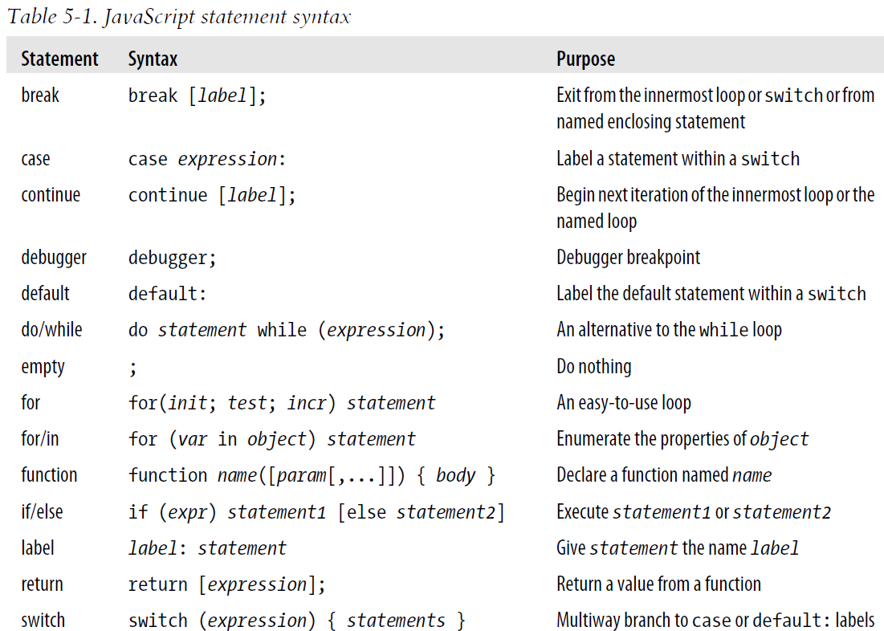
Summary of JavaScript Statements

Slide 50

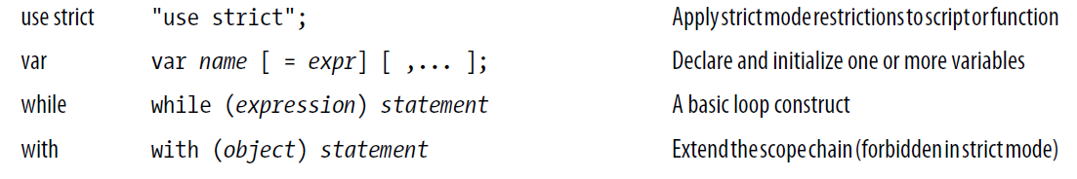
Summary of JavaScript Statements

Slide 51
練習時間
(練習上述操作)

Slide 52
THE END
Q&A

