Slide 1
JavaScript程式設計 (JavaScript Programming)
109 學年度 第 1 學期
蘇俊銘(Jun-Ming Su)
jmsu@mail.nutn.edu.tw
數位學習科技學系, 國立台南大學
2020

Slide 2
CH 8 (CH3-Eloquent) Function
A function is a block of JS code:
defined once but may be executed,
or invoked, any number of times

Slide 3
Defining a function
const square = function(x) {
return x * x;
};
console.log(square(12)); // → 144
const stands for constant: (值不變)
defines a constant binding:
points at the same value for as long as it lives.
const power = function(base, exponent) {
let result = 1;
for (let count = 0; count < exponent; count++) {
result *= base; }
return result; };
console.log(power(2, 10)); // → 1024
const function square(x) {
return x * x; };

Slide 4
Bindings and scopes
Each binding has a scope:
is the part of the program:
in which the binding is visible.
Global binding:
the scope is the whole program:
you can refer to such bindings wherever you want
Local binding:
bindings created for function parameters or declared inside a function can be referenced only in that function
let & const: //let宣告一個「只作用在當前區塊的變數」
are local binding to the block that they are declared in:
create one of those inside of a loop
the code before and after the loop cannot “see” it.
var: (pre-2015 JS, old-style bindings):
are visible throughout the whole function that they appear in—or throughout the global scope:
if they are not in a function.

Slide 5
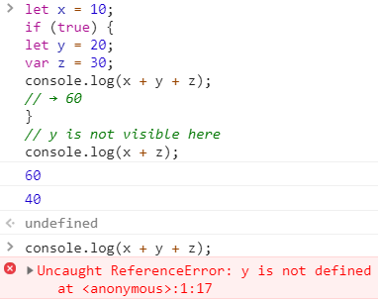
Bindings and scopes
let x = 10;
if (true) {
let y = 20;
var z = 30;
console.log(x + y + z); // → 60
}
// y is not visible here
console.log(x + z); // → 40

Slide 6
Bindings and scopes
When the code inside the halve function refers to n, it is seeing its own n, not the global n.
const halve = function(n) {
return n / 2;
};
let n = 10;
console.log(halve(100)); // → 50
console.log(n); // → 10

Slide 7
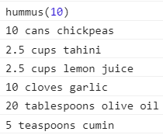
Nested scope
JS distinguishes not just global and local bindings:
Blocks and functions can be created inside other blocks and functions:
to produce multiple degrees of locality.
const hummus = function(factor) { //outer fucntion
const ingredient = function(amount, unit, name) {
let ingredientAmount = amount * factor;
if (ingredientAmount > 1) { unit += "s"; }
console.log(`${ingredientAmount} ${unit} ${name}`);
};
ingredient(1, "can", "chickpeas");
ingredient(0.25, "cup", "tahini");
ingredient(0.25, "cup", "lemon juice");
ingredient(1, "clove", "garlic");
ingredient(2, "tablespoon", "olive oil");
ingredient(0.5, "teaspoon", "cumin");
};
lexical scoping:
each local scope can also see all the local scopes that contain it,
all scopes can see the global scope

Slide 8
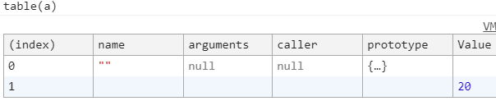
Functions as values
It’s possible to store a function value in a new binding:
pass it as an argument to a function
if not constant (const), be assigned a new value:
let launchMissiles = function() {
missileSystem.launch(“now”); };
let safeMode;
if (safeMode) {
// be assigned a new value
launchMissiles = function() {/* do nothing */}; }
Functions can be assigned to object properties rather than variables:
var o = {square: function(x) { return x*x; }}; // An object literal
var y = o.square(16); // y equals 256
Functions don’t require names at all:
as when they’re assigned to array elements:
var a = [function(x) { return x*x; }, 20]; // An array literal
a[0](a[1]); // => 400

Slide 9
Declaration notation
a slightly shorter way to create a function binding:
function square(x) { return x * x; }
// hoisted: function is defined below the code that uses it
console.log("The future says:", future());
function future() { return "You'll never have flying cars"; }

Slide 10

Arrow functions
a third notation for functions:
an arrow (=>)
expresses like:
“this input (the parameters) produces this result (the body)”.
it were added in 2015:
to write small function expressions in a less verbose way:
EX:
const power = (base, exponent) => {
let result = 1;
for (let count = 0; count < exponent; count++) {
result *= base; }
return result;
};
only one parameter name:
parentheses around the parameter list can be omitted:
const square1 = (x) => { return x * x; };
const square2 = x => x * x;
arrow function has no parameters:
const horn = () => { console.log("Toot"); };

Slide 11
Optional Arguments
following code is allowed and executes without any problem:
function square(x) { return x * x; }
console.log(square(4, true, "hedgehog")); // → 16
JS ignores the extra arguments and computes the square of the first one.
JS is extremely broad-minded about the number of arguments you pass to a function.
If you pass too many, the extra ones are ignored.
If you pass too few, the missing parameters get assigned the value undefined.
this minus function tries to imitate the － operator by acting on either one or two arguments:
function minus(a, b) { if (b === undefined) return -a;
else return a - b; }
console.log(minus(10)); // → -10
console.log(minus(10, 5)); // → 5

Slide 12
練習時間
(練習上述操作)

Slide 13
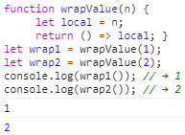

Closure
This combination of a function object and a scope (a set of variable bindings) in which the function’s variables are resolved
The ability to treat functions as values.
What happens to local bindings when the function call that created them is no longer active?
a function, wrapValue:
creates a local binding
It then returns a function that accesses and returns this local binding.
function wrapValue(n) {
let local = n;
return () => local; }
let wrap1 = wrapValue(1);
let wrap2 = wrapValue(2);
console.log(wrap1()); // → 1
console.log(wrap2()); // → 2

Slide 14
closure
a good demonstration of the fact:
local bindings are created anew for every call,
different calls can’t trample on one another’s local bindings.
a closure: (pass by reference)
being able to reference a specific instance of a local binding in an enclosing scope
A function that references bindings from local scopes around it.
This behavior:
frees you from having to worry about lifetimes of bindings
makes it possible to use function values in some creative ways.

Slide 15

closure
to create functions that multiply by an arbitrary amount:
function multiplier(factor) {
return number => number * factor; }
// pass the reference of the local binding of function as value,
// number => number * factor (2);
let twice = multiplier(2);
console.log(twice(5)); // → 10
console.log(twice(5)); // → 10
// number => number * factor (3);
let three = multiplier(3);
console.log(three(5)); // → 15
multiplier is called and creates an environment:
in which its factor parameter is bound to 2
The function value it returns:
which is stored in twice, remembers this environment
when twice is called, it multiplies its argument by 2.
number => number * factor (2);

Slide 16
closure
Try the following case:
function multiplier(factor) {
return number => number * factor * factor; }
let twice = multiplier(2);
console.log(twice(5)); // → ???
//再try
console.log(twice(5)); // → ???
//再try
var twice = multiplier(2);
console.log(twice(5));
console.log(twice(5));
function multiplier(factor) { return number => factor * factor; }
let twice = multiplier(2);
console.log(twice(5)); // → ???

Slide 17
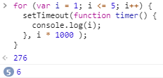
迴圈(loop)與閉包(closure)
實作一個每秒依序印出數字 1, 2, 3, …, 5 的功能:
for (var i = 1; i <= 5; i++) {
setTimeout(function timer() {
console.log(i);
}, i * 1000 );
}
ANS?
https://cythilya.github.io/2018/10/22/closure/

Slide 18
Result
var變數不具區塊範疇特性
當 1 秒、2 秒…5 秒後執行 console.log(i) 時:
就會去取 i 的值:
此時 for 迴圈已跑完:
i 變成 6，因此就會每隔一秒印出一個「6」

Slide 19
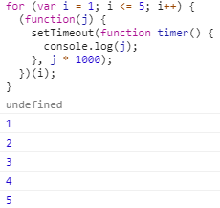
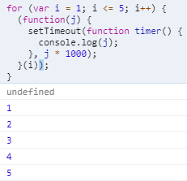
Solution 1: using IILF
可使用 IIFE 加入[新的範疇(Scope)]修改:
即為每次迭代都建立一個新的函式範疇
for (var i = 1; i <= 5; i++) {
(function(j) {
setTimeout(function timer() {
console.log(j);
}, j * 1000);
})(i); //OR => (function(j){…}(i))
}
https://cythilya.github.io/2018/10/22/closure/

Slide 20
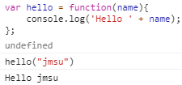
IILF(立即(執行)函式)
Immediately Invoked Functions Expressions (IIFE):
可立即執行的Functions Expressions函式表示式
var hello = function(name){
console.log('Hello ' + name);
};
hello(“jmsu”);
https://ithelp.ithome.com.tw/articles/10193313

Slide 21

IILF(立即(執行)函式)
若把hello()這句刪掉
var hello = function(name){
console.log('Hello ' + name);
}("jmsu");
電腦在函式表示式後面讀到():
知道要立刻呼叫這個函式，
這種立刻執行的函式寫法就稱為IIFE。
https://ithelp.ithome.com.tw/articles/10193313

Slide 22
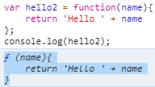

一般的函式表示式:
var hello2 = function(name){
return 'Hello ' + name
};
console.log(hello2);
沒有()表示立即執行:
故console.log印出hello2時:
是印出hello2指向的函式
IIFE方式:
var hello2 = function(name){
return 'Hello ' + name
}('jmsu');
console.log(hello2)
有()表示立即執行:
當console.log印出hello2時:
是印出hello2指向函式立即執行的結果值。
https://ithelp.ithome.com.tw/articles/10193313

Slide 23

var hello2 = function(name){ return 'Hello ' + name }('jmsu');
console.log(hello2());
寫成hello2():
乍看指向立即執行函式:
但其實可視為指向立即執行函式的[返回值Hello jmsu]:
console.log()的hello2後面多加一個():
會往return回傳的'Hello ' + name去找函式:
現在'Hello ' + name是字串Hello jmsu，並不是函式
https://ithelp.ithome.com.tw/articles/10193313

Slide 24

不用變數指著IIFE，這種寫法可否?
function(name){
console.log(‘大家最愛’ + name)
}('JMSU');
沒有變數指向它(不是Functions Expressions)
也沒有名子(不是Function Statement):
所以語法解析器認為這段程式寫錯了
https://ithelp.ithome.com.tw/articles/10193313

Slide 25


解法: 最外面再用一個()把它包起來
(function(name){
console.log('大家最愛' + name)
}('JMSU'));
這就是IIFE:
最常在JS框架、套件看到的寫法。
() :要放在裡面或外面都可以:
(function(name){
console.log('大家最愛' + name)
})('JMSU');
https://ithelp.ithome.com.tw/articles/10193313

Slide 26

設定IIFE: 確保不會汙染到全域環境的變數。
var seafood = '龍蝦';
(function(name){
var seafood = '帝王蟹';
console.log(name + '要吃' + seafood);
}(' jmsu’));
不少JS框架、套件的開頭與結尾被()包住:
程式碼被立即函式包著:
其目的是怕污染到使用者(開發者)的全域環境
https://ithelp.ithome.com.tw/articles/10193313

Slide 27
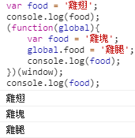
若全域和IIFE內有重複變數名， 框架、套件該如何取用全域的變數呢？
var food = '雞翅';
console.log(food);
(function(global){
var food = '雞塊';
global.food = '雞腿';
console.log(food);
})(window);
console.log(food);
https://ithelp.ithome.com.tw/articles/10193313

Slide 28
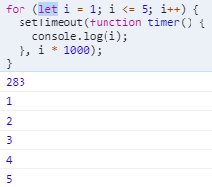
Solution 2: using let
為每次迭代建立區塊範疇，更好的解法:
使用 let:
let 會在每次迭代時重新宣告變數 i，
並將上一次迭代的結果作為這一次的初始值
for (let i = 1; i <= 5; i++) {
setTimeout(function timer() {
console.log(i);
}, i * 1000);
}
https://cythilya.github.io/2018/10/22/closure/

Slide 29
模組模式(Module Pattern) & Closure
利用函數的「閉包(closure)」特性來避免汙染全域的問題:
使用閉包(closure)來提供[封裝]的功能
將[方法]和[變數]限制在一個範圍內存取與使用:
好處:
除了避免汙染全域外，也將實作隱藏起來:
只提供公開的介面(public API)供其他地方使用
簡單易懂。
JS無熟知的private、protected和public語法可用:
靠函數的作用域，即「閉包(closure)」來實作。
http://cythilya.blogspot.com/2015/06/javascript-module-pattern.html#more

Slide 30
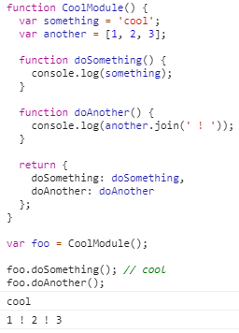
Module Pattern範例: 一般型寫法
function CoolModule() {
var something = 'cool';
var another = [1, 2, 3];
function doSomething() {
console.log(something);
}
function doAnother() {
console.log(another.join(' ! '));
}
return {
doSomething: doSomething,
doAnother: doAnother
};
}
var foo = CoolModule();
foo.doSomething(); // cool
foo.doAnother(); // 1 ! 2 ! 3
https://cythilya.github.io/2018/10/22/closure/

Slide 31
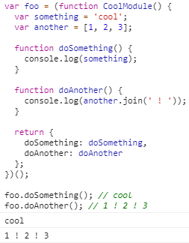
MP範例-Singleton + IIFE
用於只想要產生[單一實體](Singleton)時。
var foo = (function CoolModule() {
var something = 'cool';
var another = [1, 2, 3];
function doSomething() {
console.log(something);
}
function doAnother() {
console.log(another.join(' ! '));
}
return {
doSomething: doSomething,
doAnother: doAnother
};
})();
foo.doSomething(); // cool
foo.doAnother(); // 1 ! 2 ! 3

Slide 32
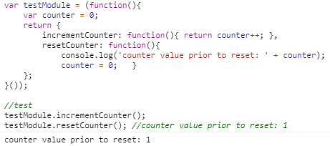
MP範例-Singleton + IIFE
變數counter是個private變數:
無法被function外的其他地方任意存取，
僅能由公開方法incrementCounter 和 resetCounter取用。
function最後會return一個物件:
此物件即是公開出去的API:
讓程式的其他區域可以與之互動。
這就是利用函數的閉包特性來達成的。
var testModule = (function(){
var counter = 0;
return {
incrementCounter: function(){ return counter++; },
resetCounter: function(){
console.log('counter value prior to reset: ' + counter);
counter = 0; }
};
}());
//test
testModule.incrementCounter();
testModule.resetCounter(); //counter value prior to reset: 1

Slide 33
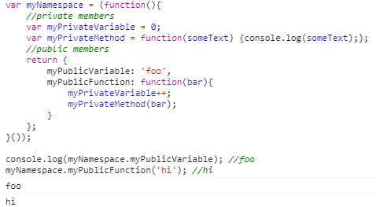
var myNamespace = (function(){
//private members
var myPrivateVariable = 0;
var myPrivateMethod = function(someText) {console.log(someText);};
//public members
return {
myPublicVariable: 'foo',
myPublicFunction: function(bar){
myPrivateVariable++;
myPrivateMethod(bar);
}
};
}());
console.log(myNamespace.myPublicVariable); //foo
myNamespace.myPublicFunction('hi'); //hi

Slide 34
JS Singleton 單體模式
同一個 class 只能建立唯一一個實體物件(instance):
當第二次使用同一個 class 建立新物件的時候:
會得到和第一次建立時同一個物件。
一般當利用同一個 class 建立實體物件時:
每次建立得到的物件都會是不同的
var obj = {
myProp: 'myValue'
};
var obj2 = {
myProp: 'myValue'
};
console.log(obj === obj2); // false
console.log(obj == obj2); // false
預期 Singleton 效果
function Universe() {
// no-op
}
var uni = new Universe();
var uni2 = new Universe();
console.log(uni === uni2); // true
https://cythilya.github.io/2015/06/26/javascript-design-pattern-singleton/

Slide 35
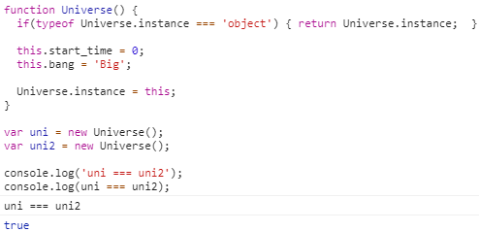
方法1:儲存在靜態屬性中的實體
將快取建立在建構式的靜態屬性中(Instance in a Static Property):
建立類似Universe.instance的屬性，將物件實體儲存於此。
缺點: 是 instance 屬性可被 public 存取，可能會被修改，失去應有正確性。
function Universe() {
if(typeof Universe.instance === 'object') { return Universe.instance; }
this.start_time = 0;
this.bang = 'Big';
//如無，建立新物件，存在Universe.instance裡
Universe.instance = this;
}
var uni = new Universe();
var uni2 = new Universe();
console.log('uni === uni2');
console.log(uni === uni2); // true
// 公開屬性，被修改了...
Universe.instance = null;
var uni3 = new Universe();
console.log(uni === uni3); // false

Slide 36
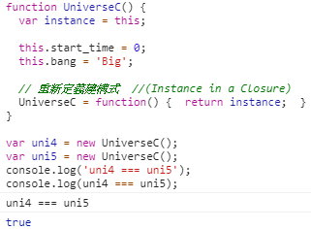
方法2:儲存在 Closure 中的實體
將實體包在 closure 裡(Instance in a Closure):
保持為 private狀態，無法在建構式之外被修改:
就能保證為唯一
缺點: 重新定義的函式會失去在重新定義後加上去的屬性
function UniverseC() {
var instance = this;
this.start_time = 0;
this.bang = 'Big';
// 重新定義建構式 //(Instance in a Closure)
UniverseC = function() { return instance; }
}
var uni4 = new UniverseC();
var uni5 = new UniverseC();
console.log('uni4 === uni5');
console.log(uni4 === uni5); // true
失去在重新定義後加上去的屬性
UniverseC.prototype.inEverything = true;
var uni6 = new UniverseC();
console.log(uni6.inEverything); // undefined

Slide 37
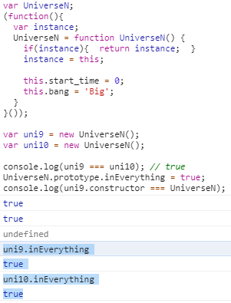
解法:用立即函式(IIFE)包住建構式和實體
第一次呼叫時:建立一個 private 物件並回傳；
第二次之後呼叫:只回傳這份 private 物件。
var UniverseN;
(function(){
var instance;
UniverseN = function UniverseN() {
if(instance){ return instance; }
instance = this;
this.start_time = 0;
this.bang = 'Big';
}
}());
var uni9 = new UniverseN();
var uni10 = new UniverseN();
console.log(uni9 === uni10); // true
UniverseN.prototype.inEverything = true;
console.log(uni9.constructor === UniverseN); // true
https://cythilya.github.io/2015/06/26/javascript-design-pattern-singleton/

Slide 38

recursive
A function that calls itself:
function power(base, exponent) {
if (exponent == 0) { return 1;}
else { return base * power(base, exponent - 1); }
}
console.log(power(2, 3)); // → 8
Consider this puzzle:
starting from number 1 and repeatedly either adding 5 or multiplying by 3:
an infinite set of numbers can be produced.
function findSolution(target) {
function find(current, history) {
if (current == target) { return history; }
else if (current > target) { return null;}
else {
return find(current + 5, `(${history} + 5)`) || find(current * 3, `(${history} * 3)`);
}
}
return find(1, "1");
}
console.log(findSolution(24)); // → (((1 * 3) + 5) * 3)

Slide 39
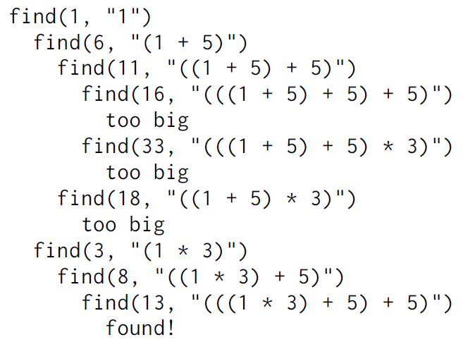
how this function produces the effect we’re looking for
when searching for a solution for the number 13:
console.log(findSolution(24)); // → (((1 * 3) + 5) * 5)

Slide 40

Growing functions
How difficult it is to find a good name for a function:
is a good indication of how clear a concept:
it is that you’re trying to wrap.
a program that prints two numbers:
the numbers of cows and chickens on a farm:
007 Cows
011 Chickens
function printFarmInventory(cows, chickens) {
let cowString = String(cows);
while (cowString.length < 3) { cowString = "0" + cowString; }
console.log(`${cowString} Cows`);
let chickenString = String(chickens);
while (chickenString.length < 3) { chickenString = "0" + chickenString; }
console.log(`${chickenString} Chickens`);
}
printFarmInventory(7, 11);

Slide 41

a Version with ‘pig’
function printZeroPaddedWithLabel(number, label) {
let numberString = String(number);
while (numberString.length < 3) {
numberString = "0" + numberString; }
console.log(`${numberString} ${label}`);
}
function printFarmInventory(cows, chickens, pigs) {
printZeroPaddedWithLabel(cows, "Cows");
printZeroPaddedWithLabel(chickens, "Chickens");
printZeroPaddedWithLabel(pigs, "Pigs");
}
printFarmInventory(7, 11, 3);

Slide 42

Better version
Function name, printZeroPaddedWithLabel,
is a little awkward.
It conflates three things—printing, zero-padding, and adding a label—into a single function
zeroPad() makes it easier for someone who reads the code to figure out what it does:
function zeroPad(number, width) {
let string = String(number);
while (string.length < width) { string = “0” + string; }
return string;
}
function printFarmInventory(cows, chickens, pigs) {
console.log(`${zeroPad(cows, 3)} Cows`);
console.log(`${zeroPad(chickens, 3)} Chickens`);
console.log(`${zeroPad(pigs, 3)} Pigs`);
}
printFarmInventory(7, 16, 3);

Slide 43
summary
// Define f to hold a function value
const f = function(a) {
console.log(a + 2);
};
// Declare g to be a function
function g(a, b) {
return a * b * 3.5;
}
// A less verbose function value
let h = a => a % 3; //= let h = (a) => a % 3;
h(20) //=> 2

Slide 44
練習時間
(練習上述操作)

Slide 45
CH5 Eloquent (CH8.8.2) Higher-order functions

Slide 46
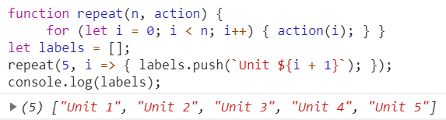
Abstracting repetition
abstract “doing something N times” as a function?
function repeatLog(n) {
for (let i = 0; i < n; i++) { console.log(i); } }
we can pass our action as a function value:
function repeat(n, action) {
for (let i = 0; i < n; i++) { action(i); } }
repeat(3, console.log); // → 0 // → 1 // → 2
we don’t have to pass a predefined function to repeat:
let labels = [];
repeat(5, i => { labels.push(`Unit ${i + 1}`); });
console.log(labels);
// → ["Unit 1", "Unit 2", "Unit 3", "Unit 4", "Unit 5"]
//the body is now written as a function value
is wrapped in the parentheses of the call to repeat.

Slide 47

Higher-order functions
Functions that operate on other functions:
either by taking them as arguments
or by returning them
It allow us to abstract over actions, not just values:
function greaterThan(n) { return m => m > n; }
let greaterThan10 = greaterThan(10); //=> m>10 // closure
console.log(greaterThan10(11)); // → true
...args
rest parameter syntax allows us:
to represent an indefinite number of arguments as an array.
function sum(...theArgs) {
return theArgs.reduce((previous, current) => {
return previous + current;
} );
}
console.log(sum(1, 2, 3)); //=> 6, like [1,2,3].theArgs.reduce(…)
console.log(sum(1, 2, 3, 4)); //=> 10 , like [1,2,3,4].theArgs.reduce(…)

Slide 48
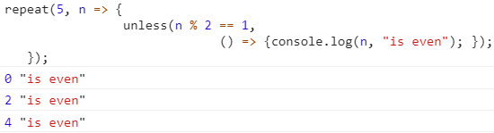
Higher-order functions
write functions that provide new types of control flow (Recursive):
function unless(test, then) {
// if even, then() => {console.log(n, "is even");
if (!test) then(); }
repeat(3, n => {
unless(n % 2 == 1,
() => {console.log(n, "is even"); });
});
// → 0 is even
// → 2 is even
forEach():
a built-in array method,
like a for/of loop as a higher-order function.
["A", "B"].forEach(l => console.log(l));
// → A
// → B
function repeat(n, action) {
for (let i = 0; i < n; i++) { action(i); } }

Slide 49
Higher-order functions
for...of statement:
creates a loop iterating over iterable objects:
built-in String, Array, Array-like objects (e.g., arguments or NodeList), TypedArray, Map, Set, and user-defined iterables
let iterable = [10, 20, 30];
for (let value of iterable) { value += 1; console.log(value); }
// 11
// 21
// 31
use const instead of let too:
if you don't reassign the variable inside the block.
let iterable = [10, 20, 30];
for (const value of iterable) { console.log(value);}
// 10
// 20
// 30

Slide 50
SCRIPTS data https://eloquentjavascript.net/code/scripts.js
var SCRIPTS = [
{
name: "Adlam",
ranges: [[125184, 125259], [125264, 125274], [125278, 125280]],
direction: "rtl",
year: 1987,
living: true,
link: "https://en.wikipedia.org/wiki/Fula_alphabets#Adlam_alphabet"
},
{
name: "Caucasian Albanian",
ranges: [[66864, 66916], [66927, 66928]],
direction: "ltr",
year: 420,
living: false,
link: "https://en.wikipedia.org/wiki/Caucasian_Albanian_alphabet"
},
{
name: "Ahom",
ranges: [[71424, 71450], [71453, 71468], [71472, 71488]],
direction: "ltr",
year: 1250,
living: true,
link: "https://en.wikipedia.org/wiki/Ahom_alphabet"
}];

Slide 51
SCRIPTS.html https://eloquentjavascript.net/code/scripts.js
<!DOCTYPE html>
<html>
<body>
<script src="https://eloquentjavascript.net/code/scripts.js">
</script>
</body>
</html>

Slide 52

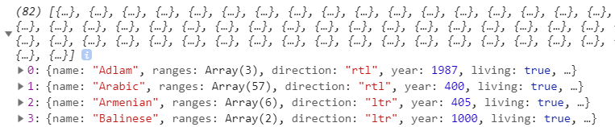
Filtering arrays
It filters out the elements in an array that don’t pass a test.
Like forEach, filter() is a standard array method.
function filter(array, test) {
let passed = [];
for (let element of array) {
if (test(element)) { passed.push(element);}
}
return passed;
}
console.log(filter(SCRIPTS, script => script.living));
// → [{name: "Adlam", …}, …]
use SCRIPTS.html

Slide 53
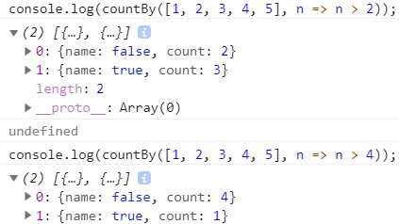
Recognizing text
findIndex() : Array.prototype.findIndex()
依據提供的測試函式，尋找陣列中符合的元素，並返回其 index（索引）
IF沒有符合的對象，返回 -1 。
to count the characters that belong to each script:
function countBy(items, groupName) {
let counts = [];
for (let item of items) {
let name = groupName(item);
let known = counts.findIndex(c => c.name == name);
if (known == -1) { counts.push({name, count: 1});}
else { counts[known].count++;}
}
return counts;
}
console.log(countBy([1, 2, 3, 4, 5], n => n > 2));

Slide 54
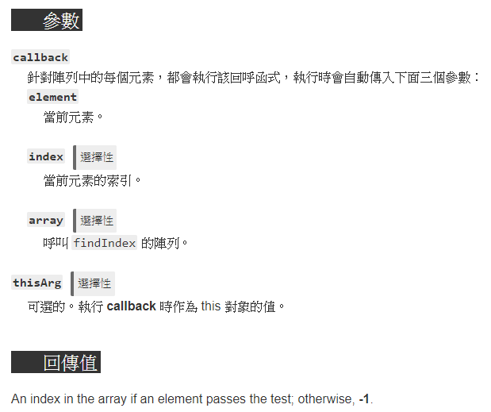
Array.prototype.findIndex()
語法: arr.findIndex(callback[, thisArg])
查找一個陣列中首個質數元素的索引，無則 -1
function isPrime(element, index, array) {
var start = 2;
while (start <= Math.sqrt(element)) {
if (element % start++ < 1) {
return false;
}
}
return element > 1;
}
// -1, not found
console.log([4, 6, 8, 12].findIndex(isPrime));
console.log([4, 6, 7, 12].findIndex(isPrime)); // 2

Slide 55
練習時間
(練習上述操作)

Slide 56
CH6 (eloquent) Class
the class keyword is introduced in ES2015,
but is syntactical sugar,
JavaScript remains prototype-based

Slide 57

Class notation
JS classes are constructor functions with a prototype property (ES6, 2015):
class Rabbit {
constructor(type) { this.type = type;}
speak(line) {
console.log(`The ${this.type} rabbit says ‘${line}’`); }
}
let killerRabbit = new Rabbit("killer");
let blackRabbit = new Rabbit("black");
Like function:
class can be used both in statements and in expressions:
let object = new class { getWord() { return "hello"; } };
console.log(object.getWord()); // → hello
allowed to omit the class name in a class expression.

Slide 58
Overriding derived properties
add a property to an object:
If there was already a property with the same name in the prototype
this property will no longer affect the object
// use previous Rabbit class
Rabbit.prototype.teeth = "small"; // add new property
console.log(killerRabbit.teeth); // → small
//add new property: teeth to killerRabbit object
killerRabbit.teeth = "long, sharp, and bloody";
console.log(killerRabbit.teeth); // → long, sharp, and bloody
console.log(blackRabbit.teeth); // → small
console.log(Rabbit.prototype.teeth); // → small

Slide 59
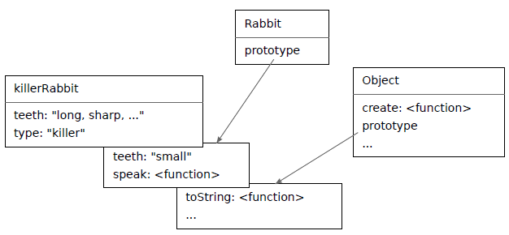
Overriding
Overriding is also used to give the standard function and array prototypes a different toString method than the basic object prototype:
console.log(Array.prototype.toString == Object.prototype.toString); // → false
console.log([1, 2].toString()); // → 1,2

Slide 60
Maps
It is a data structure:
associates values (the keys) with other values.
let ages = { Boris: 39, Liang: 22, Júlia: 62 }; // a object
console.log(`Júlia is ${ages["Júlia"]}`); // → Júlia is 62
console.log("Is Jack's age known?", "Jack" in ages);
// → Is Jack's age known? false
console.log("Is toString's age known?", "toString" in ages);
// → Is toString's age known? True
//a plain objects derive from Object.prototype, the property is there (toString).

Slide 61
Map //not map()
JS comes with a class called Map: (語法: new Map([iterable]) )
that is written for this exact purpose:
let ages = new Map(); //M大寫, 非map
ages.set("Boris", 39);
ages.set("Liang", 22);
ages.set("Júlia", 62);
console.log(`Júlia is ${ages.get("Júlia")}`);
// → Júlia is 62
console.log("Is Jack's age known?", ages.has("Jack"));
// → Is Jack's age known? false
console.log(ages.has("toString"));
// → false
set, get, and has:
are part of the interface of the Map object
hasOwnProperty:
console.log({x: 1}.hasOwnProperty(“x”)); // → true
console.log({x: 1}.hasOwnProperty(“toString”)); // → false

Slide 62
Symbols
Symbols are values created with the Symbol function.
Unlike strings:
newly created symbols are unique:
you cannot create the same symbol twice.
let sym = Symbol("name");
console.log(sym == Symbol("name")); // → false
// unique Symbol
Rabbit.prototype[sym] = 55;
console.log(blackRabbit[sym]); // → 55

Slide 63

The iterator interface
Symbol.iterator:
It has a next method that returns the next result.
That result should be an object with a value property that provides the next value
a done property should be true:
when there are no more results and false otherwise
next, value, & done property names:
are plain strings, not symbols
let okIterator = "OK"[Symbol.iterator]();
console.log(okIterator.next()); // → {value: "O", done: false}
console.log(okIterator.next()); // → {value: "K", done: false}
console.log(okIterator.next()); // → {value: undefined, done: true}

Slide 64
The iterator interface- matrix class
implement an iterable data structure.
build a matrix class, acting as a two-dimensional array.
class Matrix {
constructor(width, height, element = (x, y) => undefined) {
this.width = width;
this.height = height;
this.content = [];
for (let y = 0; y < height; y++) {
for (let x = 0; x < width; x++) {
this.content[y * width + x] = element(x, y); } }
}
get(x, y) { return this.content[y * this.width + x]; }
set(x, y, value) { this.content[y * this.width + x] = value; }
}

Slide 65
class MatrixIterator {
constructor(matrix) {
this.x = 0;
this.y = 0;
this.matrix = matrix;
}
next() {
if (this.y == this.matrix.height) return {done: true};
let value = {x: this.x,
y: this.y,
value: this.matrix.get(this.x, this.y)};
this.x++;
if (this.x == this.matrix.width) { this.x = 0; this.y++; }
return {value, done: false};
}
}

Slide 66
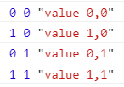
set up the Matrix class to be iterable.
Matrix.prototype[Symbol.iterator] = function() {
return new MatrixIterator(this); };
We can now loop over a matrix with for/of:
let matrix = new Matrix(2, 2, (x, y) => `value ${x},${y}`);
for (let {x, y, value} of matrix) {
console.log(x, y, value);
}
// → 0 0 value 0,0
// → 1 0 value 1,0
// → 0 1 value 0,1
// → 1 1 value 1,1

Slide 67
Inheritance
The prototype for the new class derives from the old prototype but adds a new definition.
extends:
this class shouldn’t be directly based on the default Object prototype but on some other class (called superclass).
The derived class is the subclass.
class SymmetricMatrix extends Matrix { // SymmetricMatrix (derived class)
constructor(size, element = (x, y) => undefined) {
super(size, size, (x, y) => {
if (x < y) return element(y, x);
else return element(x, y);
}); //super keyword is used to access and call functions on an object's parent.
}
set(x, y, value) {
super.set(x, y, value);
if (x != y) { super.set(y, x, value); }
}
}
let matrix = new SymmetricMatrix(5, (x, y) => `${x},${y}`);
console.log(matrix.get(2, 3)); // → 3,2
super([arguments]); // calls the parent constructor.
super.functionOnParent([arguments]);

Slide 68
The instanceof operator
to know whether an object was derived from a specific class.
console.log(
new SymmetricMatrix(2) instanceof SymmetricMatrix);
// → true
console.log(new SymmetricMatrix(2) instanceof Matrix);
// → true
console.log(new Matrix(2, 2) instanceof SymmetricMatrix);
// → false
console.log([1] instanceof Array);
// → true

Slide 69
super keyword
Syntax
super([arguments]); // calls the parent constructor.
super.functionOnParent([arguments]);
Note:
In derived classes,
super() must be called before you can use 'this’:
Leaving this out will cause a reference error.

Slide 70
class Rectangle {
constructor(height, width) {
this.name = 'Rectangle';
this.height = height;
this.width = width;
}
sayName() { console.log('Hi, I am a ', this.name + '.'); }
get area() { return this.height * this.width; }
set area(value) { this.height = this.width = Math.sqrt(value); }
}
class Square extends Rectangle {
constructor(length) {
this.height; // ReferenceError, super needs to be called first!
// Here, it calls the parent class' constructor with lengths
// provided for the Rectangle's width and height
super(length, length);
// Note: In derived classes, super() must be called before you
// can use 'this'. Leaving this out will cause a reference error.
this.name = 'Square';
}
}

Slide 71
Super-calling static methods
class Rectangle {
constructor() {}
static logNbSides() { //取消static會產生access錯誤
return 'I have 4 sides';
}
}
class Square extends Rectangle {
constructor() {}
static logDescription() {//取消static會產生access錯誤
return super.logNbSides() + ' which are all equal';
}
}
Square.logDescription(); // 'I have 4 sides which are all equal'

Slide 72
練習時間
(練習上述操作)

Slide 73
THE END
Q&A

