Slide 1


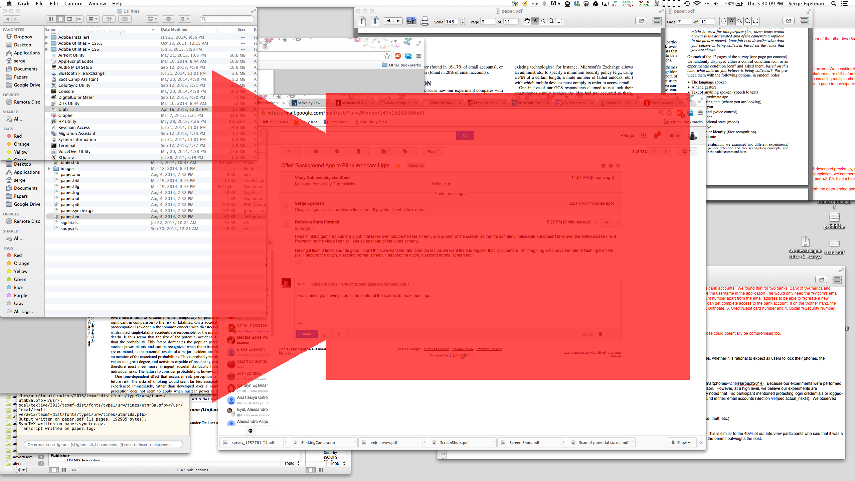
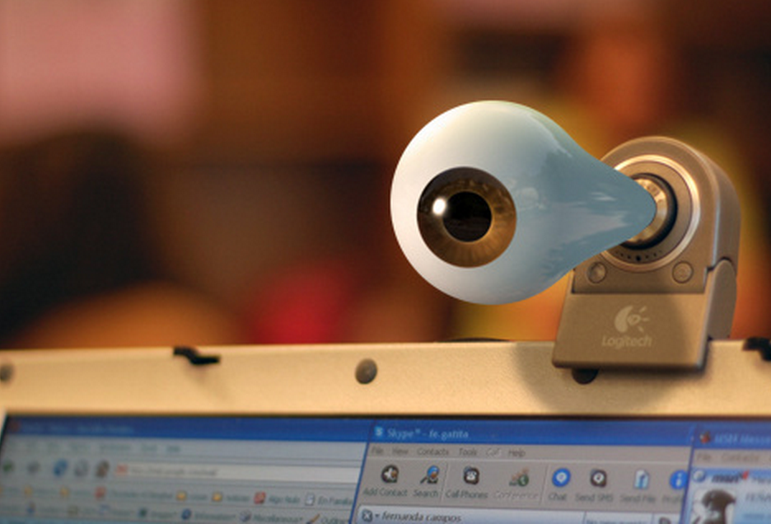
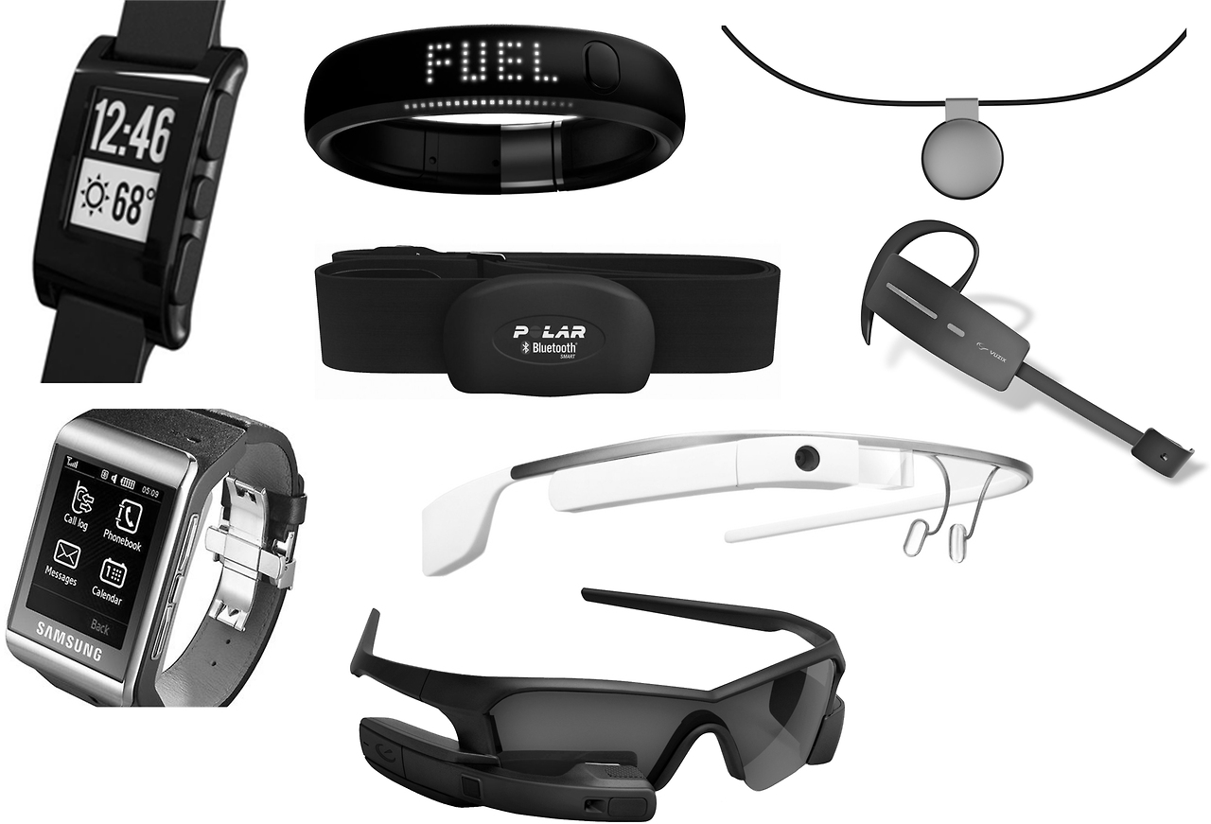
Somebody’s Watching Me?
Rebecca Portnoff, Linda Lee, Serge Egelman, David Wagner
Motivation
We are entering an age of wearable and ubiquitous computing, where more and more consumer devices will be accepting continuous input.
Privacy indicators need to reliably communicate what is accessed and by what application.
Current privacy indicators, such as the webcam LED, are insufficient for informing users of data capture.
Experiments
Mturk Survey of Webcam Awareness and Perceptions
Laboratory Study of Webcam LEDs
Laboratory Study of Mitigations
Results
45% of participants noticed an illuminated webcam LED indicator when performing a computer-based task; 5% noticed during a non-computer based task.
Full screen glyphs significantly increase the likelihood that participants notice the webcam indicator: 93% noticed during a computer task, 59% noticed during a non-computer based task.
My figure
Related Work
Attacks on webcam LEDs
-iSight (Brocker et al.)
Indicators and Warnings
-indicator evaluation, current research
-consequences of poor indicators
Ubiquitous Sensing Privacy Concerns
-even more risks in the future
Our mitigation: a full-screen red camera glyph
My figure
Procedure
Setup at Xlab, 36 laptops in 6 rows, with cubicle walls separating each laptop, staggering used to prevent participants viewing other participants’ laptops.
Participants performed one computer-based task and one non-computer-based task in the proximity of the computer; distraction tasks were used in between.
Image source: http://blog.jammer-store.com/wp-content/uploads/2013/03/Webcam-Spying.jpg
My figure
Demographics
98 participants total at Xlab, in groups <15. 36 Toshiba Terca R850 laptop (blue LED), staggering, survey, tasks, exit survey. 55 female, age (μ = 37.9, σ = 15.4), 30-60 min.
81 participants total, separated into control and experimental. Same setup as 2). 46 female, 37 control, age (μ = 33.7, σ = 13.1), 30-60 min
Conclusion and Discussion
The current webcam LED is not an effective indicator to communicate when the webcam is recording.
Indicators should aim to be more noticeable and understandable.
There are many sophisticated attacks that attackers could use to spy on users.
Image source: http://www.cartwheelit.com/blog/2014/03/06/wearable-tech-wearable/

