Slide 1
Private Network Azure AI Foundry Agent Workshop
Foundry Private Network Agent Workshop Suite
Notes:
State workshop objective in one sentence.

Slide 2
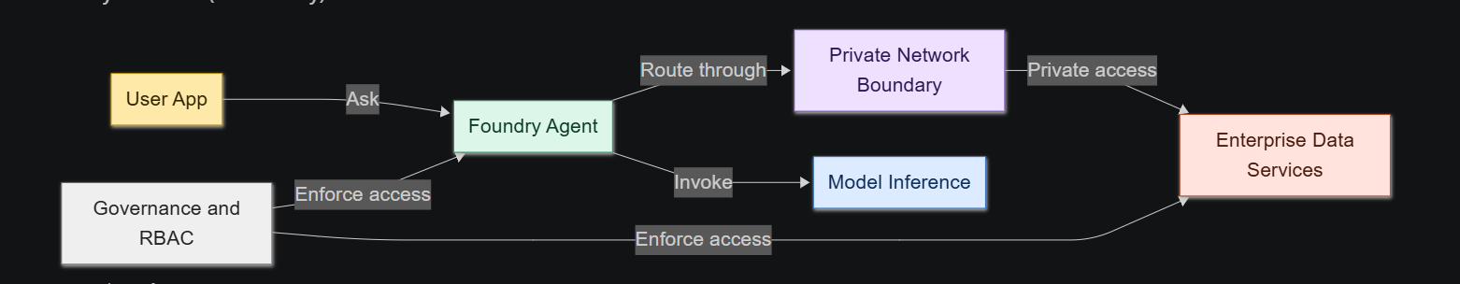
Why Private Network for Agents
Compliance and data boundary requirements
Private endpoint and managed identity patterns
Reduced attack surface
Notes:
Tie to enterprise controls and audit needs.

Slide 3
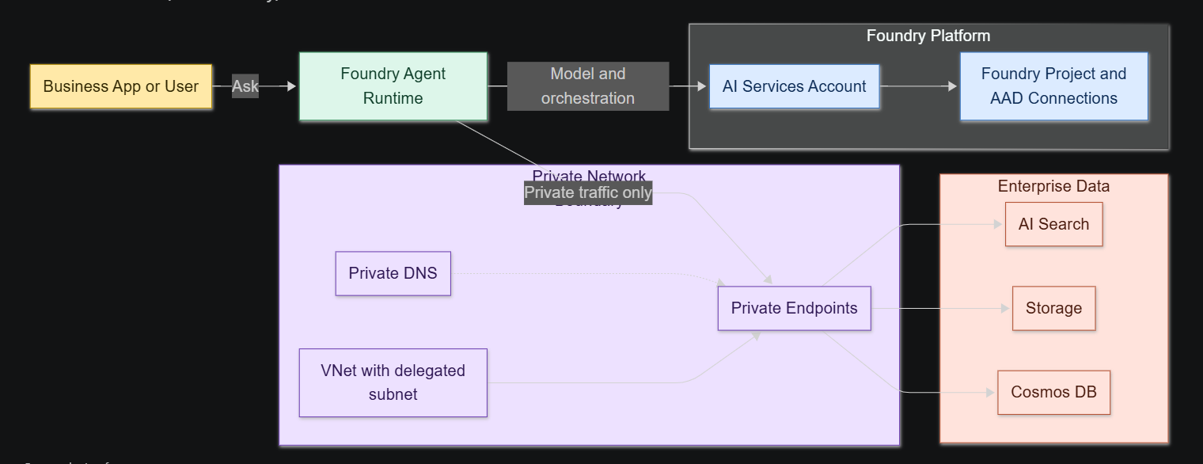
End-State Architecture
VNet with delegated subnet and PE subnet
AI Services account + model deployment
Project capability host linked to Search, Storage, Cosmos
Notes:
Emphasize two capability host levels: account and project.

Slide 4
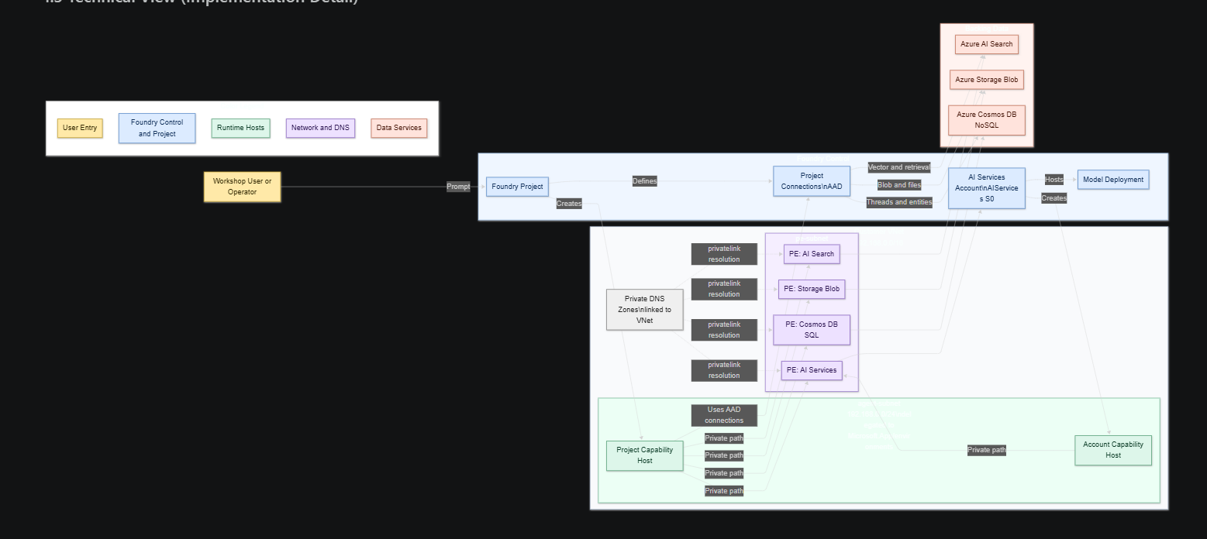
Deployment Flow at a Glance
Ordered sequence from RG to agent test
Highlight critical dependency points
Notes:
Explain why ordering prevents hard-to-debug failures.

Slide 5
Prerequisites and Guardrails
Required roles and permissions
Supported regions and quota checks
CLI and tooling baseline
Notes:
Call out common preflight misses.

Slide 6
Networking Foundation
Address spaces and subnet purposes
Delegation requirement for agent-subnet
Notes:
Stress exclusive subnet use for Microsoft.App environments.

Slide 7
Backing Services Security Posture
Search, Storage, Cosmos DB hardened settings
Public network access disabled
Notes:
Explain why AAD auth is used for project connections.

Slide 8
Creating AI Services Account via REST
Why REST is used (preview API and network injection)
Minimal required payload fields
Notes:
Mention account-level capability host is created from this step.

Slide 9
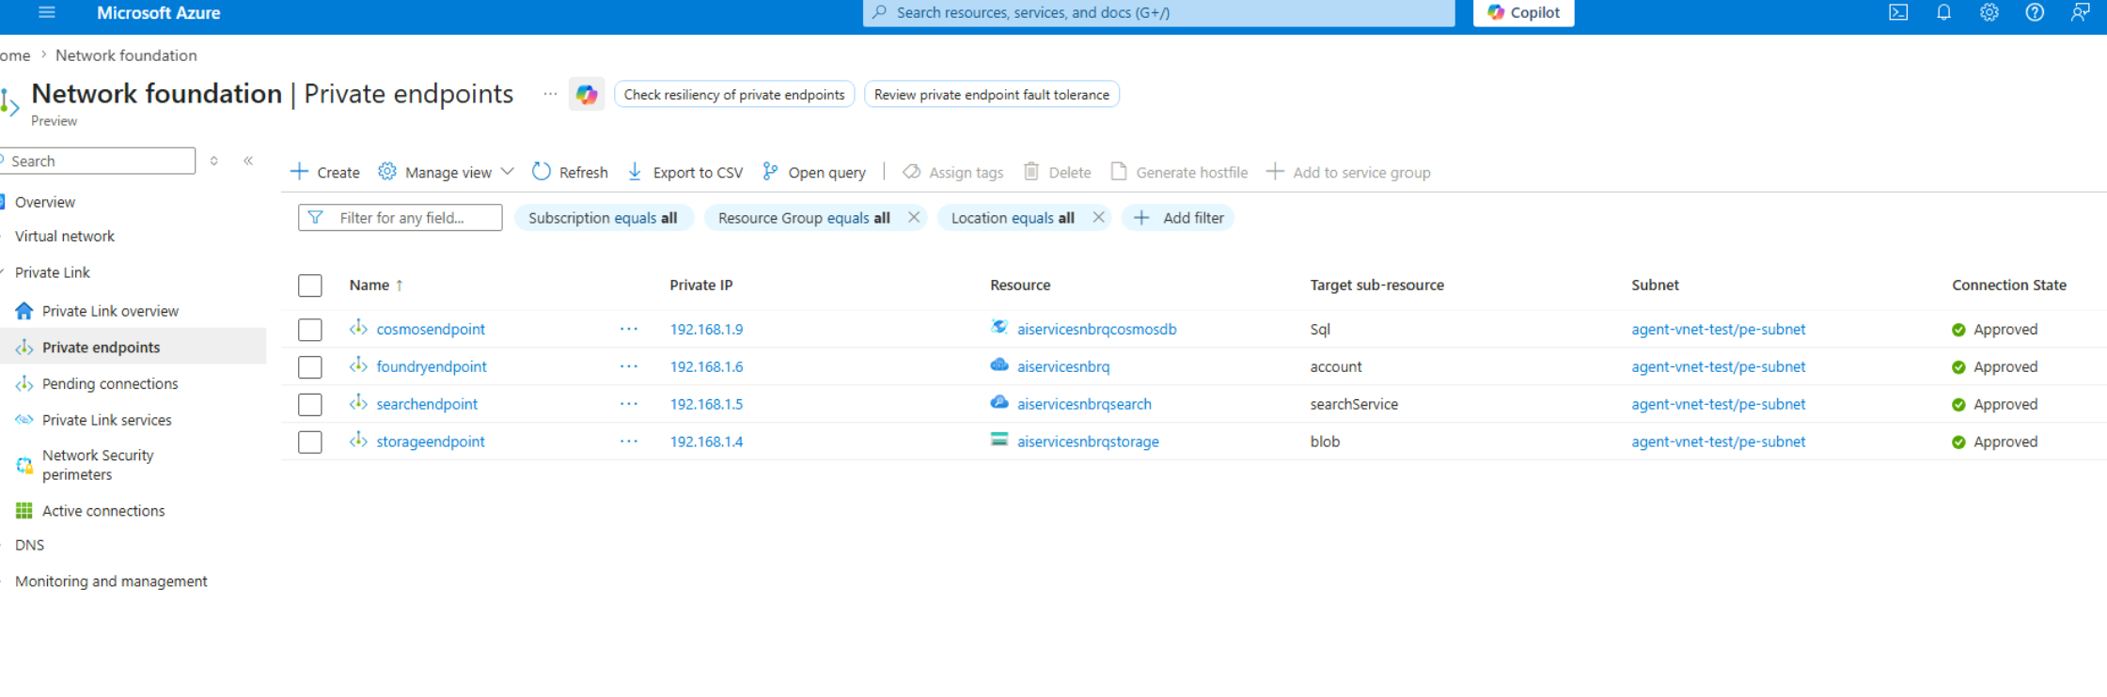
Private Endpoints and Private DNS
Required endpoints and DNS zones
Zone links and A record validation
Notes:
Show how DNS correctness proves private path wiring.

Slide 10
Foundry Project and Connections
Project identity creation
Connection categories and targets
AAD auth-only configuration
Notes:
Reinforce naming consistency for connection mapping.

Slide 11
RBAC Before Capability Host
Storage and Cosmos roles
Search roles
Propagation wait requirement
Notes:
This slide should be treated as non-negotiable gating criteria.

Slide 12
Project Capability Host (Most Critical)
Capability host payload fields
Async operation and polling pattern
Success and failure states
Notes:
Explain failure recovery: fix RBAC, recreate the project capability host.

Slide 13
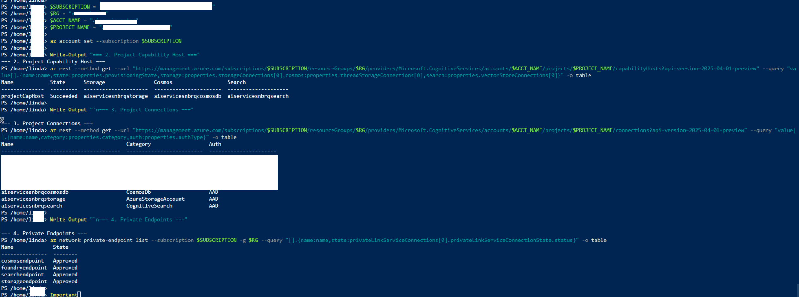
Verification Checklist
Capability host status checks
Connection checks
Private endpoint and DNS checks
Model deployment check
Notes:
Ask teams to capture evidence for each check.

Slide 14
Agent Creation and Tool Validation
Portal access path (inside private network)
Add Search tool from project connection
Run test prompt
Notes:
Point out this is the final proof of end-to-end success.

Slide 15
Troubleshooting Patterns
Invalid endpoint or connection failed
Capability host failed provisioning
Embedding permission denied
Notes:
Map each symptom to likely root cause and fix.

Slide 16
Cleanup and Cost Control
Delete project capability host first
Delete resource group
Notes:
Remind teams not to leave resources running.

Slide 17
Recap and Key Takeaways
What was built
Why sequence and RBAC matter
Next-step options
Notes:
Provide path to production hardening and automation.

Slide 18
Appendix
Command references
API versions used
Role matrix summary
Notes:
Keep appendix in deck for troubleshooting support.

