Slide 1
01 / 13
MGT159 · Advising the ACCC
Does the entry of a Costco gas station
into an Australian local market cause
nearby competitor stations to lower
their retail fuel prices?
A synthetic-control study, advising the Australian Competition and Consumer Commission.
[Speaker 1] · [Speaker 2] · [Speaker 3] · [Speaker 4]
Notes:
Fuel prices are politically charged in Australia, and the ACCC
is the country's competition watchdog. The question we tackle:
when a credible new entrant like Costco opens a gas station,
does it actually pull nearby competitor prices down? We are
[NAMES], and our client is the Australian Competition and
Consumer Commission.

Slide 2
Section 01 of 04
01
THE QUESTION
What we asked and why a regulator should care.

Slide 3
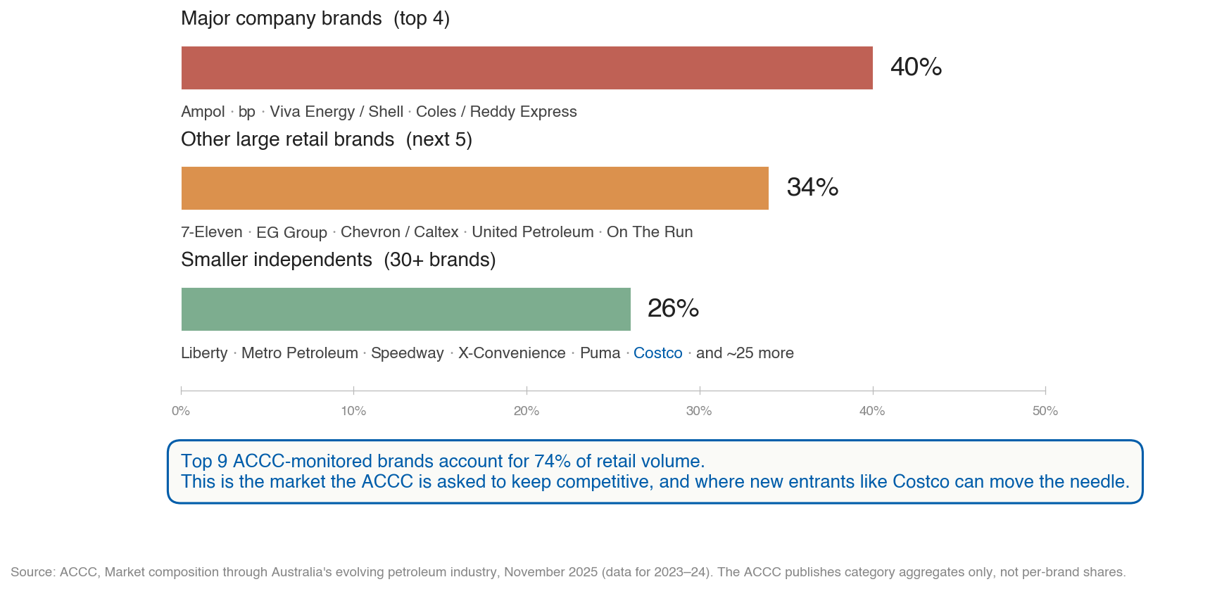
Why this matters
02 / 13
Notes:
Here is the market the ACCC is asked to keep competitive. Four
major brands, Ampol, BP, Viva or Shell, and Coles or Reddy
Express, together control 40 percent of national retail fuel
volume. Five more large retail chains, including 7-Eleven, EG
Group, and Chevron, add another 34 percent. So nine brands
together hold 74 percent of the market. Costco shows up in the
smaller-independents tier, alongside Liberty, Metro, and about
30 other brands. The empirical question becomes: when a
credible new entrant like Costco arrives, does the rest of the
market actually respond? That is what we set out to measure.

Slide 4
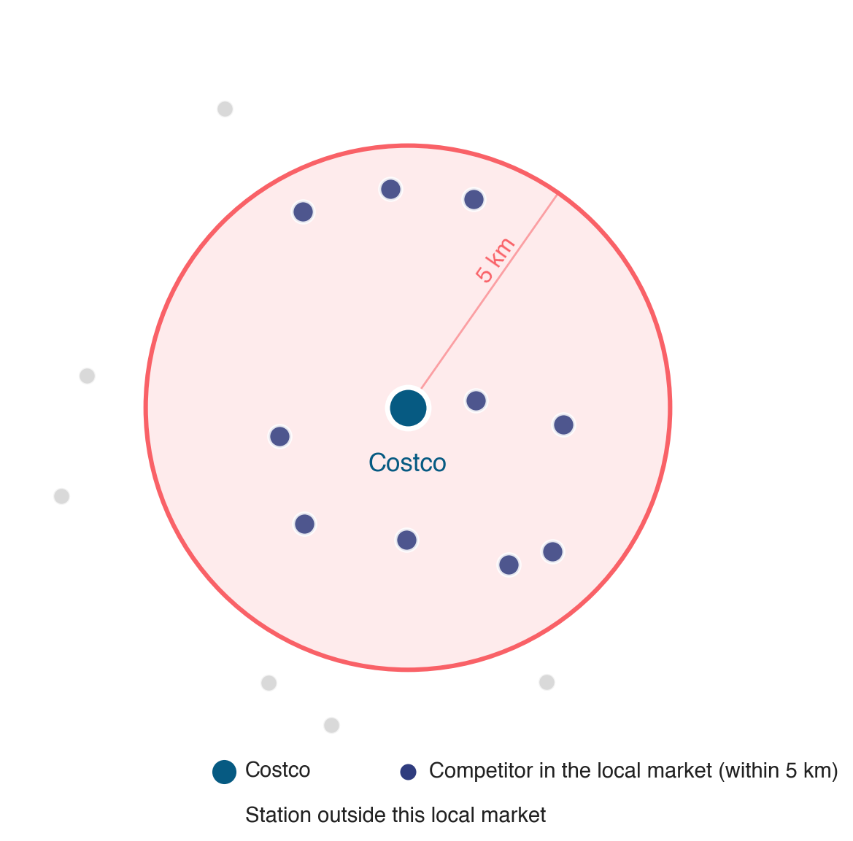
Our causal question
03 / 13
Notes:
To answer that, we needed to nail down what we mean by the
local market. Look at the schematic. The blue dot is the
Costco. Every navy dot inside the 5 kilometer ring is a
competitor we treat as in the market. Anything beyond 5
kilometers is outside. Crucially, the price we track is not
Costco's own. Costco is cheap by design. We are asking whether
everyone else in the ring lowers their prices when Costco
shows up.

Slide 5
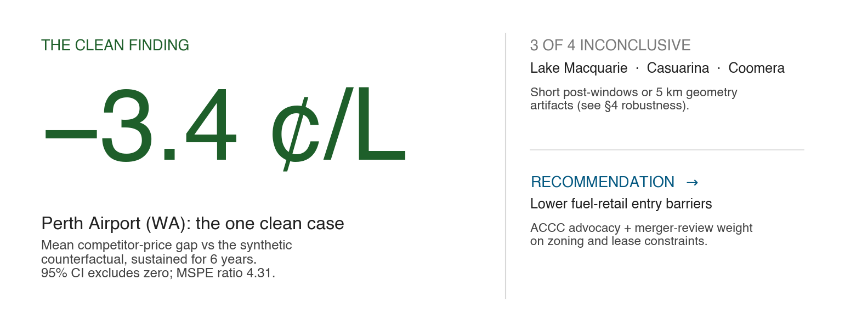
Where we end up
04 / 13
Notes:
Here is where we end up before we walk you through the work.
At Perth Airport in WA, competitor prices ran about 3.4 cents
per litre below their synthetic counterfactual, sustained for
six straight years, with a 95 percent confidence interval that
excludes zero. The other three Costcos we studied were
inconclusive, for reasons we will get into. Based on the Perth
Airport finding, our recommendation to the ACCC is to lower
the zoning and lease barriers that delay big-box fuel entry.
Let us walk you through how we got there.

Slide 6
Section 02 of 04
02
DATA & METHOD
Where the data came from, and how we built the counterfactual.

Slide 7
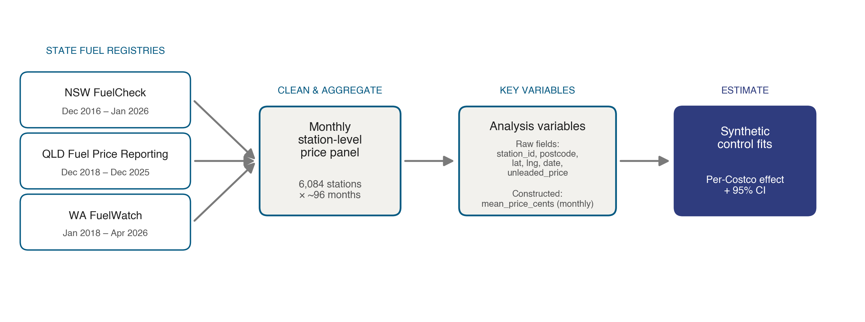
Our data
05 / 13
Notes:
Our data comes from three Australian state fuel registries,
all public. NSW FuelCheck covers December 2016 through January
2026. QLD Fuel Price Reporting covers December 2018 through
December 2025. WA FuelWatch covers January 2018 through April
2026. We clean and aggregate every individual price report
into a monthly station-level panel of 6,084 unique stations
across roughly 96 months. From the raw data we use six fields:
station_id, postcode, latitude, longitude, date, and
unleaded_price. We construct one variable, mean_price_cents,
which is the average unleaded price per station per month.
That panel feeds our synthetic-control estimates.

Slide 8
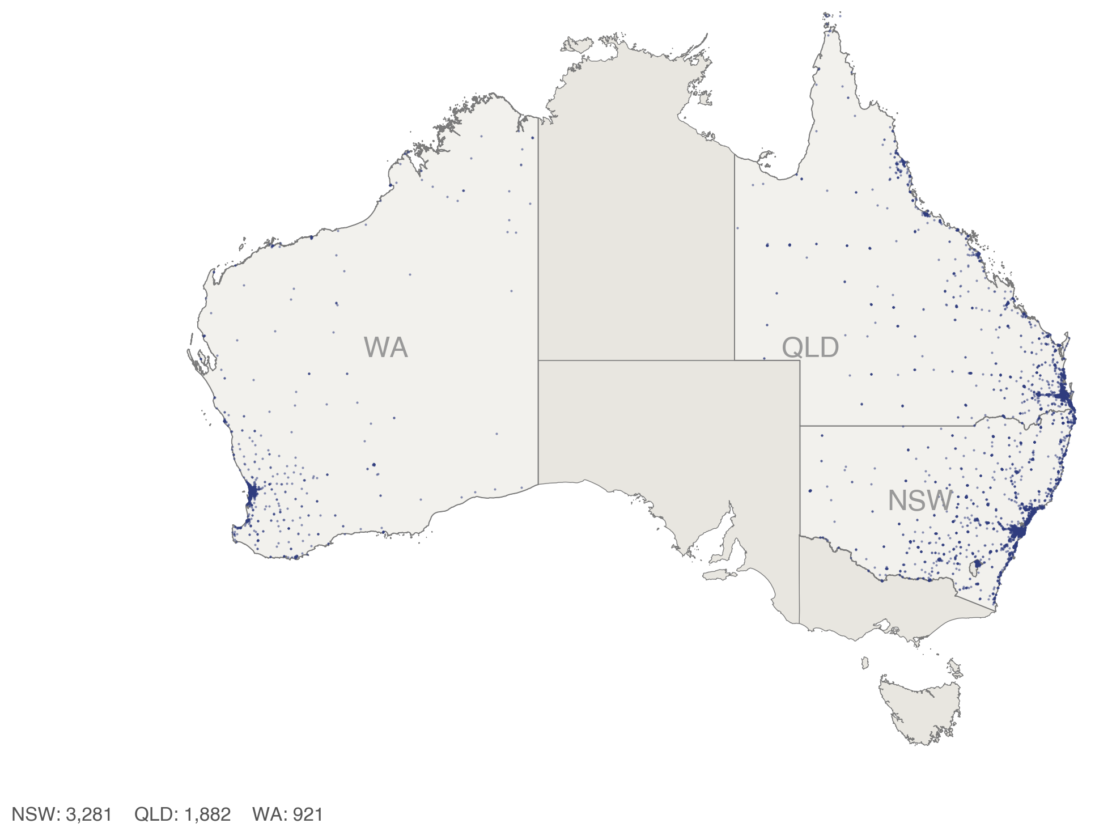
What the data looks like
06 / 13
Notes:
Every dot on this map is one of those 6,084 stations. NSW
gives us 3,281 stations, QLD gives us 1,882, and WA gives us
921. The pattern follows population: stations cluster along
the east coast and around Perth in the southwest, with an
essentially empty interior. That means our donor pool, the
postcodes we build counterfactuals from, naturally concentrates
where Costco lives too.

Slide 9
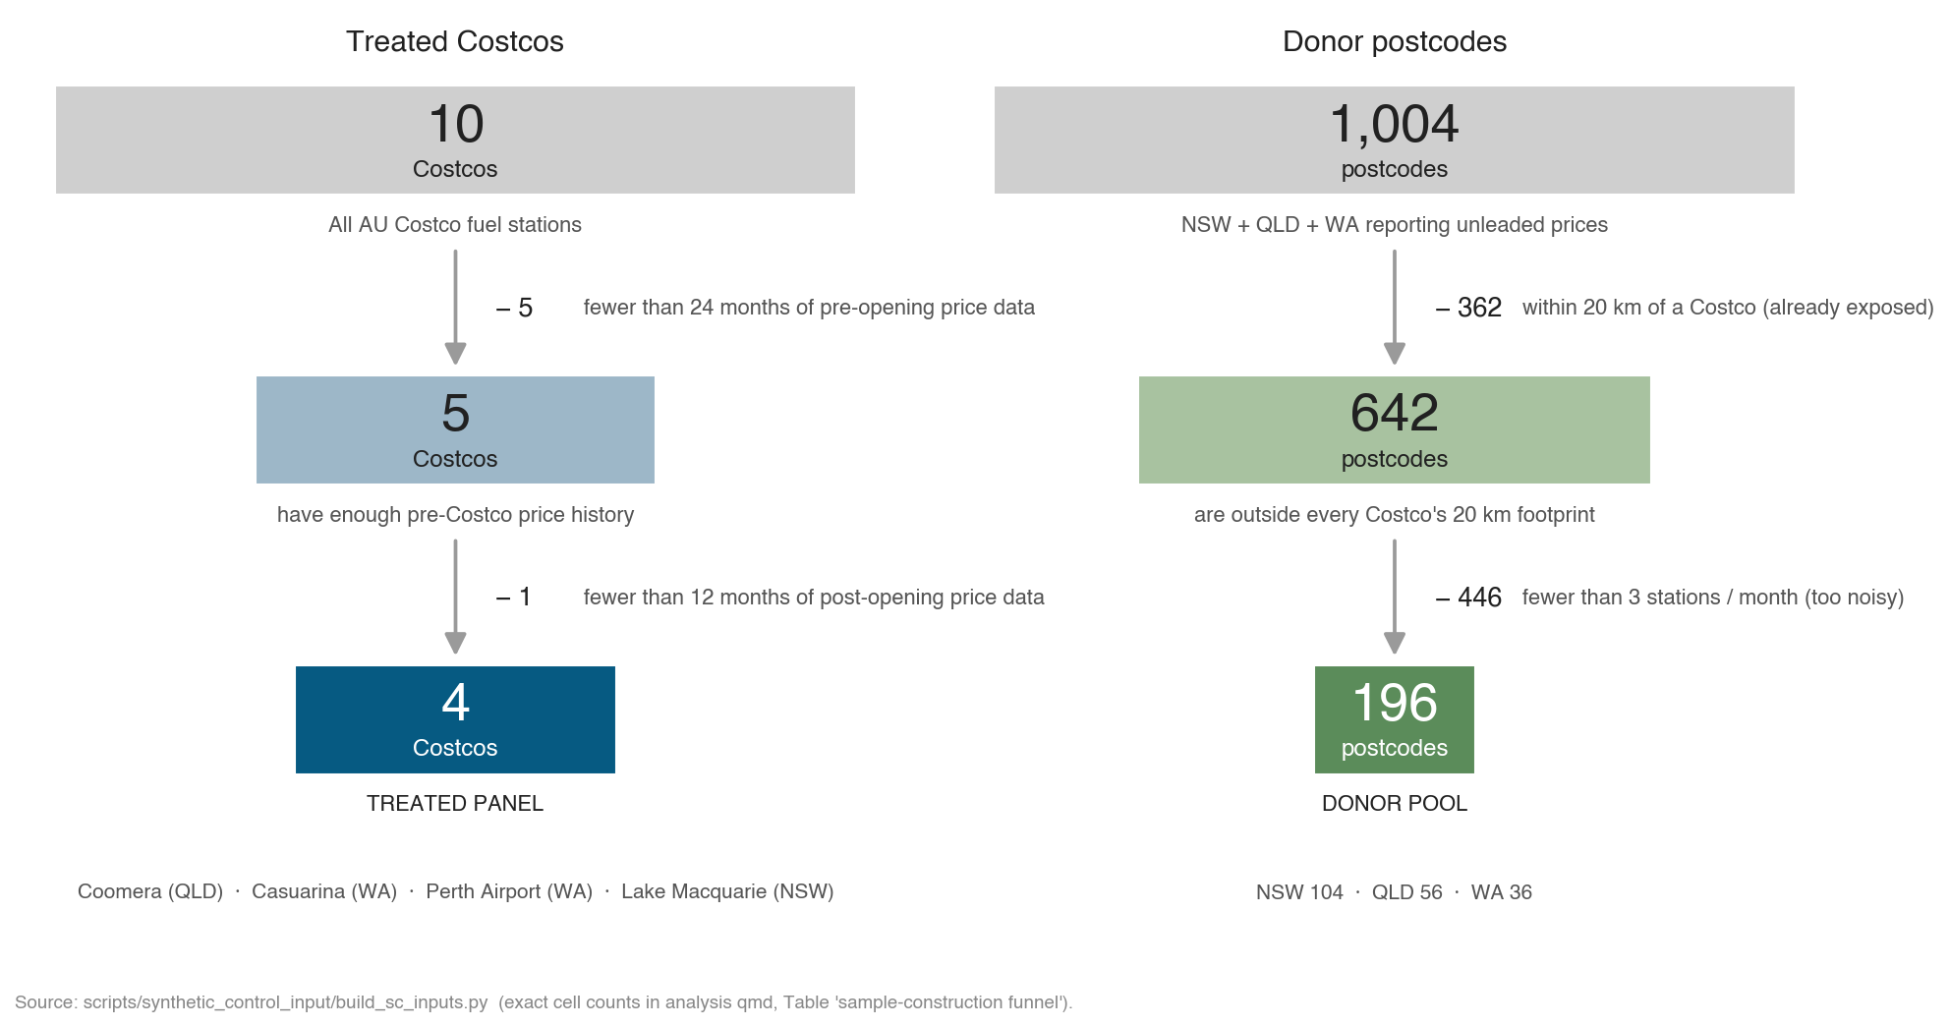
From universe to sample
07 / 13
Notes:
Two big filters on each side. On the left, all 10 Australian
Costco fuel stations. We drop 5 with fewer than 24 months of
pre-opening data, and one more, Auburn, with fewer than 12
months of post-opening data. That leaves 4 treated Costcos:
Coomera, Casuarina, Perth Airport, and Lake Macquarie. On the
right, 1,004 NSW, QLD, and WA postcodes that report unleaded
prices. We drop 362 within 20 kilometers of any Costco, since
those are already exposed. We drop 446 more that average fewer
than 3 stations per month, too noisy to trust monthly. That
leaves 196 donor postcodes that build our counterfactuals.

Slide 10
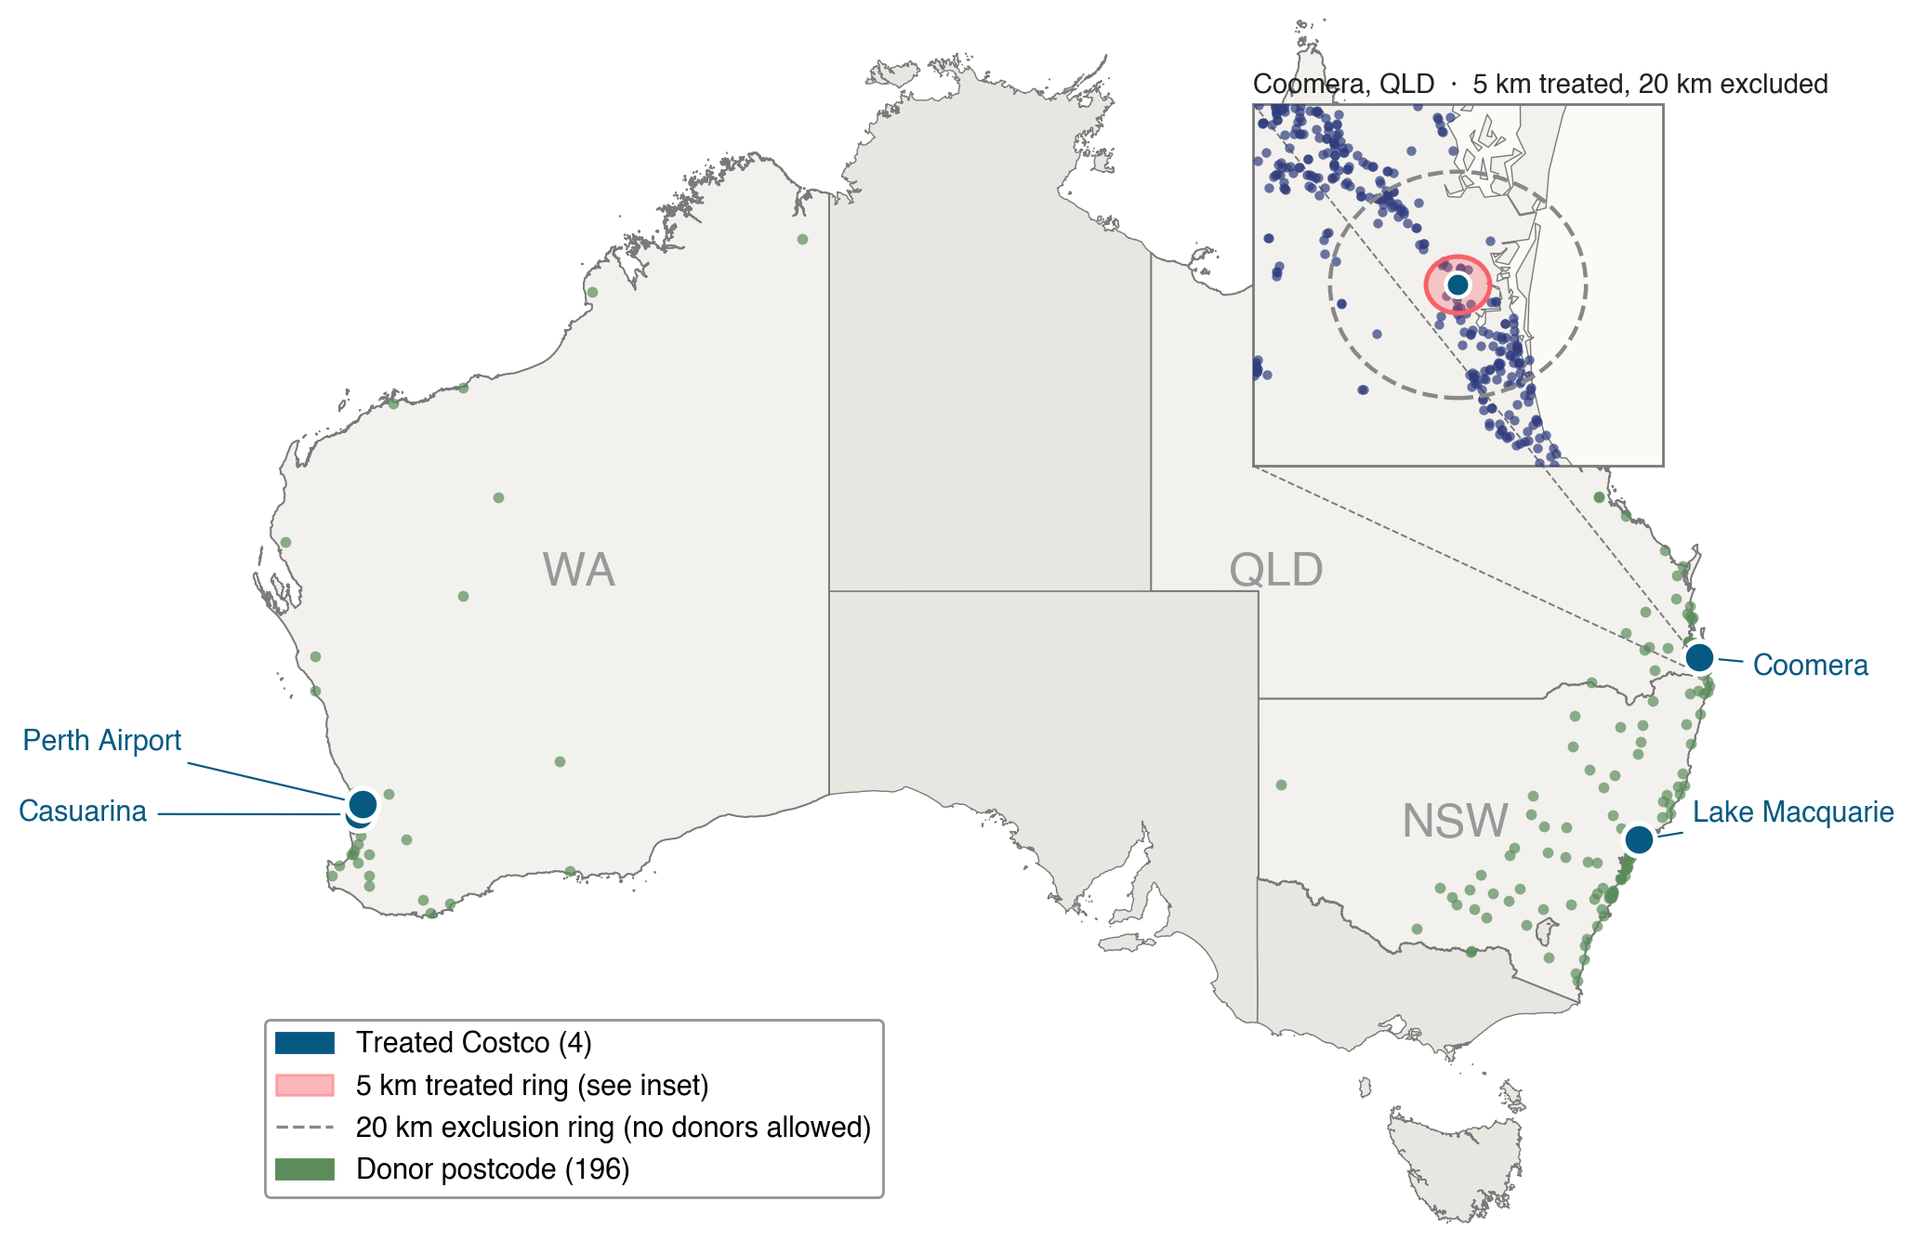
Identification strategy
08 / 13
Notes:
Now how we separate cause from correlation. For each treated
Costco, we build a synthetic version of it: a weighted blend
of donor postcodes whose pre-Costco price history matches the
treated ring as closely as possible. Once Costco opens, the
gap between the actual prices and the synthetic prices is what
we attribute to Costco. The identifying assumption is that
nothing else changed differently between the treated 5 km ring
and its synthetic blend. On this map you can see the 4 treated
Costcos as blue dots, each surrounded by a 20 kilometer
exclusion ring in dashed gray so donors stay clean. The 196
donor postcodes are the green dots. The inset zooms into
Coomera so you can see the 5 km treated ring in coral. Donors
are restricted to the same state as the treated Costco, so any
state-level shock is absorbed by construction.

Slide 11
Section 03 of 04
03
WHAT WE FOUND
The headline result and how it holds up across all four Costcos.

Slide 12
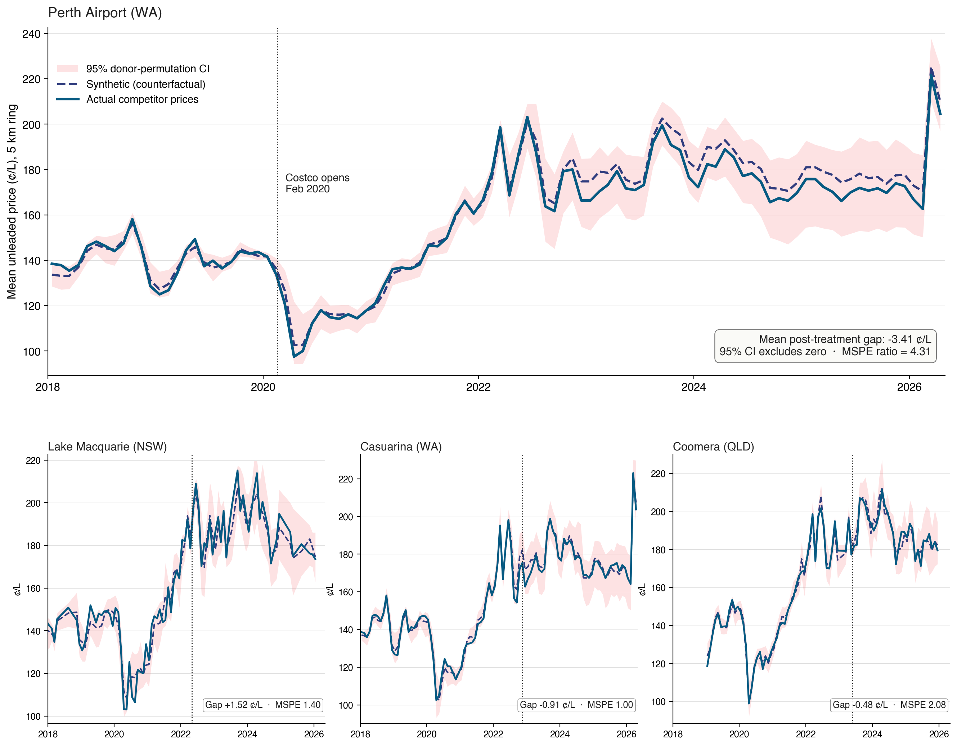
Headline result
09 / 13
Notes:
This is our main figure. The top panel is Perth Airport, our
cleanest case. X axis is months from 2018 through 2026. Y
axis is the mean unleaded price within 5 kilometers of Perth
Airport, in cents per litre. The solid blue line is the actual
price competitors charged. The dashed navy line is the
synthetic counterfactual. The coral band is the 95 percent
confidence interval from donor permutation. Look at the
pre-period: actual and synthetic track each other tightly
through 2018 and 2019. That is the proof our counterfactual
is credible. The dotted vertical line marks February 2020,
when Costco opened. After that, actual drops about 3.4 cents
per litre below synthetic and stays there for six years. The
MSPE ratio is 4.31, well above the credibility bar. The
bottom row shows the other three Costcos. Notice the much
shorter post-windows, and notice that none of them produces a
clean separation like Perth Airport does.

Slide 13
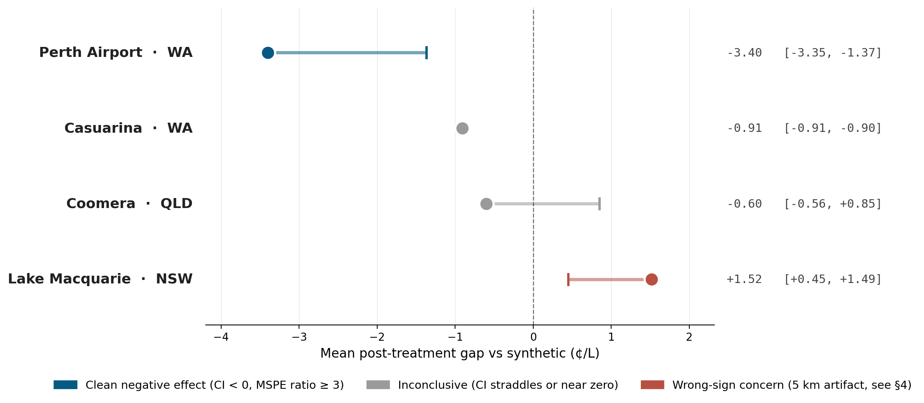
Does it generalize?
10 / 13
Notes:
Same four results in summary form. Each row is one Costco.
The dot is the point estimate. The horizontal bar is the 95
percent confidence interval. The vertical dashed line is zero.
Only Perth Airport, in blue, has a confidence interval that
sits squarely below zero and clears our pre-set credibility
bar. Casuarina looks tight, but that is artificial: its 5 km
ring contains only about 3 stations on average, so there is
barely any donor variation to compare against. Coomera is
inconclusive, with a CI that straddles zero. Lake Macquarie
comes in wrong-signed, but we trace that to a 5 km geometry
artifact, documented in our robustness checks. The honest
read: one of four is clean, and we are not going to claim
more than the data supports.

Slide 14
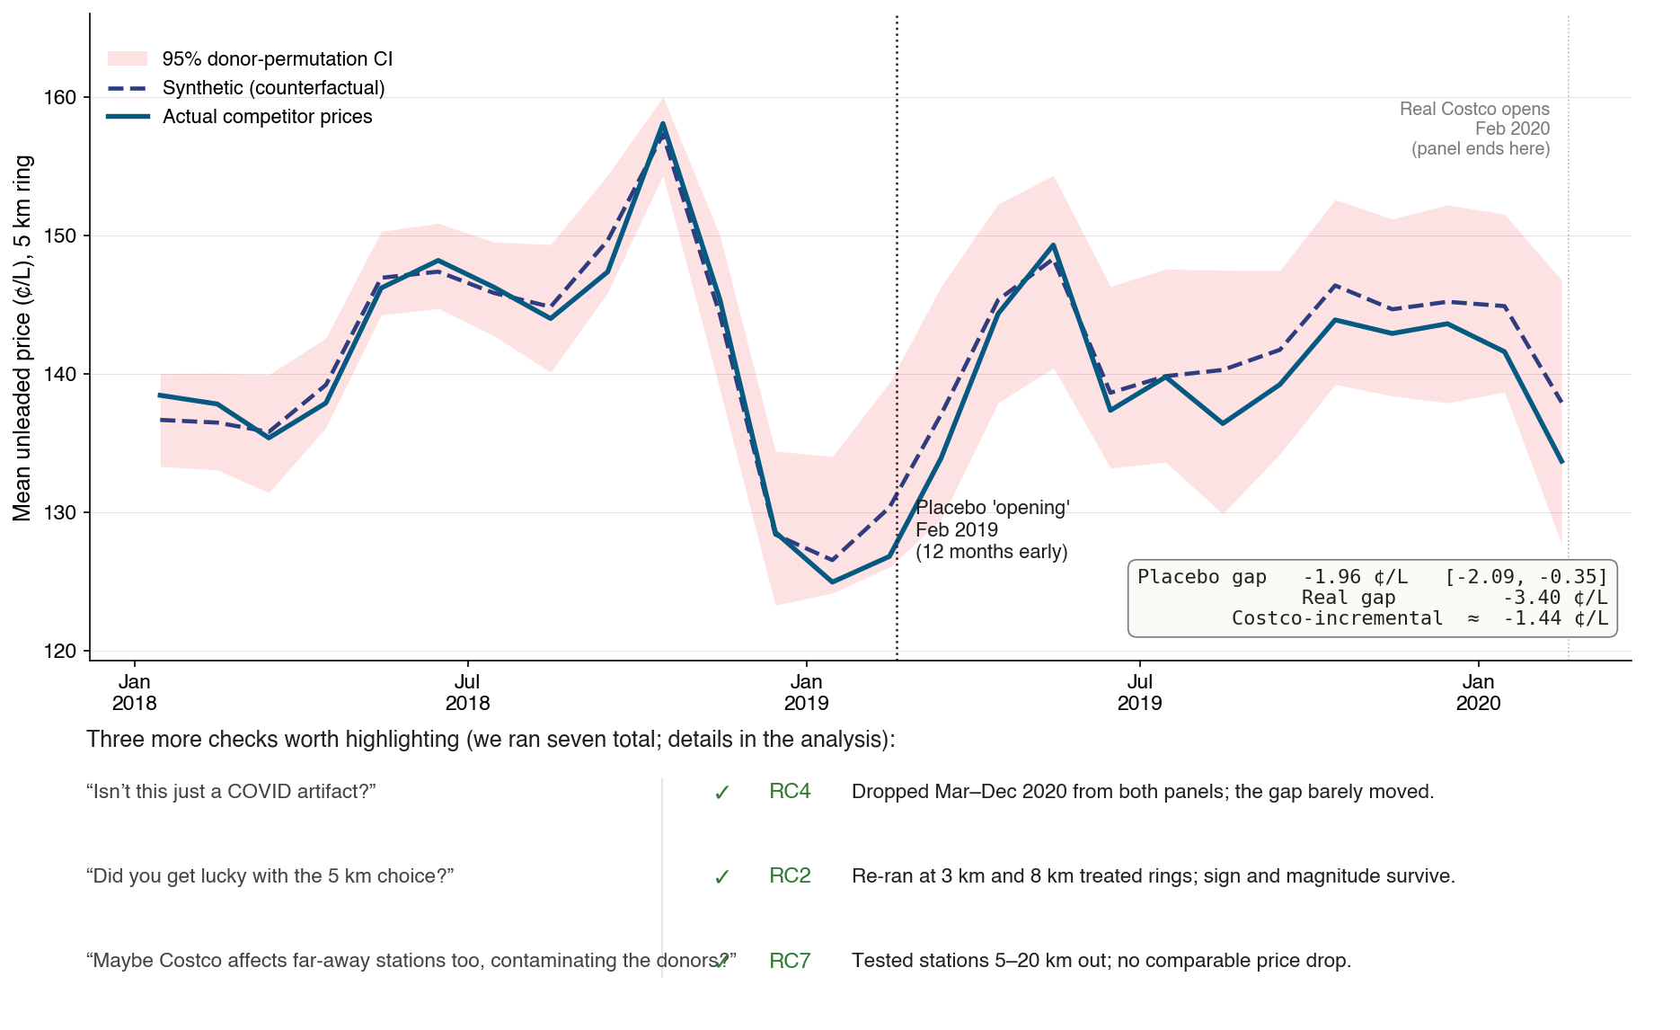
Did we just get lucky?
11 / 13
Notes:
We tried to break our headline finding seven different ways.
Here is the most intuitive: a placebo in time. We pretend
Costco arrived 12 months early, in February 2019, refit on
truncated data, and check whether a fake effect appears at
the fake date. The honest answer is: partially. The placebo
gap is about negative 1.96 cents per litre with a CI that
excludes zero. That means there is some pre-existing downward
drift in WA prices. But the real post-Costco gap of negative
3.4 is much larger, so the Costco-incremental effect is
around negative 1.4 cents per litre. Real, just smaller than
the headline number. Three more checks worth highlighting,
each addressing a different concern someone might raise.
Was this a COVID artifact? We dropped March through December
2020 and the gap barely moved. Did we get lucky with the
5 km ring? We re-ran at 3 km and 8 km and the sign and
magnitude survive. Could Costco be affecting far-away
stations and contaminating our donors? We tested the 5 to
20 km donut and saw no comparable price drop. Three more
checks are in our analysis document.

Slide 15
Section 04 of 04
04
WHAT TO DO
Our recommendation to the ACCC, and what we can’t claim.

Slide 16
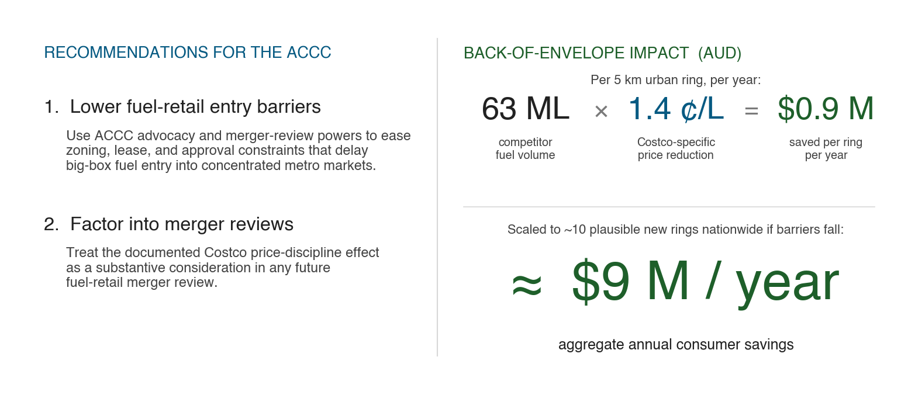
Recommendation
12 / 13
Notes:
Two concrete recommendations for the ACCC. First, use
advocacy and merger-review powers to lower the zoning and
lease barriers that delay big-box fuel entry. Second, treat
the documented Costco price-discipline effect as a substantive
consideration in fuel-retail merger review. Back-of-envelope,
in Australian dollars: a typical 5 kilometer urban ring covers
roughly 100,000 residents and about 63 million litres of
competitor fuel per year. At our conservative Costco-specific
estimate of negative 1.4 cents per litre, that is about
0.9 million dollars in consumer savings per ring per year. If
lowering barriers enables ten more credible big-box entries
nationwide, that scales to roughly 9 million dollars per year
in aggregate consumer savings. Modest by federal-budget
standards, real on the ground, and the policy cost is
essentially the cost of advocacy.

Slide 17
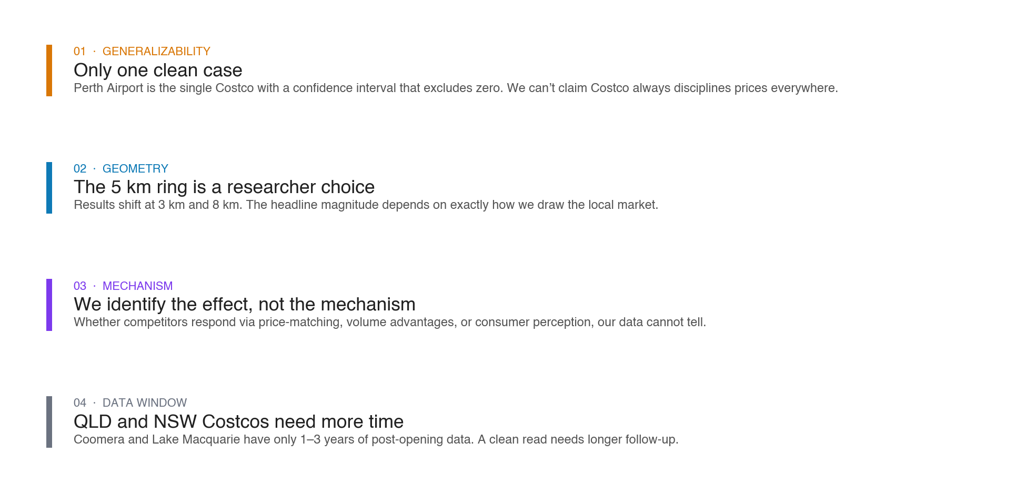
What we can't claim
13 / 13
Notes:
Four limitations our robustness checks did not fully resolve.
One: only Perth Airport is a clean case. We cannot claim
Costco always disciplines prices everywhere. Two: the 5 km
ring is a researcher choice, and results shift at 3 km and
8 km. Three: we identify the effect, not the mechanism.
Whether competitors respond via price-matching, volume
advantages, or consumer perception, our data cannot tell.
Four: the QLD and NSW Costcos need more post-opening months
before they can be read cleanly. Thank you.

Slide 18
MGT159 · Advising the ACCC
Questions?
Full Quarto analysis and reproducible pipeline:
github.com · costco-australia-sc
[Speaker 1] · [Speaker 2] · [Speaker 3] · [Speaker 4]
Notes:
Thank you. Happy to take any questions on the methodology, the robustness checks, or the back-of-envelope assumptions.

